Slide 1



AVEKSHA: A Hardware-Software Approach for Non-
intrusive Tracing and Proﬁling of Wireless Embedded
Systems
!
Matthew Tancreti, Mohammad Sajjad Hossain,
Saurabh Bagchi, Vijay Raghunathan
School of Electrical and Computer Engineering!
Purdue University!
!
Slide 1/23

Slide 2
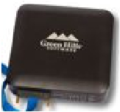
!
Problem Statement
• Debugging deployed Wireless Sensor Networks (WSN)
– Software: profilers affect timing and are OS
specific
– Hardware: bench debuggers not suitable for
WSN deployment
• How to perform tracing and profiling of software
–
–
–
–
–
Non-intrusively
With high spatial and temporal granularity
Low energy
Low cost
Easy to integrate and deploy
• Tracing provides a sequence of events useful for debugging
• Profiling determines energy consumption and time per event
Slide 2/23

Slide 3
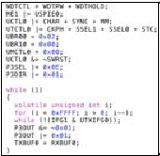

!
Solution Approach: AVEKSHA
JTAG!
10010011011100!
!
Debug
Board
!
• AVEKSHA is a hardware/software approach
• Exploit on-chip debug module (OCDM)
– Comes free on most MCUs (also called EEM on MSP430)
– Exposed through JTAG interface
– Asynchronous with MCU operation
– Advanced features: complex triggers for breakpoints and
watchpoints, store state on trigger
Slide 3/23

Slide 4
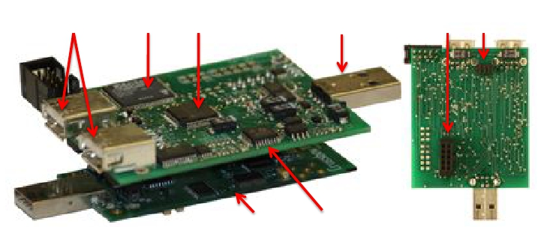
!
What We Built: The Telos Debug Board
-0@391426:%(<.%
=10%:012%0;>0368?% !"#$% &'(%
(;91426:%(<.% ,-./&012%)31245672%
=10%"'%0;>0368?% )*% +,$#%
,2809%:012%
,-.%
• Connects to mote IO and JTAG
• Has an MCU for initialization and configuration
• Has an FPGAfor high speed polling of OCDM state
Slide 4/23

Slide 5
!
Our Contributions
• Reverse engineered important JTAG protocol (MSP430)
– Common low-power sensor network MCU
– Enables profiling and tracing for this class of MCU chips
• Designed a HW/SW debugger suitable for deployed WSN
–
–
–
–
–
Non-intrusive (does not alter software timing)
OS and compiler agnostic
Low power
No significant hardware modification to mote
Easy to deploy (does not need to be customized per application)
• Validated design through case studies
– Tracing and profiling in TinyOS and Contiki
– Found resource consuming bug in TinyOS low-power-listening radio stack
Slide 5/23

Slide 6
!
Presentation Outline
• OCDM Background
• Design
– Hardware
– Firmware
– Energy monitoring and other features
• Case studies
–
–
–
–
Tracing TinyOS tasks and states
A TinyOS bug
Contiki Processes
Profiling Functions
• Conclusions and Future Research
Slide 6/23

Slide 7
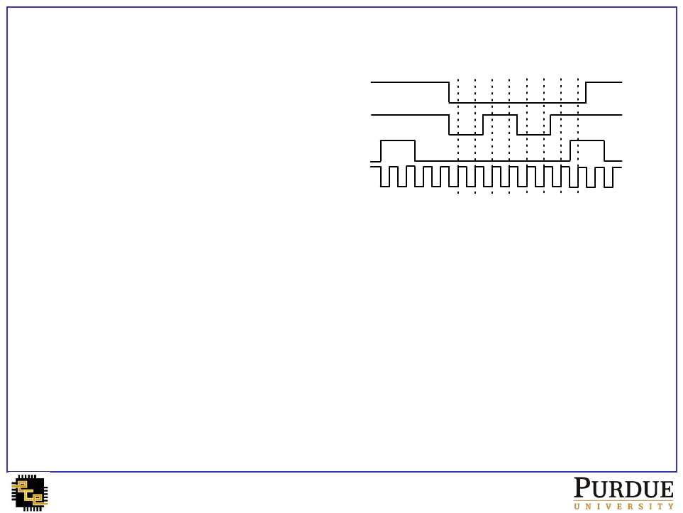
!
Background: Interfacing to the OCDM over JTAG
• JTAG interface uses 4 pins
– TDO data output
BIT 0 1 2 3 4 5 6 7
TDO
–
–
–
TDI data input
TMS select mode
TCK clock
TDI
TMS
TCK
• MSP430 OCDM responds to various commands sent over JTAG
• Used command sequences
–
–
–
–
Set watchpoint and breakpoint triggers
Poll CPU status (e.g., if halted at a breakpoint)
Poll the state-storage buffer (for information stored at watchpoint trigger)
Poll the program counter (PC)
• These sequences map to 3 operation modes of the board:
watchpoint (WP), breakpoint (BP), and PC polling
Slide 7/23

Slide 8
!
WP/BP Mode: MSP430 OCDM Triggers
• Total of 8 triggers can be set on OCDM through JTAG
• Each trigger specifies a condition on
– Value present on data or address bus (MDB/MAB)
– Operation type: read, write, or instruction fetch (-R/-W/-F)
• Can combine individual triggers to create complex triggers
• 8 entry state-storage circular buffer stores MDB and MAB when trigger fired;
can be read out through JTAG
Code!
...!
0x4545: call 0x5550!
Triggers!
MDB-F==0x12B0!
data=0x12B0!
addr=0x4545!
next!
...!
State!
Storage!
• Key design challenge: read buffer at a fast rate to prevent overwritten data
Slide 8/23

Slide 9
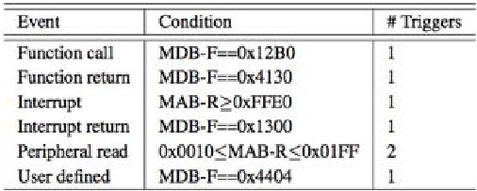
!
WP/BP Mode: Mapping Software Events to Triggers
• Triggers can be set for generic events e.g., function call and return
• A“nop” instruction can be used by the programmer to specify
arbitrary trigger locations in code
provided to tracer!
name value!
if (ready())
NOP; //
state_m =
} else {!
NOP; //
state_m =
{!
state_m ON!
ON;!
state_m OFF!
OFF;!
}
!!
Slide 9/23

Slide 10
!
PC Polling Mode
• OCDM allows continuous polling of program counter
• Provides information about program control flow
• PC value can be mapped to a code block or function
– Need to know the start address of each code block or function
• Basic use of PC polling
Flow a!
Flow b!
!
void f() {!
if (x) {!
a();!
} else {!
f
b();!
!
a
!
}!
b
...!
}!
!
f
Slide 10/23

Slide 11
!
PC Polling: Extracting Function Start Addresses
• At boot-up, read program binary from mote through
JTAG and perform disassembly
– Discover location of function and interrupt start addresses
– Used to lookup what function a PC address belongs to
– Has the advantage of requiring no setup in advance
ffe0 <InterruptVectors>:!
403a!
8536!
8c24!
8876!
8460!
40c4!
4078!
86aa!
4078 <sig_TIMERA0_VECTOR>:!
4078: 0f 12 push r15!
407a: 0e 12 push r14!
407c: 0d 12 push r13!
407e: 0c 12 push r12!
4080: b0 12 94 40 call #0x4094!
4084: 3c 41 pop r12!
4086: 3d 41 pop r13!
4088: 3e 41 pop r14!
408a: 3f 41 pop r15!
408c: b1 c0 f0 00 bic #240, 0(r1)!
4090: 00 00!
4092: 00 13 reti!
!
4094 <Msp430TimerCapComP__0__Event__fired>:!
4094: 1f 42 62 01 mov &0x0162, r15!
4098: 8f 10 swpb r15!
409a: 5f f3 and.b #1, r15!
409c: 02 24 jz $+6!
409e: 1f 42 72 01 mov &0x0172,r15!
40a2: 30 41 ret!
Slide 11/23
Function start address table!
0x4078!
0x4094!
...!

Slide 12
!
Limitations of Watchpoint and PC Polling Modes
• Watchpoint mode
– State-storage buffer is 8 entries
– Each poll and read of state buffer takes 122 mote cycles
– Therefore, cannot exceed burst of 8 events in 976 mote cycles
– For example, suitable for monitoring task execution and state
transitions in TinyOS, but not function calls
• PC polling mode
– Only provides PC values, cannot get MDB and MAB values
– Each PC poll takes 7 mote cycles
– Suitable for task and function call granularity
• Cannot do watchpoint polling and PC polling at the same
time
Slide 12/23

Slide 13
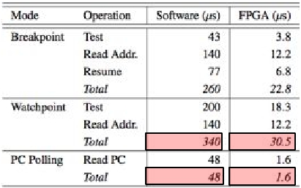
!
Design Challenge: Speed of JTAG Polling
• If JTAG is controlled by software
– MCU has to generate JTAG clock and process data
– For example, using another MSP430 running at 8MHz would take the time shown
• Datasheet specifies 10MHz JTAG clock maximum
– We find we can reliably clock at 12MHz (WP mode) and up to 24MHz (PC poll)
• Using FPGAclocked at 48MHz we can achieve the maximum polling rate
– FPGAgenerates 24Mhz JTAG clock
Slide 13/23

Slide 14
!
FPGA Pipeline for Function Proﬁling
• We use a pipelined architecture on the FPGAto improve
the throughput of OCDM to TDB communication
• For example, PC polling pipeline stages are
– Poll PC address
– Binary search for function pointer
– Filter block: does PC value indicate entry into a new function
– Output buffer interfaces to debug board MCU
On TDB FPGA
PC poll
Mote
Function
lookup
Filter
Output
Buffer
MCU
JTAG
• The pipelined architecture enables us to keep up with the
rate of the OCDM event stream
Slide 14/23

Slide 15
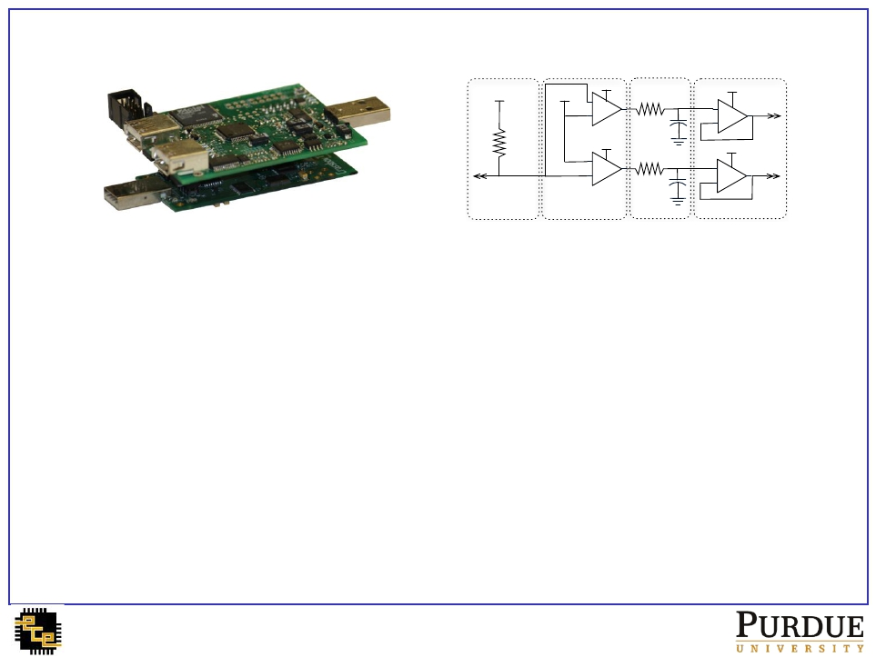
!
Other Features of the Board
3.3V
Rsense
3.74
Mote DVCC
3.3V
5V
-
+ 10
5V
+
105
100
0.1u
100
0.1u
3.3V
+ ADCx10
-
3.3V
+ ADCx105
-
-
Sense
Amplify
Filter
Protect
• Energy monitoring
–
–
–
–
Range of 18uAto 30mA
Two amplifiers x10 and x105
Inexpensive 12bitADC (on MSP430)
Samples at 20kHz
• Streaming data over USB
– Can also be used as a bench-top debugger
• Can be powered through USB or battery
– Provides power to the mote
• Low power, board enters sleep when mote is in sleep
Slide 15/23

Slide 16
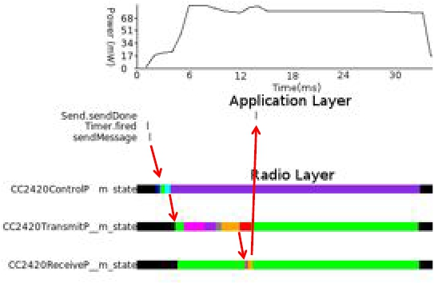
!
Case Study 1: Using Watchpoints to Trace TinyOS States
• Inserted “nop” instruction for
– Each state transition (indicated by an assignment to variables *m_state)
– Each task handler
• Gives visibility of fine grained events
Slide 16/23

Slide 17
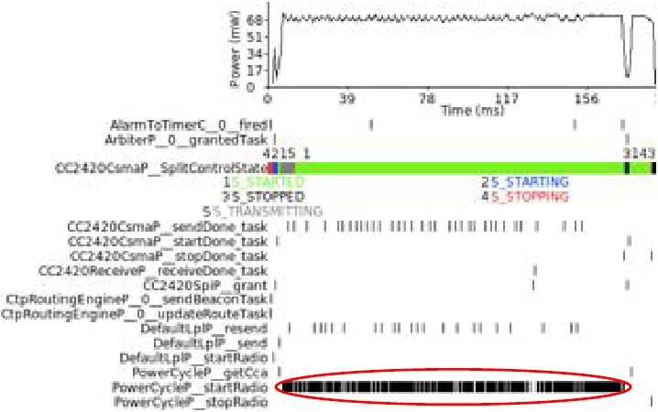
!
PowerCycleP Re-post Bug
• Discovered a bug in TinyOS when tracing tasks
• PowerCycleP__startRadio re-posts itself
Slide 17/23

Slide 18

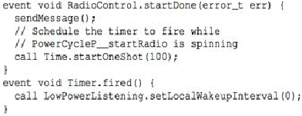

!
PowerCycleP Bug Explained
• startRadio task re-posts if SubControl__start() != SUCCESS!
• When radio is already started, SubControl__start() = EALREADY!
• Re-post could be permanent with following hypothetical code
• Simple fix
• Now patched in TinyOS repository (bug tracker issue 51)
Slide 18/23

Slide 19
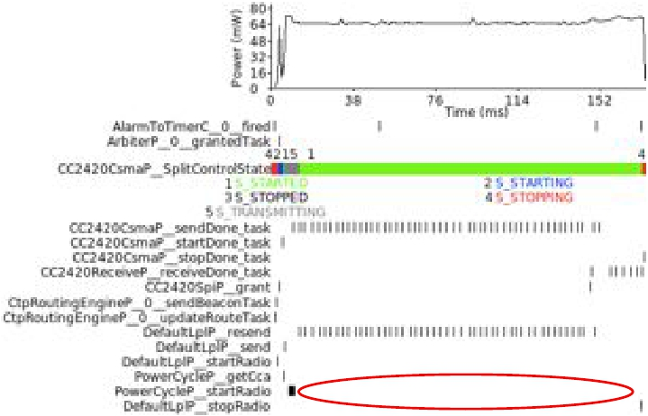
!
With Bug Fixed
Slide 19/23

Slide 20
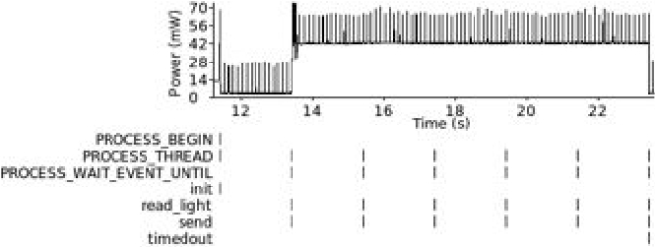
!
Case Study 2: Monitoring Contiki Processes
• Light tracking application [IPSN’11]
• Set “nop” instructions for Contiki processes
• Verifies OS agnostic nature of our architecture
– Required no change of TDB switching from TinyOS to Contiki
application
Slide 20/23

Slide 21
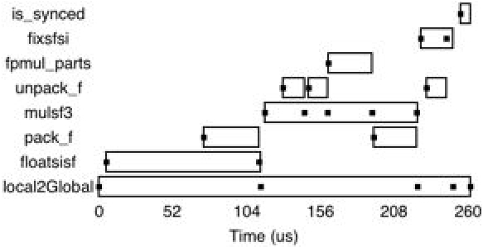
!
Case Study 3: Proﬁling with PC Polling
• PC polling down to granularity of 7 mote cycles
• Usually enough to catch every function transition
• Can be combined with call graph information to generate
a profile
Slide 21/23

Slide 22
!
Conclusions
• We proposed a hardware software approach for tracing and
profiling of sensor network software
• Designed, implemented, and tested the Telos Debug Board
–
–
–
–
Non-intrusive (does not change timing)
OS/compiler agnostic
No significant hardware modification to mote
Easy to deploy (does not need a priori knowledge of application)
• Future design improvements
– Reduce power in sleep mode (fast wakeup)
– Improve energy monitoring accuracy
– Add additional flash storage
• Future research directions
– Debugging a deployed network
– Applications such as record-and-replay
Slide 22/23

Slide 23
!
Thank You
Matthew Tancreti (mtancret@purdue.edu)
Slide 23/23

