Slide 1
1: Introduction
김효곤

Slide 2
Introduction
Effective communication depends on the use of a common language: “protocol”
A collection of related protocols is called a protocol suite
The design that specifies how various protocols of a protocol suite relate to each other and divide up tasks to be accomplished is called the architecture or reference model for the protocol suite
(Internet history skipped)

Slide 3
1.1: Architectural principles
김효곤

Slide 4
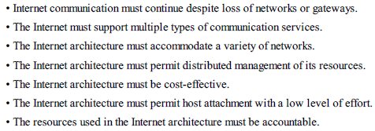
Architectural principles
Internet architecture should be able to interconnect multiple distinct networks and that multiple activities should be able to run simultaneously on the resulting interconnected network
  “develop an effective technique for multiplexed utilization of existing interconnected networks” (Clarke)
Second-level goals

Slide 5
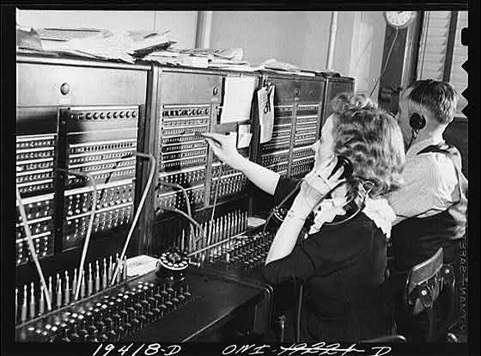
1.1.1 Packets, connections and datagrams
A telephone call was normally implemented by establishing a connection from one party to another.
Establishing a connection meant that a circuit (initially, a physical electrical circuit) was made between one telephone and another for the duration of a call.
When the call was complete, the connection was cleared, allowing the circuit to be used by other users’ calls: “circuit switching”

Slide 6
1.1.1 Packets, connections and datagrams
When established, the connection provided each user a certain amount of bandwidth or capacity to send information (usually voice sounds).
Data inserted into one end of a circuit follows some pre-established path through the network switches and emerges on the other side in a predictable fashion, usually with some upper bound on the time (latency).
This gives predictable service, as long as a circuit is available when a user needs one.
Circuits allocate a pathway through the network that is reserved for the duration of a call, even if they are not entirely busy.

Slide 7
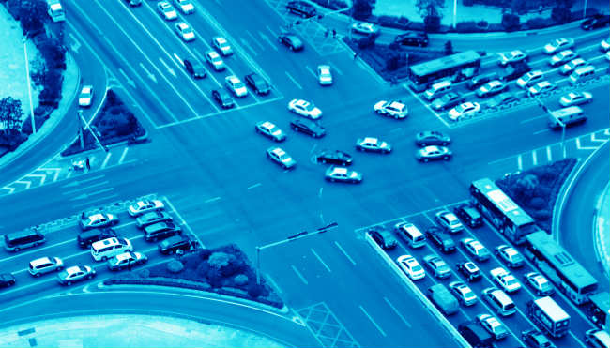
1.1.1 Packets, connections and datagrams
In packet switching, “chunks” (packets) of digital information comprising some number of bytes are carried through the network somewhat independently.
Chunks coming from different sources or senders can be mixed together and pulled apart later, which is called multiplexing.

Slide 8
1.1.1 Packets, connections and datagrams
The chunks can be moved around from one switch to another on their way to a destination, and the path might be subject to change.
This has two potential advantages
  The network can be more resilient.
  There can be better utilization of the network links and switches because of statistical multiplexing.
In statistical multiplexing, traffic is mixed together based on the arrival statistics or timing pattern of the traffic.
  High utilization
  Limited predictability

Slide 9
1.1.2 End-to-end argument and fate sharing
One of the most important principles that influenced the design of the TCP/IP suite is called the end-to-end argument
In short, this principle argues that important functions (e.g., error control, encryption, delivery acknowledgment) should usually not be implemented at low levels
The end-to-end argument tends to support a design with a “dumb” network and “smart” systems connected to the network.
  This is what we see in the TCP/IP design, where many functions (e.g., methods to ensure that data is not lost, controlling the rate at which a sender sends) are implemented in the end hosts where the applications reside.

Slide 10
1.1.2 End-to-end argument and fate sharing
Fate sharing suggests placing all the necessary state to maintain an active communication association (e.g., virtual connection) at the same location with the communicating endpoints.
The only type of failure that destroys communication is one that also destroys one or more of the endpoints, which obviously destroys the overall communication anyhow.
Fate sharing also supports a “dumb network with smart end hosts” model
  And one of the ongoing tensions in today’s Internet is what functions reside in the network and what functions do not.

Slide 11
1.1.3 Error control and flow control
Error control can be implemented in the systems constituting the network infrastructure, or in the systems that attach to the network, or some combination.
  Naturally, the end-to-end argument and fate sharing would suggest that error control be implemented close to or within applications.
Usually, if a small number of bit errors are of concern, a number of mathematical codes can be used to detect and repair the bit errors when data is received or while it is in transit.
  This task is routinely performed within the network.
When more severe damage occurs in a packet network, entire packets are usually resent or retransmitted.

Slide 12
1.1.3 Error control and flow control
In circuit-switched or VC-switched networks, retransmission tends to be done inside the network.
  This may work well for applications that require strict in-order, error-free delivery of their data.
As an alternative, best-effort delivery was adopted by Internet Protocol.
  With best-effort delivery, errors are usually detected using error-detecting codes or checksums.
  When such errors are detected, the errant datagram is merely discarded without further action.

Slide 13
1.1.3 Error control and flow control
A fast sender can produce information at a rate that exceeds the receiver’s ability to consume it.
In best-effort IP networks, slowing down a sender is achieved by flow control mechanisms that operate outside the network and at higher levels of the communication system.
  TCP
This is consistent with the end-to-end argument.
It is also consistent with fate sharing
  Allows some elements of the network infrastructure to fail without necessarily affecting the ability of the devices outside the network to communicate.

