Slide 1
Desining Intuitive UI for Notifying Android Permission Information
최종 보고
배정한

Slide 2
Motivation
As the most popular mobile operating system, Android uses permission-based mechanism
  With permission, an app is allowed to access certain sensitive resources
  When installs an app, the user has the opportunity to review the list of permissions requested by the app
Users often feel difficult to why and how each permission is required by the apps
  For users, to understand how and why the permissions are used within a particular application is not easy
  Add, one permission can use in multiple function

Slide 3
Problem
Former studies connect permissions to third-party libraries, code segments or textual descriptions in order to understand the purpose of permission requests
  These approaches are mostly more developer-oriented than end-user-oriented
  Besides, it requires additional program installation except mobile application environment

Slide 4
Problem(cont.)
Limitations of former researches (PERIUM)
  Low usability and Applicability
    Need to install some additional programs
    Do not deliver some informations easy to understand
  Not eidetic, and not familiar UI with end-user’s perspective
    It contains some ambiguous layouts
    They don’t want to install additional computer programs

Slide 5

Proposed Solution Approach
Wiget design
Alert
Move activity
Safe permission field
Suspicious permission field

Slide 6
Methodology
  App Execution Monitoring
    Monitor the time when the application was running and switching screens
    Identify whether the specific application was executed or not and whether the activity was switched
  Obtaining Required Permissions
    Get the permissions required by the running activity of each application
    Store the permission list in the smartphone’s storage
  Notifying to users
    Show the permission information of the activity in real time
    Create a UI that floats at the top of the screen at all times
  Informing Details of Permissions
    Allows the user to check detailed information about the permission of the currently running activity
    Detect information about permission usage

Slide 7
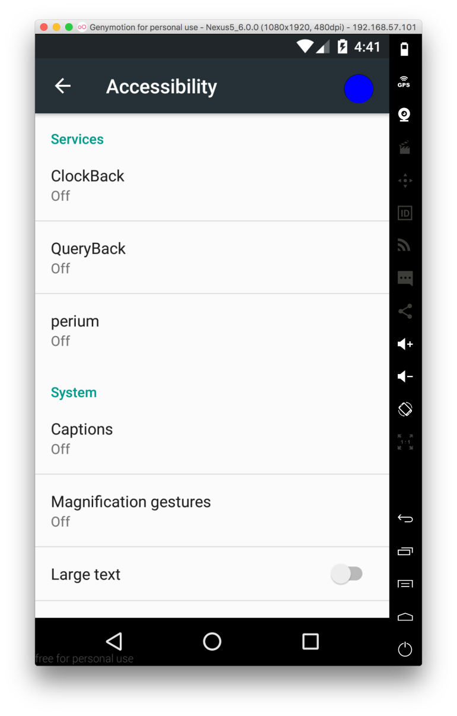
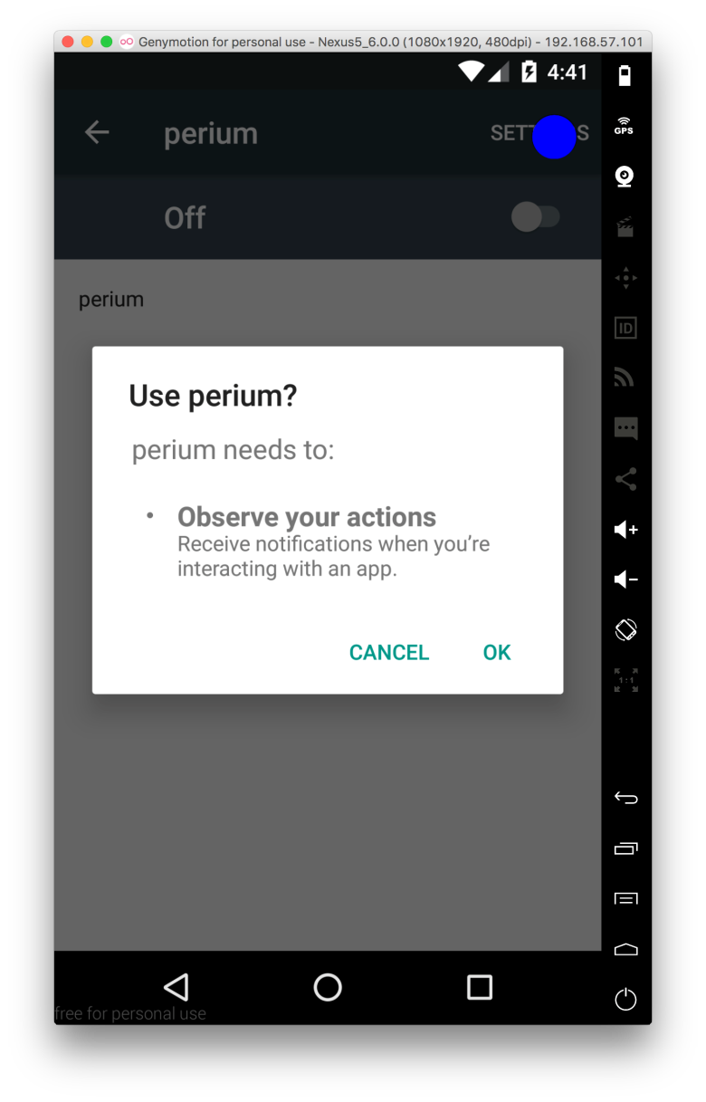
Implementation
  Accessibility Service

Slide 8
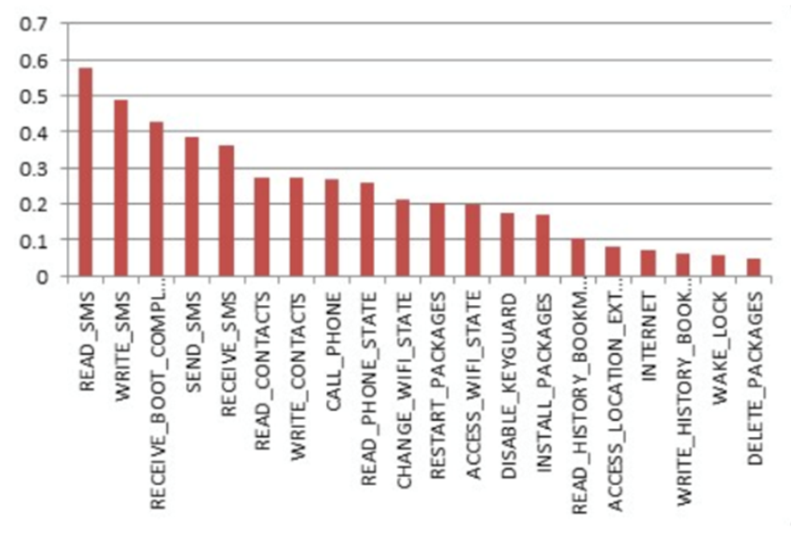
Implementation
  Matching with Known Suspicious Permissions
    Actually, mapped the top 10 permissions only

Slide 9
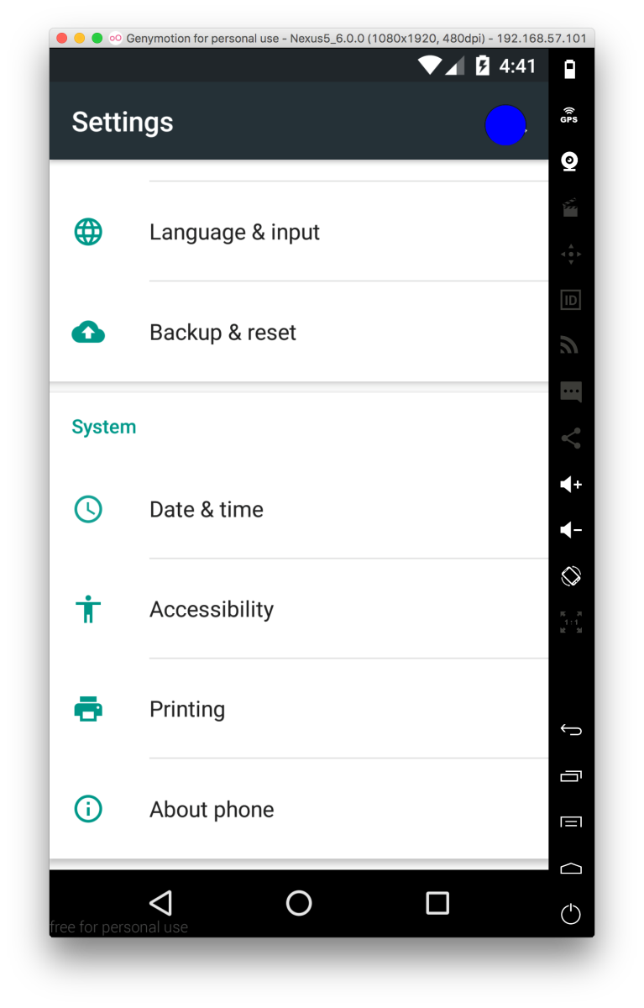
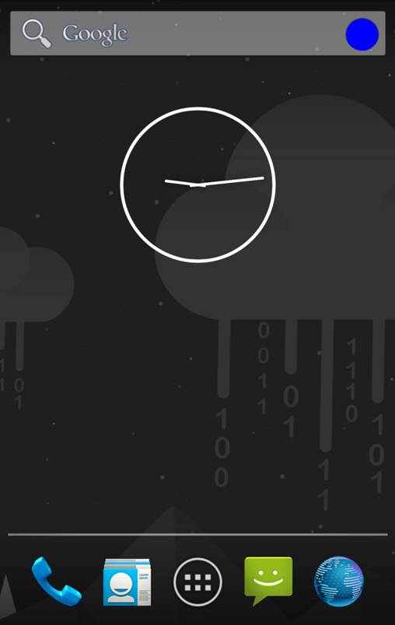
Implementation
  AlwaysOnTopUI

Slide 10
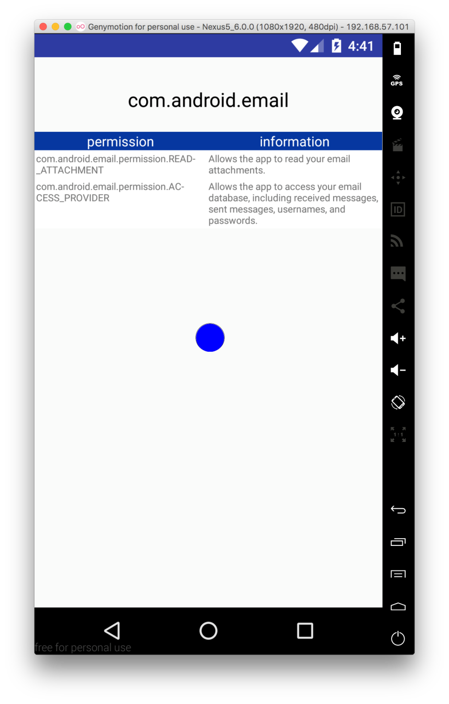
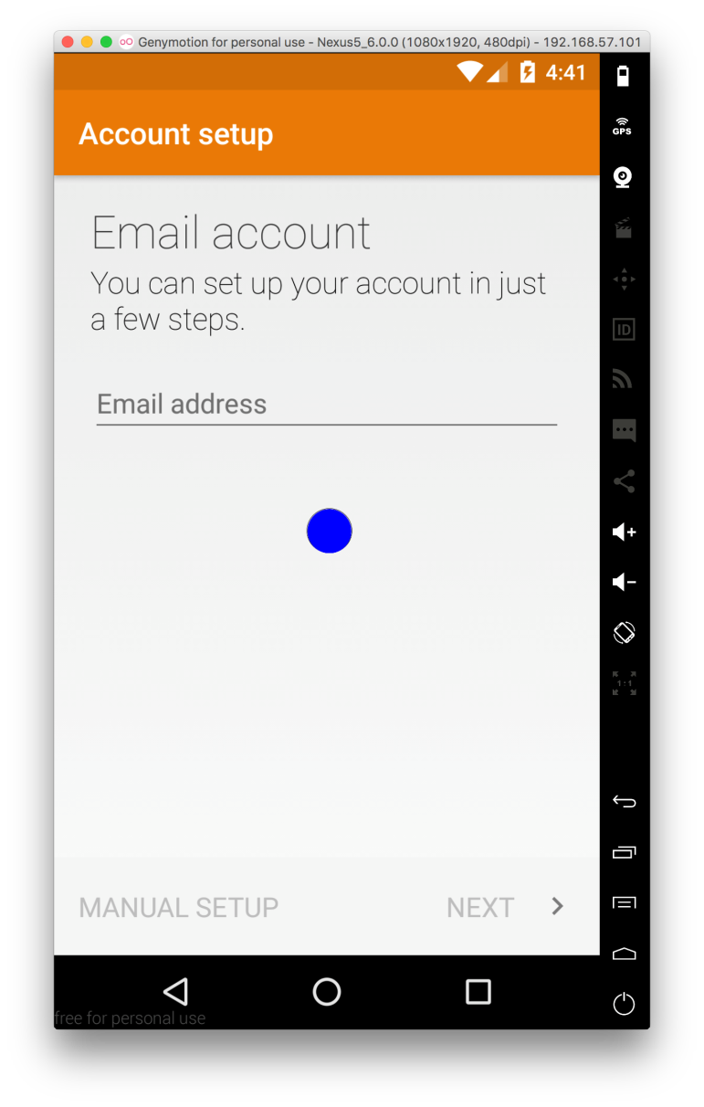
Implementation
  LoadDescriptions of Permission

Slide 11
Limitations
  Impossible to Detect the Applications Type of Services
    Hard to detect some apps which operate only in the background of the Android, like a specific service
  Lack of Suspicious Permission Request
    Few applications were able to detected which use more than one suspicious permission
    It could be overcome by using larger testing app sets
  Failed to apply to real device
    Most smartphones use a unique permission API for each vendor
    Applying it to a function in the Google Android Developers API, it has not worked well since the permission description load function is not working properly

Slide 12
Future work / Conclusion
Designed an intuitive UI design to inform the user about the use of Android permissions
Compared with previous studies, usability has improved, more intuitive, and user convenience has increased significantly
There are also some problems
  Difficult to apply to service type applications
  Threat detection is possible only in a small number of applications
  In future work, it is expected that the limitations will be supplemented
However, it has a great benefit in solving the problems of user convenience of inform Android permission informations

Slide 13


