Slide 1
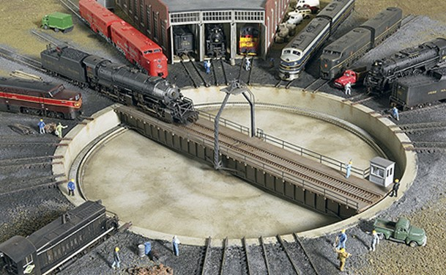
Link layer and interfaces
Lecture 2

Slide 2
What link layer does
Framing
Error control
Flow control
Medium access control (MAC)
But only framing and MAC address part are of interest to IP

Slide 3
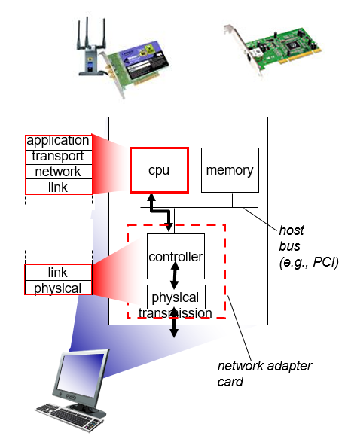
Where the link layer is

Slide 4
“Network” in inter-”network”ing
From IP perspective - all are just link layer
  Although none were developed for IP
2 types of link layer
  Point to point
  Shared medium

Slide 5

Frame: link layer packet
Link layer address (if necessary)
Network layer protocol identifier
Data
Frame check sequence (FCS)

Slide 6
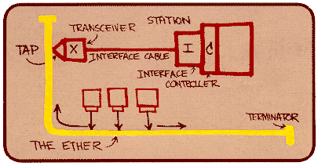
Shared medium
Ethernet, Wi-Fi, …
Need MAC addresses!

Slide 7
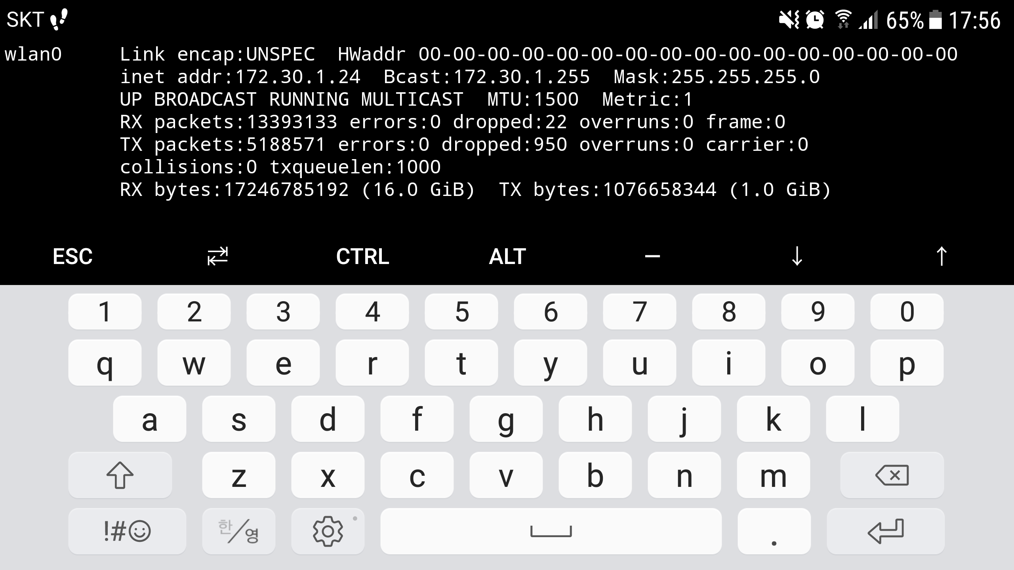
Shared medium

Slide 8
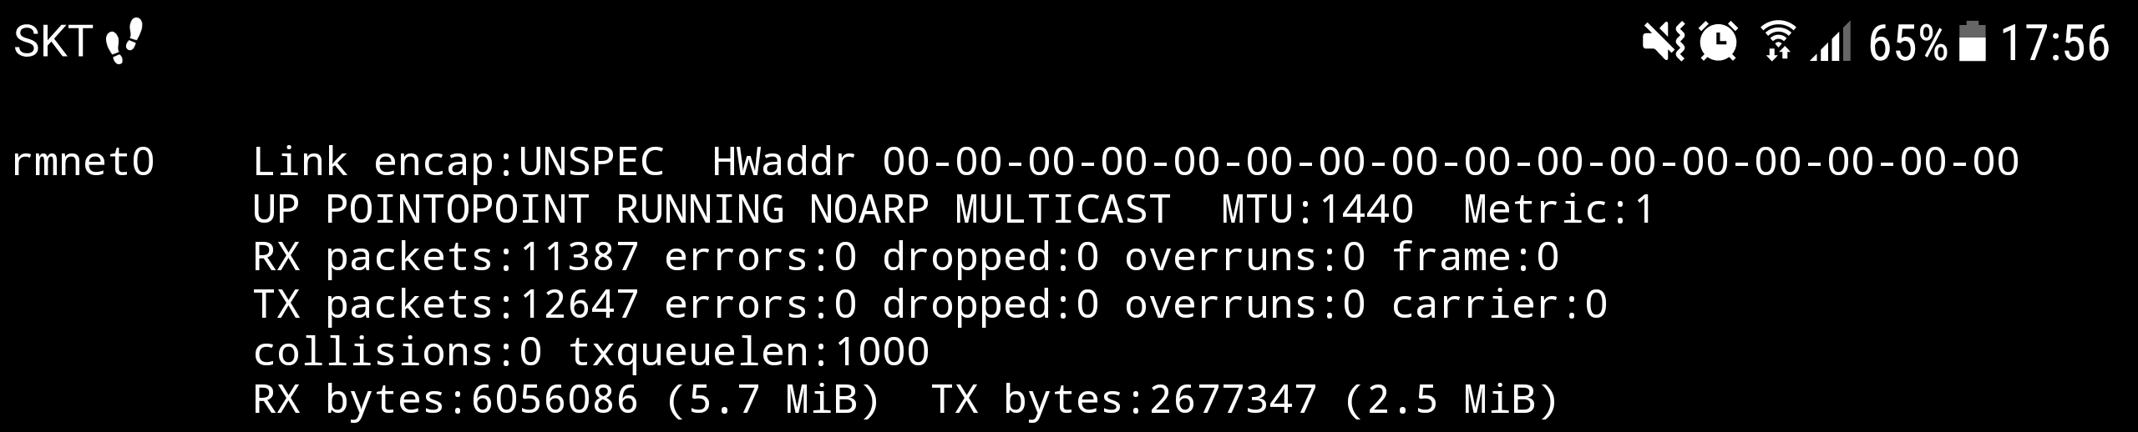
Point to point
Point-to-Point Protocol (PPP), LTE, …
  For serial links
No MAC
  Cf. LTE is a logical point to point protocol, so it actually needs MAC

Slide 9
Interface
Link layer
  Network Interface Card (NIC)
  Device driver in kernel
From IP perspective – represented as “Interface”
  Never means the hardware

Slide 10

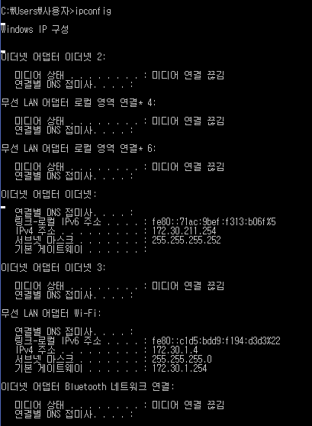
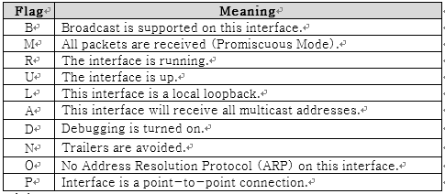
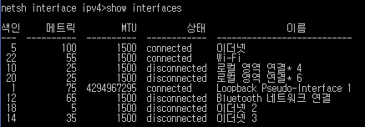
Interface

Slide 11
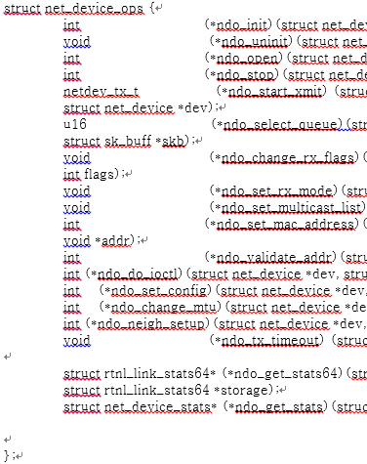
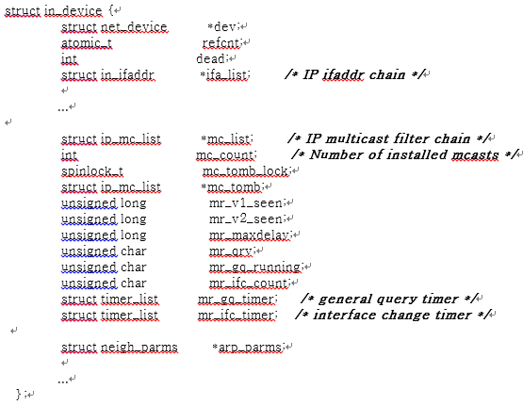
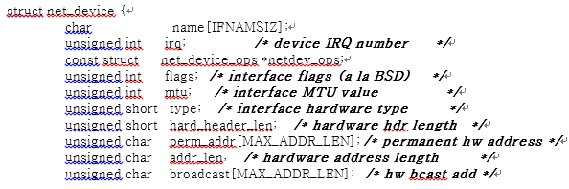
Interface

Slide 12
MTU
Maximum transmission unit: size of “Data“ field in frame
Technology-specific
  E.g. Ethernet → 1500B
Determines IP data gram size on the link
Path MTU = min(MTUs) of a given path

Slide 13
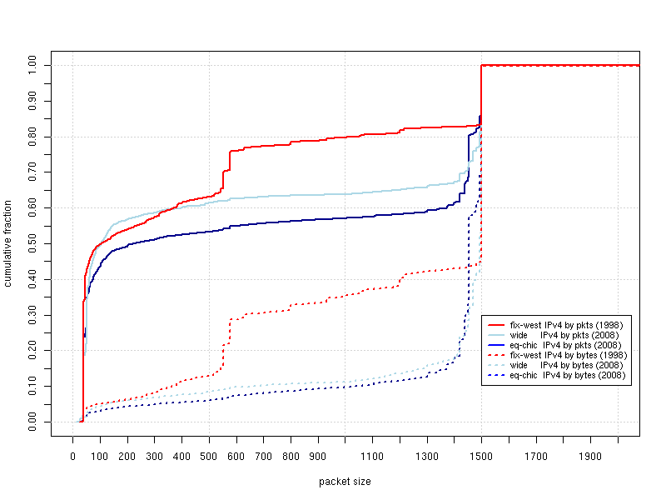
MTU

Slide 14
To be an IP link
Encapsulation
ARP
  For shared medium only
Management Information Base (MIB)

Slide 15

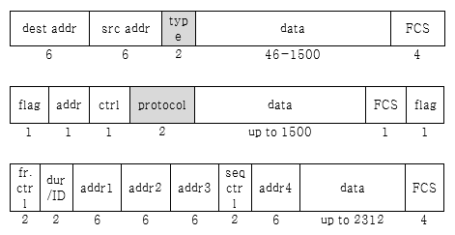
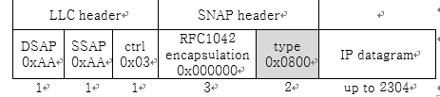
Encapsulation

Slide 16
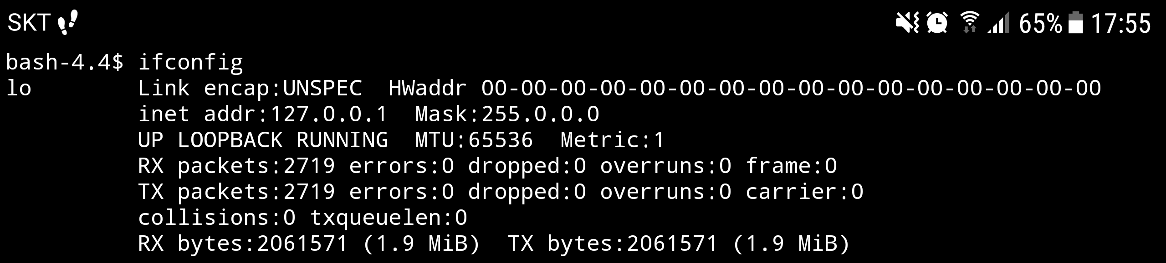
Loopback
Special interface
  Logical
Local inter-process communication (IPC)

Slide 17


IP’s perspective
Proc A
Proc B
Proc C
Proc D
TCP
UDP
SCTP
IP
Loopback
LTE
Wi-Fi
Internet

Slide 18
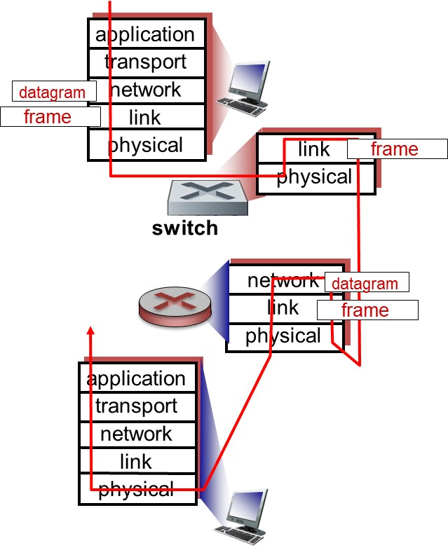
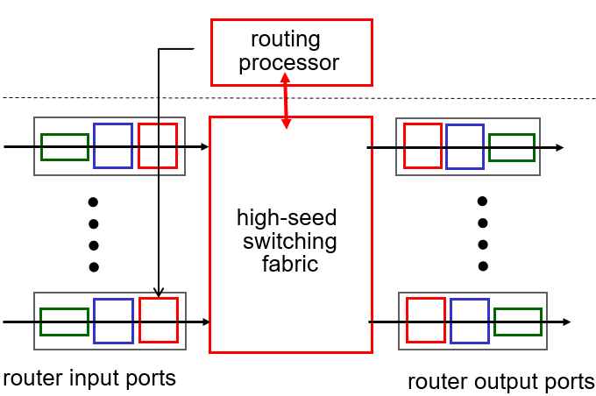
What happens on routers

Slide 19
Labs
Try “ifconfig” on your Android smartphone using Termux app
Try “ipconfig/all” on Windows
Try “netstat –i” on Linux
Try “netsh interface ipv4 show interface” on Windows

Slide 20
Backup slides

Slide 21
Tunneling
GRE
PPTP (Microsoft proprietary)
L2TP

