Slide 1
IP Multicast
Chapter 12

Slide 2
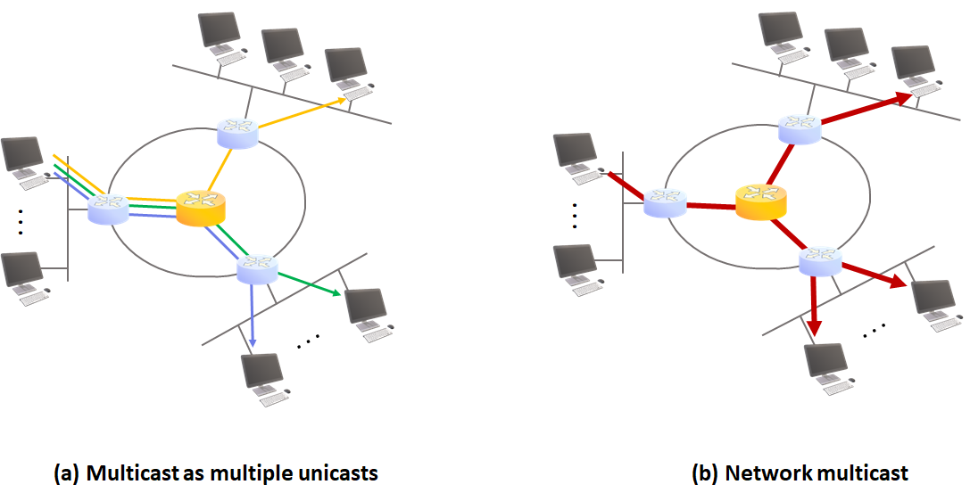
12.0 IP Multicast Overview
Enables efficient delivery to multiple destination interfaces using IP multicast addresses instead of multiple unicasts
  Saves computation and bandwidth: "Green technology"
Killer app → IPTV
  IPTV has brought a revival of IP multicast technology

Slide 3
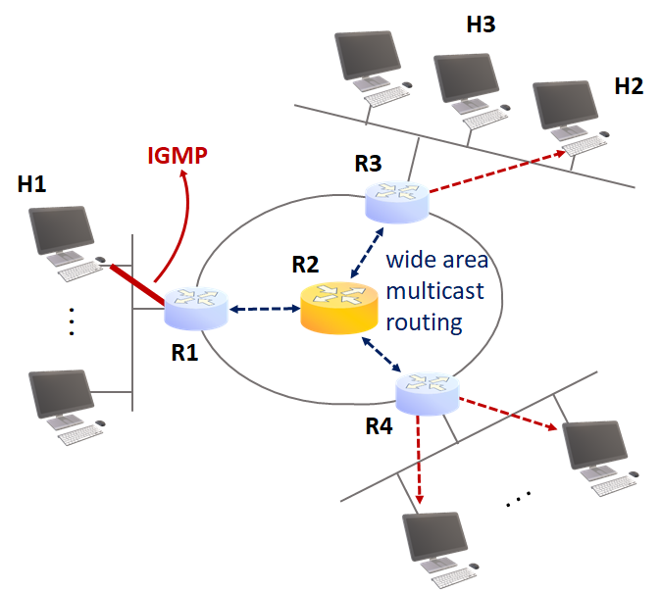
12.0 IP Multicast Overview
Two-stage implementation
  End host to router: collect join/leave information
    Uses group management protocol (IGMP)
  Router to router: form distribution tree
    Uses multicast routing protocol
      Where to branch? (replication)

Slide 4
12.1 Internet Group Management Protocol
IGMP
  Protocol for host computers to notify routers of joining/leaving specific IP multicast groups
  Host records the list of groups joined on each interface
    Also, configure to recognize 32:1 MAC address mapping!
    On the interface that will receive multicast traffic
    When multiple programs join the same group: increment reference count
  Router maintains the group list joined by interfaces in its subnet
    Periodic/aperiodic membership checks
    State changes (join/leave) are reflected in the distribution tree using the multicast routing protocol

Slide 5
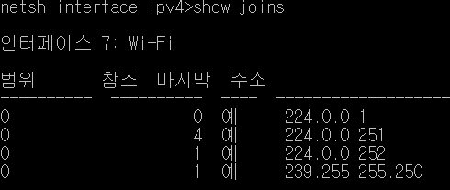
12.1 Internet Group Management Protocol
IGMP
  Host records the list of groups joined on each interface
    Netsh interface ip show joins

Slide 6
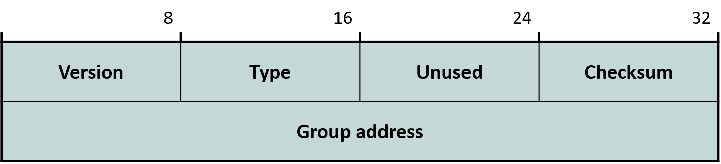
12.1 Internet Group Management Protocol
IGMP v1 Message Format
  Version = 1
  Type
    0x11: Membership Query
    0x12: Membership Report (can be sent unsolicited)
      Only one interface needs to respond to a query
      Respond randomly within 10s; if someone responds first, no additional response
  Group address = the target group
    Set to 0 in General Query
      Applies to all groups

Slide 7
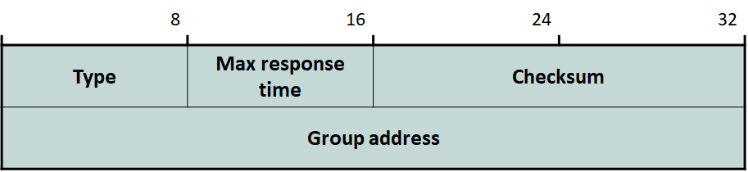
12.1 Internet Group Management Protocol
IGMP v2 Message Format
  Type: implicitly includes version field ("1")
    0x11: Membership Query
    0x12: v1 Membership Report
    0x16: v2 Membership Report
    0x17: Group Leave
      General Query interval = 125s, timeout = 125*2+10 = 260s
  Max response time
    Time allowed for response to 0x11 (in units of 0.1s)

Slide 8
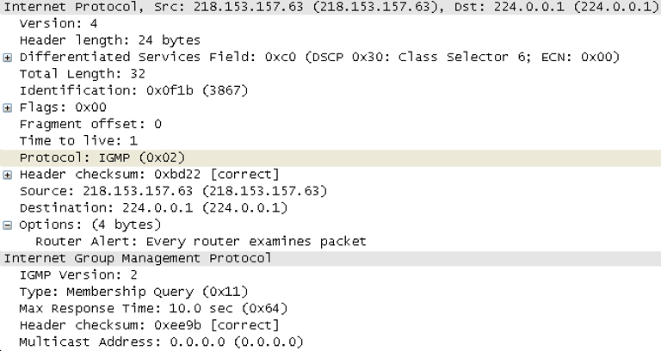
12.1 Internet Group Management Protocol
IGMP
  IGMPv2 Message Example

Slide 9
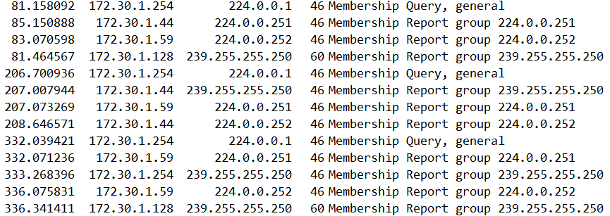
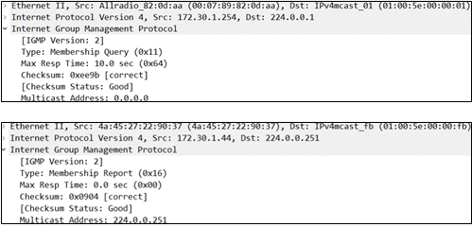
12.1 Internet Group Management Protocol
General query

Slide 10
12.1 Internet Group Management Protocol
Group-specific query
  After sending Leave message

Slide 11
12.1 Internet Group Management Protocol
Change in multicast model from IGMPv2 to IGMPv3
  Any-Source Multicast (ASM) → Source-Specific Multicast (SSM)
ASM: the original IP multicast model
  Receivers accept all traffic regardless of sender, as long as the destination matches a joined group
    Senders also need not know the receivers: IP multicast design philosophy
      Senders do not need to manage membership: group size scalability
  IPTV: should anyone be allowed to send packets to a group ("channel")?
    Vulnerable to hacking

Slide 12
12.1 Internet Group Management Protocol
SSM: model that can check and reject senders, for IPTV
  Accept only if IP source address = designated sender (e.g., broadcaster content server)
  IGMPv2 messages have no field for source IP address
    Naturally, since it follows the ASM model
  A new version was needed
    IGMPv3 (IPv4)
    MLDv2 (IPv6)

Slide 13
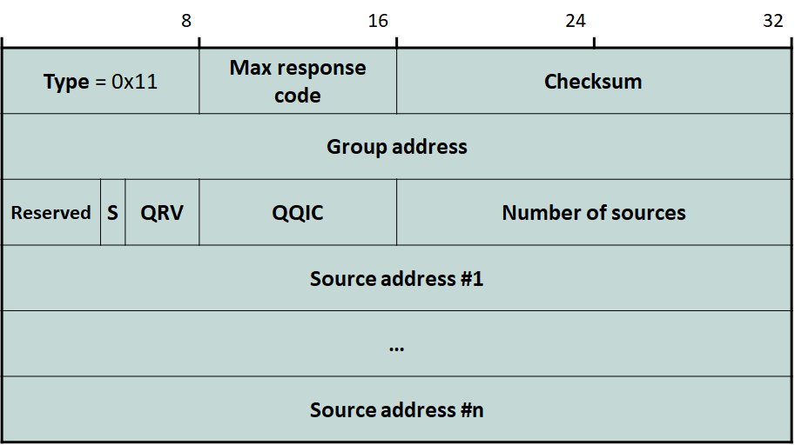
12.1 Internet Group Management Protocol
IGMP v3 Message Format
  Type
    0x11: Membership Query
    0x22: Membership Report
    0x12: v1 Membership Report
    0x16: v2 Membership Report
    0x17: v2 Group Leave
  Querier’s Robustness Variable (QRV)
    How many times to retransmit when a query is lost
  Querier’s Query Interval Code (QQIV)
    Interval between queries (unit = seconds)

Slide 14
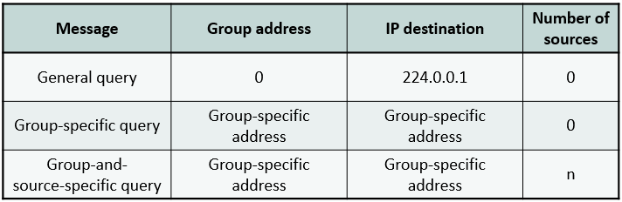
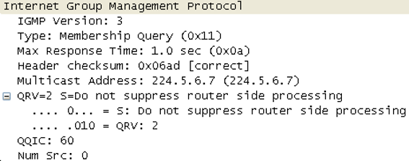
12.1 Internet Group Management Protocol
IGMP v3 Message Format
  Three types of queries

Slide 15
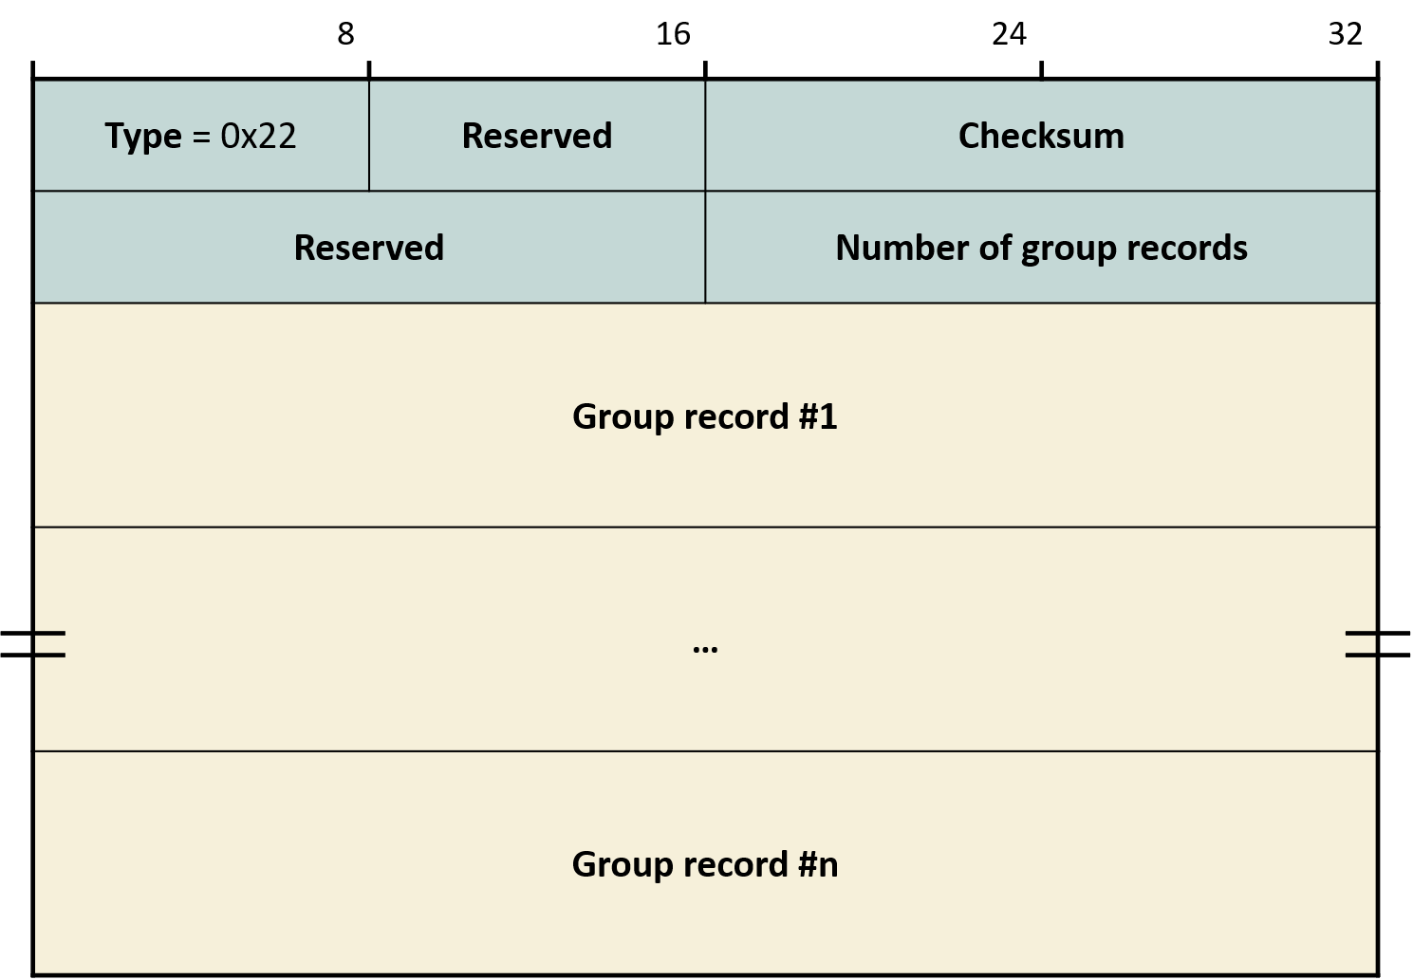
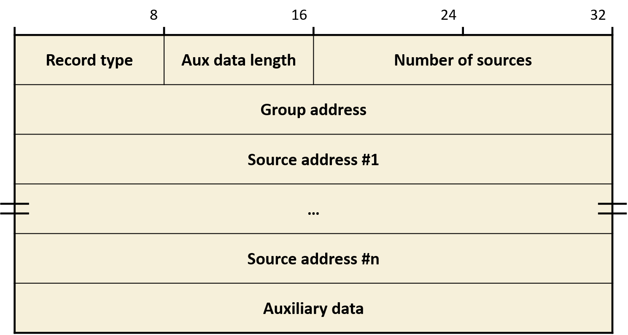
12.1 Internet Group Management Protocol
IGMP v3 Membership Report
  Each group record expresses per-source reception status for a group

Slide 16
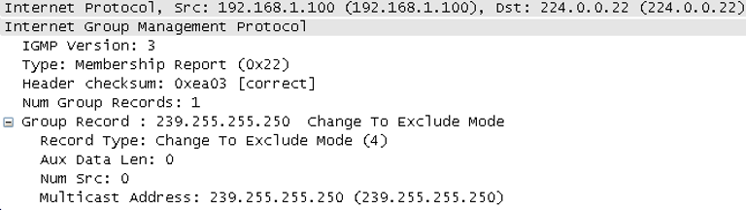
12.1 Internet Group Management Protocol
IGMP v3 Membership Report Example

Slide 17
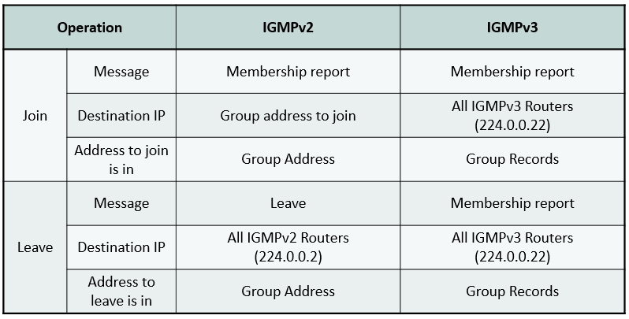
12.1 Internet Group Management Protocol
Differences between IGMPv2 and IGMPv3 messages for join/leave

Slide 18
12.1 Internet Group Management Protocol
Record type: filtering mode = INCLUDE vs. EXCLUDE
  Solicited Report
    MODE_IS_INCLUDE (1)
    MODE_IS_EXCLUDE (2)
  Unsolicited Report
    CHANGE_TO_INCLUDE_MODE (3)
      Notably, CHANGE_TO_INCLUDE MODE { }: leave!
    CHANGE_TO_EXCLUDE_MODE (4)
  When adding or removing sources from the list
    ALLOW_NEW_SOURCES (5)
    BLOCK_OLD_SOURCES (6)

Slide 19
12.1 Internet Group Management Protocol
Filtering Mode Configuration Example
  Changing INCLUDE {a,b,c} state to INCLUDE {b,c,d}
    ALLOW_NEW_SOURCES(d)
    BLOCK_OLD_SOURCES(a)
  Changing EXCLUDE {a,b,c} state to EXCLUDE {b,c,d}
    ALLOW_NEW_SOURCES(a)
    BLOCK_OLD_SOURCES(d)

Slide 20
12.1 Internet Group Management Protocol
Filtering Mode Configuration with Multiple Applications
  When all applications use INCLUDE mode only
    Source list = union of all sources
  When even one application uses EXCLUDE mode
    Source list = intersection of all excludes (rejected)
  Example: 3 applications joined group G through one interface
    INCLUDE {a,b,c}, {b,c,d}, {e,f} (union) -> INCLUDE {a,b,c,d,e,f}
    EXCLUDE {a,b,c}, {b,c,d} + INCLUDE {d,e,f} -> EXCLUDE {b,c} (intersection of excludes - includes)

Slide 21
12.1 Internet Group Management Protocol
Per-group state at the router
  <group addr, timer, filter mode, [sender addr, sender timer]>
    Example: sender addr = { }, filter mode = EXCLUDE: group joined state
  Group timer is used only in EXCLUDE mode
    Timeout -> convert to INCLUDE

Slide 22
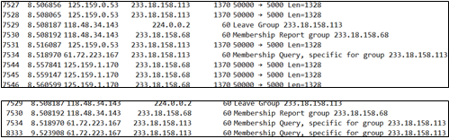

12.2 IPTV
IGMPv2 packets generated during channel change
  Using KT's GLOP address
IGMP Proxying

Slide 23
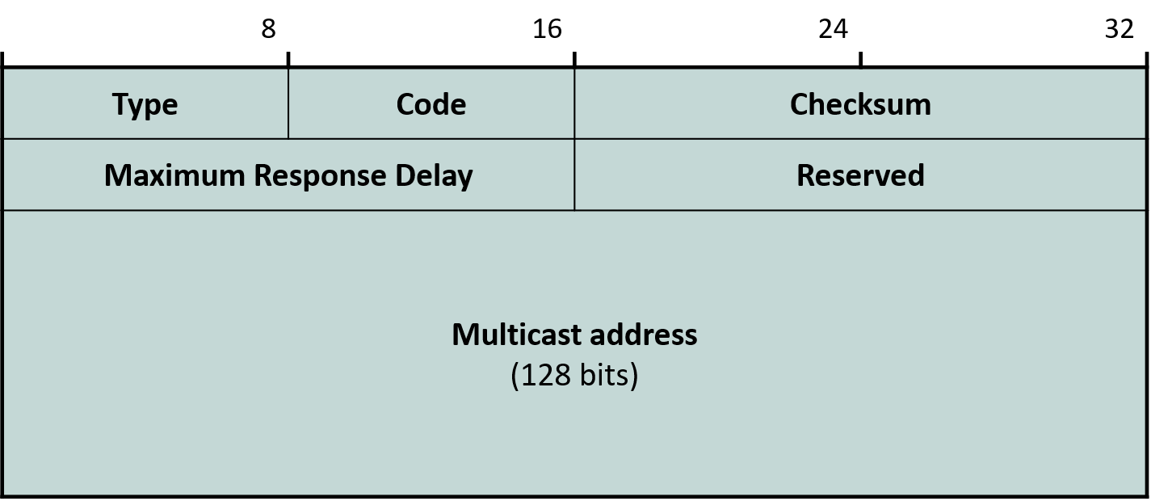
12.3 Membership Management in IPv6
No IGMP: Multicast Listener Discovery (MLD) using ICMPv6
    MLDv1 ≡ IGMPv2 (ASM)
    MLDv2 ≡ IGMPv3 (SSM)
  Link-local source IP, TTL=1, IP Router Alert Option
MLDv1 Format

Slide 24
12.3 Membership Management in IPv6
Type
  130 = receiver query
  131 = receiver report
  132 = receiver done (leave)
Checksum: uses pseudo-header
  2 IP addresses + payload length + next header
Max Response Delay (unit: ms)

Slide 25
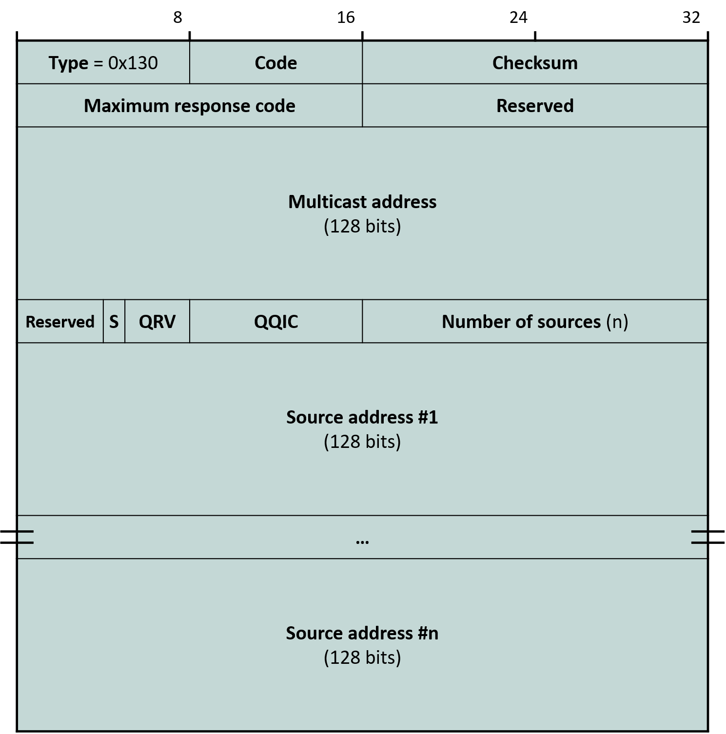
12.3 Membership Management in IPv6
MLDv2 Messages
  General Query sent to ff02::1
  Multicast-Address-Specific Query (formerly Group-Specific Query) sent to group address
  Report
    MLDv1: sent to the group address
    MLDv2: sent to ff02::16
      All MLDv2-capable routers group
  Done message sent to ff02::2
    All routers group

Slide 26
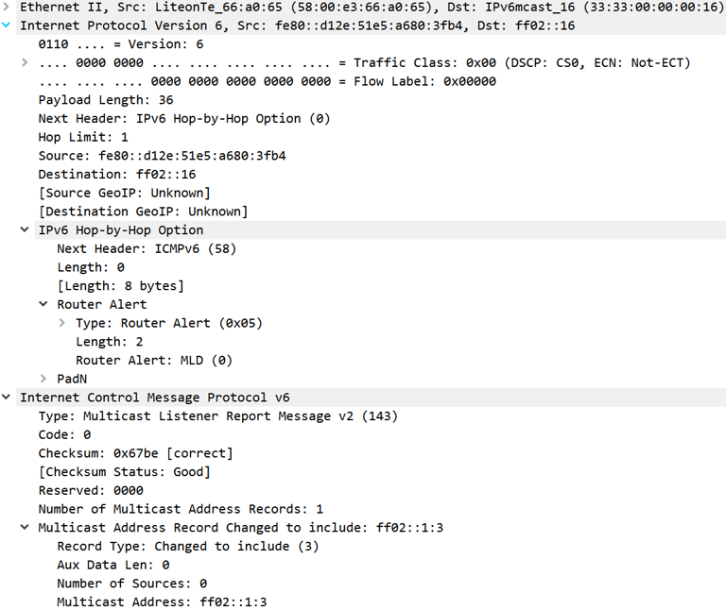
12.3 Membership Management in IPv6
MLDv2 Message Example

Slide 27
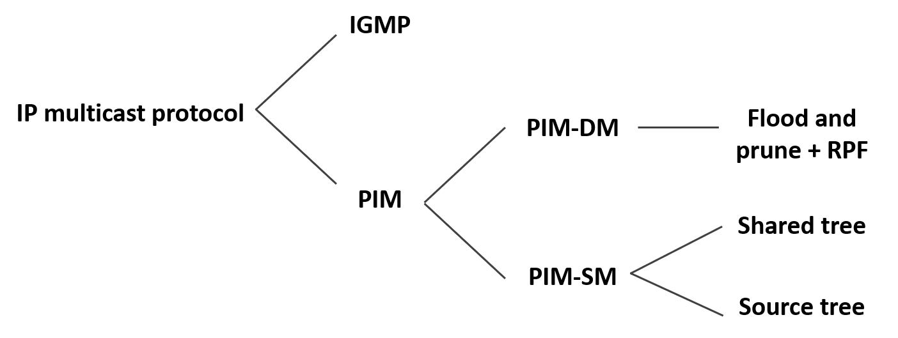
12.4 Multicast Routing Protocols
Protocol-Independent Multicast (PIM) is the standard

Slide 28
12.4 Multicast Routing Protocols
PIM-DM uses flood-and-prune method
  To update the distribution tree with membership changes, all multicast routers periodically allow flooding of traffic from source
    Copy and forward multicast packets out all interfaces except the incoming one
    Interval example: 2 minutes
  Reverse Path Forwarding (RPF) Check
    Check to eliminate unnecessary flooding
    If multicast arrived on the interface used for unicast toward source: forward; from other interfaces: drop
  Multicast routers notify upstream router of reception status
    If there are downstream receivers: no action
    If no downstream receivers: PRUNE message

Slide 29
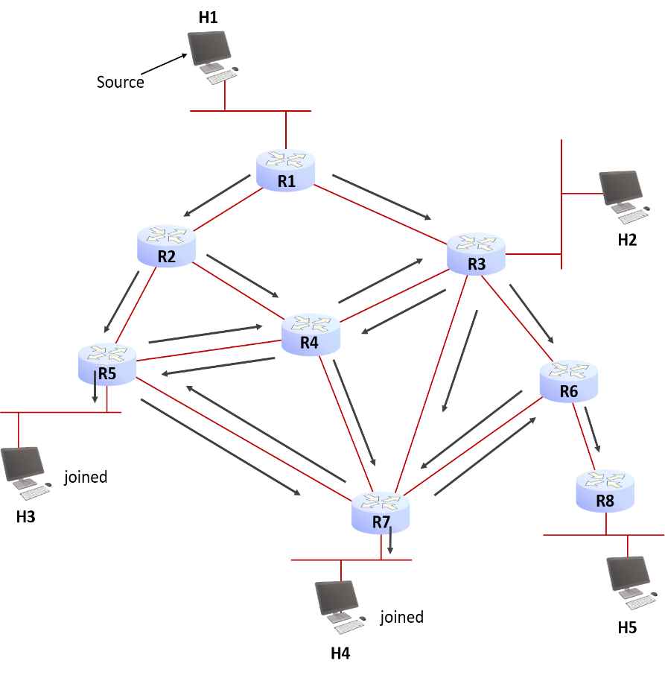
12.4 Multicast Routing Protocols
PIM-DM uses flood-and-prune method
  Flood

Slide 30

12.4 Multicast Routing Protocols
PIM-DM uses flood-and-prune method
  Reverse Path Forwarding (RPF) check

Slide 31
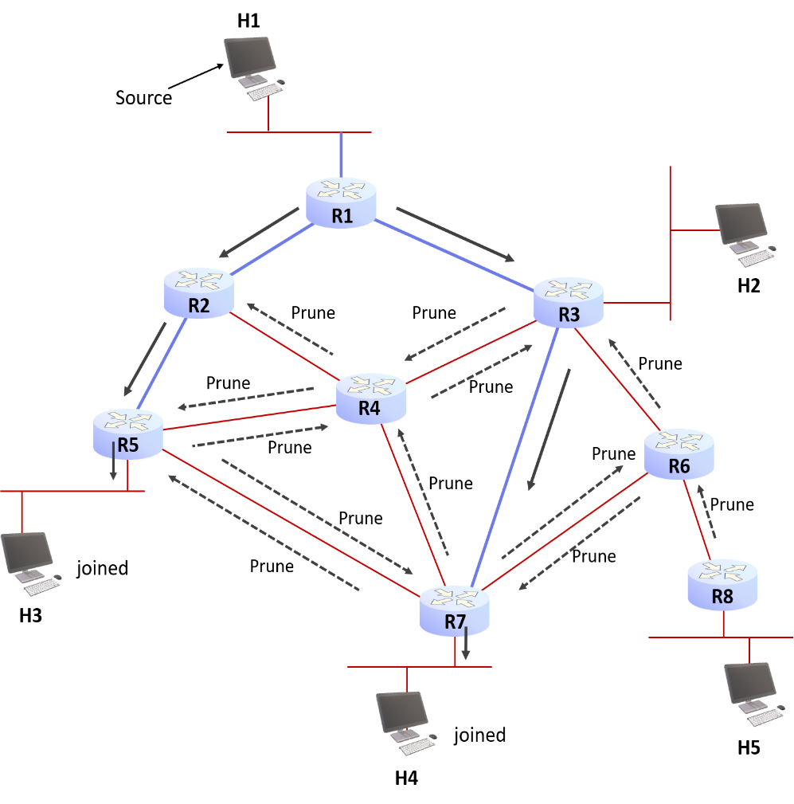
12.4 Multicast Routing Protocols
PIM-DM uses flood-and-prune method
  Prune

Slide 32
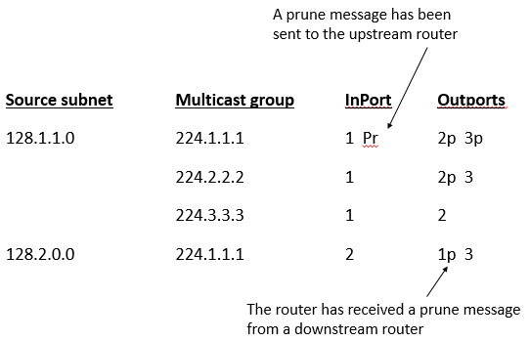
12.4 Multicast Routing Protocols
PIM-DM Multicast Router State
  Multicast routing table vs. unicast routing table
  Prune records are valid only until next flooding

Slide 33
12.4 Multicast Routing Protocols
Protocol-Independent Multicast (PIM) Protocol
  De facto standard
  References unicast routing table for RPF computation
    Independent of which unicast routing protocol is used (protocol-independent)
PIM Modes
  DM
    Flood-and-prune
    Meaningful when most multicast routers have receivers (cf. IPTV???)
  Sparse Mode (SM)
  Source-Specific Multicast (SSM)
  Bi-directional PIM

Slide 34
12.4 Multicast Routing Protocols
PIM-SM
  Tree branches are created only upon JOIN requests
  Uses a special router called Core (Rendezvous Point; RP)
PIM-SSM
  To support SSM, not only IGMP but also PIM had to change
Bi-directional PIM
  When there are many senders to a group
  A Designated Forwarder (DF) exists on each link toward RP

Slide 35
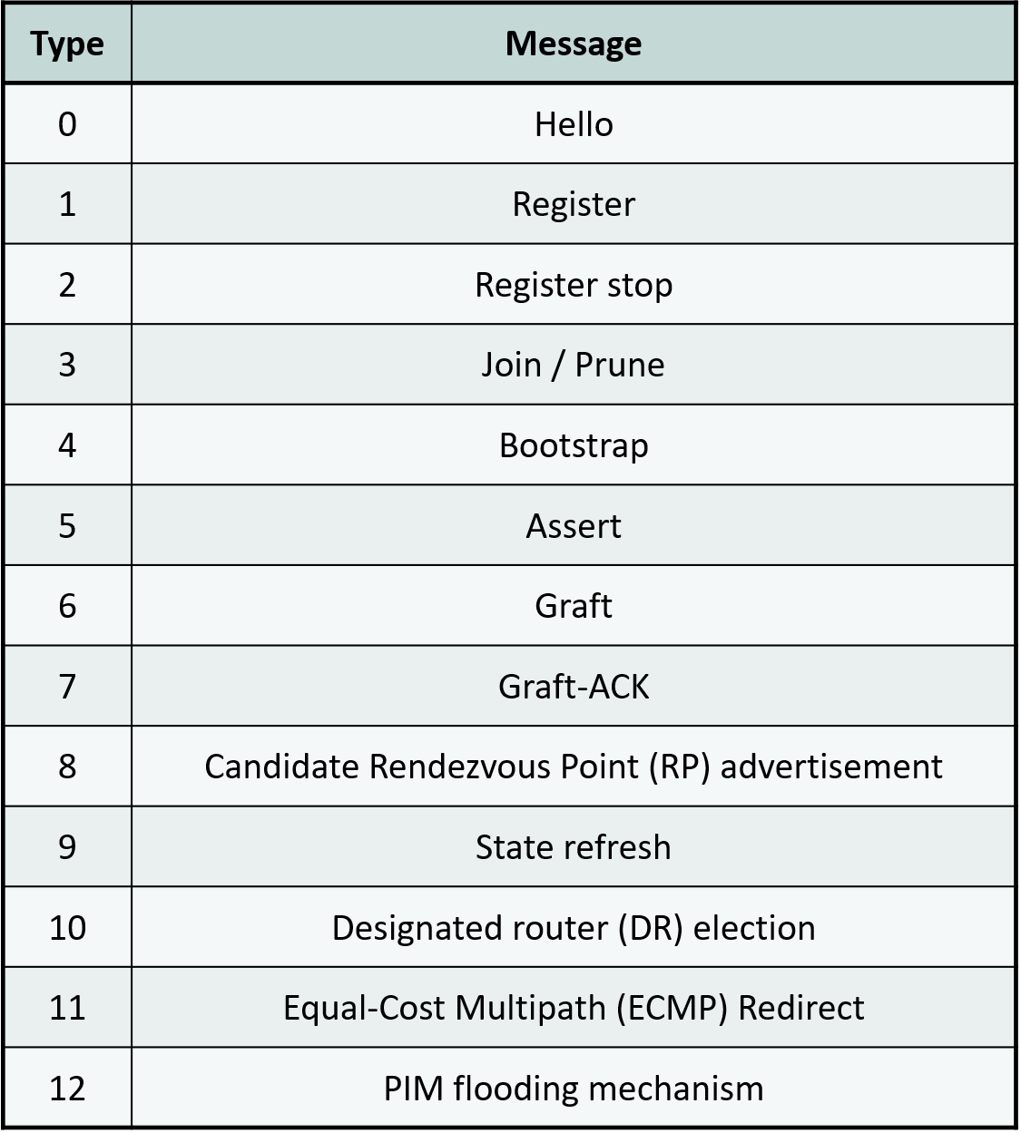
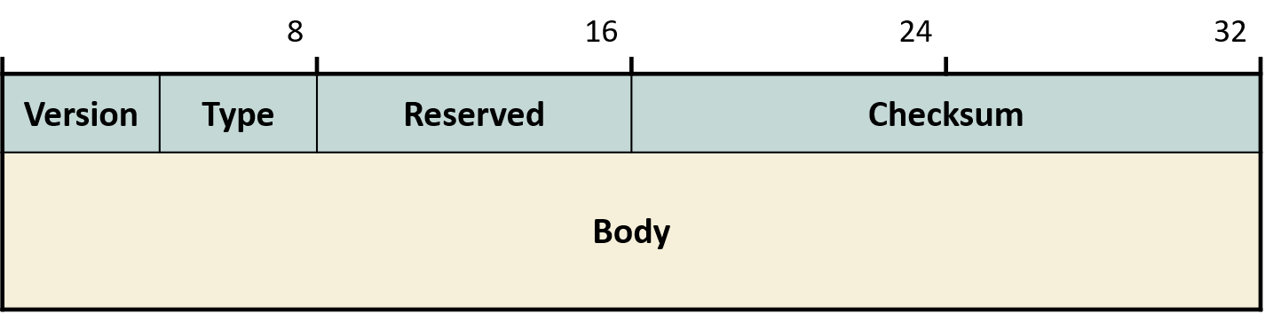
12.4 Multicast Routing Protocols
PIM Message Format
  PIM = IP protocol 103

Slide 36
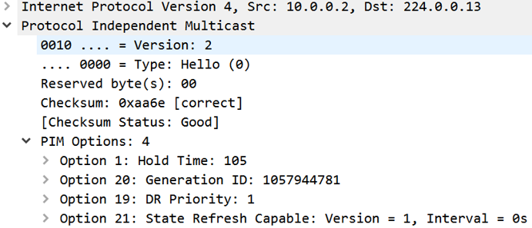
12.4 Multicast Routing Protocols
PIM Message Format
  Hello: each interface periodically sends to ALL-PIM-ROUTERS group
    224.0.0.13, ff02::d
    Discover neighbor routers
    Hold time: if this time elapses without Hello, neighbor is considered unreachable
    Generation ID: if changed, neighbor's state is considered changed
    DR priority

Slide 37
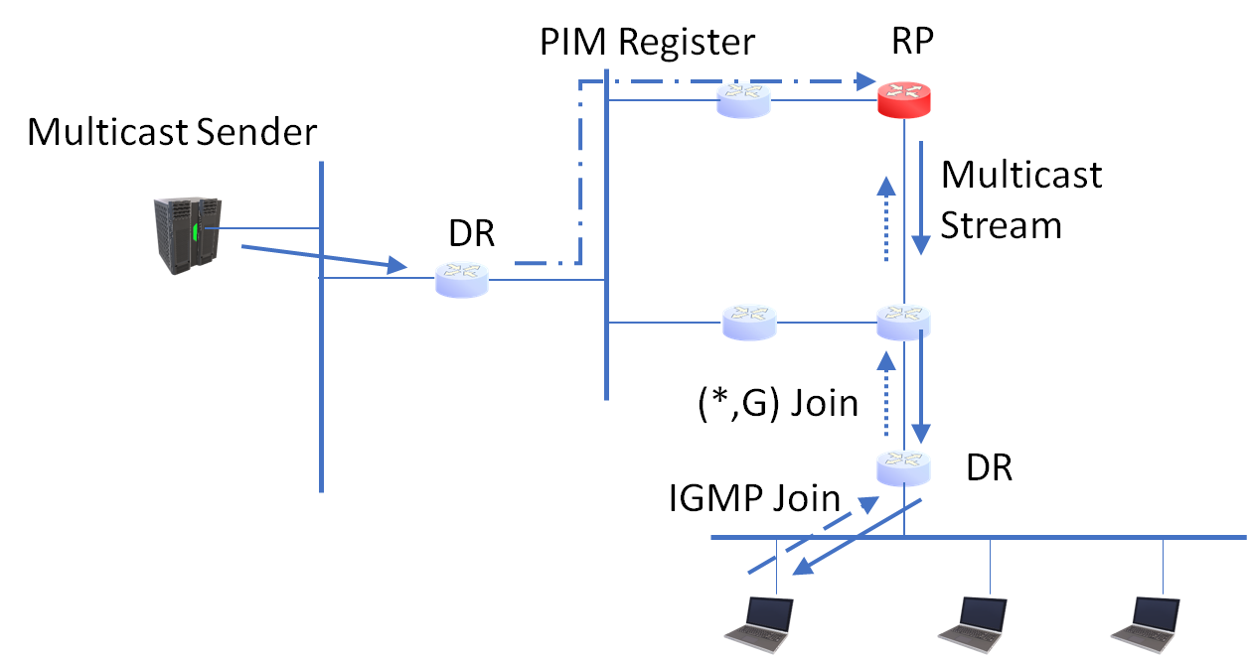
12.4 Multicast Routing Protocols
PIM Message Format
  Register
    Used only in PIM-SM
    Router responsible for source tunnels multicast packets to RP to register traffic
    Register-Stop is sent by RP to source router to switch delivery via shortest path tree

Slide 38
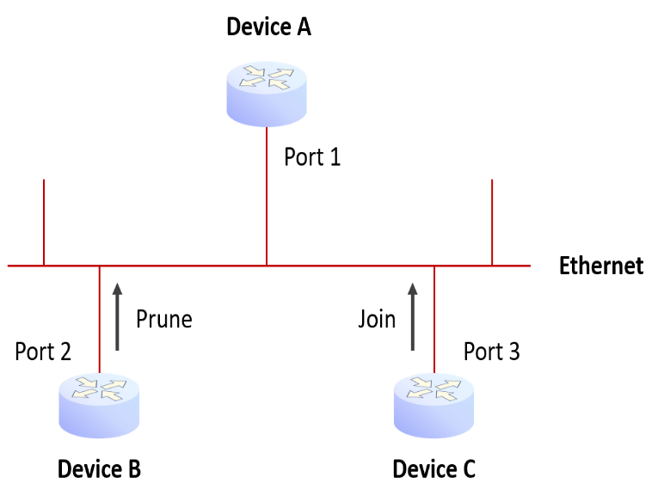
12.4 Multicast Routing Protocols
PIM Message Format
  Join/Prune: can express Join and Prune for separate groups (simultaneously)
    Prune: router sends upstream when there are no downstream receivers
    Join: sent through the RPF interface
    Join creates multicast state in each router until grafting onto RP tree
    Join is also used to create SP tree
    If another router on the same link has pruned the same group, must send Join to override upstream Prune

Slide 39
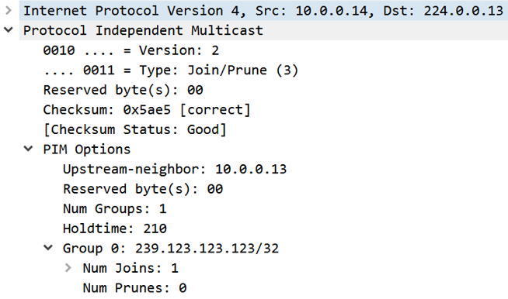
12.4 Multicast Routing Protocols
PIM Message Format
  Join/Prune Message Example
    Join/Prune messages are sent to 224.0.0.13 (all PIM routers on link)
    Join group 239.123.123.123
    Upstream router = 10.0.0.13

Slide 40
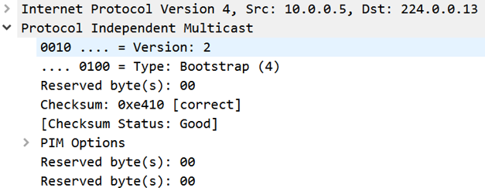
12.4 Multicast Routing Protocols
PIM Message Format
  Bootstrap Message
    If RP is statically configured, setting up a new RP takes time when RP fails
    Use a Bootstrap Router (BSR) to automatically notify PIM routers
    Example when BSR is at 10.0.0.5

Slide 41
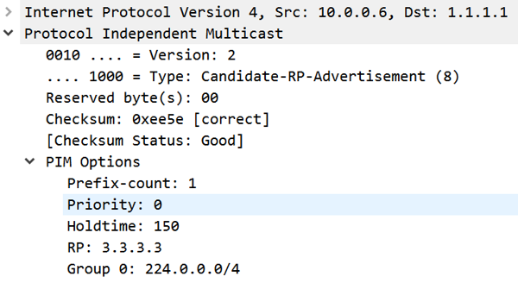
12.4 Multicast Routing Protocols
PIM Message Format
  Candidate-RP-Advertisement Message
    Once BSR is known, routers wishing to become RP unicast to BSR
    Sets the range of groups it wants to serve
    Example: BSR=1.1.1.1, 10.0.0.6 wants to serve as RP on interface 3.3.3.3

Slide 42
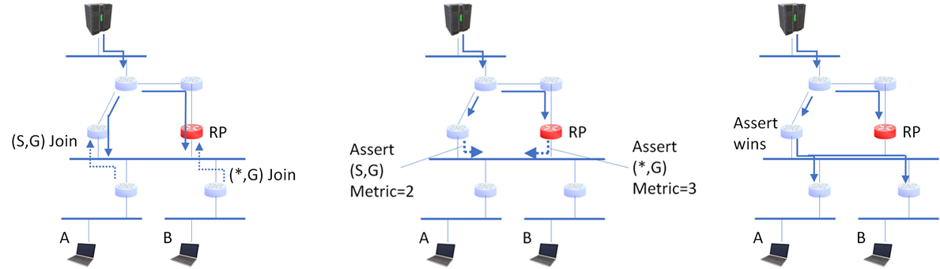
12.4 Multicast Routing Protocols
PIM Message Format
  Assert Message
    Message to determine a single downstream forwarder on a shared link
    In upstream flow case, the one closer to source wins by revealing distance to source
  Other messages include Graft, State-Refresh, DF Election, ECMP Redirect, PIM Flooding Mechanism, etc. (omitted)

Slide 43

12.4 Multicast Routing Protocols
PIM-SM
  Phase 1
    Receiver uses IGMP/MLD to express desire to receive group G traffic
    Router sends PIM Join (*, G) to RP of G (not IGMP Join!)
      Periodically sends Join
      Sends Prune if no downstream receivers
    RP tree is shared by all sources sending to G ("shared tree")

Slide 44
12.4 Multicast Routing Protocols
PIM-SM
  Phase 1
    When source starts sending to G, source router (DR) unicast-tunnels to RP
      Called Register
    RP forwards this down the shared tree
    Each router on the shared tree forwards down branches per (*,G) state

Slide 45
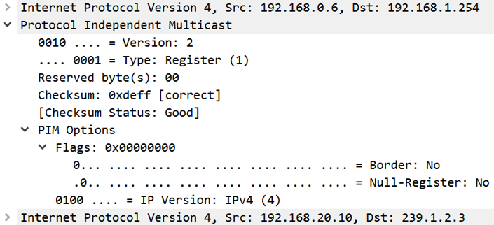
12.4 Multicast Routing Protocols
PIM-SM
  Phase 1
    Register Packet Example

Slide 46
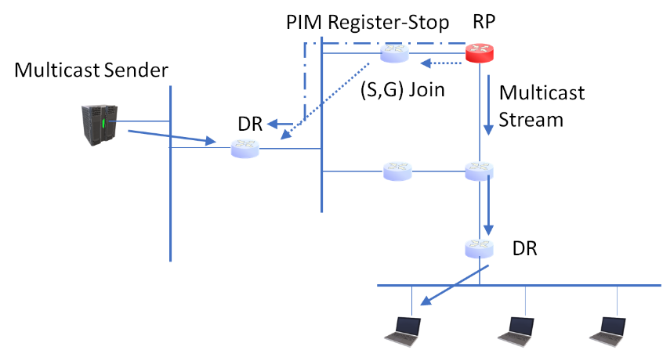
12.4 Multicast Routing Protocols
PIM-SM
  Phase 2
    Register is complex and inefficient since it goes via RP to receiver
    RP sends (S,G) Join toward source once multicast packets flow
    RP grafts onto source's SP tree
    When RP starts receiving duplicate copies, it sends Register-Stop to source DR

Slide 47
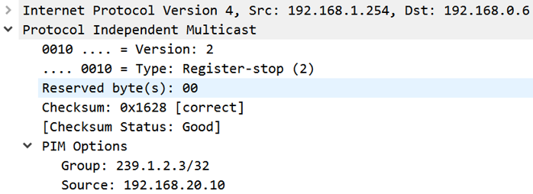
12.4 Multicast Routing Protocols
PIM-SM
  Phase 2
    Register-Stop Packet Example

Slide 48
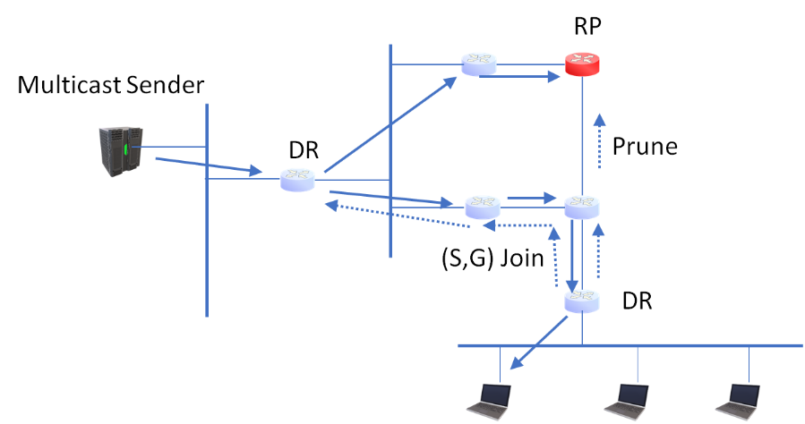
12.4 Multicast Routing Protocols
PIM-SM
  Phase 3
    Receiver DR can improve delivery efficiency by switching from RP tree to SP tree
    When data starts arriving from source, receiver DR sends (S,G) Join toward source
    When DR starts receiving duplicate copies, it sends (S,G,RP) Prune toward RP

Slide 49
12.4 Multicast Routing Protocols
PIM-SSM
  A special case of PIM-SM
    Simpler because there is one source per group
  Used in IPTV scenarios, so the set-top box knows the source address
    Joins SP tree directly

