Slide 1
Chapter 4
Digital Transmission
Data to digital signal, analog signal to data, bits onto wires
Forouzan, Data Communications and Networking, 5th ed., Chapter 4
4.1 Digital-to-digital: line coding, block coding, scrambling
4.2 Analog-to-digital: PCM, delta modulation
4.3 Transmission modes: parallel, serial
Textbook figures; printed errors corrected and marked

Slide 2
4.1
Digital-to-digital conversion
4.2
Analog-to-digital conversion
Line coding: bits → digital signal
Block coding: redundancy for sync
Scrambling: break zero runs, no extra bits
Judge by: levels, signal rate, timing, DC
PCM: sample, quantize, encode
Nyquist rate: how often to sample
Delta modulation: send the change
Quantization: where information is lost
4.3
Transmission modes
Chapter 4
Where we are
Parallel: n wires, n bits
Serial: one wire, one bit at a time
Async, sync, isochronous: where timing is enforced
Chapter 3: what a signal is, what a channel does to it
Chapter 4: build the signal
digital data → digital signal: line coding
analog data → digital data: sampling
Chapter 5: digital or analog data on an analog signal
Every scheme trades three things
bandwidth, self-synchronization, energy at 0 Hz

Slide 3
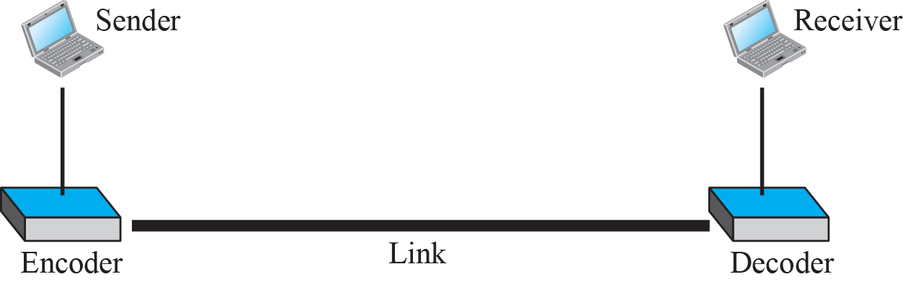
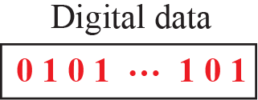
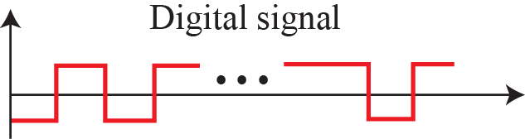
4-1
Digital-to-digital conversion
4.1.1
Line coding
Digital data → digital signal
Line coding: always needed
Block coding, scrambling: when channel or receiver demands
Order: block coding before, scrambling during line coding
Bits in memory → digital signal at sender
Decoding recovers bits at receiver
Data element: bit. Signal element: symbol
r = data elements per signal element
1, several, or a fraction of a bit
Figure 4.1
Line coding and decoding

Slide 4
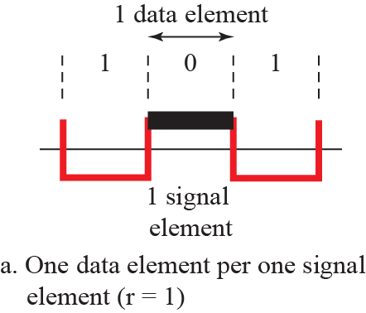
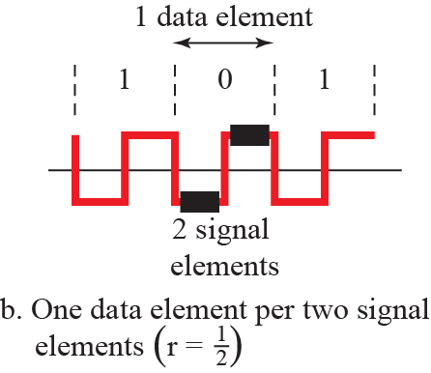
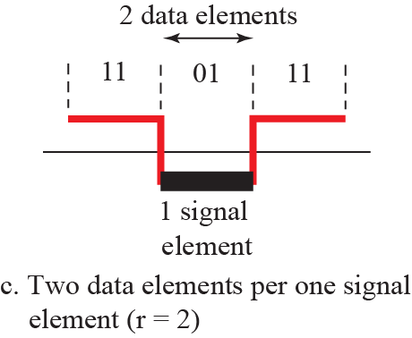
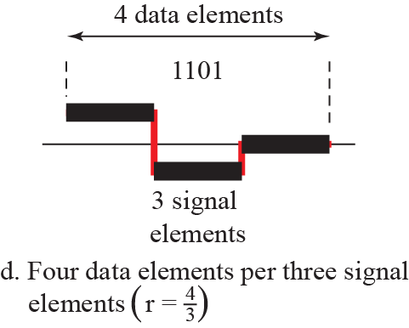
Figure 4.2
Signal elements versus data elements
4.1.1
Data rate and signal rate
Data rate N: bits per second (bit rate)
Signal rate S: signal elements per second, baud
also pulse rate, modulation rate, baud rate
Goal: raise N, lower S
more people, fewer vehicles
S = c × N × (1/r) baud
c: case factor, worst, best, average
Bandwidth follows S, not N
4.1.1
Bandwidth of a digital signal
Nonperiodic → continuous, infinite spectrum
Effective bandwidth: finite, small components ignored
More changes → more frequencies → B proportional to S
Bmin = c × N × (1/r), Nmax = (1/c) × B × r
Example 4.1
Average baud rate when r = 1
Example 4.2
Agreement with Nyquist
N = 100 kbps, r = 1, c = 1/2
Chapter 3: Nmax = 2 × B × log2 L
L levels → r = log2 L, c = 1/2
Nmax = (1/c) × B × r = 2 × B × log2 L: agrees

Slide 5
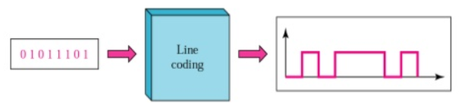
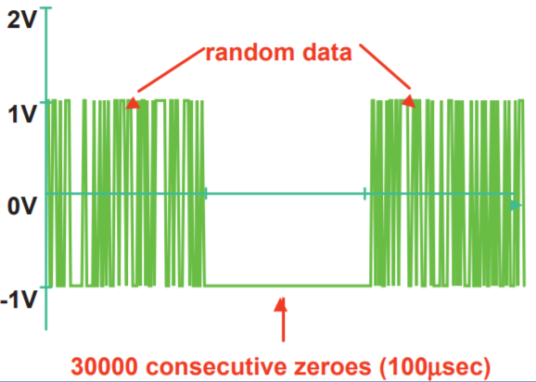
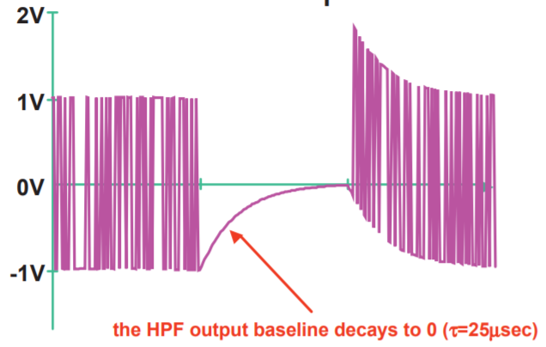
4.1.1
What a line code must get right
Avoid: baseline wandering, DC component, costly complexity
Pursue: self-synchronization, error detection, noise immunity
No scheme wins all six: channel and receiver budget decide
4 levels cost more than 2, in silicon and noise margin
4.1.1
Baseline wandering
Figure
Effect of a long run on the baseline
Baseline: running average of received power
Each element judged against it
Long run of 0s or 1s → baseline drifts
Forced transitions bound the drift

Slide 6
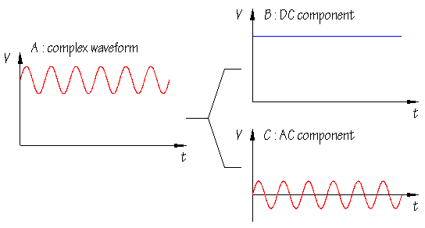
4.1.1
DC components
Figure
A constant level puts energy at zero frequency
Constant nonzero level → energy near 0 Hz
Not passed by band-limited channels
telephone line: nothing below ≈ 200 Hz
transformer or capacitor coupling: blocked
DC energy carries no information: wasted

Slide 7
4.1.1
Baseline wander, physically
4.1.1
Effect on the receiver
Serial links are AC coupled
series capacitor; Ethernet: transformer
reason: separate common modes, isolation
Series capacitor = high-pass filter
Long identical run = slow signal
capacitor charges, level droops toward 0
Leftover charge = offset = moving baseline
Signal moves, threshold does not
Eye diagram: vertical closure, BER up
Pattern-dependent droop → edges move
= data-dependent jitter
Book's "running average": receiver's estimate of this moving baseline
4.1.1
How real links deal with it
Bound the run: 8B/10B ≤ 5 identical bits, disparity ±2
Large capacitor: PCI Express ≈ 100 nF coupling
Correct at receiver: low-frequency feed-forward path
Same effect elsewhere: ECG baseline wander
4.1.1
Self-synchronization
Example 4.3
0.1 percent clock error
Receiver bit intervals must match sender's
Self-synchronizing: timing carried by transitions
1 kbps: 1001 bps received, +1 bit/s
1 Mbps: 1,001,000 bps received, +1000 bit/s
fast links: tighter clocks or timing in the data

Slide 8
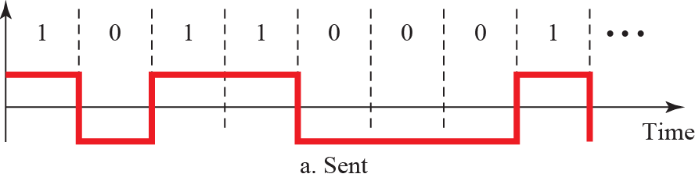
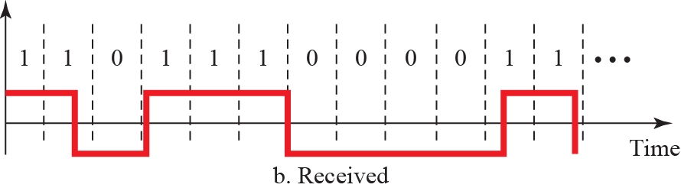
Figure 4.3
Effect of lack of synchronization
4.1.1
Cost of a slip
Drift → a bit read twice or missed
Every later bit misaligned: frame lost
Schemes judged first on timing recovery

Slide 9
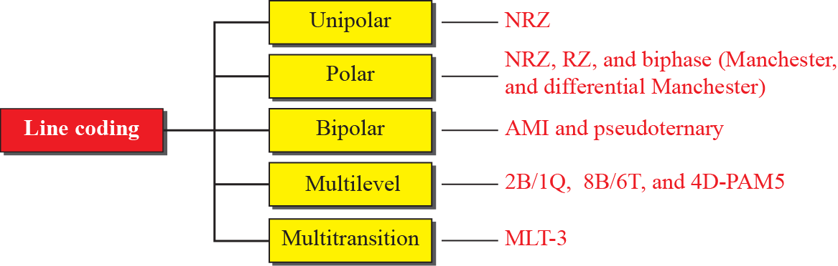
Figure 4.4
Taxonomy of line coding schemes
4.1.2
Five categories
Unipolar: all levels on one side of 0
Polar: both sides
Bipolar: 3 levels, one data element at 0 V
Multilevel: several bits per element
Multitransition: level set by a rule
4.1.2
Four questions per scheme
How many levels?
Signal rate for a given data rate?
Transition to lock to?
Average at zero?
answers: summary table at end of 4.1.2

Slide 10
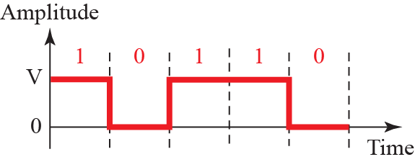
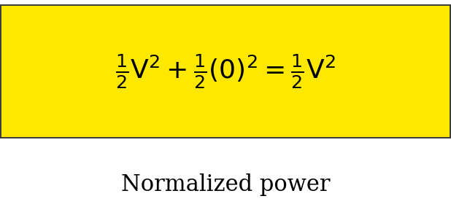
Figure 4.5
Unipolar NRZ scheme
4.1.2
Unipolar NRZ
All levels on one side of 0
Average = half amplitude: maximum DC
Normalized power: 2× polar NRZ
Not used today: teaching example
Figure erratum: ½ missing before V², corrected
4.1.2
Polar schemes
Levels on both sides of 0
Balanced stream → average ≈ 0
NRZ, RZ, biphase: differ in transitions per bit

Slide 11
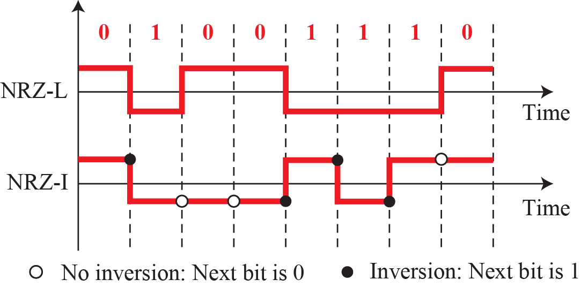
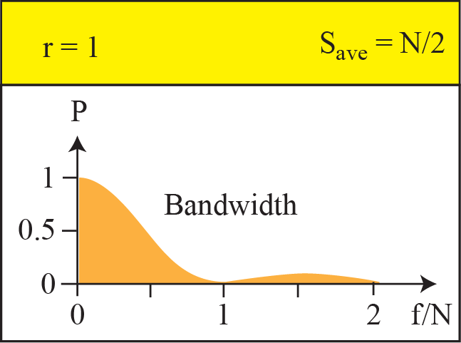
Figure 4.6
Polar NRZ-L and NRZ-I
4.1.2
NRZ-L and NRZ-I
NRZ-L: level = bit value
NRZ-I: invert on 1, hold on 0
Baseline wandering: both, NRZ-L 2× worse
long 0s: both, long 1s: NRZ-L only
No self-sync, power near 0 Hz
S = N/2, Bmin = N/2
Reversed pair polarity: NRZ-L inverts all bits
NRZ-I immune: reads changes
Uses: NRZ-L automotive, NRZ-I USB
Example 4.4
NRZ-I at 1 Mbps
S = N/2 = 500 kbaud, Bmin = 500 kHz
Manchester: 1 MHz, price of self-sync

Slide 12
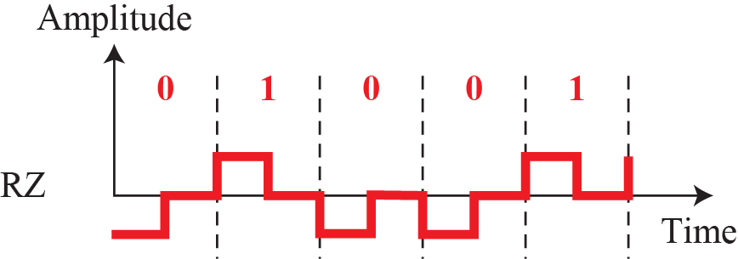
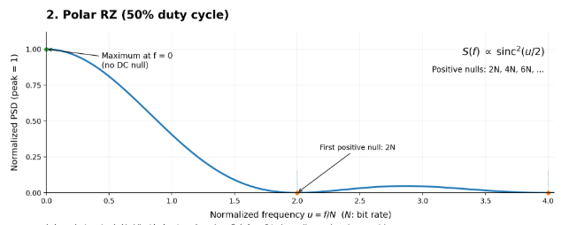
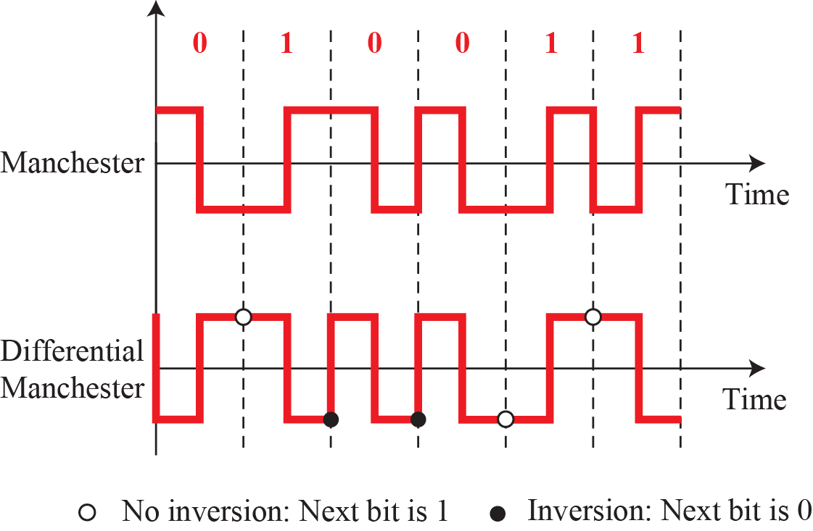
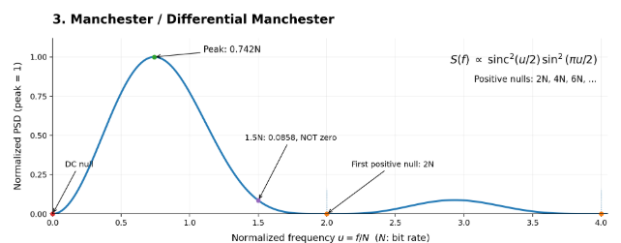
Figure 4.7
Polar RZ scheme
PSD
Polar RZ, computed
4.1.2
Return to zero
Return to 0 mid-bit: transition every bit
Sync, zero mean
PSD: maximum at 0 Hz, first null 2N
zero mean ≠ no low-frequency power
Cost: 3 levels, 2× bandwidth
Not used
Figure 4.8
Biphase schemes
PSD
Manchester, computed
4.1.2
Biphase
Mid-bit transition: timing + data
No baseline wandering, DC null
PSD: peak 0.74N, first null 2N
S and B: 2× NRZ
Uses: Ethernet, IrDA, RFID, NFC

Slide 13
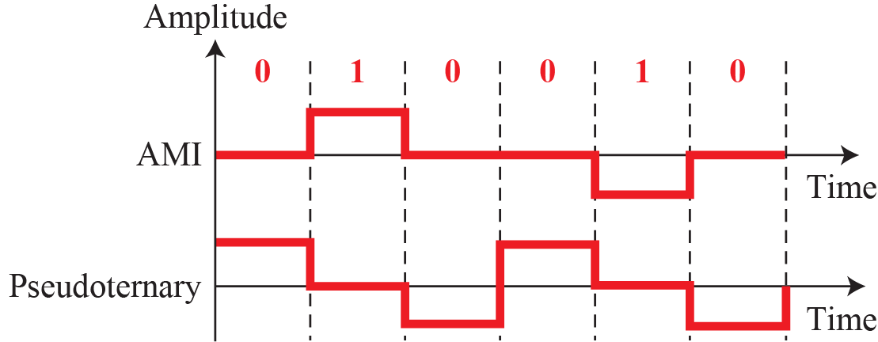
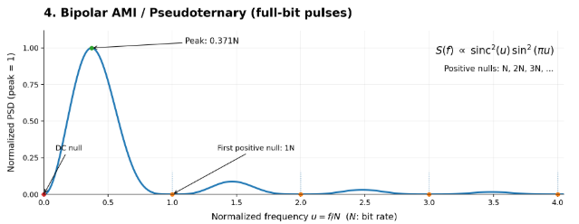
Figure 4.9
AMI, pseudoternary
PSD
AMI, computed
4.1.2
Bipolar schemes
3 levels: one element at 0 V, other alternates ±
AMI: mark (1) alternates
Pseudoternary: 0 and 1 swapped
Third level: for alternation only
PSD: peak 0.37N, nulls at 0, N, 2N
book's plot peaks at N/2: wrong
4.1.2
Why bipolar, and its weakness
S as NRZ, pulses cancel → 0 at 0 Hz
Long links: transformers pass nothing at DC
T1 (North America), E1 (Europe)
Long zero run: nothing to lock to
fixed in 4.1.4 without extra bits

Slide 14
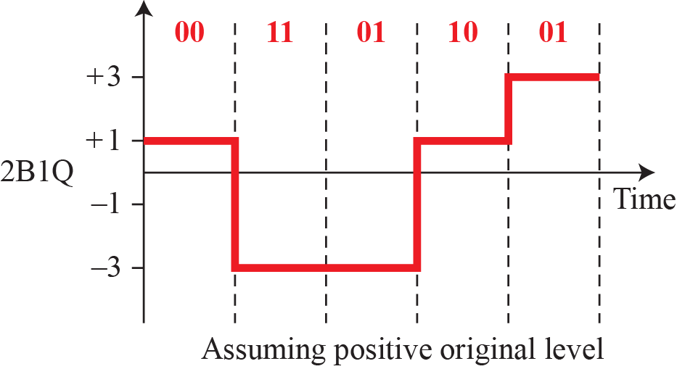
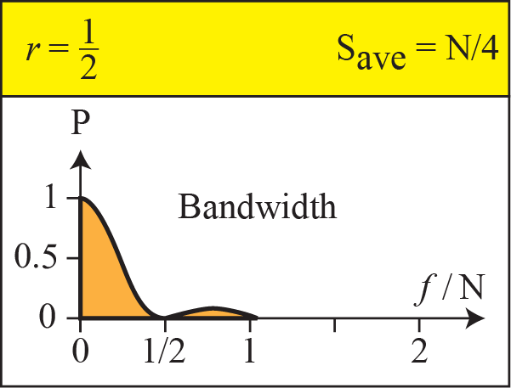
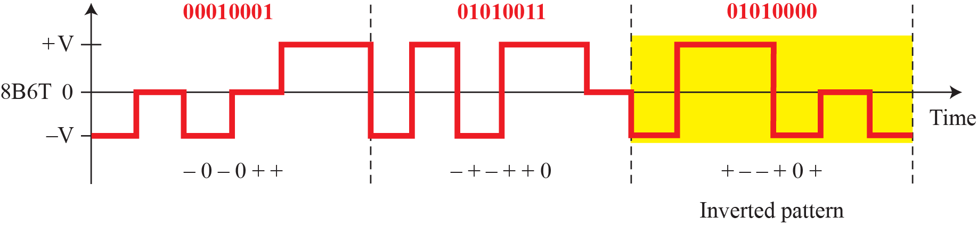
Figure 4.10
Multilevel 2B1Q
4.1.2
Multilevel schemes
mBnL: m bits → n elements, L levels
2B1Q: 2 bits per element, 4 levels
S = N/2
Cost: levels closer, less noise margin
Uses: ISDN basic rate, HDSL
Figure 4.11
Multilevel 8B6T

Slide 15
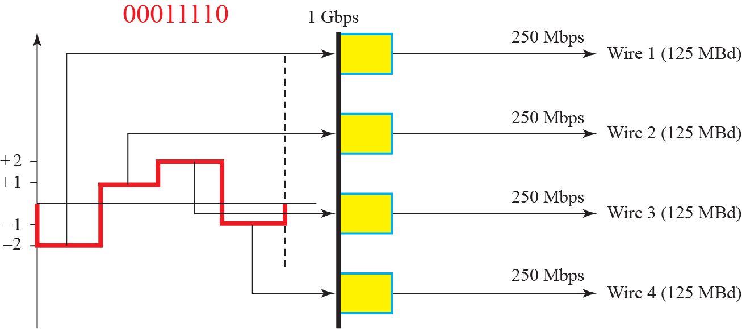
Figure 4.12
Multilevel 4D-PAM5
4.1.2
4D-PAM5
5 levels, one reserved for FEC
4 levels → 2 bits, over 4 wires at once
Gigabit Ethernet: 4 pairs × 125 Mbaud
4.1.2
Multilevel vs. multitransition
Multilevel: spend levels for lower S
Multitransition: spend a rule, keep levels few
Limit: noise decides how many levels fit (Chapter 3)

Slide 16
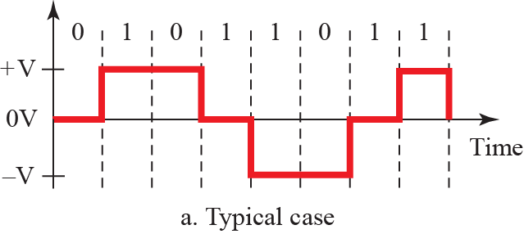
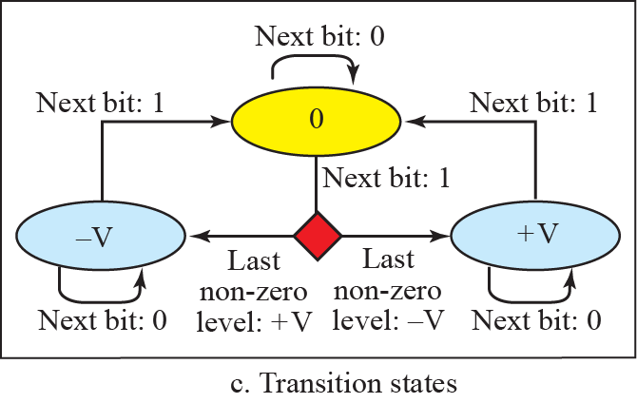
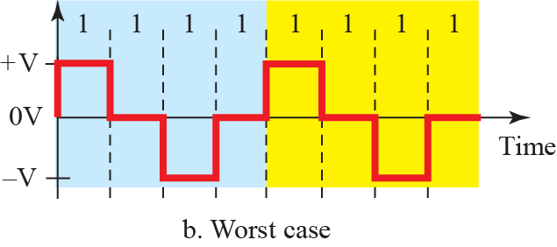
Figure 4.13
Multi-transition MLT-3
4.1.2
MLT-3
3 levels, chosen by a transition rule
0: no transition
1 from nonzero: → 0
1 from 0: → opposite of last nonzero
All-1s input: repeats every 4 bits
Why bother
worst case periodic: S = N/4, near-sinusoidal
little energy in high harmonics
100 Mbps in < 32 MHz: Fast Ethernet on copper

Slide 17
Table 4.1
Summary of line coding schemes, corrected
Category
Scheme
Bandwidth
Characteristics
Unipolar
NRZ
B = N/2
costly, no self-sync on long 0s or 1s, DC
Polar
NRZ-L
B = N/2
no self-sync on long 0s or 1s, DC
Polar
NRZ-I
B = N/2
no self-sync on long 0s, DC
Polar
Biphase
B = N
self-sync, no DC, 2× bandwidth
Bipolar
AMI
B = N/2
no self-sync on long 0s, no DC
Multilevel
2B1Q
B = N/4
no self-sync on long same pairs, DC
Multilevel
8B6T
B = 3N/4
self-sync, no DC
Multilevel
4D-PAM5
B = N/8
self-sync, no DC
Multitransition
MLT-3
B = N/4
no self-sync on long 0s, no DC
AMI: printed "DC" → no DC, the reason bipolar exists
MLT-3: printed N/3 → N/4, book's own derivation, 100BASE-TX: 125 Mbaud → 31.25 MHz
2B1Q, MLT-3: DC status missing in print, added
8B6T: S = 3N/8 average, Bmin ≈ 6N/8 in practice, both correct

Slide 18
4.1.2
Where the spectrum plots come from
4.1.2
Reading the four spectra
Book: plots given, derivation never
Random bits → stochastic signal → power spectral density
Signal = pulse train, amplitudes set by data
PSD = pulse part × coding part
pulse shape → envelope; rectangle width T → sinc², null at 1/T
coding rule → autocorrelation → what is carved out
Polar NRZ: bare sinc², null at N, half power < N/2
origin of B = N/2
Unipolar NRZ: + impulse at 0 Hz = DC
Polar RZ: half-width pulse → sinc², max at 0 Hz, null 2N
Biphase: doublet pulse → 0 at 0 Hz, peak 0.74N, null 2N
AMI: negative 1-lag correlation → 0 at 0 and N, peak 0.37N
book's N/2 peak: wrong
EXPLORE
Derivations and measurements
Continued
Stanford EE179, Lecture 14: the derivation
https://web.stanford.edu/class/ee179/lectures/notes14.pdf
KFUPM EE370, Lecture 27: polar NRZ term by term
https://faculty.kfupm.edu.sa/EE/wajih/files/EE%20370/EE%20370,%20Lecture%2027.pdf
GaussianWaves: line code spectra in Matlab and Python
https://www.gaussianwaves.com/2021/01/line-code-demonstration-in-matlab-and-python/
UBC ELEC 3525, lab 6: NRZ, Manchester, 4B5B + MLT-3 measured
https://people.ece.ubc.ca/~edc/3525.jan2018/lab6.pdf

Slide 19
4.1
Which technology uses which scheme today
Scheme
Used in
Why
Unipolar NRZ
TTL serial between chips, optical on-off
cheapest, DC harmless at 10 cm
NRZ-L
RS-232, CAN and LIN in vehicles
slow: bit stuffing or clock suffices
NRZ-I
USB low and full speed
bit stuffing after six 1s
Manchester
10BASE-T, RFID, NFC, IrDA, DALI
self-clocking, bandwidth cheap at 10 Mbps
Diff. Manchester
IEEE 802.5 Token Ring
immune to reversed pair
AMI + B8ZS
T1, North America
no DC, timing without extra bits
HDB3
E1, Europe and most of Asia
acts after 4 zeros
2B1Q
ISDN U interface, HDSL
2 bits/symbol on voice pairs
8B6T
100BASE-T4
3 levels on 4 Cat 3 pairs
4D-PAM5
1000BASE-T
4 pairs × 125 Mbaud on Cat 5
MLT-3
100BASE-TX
fundamental 31.25 MHz
4B/5B
100BASE-TX, FDDI
bounds zero runs before MLT-3
8B/10B
1000BASE-X, Fibre Channel, SATA, PCIe 1/2, USB 3.0
DC balance, control symbols, 25% overhead
> 10 Gbps: 64B/66B (10GBASE-R), 128B/130B (PCIe 3.0+), scrambler replaces table, overhead 3% and 1.5%

Slide 20
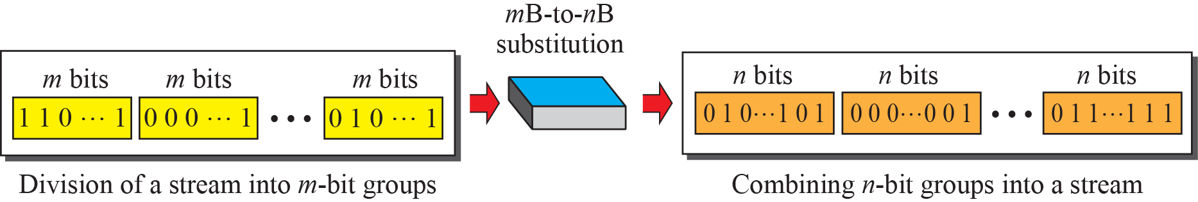
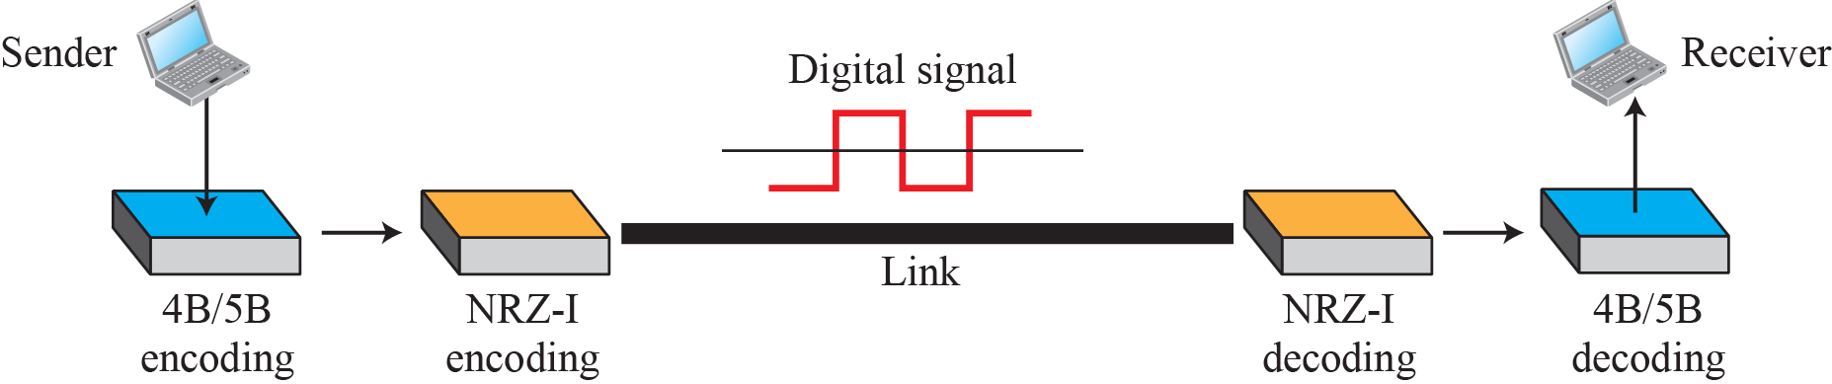
4.1.3
Block coding
Figure 4.14
Block coding concept
Line coding alone: no spare bits for sync or error detection
mB/nB: m bits → n bits, n > m
Legal words: no long runs → sync
Only some of 2^n words legal → illegal word = detected error
Runs before line coding
Figure 4.15
4B/5B ahead of NRZ-I
4.1.3
4B/5B
Fixes NRZ-I's long-0 problem: ≤ 3 consecutive 0s
Cost: S +25%
NRZ-I DC component remains

Slide 21
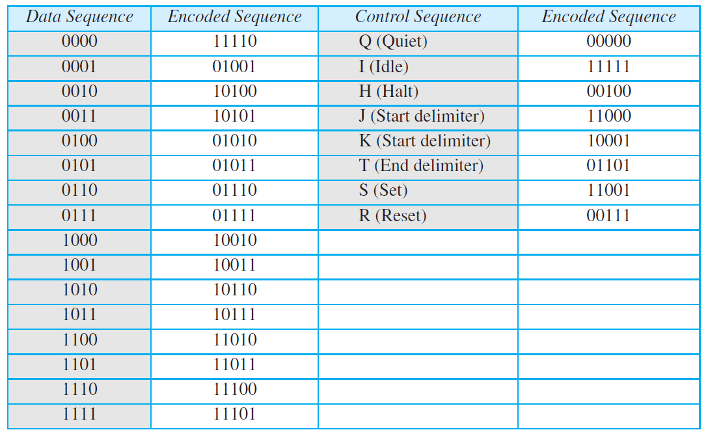
Table 4.2
4B/5B mapping codes
4.1.3
Spare code words
16 data blocks, 32 five-bit words
Rest: control (start, end, idle) or invalid
Invalid word received = detected error
Redundancy pays twice: sync + detection
Example 4.5
1 Mbps: 4B/5B + NRZ-I vs. Manchester
4B/5B → 1.25 Mbps, NRZ-I Bmin = N/2 = 625 kHz, DC
Manchester: Bmin = 1 MHz, no DC
Channel decides which price

Slide 22
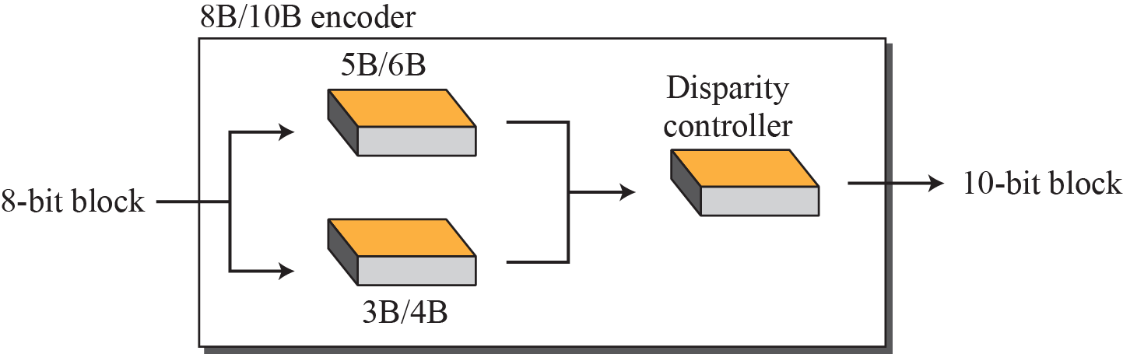
Figure 4.17
8B/10B block encoding
4.1.3
8B/10B
8 → 10 bits: 1024 words for 256 blocks
5B/6B + 3B/4B stages, disparity controller
Running disparity: 1s minus 0s sent
next word chosen to pull it toward 0
More redundancy than 4B/5B: better detection
Uses: Gigabit Ethernet, Fibre Channel, PCIe, SATA
4.1.3
Why 5B/6B + 3B/4B, not 2 × 4B/5B
4.1.3
What the partition buys
DC balance needs even length: half the bits 1
6 and 4 even; 5-bit words always ±1
5B/6B: 20 balanced words for 32 inputs
3B/4B: 6 balanced words for 8 inputs
rest: complementary pairs, chosen by disparity
Tables: 32 + 8 entries, not 256 × 2
One disparity counter, 6B → 4B
Run length ≤ 5, digital sum variation 6
Widmer, Franaszek, IBM J. R&D 27(5), 1983

Slide 23
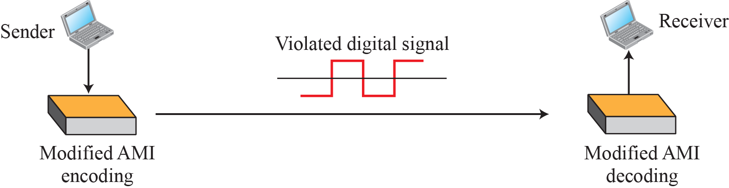
4.1.3
One generation later
25% overhead: fine at 1 Gbps, painful at 10
10GBASE-R, PCIe 3.0: scrambler + 2-bit header per 64 or 128 bits
Transitions and DC balance: probable, not guaranteed
Guarantees cost bits; when bits are dear, accept probabilities
4.1.4
Scrambling
Long links need: no extra bits, sync, zero average
biphase too wide, block + NRZ keeps DC, AMI loses sync on zeros
Substitute long zero runs with a fixed pattern
Done during encoding: N and S unchanged
B8ZS, HDB3
Figure 4.18
AMI used with scrambling
4.1.4
Where scrambling sits
Same time as encoding, not a pass before
Pattern violates AMI alternation on purpose
violation = signal to restore zeros

Slide 24
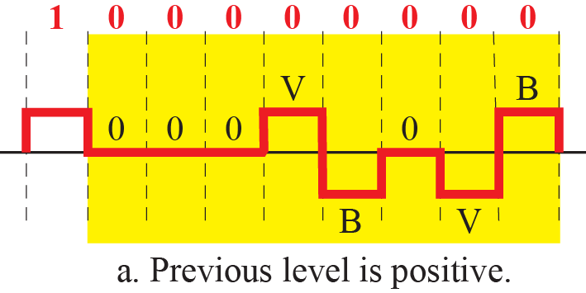
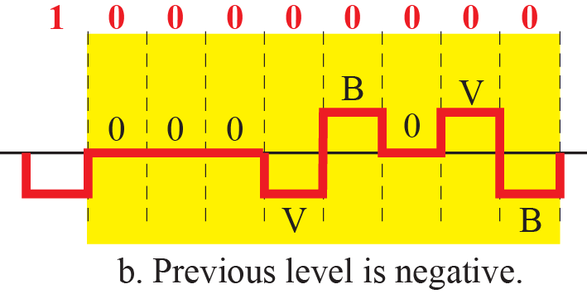
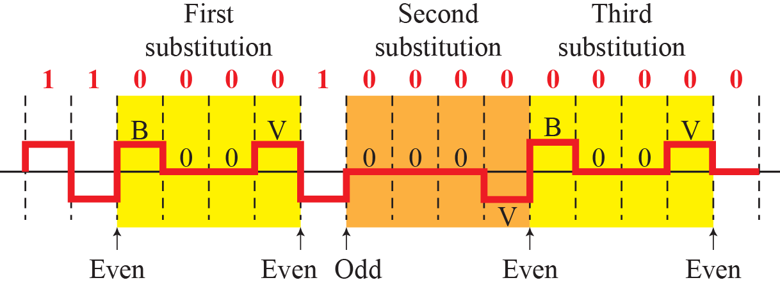
Figure 4.19
B8ZS, two cases
4.1.4
B8ZS
8 zeros → 000VB0VB
V: violation, B: bipolar (obeys rule)
Average stays 0
North American carrier systems
Figure 4.20
HDB3 substitution in four situations
4.1.4
HDB3
4 zeros → 000V or B00V
Odd nonzero pulses since last: 000V
Even: B00V
Purpose: keep average at 0
European carrier systems

Slide 25
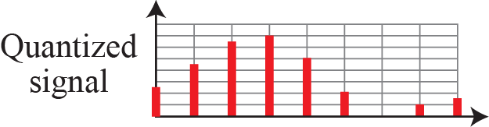
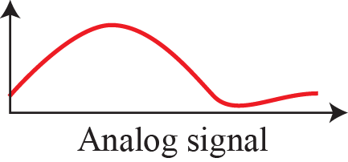
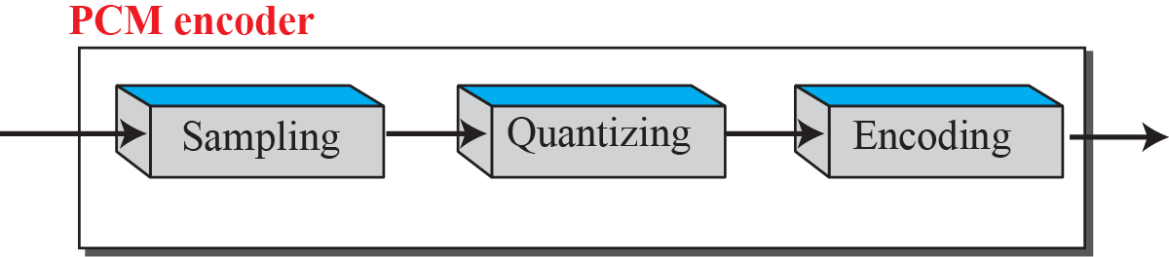
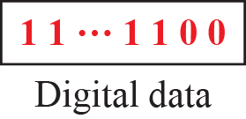
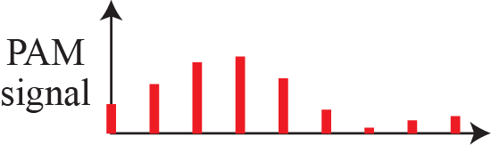
4-2
Analog-to-digital conversion
4.2.1
Pulse code modulation
Microphone, camera → analog signal
Digital survives repeaters, analog accumulates noise
Cost: bandwidth, quantified at end of 4.2
PCM, delta modulation
Sampling: continuous → discrete time
Quantization: continuous → discrete amplitude
only irreversible step
Encoding: → bits
G.711 (1972): 8000 samples/s × 8 bits, every phone call
Figure 4.21
Components of a PCM encoder

Slide 26
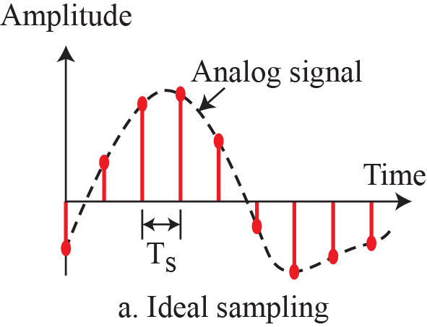
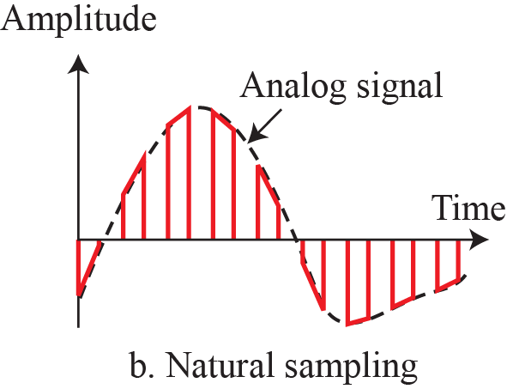
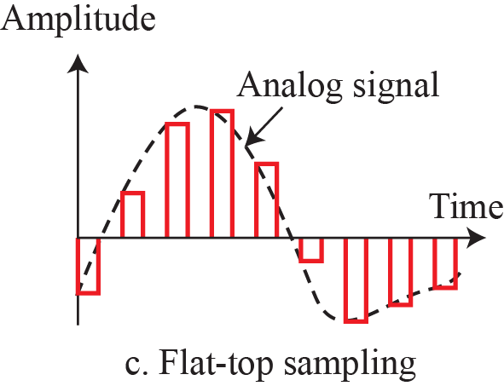
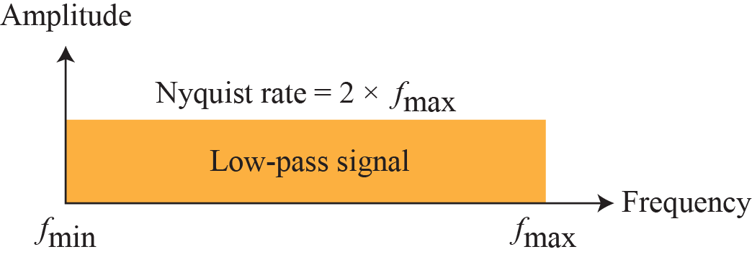
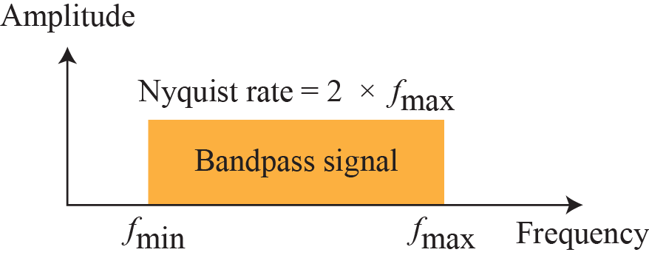
Figure 4.22
Three sampling methods for PCM
4.2.1
Sampling
Interval Ts, rate fs = 1/Ts
Ideal: instantaneous, not realizable
Natural: follows signal for pulse width
Flat-top: hold value, sample-and-hold, used in practice
Also called PAM
Discrete time, still continuous amplitude
4.2.1
Sampling rate
Figure 4.23
Nyquist rate for low-pass and bandpass signals
Nyquist: fs ≥ 2 × highest frequency
highest frequency, not bandwidth
Same only for low-pass from 0 Hz
Bandpass: fs ≥ 2 × bandwidth, band position needed
Example 4.6
One sine wave, three rates
fs = 2f (Nyquist): good recovery
fs = 4f: same result, wasted samples
fs = f: unrecoverable

Slide 27
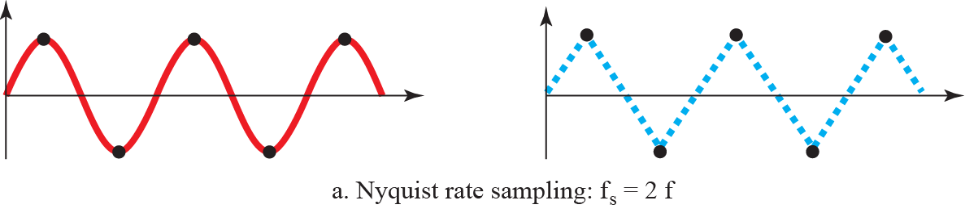


Figure 4.24
Recovery of a sine wave at three sampling rates

Slide 28




Figure 4.25
Sampling a clock that has only one hand
Example 4.7
Aliasing
Film: 24 frames/s
Wheel > 12 turns/s → appears backward
False low frequency: alias

Slide 29

4.2.1
Aliasing in video
4.2.1
Rolling shutter
Frame rate = sampling rate for rotation
Spoke advances just under one spacing → looks backward
negative alias frequency
Exactly one spacing → frozen (helicopter rotors)
24 frames/s: > 12 turns/s aliases
Cure: filter before sampling, longer shutter
Phone sensors read row by row
bottom row ms after top
Propeller: sampled at a different instant per row
bent, detached blades
Spatial + temporal aliasing
Global shutter: whole frame at once, no artifact
Simulation
Car wheel filmed at 24 fps: click to play
4.2.1
Reading the animation
Wheel: 4.4 rev/s forward, 5 identical spokes
Camera: 24 fps → 0.183 rev per frame
Spoke spacing 0.2 rev: each frame 1/60 rev short
eye matches nearest spoke → -6° per frame
appears backward at 0.4 rev/s
Spoke pattern 22 Hz > 12 Hz (Nyquist)
alias: 22 - 24 = -2 Hz
Rim mark: 4.4 Hz < 12 Hz, no alias

Slide 30
EXPLORE
Real footage and background
Continued
Real car, filmed: why car wheels spin backwards on video
https://www.youtube.com/watch?v=B8EMI3_0TO0
Car commercials: wheels in reverse, explained
https://www.youtube.com/watch?v=CaiIZI1oe40
Math behind it: when the wheel stops or reverses
https://www.youtube.com/watch?v=CoAj4FmMYTg
Wikipedia, wagon-wheel effect: negative-frequency reading
https://en.wikipedia.org/wiki/Wagon-wheel_effect
Wikipedia, rolling shutter: detached propeller blades
https://en.wikipedia.org/wiki/Rolling_shutter
Wikipedia, stroboscopic effect: aliasing by flickering light
https://en.wikipedia.org/wiki/Stroboscopic_effect

Slide 31
Example 4.8
Telephone voice
Example 4.9
Low-pass, 200 kHz
Example 4.10
Bandpass, 200 kHz
Max voice frequency 4000 Hz → 8000 samples/s
4000 Hz: the channel the network reserved
Band 0 to 200 kHz → fs = 400,000 samples/s
Band edges unknown → fs undetermined
4.2.1
Quantization
Sample amplitudes: infinitely many values
Range Vmin to Vmax → L zones, Δ = (Vmax - Vmin)/L
Zone midpoints: values 0 to L-1
Sample → value of its zone
L: set by amplitude swing and accuracy
audio 256, video thousands
Small L: fewer bits, more error

Slide 32

Figure 4.26
Quantization and encoding of a sampled signal
4.2.1
Reading the chart
Row 1: normalized amplitude (÷ Δ)
Row 2: zone midpoint
Row 3: normalized error
Row 4: quantization code
Row 5: encoded word, the output
Error ≤ Δ/2, never zero

Slide 33

4.2.1
Quantization error and SNR
4.2.1
Why 6 dB per bit
Error in [-Δ/2, +Δ/2]: bounded, never 0
SNRdB = 6.02 nb + 1.76
+1 bit/sample ≈ +6 dB
Nonuniform amplitudes → nonuniform zones
companding: compress large, expand at receiver
Error ≈ uniform on [-Δ/2, +Δ/2]
Noise power = Δ²/12, independent of signal
2× levels → Δ/2 → noise ÷ 4 → 6.02 dB
+1.76 dB: full-scale sine peak-to-rms
Fixed noise → worst SNR on quiet passages
Example 4.11
Eight levels
Example 4.12
Telephone line, SNRdB > 40
nb = 3 → SNRdB = 6.02(3) + 1.76 = 19.82 dB
Printed n = 6.35 → nb ≥ 6.35 → nb = 7
practice: 7 or 8 bits

Slide 34
4.2.1
What quantization error sounds like
Continued
Correlated with signal: distortion, not hiss
Heard on fades, reverb tails
8 bits: obvious. 16 bits: only on quiet tails
Dither: add noise before quantizing
distortion → steady hiss, +4.8 dB floor
Companding: fine steps when quiet
CMUSE calculator: bit depth → step, noise floor, SNR
https://www.cmuse.org/quantization-noise-calculator
iZotope: why dither helps
https://www.izotope.com/en/learn/what-is-dithering-in-audio
EXPLORE
Hear it
AudioCheck: 16-bit, 8-bit, 8-bit + dither, headphones
https://www.audiocheck.net/audiotests_dithering.php
SoundGuys: error plotted at 2, 4, 8 bits
https://www.soundguys.com/audio-bit-depth-explained-23706/

Slide 35





4.2.1
Encoding
Example 4.13
Human voice
Sample → nb-bit word, nb = log2 L
code 2 → 010, code 5 → 101
Bit rate = fs × nb
0 to 4000 Hz, 8 bits/sample
4.2.1
Recovering the signal
Figure 4.27
Components of a PCM decoder
Code word → held pulse → staircase
Low-pass filter, original cutoff → analog
Needs: Nyquist-rate sampling, enough levels
Faster sampling: no gain
More levels: gain, costs bits
4.2.1
PCM bandwidth
Example 4.14
4 kHz voice
4.2.1
Max data rate, min bandwidth
N = nb × fs = nb × 2 × Banalog
Into Bmin = c × N × (1/r), r = 1, c = 1/2
Bmin = nb × Banalog
Price of digitization: nb × bandwidth
Analog: 4 kHz
8 bits/sample: 8 × 4 = 32 kHz
Filter to B, sample at 2B, L levels
extra levels useless: signal had L
N = 2 × B × log2 L = Nmax (Chapter 3)
Bmin = N / (2 × log2 L)

Slide 36



4.2.2
Delta modulation
Figure 4.28
The process of delta modulation
PCM complex; DM simplest alternative
PCM: amplitude per sample
DM: change since last sample, 1 bit
1: up by Δ, 0: down by Δ
No code words
Cost: tracking error on fast changes
In service: CVSD, public-safety radio, Bluetooth SCO
Figure 4.29
Delta modulation components
Figure 4.30
Delta demodulation components

Slide 37

4-3
Transmission modes
Figure 4.31
Data transmission modes
How bits are laid on the wiring
Parallel or serial
serial: async, sync, isochronous
4.3.1
Parallel
4.3.2
Serial
n bits at once, n wires
Speed: n×
Cost grows with distance: short runs only
One bit after another, one channel
Cost ÷ n: every external link
Parallel/serial conversion at both ends

Slide 38






Figure 4.32
Parallel transmission
Figure 4.33
Serial transmission
4.3.2
Timing a serial stream
4.3
Choosing a mode
Async: within a byte, gaps any length
Sync: across a frame, no gaps, no framing bits
Isochronous: whole stream, fixed rate
Parallel: speed via wires, short
Async: irregular sender, overhead per byte
Sync: throughput, clocks must hold

Slide 39







Figure 4.34
Asynchronous transmission
4.3.2
Asynchronous
Start bit + stop bit(s) per byte
Resync on every start bit
Slow, uneven sources: keyboard
Overhead: slowest of three
Every microcontroller UART
Figure 4.35
Synchronous transmission
4.3.2
Synchronous, isochronous
One stream, no gaps, no framing bits
Receiver counts and regroups bits
Fastest: high-speed links
Isochronous: fixed stream rate, real-time audio and video

Slide 40
EXPLORE
Line codes on a real wire
EXPLORE
Sampling, PCM, and framing
Wikipedia, Manchester code: check why the mid-bit transition carries clock and data at once
https://en.wikipedia.org/wiki/Manchester_code
Wikipedia, 8b/10b encoding: find the run-length and disparity bounds the code guarantees
https://en.wikipedia.org/wiki/8b/10b_encoding
Ben Eater, Analyzing actual Ethernet encoding: watch him recover the clock from the waveform alone
https://www.youtube.com/watch?v=i8CmibhvZ0c
SparkFun, logic analyzer with sigrok PulseView: capture a serial line and decode it yourself
https://learn.sparkfun.com/tutorials/using-the-usb-logic-analyzer-with-sigrok-pulseview
Falstad, Fourier Series applet: cut the high harmonics and watch a square wave round off
https://www.falstad.com/fourier/
Wikipedia, Gibbs phenomenon: note that the overshoot stays near 9 percent however many terms you keep
https://en.wikipedia.org/wiki/Gibbs_phenomenon
DSPRelated, sampling and aliasing: push the signal past half the sampling rate and watch the alias appear
https://www.dsprelated.com/foundations/sampling.php
Wikipedia, Nyquist-Shannon sampling theorem: read the bandpass case, which the lecture only stated
https://en.wikipedia.org/wiki/Nyquist%E2%80%93Shannon_sampling_theorem
Wikipedia, Delta modulation: look up slope overload, the failure DM has and PCM does not
https://en.wikipedia.org/wiki/Delta_modulation
Wikipedia, adaptive differential PCM: see how G.711 and G.726 halve the bit rate of a call
https://en.wikipedia.org/wiki/Adaptive_differential_pulse-code_modulation
Chrome Music Lab, Spectrogram: find the highest frequency you actually produce, then judge the 4 kHz assumption
https://musiclab.chromeexperiments.com/Spectrogram/
SparkFun, logic analyzer with sigrok PulseView: capture an asynchronous line and find the start and stop bits
https://learn.sparkfun.com/tutorials/using-the-usb-logic-analyzer-with-sigrok-pulseview

