Slide 1
Domain Name System (DNS)
Chapter 11

Slide 2
11.0 DNS Overview
URL is not a domain name
  https://edition.cnn.com/2021/04/30/world/mars-helicopter-future-flights-rover-scn-trnd/index.html
Modern Internet heavily depends on DNS
  323 URLs on the Daum portal, 464 URLs on the Naver portal
  Email

Slide 3
11.0 DNS Overview
Started by using nicknames because host IP addresses are hard to remember
  Cannot replace IP addresses (IP address is the only address on the Internet)
  IP is attached to interface, domain name is attached to host
    1:1, 1:many, many:1 are all possible
Started in 1984, standardized in 1987
  HOSTS.TXT
  Automated as the Internet grew
  Started from domain name → IP translation, evolved into a database
    Domain name → various kinds of data
Invoked via resolver functions within applications

Slide 4
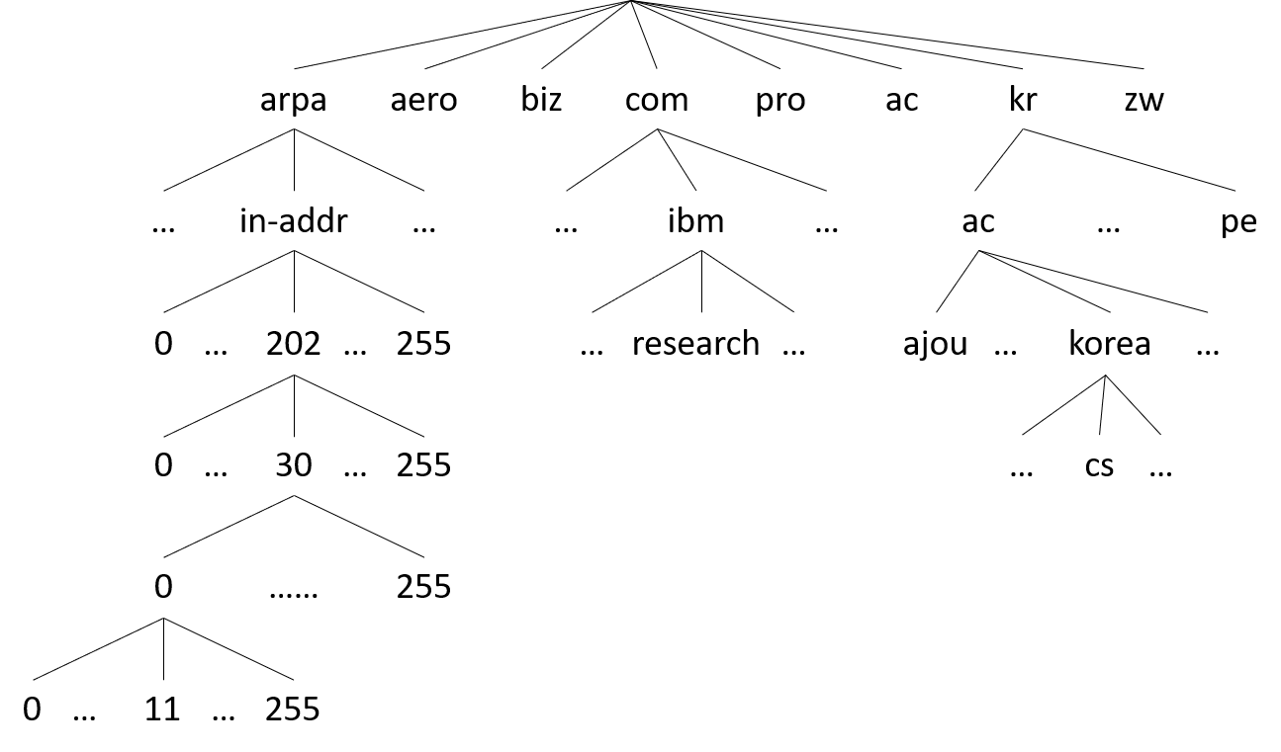
11.1 Domain Name Space
Domain = naming domain
  Domain names cannot be set arbitrarily
  The "last name", i.e., the suffix, is predetermined
    www.korea.ac.kr
Structure of the DNS name space

Slide 5
11.1 Domain Name Space
A label is attached to each tree node
  Combination of letters, digits, and hyphens; 0 to 63 characters
    Other languages must be converted to Punycode before use
    e.g., "uri-nara" (Korea) = "xn--910bs4k7yb12w"
  The label of the root node has length 0
  Case insensitive
    e.g., ReSeaRCH = research = RESEARCH
Domain name of a given node
  Concatenate the labels of nodes encountered while traversing the tree toward the root
    e.g., cs → korea → ac → kr: cs.korea.ac.kr
    Western-style naming convention

Slide 6
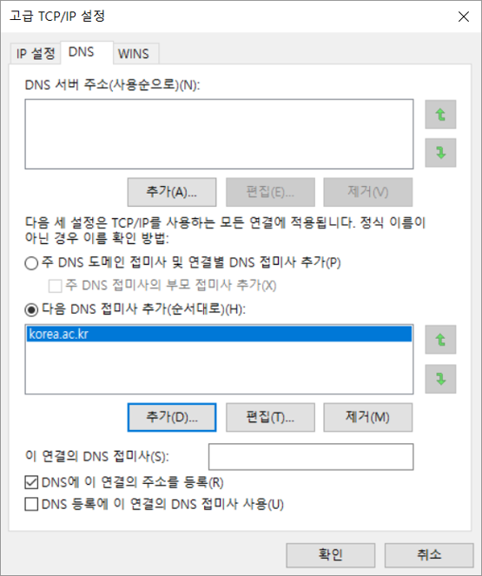
11.1 Domain Name Space
Fully Qualified Domain Name (FQDN)
  Domain name format recognized by the DNS protocol (unique!)
  All labels from the given node up to the root, read out separated by "."
  Omitting the suffix means it is not an FQDN
    Resolver auto-completion can be configured
The "." in an IP address vs. the "." in a domain name
  Completely unrelated; do not try to associate them

Slide 7
11.1 Domain Name Space
Top-Level Domain (TLD) names
  TLD = child nodes of the root
Generic TLD (gTLD)
  Started from com, net, edu, gov, int, mil, org and expanded
Country-code TLD (ccTLD)
  kr, kp, tv, ch, cn, etc.; one per country
Addressing and Routing Protocol Area (ARPA)
  For translating IP address → domain name
  For resolving identifiers other than domain names

Slide 8
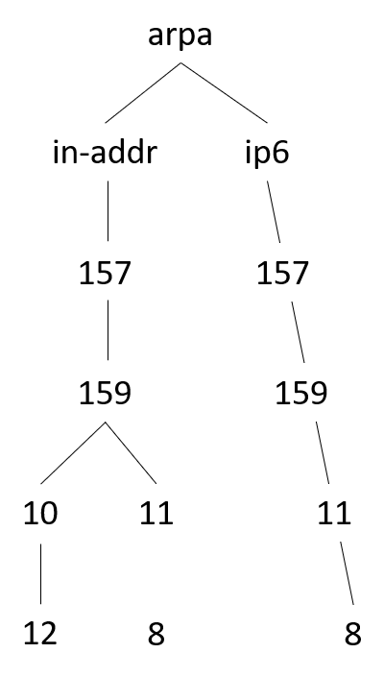
11.1 Domain Name Space
Addressing and Routing Protocol Area (ARPA)
  For translating IP address → domain name
    e.g., the domain name for 157.159.10.12 is stored as the resource record under the domain name 12.10.159.157.in-addr.arpa.

Slide 9
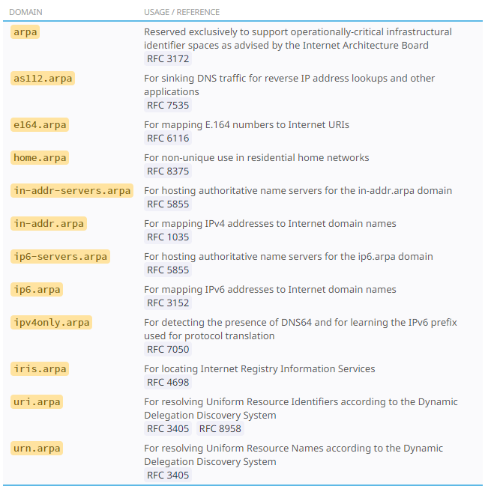
11.1 Domain Name Space
Addressing and Routing Protocol Area (ARPA)
  For resolving identifiers other than domain names
    Domain name for a phone number → URI
    e.g., 8.7.6.5.4.3.2.1.2.2.8.e164.arpa.

Slide 10
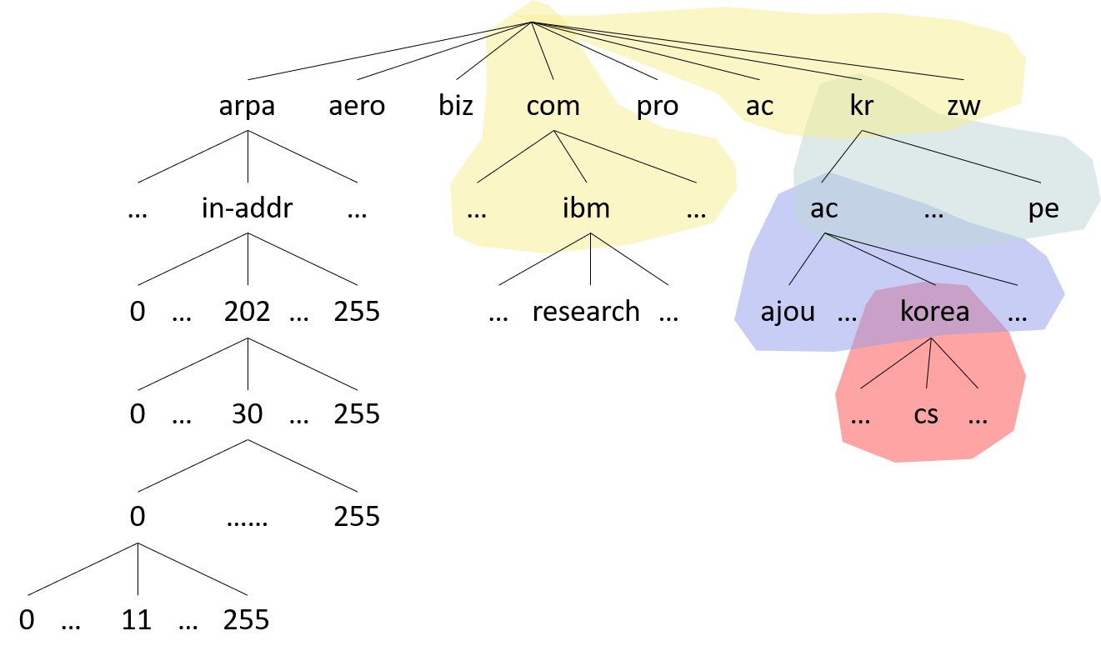
11.2 DNS as a Database
Database
  Key = domain name
  Data = Resource Records (RRs)
    e.g., IP address
Distributed database
  Federation of zone files
    Domain name → RRs file

Slide 11
11.2 DNS as a Database
Each organization is responsible for managing its own zone file
  Authoritative name server
No one else takes responsibility for the master copy
  1997 zone file corruption of the com and net domains
    4-hour worldwide access failure for com and net domains
  2002 Microsoft.com and msnbc.com domain incident
    Authoritative name server disconnected from the Internet
    Access failure for the affected domain for 2 days
Multiple authoritative name servers are operated nowadays
  1 primary + multiple secondaries

Slide 12
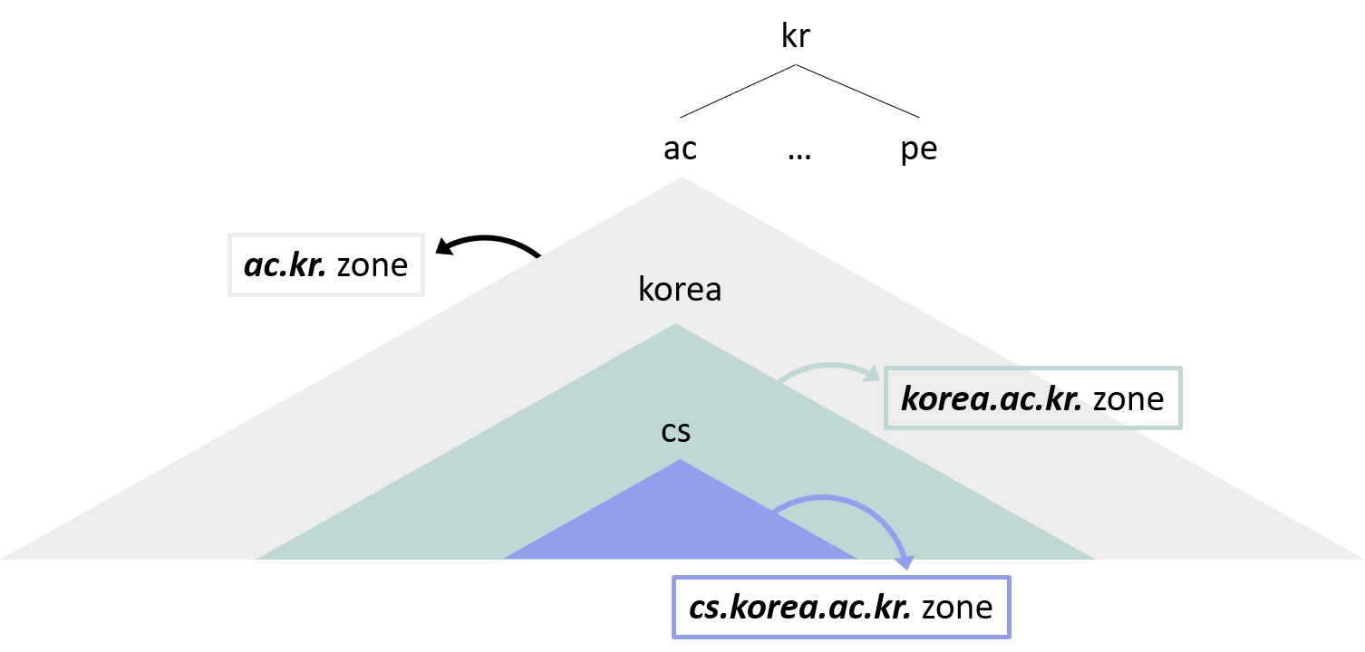
11.2 DNS as a Database
Zone delegation
Domain name registration
  Insert the domain name and its RRs into the zone file of the corresponding domain
    Registration fee = management fee

Slide 13
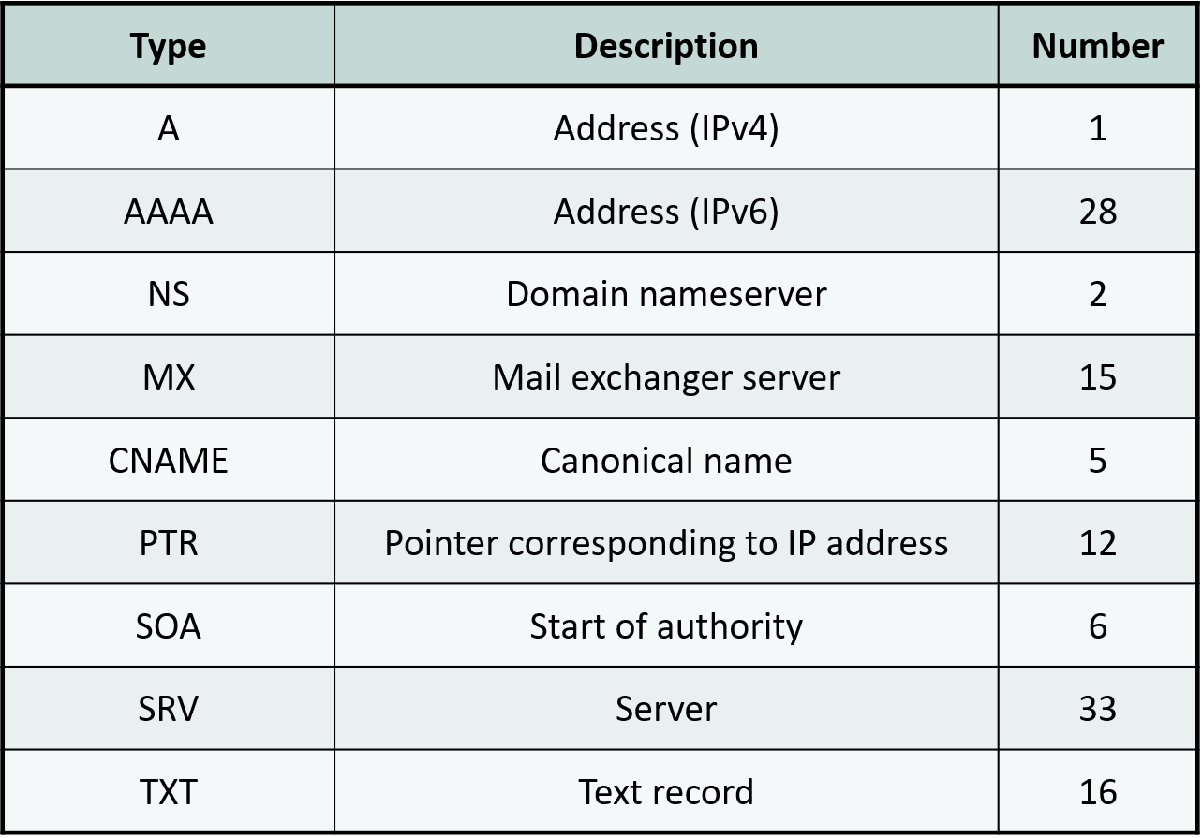
11.3 Types of RRs
Frequently used RR types
nslookup

Slide 14
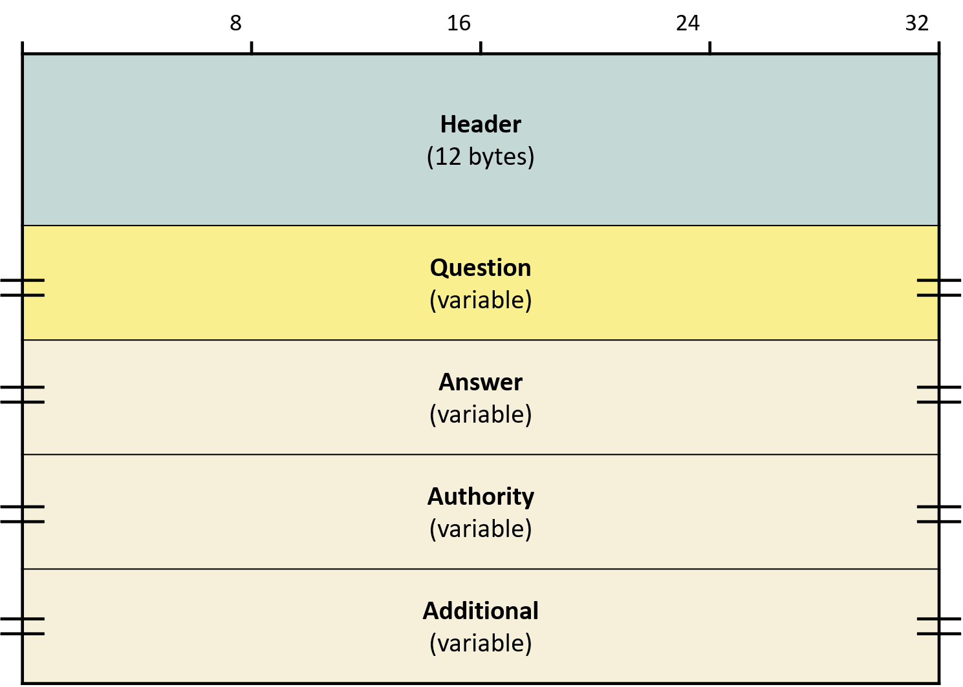
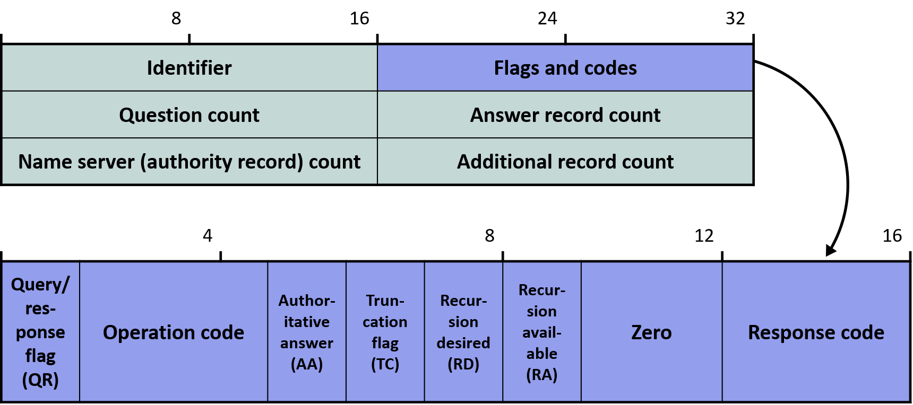
11.4 DNS Protocol
DNS message format
  OP code
    0: standard, 1: inverse query (deprecated), 2: server status report request, 3: (unused)
    4: notify (zone file changed → secondaries should request), 5: update

Slide 15

11.4 DNS Protocol
Uses UDP as the transport, but switches to TCP when TC=1

Slide 16
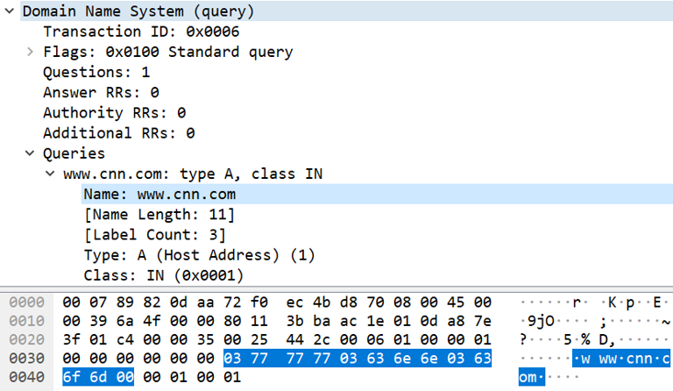
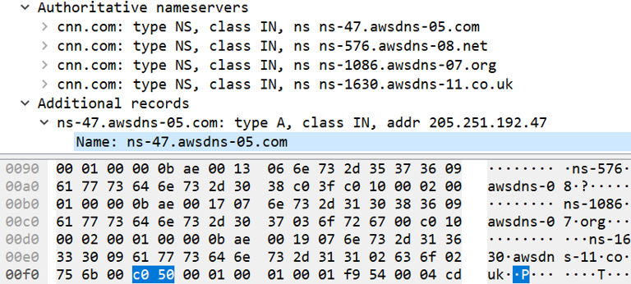
11.4 DNS Protocol
Representation of domain names
  Two ways an FQDN is represented inside a DNS packet
    A domain name appearing for the first time
    A name that reappears (even partially) → compressed form (length of the compressed part = 2 bytes)
      c0

Slide 17
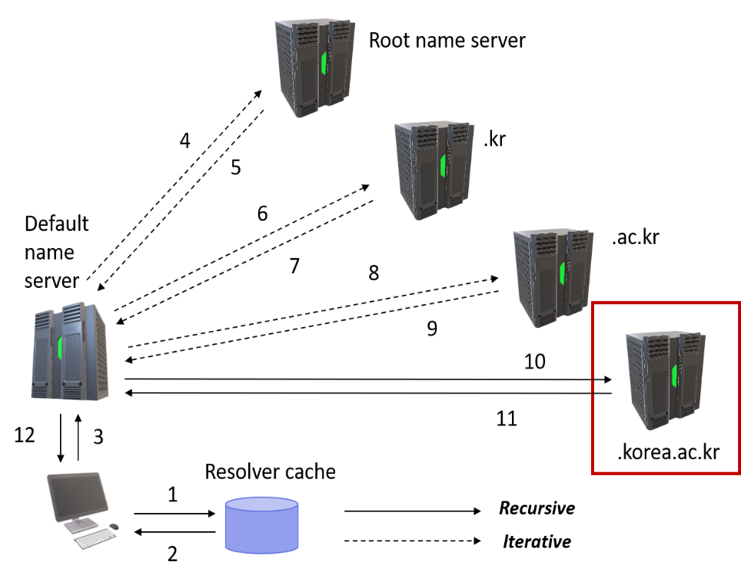
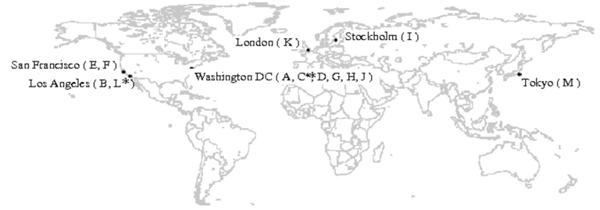
11.5 DNS Implementation
Processing order
  Search in the resolver cache
    ipconfig/displaydns
  Search in the default server
  Send the query to a root server
  Find the corresponding authoritative server and send the query to it

Slide 18
11.5 DNS Implementation
Root servers have been actively replicated since the 2002 DNS attack
  Korea replicates F, J, and M
  Replica servers use the same IP address as the original server
    Anycast
gTLD servers are operated similarly
DNS server software monitors the response time of all 13 root servers
  Queries are sent to the root server with the fastest response time
    Independent of physical distance

Slide 19
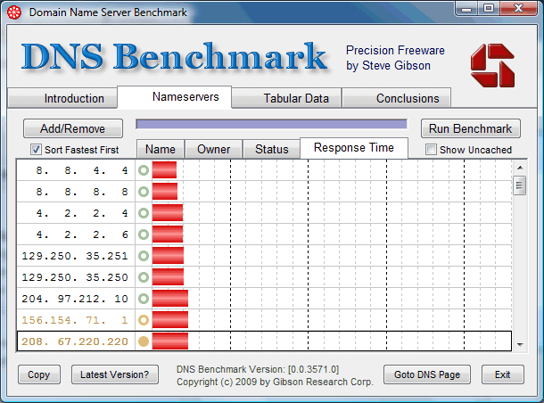
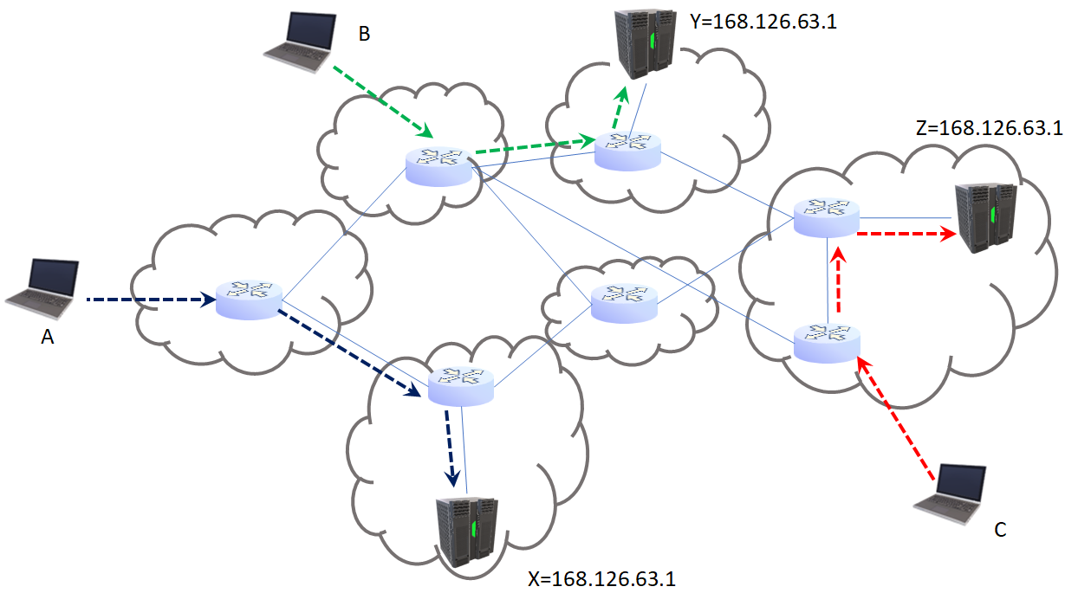
11.5 DNS Implementation
Anycast configuration of DNS servers
  KT, Google, etc.

Slide 20
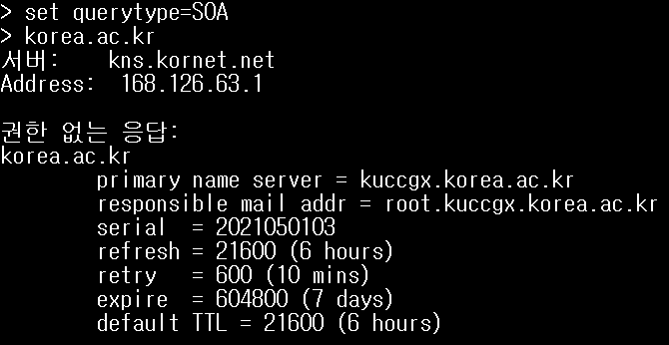
11.5 DNS Implementation
Caching
  Extremely effective
    The majority of responses are "non-authoritative"
  Essential given that there are only 13 root servers
  Caching is possible on any server
  Even negative caching
    A recent query that failed to receive an answer
  Lifetime of cached RRs is controlled by TTL
    This is different from the IP TTL!

Slide 21
11.5 DNS Implementation
Round-robin DNS
  IP address : domain name mappings can be 1:1, 1:many, or many:1
  many:1
  IP addresses are supplied in round-robin fashion for load balancing of the server
  Most resolvers use the first IP

Slide 22
11.5 DNS Implementation
Dynamic DNS
  Uses the OP-code 5 update message
  Selected RRs can be changed without updating the entire zone file
    Automatic remote update is possible
  When IP addresses are allocated dynamically (e.g., via DHCP), the A-type RR is updated
    Useful for operating servers that receive IP addresses dynamically

