Slide 1
Transmission Control Protocol (TCP)
Chapter 13

Slide 2
13.0 TCP Overview
Transports more than 90% of internet traffic
  Web, email, gaming, streaming, SNS, …
The most complex protocol in the internet protocol suite!
Full-duplex protocol
  Two data channels
    A→B + B→A
    Both can be in use simultaneously: packets may be flowing on each channel at the same time

Slide 3
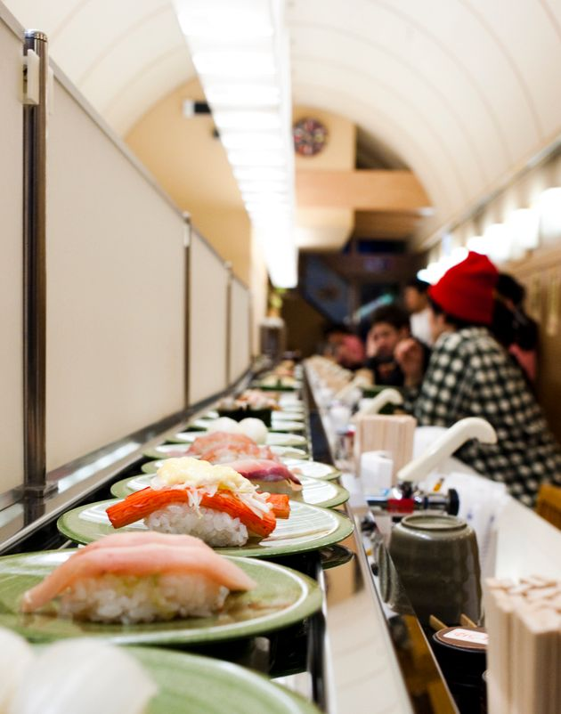
13.1 TCP Service Model
Reliable delivery
  When IP loses a packet, TCP performs retransmission
In-order delivery
  When IP performs out-of-order delivery, TCP delivers to the application after reordering
Flow control
  Delivers only as much as the receiving application can accept

Slide 4
13.1 TCP Service Model
Byte-stream
  Data is a sequence of bytes
  Segmentation
    Uses PMTU discovery
Connection-oriented
  A "connection" must be established before data can be transmitted
  "Connection" = bookkeeping setup for managing data transmission
    Management = retransmission, flow-control, reordering, segmentation

Slide 5
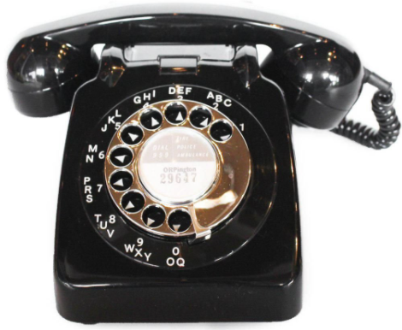
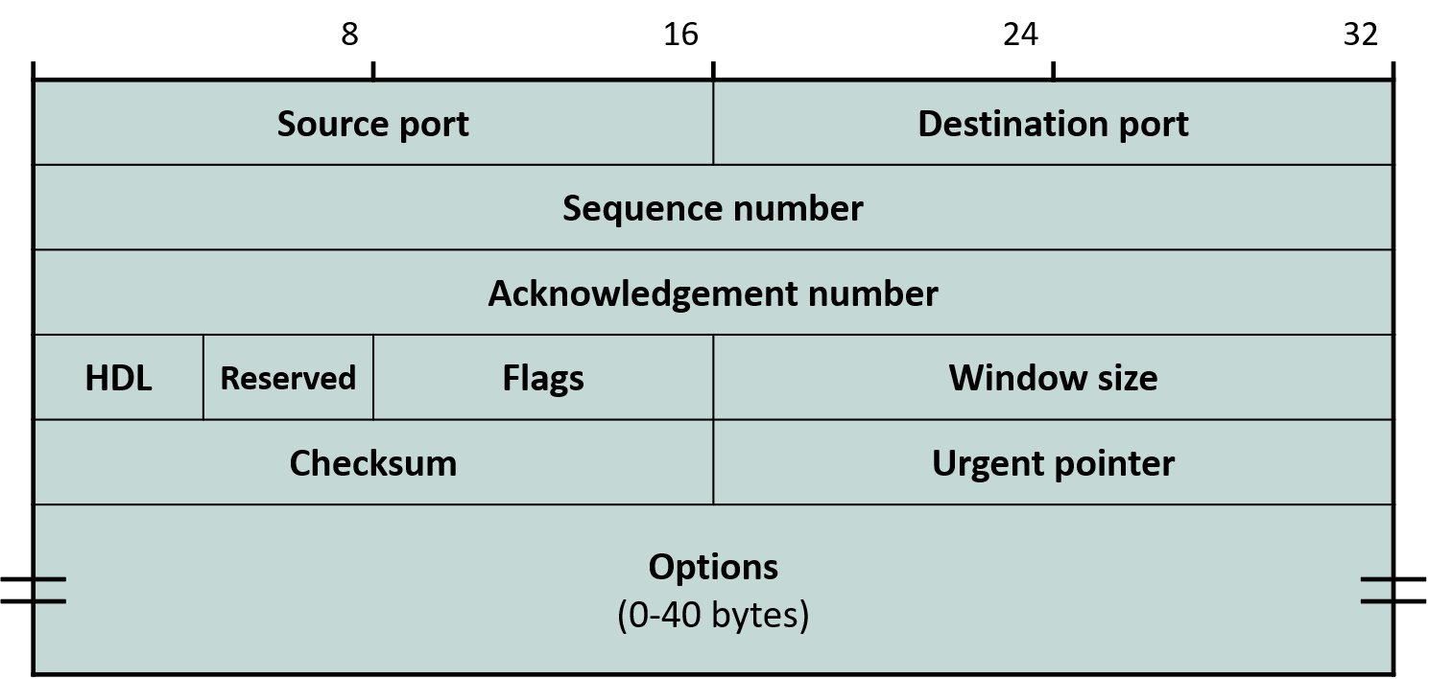
13.2 TCP Packet Format
Header format
  Socket = <IP address, port number>
  Connection = a connection between a socket and a socket

Slide 6
13.2 TCP Packet Format
Sequence number
  A serial number attached to each byte of the byte stream
  Used to detect data loss, reordering, and so on
  The sequence number of the first byte of the payload is written in the header (representative)
Acknowledgement number
  The sequence number of the last contiguously received byte + 1 (i.e., a request to send that next)
  Means that bytes up to ACK number - 1 have "settled" into the receiver-side socket buffer
    No concern of retransmission → can be removed from the sender-side socket buffer
    The sending application can pour new data into the freed space
Header length
  In units of 4 bytes
  Because of variable-length options

Slide 7
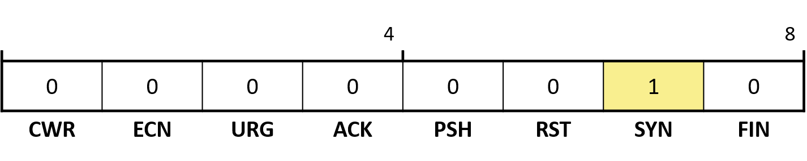
13.2 TCP Packet Format
Flags
  CWR, ECN: used for congestion control
  URG: indicates that urgent data has entered the byte stream
  ACK: whether the Acknowledgement number is valid
  PSH: currently indicates only that the send socket buffer has become empty
  RST: Kill the connection
  SYN: start of a connection
  FIN: release of a connection

Slide 8
13.2 TCP Packet Format
Window size
  The size of the free space in the receive socket buffer, relative to the ACK number
  For flow control → ACK number onward, how many more bytes can be received
Checksum
  Note the use of the pseudo-header
  Mandatory for TCP!
Urgent pointer
  Urgent data has entered the byte stream
  Indicates how many bytes ahead its location is

Slide 9
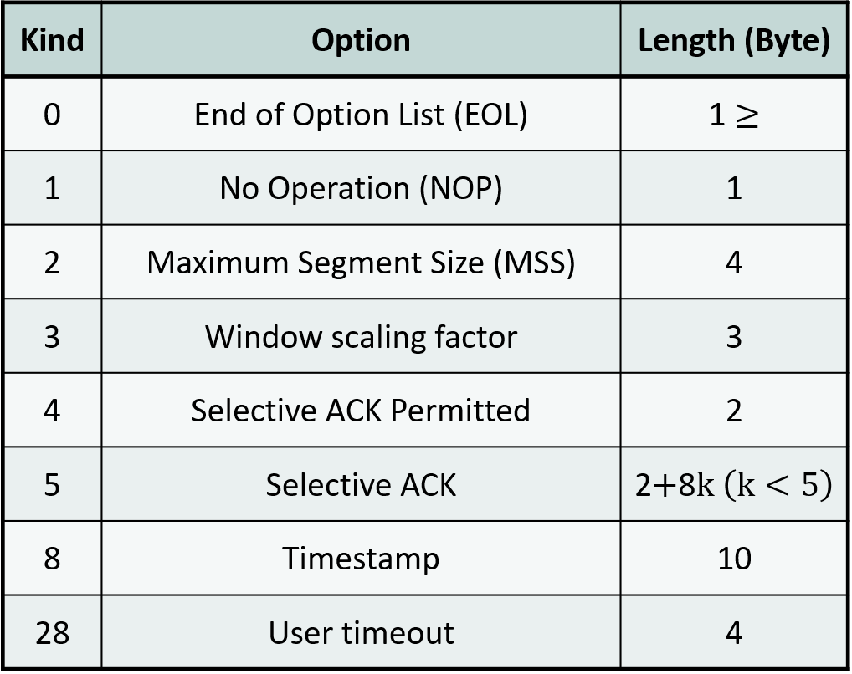
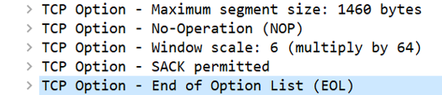
13.2 TCP Packet Format
Options: all are required (unlike IP options)
  EOL: rarely used
  NOP: used for 4-byte alignment
  Example)

Slide 10
13.2 TCP Packet Format
Options
  Maximum Segment Size (MSS): informs the peer what payload size will be used
    MTU – 40 bytes
    Initial value: may later be corrected to a smaller value by PMTU discovery
  Window Extension
    16-bit window size field → window size ≤ 65535
    When using a receive socket buffer larger than 64KB
    Option value n = left shift by n positions = X 2n

Slide 11
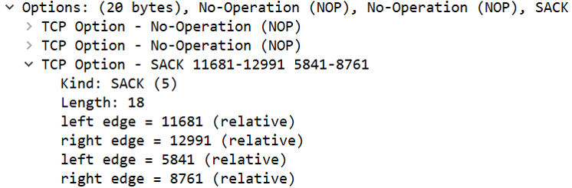
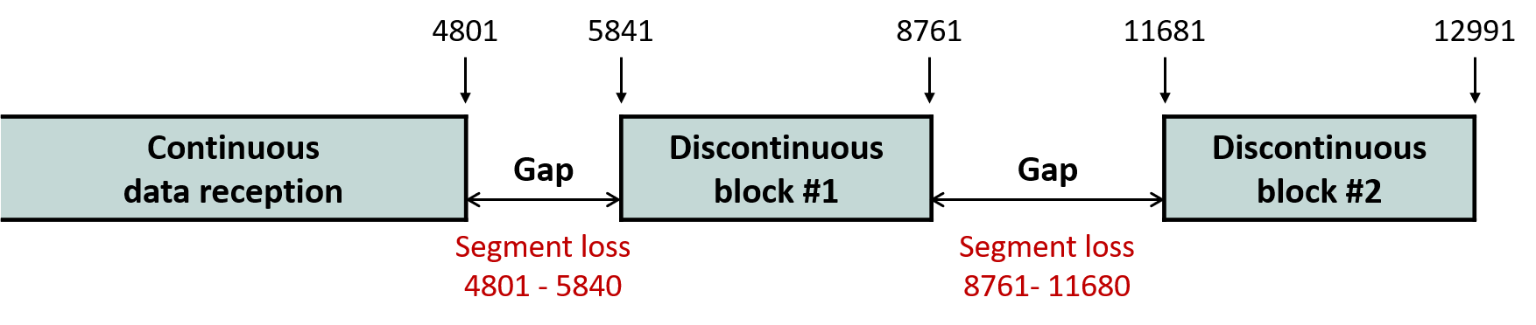
13.2 TCP Packet Format
Options
  Selective Acknowledgement (SACK) is used to request retransmission of only the missing portions when packets are received non-contiguously

Slide 12
13.2 TCP Packet Format
Options
  Timestamp: used when the sender measures round-trip time (RTT) accurately
    In the basic scheme, one RTT sample is obtained per RTT → inaccurate
  User Timeout (UTO): advance notice of how long after un-ACKed transmitted data the connection will be torn down
    Previously 100 seconds (3 minutes for SYN)
Principle: an option is used only when both peers agree on it
  An option (T) that is not understood is skipped by the length (L) of the TLV format
  A mechanism by which two TCPs of different versions negotiate
  The foundation for the evolution of TCP features

Slide 13
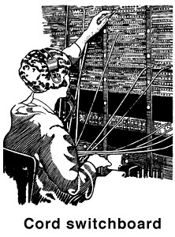
13.3 TCP Connection Control
The concept of a TCP "connection"
  Both peers share the same understanding of the transmission state of the two data channels
  “Synchronize”
    The segment used for this is the SYN segment
Three numbers that must be synchronized
  Initial sequence number (ISN)
  Window size
    The size of the free space in the receive socket buffer → flow control use
  Maximum segment size (MSS)
    MTU - 40 bytes

Slide 14
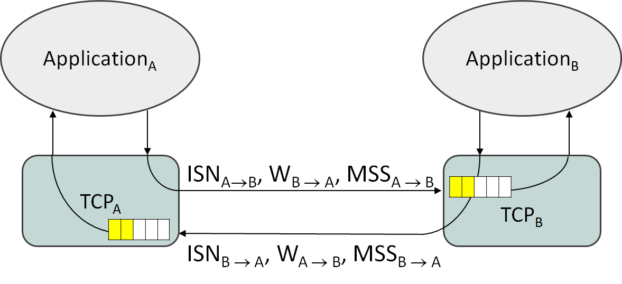
13.3 TCP Connection Control
TCP connection synchronization
  These values are stored in the TCP Control Block (TCB)

Slide 15
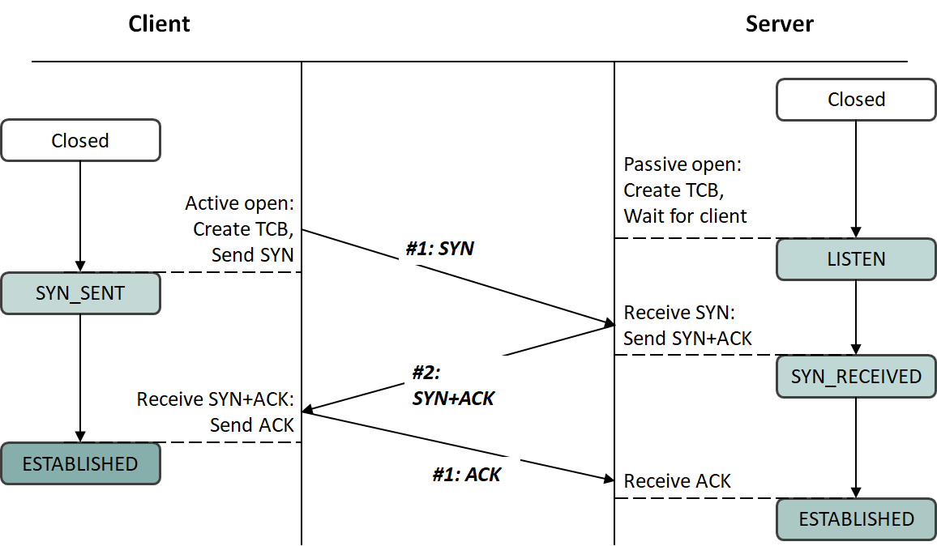
13.3 TCP Connection Control
Establishing a TCP connection
  3-way handshake

Slide 16
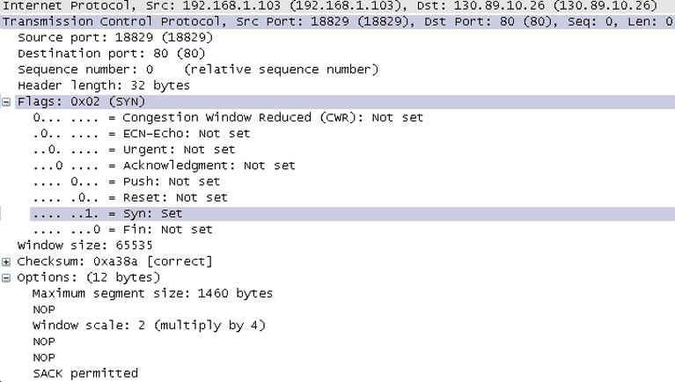
13.3 TCP Connection Control
Establishing a TCP connection
  SYN segment example

Slide 17
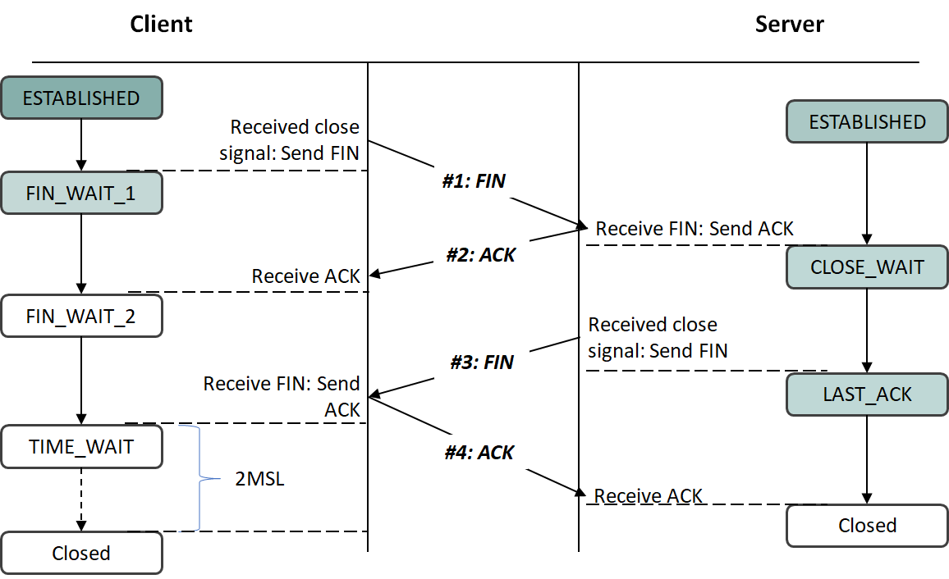
13.3 TCP Connection Control
Tearing down a TCP connection
  By FIN or RST

Slide 18
13.4 TCP Flow Control
TCP flow control
  Transmits at the rate the application consumes data on the receiver host
  The "pipe" must not become empty
  Uses the window size value written in the TCP header arriving on the reverse channel
  Uses two pieces of information carried in the ACK
    ACK number, Window size

Slide 19
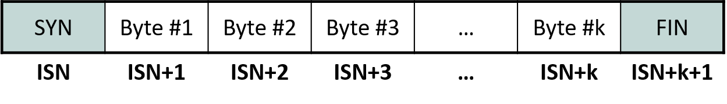
13.4 TCP Flow Control
ACK number
  The last contiguously received sequence number + 1
    A SYN segment also consumes one sequence number
    A FIN segment also consumes one sequence number
    A sequence number is attached to every other byte

Slide 20
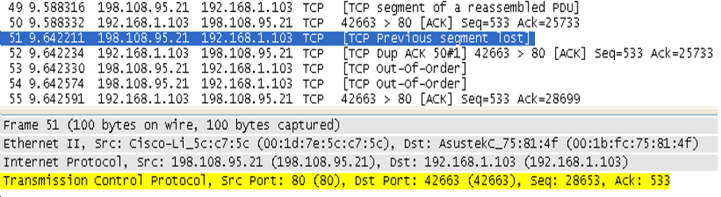
13.4 TCP Flow Control
ACK number
  Cumulative ACK
    ACK number = the last contiguously received sequence number + 1
    When a missing segment occurs, the ACK number stops increasing
    Un-ACKed bytes do not enter the receive socket buffer
      In order to uphold the in-order delivery service model
      A reordering buffer is used

Slide 21
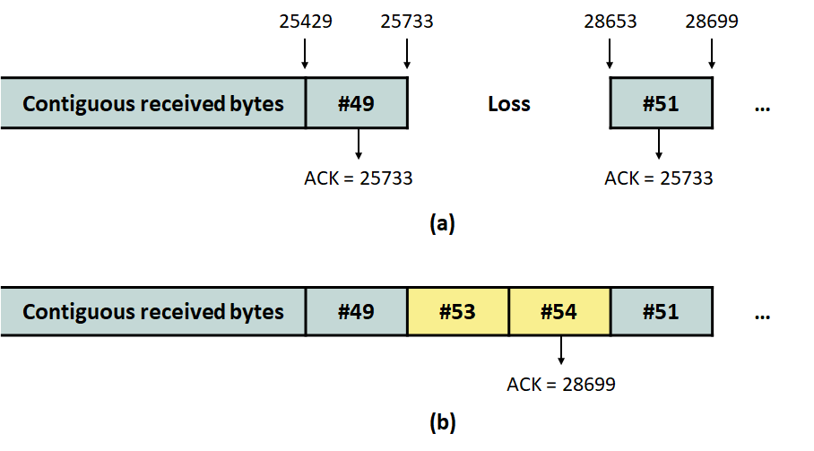
13.4 TCP Flow Control
ACK number
  Cumulative ACK
    Improves the reliability of ACK delivery
      Even if an ACK segment is lost, no information is lost once the next ACK arrives
    When data lost by an earlier loss is recovered through retransmission, even the data sitting in the reordering buffer is delivered to the receive socket buffer all at once, in order
    The ACK number is updated

Slide 22
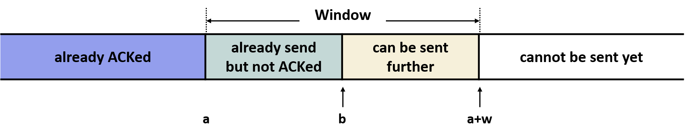
13.4 TCP Flow Control
Window size
  The size of the free space in the receive socket buffer at the time of the ACK
  Must be interpreted relative to the ACK number
    Cannot be interpreted on its own
    Because of the segments currently in transit within the pipe
    Example) w-{(b-a)+1} more bytes can be transmitted

Slide 23
13.4 TCP Flow Control
Window size
  If there is a change in the receive socket buffer space, an ACK can be sent even without receiving data
    The sender must not stay idle while the pipe is empty
  Window update rule
    When the right end of the sender window can advance by 2 MSS, an ACK is sent

Slide 24
13.4 TCP Flow Control
The importance of the receive socket buffer size
    B = the processing speed of the bottleneck router
    L = the latency from sender to receiver
    Receiver socket buffer size P = 2BL
      B = P/2L
      B > P/2L → pipe underutilization
      B < P/2L → buffer bloating
  Techniques for automatically adjusting the receive buffer size
    Dynamic Right Sizing (DRS)
    Auto-tuning
  Send socket buffer size
    If it is not large enough for the application process to write, the process is blocked

Slide 25
13.5 Error Control
ACK rule
  The expected, contiguous sequence number (s=a)
    Normal: placed into the receive socket buffer
    The ACK is delayed by default (Delayed ACK algorithm)
  A sequence number larger than expected (s > a)
    Error control needed: placed into the reordering buffer
    Immediate ACK: ACK # = a
  A sequence number smaller than expected (s < a)
    Keepalive probe
    Immediate ACK: ACK # = a

Slide 26

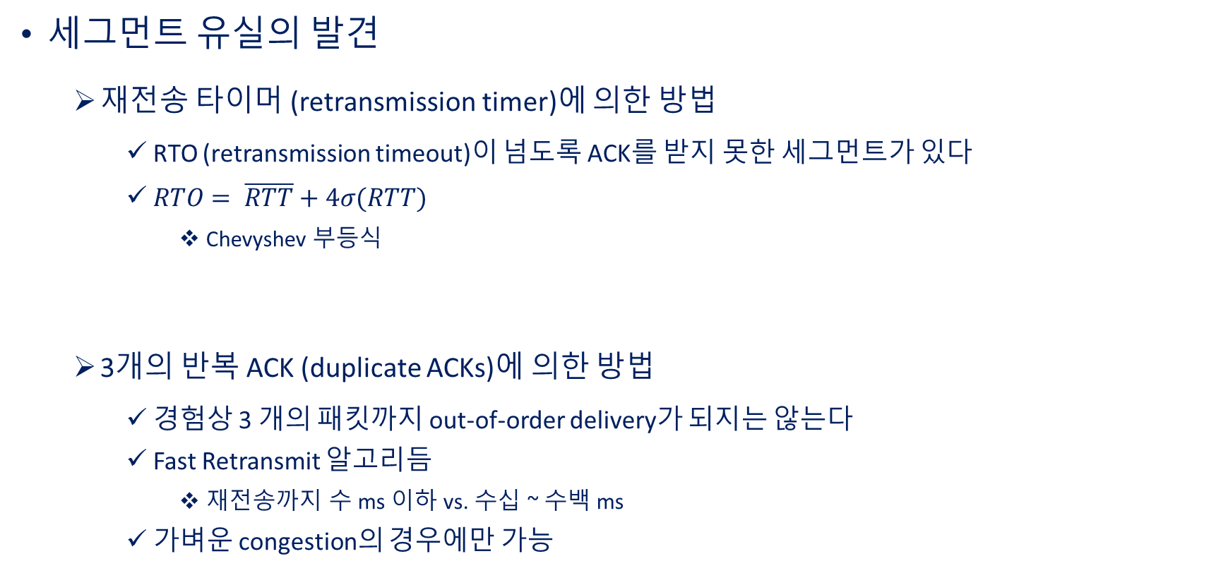
13.5 Error Control
Detecting segment loss
  Method using the retransmission timer
    There is a segment whose ACK has not been received beyond the RTO (retransmission timeout)
    $RTO= \overline{RTT}+4σ(RTT)$
      Chevyshev inequality
  Method using three duplicate ACKs
    Empirically, out-of-order delivery does not occur for as many as three packets
    Fast Retransmit algorithm
      A few ms or less until retransmission vs. tens to hundreds of ms
    Possible only in the case of light congestion

Slide 27
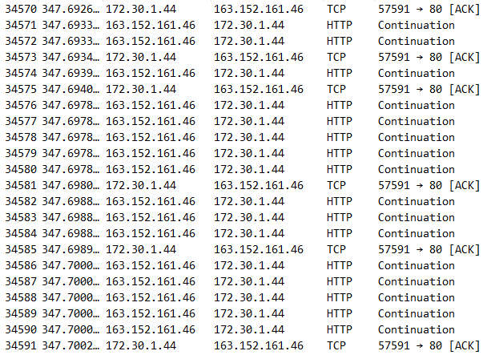
13.6 TCP Timers
    TCP has many timers besides the retransmission timer
Delayed ACK timer
  TCP suppresses ACKs by default
    In order to deliberately avoid sending ACK packets
    If there is data being sent on the opposite-direction channel, its header is used
      ACK #, window size
    Example →
  One ACK per two data packets is a misconception!
    Suppressed until the Delayed ACK timer expires

Slide 28
13.6 TCP Timers
The 2:1 "legend" of the Delayed ACK timer is
  the interaction between the Window update rule and a "diligent" receiver-side application
    Window update rule: when 2 MSS or more of new space appears, ACK immediately
Delayed ACK timer
  By the standard, expires every 500 ms
  Recent OSes use shorter values
    200 ms, 40 ms, 4 ms, etc.

Slide 29
13.6 TCP Timers
Persist timer
  Triggered when an ACK with Window size = 0 (0-window ACK) arrives
    Only a Window update ACK can break out of this situation
  What if the Window update ACK is dropped?
    Livelock!
  As an exception, the sender may go past the right end of the transmission window to test sending a small segment (Persist Probe)
    Typically 1 byte

Slide 30
13.6 TCP Timers
Persist timer
  There are three receiver responses to a Persist Probe
  Sends a 0-window ACK again + the same ACK number
    There is no change in the receive socket buffer situation
    No ACK with Window size > 0 has ever been sent
  Sends a 0-window ACK again + ACK number increased by 1
    New space appeared in the receive socket buffer but it was 2 MSS or less
      Silly Window Syndrome prevention
    No ACK with Window size > 0 has ever been sent
  Sends an ACK with Window size > 0
    An ACK with Window size > 0 had been sent but was lost

Slide 31
13.6 TCP Timers
Keepalive timer
  Not in the TCP standard
  Intended to detect the half-open state and tear down the connection
    Expires after about 2 hours
    Checks by sending an empty TCP packet (header only) whose sequence number > the ACK number the receiver expects
  Used at the server
    With millions of concurrent users, there is overhead from data structures such as the TCB and from timer interrupt handling

Slide 32
13.7 Congestion Control
Today, more than 10 kinds of congestion control algorithms are implemented in Linux
  Only one is used
    Chosen according to the TCP operating environment
      Wireless? High speed? Large delay?
Origin: the congestion collapse observed on the internet in the 1980s
    The queue of a congested router grows longer → the time until a packet is ACKed increases → unnecessary retransmissions occur due to timeouts → the queue of the congested router grows even longer → … (the cycle keeps worsening)
  The 1989 Van Jacobson algorithm
    Self-clocking for the equilibrium of the pipe
    The progenitor of modern TCP congestion control algorithms

Slide 33
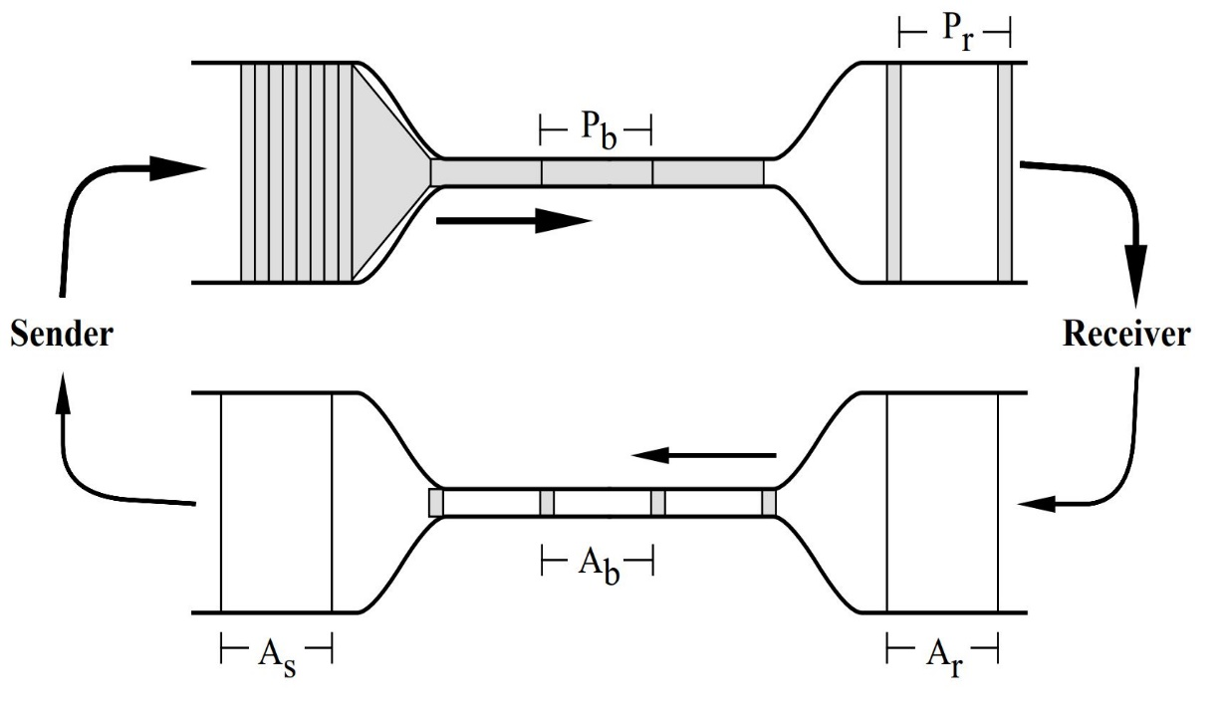
13.7 Congestion Control
Van Jacobson algorithm
  Must push in enough packets to fill the pipe completely, without bursting it (packet loss)
  Problem: the pipe changes rapidly in both thickness and length!
    Bandwidth-delay product

Slide 34
13.7 Congestion Control
Van Jacobson algorithm: Congestion Avoidance
  Gradually increases the "number of packets sent per rtt" (the sending rate) until the pipe bursts
    Each time an ACK arrives, W ← W + 1/W (segment)
      Linear increase
    If no ACK arrives and the retransmission timer expires, W ← 1 (segment)
Slow Start
  Linear increase takes too long to fill the pipe
  Let us quickly estimate the current value of the pipe with exponential increase
    Each time an ACK arrives, W ← W + 1

Slide 35
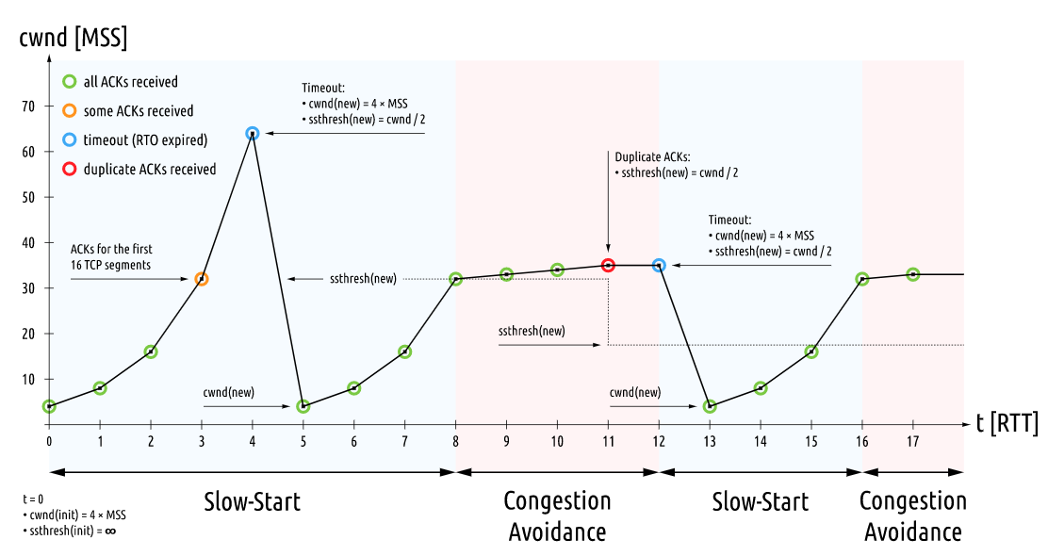
13.7 Congestion Control

Slide 36
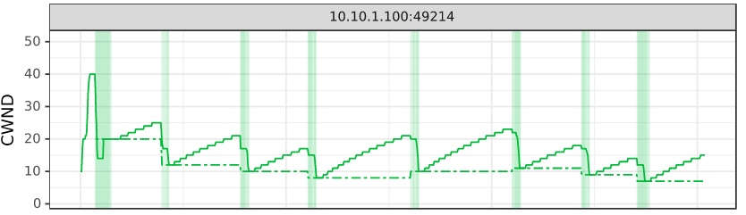
13.7 Congestion Control
Fast Recovery
  If packet loss is detected by Fast Retransmit, it is mild congestion
    Otherwise, the later packets would not have been received, and 3 duplicate ACKs would not have arrived
    W ← W/2 + 3
    Multiplicative Decrease
  In the case of packet loss detected by timeout, Slow Start as before

Slide 37
13.7 Congestion Control
Where flow control and congestion control meet
  Both control the sender's sending rate
  Whose instruction should be followed?
    The minium of the two is used

Slide 38
13.8 Small Segment Avoidance and the Robustness Principle
Small segment: a segment smaller than the MSS
  Undesirable: it increases header overhead
Silly window syndrome avoidance
  Sender: Nagle algorithm
  Receiver: pretends that receive socket buffer space smaller than 1 MSS does not exist at all
    0-window ACK
Only at one of the sender and the receiver?
  Jon Postel's robustness principle
    No one you meet on the internet can be trusted
    “be conservative in what you do, be liberal in what you accept from others”

Slide 39
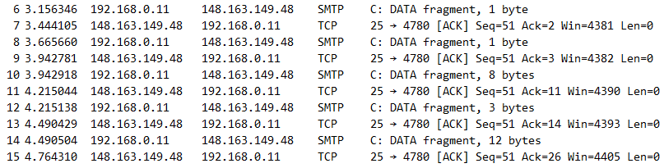
13.8 Small Segment Avoidance and the Robustness Principle
Nagle algorithm
  Only one small segment can be outstanding at any moment
    Until then, data is accumulated in the send socket buffer
  Data of MSS or more can always be transmitted if the window allows

Slide 40
13.8 Small Segment Avoidance and the Robustness Principle
→ direction: the sender side uses Nagle, the receiver side uses Delayed ACK
← direction: the same applies
Therefore, within one TCP, Nagle and Delayed ACK run at the same time
If the two conflict, which one is stronger?
  Delayed ACK
    When the Delayed ACK timer expires, even data of 1 MSS or less that the Nagle algorithm was holding back in the send socket buffer is transmitted
    The logic is that if a packet has to be sent anyway, it is better to send even a little data with it

