Slide 1
Dynamic Host Configuration Protocol (DHCP)
Chapter 10

Slide 2
10.1 History of the DHCP Protocol
Reverse ARP (RARP)
  1990s: early diskless workstations - no stable storage
  When powered off, even the OS image is lost
    Booting - must load OS image from a boot server
  How to network with the boot server?
    Run a short RARP code stored in PROM to obtain an IP address,
    then boot by downloading the OS image via TFTP from the boot server at that IP address
  The process of obtaining an IP address
    The RARP server looks up the (burnt-in) MAC address and supplies the IP address
  Same protocol family as ARP - nearly identical packet format
    Ethertype: 0x8035 instead of 0x0806
    Request = 3, Reply = 4

Slide 3
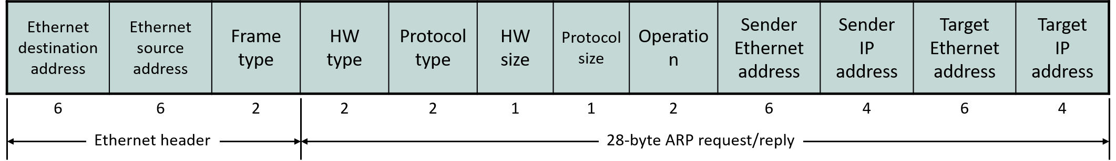
10.1 Lineage of the DHCP Protocol
Reverse ARP (RARP) Message Format
  déjà vu??
  The family also includes a protocol called InARP
    ARP: your IP → your MAC
    RARP: my MAC → my IP
    InARP: your MAC → your IP

Slide 4
10.1 Lineage of the DHCP Protocol
Bootstrap Protocol (BOOTP)
  RARP's success → a protocol that handles the entire remote boot process
  Limitations of RARP
    Only retrieves the IP address → a separate protocol (e.g., TFTP) is needed
    An RARP server is needed on each link (broadcast domain)
      Because requests are broadcast to ff-ff-ff-ff-ff-ff like ARP (the server location is unknown)
    RARP was merely a hack unrelated to the layering principle
  BOOTP Functionality
    Can configure many network parameters besides the IP address, and can also request a boot image
    BOOTP relay → only one BOOTP server is needed even at a remote location
    As an application-layer protocol, it fully adheres to the layering principle
  The immediate predecessor of DHCP

Slide 5
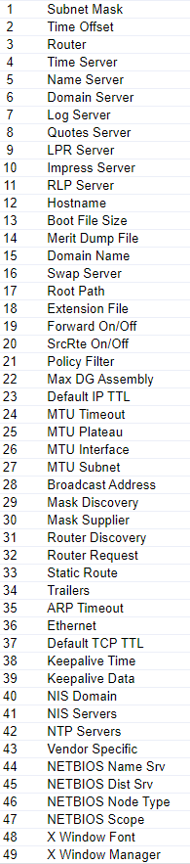
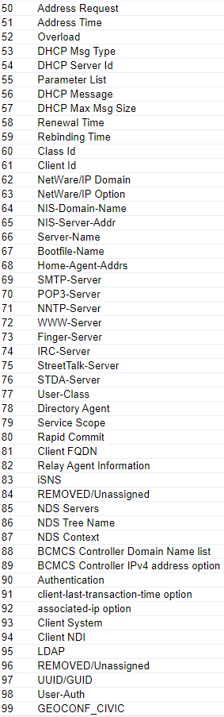
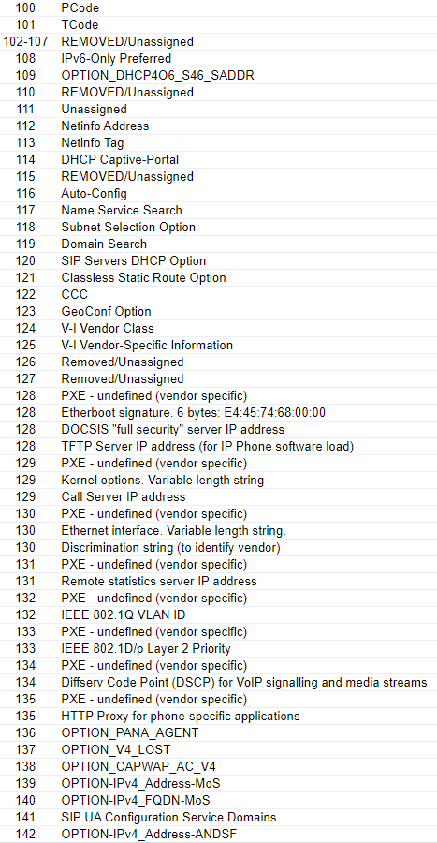
10.2 Advantages of DHCP
Advantages of BOOTP + 
  Nearly 200 network parameters can be configured
    https://www.iana.org/assignments/bootp-dhcp-parameters/bootp-dhcp-parameters.xhtml
    Some of them →

Slide 6
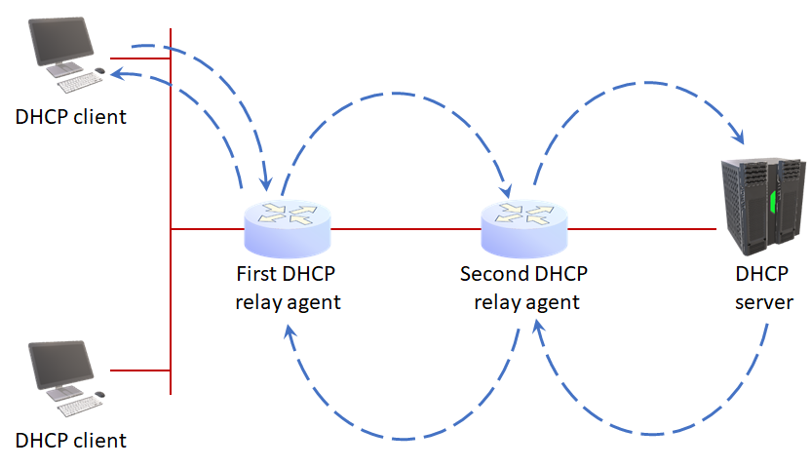
10.2 Advantages of DHCP
Advantages of BOOTP + 
  DHCP relay (BOOTP relay)
    Relay functionality implemented in routers
  Proper layering
    Application-layer protocol using UDP as transport
      Server port = 67
      Client port = 68

Slide 7
10.2 Advantages of DHCP
Advantages of BOOTP + 
  α = “LEASE”
  LEASE: automatic IP address allocation and reclamation mechanism
    A major advancement from BOOTP, where MAC-IP mappings had to be managed manually by the administrator

Slide 8
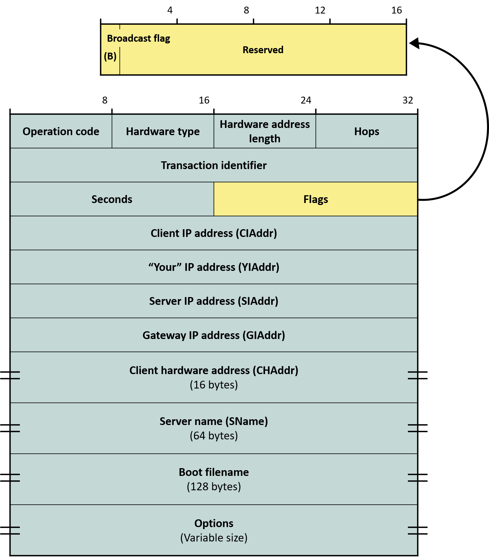
10.3 DHCP Message Format

Slide 9
10.3 DHCP Message Format
OP: 1 (request), 2 (reply) → same as ARP
HW means MAC, same as in ARP
  Type: Data link type
    e.g.: Ethernet = 1
  Length: MAC address length
    e.g.: Ethernet = 6 (bytes)
No separate "protocol" field
  IPv4 is assumed by default
  Hops: number of relays traversed
    DHCP packet dropped if exceeds 16
      Possibility of being stuck in a loop

Slide 10
10.3 DHCP Message Format
Transaction identifier
  Common characteristic of application protocols using UDP as transport
    Value echoed to match request-response pairs
Seconds
  Time elapsed since the initial request
    Requests that the server should respond to more urgently
    Can be used as a selection criterion
Flags: only the "B" (broadcast) flag
  Request the reply to be sent as broadcast
    An implementation issue

Slide 11
10.3 DHCP Message Format
Client IP address
  0 when requesting an IP, the assigned address after allocation
Your IP address
  IP address assigned by the server to the DHCP client
Server IP address
  The server to contact after the DHCP server
    0.0.0.0 if none
Gateway IP address
  Relay's IP address
    Server responds to this relay
    Relay delivers to client
Client HW address
  Used as a key at the DHCP server, just like in RARP

Slide 12
10.3 DHCP Message Format
Server name and boot file name are rarely used
  Remote booting is not done these days
    All zeros
The Options field is very important
  Up to 200 configurable network parameters are carried here
    Host parameters for IP networking
    Interface parameters for IP networking
    Link layer parameters
    TCP parameters
    Application and service related parameters
    Parameters for DHCP operation itself

Slide 13
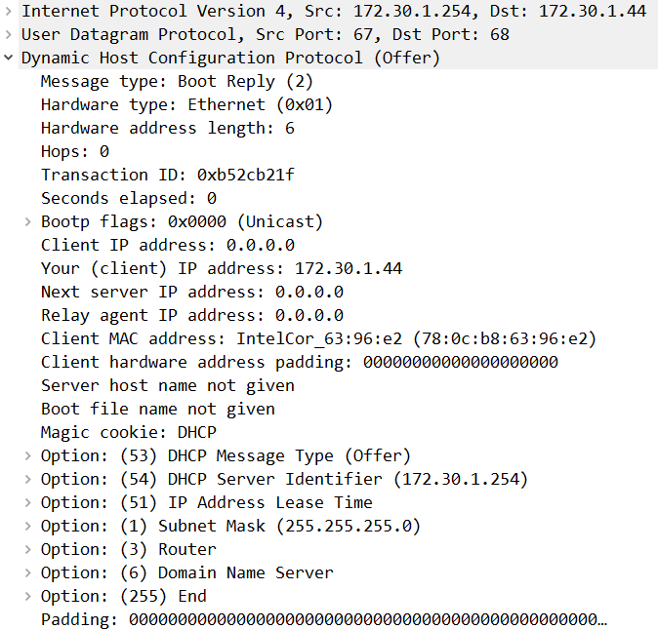
10.3 DHCP Message Format
DHCP Message Example

Slide 14
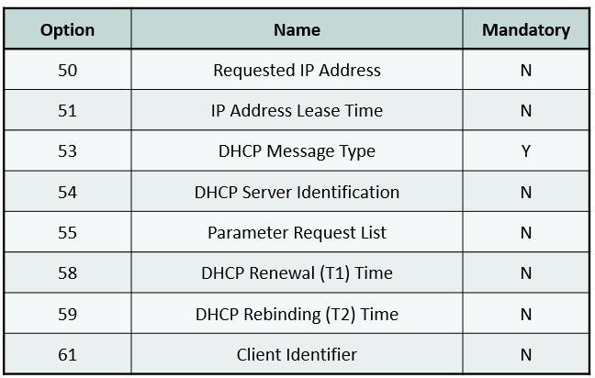
10.4 Options for DHCP Operation
Option 53 is in fact not really an "option"

Slide 15
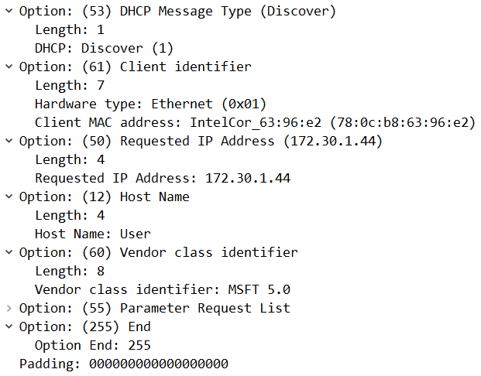
10.4 Options for DHCP Operation
Examples of options in a request
  The Client identifier option may be the same as the client HW address (typically)
    A DNS address can also be used
  Search key at the DHCP server

Slide 16
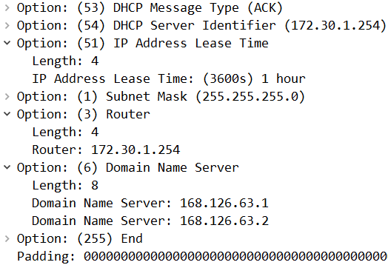
10.4 Options for DHCP Operation
Examples of options in a reply
  Server Identifier is the DHCP server address
    Server IP address in the fixed header is NOT the DHCP server!
      → The server to contact next
    Next time the client can send a request directly to the DHCP server
  Lease: the rental period of the IP address

Slide 17
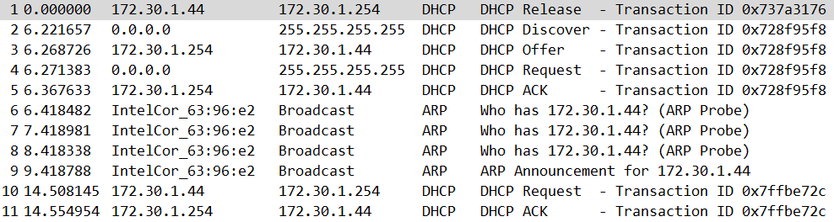
10.4 Options for DHCP Operation
Server Identifier usage example 1
Usage example 2
  When a client selects one among multiple DHCP servers
    See DHCP ACK
The client that received an IP address performs DAD

Slide 18
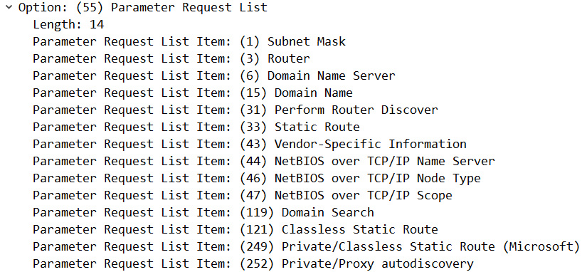
10.4 Options for DHCP Operation
Option 55: Parameter Request List
  Parameters the client wants to obtain
  The server does not need to respond to all of them

Slide 19
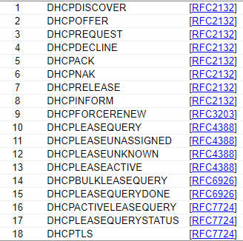
10.4 Options for DHCP Operation
Option 53: DHCP Message Type

Slide 20
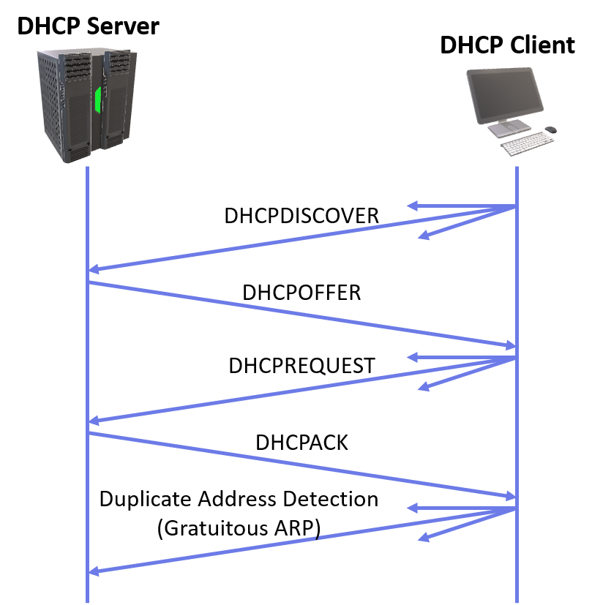
10.5 DHCP Protocol Operation
Discover: find the server
  Limited broadcast since the IP address is unknown
  Can propose desired parameter values
Offer: server proposes parameters
  There may be multiple servers
Request: client designates a server
  Can simultaneously make a counter-offer on parameter values
  Broadcast so that rejected servers can also be notified
Ack: server accepts the terms
Client performs DAD

Slide 21
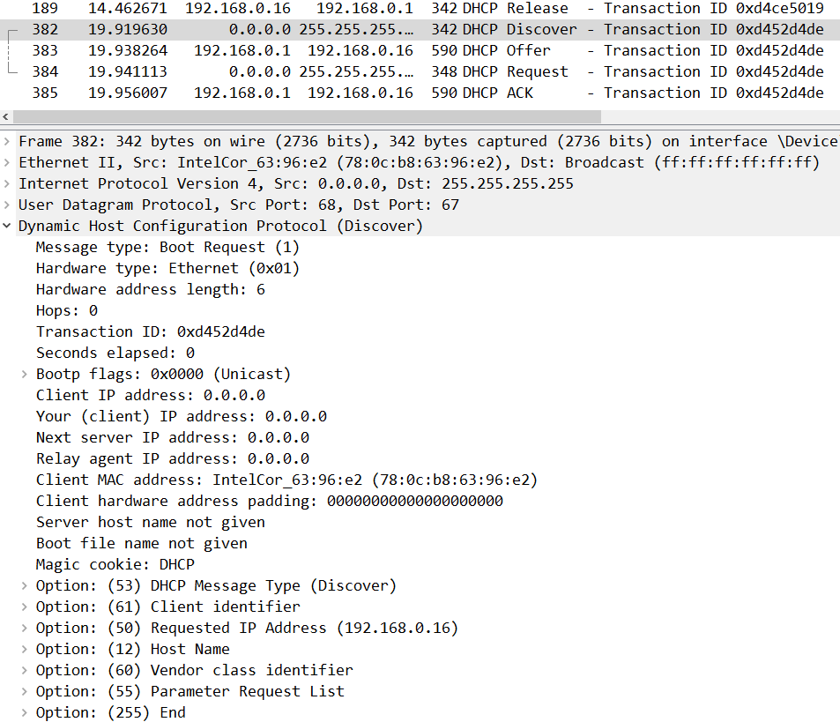
10.5 DHCP Protocol Operation
DHCP Discover Example

Slide 22
10.5 DHCP Protocol Operation
Both parties conduct an equal negotiation
  When the server cannot accept a DHCP Request, it sends DHCP Nack
  When DAD fails, the client sends DHCP Decline
    Can send DHCP Request to another server that previously made an Offer
To avoid leasing an address already leased by another server,
  the server first pings the address it is about to Offer
DHCP Release: to return the IP address that was in use
  Try ipconfig /release
    Internet connection can be restored with ipconfig /renew: triggers Discover-Offer-Request-Ack
DHCP Inform: for configuring other parameters after obtaining an IP address

Slide 23
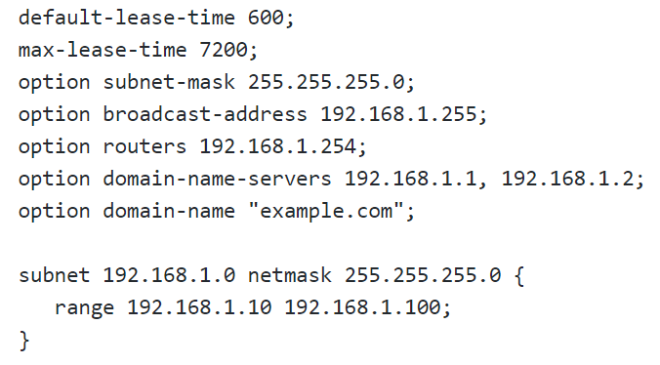
10.6 IP Address Lease
Linux configuration example
IP address leasing by DHCP has nothing to do with private addresses!!
  It manages addresses regardless of address type
Am I using an address given by DHCP?

Slide 24
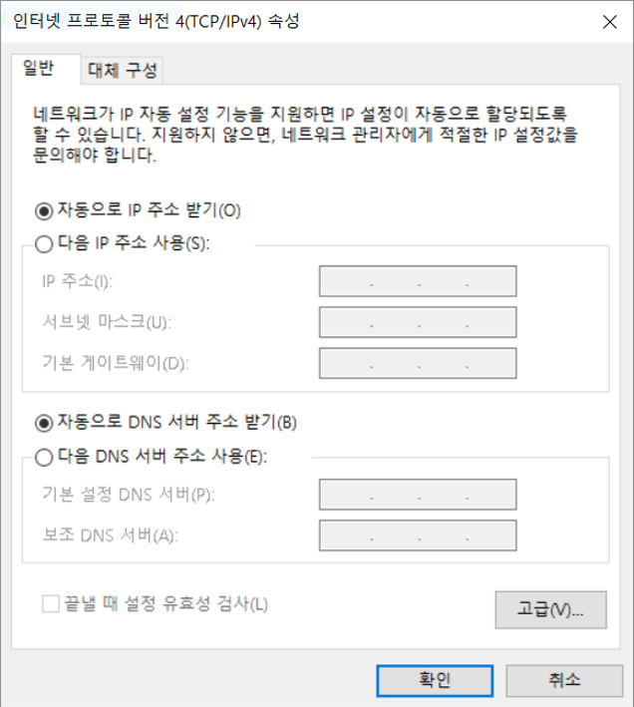
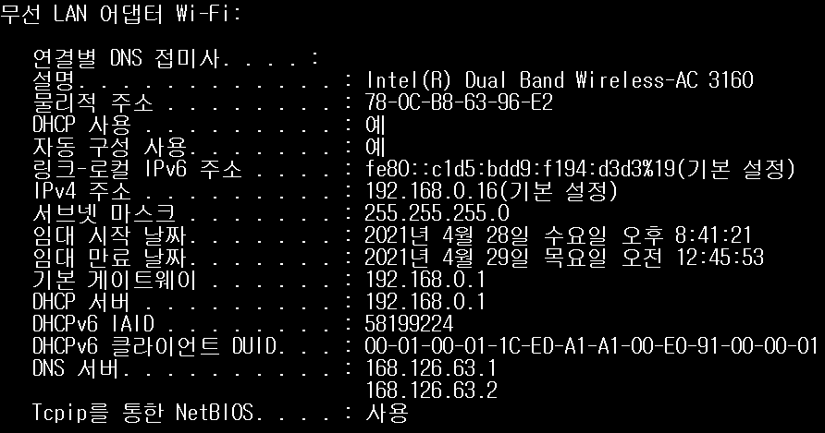
10.6 IP Address Lease
Probably?

Slide 25
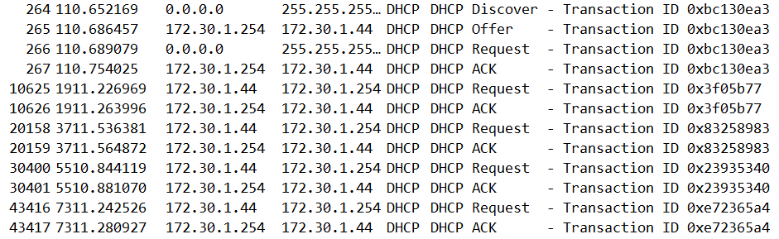
10.6 IP Address Lease
Automatic lease renewal attempt at 50% of the lease period
  If it fails, tries again at 87.5%

Slide 26
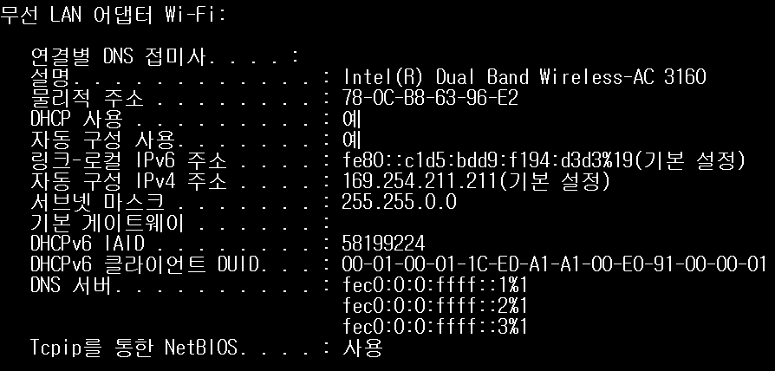
10.7 Autoconfiguration
Proper noun: autoconfiguration
  A last resort when DHCP cannot be used
  No Internet connection; only usable on the same link
  Called APIPA (Automatic Private IP Addressing) in Windows
    Randomly selected from 169.254.0.0/16 and assigned to the interface
    DAD is mandatory

