Slide 1
ICMP
8강

Slide 2
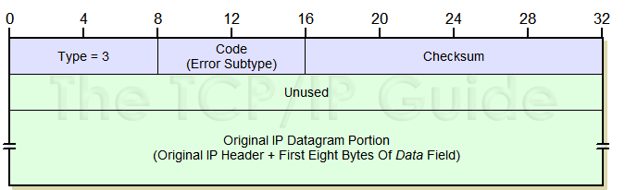
ICMP
IP protocol number 1
Formats: Fig. 8-1, 8-2
  TLV again: type, code, (checksum), payload
    Type: big classification
    Code: small classification
  Checksum is Internet checksum

Slide 3
ICMP usages
IP datagram delivery failure notification
  To source IP
  Why: should be something that source can correct (otherwise, what’s the point?)
Probing network state (“informational”)
  Ping, tracert
  Round-trip time, loss rate

Slide 4
ICMP usages
Table 8-1, 8-2
Some notable ones
  3.3, 3.4, 3.5, 5.1, 8.0, 8.1, 11.0

Slide 5
ICMP processing
Incoming
  Informational: OS
  Error: application or transport (TCP)
    DF error → TCP
    Redirect → OS : routing table update

Slide 6
ICMP errors
Explains to source why delivery failed there
Not generated for
  ICMP error
  Bad header (e.g. checksum error)
  Multicast/broadcast
  Invalid source addr (e.g. 0.0.0.0)
  Fragments other than the first

Slide 7
ICMP error
Carries a copy of the “offending” packet
  i.e. the dead one
  IP—ICMP—deadIP
Dead IP = IP header + some payload
  Contains transport port number
    At least 8 bytes of payload, now more
  Find the culprit (application)!

Slide 8
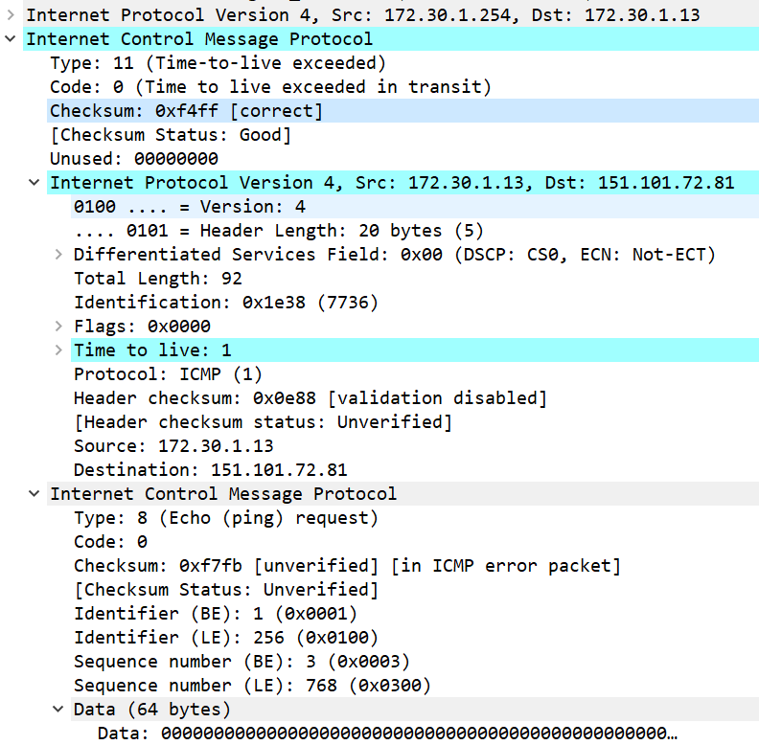
ICMP error

Slide 9
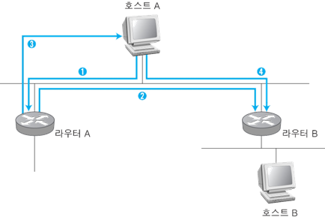
ICMP redirect
When there are more than 2 routers on a subnet
  One is default, the other’s not
  What happens your packet went to default but should have gone to the other?
    Redirect!
    Packet is normally routed

Slide 10
Tracert
Windows uses ICMP Echo Request (8.0)
  Linux uses UDP
    With high port numbers likely unused by normal processes
  What’s good about using ping instead of UDP datagram?
Try www.monaco.edu from home
  Not from KU (firewall …)

Slide 11
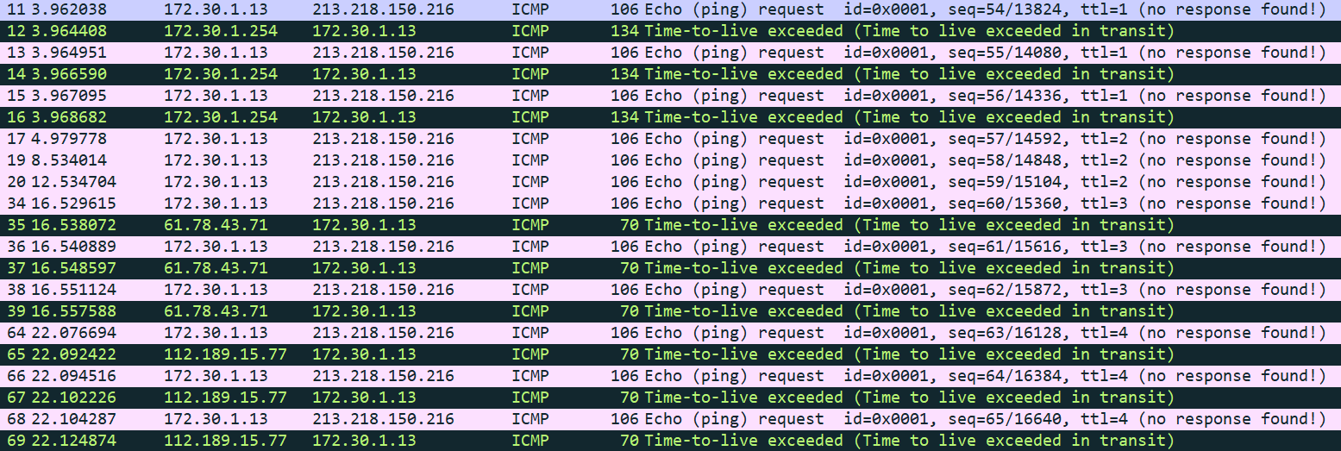
Tracert
What happens for TTL to reach the destination?

Slide 12
ICMP query/information msgs
Echo Request/Reply
Router Discovery
  IPv4: rare, used in Mobile IP
  IPv6: fundamental! -- ICMPv6
    Neighbor Discovery (ND)
    Multicast Listener Discovery (MLD)
      later
All others by DCHP today

Slide 13
ping
Ping: target OS echoes
  Sequence number
  Identifier
    Process ID in Linux

Slide 14
Neighbor Discovery (ND) in IPv6
ICMPv6 = ICMP Router Discovery + ICMP Redirect + ARP in v4
  Supports Mobile IPv6
Allow nodes on the same link
  Find each other
  Determine if they have bidirectional connectivity
  Determine if a neighbor is unavailable
  Supports stateless address autoconfig

Slide 15
ND
Two main parts
  Neighbor Solicitation/Advertisement (NS/NA)
    ARP, basically
  Router Solicitation/Advertisement (RS/RA)
    Router discovery
    Mobile agents discovery
    Redirect
    Autoconfiguration
Hop Limit = 255

Slide 16
ICMPv6 RS/RA
RA periodically
  Sent to All Nodes multicast addr = ff02::1
    Or unicast if in response to RS
RS induces RA
  Sent to All Routers multicast addr = ff02::2
  Flags
    M: should not use stateless addr autoconfig
    O: should not use stateless other autoconfig
    H: willing to act as a HA
    P: proxy ARP (experimental)

Slide 17
ICMPv6 NS
Replaces ARP request
  Sent to Solicited-Node multicast address corresponding to the target IPv6 addr
    ff02::1:ff/104
Can also be used for detecting
  Nearby nodes can be reached
  If they can be reached bidirectionally
  Sent to the target unicast address

Slide 18
Solicited-Node multicast
Acts as a pseudo-unicast address for efficient address resolution
  Fe80::210:18ff:fe00:100b → ff02::1:ff00:100b
64 bits
64 bits
Unicast prefix
Interface ID
24 bits
FF02:
0:0:0:0
:1:FF

Slide 19
ICMPv6 NA
Replaces ARP response
  In response to NS
  Asynchronously when IPv6 addr changes
    Not a request!
  Flags
    R: I am a router
    S: in response to a NS → bidirectional connectivity!
    O: override cache

