Slide 1
Network Address Translation (NAT)
7강

Slide 2
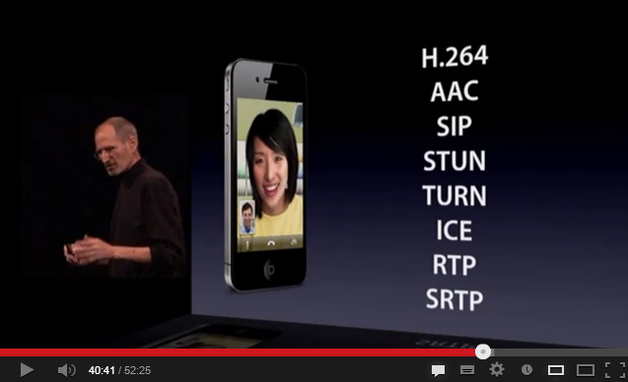
Why should we know this?
Because you are using it
  http://www.youtube.com/watch?v=z__jxoczNWc (40:00 →)

Slide 3
It all started with IPv4 address depletion fears
Two-pronged attack
  IPv6 (long-term solution)
  NAT (short-term solution)
    But became permanent
    “NAT is IPv4ever”

Slide 4
NAT
What’s good about it
  Obviates the need for long-term solution
    If address shortage is the issue
What’s bad about it
  Can’t translate IP addresses and port numbers in the payload of application protocols unless taught so
    Internet telophony, FTP, ICMP (error), etc.
  Breaks the end-to-end principle: “middlebox” problem

Slide 5
Traditional NAT
Basic NAT
  m:n address mapping (m>>n)
NAPT
  Can share the same global address
  Distinction is made by port numbers

Slide 6
Servers behind NAT
Clients are okay behind NAT
Servers need globally known address
  NAT address can be used
  Port mapping/forwarding
    Based on the destination port number, NAT forwards the requests from global Internet to an internal server
    E.g. TCP port 80 → Web server behind NAT

Slide 7
NAT traversal
Pinholes
  Mapping made at NAT is called “pinhole”
    Lives during application execution, which created the pinhole
Hole punching
  Method that allows two or more systems behind NAT to communicate directly using pinholes
    E.g. Skype peer-to-peer app

Slide 8
STUN
Session Traversal Utilities for NAT
Two objectives
  Ascertain the “external” IP and port used on a NAT for an application behind it
  Keep the NAT binding alive
STUN servers on the global Internet are necessary

Slide 9
STUN
STUN server echoes back STUN requests
Uses port 3478 with TCP/UDP
STUN message format: Fig. 7-8

Slide 10
STUN
Mapped address is the external address being used
  “reflexive transport address”
XOR-MAPPED-ADDRESS exclusive-OR’s the mapped address w/ magic cookie
  To avoid ALG’s unwanted intervention

Slide 11
TURN
STUN is asking, and getting an answer from, the STUN server
  STUN server does not do anything more than that
Traversal Using Relays around NAT extends STUN
TURN provides a way for two systems behind uncooperative NATs to communicate

Slide 12
TURN
TURN client uses the “relayed transport address” at the TURN server
  The client uses the address to communicate with its peer
Fig. 7-11
Allocation is made at the TURN server
  Requires authentication, as TURN service involves costly traffic relaying operation

Slide 13
ICE
Interactive Connectivity Establishment
  A generic facility
Developed to help UDP-based applications behind a NAT establish connectivity
Uses STUN and TURN

Slide 14
ICE
Prefers more direction communication
Priority
  Host transport > server-reflexive > relayed

