Slide 1
User Datagram Protocol (UDP)
Chapter 9

Slide 2
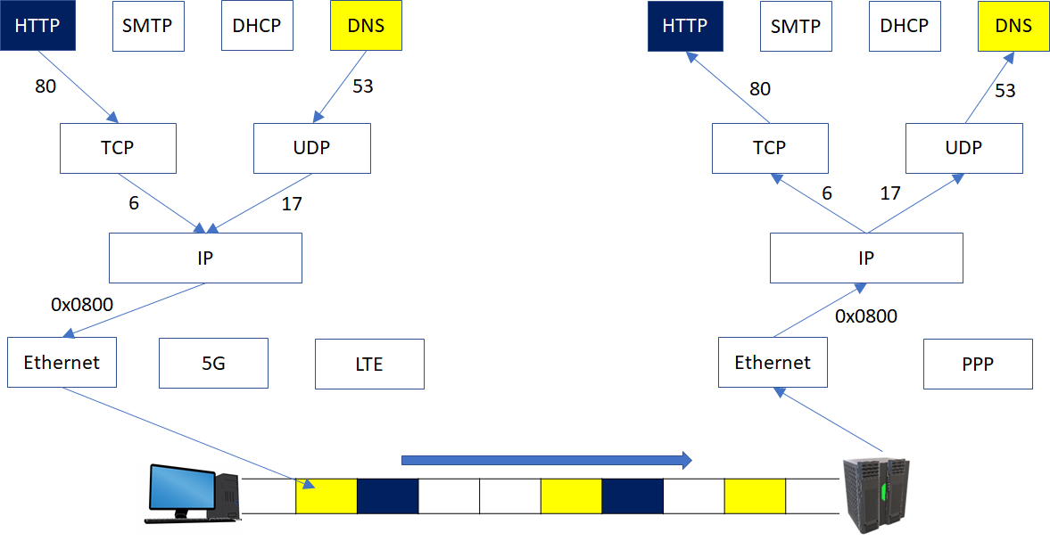
9.0 UDP Overview
Transport (Layer 4) protocol
  Topmost layer within the kernel that supports inter-process communication
    Like climbing up and down stairs
  IP protocol number 17

Slide 3
9.1 UDP Protocol Overview
The second most widely used transport protocol after TCP
Connectionless protocol
  Does nothing beyond multiplexing/demultiplexing
  Checksum: optional (IPv4) vs. mandatory (IPv6)
Use cases
  Real-time: e.g.) VoIP
  Simple transactions: e.g.) DNS, DHCP, SNMP
  Multicast/broadcast: e.g.) IPTV

Slide 4
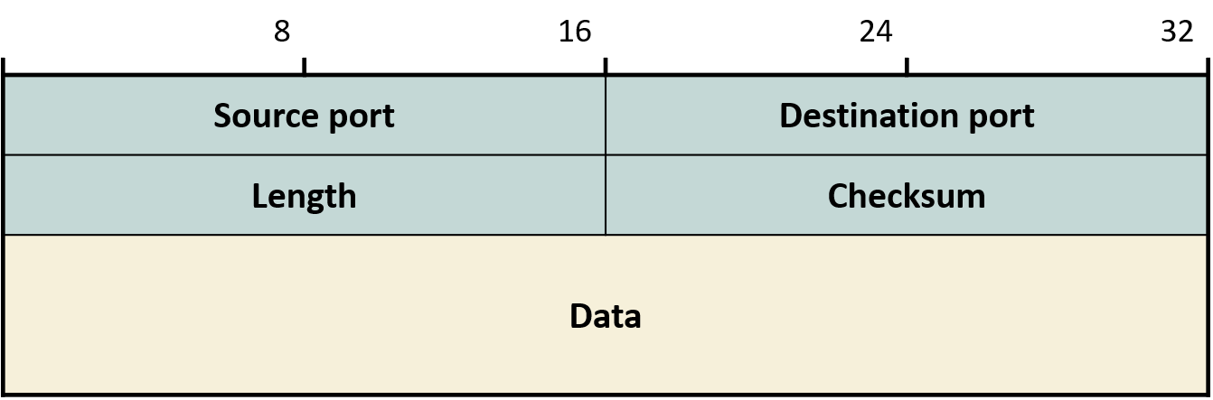
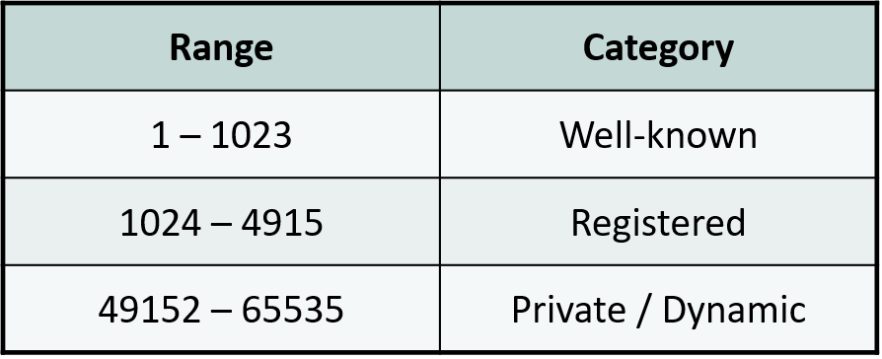
9.2 UDP Datagram Format
Header complexity  protocol complexity
Port number = transport layer "address"

Slide 5
9.2 UDP Datagram Format
Well-known ports
  Registered with IANA
  For well-known services: e.g.) DNS = 53
Registered ports
  Registered with IANA
  Can be used by clients: e.g.) ephemeral ports
Private/dynamic ports
  No special restrictions on use, but not widely used
  Used by P2P and Trojans
  Linux traceroute

Slide 6
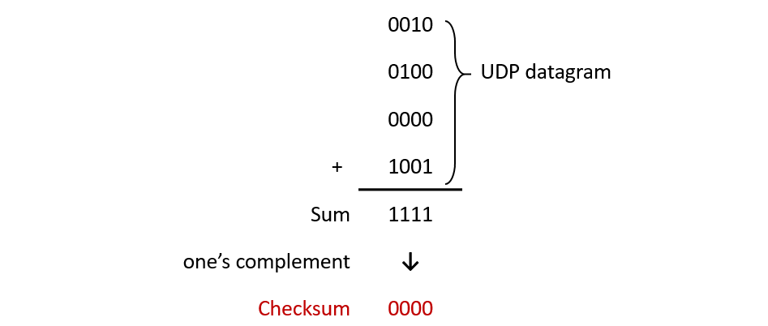
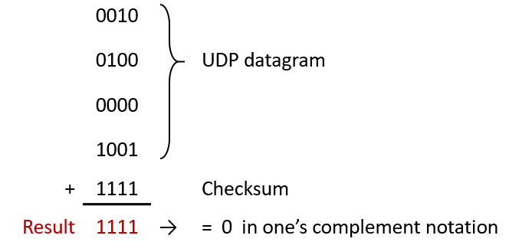
9.3 UDP Checksum
Covers the entire UDP datagram
Optional in IPv4 Internet
  Presumably for media (audio/video)?
  When not used: checksum = 000....0
  If computed checksum = 000...0, change to 111...1
    Both are 0!

Slide 7
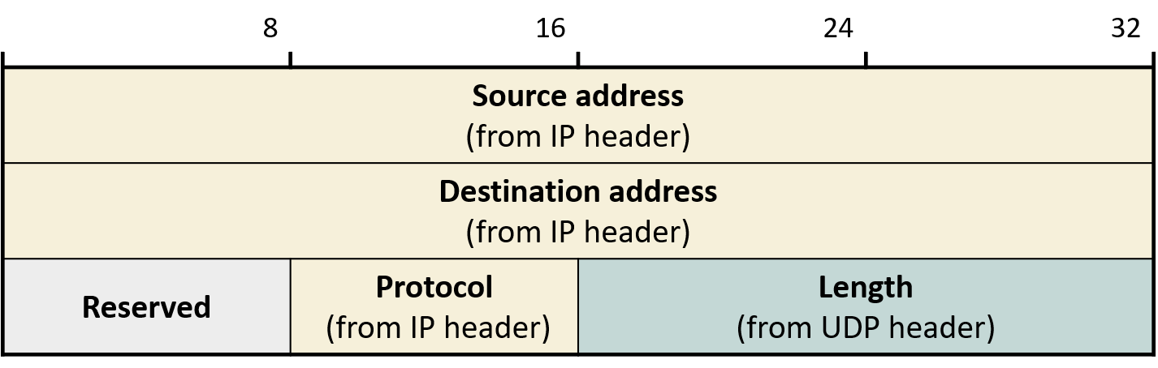
9.3 UDP Checksum
UDP checksum computation includes part of IP header
  "Pseudo-header": not actually added to the UDP header
    Also used in TCP
Pseudo-header's original purpose was to prevent forgery of key IP fields
  Intended to encrypt entire UDP datagram, but thwarted by NSA opposition (an awkward outcome)*
    Why UDP checksum is mandatory in IPv6: no IP header checksum
* D. P. Reed, Purpose of pseudo header in TCP checksum, e2e-interest mailing list, Feb. 2005. http://www.postel.org/pipermail/end2end-interest/2005-February/004616.html

Slide 8
9.4 UDP Datagram Size
Early application protocols using UDP: self-imposed message size limit
  e.g.: DNS → 512 bytes
  IPv4's minimum mandatory datagram size = 576 bytes
    A value reflecting early Internet conditions
Modern Internet conditions are different
  Minimum IP datagram size supported by all interfaces on the path is close to 1500 bytes
  Recent application protocols do not impose such limits
    e.g.: IPTV (Lecture 12)

Slide 9
9.4 UDP Datagram Size
UDP does nothing to prevent IP fragmentation
  Attaches 8-byte UDP header to application-layer protocol message and passes down to IP
UDP datagram with no payload?
  Not illegal
    Windows, iOS → does not even notify the application
    Linux, Android → notifies but no data to deliver

