Slide 1
Bringing Cross-Layer MIMO to Today’s Wireless LANs
SIGCOMM 2013
Swarun Kuman and Dina Katabi

Slide 2
ABSTRACT
Recent years have seen major innovations in cross-layer wireless designs
Deploying cross-layer innovations requires adoption from Wi-Fi chip manufacturers
→ Manufacturers hesitate to undertake major investments without
a better understandings of how these designs interact with real
networks and application
This Paper presents OpenRF
  Enabling the adoption of cross-layer designs in today’s networks with commodity Wi-Fi cards and actual application
  A cross-layer architecture for managing MIMO signal processing
  Enabling access points on the same channel to cancel their interference at each other’s clients, while beam-forming their own clients

Slide 3
CONTENTS
INTRODUCTION
MIMO PRIMER
OPENRF’s DESIGN PRINCIPLES
OPENRF’s ARCHITECTURE
INTEGRATION WITH 802.11 PROTOCOL
IMPLEMENTATION
RESULTS
CONCLUSION

Slide 4
INTRODUCTION
Recent works jointly optimize network protocol & PHY
→ Hardly any of these ideas have made it into
Wi-Fi chips or real network
Wi-Fi chip manufacturers cannot make expensive hardware investments
→ Need better understanding how these designs interact
with real applications and real network
Similar picture from 10 years, when Internet protocols were developed and demonstrated in small test-beds and the ns simulator, but were not adopted by switch manufacturers
→ Wired networks broke this cycle by SDN
(Software defined networks)
Similarly, cross-layer research needs to start targeting commodity Wi-Fi cards, actual applications, and today’s network

Slide 5
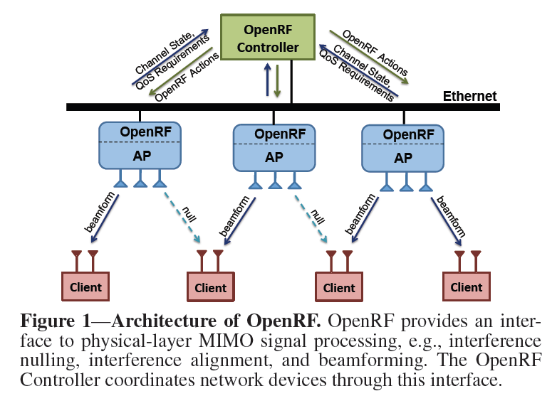
INTRODUCTION
OpenRF
  A cross-layer architecture for MIMO interference management
  Resides on AP and enable them to control MIMO signal processing at the PHY layer
  Capabilities
    Three MIMO interference management techniques
    (Interference nulling, Coherent beam-forming, Interference alignment)
    Self-configuring
    High-level quality of service requirements
    Fully compatible with commodity 802.11n cards
  SDN design, separates the control plane from the data plane

Slide 6
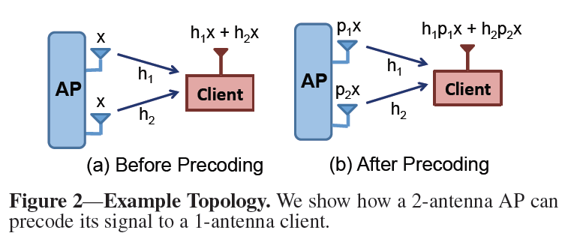
MIMO PRIMER
Interference Nulling
  A transmitter completely cancel its signal at a receiver
  Received signal needs to be 0
  Nulling for a multi-antenna client by using a pre-coding matrix P such that HP = 0, where H is the channel matrix from transmitter to receiver
Coherent Beam-forming
  AP maximize its signal at a receiver, i.e., increase the SNR
  AP can indeed do so by applying pre-coding once again
  Received signal, h1p1x + h2p2x, needs to be maximized
    H1p1 and h2p2 are complex numbers, to maximize their sum need to choose p1 and p2 to align the 2 complex numbers
    → (p1, p2) = (h1*, h2*)
Setting
p1 = -h2
P2 = h1

Slide 7
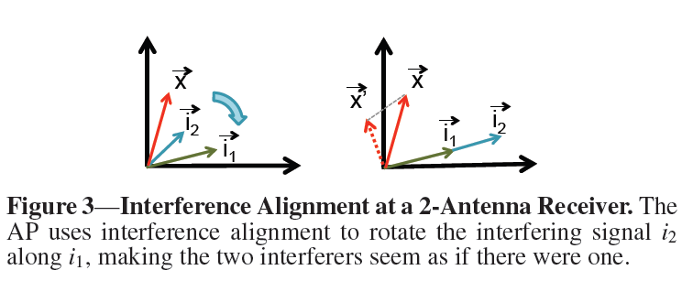
MIMO PRIMER
Interference Alignment
  AP align interfering signals
  A 2-antenna receiver can decode two concurrent signals, it can discard the interfering signal, to obtain its desired signal
  However, if another interferer joins the network, the receiver can no longer decode, since the 2-D space has a third vector i2
Rotate the vector i2 and align it along the same direction as i1
Projecting x1 orthogonal to the interference

Slide 8
OPENRF’s DESIGN PRINCIPLES
Provides a general framework for applying MIMO PHY techniques in an Enterprise WLAN
  Perform interference nulling and coherent beam-forming without modifications to the clients
  Perform interference alignment by patching the client’s driver
  Compatible with commodity 802.11n cards
Based on the realization that cross-layer interference management techniques can be decoupled into two classes:
  Coherence techniques can be performed completely locally
  Interference techniques need APs to synchronize with other AP
OpenRF steers the signal of each flow along a particular spatial direction
  Not directly assign a pre-coding vector to each flow
  Need to combine transmitting flows coherently to their clients along with canceling interference at other AP’s clients
OpenRF policy
  Only interference techniques need to be coordinated by the central controller
  Perform late binding of interference and coherence decisions

Slide 9
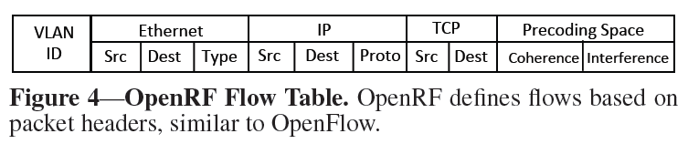
OPENRF’s ARCHITECTURE
Architecturally similar to SDN, separates the control and data planes
  Data plane is controlled by an open interface managed in software by a controller
OpenRF Interface
  Flows are identified based on fields in the packet header, such as destination IP address, port number etc.
  Additionally, OpenRF maintains for each flow, a coherence vector, and an interference vector

Slide 10
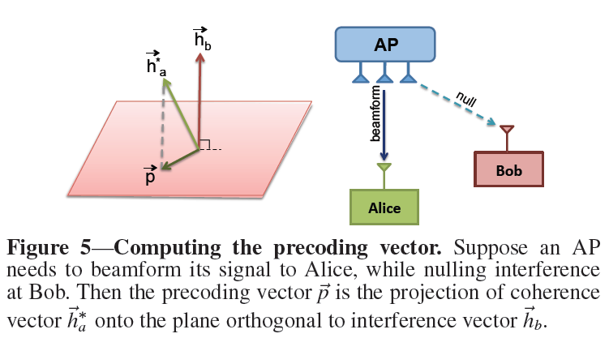


OPENRF’s ARCHITECTURE
OpenRF Interface
  Interference Condition
    To null to Bob, the AP has to pre-code its signal such that it falls in the pink-colored plane orthogonal to Bob’s channel vector
  Coherence Condition
    The AP also wants to beamform
    its signal to Alice
    Beam-forming requires the AP to
    Align its transmission with Alice’s
    channel
    This pre-coding vector creates
    Interference at Bob
    (it does not satisfy the nulling
    condition )
    AP’s best option is to pick a
    pre-coding vector that satisfies
    the nulling condition

Slide 11
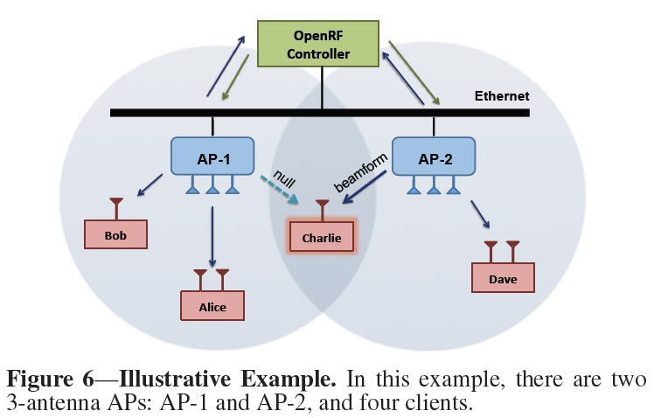
OPENRF’s ARCHITECTURE
OpenRF controller has 2 components
  A central component that coordinates all APs
  A local component residing on each AP that adapts to real-time changes to channels and traffic patterns
  OpenRF key design principle
    Central controller manages only
    interference spaces across APs
    Local component at each AP
    manage coherence space
To schedule concurrent trans.
  802.11n’s aggregate frames
  (default = 5 ms)
  Central controller designates some
  slots for scheduling edge clients
  where 2 or more APs interfere
  → interference slots

Slide 12
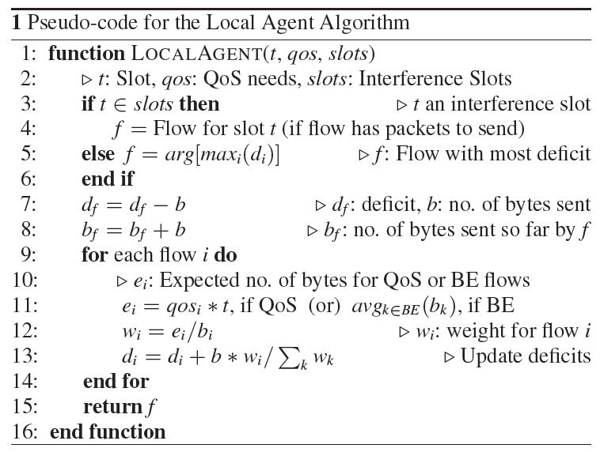
OPENRF’s ARCHITECTURE
Local Agent
Interference slot
Deficit round robin
QoS requirement
Proportional allocation
QoS or BE

Slide 13
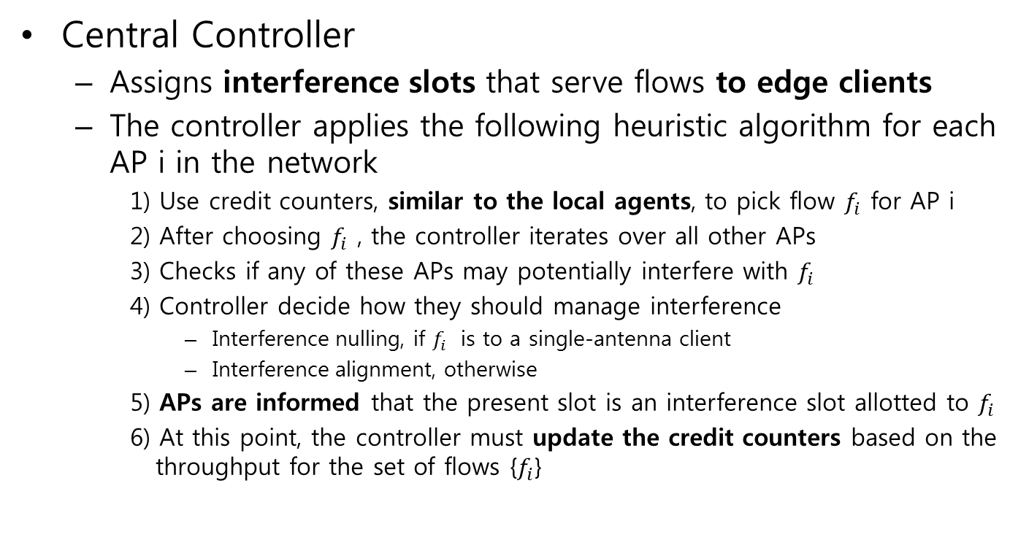
OPENRF’s ARCHITECTURE
Central Controller
  Assigns interference slots that serve flows to edge clients
  The controller applies the following heuristic algorithm for each AP i in the network
    1) Use credit counters, similar to the local agents, to pick flow $f_{i}$ for AP i
    2) After choosing $f_{i}$ , the controller iterates over all other APs
    3) Checks if any of these APs may potentially interfere with $f_{i}$
    4) Controller decide how they should manage interference
      Interference nulling, if $f_{i}$ is to a single-antenna client
      Interference alignment, otherwise
    5) APs are informed that the present slot is an interference slot allotted to $f_{i}$
    6) At this point, the controller must update the credit counters based on the
    throughput for the set of flows {$f_{i}$}

Slide 14
INTEGRATION WITH 802.11 PROTOCOL
To implement OpenRF on commodity Wi-Fi cards, it must be integrated with the 802.11 protocol
Unfortunately, 802.11 protocol was not designed with MIMO interference management techniques
Subtle interaction between PHY-layer interference management and 802.11’s MAC
  Ensuring Reliability
    Carrier Sense
    MAC ACKs and Transmission
  Working with Unmodified Clients
  Overcoming Limitations of the 802.11n standards

Slide 15
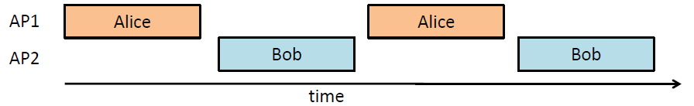
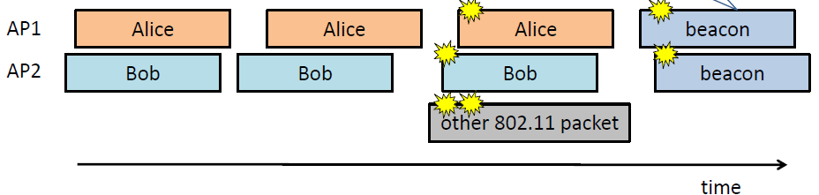
INTEGRATION WITH 802.11 PROTOCOL
Ensuring Reliability (Carrier Sense)
  802.11 APs use carrier sense → Never send at same time !
  If carrier sense is disabled on 2 APs, causing the other AP to carrier sense the signal and abstain from concurrently transmitting
  (to deactivate carrier sense altogether; but that would lead to severe
  collision with uplink traffic)

Slide 16
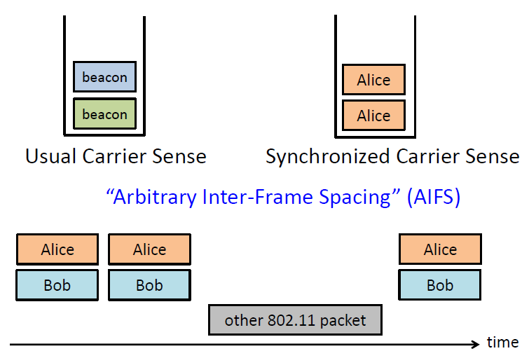
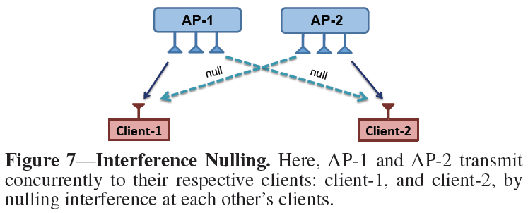
INTEGRATION WITH 802.11 PROTOCOL
Ensuring Reliability (Carrier Sense)
  To ensure that the two APs in Fig 7 transmit concurrently, despite carrier sense,
    OpenRF synchronizes their packets
    OpenRF start precisely at the same point
AIFS = DIFS + CWmin/2

Slide 17
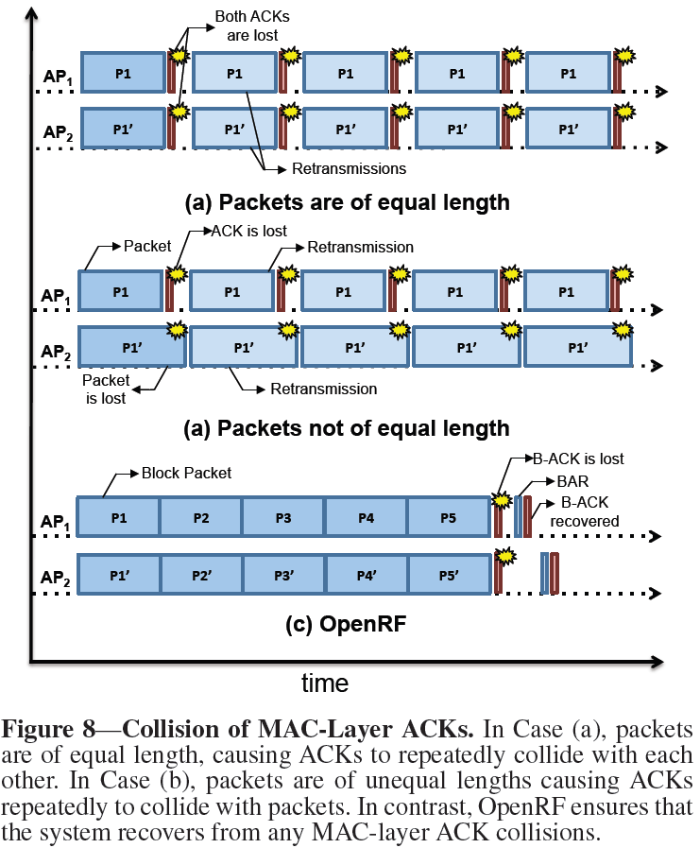
INTEGRATION WITH 802.11 PROTOCOL
Ensuring Reliability (MAC ACKSs & Transmission)
802.11’s ACK are transmitted immediately after a packet
Collision
802.11n block aggregation
Greatly reduces # of ACKs
Block ACK request can solve B-ACK lost

Slide 18
INTEGRATION WITH 802.11 PROTOCOL
Working with Unmodified Clients
  PHY-aware techniques all require knowledge of the channels from APs to their clients
    Require clients to measure their channels & provide this information as feedback to the APs
    → High overhead & many clients may not have the capability to measure
    channels
  Use the principle of channel reciprocity
    Channel in the forward direction is the same as the channel in the reverse direction, up to some calibration constant
    APs can use packets sent from the clients to measure the reverse channel, and then use those measurements to infer the forward channel

Slide 19
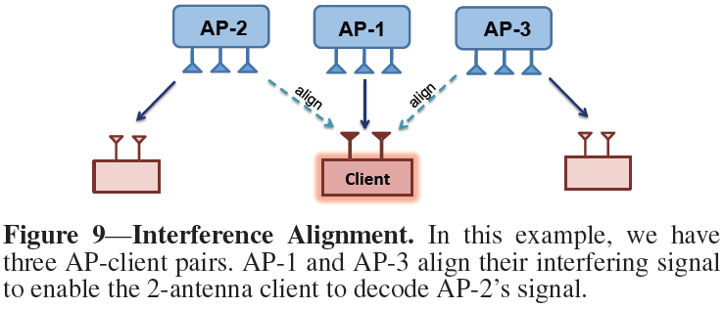
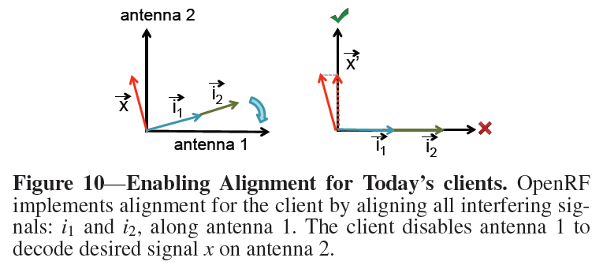
INTEGRATION WITH 802.11 PROTOCOL
Overcoming Limitations of the 802.11n standard
  Implementing interference alignment with today’s 802.11 nodes is quite challenging
  Current 802.11 standards enforce fate sharing between the different MIMO streams
  → Client in Fig 9. is not designed to ignore the interference
  stream
  Only way to implement interference alignment on off-the-shelf MIMO nodes is to convince the receiver that one of antennas is not functional

Slide 20
IMPLEMENTATION
Implemented OpenRF by modifying the iwlwifi driver for Intel Wi-Fi cards on Ubuntu 10.04 LTS
APs also use the transmit beam-forming feature of the Intel 5300 Wi-Fi cards
Central controller is implemented on a Linux workstation
Built solution over the University of Washington’s 802.11 CSI tool
NTP over the wired Ethernet backbone to synchronize the block aggregation
Fully complies with 802.11n and handles concurrent transmissions, carrier sense, and ACKs

Slide 21
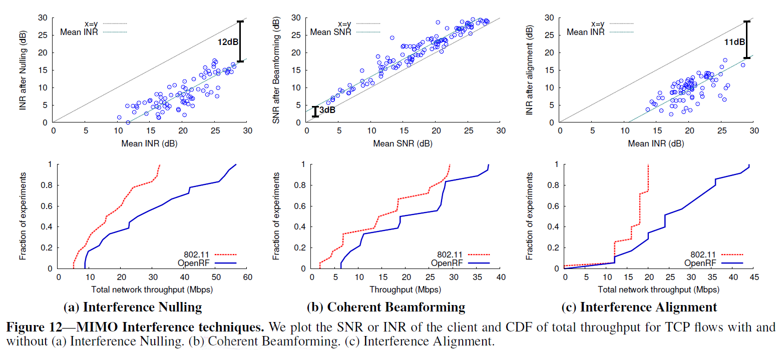
RESULTS
PHY-aware techniques on Commodity Cards

Slide 22
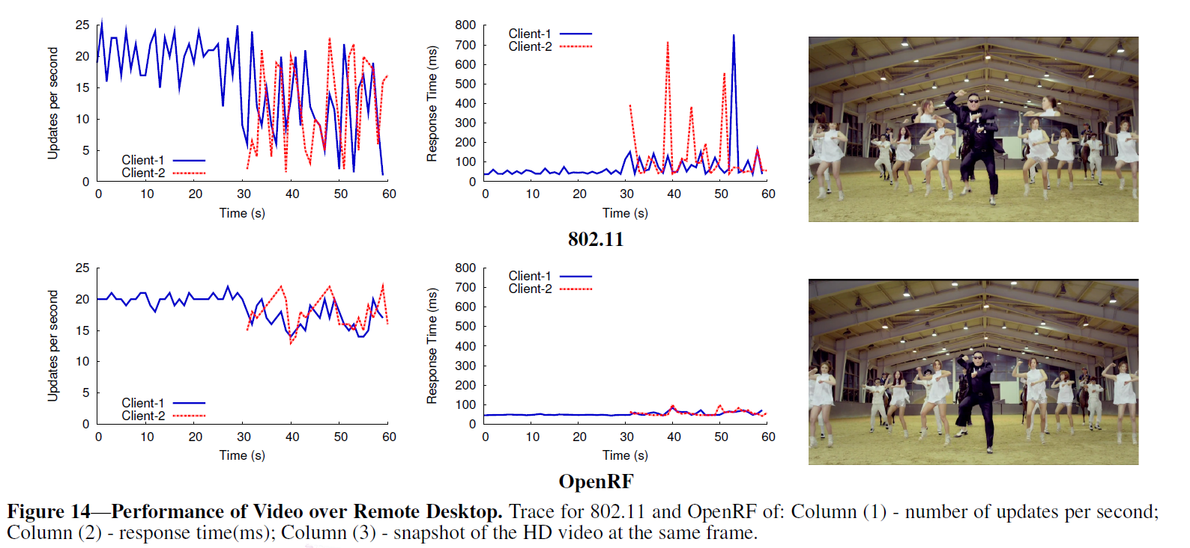
RESULTS
Application performance

Slide 23
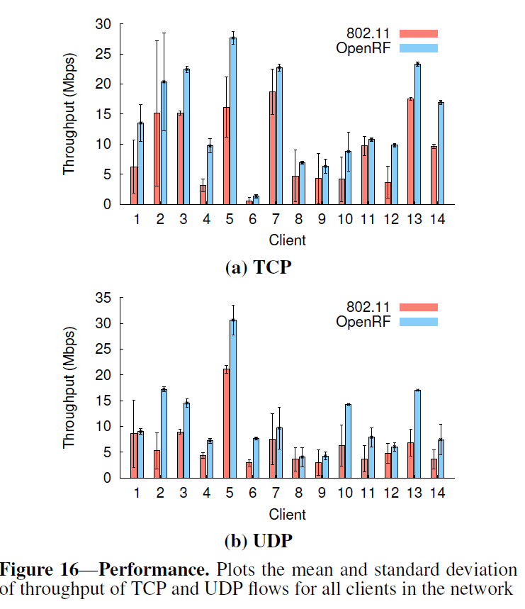
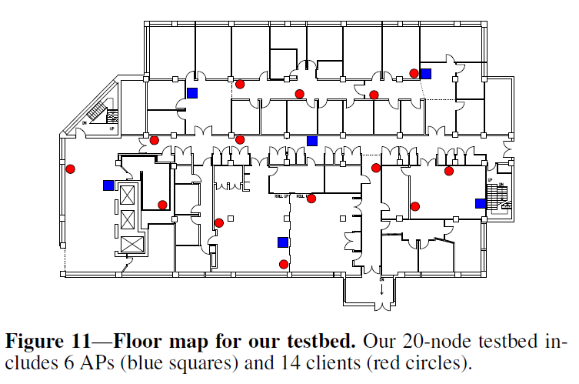
RESULTS
Large scale measurements
Six 3-antenna APs,
14 clients including seven 1-antenna,
five 2-antenna, two 3-antenna wireless nodes

Slide 24
CONCLUSION
Enables deployment of PHY-layer MIMO techniques on commodity Wi-Fi cards
Achieves gains over fully operational network stack with real application
First steps towards opening up PHY research to a wider community

