Slide 1
10.11~10.13
한승우
2015021525

Slide 2
10.11 UDP Server Design
Servers typically interact with the operating system, and most need a way to handle multiple clients at the same time.
A client starts, immediately communicates with a single server, and is done.
Servers start and go to sleep, waiting for a client’s request to arrive.
  They awaken when a client’s datagram arrives, which usually requires the server to evaluate the request and possibly perform further processing.

Slide 3
10.11.1 IP Addresses and UDP Port Numbers
UDP datagram
  The IP header contains the source and destination IP addresses.
  UDP header contains the source and destination UDP port numbers.
  When an application receives a UDP message, the IP and UDP headers have been stripped off.
Servers need to know to whom the datagram was sent.
  Destination IP address
Because of multihoming, IP address aliasing, and ordinary IPv6 usage with multiple scopes, a host may have multiple IP addresses
  If the server wants to perform its tasks differently depending on the destination IP address selected by the client, it requires access to the destination IP address information.

Slide 4
10.11.1 IP Addresses and UDP Port Numbers
UDP servers designed for use with both IPv4 and IPv6.
The interoperability mechanism of encoding IPv4 addresses in IPv6 addresses may allow the use of IPv6 sockets to handle both IPv4 and IPv6 addressing.

Slide 5
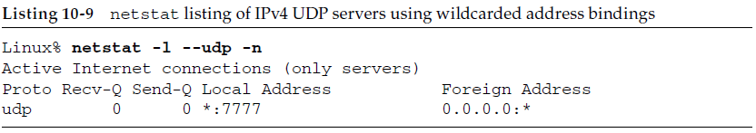
10.11.2 Restricting Local IP Addresses
Most UDP servers wildcard their local IP address when they bind a UDP endpoint.
  An incoming UDP datagram destined for the server’s port is accepted on any local IP address.
Ex) start an IPv4 UDP server on port 7777;
  Linux% sock -u -s 7777
Use the netstat command to see the state of the endpoint

Slide 6
10.11.2 Restricting Local IP Addresses
The -l flag reports on all listening sockets (servers).
The --udp flag provides data relating only to the UDP protocol.
The -n flag prints IP addresses rather than fully expanded host names.
The local address is printed as *:7777. * means that the local IP address has been wildcarded.
With sock
  If specify an IP address before the port number, that IP address becomes the local IP address for the endpoint.

Slide 7
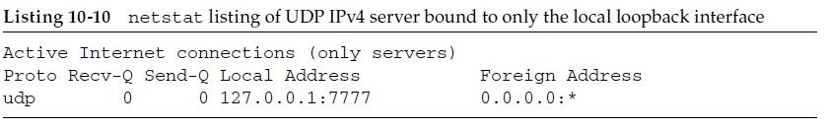
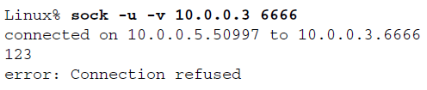
10.11.2 Restricting Local IP Addresses
Linux% sock -u -s 127.0.0.1 7777
  restricts the server to accepting only datagrams arriving on the local loopback interface (127.0.0.1)
If we try to send this server a datagram, ICMPv4 Port Unreachable message is returned and the sending application receives an error.

Slide 8
10.11.3 Using Multiple Addresses
It is possible to start different servers on the same port number, each with a different local IP address.
  The system must be told by the application that it is OK to reuse the same port number in this way.
  SO_REUSEADDR socket option.
  sock program by specifying the -A option.
Ex) Host has a native IPv4 address of 10.0.0.30 and give it two additional addresses
  Linux# ip addr add 10.0.2.13 scope host dev eth0
  Linux# ip addr add 10.0.2.14 scope host dev eth0

Slide 9
10.11.3 Using Multiple Addresses
Ex cont’d) Now host has four unicast IPv4 addresses: its native address, the two we have just added, plus its local loopback address.
  It is possible to start three different instances of the UDP on the same port (8888) using sock
  Linux% sock -u -s -A 10.0.2.13 8888
  Linux% sock -u -s -A 10.0.2.14 8888
  Linux% sock -u -s -A 8888
  The servers must be started with the -A flag, telling the system that it is OK to reuse the same addressing information.

Slide 10
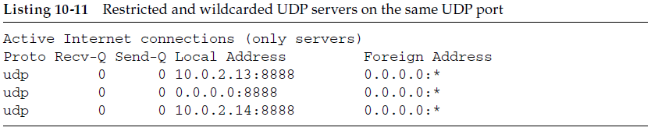
10.11.3 Using Multiple Addresses
Ex cont’d)
  The only IPv4 datagrams that will go to the server with the wildcarded local address are those destined for
    10.0.0.30
    The directed broadcast address (e.g., 10.255.255.255)
    The limited broadcast address (255.255.255.255)
    The local loopback address (127.0.0.1)
Priority implied when an endpoint with a wildcard address exists.
  An endpoint with a specific IP address that matches the destination IP address is always chosen over a wildcard.

Slide 11
10.11.4 Restricting Foreign IP Address
netstat output shows
  the foreign IP address and foreign port number are shown as 0.0.0.0:*
  Meaning that the endpoint will accept an incoming UDP datagram from any IPv4 address and any port number.
There is an option to restrict the foreign address.
  This restriction can be added once a server has heard from a client, in order to filter out additional traffic from other clients
  sock uses the -f option to specify the foreign IPv4 address and port number
  Linux% sock -u -s -f 10.0.0.14.4444 5555
  This sets the foreign IPv4 address to 10.0.0.14 and the foreign port number to 4444. The server’s port is 5555.

Slide 12
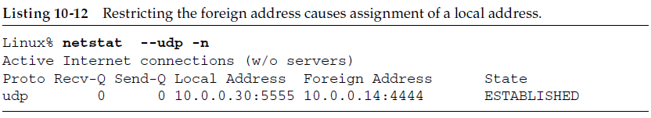
10.11.4 Restricting Foreign IP Address
This is a typical side effect of specifying the foreign IP address and foreign port.
  The local address is chosen automatically.
  As a consequence of the endpoints being determined and the foreign address restricted, the State column now indicates that the association is ESTABLISHED.

Slide 13
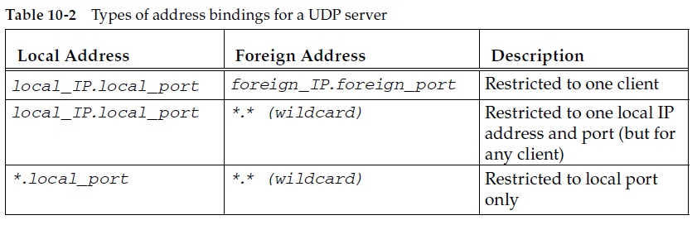
10.11.4 Restricting Foreign IP Address
local_port is the server’s port and local_IP must be one of the locally assigned IP addresses.
The most specific binding (the first row) is tried first, and the least specific (the last row with both IP addresses wildcarded) is tried last.

Slide 14
10.11.5 Using Multiple Servers per Port
Most implementations allow only one application endpoint at a time to be associated with any one (local IP address, UDP port number) pair for a given address family (i.e., IPv4 or IPv6).
If try to start another server with the same wildcarded local address and the same port using the same address family, it does not work
  Linux% sock -u -s 12.46.129.3 8888 &
  Linux% sock -u -s 12.46.129.3 8888
  can’t bind local address: Address already in use

Slide 15
10.11.5 Using Multiple Servers per Port
Multiple endpoints can be allowed to use the same (local IP address, UDP port number) pair, although the application normally must tell the API that this is OK.
When a UDP datagram arrives whose destination IP address is a broadcast or multicast address, multiple endpoints at the destination IP address and port number,
  The incoming datagram is passed to each endpoint.
If a UDP datagram arrives whose destination IP address is a unicast address (i.e., an ordinary address)
  A single copy of the datagram is delivered to one of the endpoints.
Multithreaded and multiprocess servers to operate without being invoked multiple times

Slide 16
10.11.5 Using Multiple Servers per Port
If a UDP datagram arrives whose destination IP address is a unicast address (i.e., an ordinary address)
  A single copy of the datagram is delivered to one of the endpoints.
Which endpoint gets the unicast datagram is implementation-dependent, but this policy helps to allow
  Multithreaded and multiprocess servers to operate without being invoked multiple times

Slide 17
10.11.6 Spanning Address Families: IPv4 and IPv6
It is possible to write servers that span not only protocols but also across address families.
The port space between IPv6 and IPv4 for UDP (and TCP) is shared.
If a service binds to a UDP port using IPv4, it is also allocated the same port in the IPv6 port space, preventing other services from using it.
Because IPv6 addresses can encode IPv4 addresses in an interoperable way, wildcard bindings in IPv6 may receive incoming IPv4 traffic.

Slide 18
10.11.6 Spanning Address Families: IPv4 and IPv6
Implementation-specific
  In Linux, all port space is shared and any wildcard IPv6 binding implies a corresponding IPv4 binding.
  In FreeBSD, the IPV6_V6ONLY socket option may be used to ensure that bindings are present only in the IPv6 space.

Slide 19
10.11.7 Lack of Flow and Congestion Control
Most UDP servers are iterative servers.
  A single server thread handles all the client requests on a single UDP port.
There is a limited-size input queue associated with each UDP port that an application is using.
  Requests arriving at about the same time from different clients are automatically queued by UDP.
It is possible that queue to overflow, causing the UDP implementation to discard incoming datagrams because UDP provides no flow control.

Slide 20
10.11.7 Lack of Flow and Congestion Control
Because UDP is a connectionless protocol with no reliability mechanism, applications are not told when the UDP input queue overflows.
  Just discarded by UDP.
Queues are also present in the IP routers between the sender and the receiver.
  When these queues become full, traffic may be discarded.
  The network is congested.
Congestion is undesirable.
  It affects all network users with traffic.

Slide 21
10.11.7 Lack of Flow and Congestion Control
Congestion is undesirable.
  It affects all network users with traffic.
UDP poses a special concern for congestion.
  It has no way of being informed that it should slow down its sending rate if the network is being driven into congestion.
  It is said to lack congestion control.

Slide 22
10.12 Translating UDP/IPv4 and UDP/IPv6 Datagrams
For UDP/IPv4 datagrams, the UDP header’s Checksum field is allowed to be 0 (uncomputed), whereas in UDP/IPv6 this is not allowed.
Complete datagrams arriving with a zero checksum being translated from IPv4 to IPv6 result in either a UDP/IPv6 datagram with a fully computed pseudo-header checksum being generated, or with the arriving packet being dropped.
Checksum being translated in either direction require the checksum to be updated if a non-checksum-neutral address mapping is used

Slide 23
10.12 Translating UDP/IPv4 and UDP/IPv6 Datagrams
For stateless translators
  A fragmented UDP/IPv4 datagram with a zero checksum cannot be translated, as the appropriate UDP/IPv6 checksum cannot be computed.
  Such datagrams are dropped.
For stateful translators
  Fragmented UDP/IP datagrams with computed checksums are handled as ordinary fragments in either direction.
Large UDP/IPv4 datagrams that require fragmentation to fit within the IPv6 minimum MTU after translation are also handled as conventional IPv4 datagrams.

Slide 24
10.13 UDP in the Internet
UDP accounts for between 10% and 40% of Internet traffic.
The use of UDP is also on the rise.
Fragmentation of Internet traffic is found to be most common with UDP (68.3% of the fragmented traffic is UDP).
  Although very little traffic overall is fragmented (about 0.3% of packets, 0.8% of bytes).
  The most common type of traffic that is fragmented is UDP-based multimedia traffic (53%).
  Encapsulated/tunneled traffic such as that present in VPN tunnels (about 22%)
  About 10% of the fragmentation is reverse-order

Slide 25
10.13 UDP in the Internet
The most commonly seen fragment size is 1500 bytes (79%), followed by 1484 bytes (18%) and 1492 bytes (1%).
  The 1500-byte MTU is related to the native usable payload size for Ethernet.
The causes of fragmentation
  Careless encapsulation and lack of path MTU discovery
    Relates to multiple levels of encapsulation across many protocol layers
  Adaptation for applications that like to use large messages.
    Applications that use larger packets (e.g., video applications) that end up being fragmented.

