Slide 1
Section 3.6: Point-to-Point Protocol
(PPP)
권현수
2014021626

Slide 2
Point-to-Point Protocol (PPP)
Popular method for carrying IP datagrams over serial links
A collection of protocols than a single protocol
Supports the Link Control Protocol(LCP), Network Control Protocol(NCP)
Compression, encryption, and authentication for PPP

Slide 3
Link Control Protocol (LCP)
Used to establish and maintain a low-level two-party communication path over a point-to-point link
Concerned only with two ends of a single link, does not need to handle the problem of mediating access to a shared resource
Must support bidirectional operation
Simple bit-level framing format based on the High-Level Data Link control(HDLC)

Slide 4
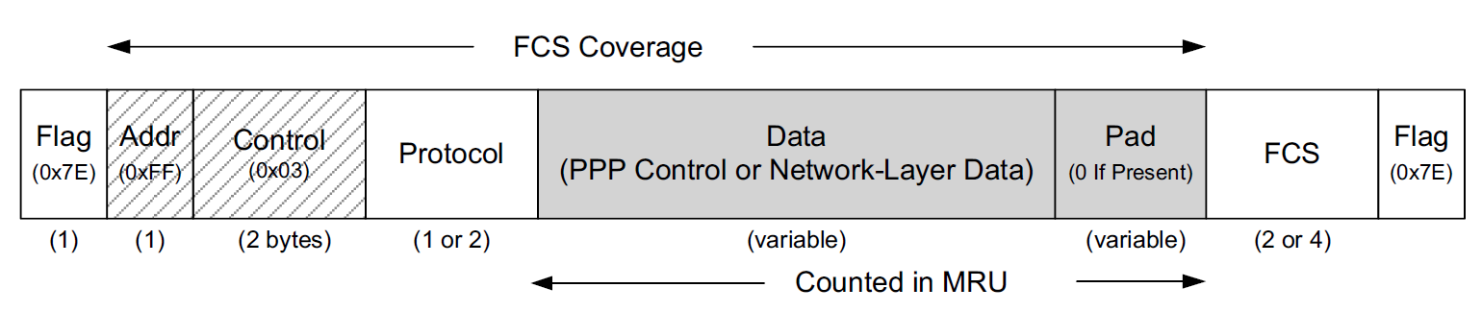
Link Control Protocol (LCP) (cont.)
Flag field: to find the beginning and end of the frame
If the value 0x7E itself occurs inside the frame
  Asynchronous link: character stuffing(byte stuffing)
  Synchronous link: bit stuffing

Slide 5
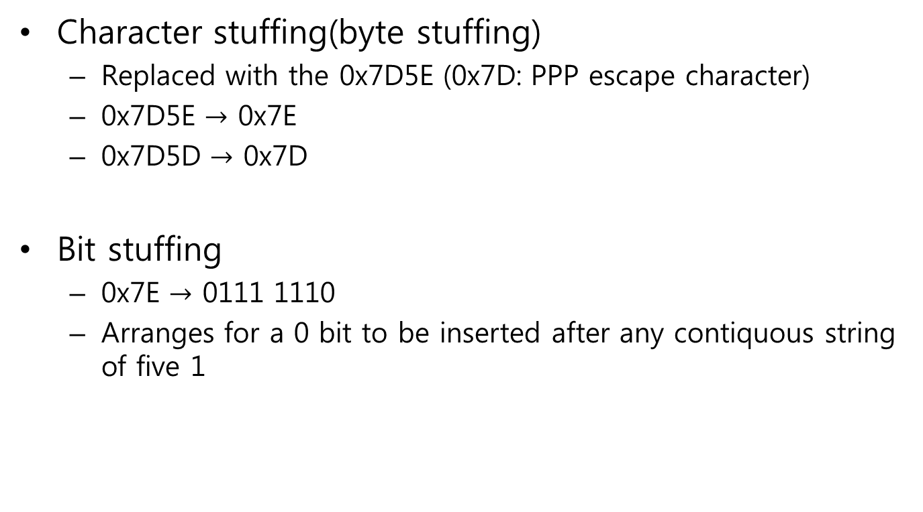
Link Control Protocol (LCP) (cont.)
Character stuffing(byte stuffing)
  Replaced with the 0x7D5E (0x7D: PPP escape character)
  0x7D5E $→$ 0x7E
  0x7D5D $→$ 0x7D
Bit stuffing
  0x7E $→$ 0111 1110
  Arranges for a 0 bit to be inserted after any contiquous string of five 1

Slide 6
Link Control Protocol (LCP) (cont.)
Addr field: converned only with a single destination, always defined to have the value 0xFF(all stations)
Control field: used to indicate frame sequencing and retransmission behavior, link-layer reliability are not ordinarily implemented, 0X03
Often omitted with an Address and Control Field Compression(ACFC)

Slide 7
Link Control Protocol (LCP) (cont.)
Protocol field: indicates the type of data being carried
  0x0000-0x3FFF: identify network-layer protocols
  0x8000-0xBFFF: identify data belonging to an associated NCP
  0x4000-0x7FFF: used for “low-volue” protocols with no associated NCP
  0xC000-0xEFFF: identify control protocols

Slide 8
Link Control Protocol (LCP) (cont.)
FCS field: a CRC16(or 32) covers the entire frame except the FCS, Flag

Slide 9
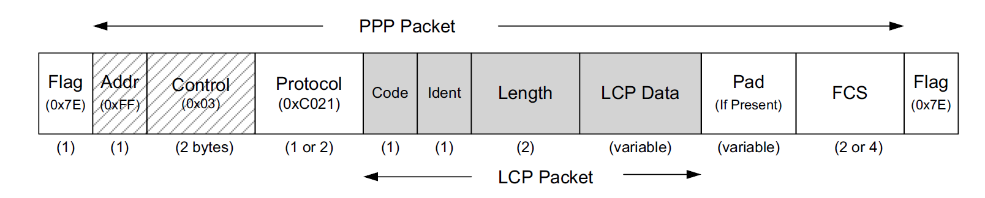
LCP Operation
Protocol field: 0xC021,
  not eliminated using PFC(Protocol Field Compression)
Ident field: a sequence number
Code field: gives the type of operation being either requestd or responded to
  Configure-request, configure-ACK, configure-NACK, configure-REJECT, terminate-request, terminate-ACK, code-REJECT…

Slide 10
LCP Operation (cont.)
Length field: indicates the length of the LCP packet in bytes, not permitted to exceed the links’ maximum received unit (MRU)

Slide 11
LCP Operation (cont.)
The main job of LCP is to bring up a point-to-point link to a minimal level
  Configure message
  Termination message
  Echo Request/Replay message
  Discard Request message
  Identifaction message
  Time-Remaining message

Slide 12
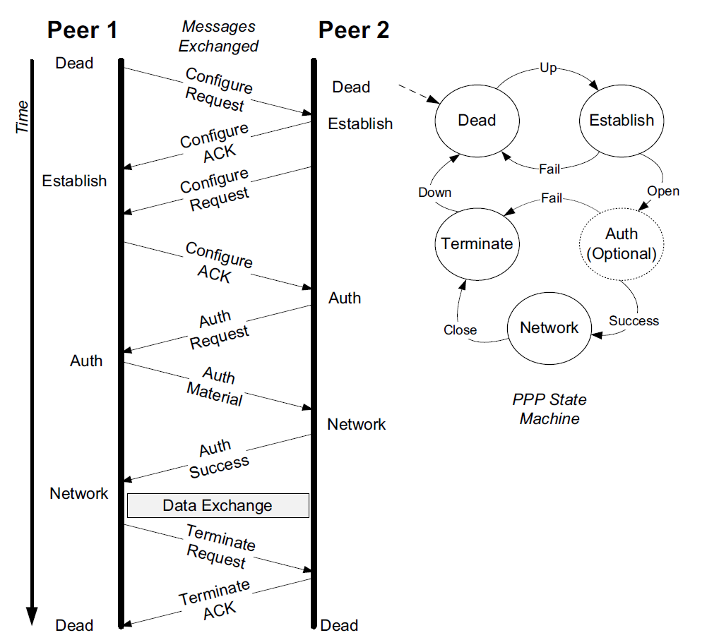
LCP Operation (cont.)
How PPP links are established and options are negotiated

Slide 13
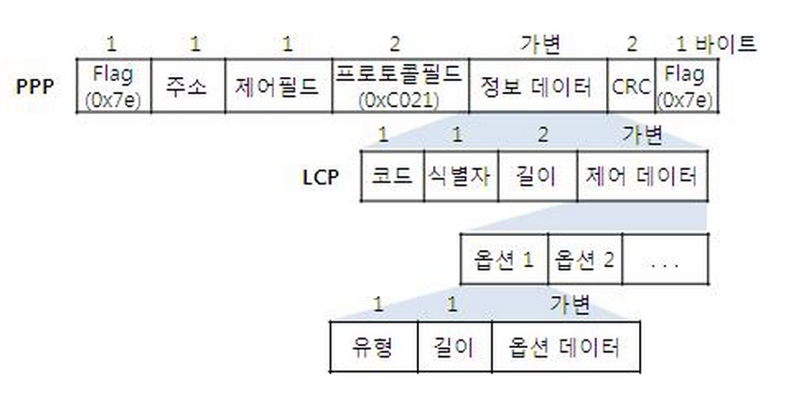
LCP Option
Several options can be negotiated by LCP
Asynchronous Control Character Map (ACCM)
MRU option

Slide 14
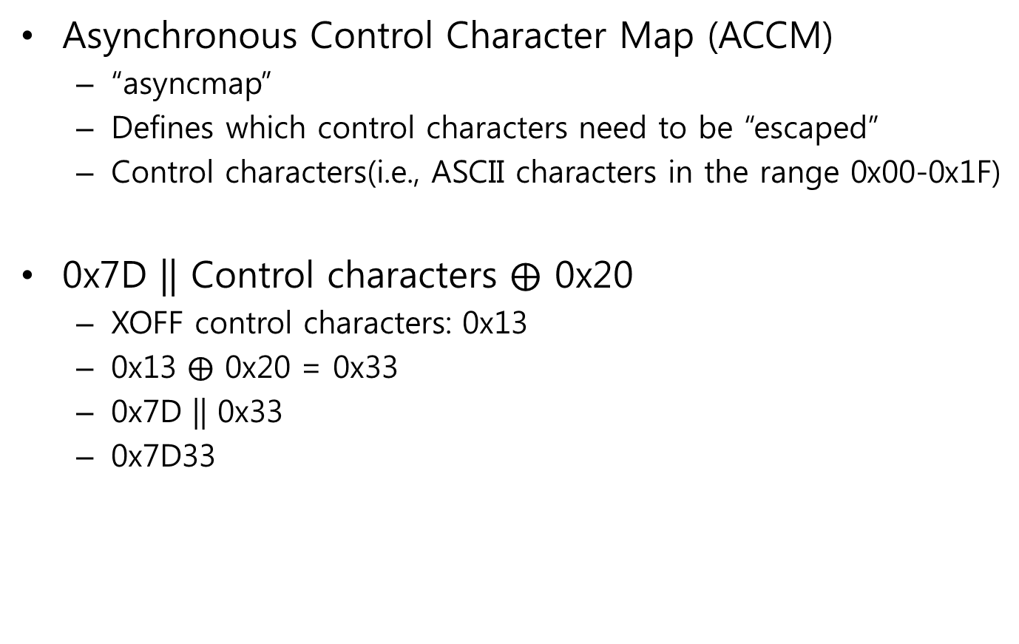
LCP Option (cont.)
Asynchronous Control Character Map (ACCM)
  “asyncmap”
  Defines which control characters need to be “escaped”
  Control characters(i.e., ASCII characters in the range 0x00-0x1F)
0x7D || Control characters $⨁$ 0x20
  XOFF control characters: 0x13
  0x13 $⨁$ 0x20 = 0x33
  0x7D || 0x33
  0x7D33

Slide 15
LCP Option (cont.)
Asynchronous Control Character Map (ACCM)
Asyncmap options is generally bit position indicates that the control character with value n should be escaped
0xffffffff: would escape all control charcters
0x00000000: would escape none of them
ex) 0x000A0000
  0000 0000 0000 1010 0000 0000 0000 0000
  would escape XON(0x11) and XOFF(0x13)

Slide 16
LCP Option (cont.)
MRU option (type 0x01)
When a host specifies a MRU option, the peer is requested to neber send frames longer than the value
Length of the data field in bytes, does not count the various other PPP overhead fileds
MRU serves more as advice to peer

Slide 17
LCP Option (cont.)
PPP supports a mechanism to exchange link quality reporting information
16-bit of the options are reserved to specify the particular protocol
Most common is a PPP standared involving LQRs, using the value 0xC025 in the PPP protocol field
If this is enabled, the peer is asked to provide LQRs at some periodic rate

Slide 18
LCP Option (cont.)
PPP supports a callback capability
A PPP dial-up callback client calls in to a PPP callback server
Authentication information is provided, the server disconnects and calls the client back
LCP option with value 0x0D is used to negotiate callback
Callback Control Protocol(CBCP)

Slide 19
LCP Option (cont.)
When data is not otherwise long enough, padding may be added to cause the length to become an even multiple of the block size
self-describing padding alters the value of padding to be nonzero
The first byte of pad would have the value 0x01
The final byte contains the number of pad bytes that were added

Slide 20
LCP Option (cont.)
To lessen the impact of the fixed costs of sending a header on every frame, PPPMux has been introduced
PPP header protocol field is set to multiplexed frame(0x0059)
Introduce a 1-to 4-byte subframe header in fromt of each payload block
PPF bit, LTX bit

Slide 21
Multilink PPP (MP)
Used to aggregate multiple point-to-point links to act as one
Bundle operates as a complete virtual link and can contain its own configuration information
Bundle comprises a number of member links
Simple method to implement MP, alternate packets across the member links

Slide 22
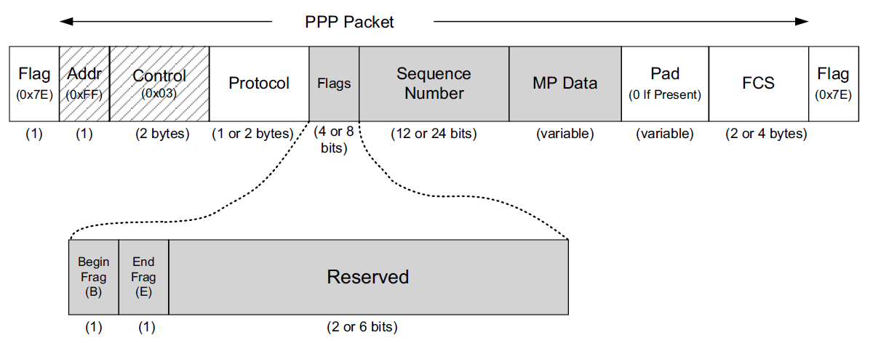
Multilink PPP (MP) (cont.)
MP fragment with the Begin and End fragment bit fields and Sequence Number field

Slide 23
Multilink PPP (MP) (cont.)
If a frame is not fragmented, both the B and E bits are set
Otherwise, the first fragment has the BE bit combination set to 10 and the final fragment has the BE bits set to 01, and all framents in between have them set to 00
Sequence number indicates the packet number offset relative to the first fragment

Slide 24
Multilink PPP (MP) (cont.)
Use of MP is requested by including an LCP option called the multilink maximum received reconstructed unit (MRRU)
Member links are identified by the LCP endpoint discriminator option
MP expects that member links are going to be used symmetrically
More sophisticated, Bandwidth Allocation Protocol(BAP)
Bandwidth Allocation control Protocol (BACP)

Slide 25
Compression Control Protocol (CCP)
LCP can negotiate an option to enable the Compression Control Protocol (CCP)
CCP can be negotiated only once the link has entered the Network state
Protocol field: 0x80FD
Code field: reset-request(0x0E), reset-ACK(0x0F)
CCP can enable one of about a dozen compression algorithms

Slide 26
PPP Authentication
Before a PPP link becomes operational in the Network state, it is often necessary to establish the identity of the peer of the link using authentication mechanism
Password Authentication Protocol (PAP)
Challenge-Handshake Authentication Protocol (CHAP)
EAP: authentication framework available for many different network types

Slide 27
Network Control Protocols (NCPs)
IPCP, the standard NCP for IPv4
  Protocol field: 0x8021
IPV6CP uses the same packet exchange and format as LCP, except it has two different options
  Interface-identifier
  IPv6-compression-procol

Slide 28
Header Compression
It is useful to have a way of compressing the headers of higher-layer protocols
VJ compression, portions of the higher-layer headers are replaced with a small, 1-byte connection identifier
When the nonchanging values are sent over a link once and kept in a table, a small index can be used as a replacement
The limited changing values are encoded differentially

Slide 29
Header Compression (cont.)
IP header compression
Robust Header Compression (ROHC)

Slide 30
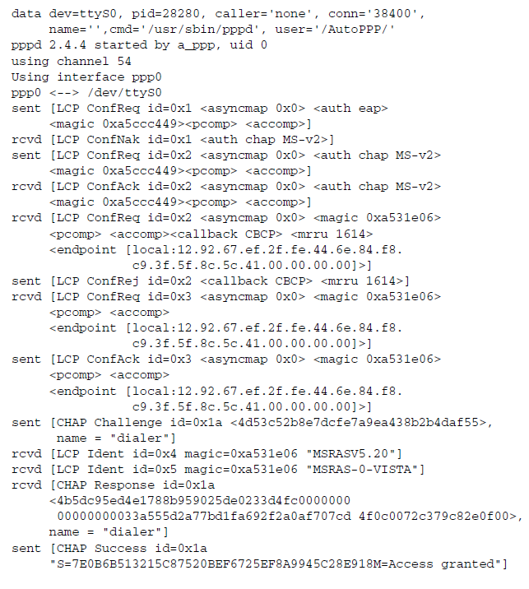
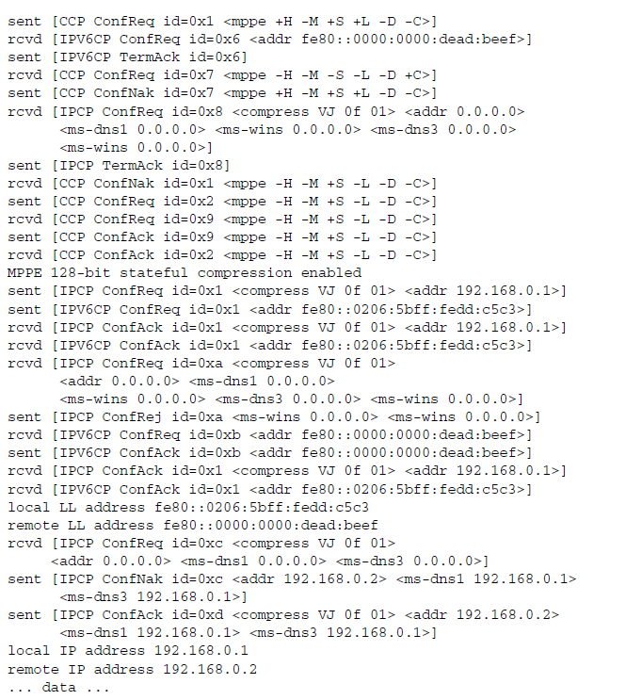
Example
IP header compression
Robust Header Compression (ROHC)

Slide 31
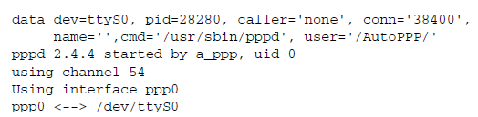
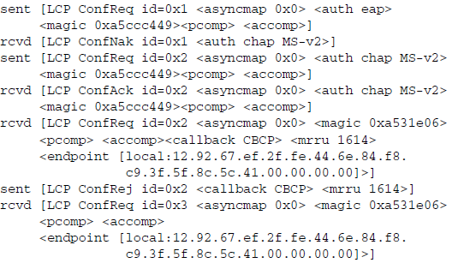
Example

Slide 32
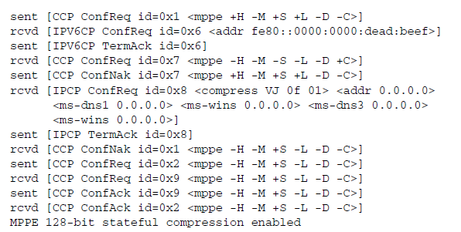
Example

Slide 33
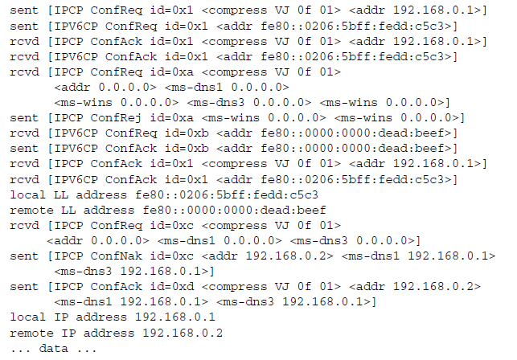
Example

