Slide 1
3.9: Tunneling Basics
최성민
2015020501

Slide 2
3.9 Tunneling Basics
In some cases it is useful to establish a virtual link between one computer and another across the Internet or other network.
The method most commonly used to implement these types of services is called tunneling.

Slide 3
3.9 Tunneling Basics
Tunneling, generally speaking, is the idea of carrying lower-layer traffic in higher-layer (or equal-layer) packets.
  IPv4 can be carried in an IPv4 or IPv6 packet
  Ethernet can be carried in a UDP or IPv4 or IPv6 packet
Overlay network

Slide 4
3.9 Tunneling Basics
Three of the more common protocols
  GRE; Generic Routing Encapsulation [RFC2784]
  PPTP; Point-to-Point Tunneling Protocol [RFC2637]
  L2TP; Layer 2 Tunneling Protocol [RFC3931]
  IP-in-IP tunneling protocol [RFC1853] Nonstandard

Slide 5
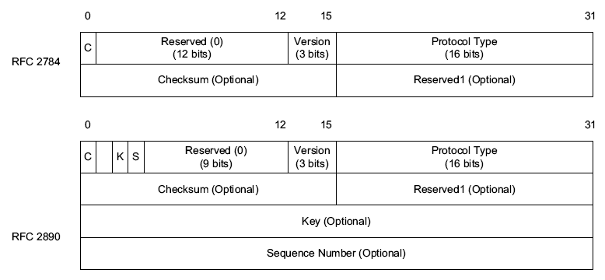
3.9 Tunneling Basics
The GRE header

Slide 6
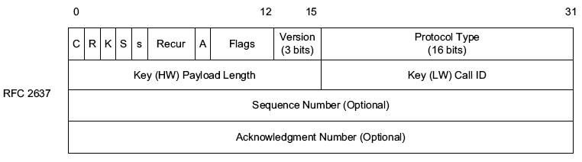
3.9 Tunneling Basics
The PPTP header

Slide 7
3.9 Tunneling Basics
GRE
  Be used between ISPs or within an enterprise intranet.
  Can be combined with IPsec.
PPTP
  Be used between users and their ISPs or corporate intranets.
  Use MPPE.

Slide 8
3.9 Tunneling Basics
PPTP is providing the “raw” link to PPP, instead of using a dial-up link.

Slide 9
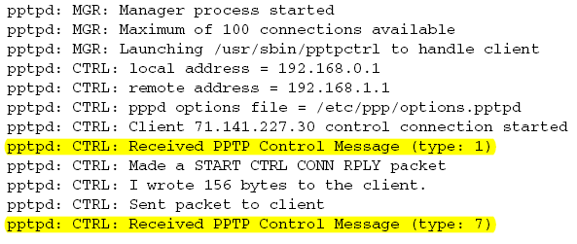
3.9 Tunneling Basics

Slide 10
3.9 Tunneling Basics
The setup begins with pptpd receiving a type 1 control message, indicating that the client wishes to establish a control connection.
After responding to this request, the server receives a type 7 control message indicating an outgoing call request from the peer.

Slide 11
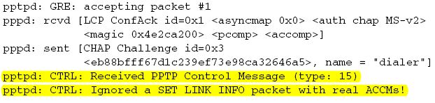
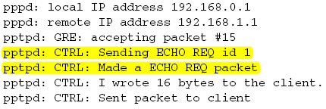
3.9 Tunneling Basics
...

Slide 12
3.9 Tunneling Basics
The only real difference between the two is that pptpd relays packets to the pppd process as they arrive and depart, and a few special PPTP messages (such as set link info and echo request) are processed by pptpd itself.

Slide 13
3.9 Tunneling Basics
PPTP uses its sequence numbers and acknowledgment numbers to determine how many frames reach the destination successfully.
To determine the amount of time to wait for an acknowledgment for frames it sends, PPTP uses an adaptive timeout mechanism based on estimating the round-trip time of the link.

Slide 14
3.9 Tunneling Basics
This example illustrates how the PPTP protocol really acts as a GRE tunneling agent for PPP packets.
This is convenient because an existing PPP implementation (here, pppd) can be used as is to process the encapsulated PPP packets.

Slide 15
3.9.1 Unidirectional Links
unidirectional links (UDLs)
  the link to be used operates in only one direction.
  many of the protocols described so far do not operate properly in such circumstances because they require exchanges of information

Slide 16
3.9.1 Unidirectional Links
To deal with this situation, a standard has been created whereby tunneling over a second Internet interface can be combined with operation of the UDL [RFC3077].

Slide 17
3.9.1 Unidirectional Links
To establish and maintain tunnels automatically at the receiver, [RFC3077] specifies a Dynamic Tunnel Configuration Protocol (DTCP).

Slide 18
3.9.1 Unidirectional Links
This approach to handling UDLs essentially “hides” the link asymmetry from the upper-layer protocols.
  The performance (latency, bandwidth) of the “two” directions of the link may be highly asymmetric and may adversely affect higher-layer protocols [RFC3449].

Slide 19
3.9.1 Unidirectional Links
one significant issue with tunnels is the amount of effort required to configure them
  selecting the endpoints of a tunnel
  configuring the devices located at the tunnel endpoints with an IP address of the peer

Slide 20
3.9.1 Unidirectional Links
A number of techniques have arisen to help in configuring or using tunnels automatically.
  6to4 [RFC3056]
    for transitioning from IPv4 to IPv6
    IPv6 packets are tunneled over an IPv4 network using the encapsulation
    Teredo [RFC4380].

