Slide 1
Auditeur: A Mobile-Cloud Service Platform for Acoustic
Event Detection on Smartphones
Mobisys 2013

Slide 2
ABSTRACT
Auditeur
  an acoustic event detection platform for smartphones.
  Provide API to developers to enable their app register for and get notified on a wide variety of acoustic events.
  backed by a cloud service to store sound clips and to generate an classification plan for the phone.

Slide 3
CONTENTS
INTRODUCTION
AUDITEUR SYSTEM OVERVIEW
IN-PHONE COMPONENTS
IN-CLOUD COMPONENTS
EVALUATION
CONCLUSION

Slide 4
INTRODUCTION
Smartphones can use their microphones to do acoustic event detection
  speaker identification ,music recognition, music discovery , music genre classification
Auditeur
  performs the signal processing and feature classification inside the phone
  use the cloud to store sound clips, build new classifiers, and obtain an energy-aware classification plan.

Slide 5
INTRODUCTION
Usage scenarios
  Auditeur is for Developers
    Alice uses Auditeur’s API to obtain a music genre classifier , perform the classification on the phone, get a list of songs of the same genre.
  Auditeur is for Researchers
    Bob records the audio and add proper tags, e.g., voice, laughter, yell, context, and recording environment; upload the samples, and obtains a classifier; continuously listen to the microphone and log social interactions of his study subjects.
  Auditeur is for End-users
Notes:
Alice is a smartphone app developer
who has an exciting idea for an app. Her envisioned app
listens to a piece of music, determines its genre, and suggests similar
music to the user. But the problem is, Alice does not know the
technical details of how to classify music based on their acoustic
features. She finds Auditeur helpful which has a collection of short
music clips and their genre。
Bob is a behavioral researcher
who wants to perform a quick study on how people interact socially.
For his study, he gathers some volunteers and collects samples of
their voice, laughter, and yelling sounds using a custom app powered
by Auditeur

Slide 6
CONTENTS
INTRODUCTION
AUDITEUR SYSTEM OVERVIEW
IN-PHONE COMPONENTS
IN-CLOUD COMPONENTS
EVALUATION
CONCLUSION

Slide 7
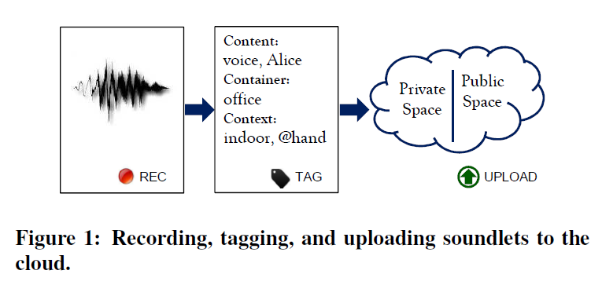
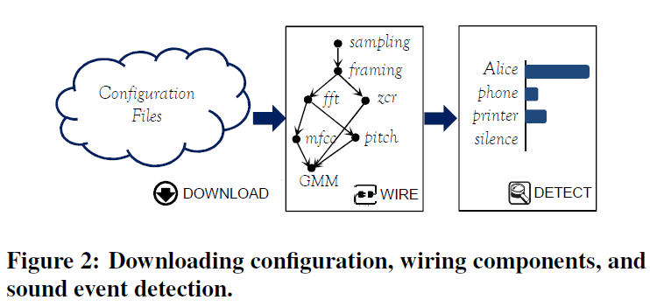
AUDITEUR SYSTEM OVERVIEW
Tags
  Content tags
  -what the sound is
  container tags
  -background
  context
  additional information
configuration file
  The sound processing
  pipeline, feature set, the
  classifiers, and their
  parameters altogether
  form the contents of a
  configuration file
Notes:
Auditeur provides an API to record, add tags, and upload soundlets
to the cloud. After the sound is captured, the tagging process automatically
generates the phone contexts, and the user can review and change it
prior to uploading. The sound clip is then uploaded to the cloud.
The cloud generates an app tailored acoustic event detection
plan that directs the phone on which components should be instantiated
on the phone and how they should be wired together to form
an acoustic processing pipeline.
Once the pipeline is ready, an API call starts reading audio samples from the
microphone, and pushes data down the pipeline. The app is issued
a callback once the desired sound event is detected.

Slide 8
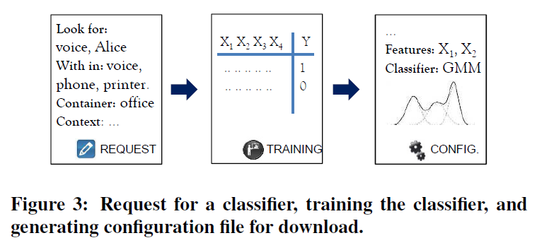
AUDITEUR SYSTEM OVERVIEW
Lookfor tags
- describe a class of soundlets that the user wants
to recognize
within tags
-describe the class of soundlets that represents the
universe of sounds
Notes:
An energy-aware acoustic event detection plan is generated in
the cloud upon receiving a request from the phone. A request contains:
sounds the app is looking for, other unwanted sounds that
might occur in the environment, contextual information, and energy
constraints. The tags and contexts are then used to create a
comprehensive training set using a subset of the currently available
soundlets in the desired space.

Slide 9
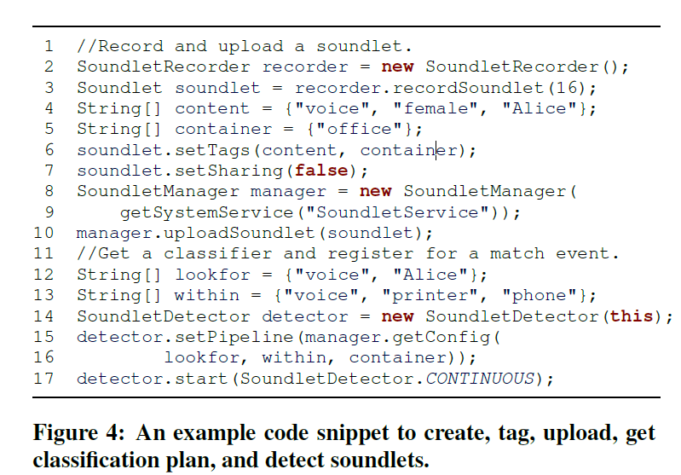
API Example
Notes:
Figure 4 shows a code snippet which demonstrates the usage
of Auditeur API for recording, tagging, and uploading soundlets to
the cloud, and obtaining and using a classification plan from the
cloud. Lines 2-- 3 create a SoundletRecorder to record a 16s
audio and obtain a Soundlet. Lines 4 --5 create the content and
container tags, and lines 6-- 7 set the tags and make the soundlet
private. Lines 8 --10 grab the SoundletManager, and upload
the soundlet to the cloud. Lines 12--13 create the lookfor and
within tags. Line 14 creates a SoundletDetector and registers
the application as a listener. Line 15 obtains a classification plan
and initializes the detector, and line 17 starts the continuous sound
event detection process.

Slide 10
CONTENTS
INTRODUCTION
AUDITEUR SYSTEM OVERVIEW
IN-PHONE COMPONENTS
IN-CLOUD COMPONENTS
EVALUATION
CONCLUSION

Slide 11
IN-PHONE COMPONENTS
The Sound Engine
  instantiating and initializing the acoustic processing units(APU)
  forming a processing pipeline that detects sound events
  providing registration and notification services to the running applications.

Slide 12
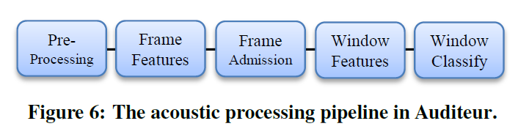
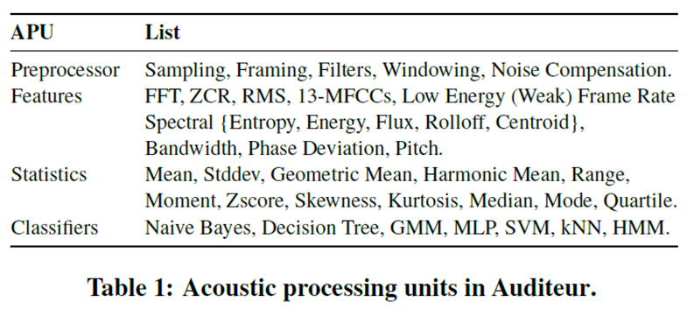
IN-PHONE COMPONENTS

Slide 13
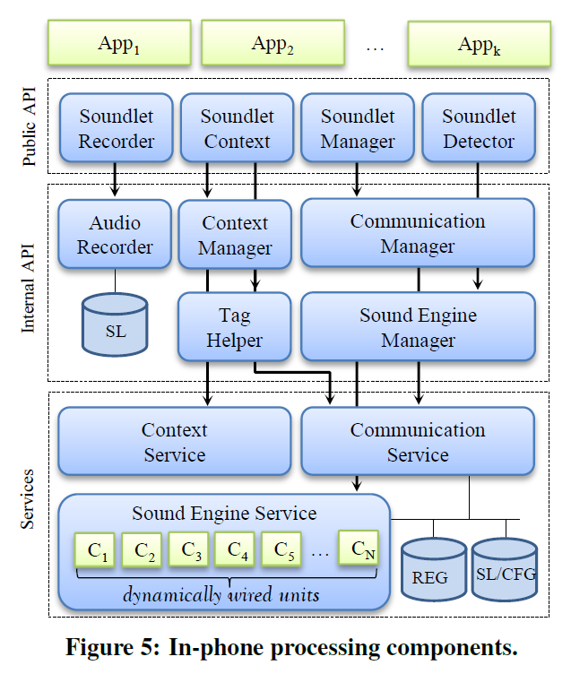
IN-PHONE COMPONENTS
Four components constitute the public API layer
  Soundlet Recorder
  SoundletContext
  SoundletManager
  SoundletDetector
Applications communicate to the cloud via the communication service
  submits new soundlets to the cloud through a Web HTTP interface
  use the Amazon web services infrastructure
Notes:
Soundlet Recorder records audio from the microphone, converts it to a Soundlet, and stores them locally.
The SoundletContext uses the ContextManager to get the current context, and the TagHelper to
get a list of matching tags from the cloud.
The SoundletManager, with the help of CommunicationManager, manages the communication
between the phone and the cloud to upload soundlets and to download classification plans.
The SoundletDetector registers the running application as a listener for desired sound events,
initializes the SoundEngine, and notifies the application at desired sound events

Slide 14
CONTENTS
INTRODUCTION
AUDITEUR SYSTEM OVERVIEW
IN-PHONE COMPONENTS
IN-CLOUD COMPONENTS
EVALUATION
CONCLUSION

Slide 15
IN-CLOUD COMPONENTS
Energy Aware Classification Plan
  Given a set of tags and phone context, a service in the cloud creates an energy aware acoustic event detection plan.
    Training Set Generation
    Feature Selection Algorithm
      to minimize the total energy consumption of feature extraction on the phone
    APU and Parameter Selection

Slide 16
IN-CLOUD COMPONENTS
Eg. creating a training set for a classifier that detects Alice’s voice at her office
lookfor tags: {voice, Alice}
within tags: {voice, printer, phone}
Container: {office}
Content tags: {voice,female,Alice}
Energy Aware Classification Plan
  Training Set Generation
      selects the soundlets having all of the container tags
      filters out soundlets that do not contain any of the
      lookfor or within tags
      Among the remaining soundlets, the ones having all of the content tags are marked as positive examples, and the rest are marked as negative examples
      Finally, all acoustic features are extracted to form an extended training set

Slide 17


IN-CLOUD COMPONENTS
Feature Selection Algorithm
  measuring the correlation based on entropy
    The entropy of a feature X is defined as
    and the entropy of X, after observing Y is defined as
    P(xi) and P(xi|yj) are the prior and posterior probabilities of X
Notes:
difference between the two equations indicate how much is the addedvalue of taking feature X,
given that Y is already selected

Slide 18
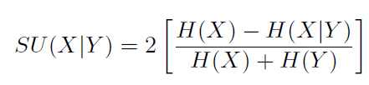

IN-CLOUD COMPONENTS
normalized information gain
recurrence relation
  Let f_{j}(b) be the optimal subset of features within an energy bound of b, considering the first j features, for (0 < j ≤m). Based on the decision on X_{j} , there can be two cases:

Slide 19
CONTENTS
INTRODUCTION
AUDITEUR SYSTEM OVERVIEW
IN-PHONE COMPONENTS
IN-CLOUD COMPONENTS
EVALUATION
CONCLUSION

Slide 20
EVALUATION
Experimental Setup
  smartphone
    Galaxy Nexus phones running Android 4.0 OS, each having a 1.2 GHz TI OMAP4460 dual core processor, 1 GB RAM, 32 GB internal storage, and 28 GB USB storage
  Database
    about 5000 tagged soundlets with contextual
    information(collected from 35 participants)
    another 2000 tagged soundlets(from website, like sounds of monkey…)

Slide 21
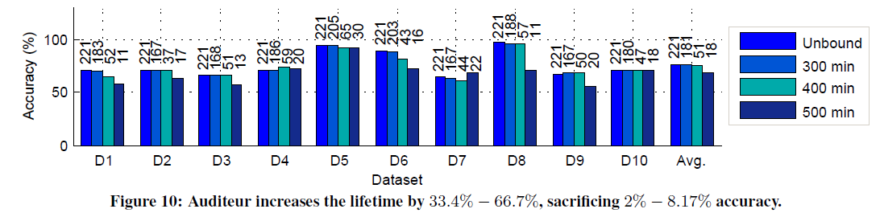
EVALUATION
Lifetime and Accuracy Trade-off
The number on top of each bar denotes the number of selected features
Notes:
For each dataset, the first bar corresponds to
the highest achievable accuracy considering no energy bound, and
the other three bars correspond to minimum lifetime requirements
of 300, 400, and 500 mins, respectively. The number on top of
each bar denotes the number of selected features.
The accuracy is below 70% for some datasets,
such as D7, D3, and D9, which contain varieties of similar sounds.

Slide 22
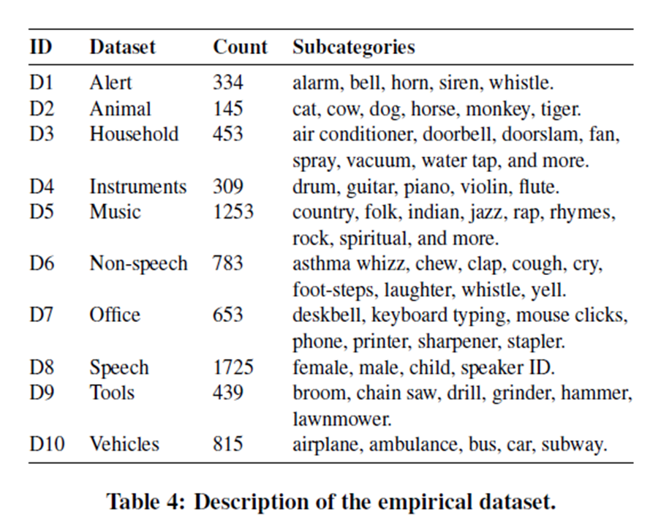
EVALUATION

Slide 23
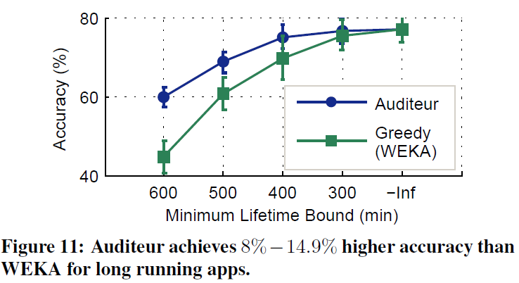
EVALUATION
Evaluating Feature Selection Algorithm
WEKA: greedy algorithm

Slide 24
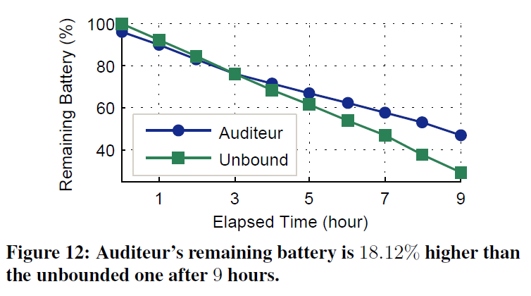
EVALUATION
Two identical Android phones for about 9 hours.
one assumes an infinite energy bound
the other one changes its classification plan after two hours to last longer
Energy Efficiency

Slide 25
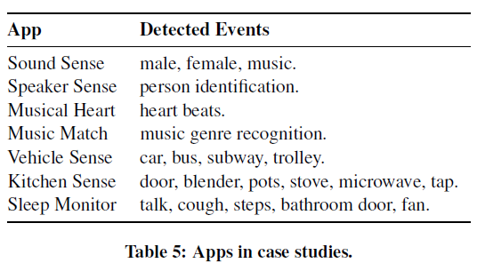
EVALUATION
Case Studies
  evaluate seven apps with Auditeur
  Compare against two baseline:
    In-phone
      do everything on the device
    In-cloud
      extract features on the phone, sends them to the cloud in real-time to get the classification results

Slide 26
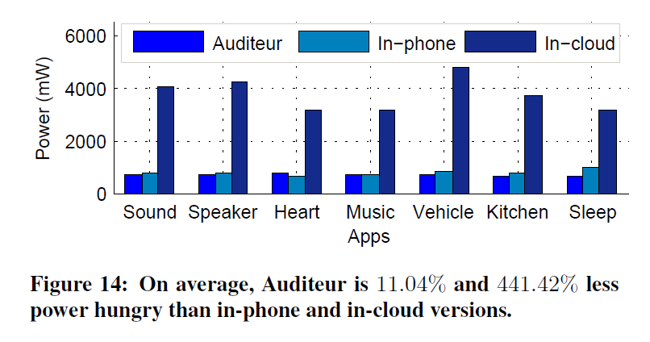
EVALUATION
Power Consumption

Slide 27
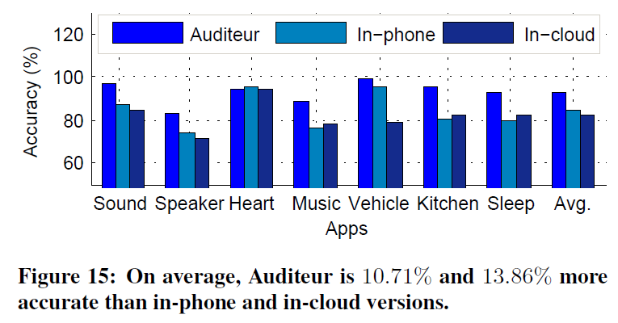
EVALUATION
Detection Accuracy

Slide 28
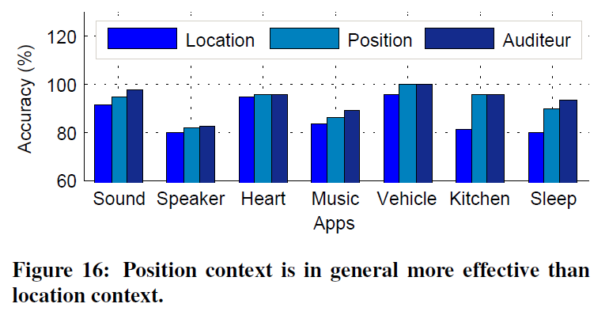
EVALUATION
Context Awareness
  Auditeur uses different pipeline configurations for different location (indoors vs outdoors) and body position (direct, pocket, or distant) contexts to boost its accuracy.

Slide 29
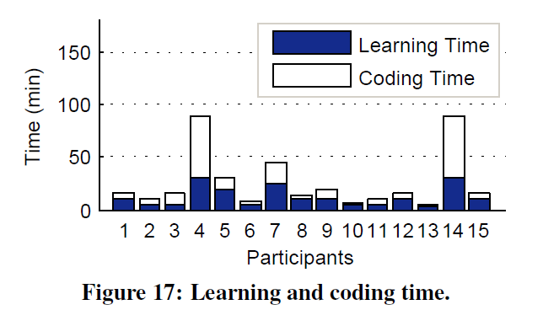
EVALUATION
User Study
Auditeur is very easy to learn and code!

Slide 30
CONCLUSION
Auditeur’s is energy-efficient and have high accuracy.
programmers can learn to use it in less than 30 minutes, using only 15-20 lines of Java code.

Slide 31
THE END
THANKS

