Slide 1
Use It Free: Instantly Knowing Your Phone Attitude
Pengfei Zhou, Mo Li, Guobin Shen
Mobicom 2014

Slide 2
Contents
Introduction
Background and Motivation
Understanding MEMS Gyroscope
Instant Attitude Detection
Opportunistic Calibration
Evaluation
Related Work
Conclusion

Slide 3
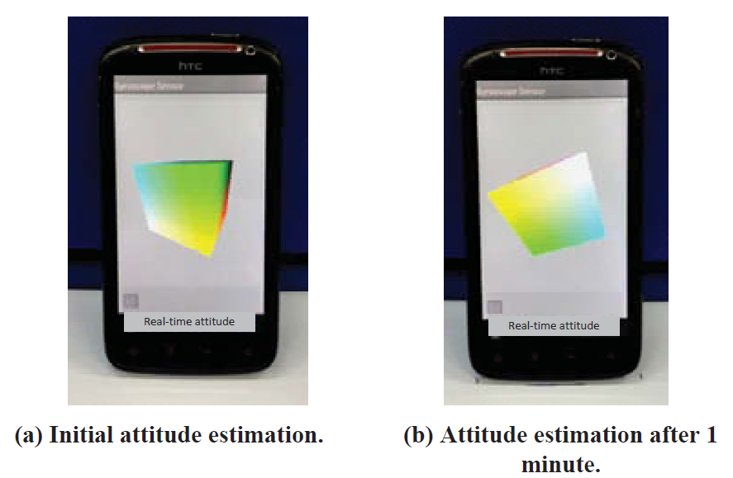
Introduction
MEMS gyroscope integrated in 2010
  Measure 3dimensional angular velocities
  Poor accuracy
Various ways of movement and position
  Walk, run, play a game, etc.
  Hands, pockets, bags, armband, etc.
Kalman-based sensor fusion technique
to estimate the phone attitude
  Suffers significant performance degradation
Need to understand fundamental
performance of MEMS gyroscope.
Figure 1: Phone attitude tracking error of a popular smartphone app.

Slide 4
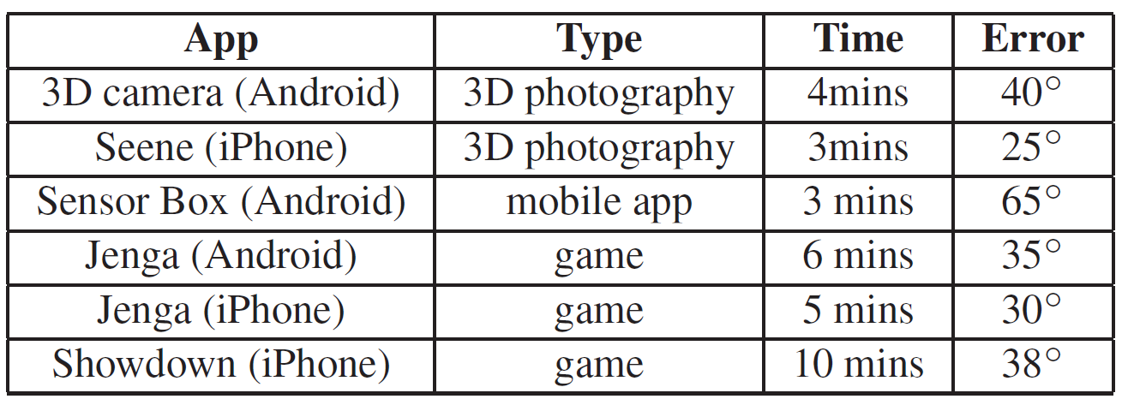
Background and Motivation
The gyroscope have been playing a critical role in estimating phone
attitude since the first integration to smartphones in 2010
  Poor accuracy can be achieved for long period of tracking
The large cumulative tracking errors require frequent reset of the phone
attitude from the user
  Up to 20m within 10mins
Types of gyroscope
  Fiber Optic Gyroscope
    Error < 10⁻⁴°/h
  Coriolis Vibrating Gyroscope
    Low cost MEMS
Table 1: The attitude estimation error measured from popular apps.

Slide 5
Background and Motivation(cont'd)
No much progress has been made for improving the attitude detection
accuracy in the field of mobile phone study, many efforts have been made in robotics domain to address a similar problem.
No existing studies have quantitatively understood the nature of
smartphone MEMS sensors and their performance in different condition
ranges.
Simply migrating the approaches for robotics systems to smartphone
platforms results in suboptimal performance
  E.g. Android API getRotationMatrixFromVector() directly adopts existing
  Kalman-based sensor fusion algorithms to calculate phone attitude.

Slide 6
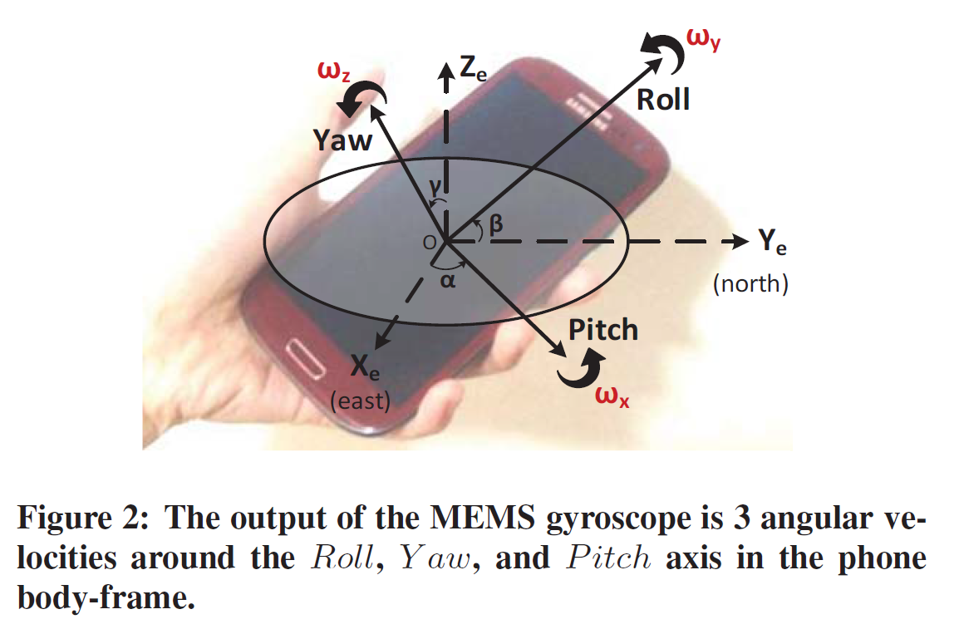
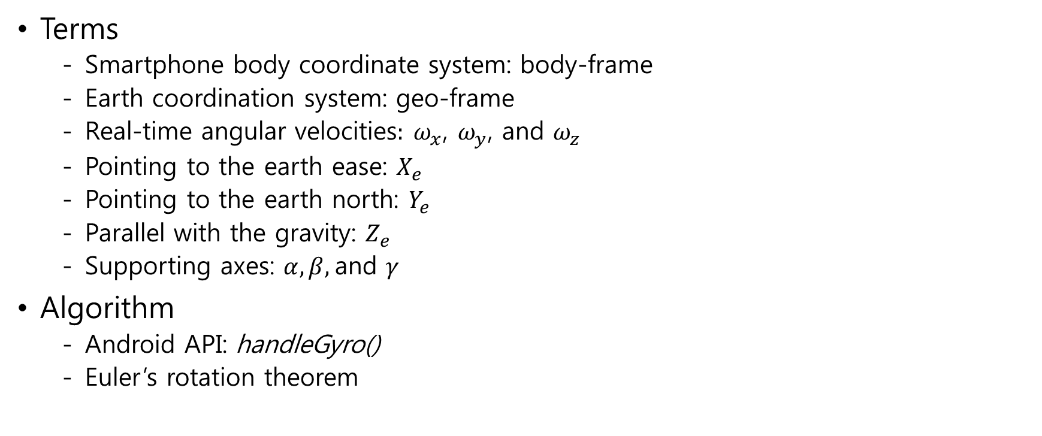
Understanding MEMS Gyroscope
- Angular Velocity Integration
Terms
  Smartphone body coordinate system: body-frame
  Earth coordination system: geo-frame
  Real-time angular velocities$: ω_{x}$, $ω_{y}$, and $ω_{z}$
  Pointing to the earth ease: $X_{e}$
  Pointing to the earth north: $Y_{e}$
  Parallel with the gravity: $Z_{e}$
  Supporting axes: $α, β,$and $γ$
Algorithm
  Android API: handleGyro()
  Euler’s rotation theorem

Slide 7
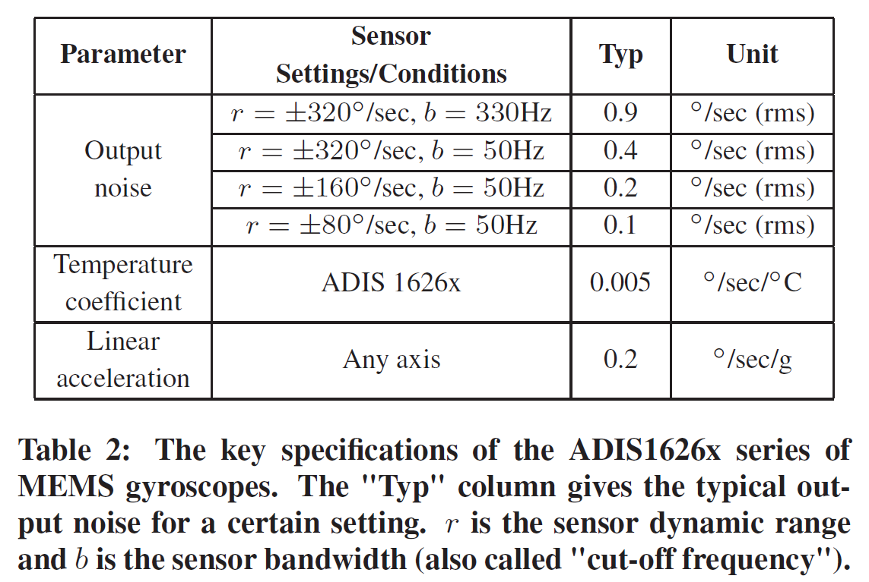
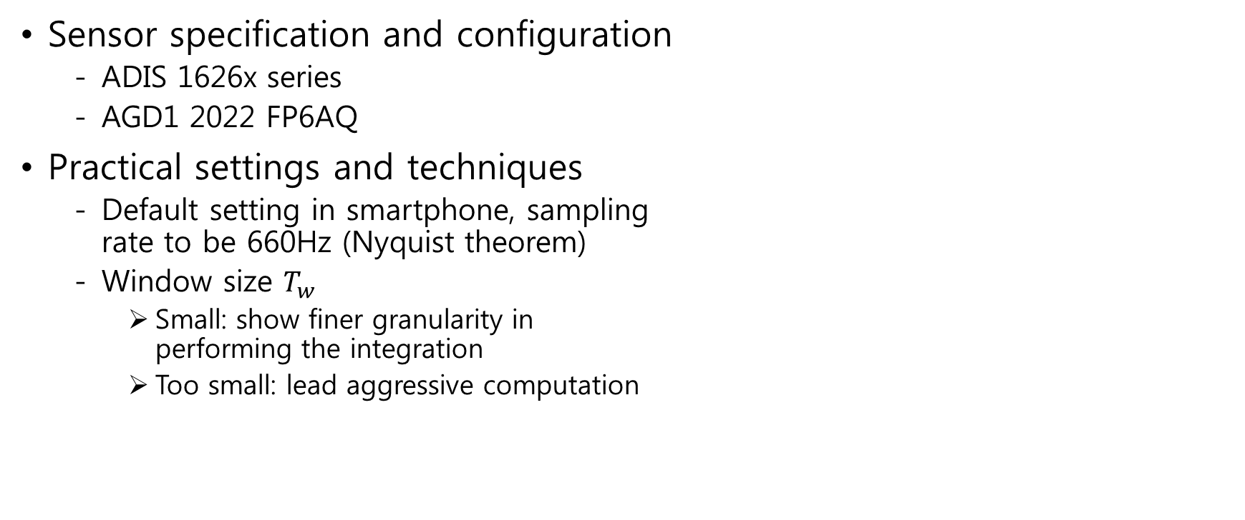
Understanding MEMS Gyroscope
- Practical Settings and Techniques
Sensor specification and configuration
  ADIS 1626x series
  AGD1 2022 FP6AQ
Practical settings and techniques
  Default setting in smartphone, sampling
  rate to be 660Hz (Nyquist theorem)
  Window size $T_{w}$
    Small: show finer granularity in
    performing the integration
    Too small: lead aggressive computation

Slide 8
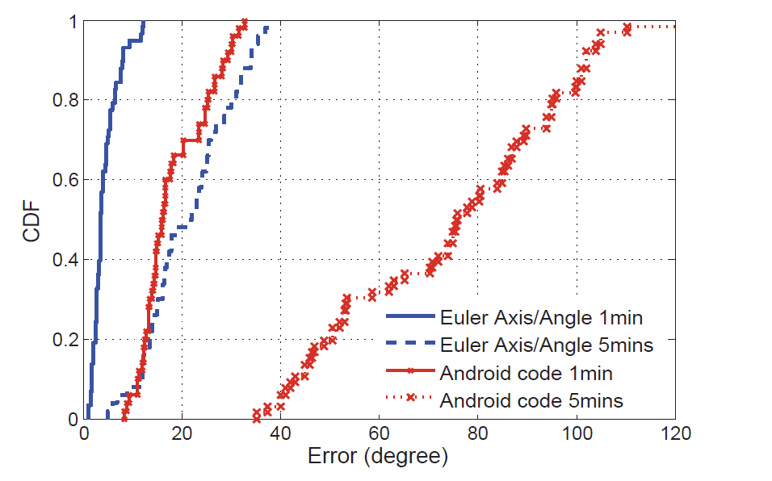
Understanding MEMS Gyroscope
- Practical Settings and Techniques (cont'd)
Performance
  Samsung Galaxy S2 i9100
  1 minute and 5 minutes walk in the lab
  20 runs for each test
  Result
Time | Type | 50% | 90%
1min | Euler | 3° | 7°
 | Android | 19.8° | 27.5°
5min | Euler | 22.3° | 31.2°
 | Android | 79° | 103°
Figure 3: Phone attitude estimation results of
different methods.

Slide 9
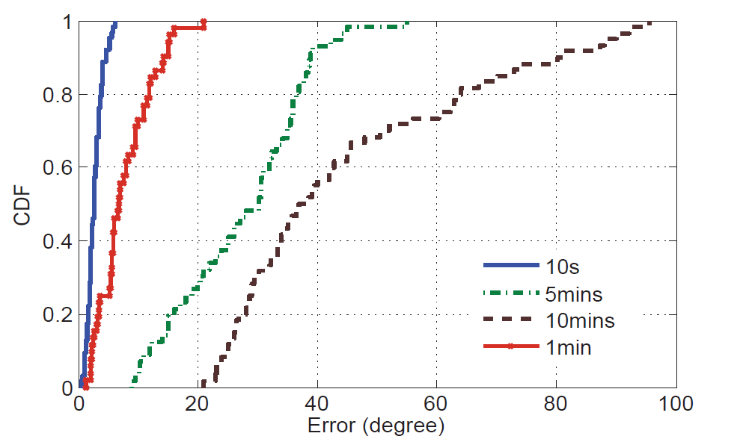
Understanding MEMS Gyroscope
- Performance Characterization
Temperature
  Best MEMS gyroscope performance at 25°C
  Tested -20°C ~ +45°C, Error < 0.002°/sec/°C
  Temperature is not a main influencing factor.
Time
  20~30 times
  10s, 1min, 5min, 10min
  Generally accurate for short time.
  Accumulate substantially with time.
Figure 4: MEMS gyroscope error
for different tracking time.

Slide 10
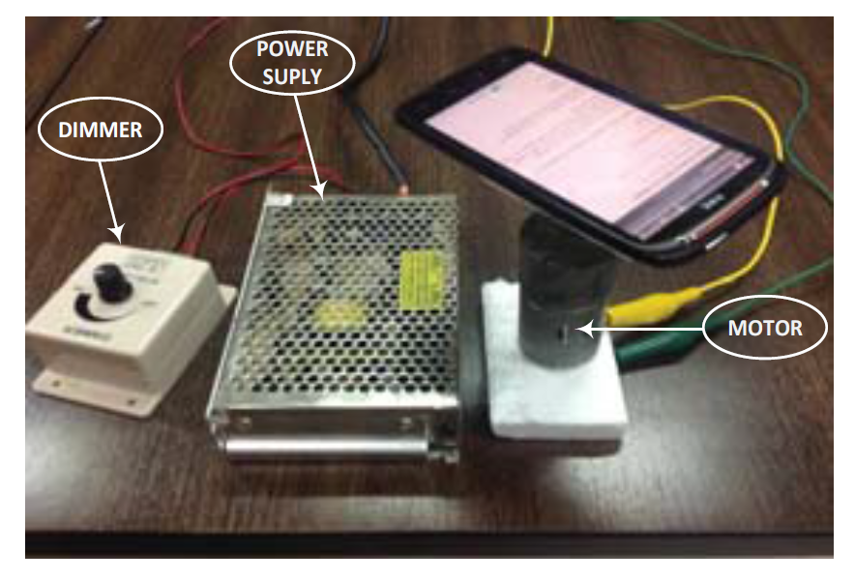
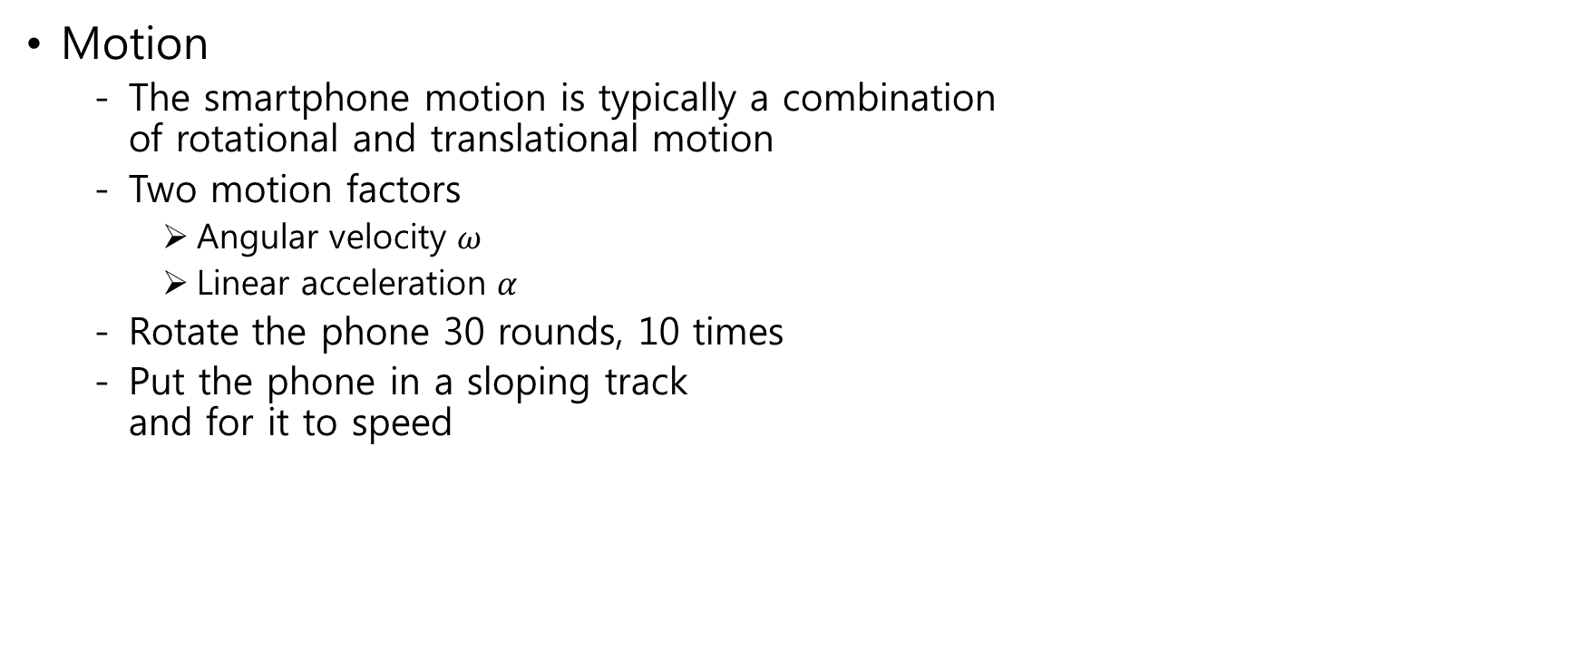
Understanding MEMS Gyroscope
- Performance Characterization (cont'd)
Motion
  The smartphone motion is typically a combination
  of rotational and translational motion
  Two motion factors
    Angular velocity $ω$
    Linear acceleration $α$
  Rotate the phone 30 rounds, 10 times
  Put the phone in a sloping track
  and for it to speed
Figure 5: Gyroscope measurement devices.

Slide 11
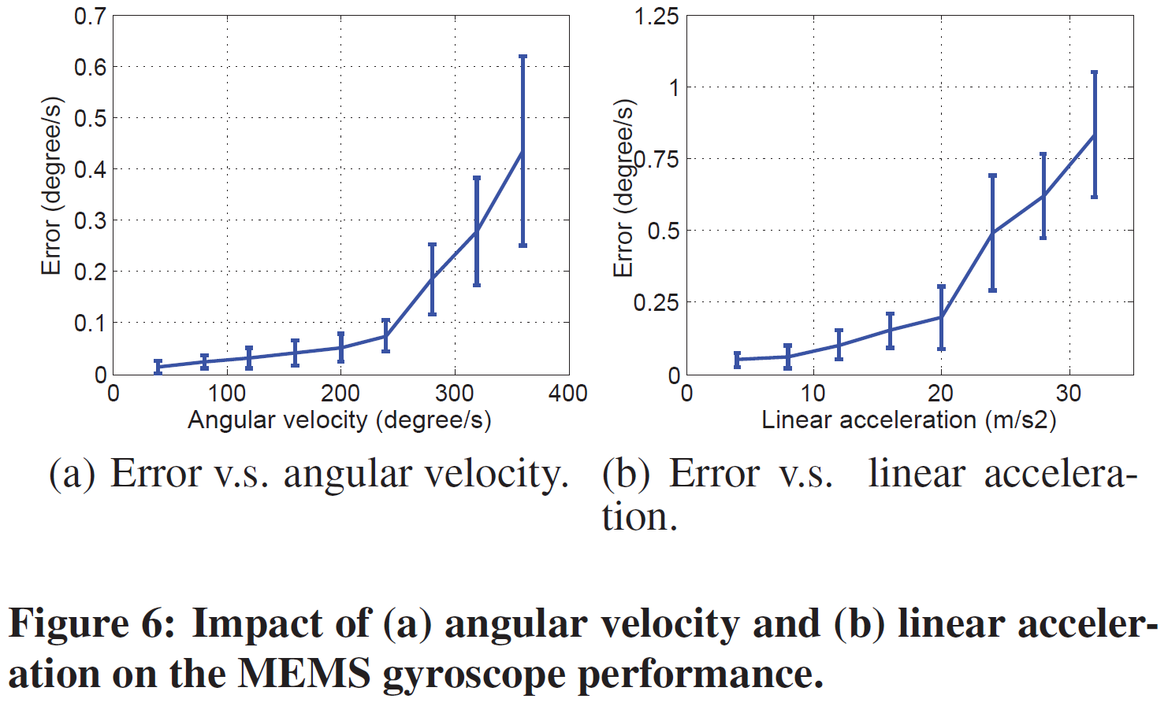
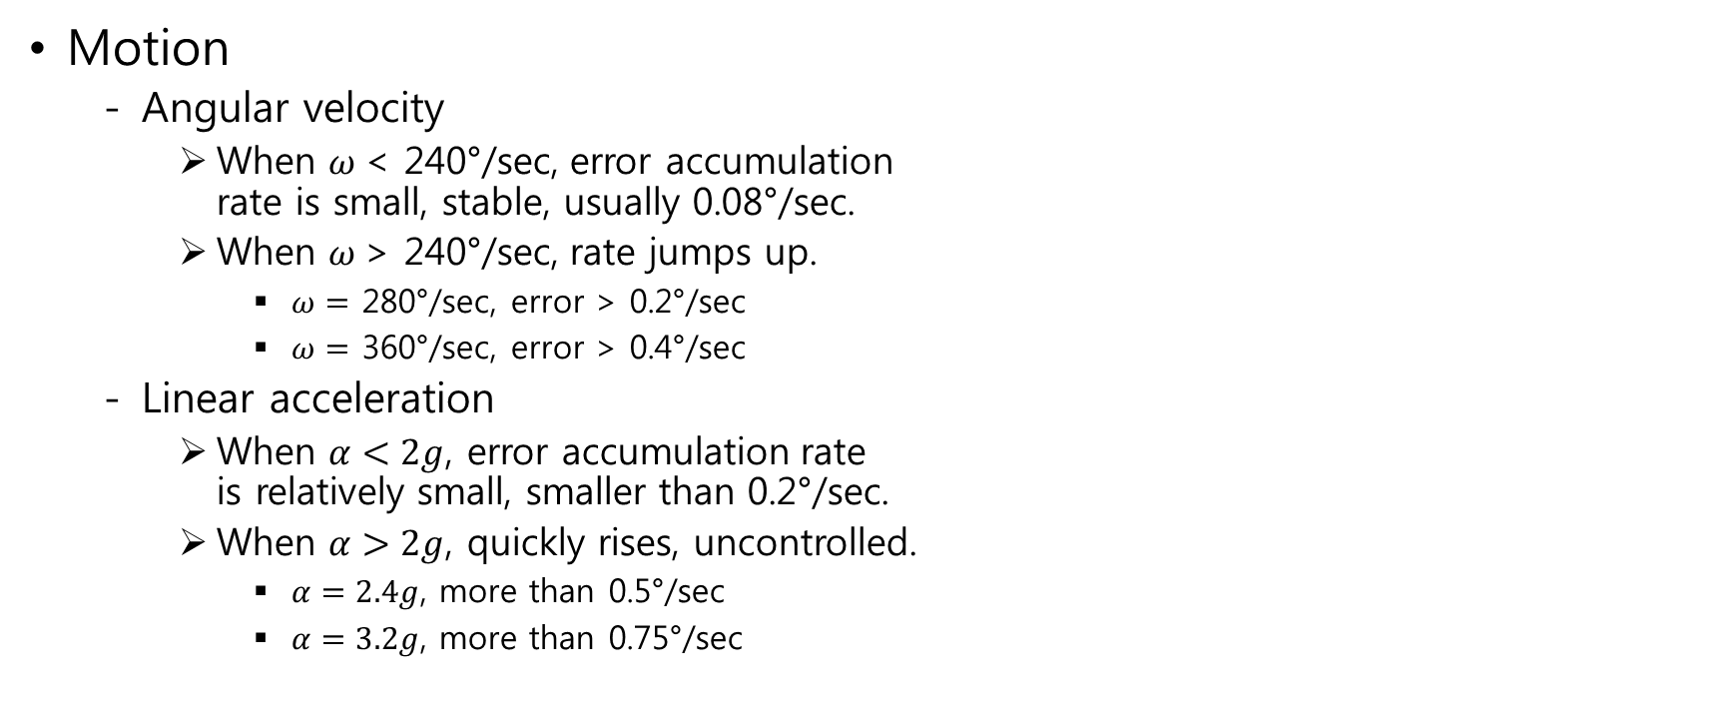
Understanding MEMS Gyroscope
- Performance Characterization (cont'd)
Motion
  Angular velocity
    When $ω$< 240°/sec, error accumulation
    rate is small, stable, usually 0.08°/sec.
    When $ω$> 240°/sec, rate jumps up.
      $ω=$ 280°/sec, error > 0.2°/sec
      $ω=$ 360°/sec, error > 0.4°/sec
  Linear acceleration
    When $α<2g$, error accumulation rate
    is relatively small, smaller than 0.2°/sec.
    When $α>2g$, quickly rises, uncontrolled.
      $α=2.4g$, more than 0.5°/sec
      $α=3.2g$, more than 0.75°/sec

Slide 12
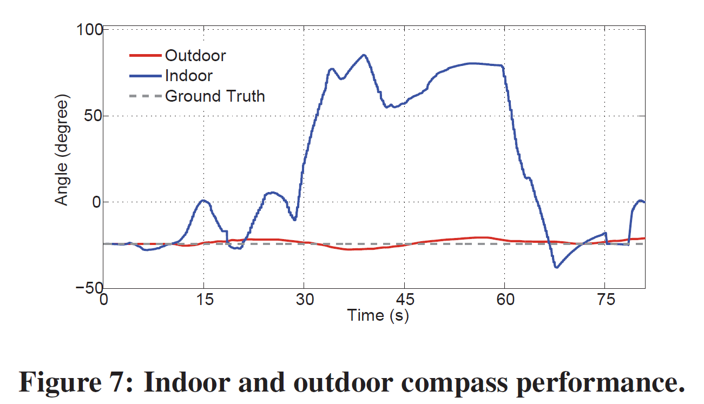
Instant Attitude Detection
- Compass and Accelerometer
Compass
  Measure geomagnetic north from the detected geo-magnetic field.
  Unstable accuracy, indoors where steel structures and electrical applications distort the geo-magnetic field.
Estimated earth north using the
compass indoors and outdoors
  Outdoors: <5°
  Indoors: >50°
Outdoor compass output is
relatively reliable

Slide 13
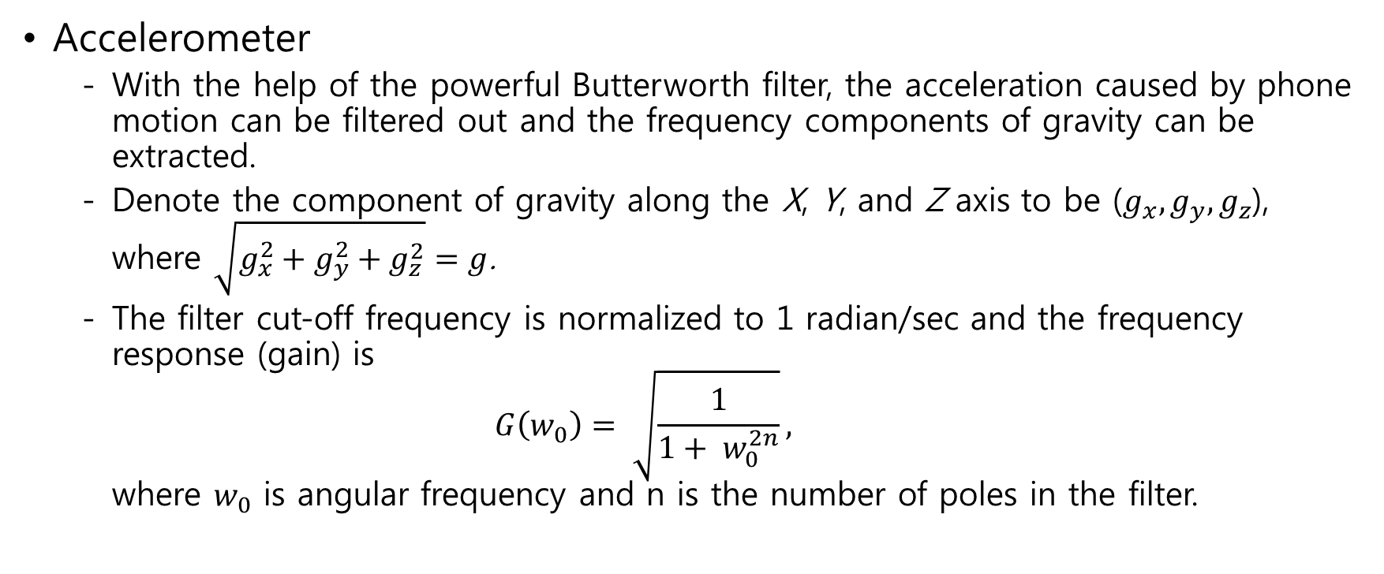
Instant Attitude Detection
- Compass and Accelerometer (cont'd)
Accelerometer
  With the help of the powerful Butterworth filter, the acceleration caused by phone motion can be filtered out and the frequency components of gravity can be extracted.
  Denote the component of gravity along the X, Y, and Z axis to be ($g_{x},g_{y}, g_{z}$), where $\sqrt{g_{x}^{2}+g_{y}^{2}+g_{z}^{2}}=g$.
  The filter cut-off frequency is normalized to 1 radian/sec and the frequency response (gain) is
  $G\left(w_{0}\right)= \sqrt{\frac{1}{1+ w_{0}^{2n}}},$
  where $w_{0}$ is angular frequency and n is the number of poles in the filter.

Slide 14
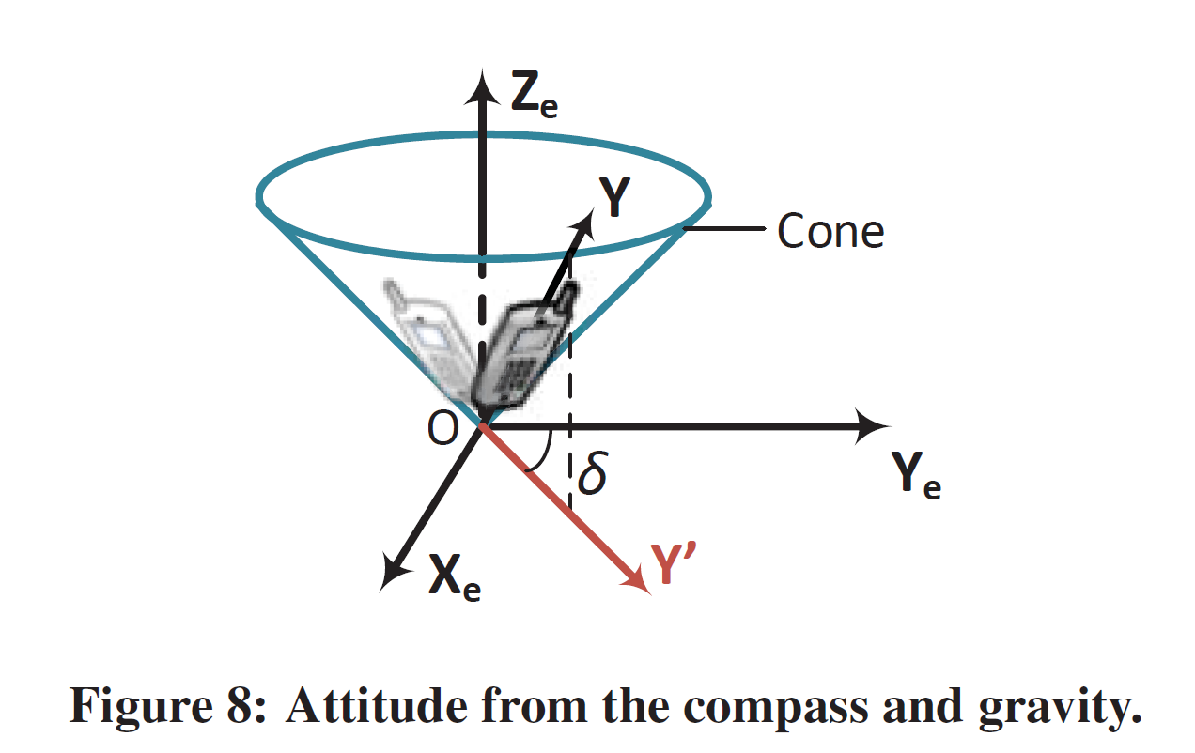
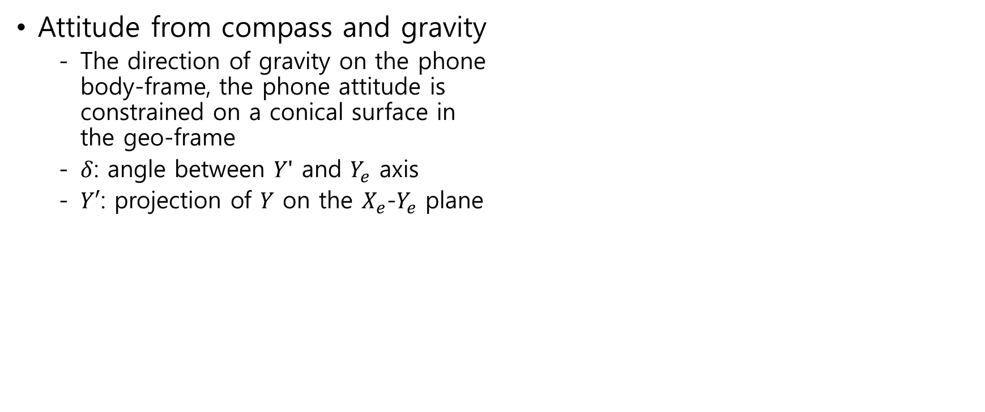
Instant Attitude Detection
- Compass and Accelerometer (cont'd)
Attitude from compass and gravity
  The direction of gravity on the phone
  body-frame, the phone attitude is
  constrained on a conical surface in
  the geo-frame
  $δ$: angle between $Y′$ and $Y_{e}$ axis
  $Y′$: projection of $Y$ on the $X_{e}$-$Y_{e}$ plane

Slide 15
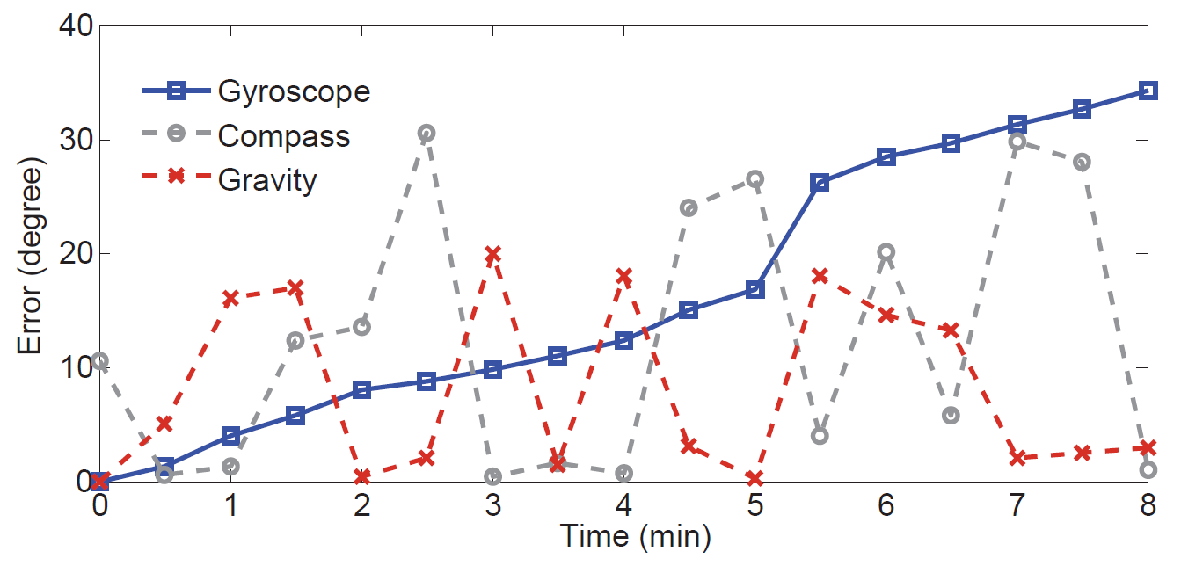
Instant Attitude Detection
- Compass and Accelerometer (cont'd)
Compared with gyroscope
  Compass and accelerometer
    Instant status estimation unrelated
    to previous estimations
  Gyroscope
    Cumulative estimation by continuous
    integration on angular velocities
  8 minutes walk
Figure 9: The performance of gyroscope, compass
and accelerometer in an instant trajectory.

Slide 16
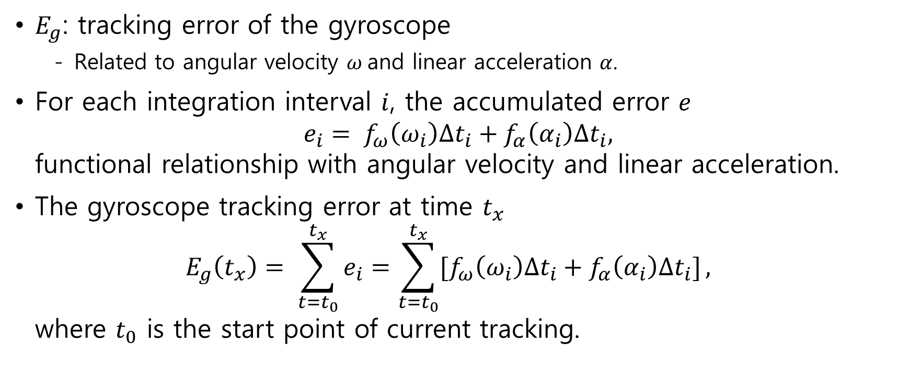
Instant Attitude Detection
- Putting It All Together
$E_{g}$: tracking error of the gyroscope
  Related to angular velocity $ω$and linear acceleration $α$.
For each integration interval $i$, the accumulated error $e$
$e_{i}= f_{ω}\left(ω_{i}\right)∆t_{i}+f_{α}\left(α_{i}\right)∆t_{i},$
functional relationship with angular velocity and linear acceleration.
The gyroscope tracking error at time $t_{x}$
$E_{g}\left(t_{x}\right)= \sum_{t=t_{0}}^{t_{x}}{e_{i}}=\sum_{t=t_{0}}^{t_{x}}{[f_{ω}\left(ω_{i}\right)∆t_{i}+f_{α}\left(α_{i}\right)∆t_{i}]},$
where $t_{0}$ is the start point of current tracking.

Slide 17
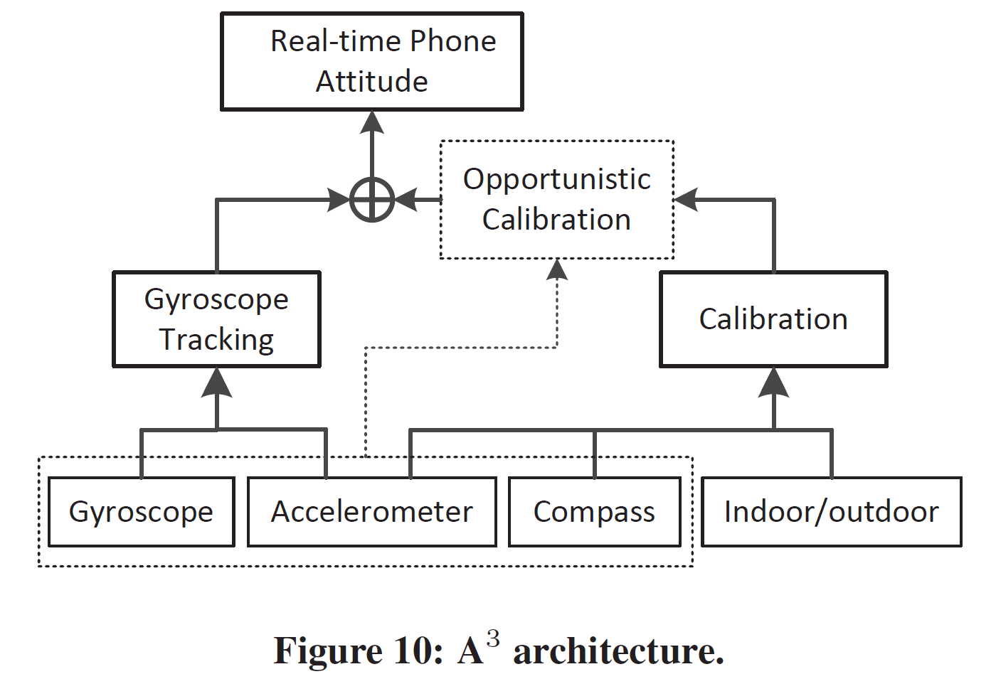
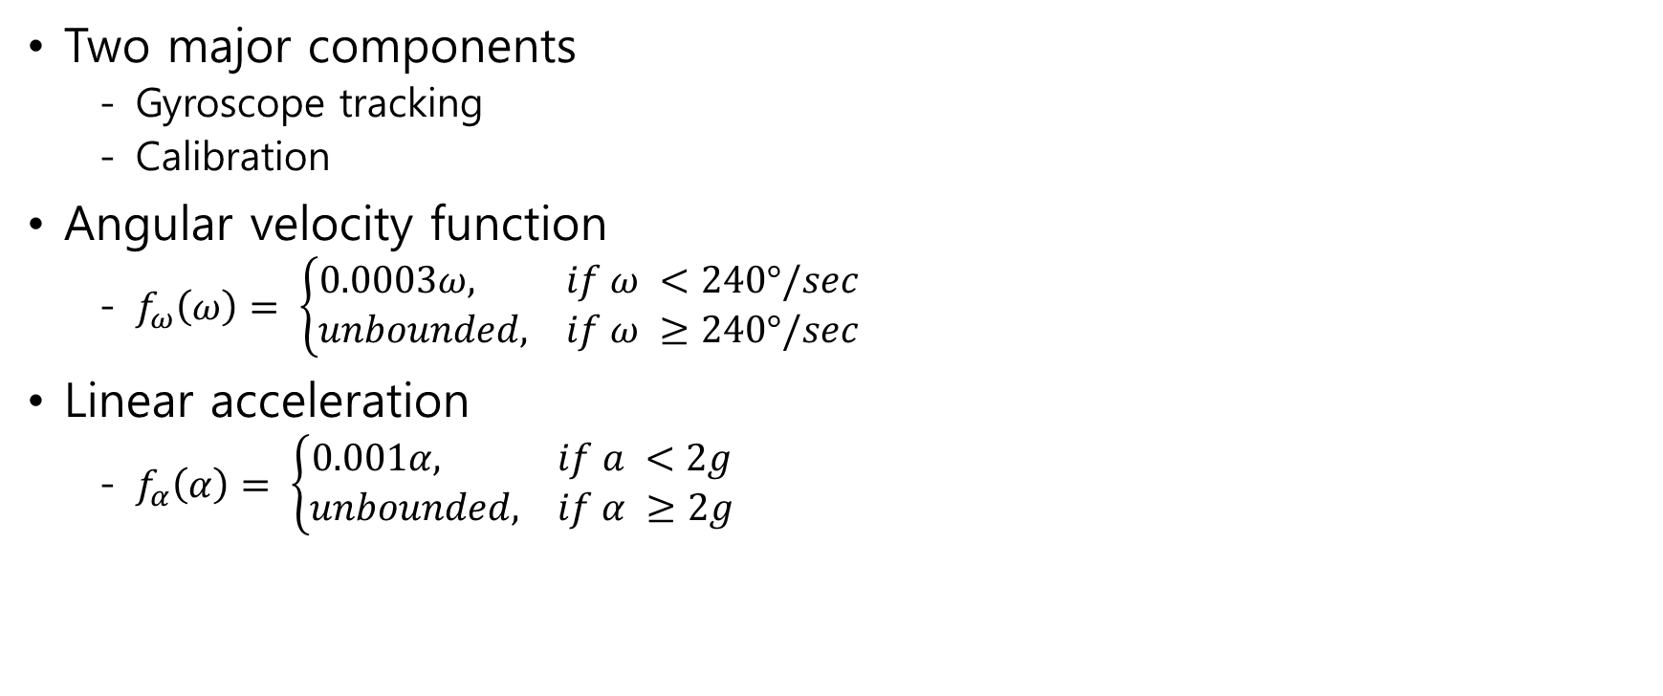
Instant Attitude Detection
- Putting It All Together(cont'd)
Two major components
  Gyroscope tracking
  Calibration
Angular velocity function
  $f_{ω}\left(ω\right)= \left\{\begin{aligned}0.0003ω, if ω <240°/sec \\ unbounded, if ω ≥240°/sec\end{aligned}\right.$
Linear acceleration
  $f_{α}\left(α\right)= \left\{\begin{aligned}0.001α, if a <2g \\ unbounded, if α ≥2g\end{aligned}\right.$

Slide 18
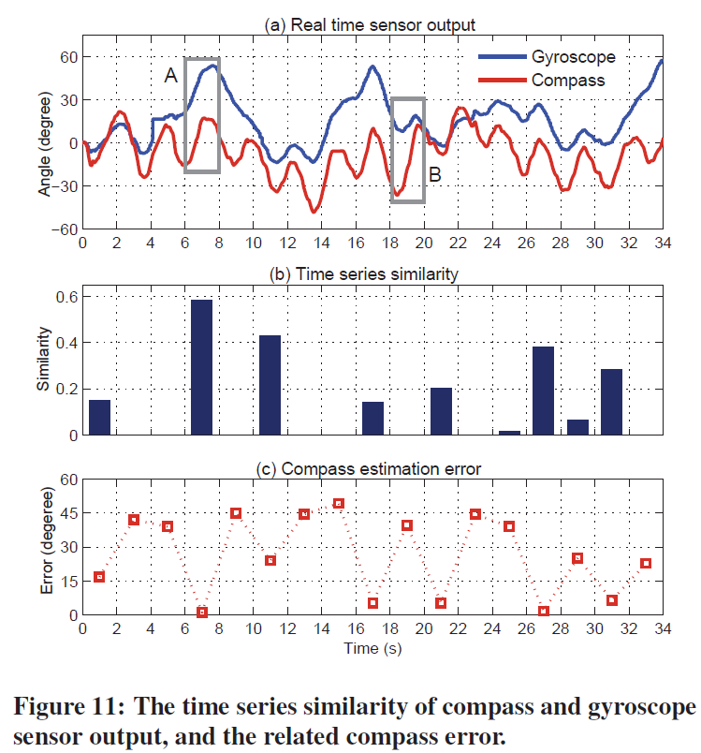
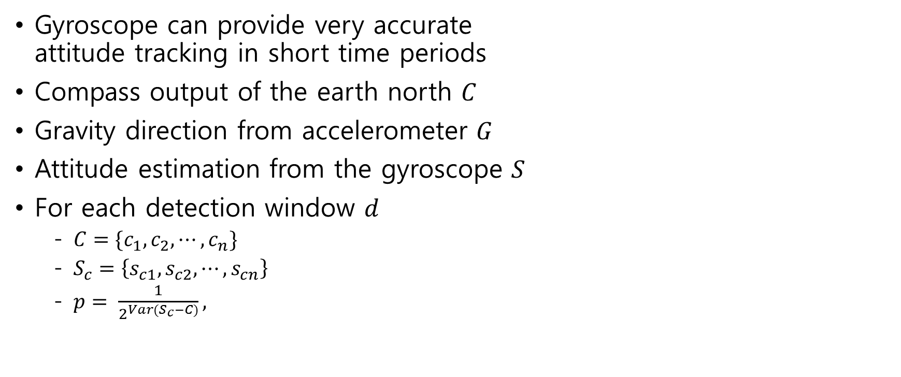
Opportunistic Calibration
Gyroscope can provide very accurate
attitude tracking in short time periods
Compass output of the earth north $C$
Gravity direction from accelerometer $G$
Attitude estimation from the gyroscope $S$
For each detection window $d$
  $C=\{c_{1},c_{2},⋯,c_{n}\}$
  $S_{c}=\left\{s_{c1},s_{c2},⋯,s_{cn}\right\}$
  $p= \frac{1}{2^{Var(S_{c}−C)}},$

Slide 19
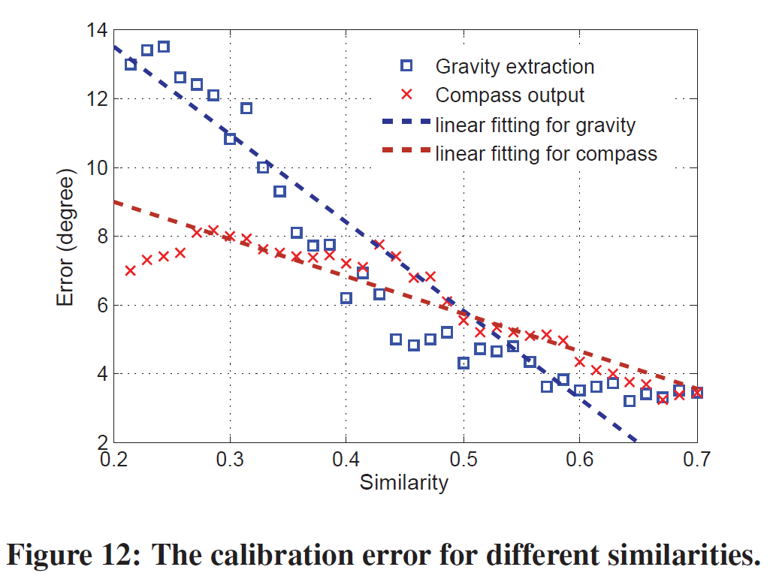
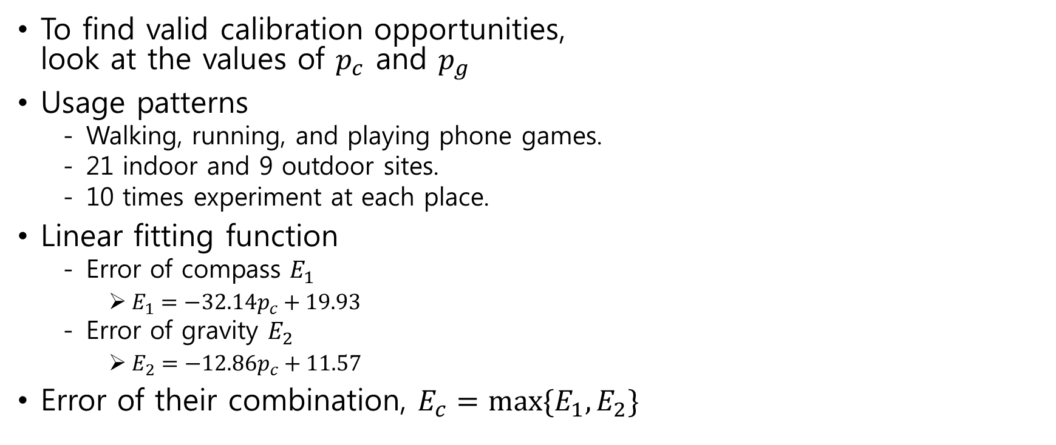
Opportunistic Calibration(cont'd)
To find valid calibration opportunities,
look at the values of $p_{c}$ and $p_{g}$
Usage patterns
  Walking, running, and playing phone games.
  21 indoor and 9 outdoor sites.
  10 times experiment at each place.
Linear fitting function
  Error of compass $E_{1}$
    $E_{1}=−32.14p_{c}+19.93$
  Error of gravity $E_{2}$
    $E_{2}=−12.86p_{c}+11.57$
Error of their combination, $E_{c}=\max{\{E_{1}, E_{2}\}}$

Slide 20
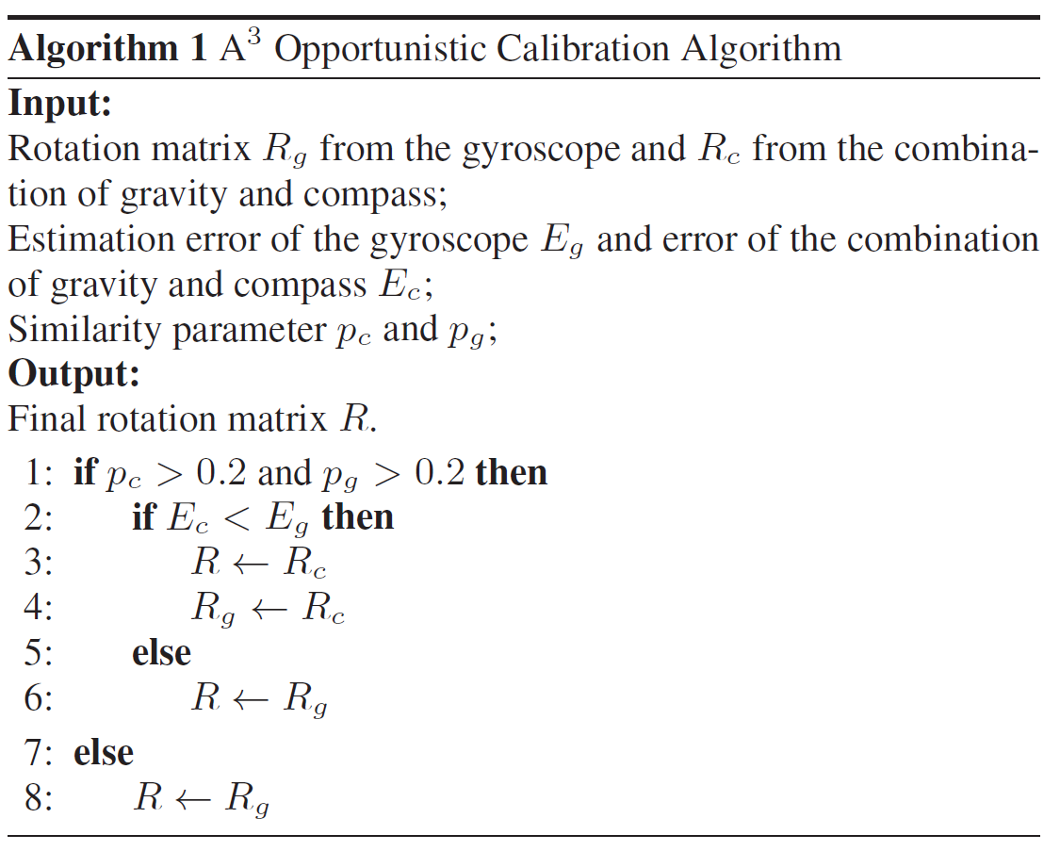
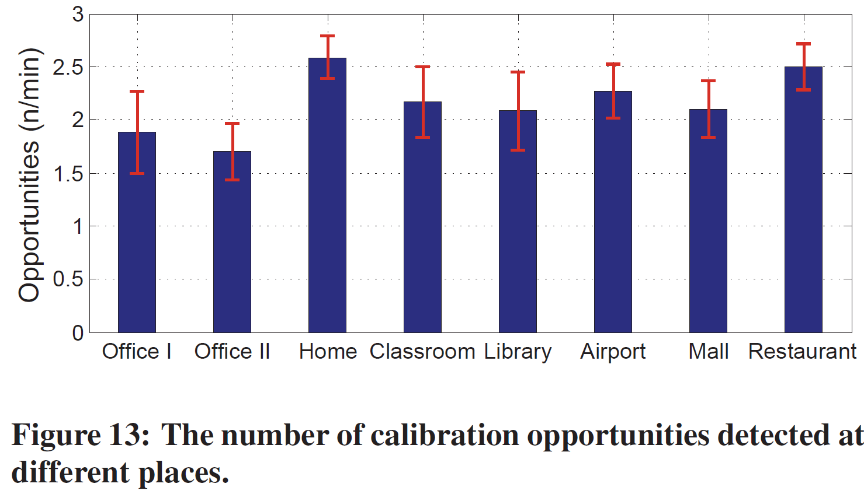
Opportunistic Calibration(cont'd)

Slide 21
Evaluation
- Experiment Devices and Settings
Smartphone
  HTC Sensation, galaxy s2 9100, google nexus 4
Experiment settings
  Scenario
    Walking with the phone in hand
    Walking with the phone free in the pocket
    Running with the phone in hand
  Sites: office, home, airport, shopping mall, laboratory, etc.
Comparison
  A³, basic A³, Android API, x-AHRS

Slide 22
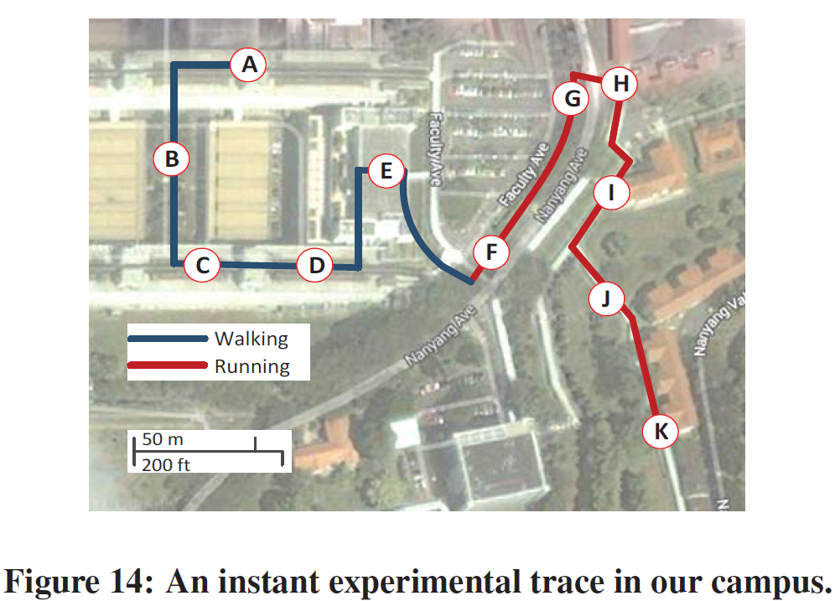
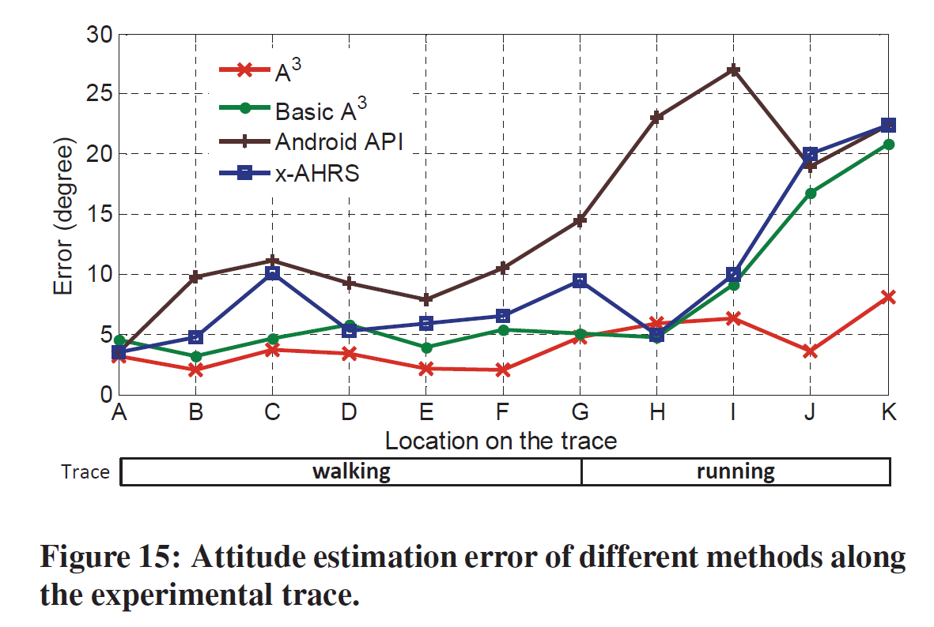
Evaluation
- Performance in Different Conditions

Slide 23
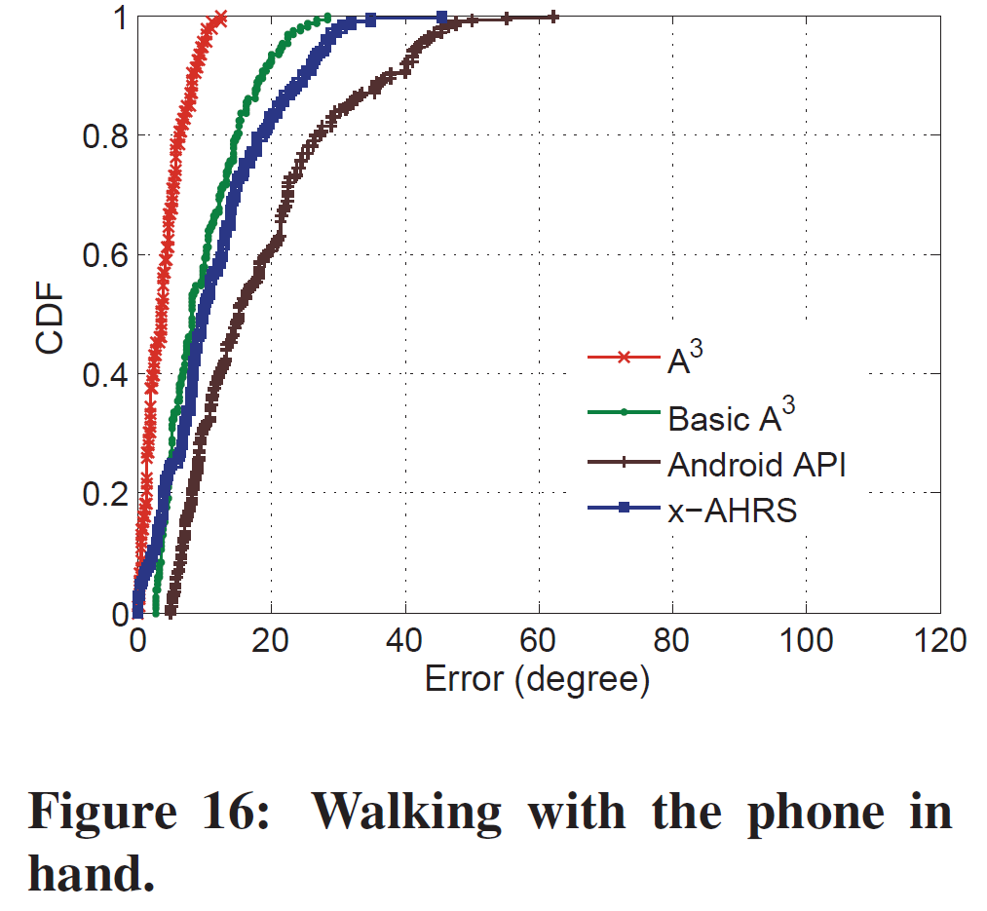
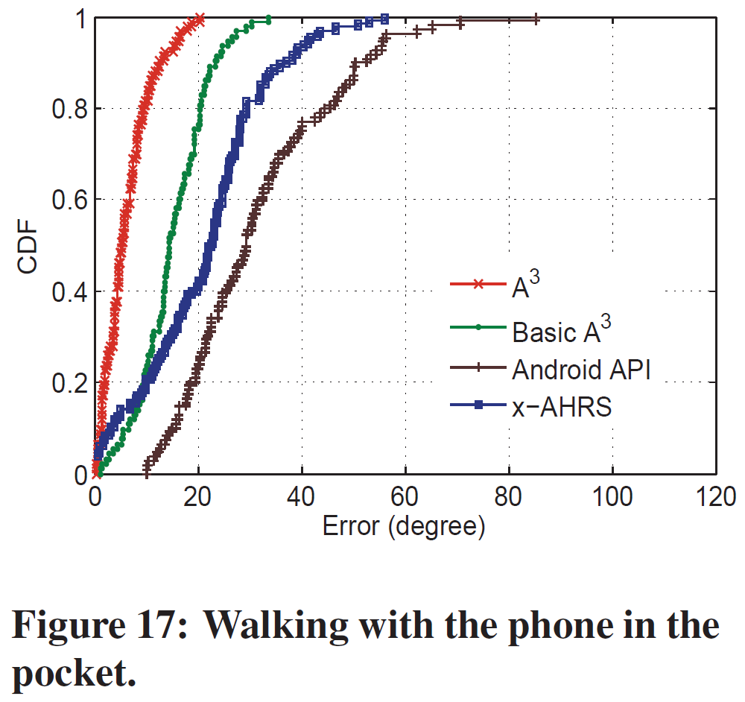
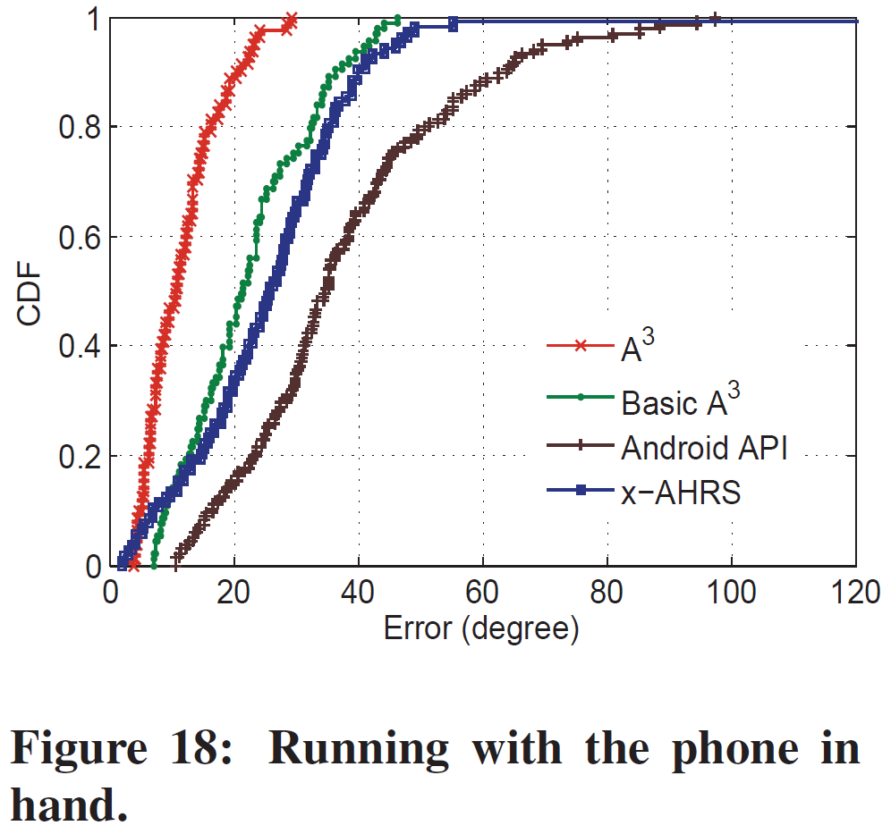
Evaluation
- Performance in Different Conditions (cont'd)

Slide 24
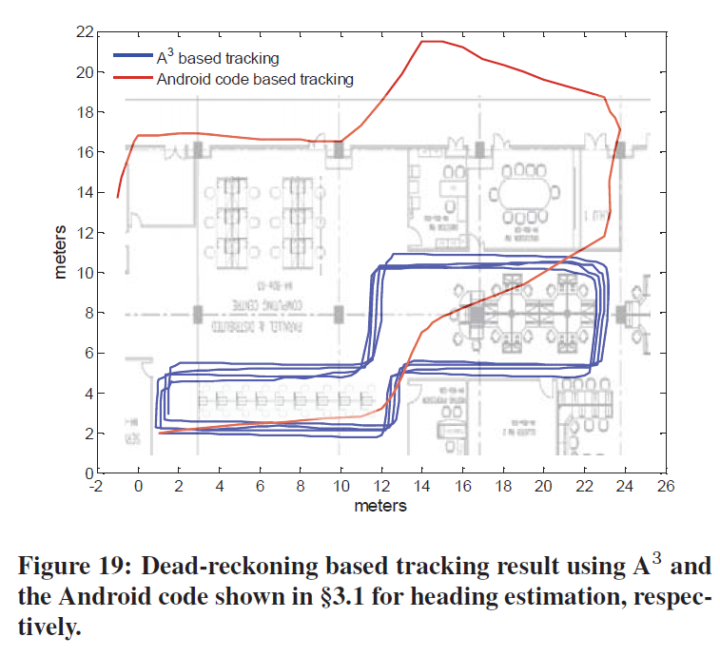
Evaluation
- Application in Heading Estimation
The detected phone attitude can be
directly used to estimate the user
heading in dead-reckoning.
58m circular path in the lab.
After 7 minutes walking on the path 4
rounds, tracking error is merely 1.3m.
After walking only one round, tracking
error accumulates to 13.2m

Slide 25
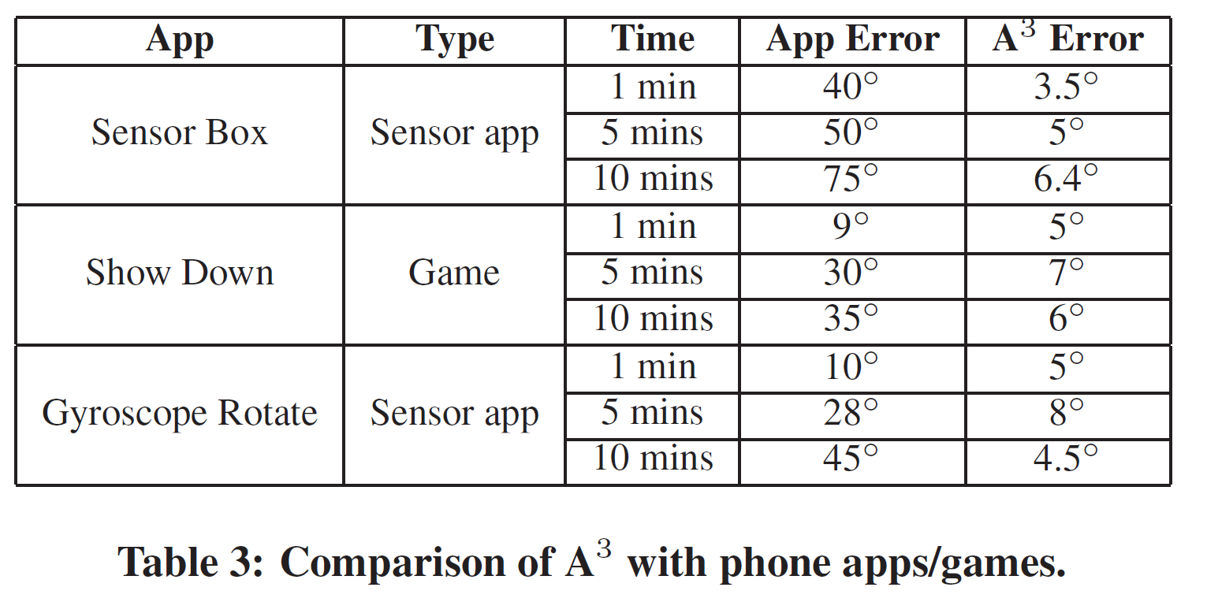
Evaluation
- Comparison with Popular Apps
Many smartphone apps and games detect and take the phone attitude changes as input.
Test the performance of the apps
  Time: 1min, 5min, 10min
  10 runs each then calculate average
  A³ is running background
  simultaneously with the app.

Slide 26
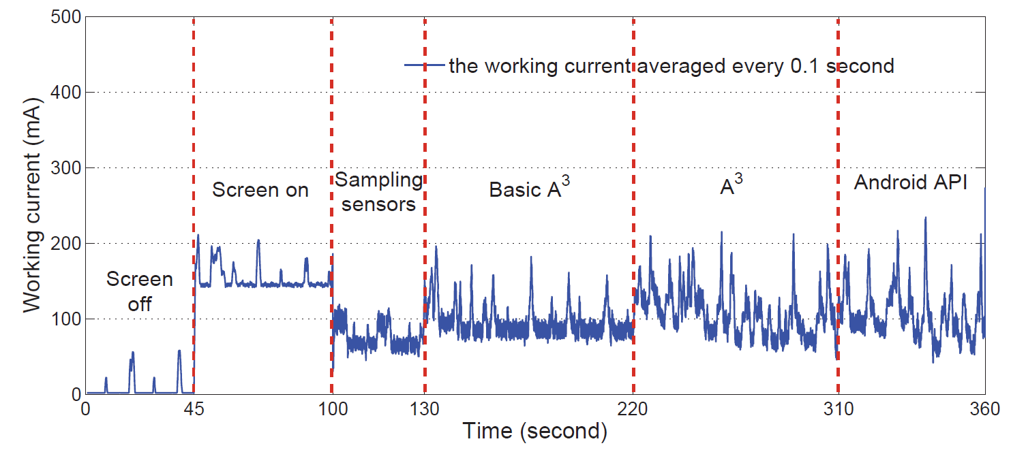
Evaluation
- Power Consumption

Slide 27
Related Work
Orientation and attitude estimation
  Kalman filter was widely used in those works to fuse different sensor input.
  Simple parameter optimization of Kalman-based approaches will not address the problem because it is based on the frequency responses of different sensors.
Heading estimation
  User heading information for indoor localization, navigation and tracking, etc.
  Using computer vision-based pattern detection techniques to provide directional references
Attitude based application
  Image stabilization, 3D photography, phone apps.
  Video stabilization and rolling shutter correction using the gyroscope.

Slide 28
Conclusion
Present A³ for accurate phone attitude detection.
Make it possible to estimate the mobile phone attitude in free motion, using gyroscope and other IMU sensors.
Provide far better tracking accuracy than other possible competitors and maintains the high accuracy during long runs.
Apply to localization, tracking, mobile gaming, etc.

