Slide 1
A Database in Every Sensor
Nicholas Tsiftes & Adam Dunkels (SenSys’ 2011)
Anthony Karoki
2013. 06. 11

Slide 2
Outline
Introduction
Contribution
Proposed Model
Motivation
Antelope DBMS
Implementation
Evaluation
Conclusion

Slide 3
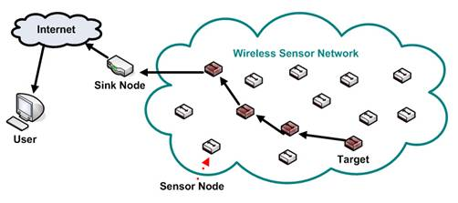
Introduction
TinyDB and Cougar
  Sensor network database models
  DB front-end at sink
  No data stored at node

Slide 4
Introduction
Low-power flash memory
  Cost dropped
  Storage increased
Therefore, opportunity for new sensor network model
  Nodes store data in local flash storage
  Provide energy-efficient means for querying
Emerging applications
  Data from individual sensors more interesting
Required
  Efficient querying mechanisms
  Simple mechanisms

Slide 5
Paper Contribution
Present Antelope
Evaluate Antelope from a macro perspective in a network environment

Slide 6

Proposed Model
Antelope DBMS
  DBMS for nodes
  Nodes store own data
  Queries made to individual nodes
  Historical data querying possible

Slide 7
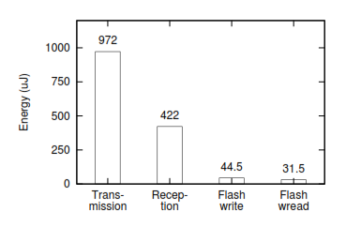
Motivation
Energy Cost
  Communication is costly in SNs
  Transceivers, need duty cycling
  Flash memory, can stay in low-power sleep mode – no I/O

Slide 8
Motivation
Application Directions
  Aggregation rarely used in practice
  Identity and position of each device is important
    Daylight harvesting
    Energy accounting

Slide 9
Motivation
Technology Directions
  Energy and power are limited
  Bandwidth is limited
  Storage is unlimited

Slide 10
Antelope DBMS
DBMS for resource-constrained sensor devices
  Allows dynamic creation of DBs and complex data querying
Each sensor nodes holds a DB
  Dynamic querying possible
  Run-time data insertion possible
Contains flexible data indexing mechanisms
  3 different index algorithms
Leverages on Coffee File System
  For storage abstraction (portability & flash complexities)
Uses AQL query language
  Building and querying DBs

Slide 11
Antelope DBMS
Features
  Energy-efficient querying
  High-level data modeling
  Index-independent
  Hides low-level I/O details
  Uses LogicVM (novel virtual machine architecture)
MaxHeap
  New flash indexing method
  Enables fast insertions and queries
  Low energy cost

Slide 12
Antelope DBMS
Challenges
  Energy-efficient querying and storage
  Physical storage semantics
    Storage structures
    Different variants of flash memory

Slide 13
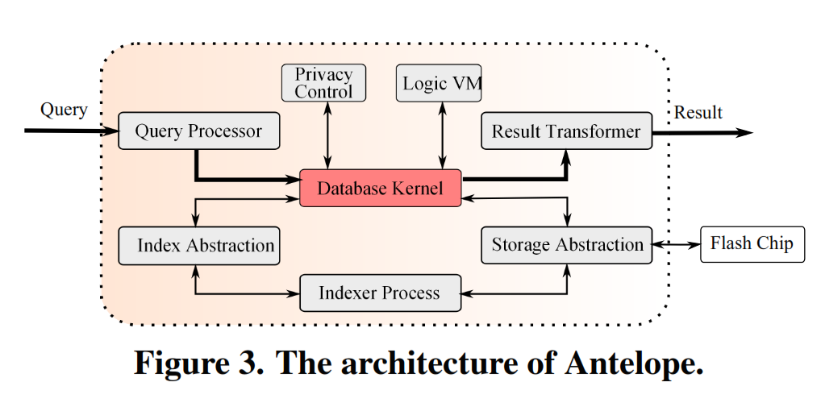
Antelope DBMS
Consists of 8 components

Slide 14
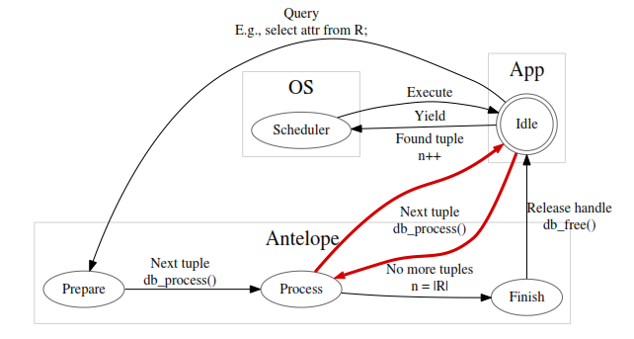
Antelope DBMS
Database Kernel
  Evaluates all relational DB ops of AQL
  Invoked by the query execution module

Slide 15
Antelope DBMS
LogicVM
  Evaluates propositional logic
  Enhances the performance of relational SELECT op
  Logic expressed compactly in bytecode
  Bytecode language
    Evaluate logical connectives, relational operators, and arithmetic operators
  Execution
    Stack-based execution model, memory allocation more precise
  Attribute range inference
    Logic analysis in LogicVM

Slide 16
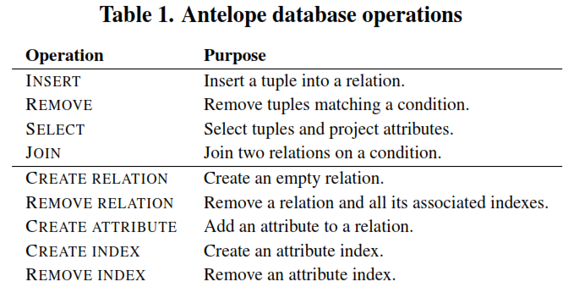
Antelope DBMS

Slide 17
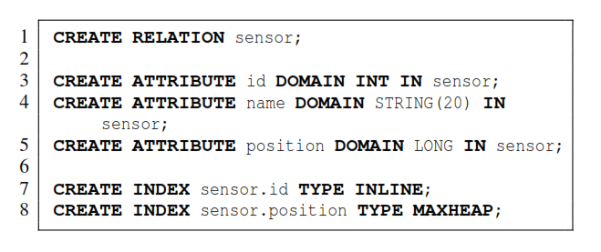
Antelope DBMS
Defining and Populating a DB
  Define a relation using a set of catalog operations
    Set of attributes and the domains (data types)
    Set of constraints on the tuples
    Set of indexes

Slide 18
Antelope DBMS
Querying a DB
  Operations
  SELECT
  JOIN
  REMOVE
  Done in two parts
  Preparation part
  Iteration part
  Minimum amount of processing
  Reading the tuple from storage into the RAM buffer
  Usually: send to serial port, send over radio, or compute statistics
  Default: query result assigned to virtual result relation

Slide 19
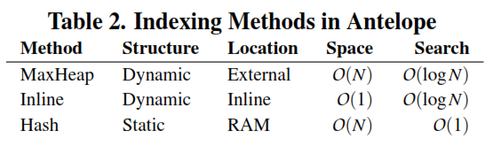
Data Indexing
Required
  Small memory footprint
  Simple/fast I/O access pattern
Flash memory indexes
  FlashDB, Lazy-Adaptive Tree, MicroHash
Antelope indexes
  Implement a generic interface
  Constructed and deconstructed dynamically at runtime

Slide 20
Implementation
Antelope implemented using C
OS-level services provided by Contiki OS
Tmote Sky derivatives with
  1 MB ST M25P80 NOR flash memory
  MSB-430 devices
  Multi-gigabyte SD cards
Storage layout
  Portable over a host of file systems
  Abstraction: Coffee File System

Slide 21
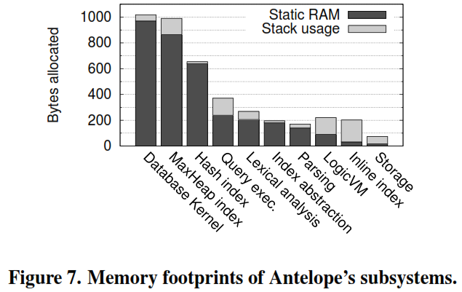
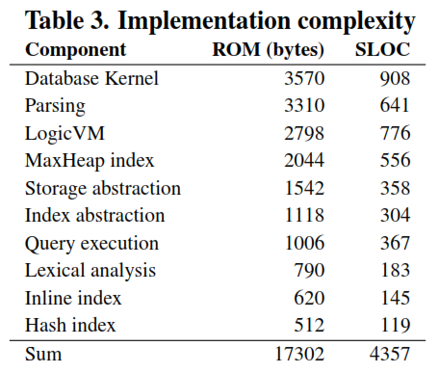
Implementation

Slide 22
Evaluation
Node-Level Evaluation
  Relational Selection
  Energy Efficiency
  Execution Time Efficiency
2. Network-Level Evaluation
    Local Querying
    Remote Querying

Slide 23
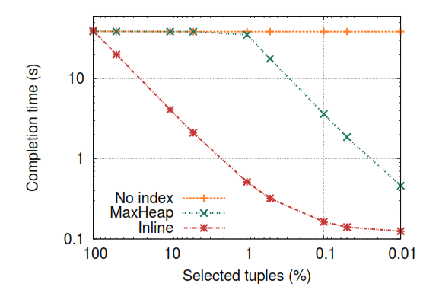
Node-Level Evaluation
Relational Selection
  Range Search
    E.g. Find all tuples inserted between two dates
    Used a relation with 50,000 tuples
    Each tuple composed of an attribute of LONG domain

Slide 24
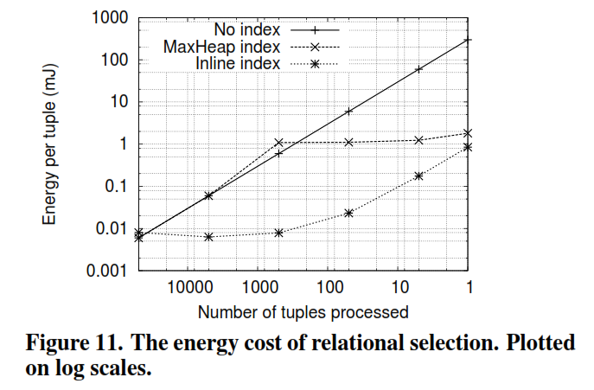
Node-Level Evaluation
Energy Efficiency

Slide 25
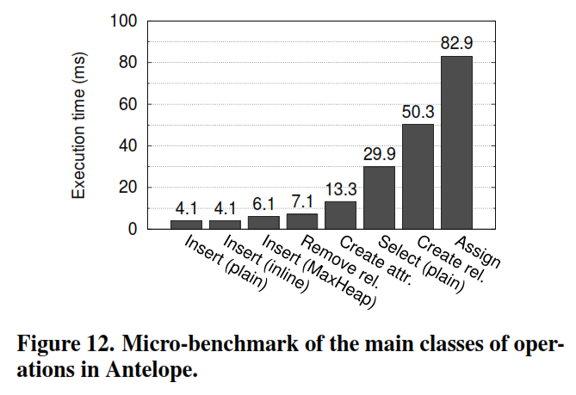
Node-Level Evaluation
Execution Time Efficiency
Texas Instruments MSP430F1611 processor using a clock frequency of 3.9 MHz

Slide 26
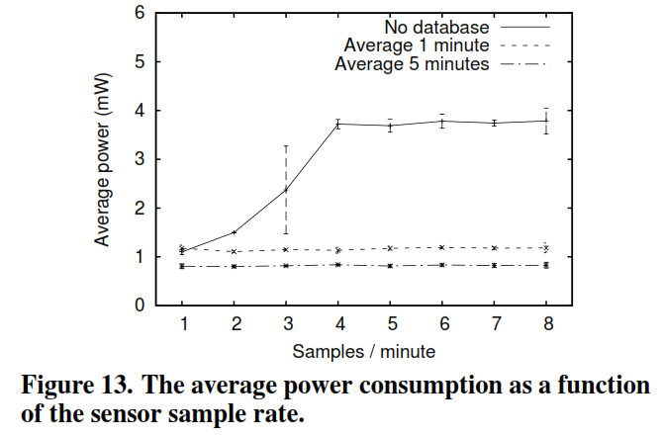
Network-Level Evaluation
Local Querying
  Simulation
    App. that monitors avg. temp. for each
    sensor
    40 nodes, multi-hop
    3 different setups
    Measured power
    consumption of all
    nodes using Contiki’s
    Powertrace

Slide 27
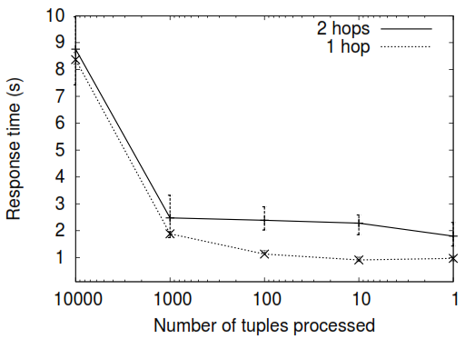
Network-Level Evaluation
2. Remote Querying
  Built and used NetDB
    Client – sink node
    Servers – other nodes
  Real network - 20 Tmote
  Sky nodes (Contiki)
  NetDB used the Mesh module for multi-hop communication

Slide 28
Conclusion
Presented DBMS (Antelope) for resource-constrained sensor devices
Showed that each sensor can store any kind of data
Showed that querying can either occur locally or remotely
Demonstrated aggregate queries can reduce network power consumption

