Slide 1
Data Link Layer and Interface
2

Slide 2
2.1 Functions of the Data Link Layer
IP, the layer directly below
  However, IP was not originally developed for it
Inherent roles of the data link layer
  Framing
  Error control (error control)
  Flow control (flow control)
  (Shared link) Medium access control (medium access control; MAC)
    MAC Address

Slide 3
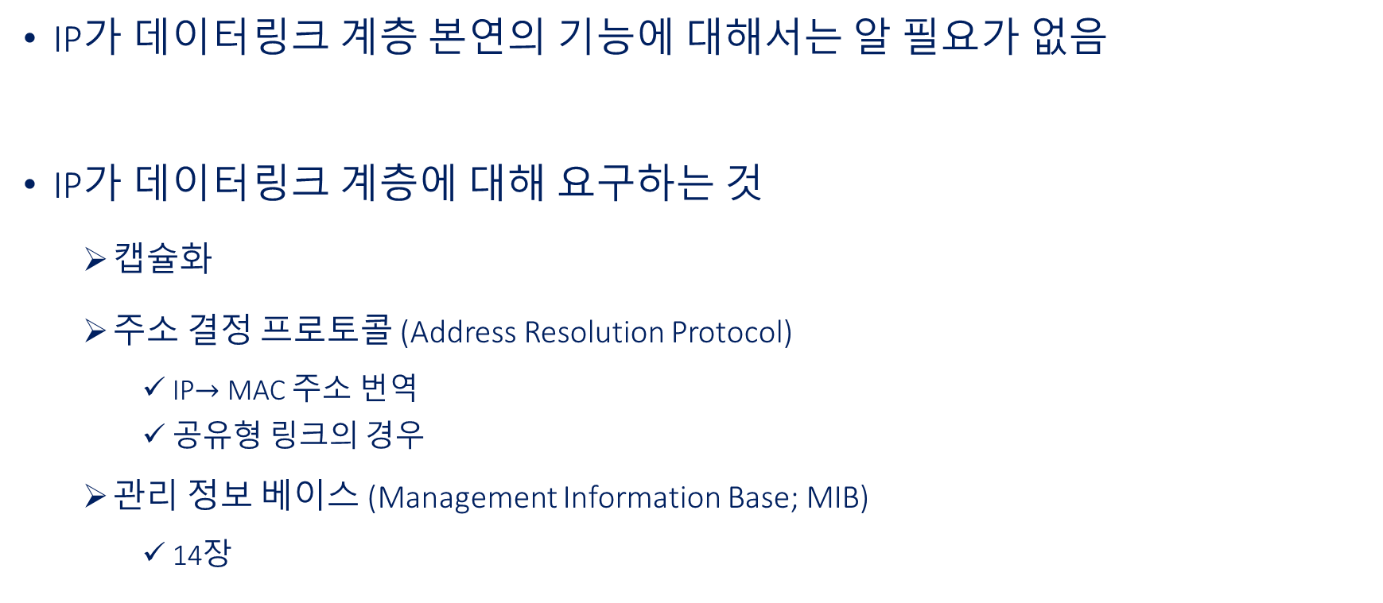
2.2 IP Requirements from the Data Link Layer
IP does not need to know the inherent data link layer functions
IP requirements from the data link layer
  Encapsulation
  Address Resolution Protocol (Address Resolution Protocol)
    IP$→$ MAC address translation
    Shared link case
  Management Information Base (Management Information Base; MIB)
    14

Slide 4
2.2 IP Requirements from the Data Link Layer
Encapsulation
  Indicates that the payload field of a frame contains IP datagram
    On transmission: IPfrom IP datagram, records the corresponding IP protocol number in the header
    On reception: reads the number, recognizes IP and delivers the payload to IPIP for processing
  Example: Ethernet Protocol type fields written in the Ethernet frame header (Linux kernel))
#define ETH_P_IP 0x0800 /* Internet Protocol packet */ #define ETH_P_X25 0x0805 /* CCITT X.25 */ #define ETH_P_ARP 0x0806 /* Address Resolution packet */

Slide 5
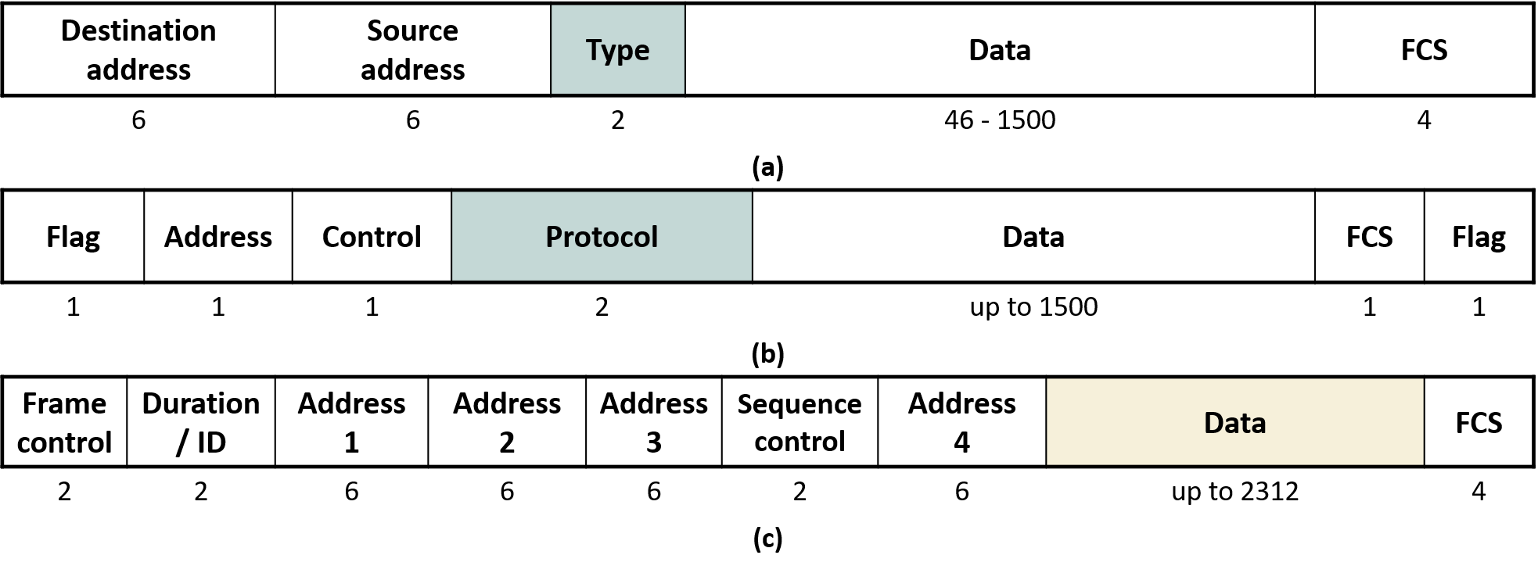
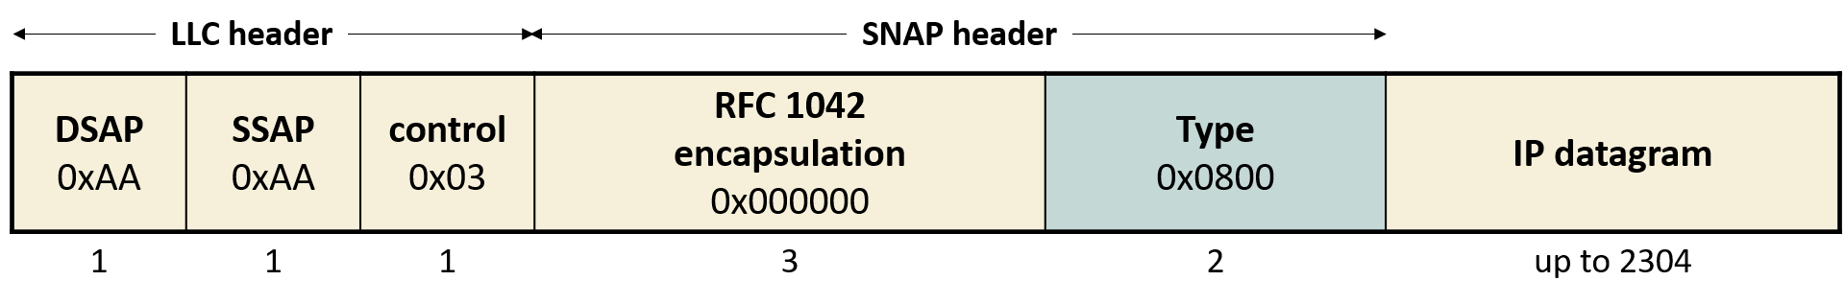
2.2 IP Requirements from the Data Link Layer
Encapsulation

Slide 6
2.2 IP Requirements from the Data Link Layer
Address Resolution Protocol (ARP)
  Shared link (shared medium)required
    Point-to-point link (point-to-point link)not required
  IP→MAC address translation protocol needed
    1Ch. “Delivery Segment” (see)
Management Information Base (MIB)
  Internet remote management standard
    Can manage not only the internet but anything connected to it (e.g.: internet-connected CCTV)
C:\Users\User>arp -a Interface: 172.30.1.59 --- 0x14 Internet Address Physical Address Type 172.30.1.37 44-cb-8b-e4-01-64 dynamic 172.30.1.43 48-e2-44-27-c7-21 dynamic 172.30.1.128 90-f8-91-89-ba-6a dynamic 172.30.1.254 00-07-89-82-0d-aa dynamic 172.30.1.255 ff-ff-ff-ff-ff-ff static 224.0.0.2 01-00-5e-00-00-02 static 224.0.0.22 01-00-5e-00-00-16 static 224.0.0.251 01-00-5e-00-00-fb static 224.0.0.252 01-00-5e-00-00-fc static 239.255.255.250 01-00-5e-7f-ff-fa static 255.255.255.255 ff-ff-ff-ff-ff-ff static

Slide 7
2.3 "Interface"
A computer (including smartphones) connects to the internet via hardware, but the interface is HW …. not that hardware itself
Rather, it is kernel the data structure representing it inside the kernel
  Network HW technology info that IP must know
    e.g.: maximum transmission unit (MTU)
  Device driver
IP abstracts all internet connection technologies as “"Interface"”
  e.g.: 5G, Ethernet, Wi-Fi, …

Slide 8
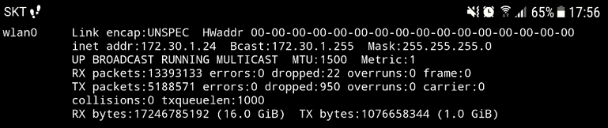
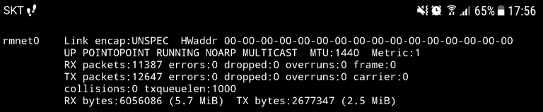
2.3 "Interface"
Android smartphone Wi-Fiand LTE “"Interface"” examples
  ifconfig, netstat -i (Linux)
  netsh interface ipv4 show interfaces

Slide 9
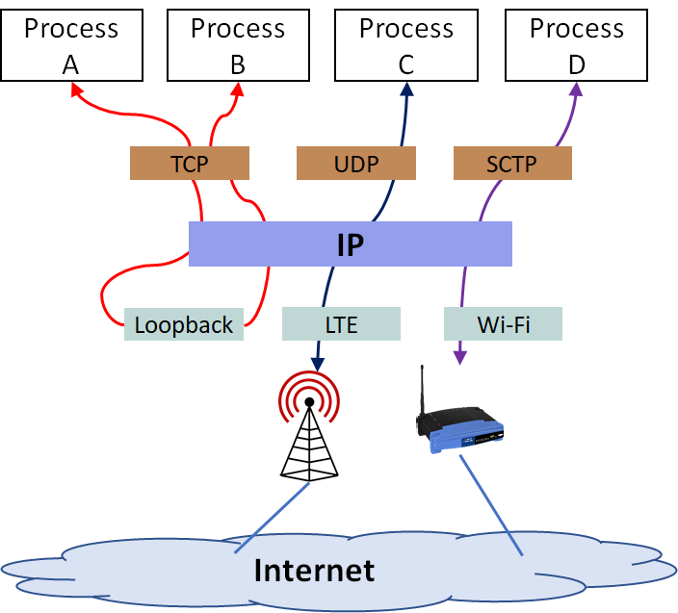
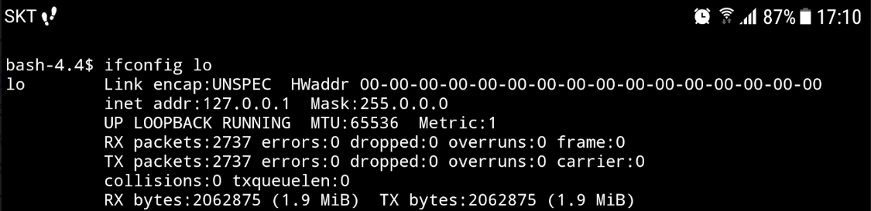
2.3 Interface
Not all interfaces HWand 1:1 correspond 1:1
Local loopback Interface
  A purely logical interface for IPC (IPC) within the same computer
  HWFewer limitations (e.g.: MTU)

Slide 10
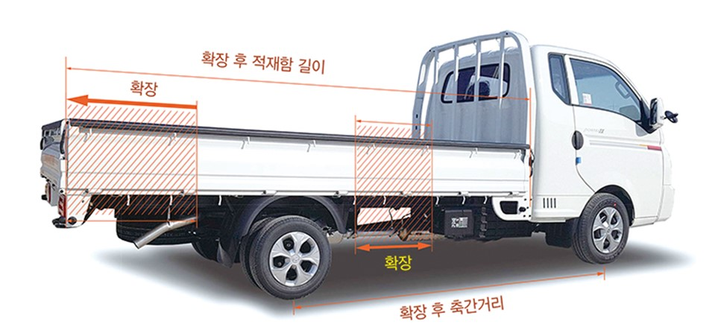
2.3 Interface
MTU
  Maximum size of the payload field in a given data link layer frame
  IP datagram size determination
    IPWhen IP segments data from upper layers into IP datagrams to be carried in frames,
  if data exceeds MTU, it is fragmented (fragmentation)into multiple datagrams for transmission

Slide 11
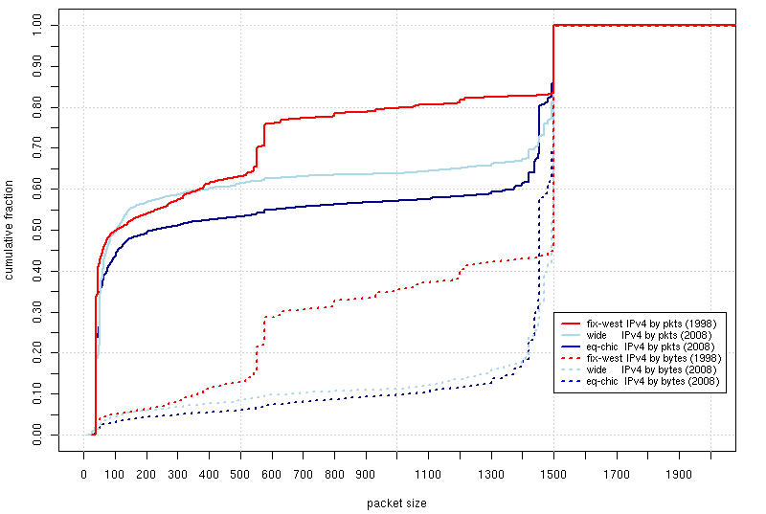
2.3 Interface
MTU-limited IP datagram size
  Ethernet is the de facto limiting factor

