Slide 1
BlueBee: a 10,000x Faster Cross-Technology Communication via PHY Emulation
Jiang, W., et al.
University of Minnesota
Sensys`17
Bong-yeol Yu
Operating Systems Lab.
2018. 10. 30.

Slide 2
Contents
Motivation
BlueBee Overview
Background
BlueBee design
Evaluation
Conclusion
Critique

Slide 3
MOTIVATION
Explosive increase of Internet of Things (IoT)
  Problems in ISM band
    Cross-technology interference (CTI)
    Channel inefficiency
  Need effective channel use
Traditional approach: Multi-radio gateway
  Bridge multi-technology communication
  Drawbacks
    Additional hardware cost
    Complicated network structure
    Increased traffic overhead

Slide 4
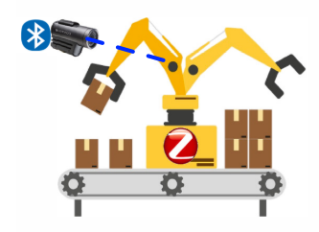
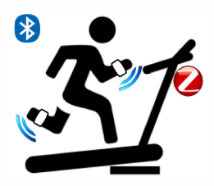
MOTIVATION
Cross-technology communication (CTC)
  Direct communication with incompatible PHY layer
  Make explicit channel coordination available
  Existing CTC design shows low performance
    E.g., 18 bps in the-state-of-the-art

Slide 5
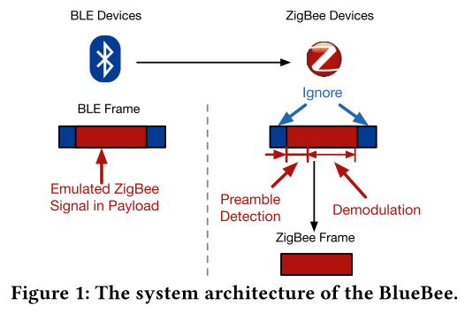
BlueBee Overview
High data-rate CTC from BLE* to ZigBee
PHY emulation
  Payload part is detected via preamble and demodulated
  Header and trailer of the BLE frame are disregarded
Two key technical insights
  Similarity of (de)modulation techniques
  → Phase shift
  Error tolerance of ZigBee demodulation
  → DSSS
*BLE: Bluetooth Low energy

Slide 6
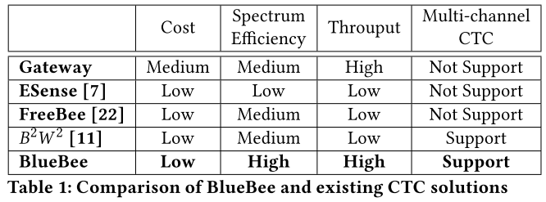
BlueBee Overview
Unique Features
  Does not incur deployment cost or additional traffic
  Multi-channel concurrent CTC
  Neither hardware nor firmware change
  Dual-standard compliance

Slide 7

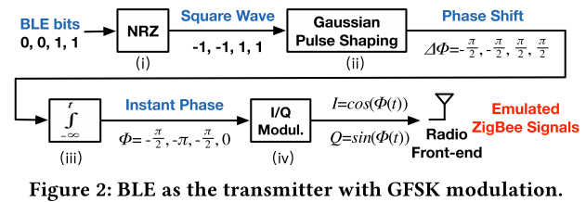
Background
BLE transmitter
  Use Gaussian Frequency Shift Keying (GFSK) modulation
    GFSK realized by phase shift over time

Slide 8
Background
BLE transmission procedure
  BLE bits go through a non-return-to-zero (NRZ) module
    Modulates series of BLE bits to series of square waves with amplitudes of either -1 or 1
  Wave passes through the Gaussian low pass filter
    Shapes the waves into a band-limited signal
    Phase shifts of ±π/2 when multiplied to the carrier

Slide 9
Background
BLE transmitter
  Taking integral of the series of waves to t yields phase with respect to time
    Time-domain representation of the accumulated phase shifts from the previous step
  In-phase and Quadrature (I/Q) signal is calculated through the cosine and sine of the instant phase
    Multiplied to the carrier and pushed into the air through the BLE RF front-end

Slide 10
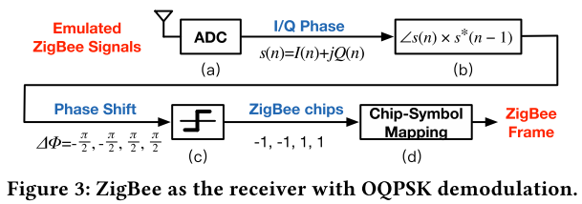
Background
ZigBee receiver
  Use the standard Offset Quadrature Phase Shift Keying (OQPSK) demodulation
ZigBee receiver procedure
  Analog-to-digital converter (ADC) captures BLE signals on the overlapping 2.4GHz
    A pair of I/Q samples are often referred to as a complex sample s(n) = I(n) + jQ(n)

Slide 11
Background
ZigBee receiver procedure
  Phase shifts between consecutive complex samples
    arctan(s(n) x s*(n-1)), where s*(n-1) is the conjugate of s(n-1)
  positive and negative phase shifts are quantized to be 1 and -1, corresponding to ZigBee chips 1 and 0

Slide 12
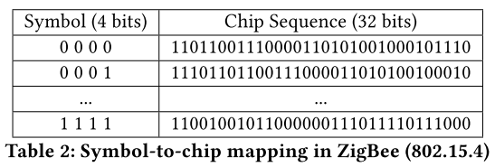
Background
ZigBee receiver procedure
  Looking up a symbol-to-chip mapping table predefined in DSSS
    32 ZigBee chips are mapped to a ZigBee symbol

Slide 13
Opportunities and Challenges
Two key technical insights
  Similarity of (de)modulation techniques of BLE and ZigBee
    GFSK and ZigBee’s OQPSK utilize phase shifts between consecutive samples to indicate symbols
  ZigBee only considers sign (+ or -) of the phase
    Offers great flexibility in emulation
Challenges
  Bandwidth of BLE (1MHz) is only half of that of ZigBee (2MHz)
    Phase shifts in BLE are not sufficiently fast to express all ZigBee chips
    Lead to inevitable errors in emulation

Slide 14
Opportunities and Challenges
Tolerance margin
  For robustness against noise and interference in DSSS
  ZigBee symbol can be correctly decoded
  Recover from the inevitable error caused by the bandwidth asymmetry

Slide 15
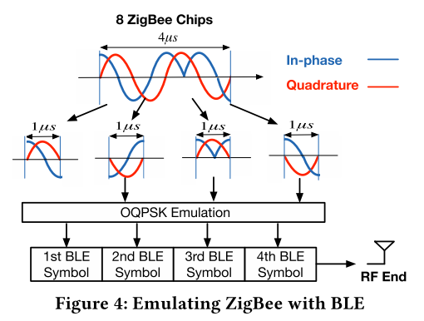
OQPSK Emulation
Emulation process
  Cut the sequence into two-chips pieces
    In-phase chip and Quadrature chip with durations of 1µs
  Each piece is emulated to be a BLE symbol
Only involves setting bit pattern of BLE packet payload

Slide 16
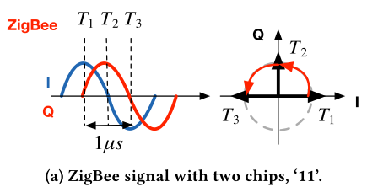
OQPSK Emulation
OQPSK in ZigBee
  Phase shift signs are translated to chips of -1 and 1
  ZigBee sampling rate: 0.5 µs
  Example
    ZigBee signal containing two chips of ’11’
    Time difference: 1 µs (T1 - T3)
      Timings of three consecutive samples every 0.5 µs
      Phase shift between the arrows of T1 and T2 is π/2

Slide 17
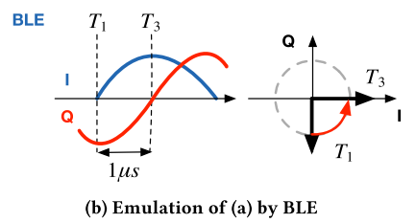
OQPSK Emulation
Emulated ZigBee signal
  Bandwidth of BLE being only half of ZigBee
    i.e., the sinusoidal curves indicating I/Q signals have half the frequency, or equivalently, double the period
  Example
    Sampled at T1-T3
    Phase shift between T1 and T2 is π/4 → chip of ‘1’
    Yield the same chip sequence of ‘11’ at the ZigBee receiver
  ZigBee signal is successfully emulated by the BLE

Slide 18
OQPSK Emulation
Single phase shift in BLE is interpreted as two phases shifts in ZigBee
BLE has lower degree of freedom
  Change phase shifts (- ↔ +) every 1 µs whereas it is 0.5 µs for ZigBee
A chip error is inevitable
  BLE can not generate ‘01’ or ’10’
  Due to the nature of BLE’s narrower bandwidth

Slide 19
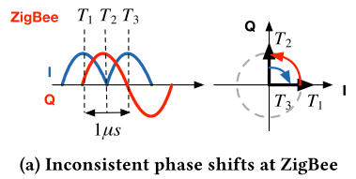
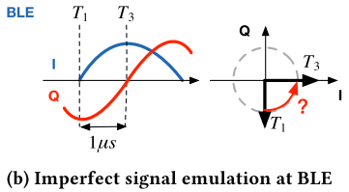
OQPSK Emulation
Example
  ‘11’ or ‘00’ can be perfectly emulated
  ’01’ or ’10’ incurring 1 chip error
Solutions
  Can be significantly reduced depending on the BLE phase shift
  Optimize DSSS mapping

Slide 20
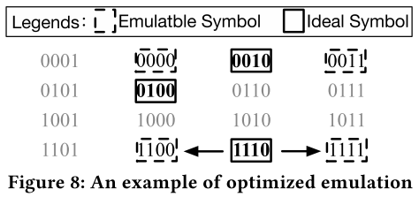
Optimal DSSS Emulation
Minimize the impact of the inevitable chip error
  Simplified walk-through example
    Emulation in the 4-bit hamming space
      Ideal symbols: need to be emulated
      Emulatable symbol: can be emulated by BlueBee
      Others: cannot be represented in BlueBee
    BlueBee can only generate a limited number of emulation symbols

Slide 21
Optimal DSSS Emulation
Two symbol distances*
  S_{i} denote the i^{th} ideal symbol, and E_{i} to denote the i^{th} emulated symbol
Definition 4.1. Intra symbol dstance Dist(E_{i}, S_{i}) is hamming distance from the emulation symbol E_{i} to the ideal symbol S_{i}
Definition 4.2. Inter symbol distance Dist(E_{i}, S_{j}) is hamming distance from the emulation symbol E_{i} to the ideal symbol S_{j}, where J ≠ i
*the Hamming distance between two strings of equal length is the number of positions at which the corresponding symbols are different

Slide 22
Optimal DSSS Emulation
Example: to emulate the ideal symbol ‘1110’
  Possible two emulatable symbols ‘1100’ and ‘1111’
  Intra symbol distance: both 1
  Inter symbol distance:
    For ‘1100’, 3 to ‘0100’ and ‘0010’
    For ‘1111’, 3 to ‘0100’ and ‘0010’
  Choose the maximum margin
    maximum value of the minimum inter symbol distance
    Choose ‘1111’

Slide 23

Optimal DSSS Emulation
BlueBee optimizes the DSSS emulation
  Inter Symbol Distance
    Increase the inter symbol distance for improving the reliability
    ’01’ can be emulated via either ‘00’ or ‘11’
    ZigBee symbol can be emulated in 2^{Dist(Ei, Si)} different sequences
    Chooses the emulation symbol with the maximum minimum inter-symbol hamming distance
  It can be precomputed and loaded on the device prior to running BlueBee

Slide 24
Concurrent communication
Frequency hopping
  Helps BLE devices to avoid busy channels
Hop among the 2.4GHz band
Communicate with multiple ZigBee devices at different channels
Control BLE frequency hopping sequence

Slide 25
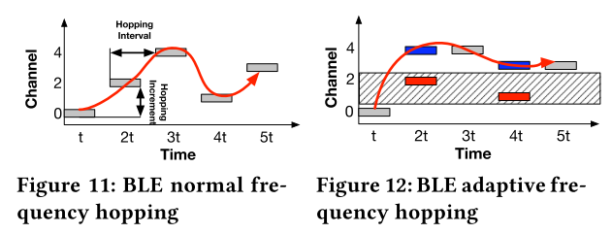
BLE Frequency Hopping
BLE has 40 2MHz wide channels (0~39)
  37~39: advertising channels
  Others: data channels
  C_{next} = C_{current} + hoppingInc (mod 37)
BLE adaptive frequency hopping (AFH)
  Maintain the channel link quality by a 37-bit channel map
  S_{good} and S_{bad} indicate the good and bad channel sets, respectively
  If next channel is bad,
  remapIndex = C_{next} mod |S_{good}|
  C_{next} = S_{good}(remapIndex)

Slide 26
BlueBee channel scheduling
AFH in BlueBee
  Unfair services to ZigBee nodes at BLE-ZigBee overlapped channels
    E.g., channel 0 will only be visited once during one hopping period
BLE supports the update of the channel bit map
  For adapting to the fast-changing network environment
  Control the hopping behavior of BLE by only updating the channel bit map

Slide 27
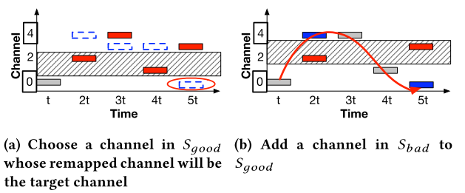
BlueBee channel scheduling
Maximum-throughput solution
  Leave the ZigBee-BLE overlapped channels in channel bit map
  Blacklist the non-overlapped channels
  No guarantee a load balanced CTC
Load balanced solution
  Balance the BLE’s frequency hopping
  Steps
    Find another channel c` in S_{good}
    Mark c` as a bad channel
    One S_{bad} channel mark as a good channel (heuristic) to
    maintain |S_{good}|

Slide 28
Link Layer Protection
Frame Retransmission
  Transmit the same Bluetooth packet multiple times
  Compatible with the ZigBee protocol at the receiver side
    Automatically ignore retransmitted ZigBee frames – 802.15.4 standard
  Probability to receive at least one ZigBee frame
    Probability = 1 – (1 – FRR)^{k}
      FRR: frame reception ratio
      k: the number of copies
  99.9% reception rate, when FRR = 70% and k = 6
  Improve the transmission reliability

Slide 29
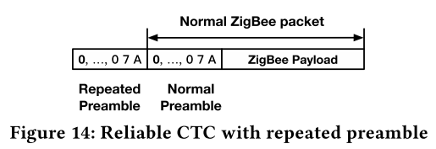
Link Layer Protection
Repeated Preamble
  Utilize the repeated preamble technique
  ZigBee preamble
    Eight ‘0’ symbols followed by the symbols ‘a7’
  If the first preamble is received, the ZigBee will discard the remaining preambles in the upper layer decoding

Slide 30
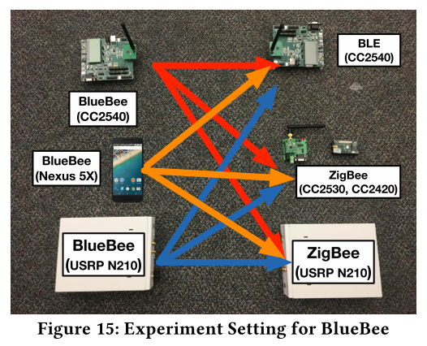
Evaluation
Platform setting
  BlueBee sender
    USRP-N210 platform
      Convenience to change parameters
    Commodity BLE development kit (CC2540)
    Commodity smartphone Nexus 5X
  Receiver
    Commodity BLE (CC2540)
    Commodity ZigBee (CC2530 and CC2420)
    USRP-N210 platform
  Broadcast frames from BlueBee to receiver

Slide 31
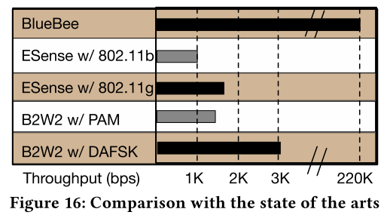
Evaluation
CTC Throughput
  Compare with FreeBee
    BlueBee: 225 kbps / FreeBee: 17 bps
    13,000 times the throughput of FreeBee
  Compare with Other Packet-Level CTC
    Esense (WiFi → ZigBee), B2W2 (BLE → WiFi)
    70~100 times the throughput of packet-level CTC

Slide 32
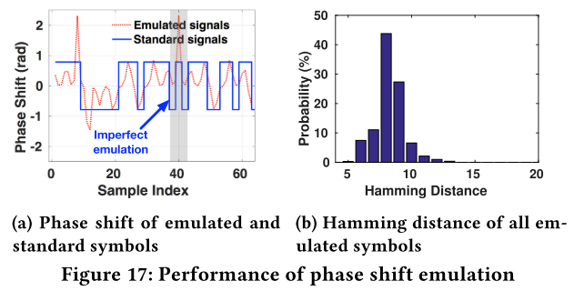
Evaluation
Emulation Reliability
  Emulated Signals
    Compare the phase shift of received ZigBee symbol and an ideal ZigBee symbol
    Failing to emulate inconsistent phase shifts
    Most Hamming distances are in the range of [6,10]
    The number of error chips is small and within the tolerance of ZigBee

Slide 33
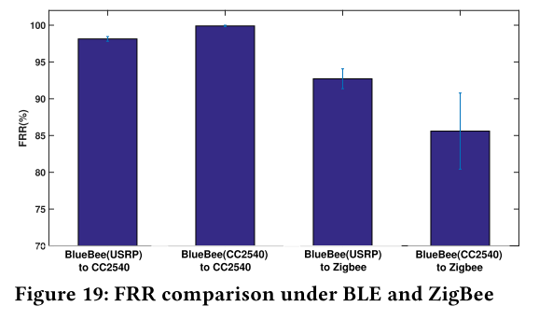
Evaluation
Emulation Reliability
  Dual-standard compliance
    99% FRR is achieved among commodity devices
    Achieve cross-technology broadcast

Slide 34
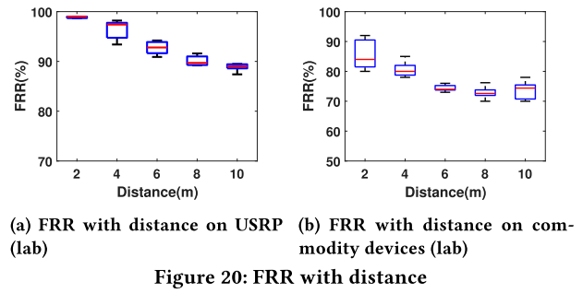
Evaluation
Emulation Reliability
  Impact of distance
    BLE sends out frames on both USRP and commodity CC2540
    Transmission power is 0dBm, maximum energy level
    Average FRR is within 92% to 86% on commodity devices
    FRR decreases with the increasing of distance, due to the lower SNR

Slide 35
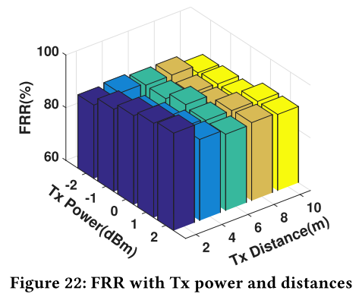
Evaluation
Emulation Reliability
  Impact of Tx power and Tx distance
    Impact of various Tx power and distance from USRP to CC2530
    When Tx power increases (-2dbm → 2dbm), the FRR also increases (85% → 90%)
    When distance is 10m, the FRR is over 80%

Slide 36
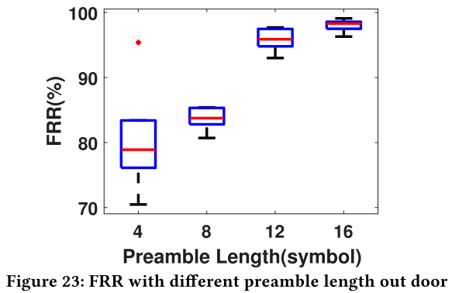
Evaluation
Emulation Reliability
  Protection in the link layer-multiple header
    Performance of link layer protection by repeated preambles
    Change the length of ZigBee preamble from 4 to 16 symbols
    When increase the preamble length, the FRR also jumps
    Shows the effectiveness of multiple preamble technique

Slide 37
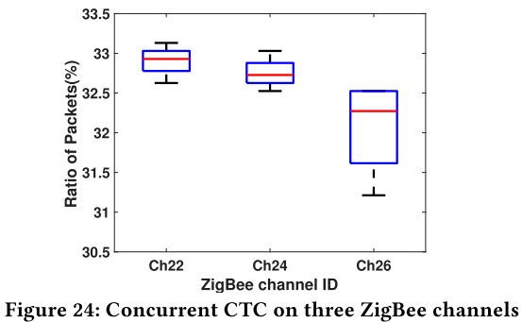
Evaluation
BlueBee channel scheduling
  Performance of the BlueBee scheduling algorithm
  BLE sends a total number of 999 emulation frames
  ZigBee channel 22, 24, and 26
  Different ZigBee receive the similar number of frames (only 1% difference)

Slide 38
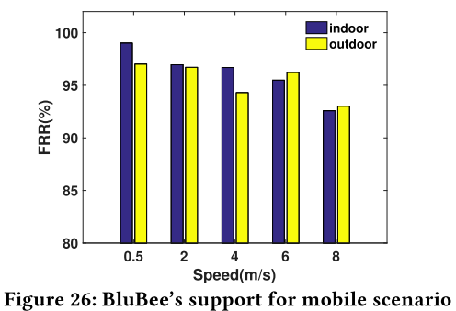
Evaluation
Mobility Support
  BLE radios are widely used in mobile scenario
  A person carrying a ZigBee node is walking, jogging, and running
  With different speed at about 10m away
  Even at speed 8m/s, about 90% FRR is achieved

Slide 39
Conclusion
New PHY layer cross-technology communication technique
BlueBee emulates legitimate ZigBee frames using BLE radio
10,000x the throughput compared to the state-of-the-art CTC
Does not require any hardware and firmware changes
Comprehensive testbed shows 99% accuracy with reliability

Slide 40
Critique
Pros
  이종 기술들의 통신 특성을 분석하고, 이를 PHY layer가 아니라
  Emulation을 통해 해결한 점
  기존 연구에 비해 10,000배 빠른 성능
  Reliability를 보이기 위해서 많은 실험을 함
  반대 방향의 통신도 (ZigBee → BlueBee) 다음 논문에서 해결함 [Mobicom`18]
Cons
  표현될 수 있는 심볼이 제한적임 → 데이터 표현에 제약이 없는지…
  트래픽 오버헤드를 해결이 모티베이션인데, Retransmission 기법을 사용함

Slide 41
Thank you!

