Slide 1
MusicalHeart: A Hearty Way of Listening to Music
Sensys 2012, University of Virginia, USA, Microsoft Research Asia, Beijing, China

Slide 2
Contents
Introduction
  Contribution
Background
System Architecture
Heart Rate Measurement
Activity and Context Detection
Evaluation
Conclusion

Slide 3
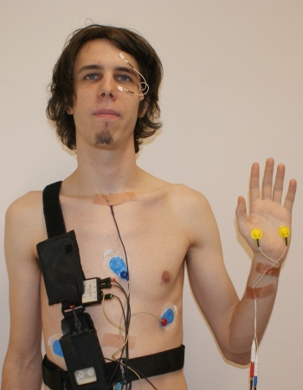
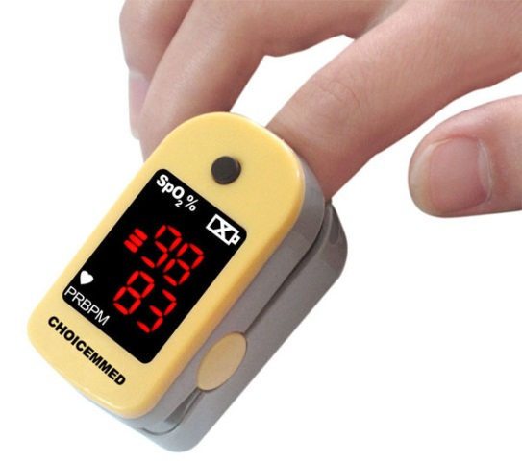
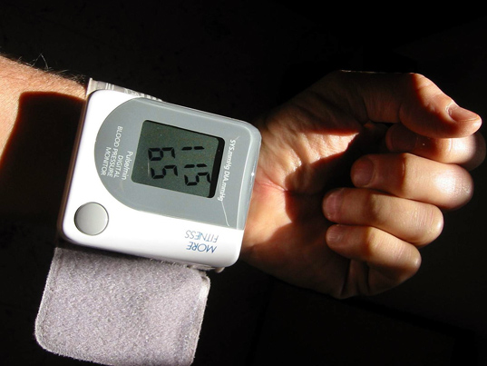
Introduction
Heart beat monitoring
  Using modern workout equipment or jogging accessories in jogging
  Worn on the chest, wrist, or finger
  Limitation
    an extra device while exercising
    Uncomfortable and extra effort- required
    High cost!

Slide 4
Introduction
They propose
  a convenient, non-invasive, personalized, and low-cost wellness monitoring system
Obtain heart rate and activity level information
  From a pair of specially designed earbuds while the user listens to music on a smartphone.
The system uses it to
  recommend, play, and share appropriate music for the user's desired heart rate intensity level

Slide 5
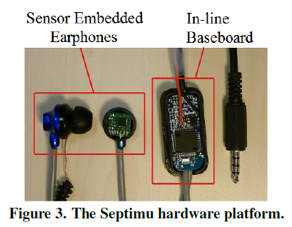
Contribution
Septimu
  Earbuds
    An inertial measurement unit (IMU)
    An analog microphone
    LED
  Baseboard
    Drives the sensors
    Communicates to the smartphone via the audio jack
MusicalHeart
  App
    Periodically samples the accelerometer and microphone
      determine the activity level and heart rate
    The information is sent to the server over the Internet
    The server uses it to recommend appropriate music that will help the user maintain their target heart rate

Slide 6
Contribution
A fast, accurate and real-time heart rate measurement algorithm
  extracts heartbeats from a mixture of acoustic signals from the earphone
3-class activity level detection algorithm
  Using accelerometers, detect activity level
  The goal of the activity detector in this work is to identify their categories that have an impact on heart rate.
A novel control-theoretic approach for recommending music
  constructs a personalized model of each user’s responses to different music at different activity levels
  uses the model to suggest the best music to satisfy a given heart rate goal

Slide 7
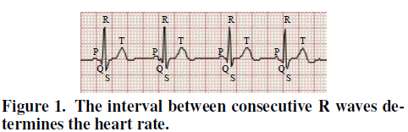
Background
ECG (electrocardiogram)
  R wave are more visible than others
  Heart rate = 1/(time interval between two consecutive R waves)
  Beats per minute (BPM)
  Pulse
    The contraction and expansion of an artery due to the beating of the heart
    Usually the same with heart rate

Slide 8
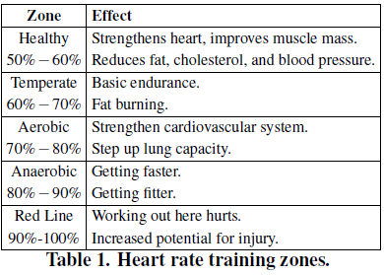
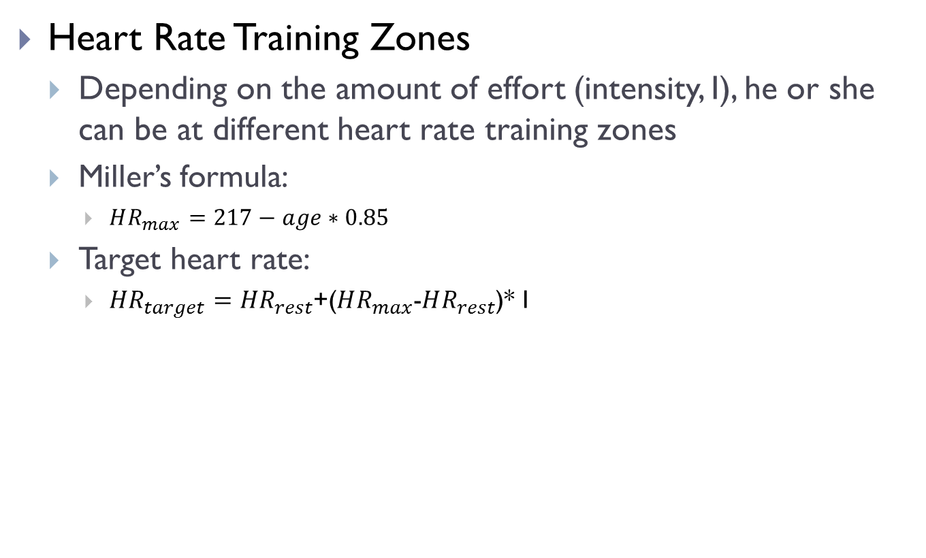
Background
Heart Rate Training Zones
  Depending on the amount of effort (intensity, I), he or she can be at different heart rate training zones
  Miller’s formula:
    $HR_{max}=217−age∗0.85$
  Target heart rate:
    $HR_{target}=HR_{rest}$+($HR_{max}$-$HR_{rest}$)* I

Slide 9
System Architecture
The Septimu Platform
  IMU
    3-axis accelerometer and gyroscope
  An analog microphone
  LED
  Baseboard
    TinyOS

Slide 10
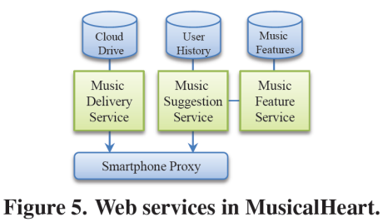
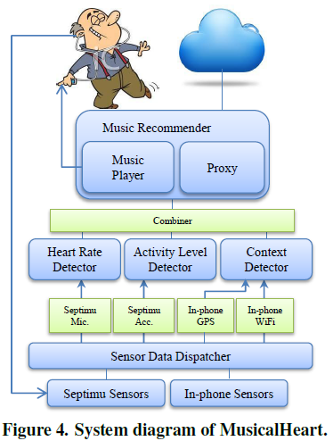
System Architecture
Processing on Smartphone in MusicalHeart

Slide 11
Heart Rate Measurement
Challenge
  The varying nature of the received signals and the presence of noise
  The received signals differ in shapes and sizes as different people have different sizes of ear canals
  a mixture of the music, the heart beats, human voices and other background noise
Two-step process
  Filtering
  Detection

Slide 12
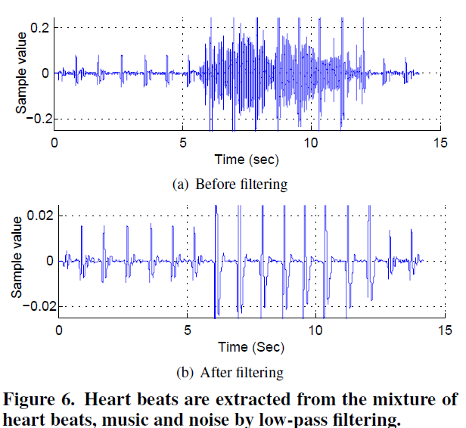
Heart Rate Measurement
Filtering
  Using possible BPM for human
    (40~100 BPM in resting, 220 BPM at maximum)
  Low-pass filter
    A second order Butterworth filters
Detection
  Taking R waves (peaks)
  and corresponding S waves
  Quality assignment
  Dynamic Programming

Slide 13
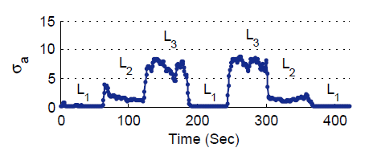

Activity and Context Detection
Activity level
  L1: Low level, sitting or lying
  L2: medium level, walking
  L3: high level, jogging
Using accelerometer and standard machine learning techniques!
  Calculate the linear magnitude of acceleration
  Calculate the standard deviation of the magnitude within 1 sec
  Using k-means clustering algorithm
    To find out the 3 cluster means corresponding to 3 activity level.

Slide 14
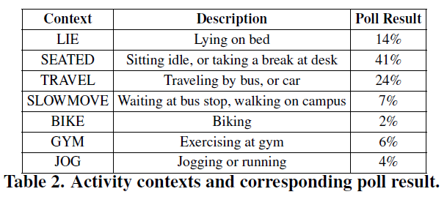
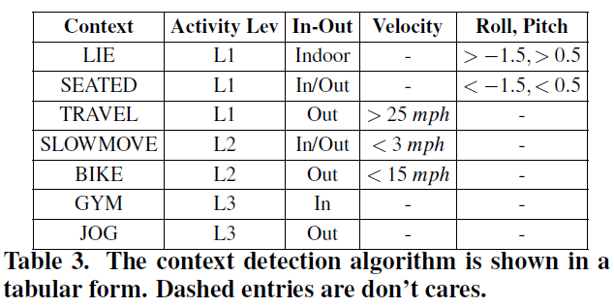
Activity and Context Detection
Augmenting Activity Levels with contexts
  When do you listen to music the most?
    Conduct a survey
  Augment activity levels with 3 types of information
    In-out, Velocity, Roll-Pitch
    To distinguish among the 7 activities(LIE,SEATED..)

Slide 15
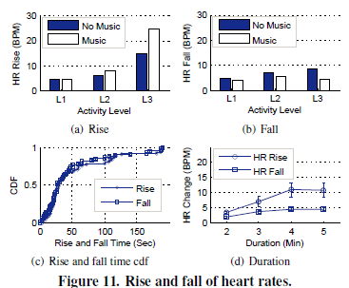
Evaluation
Heart Rate: Rise and Fall
  Question
    how much is the effect of music in rising or dropping one’s heart rate
    how long it takes to make the effect and whether these have any relation to the activity levels
Figure 11(c) shows the cumulative distribution function (cdf) of the rise and fall time of heart rates.
Figure 11(d) shows the amount of the rise and fall. The longer a person listens to the music, the more is its effect.

Slide 16
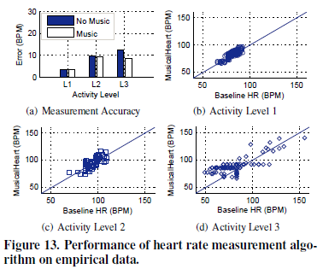
Evaluation of Heart Rate Measurement
Dataset
  37 smartphone users
Baseline
  Fingertip pulse oximeter
Figure 13(a)
  The error is similar
    Because after filtering out any unwanted signal, the algorithm handles the two cases in the same ways
Figure 13(b, c, d)
  Correlation coefficients are 0.85, 0.84, and 0.75, respectively
Figure 13(d)
  Horizontal difference: the looseness of the earphone
  Vertical difference: the inability of the pulse oximeter

Slide 17
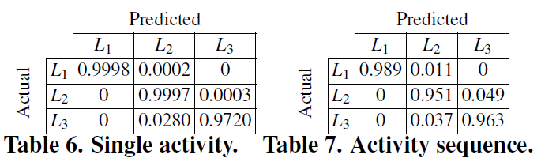
Evaluation of Activity Level Detection
First experiment
  17 users
  Each of the users perform exactly 3 activities
  1~5 minutes for each activities.
  Generation of confusion matrix
Second Experiment
  The users perform a series of activities in sequence
    {L1, L2, L3, L1, L3, L2, L1}

Slide 18
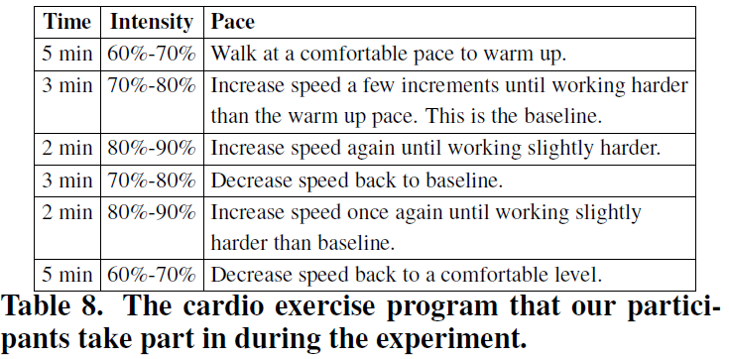
Real Deployment
The cardio exercise program
  4 volunteers

Slide 19
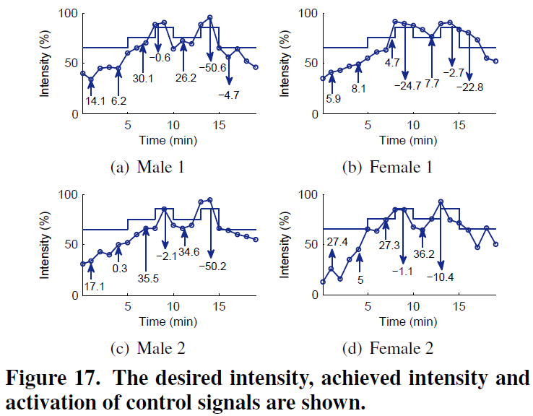
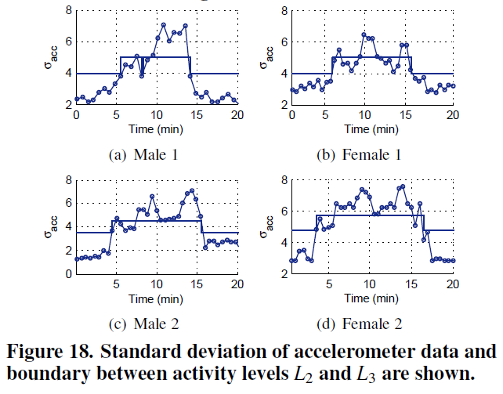
Real Deployment
The stairs represent the desired intensity
The curved lines represent the achieved intensity
The arrows represent the activation of the control input
  An upward arrow: helps to rise the current rate

Slide 20
Conclusion
We introduce Septimu, a wearable sensing platform consisting of a pair of sensor equipped earphones.
MusicalHeart is a novel bio-feedback based, context aware, automated music recommendation system for smartphones.

