Slide 1
1: Introduction
이홍원
2015020796

Slide 2
1.2: Design and Implementation
이홍원
2015020796

Slide 3
1.2 Design and Implementation
Distinction between the protocol architecture and the implementation architecture
Implementation architecture
  software, rendering the concepts in a protocol architecture
Layering
  the usual approach to implementing protocol suites
  a way to deal with verification of the logical soundness and correctness of a large software implementation
  many kinds of professional engineers could be participated to each area (layer)
  each area (layer) could be developed separately

Slide 4
1.2.1 Layering
Open Systems Interconnection (OSI) model
  base of the concept of protocol layering
  defined by ISO (the International Organization for Standardization)
OSI 7 layers
  Physical: physical medium, bit
  Link: establishing a link using bits collection by physical layer
  Network or Internetwork: router, heterogeneous networks, IP
  Transport: multi-hop path, efficient and objective transportation, UDP, TCP, …
  Session: checkpointing, recovery
  Presentation: endian converting, security, MIME, SSL, …
  Application: HTTP, FTP, …

Slide 5
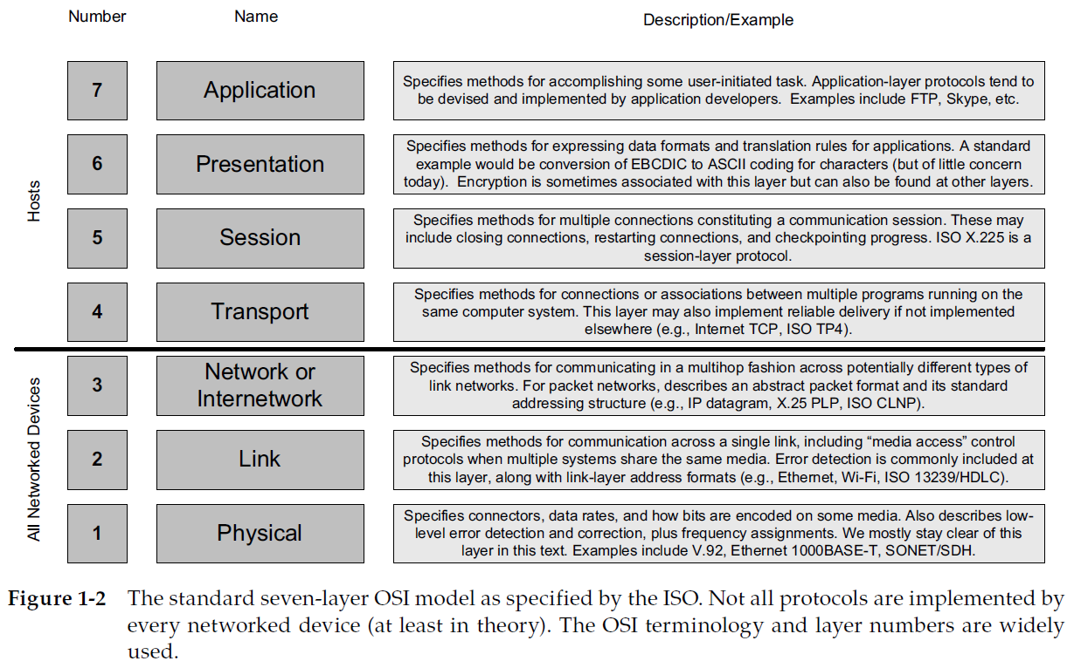
1.2.1 Layering

Slide 6
1.2.2 Multiplexing, Demultiplexing, and Encapsulation….
Multiplexing & Demultiplexing
  different protocols to coexist on the same infrastructure
  multiple instantiations of the same protocol object
  occurring at different layers, identifier (ex. protocol identifier)
  using header for multiplexing data when sending
  the receiver to perform demultiplexing, based on a demultiplexing (demux) identifier
Encapsulation & Decapsulation
  an object, protocol data unit(PDU), at one layer is carried by a lower layer
  each layer treats the data from above as opaque, uninterpretable information

Slide 7
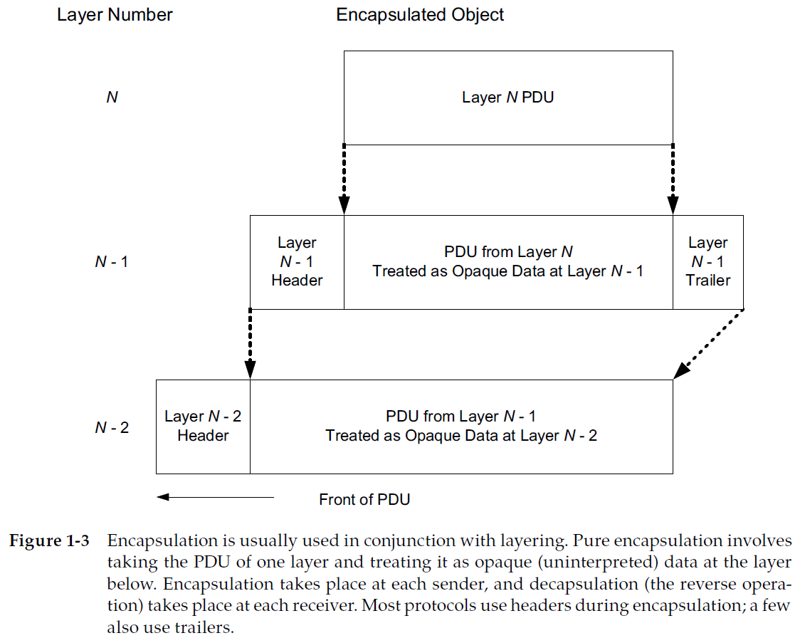
1.2.2 Multiplexing, Demultiplexing, and Encapsulation….
Encapsulation

Slide 8
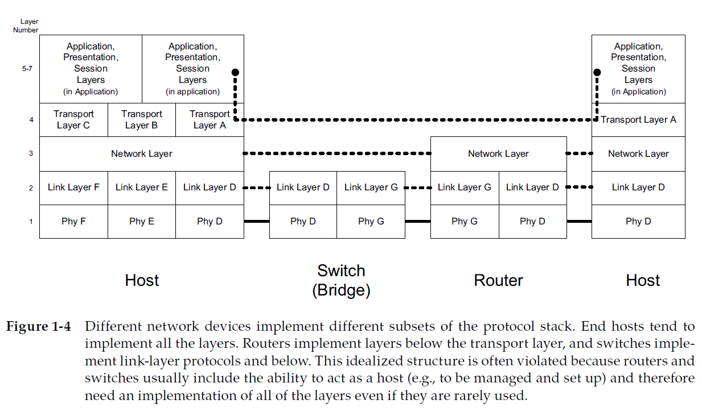
1.2.2 Multiplexing, Demultiplexing, and Encapsulation….
Different subsets of the protocol stack

Slide 9
1.2.2 Multiplexing, Demultiplexing, and Encapsulation….
The Goal of an internet
  to hide all of the details of the physical layout and lower-layer protocol heterogeneity from the applications
  the applications would run without modification
  the concept of an internet so powerful and useful

