Slide 1
Real-time Breath Monitoring Using Wireless Signals
Fadel Adib, Zachary Kabelac, Hongzi Mao, Dina Katabi, Robert C. Miller
Massachusetts Institute of Technology
{fadel,zek,hongzi,dk,rcm}@csail.mit.edu
Mobicom 2014
Presenter : Junseo Son

Slide 2
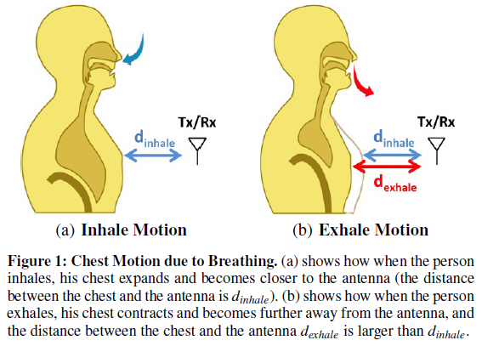
Abstract & Introduction
A wireless sensing technology that monitors breathing remotely, without requiring any body contact.
It uses reflections to track motion associated with breathing, i.e., the chest movements caused by inhaling and exhaling.
It works in non-controlled settings with no prior training.

Slide 3
Overview of Vital-Radio
Vital-Radio transmits a low-power wireless signal and monitors its reflections off the human body.
Vital-Radio builds on WiTrack (provides accurate motion tracking using radio reflections off a human body)
  “3D Tracking via Body Radio Reflections”. In Usenix NSDI, 2014.
  A frequency sweeping technique (FMCW – Frequency Modulated carrier wave)
  The accuracy of WiTrack’s localization is 10cm to 15cm.

Slide 4
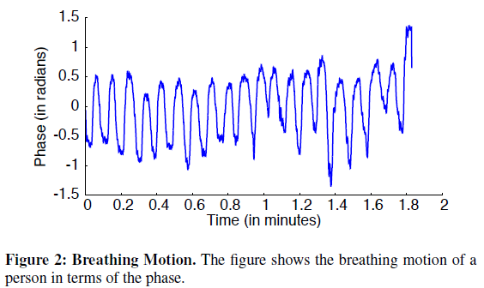
Operating method
1st step
  Eliminate reflections from static objects and sort reflections from moving objects.
  Output is the time signal reflected off the human body.
2nd step
  Identifies changes in the signal due to body motion as opposed to breathing motion. (prevent such movements from causing errors in breath monitoring)
  The breathing motion is slow in comparison to human body motion.
3rd step
  Analyzes the signal to track the breathing motion.
  It uses the phase variations to track subtle sub-centimeter oscillations in a reflector (e.g., chest breathing motion)

Slide 5
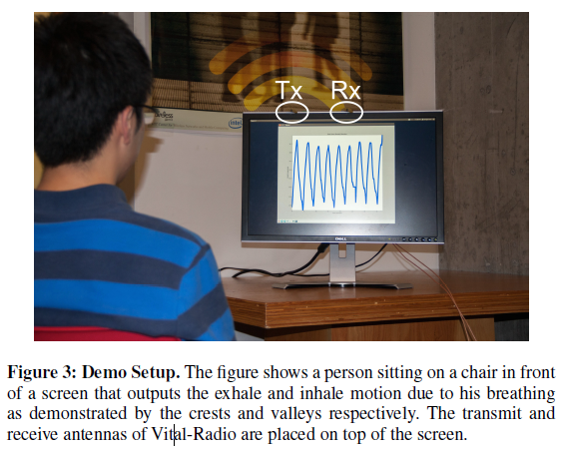
Demo setup
It includes the WiTrack hardware connected to a transmit-receive antenna pair at the frontend and to a machine via the USRP software radio at the backend.
Processing is performed in real-time in the UHD driver of the USRP
The demo will be set up in a 3m 2.5m space in a corner of a room.
The user can move his chair as desired within the region

