Slide 1
7.4: NAT Traversal
유자은
2015010659

Slide 2
Background
Alternative to ALGs and NAT editors in NAT devices, an application may perform its own NAT traversal.
Ascertain the external IP address and port numbers that will be used when its traffic passes through a NAT
Modifying its protocol operations accordingly.
Using servers which are not behind NATs, attempt to provide for method that allows direct communication.
  Direct methods have been popular for peer-to-peer file sharing, games, and communication applications.

Slide 3
7.4.1 Pinholes and Hole Punching
NAT typically includes traffic rewriting and filtering.
Traffic for a particular application is permitted to traverse the NAT in both direction, when NAT mapping is established.
  Usually apply only to a single application for its duration of execution.
‘Pinhole’: permit only a certain temporary traffic flow
  e.g. a pair of IP address and port number combination
‘Hole Punching’: method that attempts to allow systems, each behind a NAT, to communicate directly using pinholes.

Slide 4
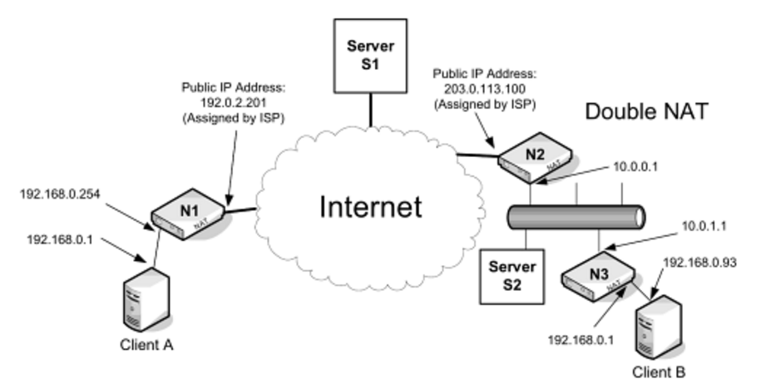
7.4.1 Pinholes and Hole Punching
Clients contact a known server using an outgoing connection that establishes a mapping in its local NAT.
The server has connections to each of the clients and knows their external addressing information.
Exchanges the client external addressing information between the clients.
Client can attempt a direct connection to the other clients.
Skype peer-to-peer application

Slide 5
7.4.2 UNilateral Self-Address Fixing (UNSAF)
‘Fixing’ the address information
  Determine the addresses their traffic will use when passed through a NAT.
  Indirect:
    Inferring a NATs behavior by exchanging traffic through the NAT.
    VoIP
  Direct:
    Direct conversation between the app and the NAT itself using one or more special protocols.
    Some are supported by some NATs.

Slide 6
7.4.2 UNilateral Self-Address Fixing (UNSAF)
UNSAF
  Attempting to fix its address without help from the NAT.
  The address fixing in a so-called unilateral fashion.
Involves a set of heuristics and is not guaranteed
  NAT behaviors vary significantly based on vendor and particular circumstance.
  Operate similar to hole punching, but with a added generality.

Slide 7
7.4.2 UNilateral Self-Address Fixing (UNSAF)
Hazards
  Lack of a single “outside” address realm for every NAT.
  Two levels of NAT – B receives different answers depending on whether it contacts server S1 or S2.
  Possibility that the NAT behavior changes over time or become inconsistent.

Slide 8
7.4.2 UNilateral Self-Address Fixing (UNSAF)
IAB has indicated that UNSAF protocol proposals must include responses to the concerns in their specification:
  1. Define a limited-scope problem that the “short-term” UNSAF proposal addresses.
    2. Define and exit strategy/transition plan.
    3. Discuss what design decisions make the approach “brittle.”
    4. Identify requirements for longer-term, sound technical solution.
    5. Discuss any noted practical issues or experiences known.

Slide 9
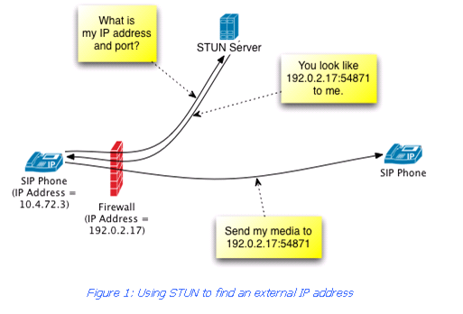
7.4.3 Session Traversal Utilities for NAT (STUN)
Client /server protocol that is able to ascertain the external IP address and port numbers.
Keep NAT bindings current by using keepalive messages.
Several pubic STUN servers are configured with globally reachable IP addresses.
Main job of a STUN server is to echo back STUN requests sent to it in a way that allows the client addressing information to be fixed.

Slide 10
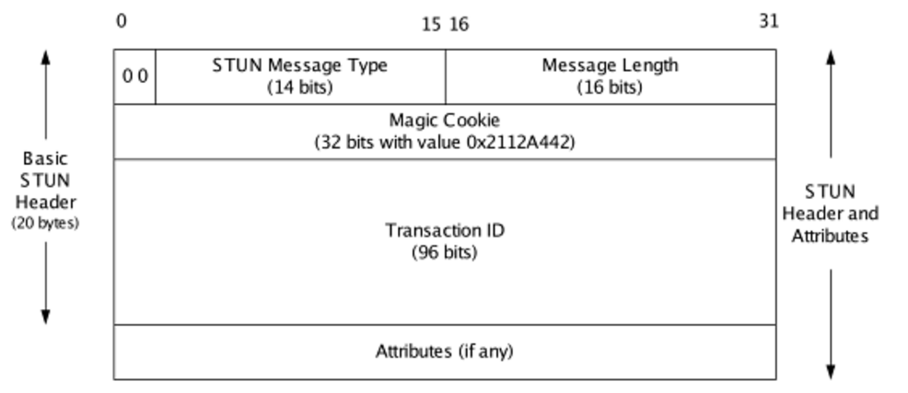
7.4.3 Session Traversal Utilities for NAT (STUN)
Operates using UDP, TCP(or with Transport Layer Security(TLS))
Port 3478 for UDP and TCP, 3479 for TCP/TLS
Two types of transactions : request/response transaction, indication transactions(does not require a response)
Messages are always padded to a multiple of 4 bytes
Message Length field’s 2 low-order bits set to 0
Begins with 00
2¹⁶-1 bytes
0 or more attributes

Slide 11
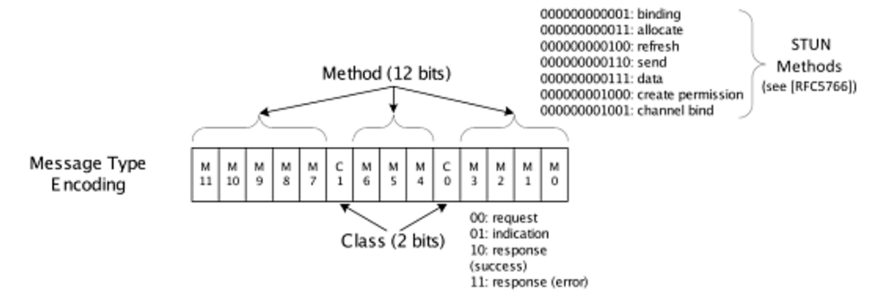
7.4.3 Session Traversal Utilities for NAT (STUN)
Message Type(14 bits) = Method(12 bits) + Class(2 bits)
Class : request, indication, response(success and error)
Method : binding, allocation, refresh, send, data, create
permission, and channel bind

Slide 12
7.4.3 Session Traversal Utilities for NAT (STUN)
STUN messages sent over UDP/IP are supposed to form IP datagrams less than the pMTU, to avoid fragmentation.
If not known, the datagram length(including IP, UDP headers) should be less than 576 bytes(IPv4), 1280 bytes(IPv6).
Has no provision for cases where a response might exceed the pMTU in the reverse direction.
Servers should arrange to use message of appropriate size.
STUN messages carried over UDP/IP are not reliable.
Resending message (interval is based on RTT)
Carried over TCP or TCP with TLS / IP are handled by TCP.

Slide 13
7.4.3 Session Traversal Utilities for NAT (STUN)
STUN attributes are encoded in a TLV (Type, Length, Value).
Type and Length: 16bit
Value: variable(up to 64KB), padded to a multiple of 4 bytes.
Type number < 0x8000: comprehension-required attributes.
The other: comprehension-optional attributes.
If a STUN agent receives comprehension-required attributes it does not know how to process: error!

Slide 14
7.4.3 Session Traversal Utilities for NAT (STUN)
RFC5389 defines a single STUN method called binding
: can be used in either request/response or indication
transactions for address fixing and keeping NAT bindings
current.

Slide 15
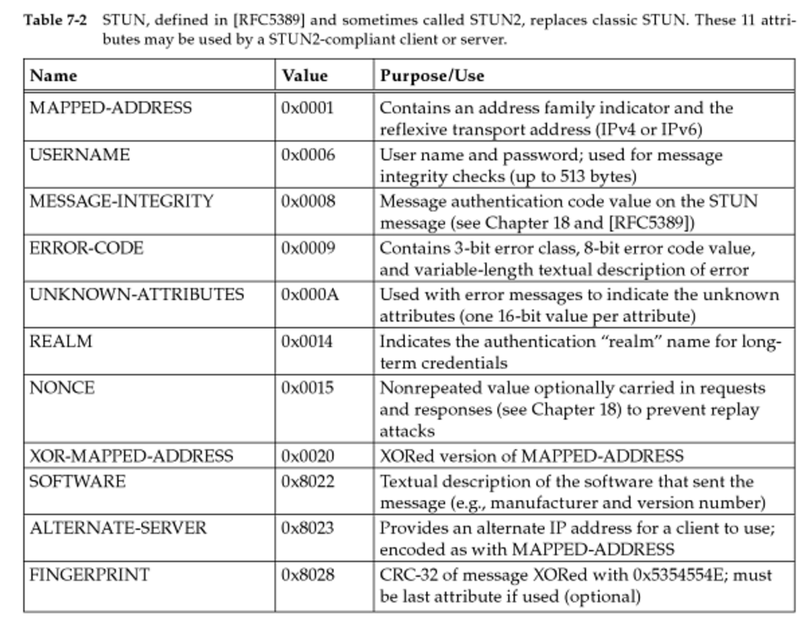
7.4.3 Session Traversal Utilities for NAT (STUN)

Slide 16
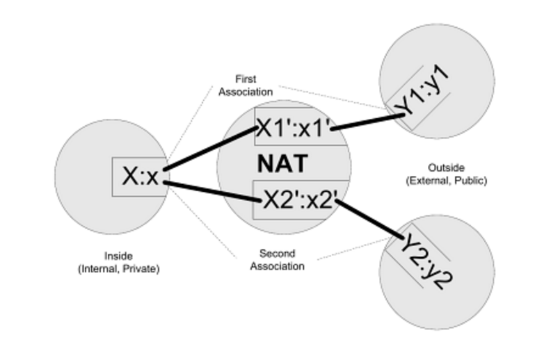
7.4.3 Session Traversal Utilities for NAT (STUN)
MAPPED-ADDRESS + [mapped address]
STUN Server
X1’:x1’ : reflexive transport address or mapped address
MAPPED-ADDRESS: 8 bit Address Family field (IPv4:0x01, IPv6:0x02)
16-bit Port Number field
32-bit or 128-bit Address field
XOR-MAPPED-ADDRESS: XORed with magic cookie value
Detect and bypass generic ALGs

Slide 17
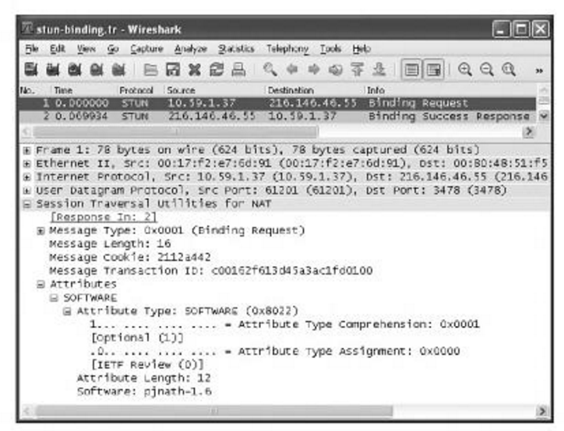
7.4.3 Session Traversal Utilities for NAT (STUN)
STUN binding request
Type: 0x0001 (Binding Request)
Transaction ID: Random
Message Length(16bytes)
= ‘pjnath-1.6’ (10)
+ Padding (2)
+ Attribute Type(2)
+ Attribute Length(2)

Slide 18
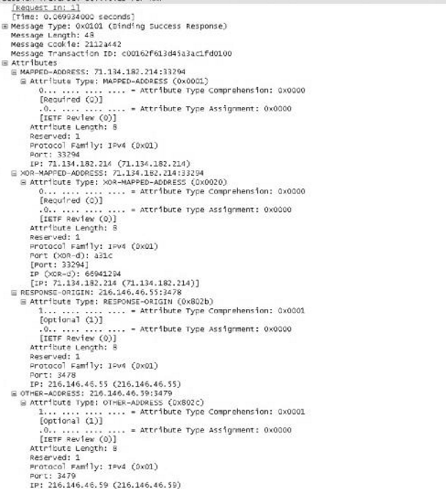
7.4.3 Session Traversal Utilities for NAT (STUN)
STUN binding response
Type: 0x0101 (Binding Request)
MAPPED-ADDRESS :
71.134.182.214:33294
XOR-MAPPED-ADDRESS :
71.134.182.214:33294
RESPONSE-ORIGIN:
216.146.46.55:3478
OTHER-ADDRESS:
216.146.46.59:3479

Slide 19
7.4.3 Session Traversal Utilities for NAT (STUN)
STUN can be used to perform a number of other functions called mechanism
Authentication and message integrity
  Short-term & Long-term credential mechanism.
Short-term credential mechanism
  Last for a single session.
  Often used in particular message exchanges.
Long-term credential mechanism
  Last across sessions: correspond to a login ID or account.
  Used when some particular resource is to be allocated.

Slide 20
7.4.3 Session Traversal Utilities for NAT (STUN)
Short-term credential mechanism
  USERNAME, MESSAGE-INTEGRITY attributes required.
  USERNAME: Indication of which credentials are required.
  Allows sender to use the password in forming an
  integrity check.
  MESSAGE-INTEGRITY: Forming an integrity check.
Long-term credential mechanism
  REALM, NONCE attributes.
  REALM: give the client information to determine which credential is needed to provide adequate authentication.
  NONCE: never reused value for integrity.

Slide 21
7.4.4 Traversal Using Relays around NAT (TURN)
Provides a way for systems to communicate even if they are located behind uncooperative NATs.
Involves relay server that shuttles data between systems.
(common server that is not behind a NAT)
If possible, direct communication methods are preferable.
Finding the server’s address and the appropriate protocol is accomplished using a special DNS NAPTR records or by manual configuration.

Slide 22
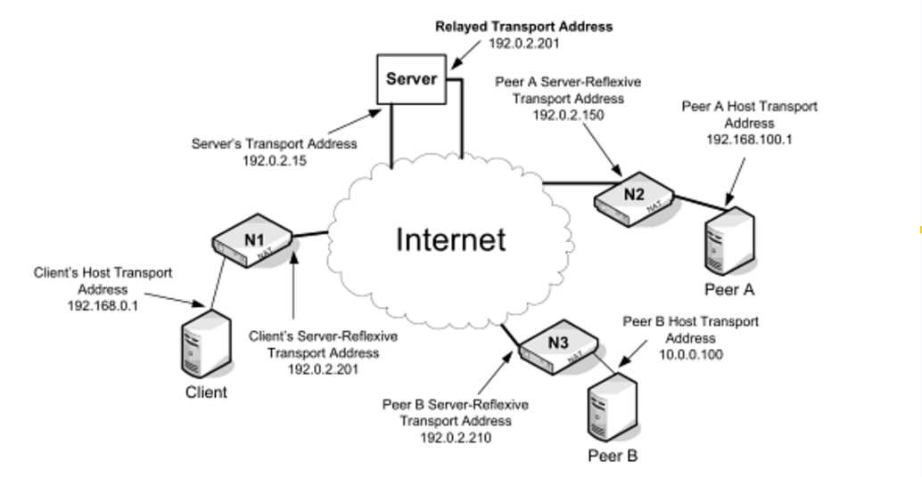
7.4.4 Traversal Using Relays around NAT (TURN)

Slide 23
7.4.4 Traversal Using Relays around NAT (TURN)
Client behind a NAT contacts a TURN server and indicates the other systems (peers) with which it wishes to communicate.
Client obtains address and port (relayed transport address) from the server, which are the address and port number used by the TURN server to communicate with the peers.
Client and peers obtains their own server-reflexive transport addresses.
  These addresses are needed by the client and server to perform the “plumbing” necessary to interconnect the client and peer.
  The method used to exchange this addressing information is not defined within the scope of TURN.
  (exchanged using some other mechanism e.g. ICE)

Slide 24
7.4.4 Traversal Using Relays around NAT (TURN)
Client uses TURN commands to create and maintain allocation on the server.
  An allocation includes the relayed transport address that each peer can use to reach the client.
  Establishing an allocation requires the client to be authenticated, usually using the STUN long-term credential mechanism.
Server/peer data is sent using straightforward TURN messages.
Server/client data is encapsulated with an indication of corresponding peer that sent or should receive the associated data.

Slide 25
7.4.4 Traversal Using Relays around NAT (TURN)
TURN supports two methods for copying data between a client and its peers.
  Send and Data : encodes data using STUN methods.
  Channels : TURN-specific concept.
  Less overhead than the Send and Data method.
The client makes a request to obtain an allocation using a TURN-defined STUN allocation method.
  If successful, the server responds with a success indicator and the allocated relayed transport address.
  Might be denied if the client fails to provide adequate authentication to the server.

Slide 26
7.4.4 Traversal Using Relays around NAT (TURN)
The client must now send refresh messages to keep the allocation alive.
  Expire in 10 min if not refreshed.
  Client can include an alternate lifetime value, encoded as a STUN LIFETIME attribute, in the allocation request.
  Allocation may be deleted by requesting an allocation with zero lifetime.
Allocations are represented using a “5-tuple”.
  Client’s host transport address & port number (Server-reflexive address & port)
  Server transport address & port number
  Transport protocol used to communicate with server

Slide 27
7.4.4 Traversal Using Relays around NAT (TURN)
Allocation may have zero or more associated permissions.
  Only packets with the matching source address received at the TURN server have their data forwarded to the corresponding client.
  Permissions are deleted if not refreshed within 5 min.
TURN enhances STUN with 6 methods, 9 attributes, and 6 error response codes.
  Can be partitioned into support for establishing and maintaining allocations, authentication, and manipulating channels.
  6 methods:
  Allocate(3), Refresh(4) : establish / keep allocation alive
  Send(6), Data(7) : use STUN message to encapsulate
  CreatePermission(8) : establish / refresh a permission.
  ChannelBind(9) : associates a particular peer with channel number

Slide 28
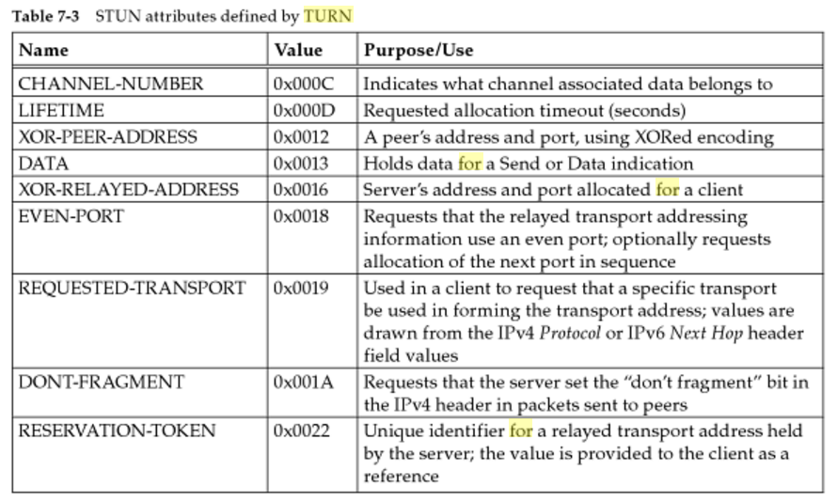
7.4.4 Traversal Using Relays around NAT (TURN)
9 STUN attributes

Slide 29
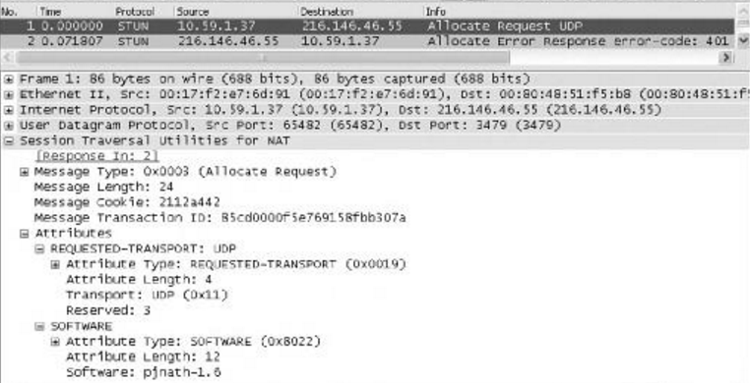
7.4.4 Traversal Using Relays around NAT (TURN)
TURN allocation request
  STUN message (message type: 0x0003)
  STUN long-term credential mechanism : initial request did not include authentication information.

Slide 30
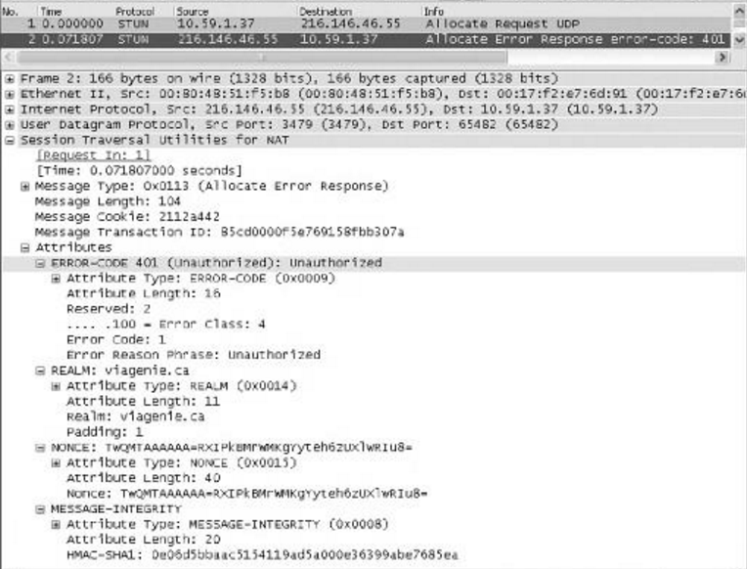
7.4.4 Traversal Using Relays around NAT (TURN)
TURN allocation error response
ERROR-CODE 401 (unauthorized)
REALM
NONCE value

Slide 31
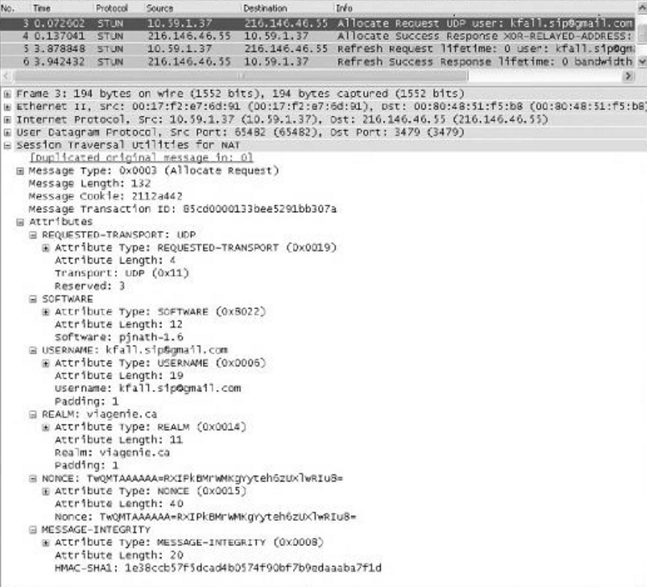
7.4.4 Traversal Using Relays around NAT (TURN)
Second TURN allocation request
USERNAME
REALM
NONCE value
MESSAGE-INTEGRITY

Slide 32
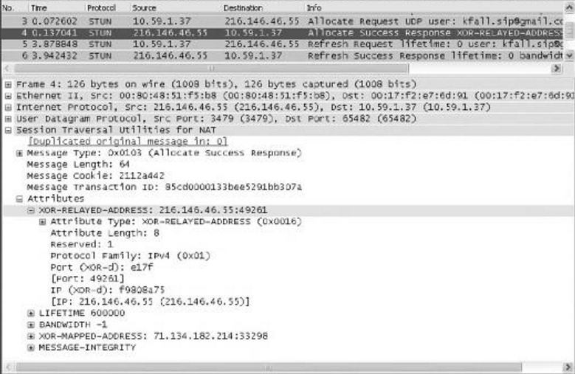
7.4.4 Traversal Using Relays around NAT (TURN)
TURN allocation success response
0 bandwidth: remove allocation
Relayed transport address

Slide 33
7.4.4 Traversal Using Relays around NAT (TURN)
Disadvantage
  Traffic must be relayed through the TURN server. : inefficient routing (TURN server may be far away)
  Certain other traffic contents are not passed through from peer to client. (ICMP values, TTL field values, IP DS Field values)
  Client configuration complexity : STUN long-term credential mechanism. Form of login credential or account assigned by TURN server.

Slide 34
7.4.5 Interactive Connectivity Establishment (ICE)
ICE has been developed to help UDP-based applications hosted behind a NAT establish connectivity.
  Extends the use of ICE to TCP-based application.
A set of heuristics by which an application can perform UNSAF in a relatedly predictable fashion.
ICE makes use of other protocols such as TURN and STUN.
ICE works with and extends “offer/answer” protocols, such as Session Description Protocol (SDP).
  Common to find ICE clients incorporated into VoIP applications that use SDP/SIP for establishing communication.
  Also be used as a generic NAT traversal mechanism.

Slide 35
7.4.5 Interactive Connectivity Establishment (ICE)
Ordinarily, ICE works to establish communication between two SDP entities(agents).
Determining a set of candidate transport addresses that each agent might use for communicating with the other.
  May make use of both STUN and TURN to determine the candidate transport addresses.
Order addresses according to a priority. (direct > relaying)
  Forms an identical set of prioritized candidate pairs (agent & peer)
Controlling agent determined selected candidate pair and nominates which valid candidate pairs will be used.
  Regular nomination / Aggressive nomination

