Slide 1
3.5. Wireless LANs-IEEE 802.11(Wi-Fi)
유형식
2015020799

Slide 2
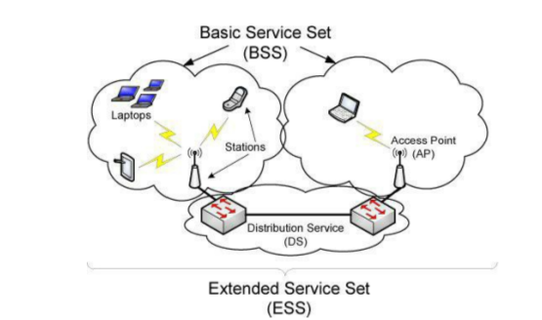
One of the most popular technologies being used to access the Internet today is wireless fidelity (Wi-Fi), also known by its IEEE standard name 802.11, effectively a wireless version of Ethernet.

Slide 3
AP - access point
BSS - a basic service set.
DS - distribution service (basically a “backbone”)
ESS - extended service set.
IBSS - an independent basic service set.
ad hoc mode. In this configuration there is no AP or
DS; instead, direct station-to-station (peer-to-peer)
SSID - set identifier.
ESSID - An extended service set identifier is an SSID that names a collection of connected BSSs and is essentially a name for the LAN that can be up to 32 characters long.

Slide 4
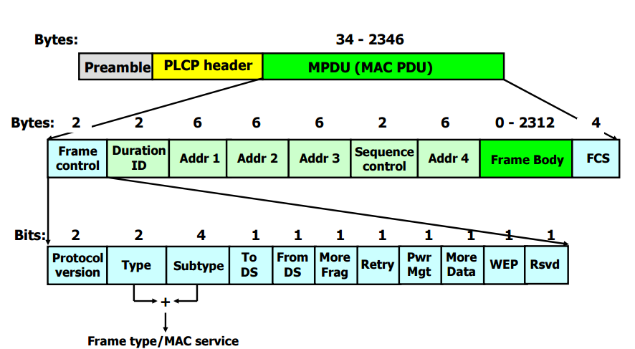
802.11 Frames
There is one common overall frame format for 802.11 networks but multiple types of frames.
PDU - Protocol Data Unit

Slide 5
802.11 Frames
a preamble for synchronization, which depends on the particular variant of 802.11 being used.
the Physical Layer Convergence Procedure (PLCP) header provides information about the specific physical layer in a somewhat PHY-independent way.
The MAC PDU (MPDU) corresponds to a frame similar to Ethernet, but with some additional fields.
The Frame Control Word includes a 2-bit Type field identifying the frame type.

Slide 6
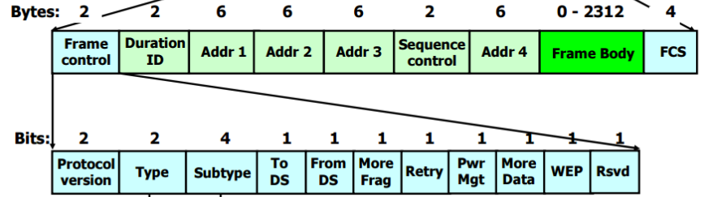
802.11 Frames
management frames, control frames, and data frames.
Type – 2 bit
management frame [00]
control frame [01]
data frame [10]

Slide 7
Management Frames
Used for creating, maintaining, and ending associations between stations and access points.
Determine whether encryption is being used, what the name (SSID or ESSID) of the network is, what transmission rates are supported, and a common time base.
Provide the information necessary when a Wi-Fi interface “scans” for nearby access points.

Slide 8
Management Frames
Linux@com:~$ iwlist wlan0 scan
wlan0 Scan completed :
Cell 01 - Address: 64:E5:99:2C:5C:D2
Channel:7
Frequency:2.442 GHz (Channel 7)
Quality=62/70 Signal level=-48 dBm
Encryption key:on
ESSID:"oslab_new"
Bit Rates:1 Mb/s; 2 Mb/s; 5.5 Mb/s; 11 Mb/s; 18 Mb/s
24 Mb/s; 36 Mb/s; 54 Mb/s
Bit Rates:6 Mb/s; 9 Mb/s; 12 Mb/s; 48 Mb/s
Mode:Master
…SNIP
IE: WPA Version 1
Group Cipher : TKIP
Pairwise Ciphers (1) : TKIP
Authentication Suites (1) : PSK

Slide 9
Management Frames
Sub type(confer)
. 0000 : Association request
. 0001 : Association response
. 0010 : Re-association request
. 0011 : Re-association response
. 0100 : Probe request
. 0101 : Probe response
. 0110 : Timing Advertisement
. 1000 : Beacon
. 1001 : Announcement traffic indication message(ATIM)
. 1010 : Disassociation
. 1011 : Authentication
. 1100 : De-authentication
. 1101 : Action
. 1110 : Action No Ack

Slide 10
Control Frames: RTS/CTS and ACKs
Handle a form of flow control as well as acknowledgments for frames.
Flow control helps ensure that a receiver can slow down a sender that is too fast.
RTS – request-to-send
CTS – clear-to-send
ACK - Acknowledgments help a sender know what frames have been received correctly.
Avoid the hidden terminal problem by instructing each station when it is permitted to transmit.
Initiates an RTS/CTS exchange for a packet if the size of the packet is large enough. (packet size threshold)

Slide 11


Control Frames: RTS/CTS and ACKs
RTS frame
Duration field contain value in µs of time need to transmit data or management + CTS + ACK + SIFS interval.
CTS Frame
Duration field contain value in µs obtained by previous
RTS minus time need to transmit CTS and it SIFS interval.

Slide 12

Control Frames: RTS/CTS and ACKs
ACK frame
Duration field contain value in µs obtained by previous
data or management frame received miuns time need to
transmit ACK and it SIFS interval.

Slide 13
Control Frames: RTS/CTS and ACKs
ACK frame
Duration field contain value in µs obtained by previous
data or management frame received miuns time need to
transmit ACK and it SIFS interval.

Slide 14
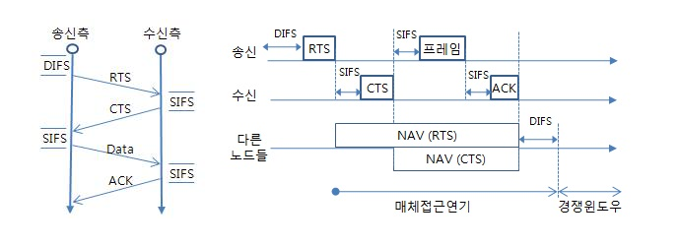
Control Frames: RTS/CTS and ACKs
DCF Collision Avoidance/Backoff Procedure
DIFS - distributed inter-frame space (backoff time)
CW - contention window(경쟁 윈도우)
SIFS(Short Interframe Space)
NAV- Network Allocation Vector

Slide 15
Control Frames: RTS/CTS and ACKs
Sub type (confer)
. 0100 : Beamforming Report Poll
. 0101 : VHT NDP Announcement
. 0111 : Control Wrapper
. 1000 : Block Ack Request
. 1001 : Block Ack
. 1010 : Power save (PS-Poll)
. 1011 : RTS
. 1100 : CTS
. 1101 : ACK
. 1110 : CF End
. 1111 : CF End + CF Ack

Slide 16
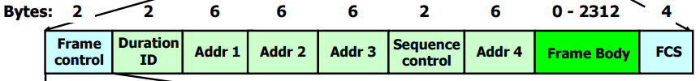
Data Frames, Fragmentation, and Aggregation
Most frames are data frames. - carry data.
802.11 supports frame fragmentation, which can help improve performance when the channel has significant interference. (only unicast destination address)
802.11n supports frame aggregation, which can be used to send multiple frames together with less overhead.
fragment number - 4Bit
Sequence number - 12bit

Slide 17
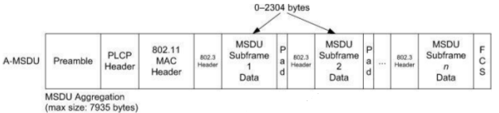
Data Frames, Fragmentation, and Aggregation
A_MSDU - The aggregated MAC service data unit.
Allows for multiple complete 802.3 (Ethernet) frames
to be aggregated within an 802.11 frame.
A savings of up to 22 bytes per extra aggregated frame could be achieved.
The A-MSDU is covered by a single FCS.
- Increases the chances it will be delivered with errors.

Slide 18
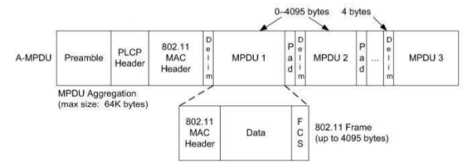
Data Frames, Fragmentation, and Aggregation
A-MPDU - The aggregated MAC protocol data unit, allows multiple MPDUs with the same source, destination, and QoS settings to be aggregated by being sent in short succession.
Multiple (up to 64) 802.11 frames.
802.11 MAC header and FCS and up to 4095 bytes each.

Slide 19
Power Save Mode and the Time Sync Function (TSF)
PSM(Power save mode)is designed to save power by allowing an STA’s radio receive circuitry to be powered down some of the time.
An STA’s outgoing frames have a bit set in the Frame Control Word.
AP noticing this bit being set buffers any frames for the station until the station requests them.
APs ordinarily send out beacon frames indicating various things like SSID, channel, and authentication information.
When stations enter PSM, they do so until the next AP beacon time, when they wake up and determine if there are pending frames stored at the AP for them.

Slide 20
Power Save Mode and the Time Sync Function (TSF)
TSF - Time synchronization function.
An STA check for pending frames at exactly the correct time.
Each station maintains a 64-bit counter reference time (in microseconds) that is synchronized with other stations in the network.
TSF update value is larger than its own. (basically, a copy of the 64-bit counter sent from another station)
802.11e(QoS)
The ability to schedule periodic batch processing of buffered frames. Automatic power save delivery(APSD) may be especially useful for small power-constrained devices.

Slide 21
Power Save Mode and the Time Sync Function (TSF)
802.11n + extended PSM
multiplexing power save mode.
Power down all radio circuit but one of the circuits
until a frame is ready.
Power Save Multi-Poll (PSMP)
Provides a way to schedule transmissions of frames
in both directions (e.g., to and from AP) at the same
time.

Slide 22
Media Access Control
In wireless networks, it is much more challenging to detect a “collision” than in wired networks.(802.3 LANs)
The medium is effectively simplex, and multiple simultaneous transmitters must be avoided, by coordinating transmissions in either a centralized or a distributed manner.
PCF - Point coordination function - optional
DCF - distribution coordination function – mandatory
HCF - hybrid coordination function 802.11e 802.11n

Slide 23
Media Access Control
DCF - distribution coordination function.
A form of CSMA/CA for contention-based access to the medium. It is used for both infrastructure and ad hoc operation.
Carrier Sense Multiple Access with Collision Avoidance.
- listen to see if the medium is free.
- carrier sensing.(may have an opportunity to transmit.)
- wait for a period of time when ready to send
(called the distributed inter-frame space or DIFS)
to allow higher-priority stations to access the channel.
- If channel busy, wait again (transmit or backoff)

Slide 24
Virtual Carrier Sense, RTS/CTS, and the Network Allocation Vector (NAV)
Virtual carrier sense mechanism operates by observing the Duration field present in each MAC frame.
Provides an estimate of how long the medium will be busy carrying the frame.
The Network Allocation Vector (NAV) that estimates how long the medium will be busy carrying the current frame, and consequently how long it will need to wait before attempting its next transmission.
The medium is considered busy when the local NAV is nonzero.
It is reset to 0 upon receipt of an ACK.

Slide 25
Physical Carrier Sense (CCA)
Clear channel assessment (CCA)
The channel is clear based upon energy and waveform recognition.
The 802.11 MAC to understand whether the medium is currently busy.
It is used in conjunction with the NAV to determine when a station must defer (wait) prior to transmission.

Slide 26
DCF Collision Avoidance/Backoff Procedure
Upon determining that the channel is likely to be free a station defers access prior to transmission. Because many stations may have been waiting for the channel to become free,
Each station computes and waits for a backoff time prior to sending.
backoff time = slot time * random number
random number = [0, CW]
aCWmin ≤ CW ≤ aCWmax

Slide 27
HCF and 802.11e/n QoS
Clauses 5, 6, 7, and 9 of the 802.11 standard [802.11-2007] are based in part on the work of the 802.11e.
The terms 802.11e, Wi-Fi QoS, and WMM (for Wi-Fi Multimedia) are often used.
Support of multimedia applications such as voice over IP (VoIP) and streaming video.
The hybrid coordination function (HCF), supports both contention-based and controlled channel access.
HFCA-controlled channel access (HCCA) and the more popular enhanced DCF channel access (EDCA), corresponding to reservation-based and contention-based access, respectively.

Slide 28
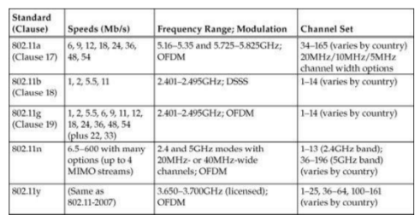
Physical-Layer Details: Rates, Channels, and Frequencies

Slide 29
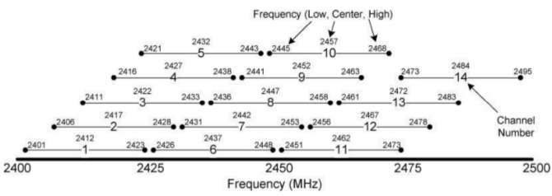
Channels and Frequencies
Regulatory bodies divide the electromagnetic spectrum into frequency ranges allocated for various uses across the world.
It is important to select which channels to assign for use in environments where multiple access points are to be used and even more important when multiple access points serving multiple different networks in the same area are to be used.

Slide 30
Wi-Fi Security
802.11 used an encryption method known as wired equivalent privacy (WEP).
Wi-Fi protected access(WPA)
- Using Temporal Key Integrity Protocol (TKIP)
- Each frame is encrypted with a different encryption
key.
- Includes a message integrity check.
- Both WEP and WPA use the RC4 encryption
algorithm [S96].
- WPA2 uses the Advanced Encryption Standard (AES)
algorithm [AES01].

Slide 31
Wi-Fi Security
the Extensible Authentication Protocol (EAP)
Robust Security Network (RSN)
Robust Security Network Access (RSNA)
Counter with CBC-MAC (CCM) is a generic authenticated encryption block cipher mode.
CCM is defined for use with 128-bit block ciphers, such as the Advanced Encryption Standard (AES).
CCMP - CCM mode Protocol
cipher block chaining message authentication code (CBC-MAC)

Slide 32

Wi-Fi Security
Using pre-shared keys (PSKs) has limitations.
- An administrator may have considerable trouble in
providing keys only to authorized users.
- This approach does not scale to environments with
many users.
A port-based network access control standard called 802.1X.

Slide 33
Wi-Fi Mesh (802.11s)
Wireless stations can act as data-forwarding agents (like APs)
802.11s defines the Hybrid Wireless Routing Protocol(HWRP), based in part on the IETF standards for Ad-Hoc On-Demand Distance Vector (AODV) routing[RFC3561] and the Optimized Link State Routing (OLSR) protocol [RFC3626]
QoS must include an implementation of HWRP and the associated airtime link metric.
Mesh AP(MAP)
- Conventional 802.11 stations can use either APs or
MAPs to access the rest of the wireless LAN.

