Slide 1
Open Shortest Path First (OSPF)
7 Chapter 7

Slide 2
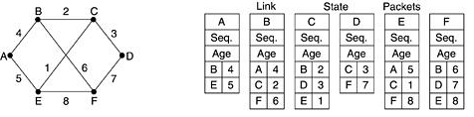
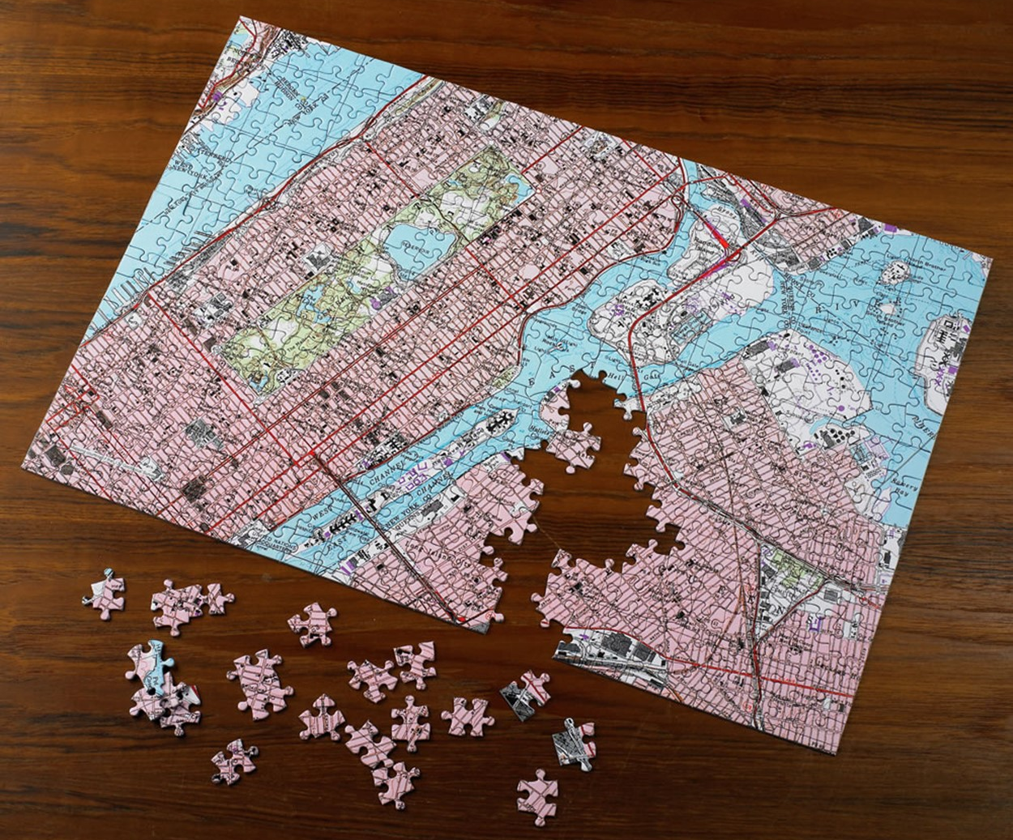
7.1 IGP's Classification
Interior gateway protocol (IGP): Efficient route computation within a network
Theoretical classification
  Distance vector (distance vector) method
    Too many problems; not used since early Internet: e.g.) RIP
  Link state (link state) method
    Used in modern Internet: Fast route convergence
    Local link state broadcast then Dijkstra compute with algorithm
      Every router sends its link info to all other routers

Slide 3
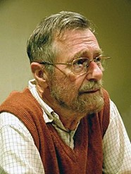
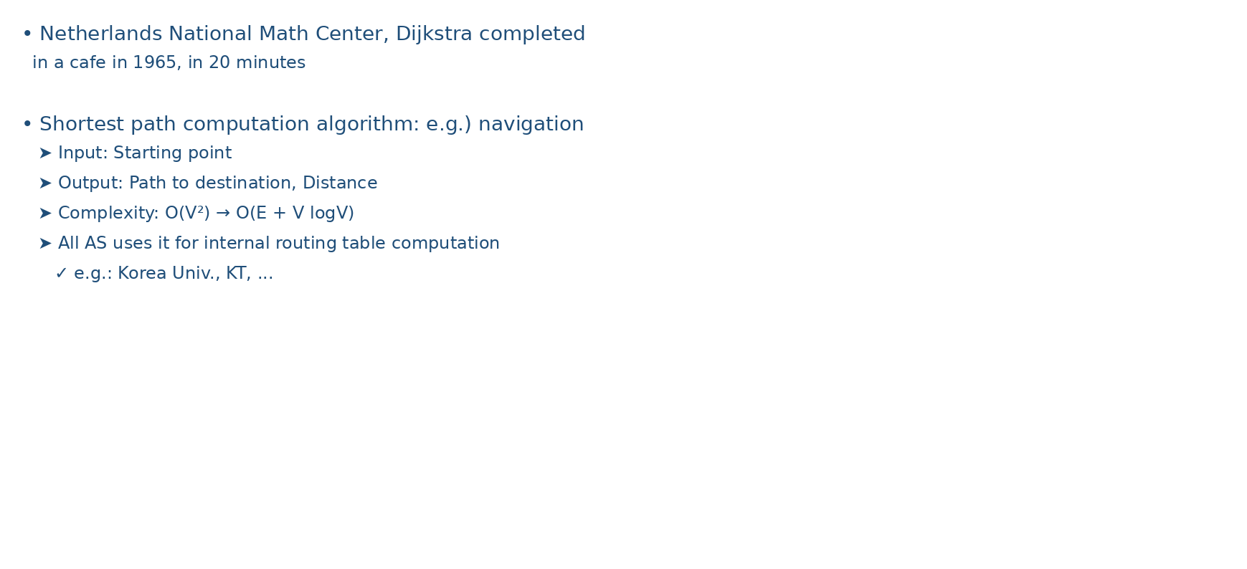
7.2 Dijkstra algorithm
Netherlands National Math Center, Dijkstra 1965, completed in a cafe in 20 minutes
Shortest path computation algorithm: e.g.) navigation
  Input: Starting point
  Output: Path to destination, Distance
  Complexity: $O\left(V2\right)→ O(E+V logV)$
  All AS uses it for internal routing table computation
    e.g.: Korea Univ., KT, …

Slide 4
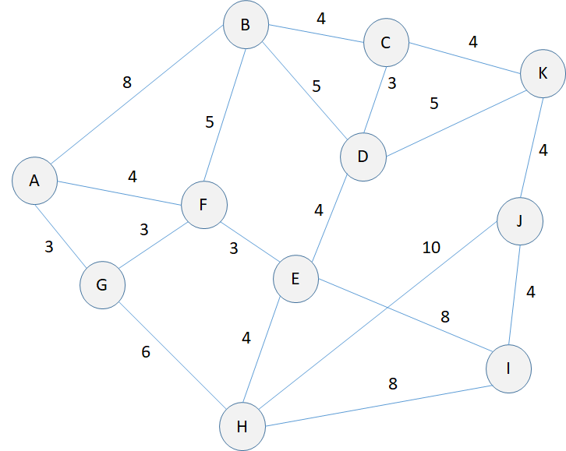
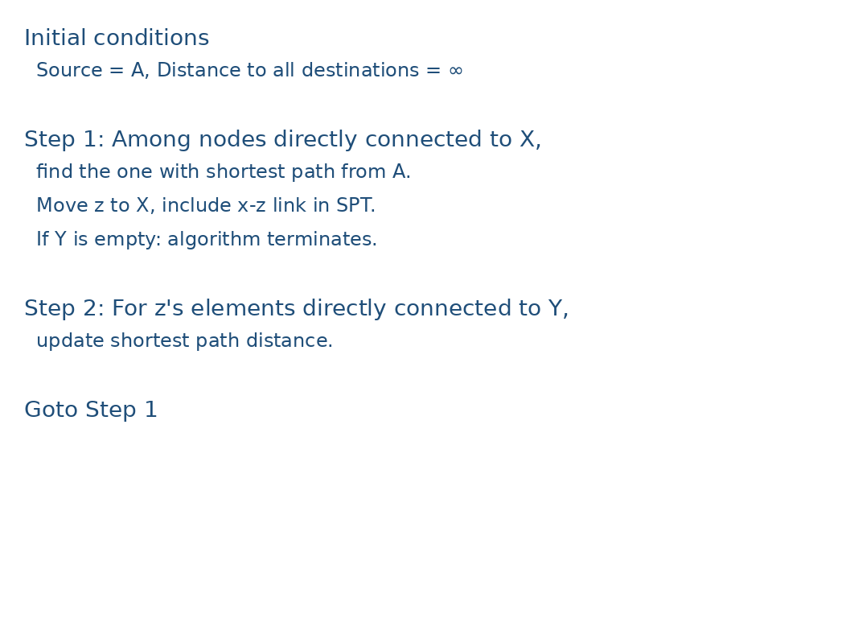
7.2 Dijkstra algorithm
Initial conditions
  Source = $A$, Distance to all destinations = ∞
  $X=\{A\}, Y=U−\{A\}$
$x∈X$Among nodes directly connected to $A$, find shortest path from $z∈Y$ to $X$, move to $x→z$ and include link in SPT
$Y=$: if algorithm terminates
$Y$'s elements $z$All nodes directly connected to $v$'s shortest path distance $min⁡(L\left(v\right),L\left(z\right)+d\left(z,v\right))$update
Goto 2

Slide 5
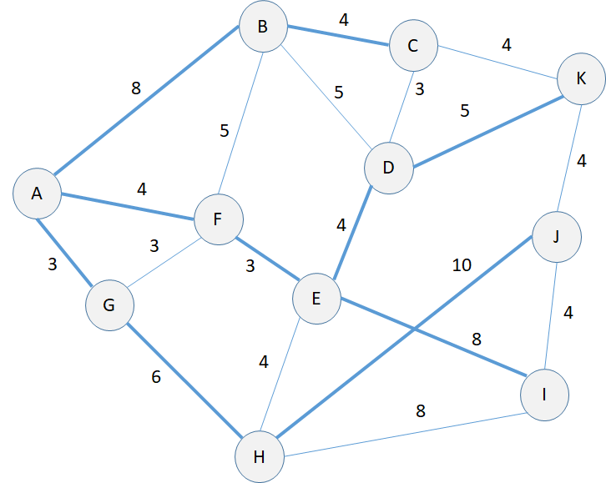
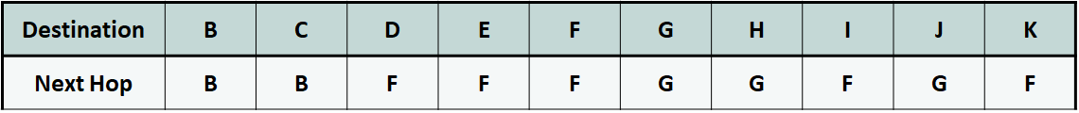
7.2 Dijkstra algorithm
For all destinations, only AA's next hop is recorded in routing table
  Cf. Dijkstra Algorithm was not developed for Internet routing

Slide 6
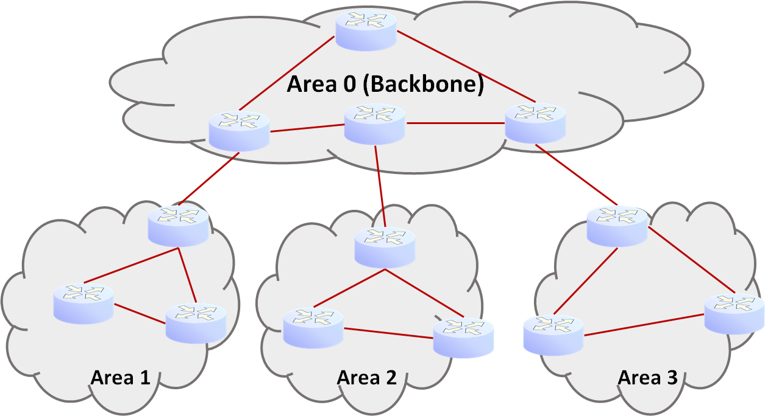
7.3 OSPF's Advanced Routing Support
OSPF is a representative link state algorithm
  IS-IS is also OSPF similar: Mainly ISPused by ISPs
Hierarchical network structure support
  Backbone area 1 (“Area 0”): Max 2-layer structure
    Area border router (ABR)
  Scalability through partitioned management scalability
  Typically contiguous prefix subnets grouped into one area

Slide 7
7.3 OSPF's Advanced Routing Support
Load balancing
  Link crossing cost can be admin set arbitrarily by admin
    Cf. RIP: each link always has cost 1 : admin: no way for admin to change routing
  Link cost can be 0 - 65535; no intrinsic meaning
    Same link can have different values depending on direction
  Link cost assignment: 2 methods
    Arbitrary: e.g.) Links to suppress traffic inflow → high cost assignment
    100 Mbps reference-based expression
      10 Mbps link → 100 Mbps / 10 Mbps = cost 10
      1 Gbps link → 100 Mbps / 1 Gbps = cost 0.1

Slide 8
7.3 OSPF's Advanced Routing Support
OSPF IP Multicast for OSPF
  Broadcast not used X → Unrelated nodes' unnecessary OSPF packet processing prevented
  Address = 224.0.0.5
    1-hop scope Address
    Link state can be hop-by-hop across the entire network

Slide 9
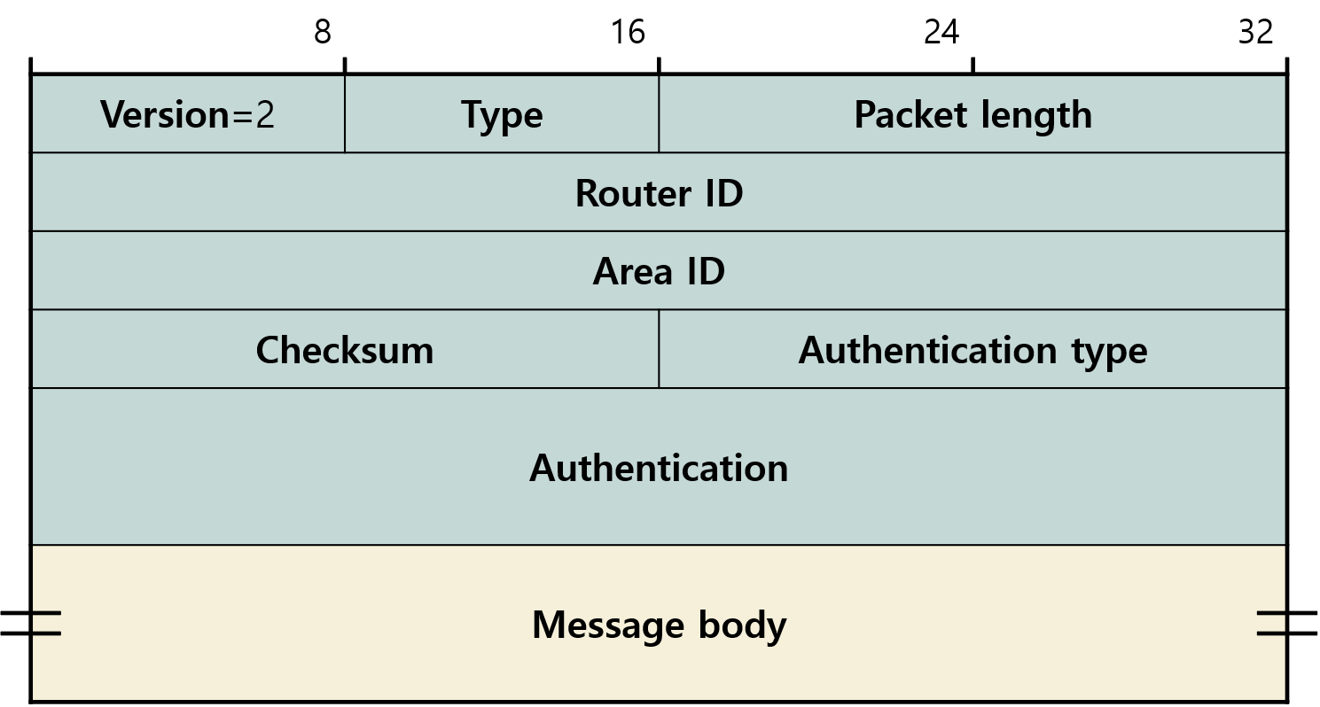
7.4 OSPF Protocol
Packet Format
  Type
    Hello
    Database Description (DBD)
    Link State Request (LSR)
    Link State Update (LSU)
    Link State Acknowledgement (LSAck)

Slide 10
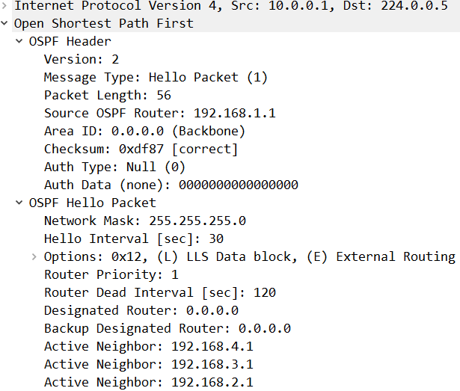
7.4 OSPF Protocol
Hello Message
  Verifies connectivity with adjacent routers
  10 sec per message
    40 sec without Hello : no connection X → Routing recalculation
  Recently Hello includes list of adjacent routers that sent Hello
    If listed in another router's Hello neighbor list?
      Means bidirectional connectivity is possible
  Router ID can be Source IP address; note this may differ
    A router naturally has multiple IP addresses
      Router ID is one representative among them

Slide 11
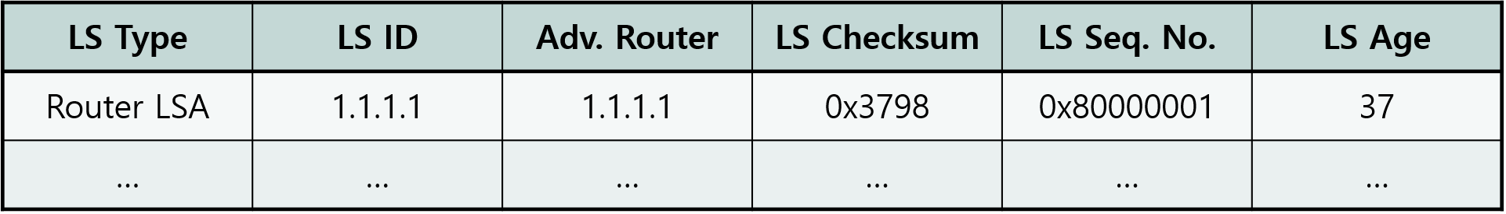
7.4 OSPF Protocol
OSPF: Each router using OSPF maintains a Link State Database (LSDB)
  LSDB = Link State Advertisement (LSA) collection = “map”
=
All OSPF routers must have the same LSDB(“map”) for consistent route computation
  In-sync

Slide 12
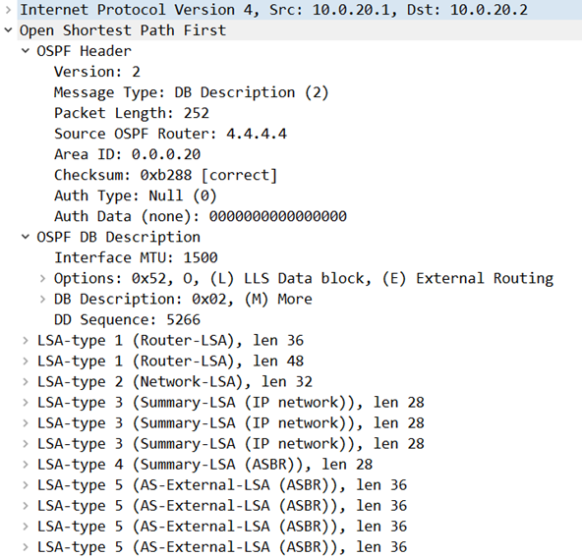
7.4 OSPF Protocol
DBD Message
  New adjacency(adjacency): sent when established
  LSDB Only LSA headers in LSDB exchanged (“Description”)
    For large networks, multiple DBD messages needed
    Only last DBD message has M(more)=0
  Sequence number increments by each 1 transmission
  DBD Receiving router compares with its own LSDB
    Newer LSA info received: not in sync → Link State Request
  In-sync: once in-sync, individual LSU/LSAck exchange via LSA
    No more DBD needed

Slide 13
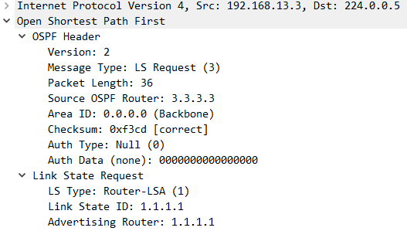
7.4 OSPF Protocol
LSR Message
  <LSA Type, LSID, Adv. Router> can be LSA identifier
  Router LSA: for LSID = Router ID
Rules for determining IP among a router's multiple Router ID
  Manually configured router ID
  Loopback Highest IP Address
    Loopback is logical and never goes down!
    e.g.) 3.3.3.3 →
  Loopback Highest IP Address

Slide 14
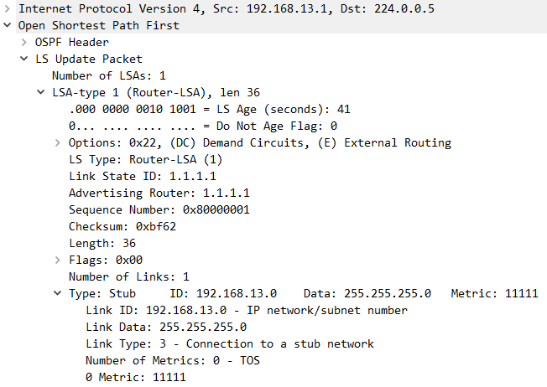
7.4 OSPF Protocol
LSU Message
  LSR: Response to LSR
  LSDB among a router's multiple updated portions of LSDB delivered
  Received LSA can be LSDB stored in LSDB
  Flooded to all interfaces except receiving interface via flooding

Slide 15
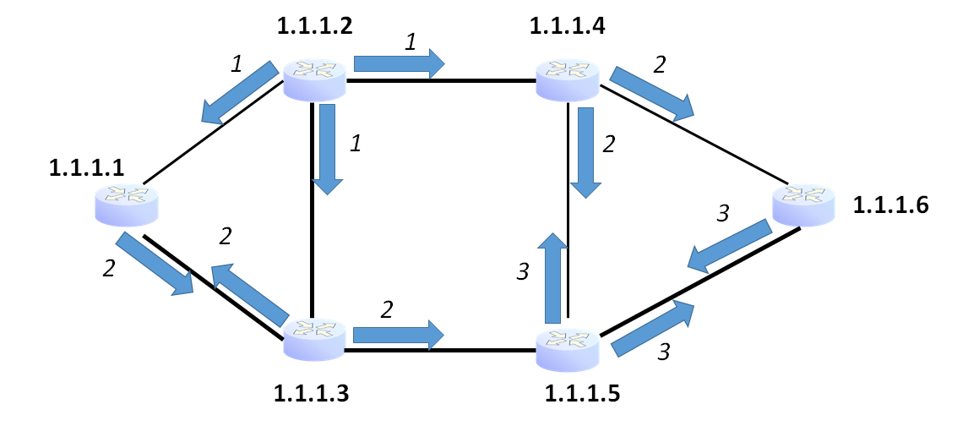
7.4 OSPF Protocol
Reliable flooding
  LSU to LSAck acknowledged by LSAck (“reliable”)
  LSU Copied and sent to all other interfaces except receiving interface (“flooding”)
    Ignored if already received
  Scope limited to within area

Slide 16
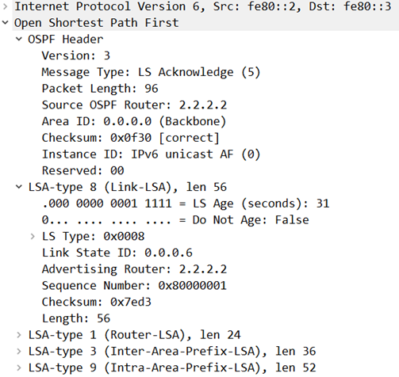
7.4 OSPF Protocol
LSAck Message
  LSU: Acknowledgement for LSU
  LSAck: Retransmit if no LSAck received
  A single LSAck message can acknowledge multiple LSA receipts
  IPv6 OSPF version = 3
Message sequence for new topology changes
  [DBD →] LSR → LSU → LSAck

Slide 17
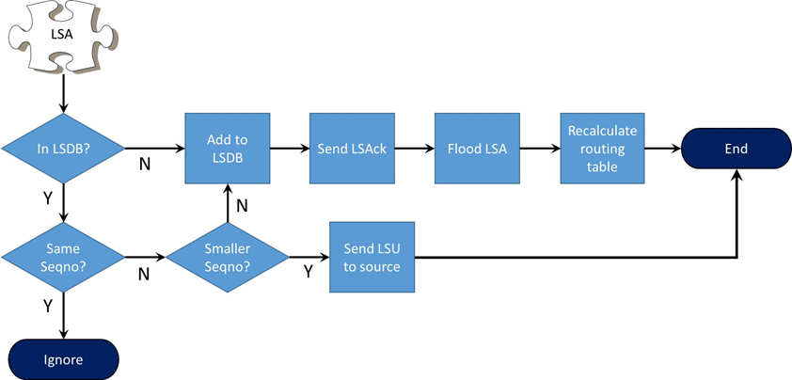
7.4 OSPF Protocol
Message sequence for new topology changes
  [DBD →] LSR → LSU → LSAck
LSDB Synchronization
  Cf. Sequence number: next slide
Dijkstra: New shortest path computation using Dijkstra

Slide 18
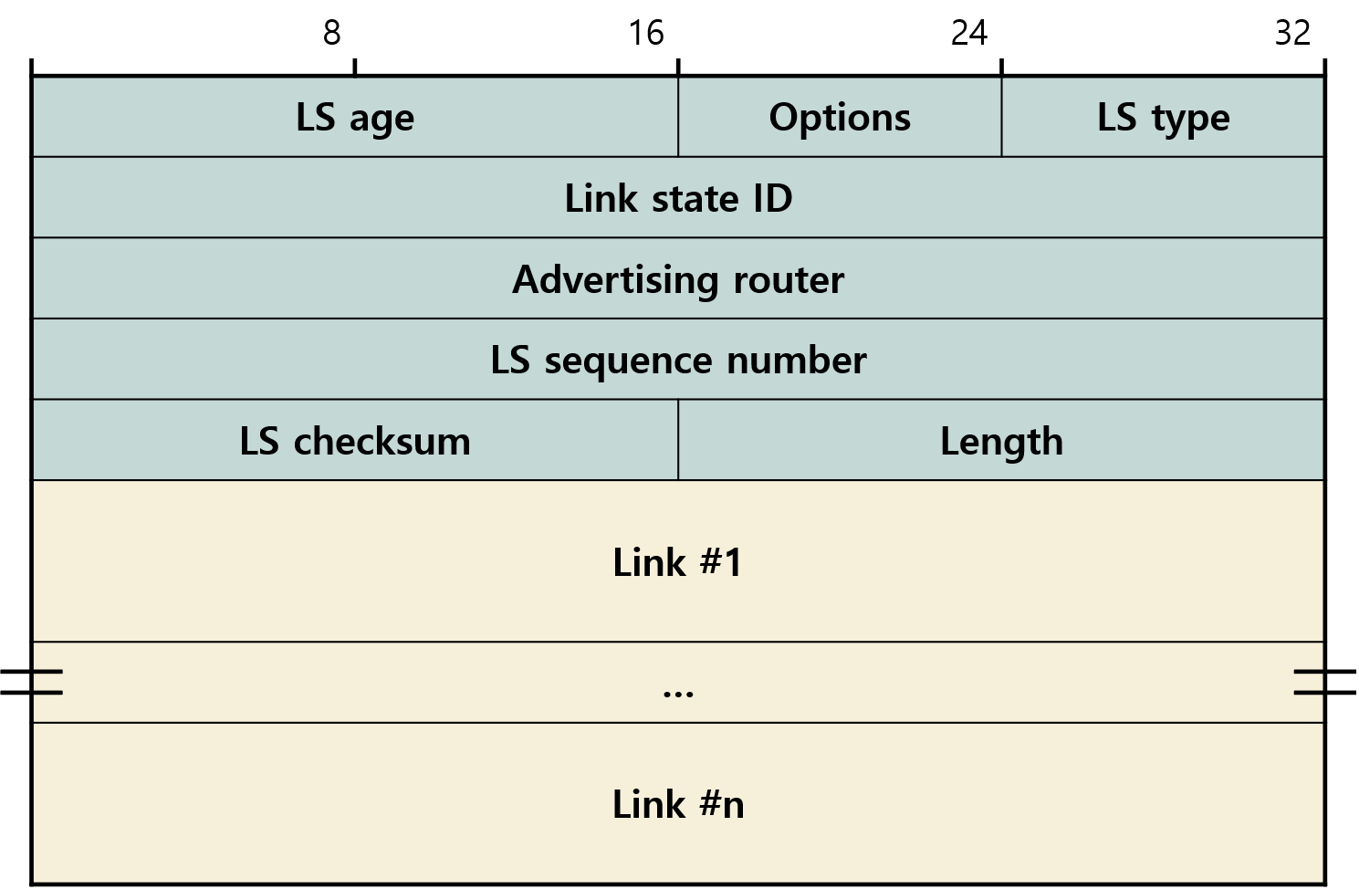
7.4 OSPF Protocol
Link State Advertisement (LSA)
  LSU Carried in LSU message body
LS age [0 – 3600 sec]: Age of this LSA
  1 hour: invalidated after
  To prevent invalidation, 30 min re-LSA flooding
    LS Age = 0 reset
    Sequence number increments by 1 transmission
  0x7fffffff increments up to, then 0x80000001 via wraparound
    To prevent being ignored due to smaller seq num, flood with LS Age = 1hr, then flooding → 1 sec, LSDB delete old seq num version from LSDB LSA
    Then flood again with 0x80000000 via flooding

Slide 19
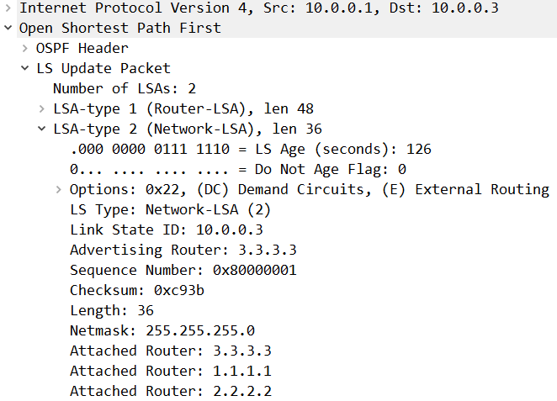
7.4 OSPF Protocol
LSA type
  Router LSA (p.14 see figure on p.14)
    All OSPF routers must send
    Announces metric of all connected links
  Network LSA →
    On shared links, designated router (DR) sends
    On the same link, all LSA can be DR sent to DR
    DR sends collected LSA to 224.0.0.5
  Summary LSA
    A single area , only Router LSA Network LSA are stored in LSDB stored in LSDB
    When sending to other areas, area border router (ABR) summarizes and sends

