Slide 1
Ad hoc and Sensor Networks
Chapter 4: Physical layer
Holger Karl

Slide 2
Goals of this chapter
Get an understanding of the peculiarities of wireless communication
  “Wireless channel” as abstraction of these properties – e.g., bit error patterns
  Focus is on radio communication
Impact of different factors on communication performance
  Frequency band, transmission power, modulation scheme, etc.
  Some brief remarks on transceiver design
Understanding of energy consumption for radio communication
Here, differences between ad hoc and sensor networks mostly in the required performance
  Larger bandwidth/sophisticated modulation for higher data rate/range

Slide 3
Overview
Frequency bands
Modulation
Signal distortion – wireless channels
From waves to bits
Channel models
Transceiver design

Slide 4
Radio spectrum for communication
Which part of the electromagnetic spectrum is used for communication
  Not all frequencies are equally suitable for all tasks – e.g., wall penetration, different atmospheric attenuation (oxygen resonances, …)
twisted pair
coax cable
optical transmission
1 Mm
300 Hz
10 km
30 kHz
100 m
3 MHz
1 m
300 MHz
10 mm
30 GHz
100 μm
3 THz
1 μm
300 THz
VLF
LF
MF
HF
VHF
UHF
SHF
EHF
infrared
visible light
UV
VLF = Very Low Frequency UHF = Ultra High Frequency
LF = Low Frequency SHF = Super High Frequency
MF = Medium Frequency EHF = Extra High Frequency
HF = High Frequency UV = Ultraviolet Light
VHF = Very High Frequency
© Jochen Schiller, FU Berlin

Slide 5
Frequency allocation
Some frequencies are allocated to specific uses
  Cellular phones, analog television/radio broadcasting, DVB-T, radar, emergency services, radio astronomy, …
Particularly interesting: ISM bands (“Industrial, scientific, medicine”) – license-free operation
Some typical ISM bands
Frequency | Comment
13,553-13,567 MHz
26,957 – 27,283 MHz
40,66 – 40,70 MHz
433 – 464 MHz | Europe
900 – 928 MHz | Americas
2,4 – 2,5 GHz | WLAN/WPAN
5,725 – 5,875 GHz | WLAN
24 – 24,25 GHz

Slide 6
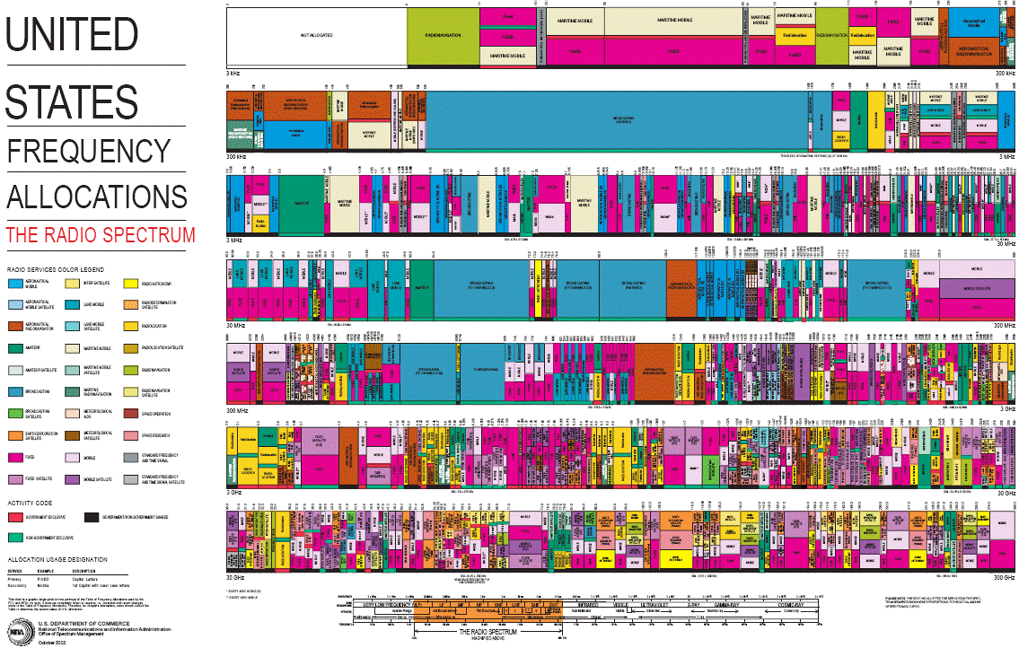
Example: US frequency allocation

Slide 7
Overview
Frequency bands
Modulation
Signal distortion – wireless channels
From waves to bits
Channel models
Transceiver design

Slide 8
Transmitting data using radio waves
Basics: Transmit can send a radio wave, receive can detect whether such a wave is present and also its parameters
Parameters of a wave = sine function:
  Parameters: amplitude A(t), frequency f(t), phase φ(t)
Manipulating these three parameters allows the sender to express data; receiver reconstructs data from signal
Simplification: Receiver “sees” the same signal that the sender generated – not true, see later!

Slide 9
Modulation and keying
How to manipulate a given signal parameter?
  Set the parameter to an arbitrary value: analog modulation
  Choose parameter values from a finite set of legal values: digital keying
  Simplification: When the context is clear, modulation is used in either case
Modulation?
  Data to be transmitted is used select transmission parameters as a function of time
  These parameters modify a basic sine wave, which serves as a starting point for modulating the signal onto it
  This basic sine wave has a center frequency f_{c}
  The resulting signal requires a certain bandwidth to be transmitted (centered around center frequency)

Slide 10
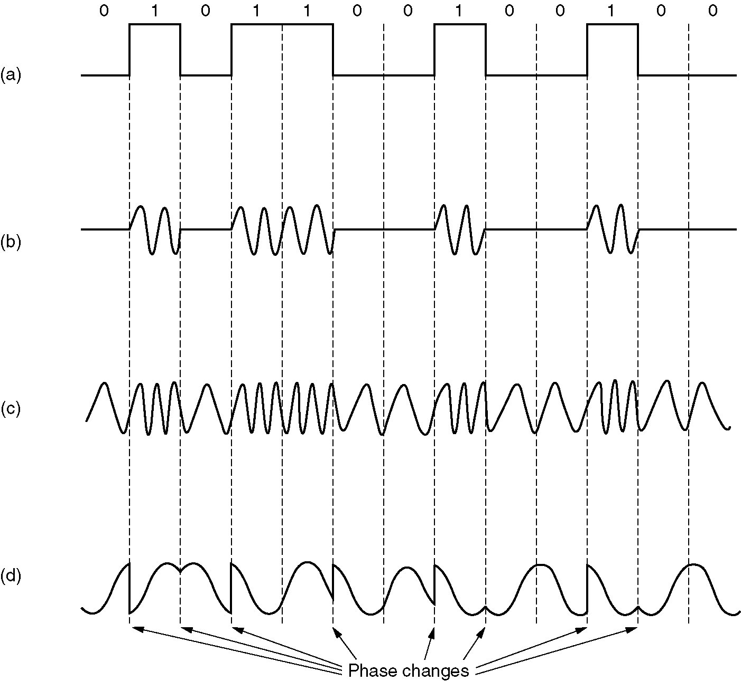
Modulation (keying!) examples
Use data to modify the amplitude of a carrier frequency ! Amplitude Shift Keying
Use data to modify the frequency of a carrier frequency ! Frequency Shift Keying
Use data to modify the phase of a carrier frequency ! Phase Shift Keying
© Tanenbaum, Computer Networks

Slide 11
Receiver: Demodulation
The receiver looks at the received wave form and matches it with the data bit that caused the transmitter to generate this wave form
  Necessary: one-to-one mapping between data and wave form
  Because of channel imperfections, this is at best possible for digital signals, but not for analog signals
Problems caused by
  Carrier synchronization: frequency can vary between sender and receiver (drift, temperature changes, aging, …)
  Bit synchronization (actually: symbol synchronization): When does symbol representing a certain bit start/end?
  Frame synchronization: When does a packet start/end?
  Biggest problem: Received signal is not the transmitted signal!

Slide 12
Overview
Frequency bands
Modulation
Signal distortion – wireless channels
From waves to bits
Channel models
Transceiver design

Slide 13
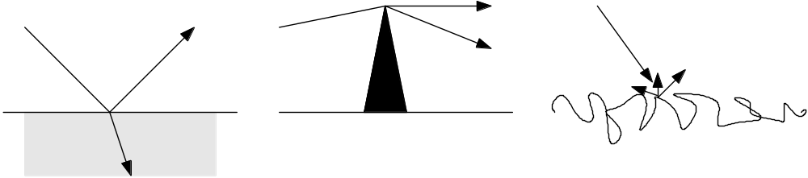
Transmitted signal <> received signal!
Wireless transmission distorts any transmitted signal
  Received <> transmitted signal; results in uncertainty at receiver about which bit sequence originally caused the transmitted signal
  Abstraction: Wireless channel describes these distortion effects
Sources of distortion
  Attenuation – energy is distributed to larger areas with increasing distance
  Reflection/refraction – bounce of a surface; enter material
  Diffraction – start “new wave” from a sharp edge
  Scattering – multiple reflections at rough surfaces
  Doppler fading – shift in frequencies (loss of center)

Slide 14
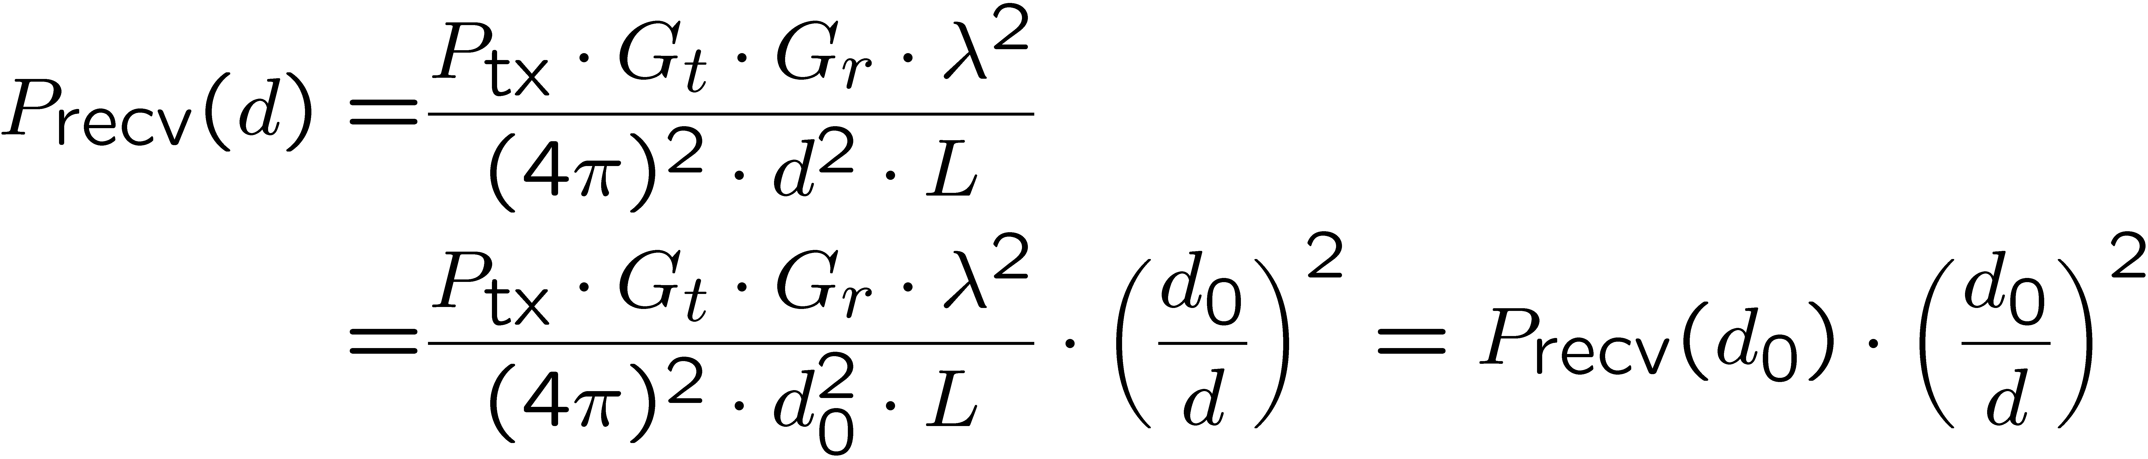
Attenuation results in path loss
Effect of attenuation: received signal strength is a function of the distance d between sender and transmitter
Captured by Friis free-space equation
  Describes signal strength at distance d relative to some reference distance d₀ < d for which strength is known
  d₀ is far-field distance, depends on antenna technology

Slide 15
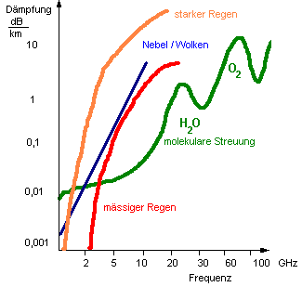
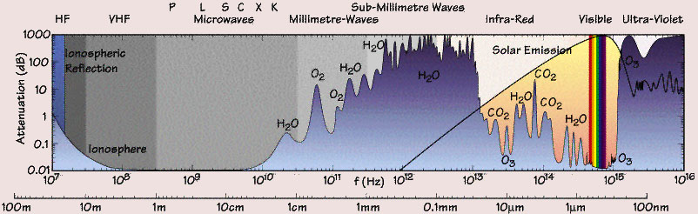
Suitability of different frequencies – Attenuation
Attenuation depends on the used frequency
Can result in a frequency-selective channel
  If bandwidth spans frequency ranges with different attenuation properties
© http://www.itnu.de/radargrundlagen/grundlagen/gl24-de.html
© http://141.84.50.121/iggf/Multimedia/Klimatologie/physik_arbeit.htm

Slide 16
Distortion effects: Non-line-of-sight paths
Because of reflection, scattering, …, radio communication is not limited to direct line of sight communication
  Effects depend strongly on frequency, thus different behavior at higher frequencies
Different paths have different lengths =
propagation time
  Results in delay spread of the wireless channel
  Closely related to frequency-selective fading
  properties of the channel
  With movement: fast fading
Non-line-of-sight path
Line-of-
sight path
multipath
pulses
LOS pulses
signal at receiver
© Jochen Schiller, FU Berlin

Slide 17
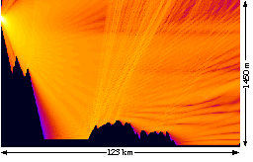
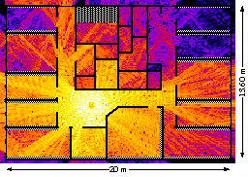
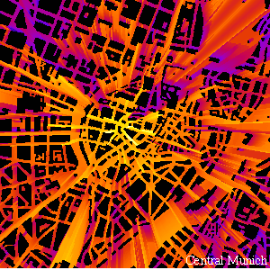
Wireless signal strength in a multi-path environment
Brighter color = stronger signal
Obviously, simple (quadratic) free space attenuation formula is not sufficient to capture these effects
© Jochen Schiller, FU Berlin

Slide 18
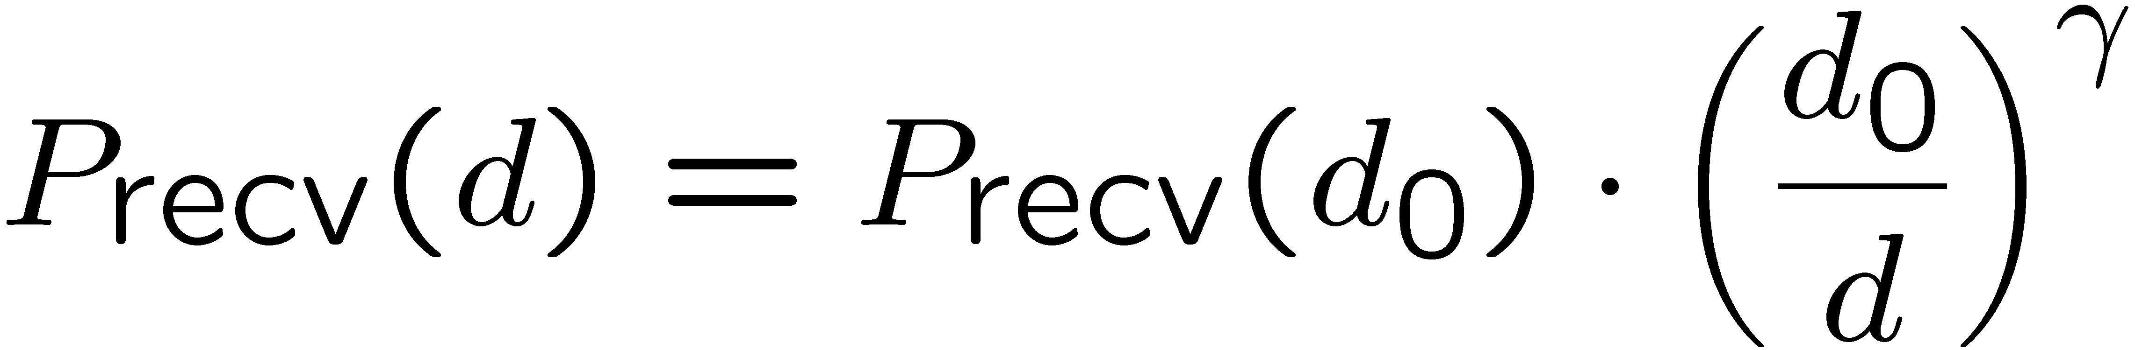
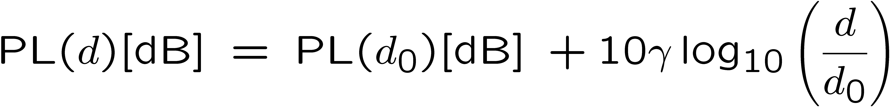
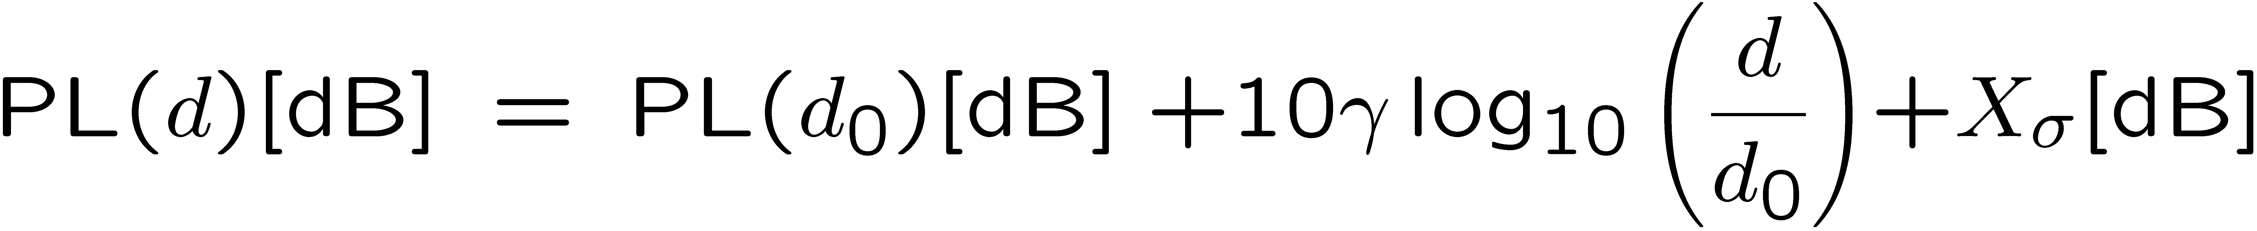
Generalizing the attenuation formula
To take into account stronger attenuation than only caused by distance (e.g., walls, …), use a larger exponent γ > 2
  γ is the path-loss exponent
  Rewrite in logarithmic form (in dB):
Take obstacles into account by a random variation
  Add a Gaussian random variable with 0 mean, variance σ² to dB representation
  Equivalent to multiplying with a lognormal distributed r.v. in metric units ! lognormal fading

Slide 19
Overview
Frequency bands
Modulation
Signal distortion – wireless channels
From waves to bits
Channel models
Transceiver design

Slide 20
Noise and interference
So far: only a single transmitter assumed
  Only disturbance: self-interference of a signal with multi-path “copies” of itself
In reality, two further disturbances
  Noise – due to effects in receiver electronics, depends on temperature
    Typical model: an additive Gaussian variable, mean 0, no correlation in time
  Interference from third parties
    Co-channel interference: another sender uses the same spectrum
    Adjacent-channel interference: another sender uses some other part of the radio spectrum, but receiver filters are not good enough to fully suppress it
Effect: Received signal is distorted by channel, corrupted by noise and interference
  What is the result on the received bits?

Slide 21
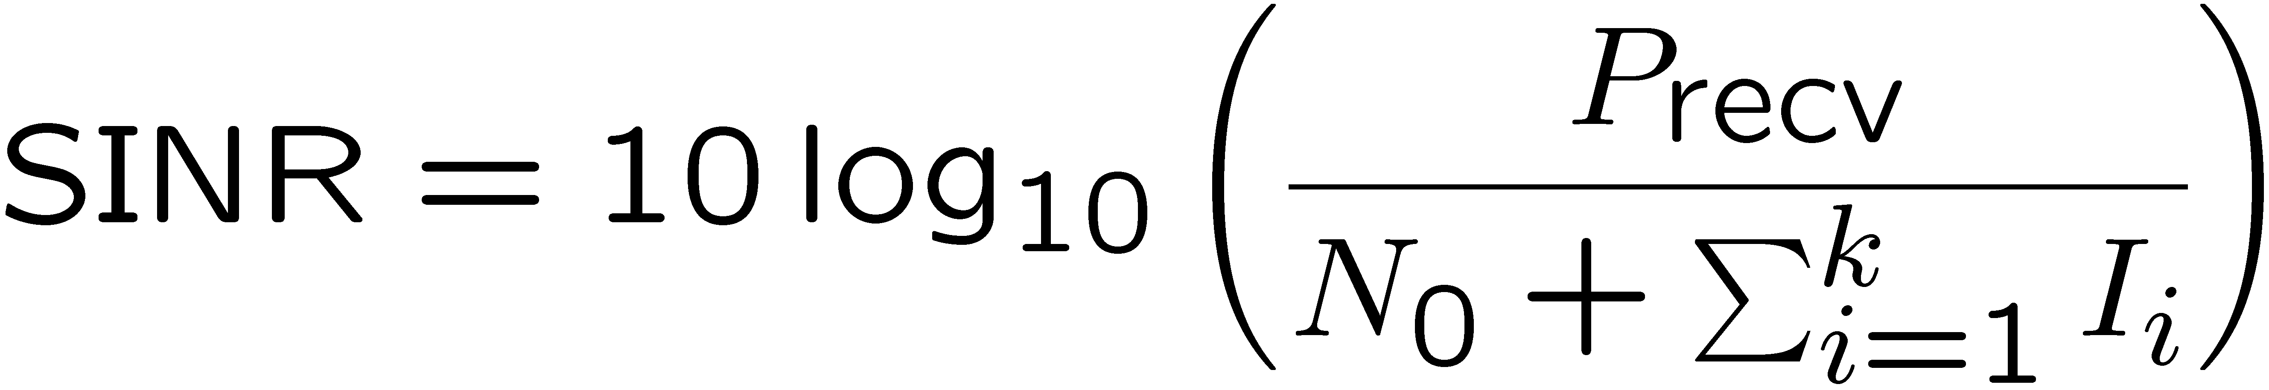
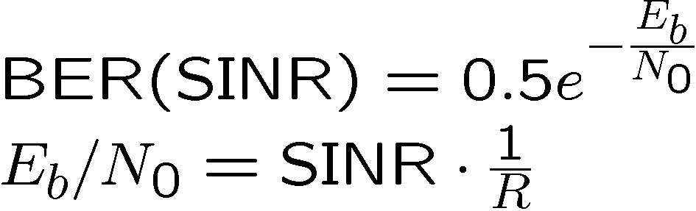
Symbols and bit errors
Extracting symbols out of a distorted/corrupted wave form is fraught with errors
  Depends essentially on strength of the received signal compared to the corruption
  Captured by signal to noise and interference ratio (SINR)
SINR allows to compute bit error rate (BER) for a given modulation
  Also depends on data rate (# bits/symbol) of modulation
  E.g., for simple DPSK, data rate corresponding to bandwidth:

Slide 22
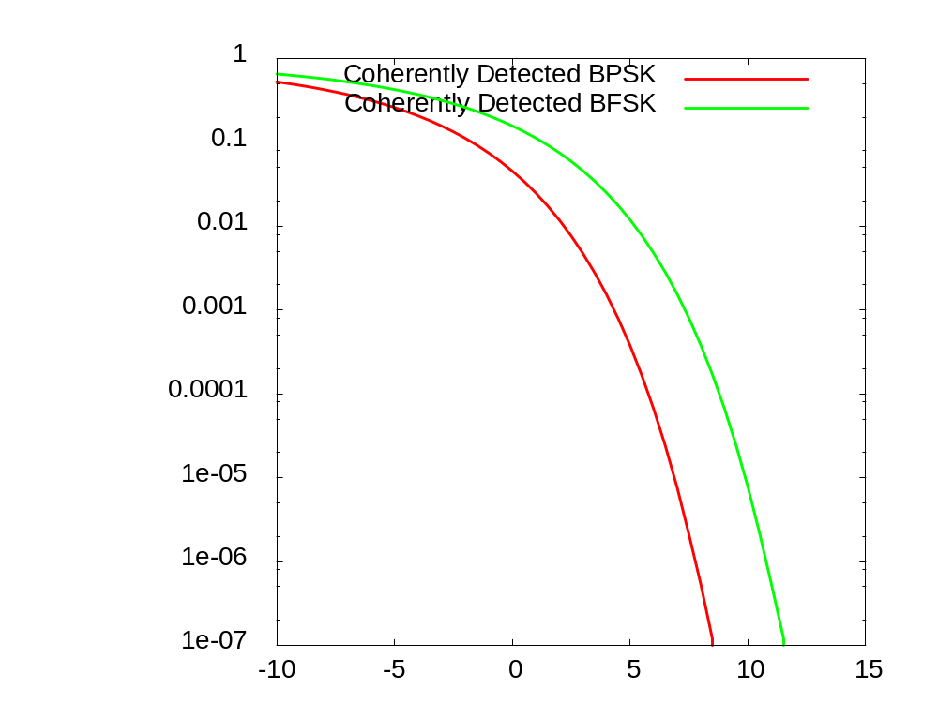
Examples for SINR ! BER mappings
BER
SINR

Slide 23
Overview
Frequency bands
Modulation
Signal distortion – wireless channels
From waves to bits
Channel models
Transceiver design

Slide 24
Channel models – analog
How to stochastically capture the behavior of a wireless channel
  Main options: model the SNR or directly the bit errors
Signal models
  Simplest model: assume transmission power and attenuation are constant, noise an uncorrelated Gaussian variable
    Additive White Gaussian Noise model, results in constant SNR
  Situation with no line-of-sight path, but many indirect paths: Amplitude of resulting signal has a Rayleigh distribution (Rayleigh fading)
  One dominant line-of-sight plus many indirect paths: Signal has a Rice distribution (Rice fading)

Slide 25
Channel models – digital
Directly model the resulting bit error behavior
  Each bit is erroneous with constant probability, independent of the other bits ! binary symmetric channel (BSC)
  Capture fading models’ property that channel be in different states ! Markov models – states with different BERs
    Example: Gilbert-Elliot model with “bad” and “good” channel states and high/low bit error rates
  Fractal channel models describe number of (in-)correct bits in a row by a heavy-tailed distribution
good
bad

Slide 26
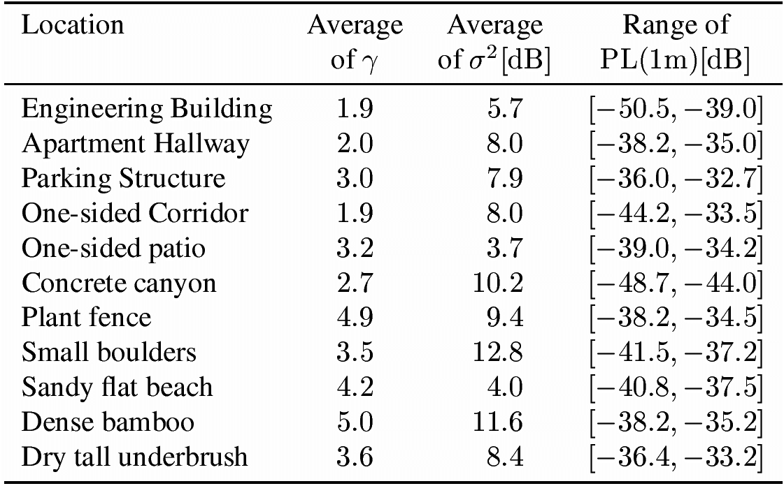
WSN-specific channel models
Typical WSN properties
  Small transmission range
  Implies small delay spread (nanoseconds, compared to micro/milliseconds for symbol duration)
  ! Frequency-non-selective fading, low to negligible inter-symbol interference
    Coherence bandwidth
    often > 50 MHz
Some example
measurements
  γ path loss exponent
  Shadowing variance σ²
  Reference path
  loss at 1 m

Slide 27
Wireless channel quality – summary
Wireless channels are substantially worse than wired channels
  In throughput, bit error characteristics, energy consumption, …
Wireless channels are extremely diverse
  There is no such thing as THE typical wireless channel
Various schemes for quality improvement exist
  Some of them geared towards high-performance wireless communication – not necessarily suitable for WSN, ok for MANET
    Diversity, equalization, …
  Some of them general-purpose (ARQ, FEC)
  Energy issues need to be taken into account!

Slide 28
Overview
Frequency bands
Modulation
Signal distortion – wireless channels
From waves to bits
Channel models
Transceiver design

Slide 29
Some transceiver design considerations
Strive for good power efficiency at low transmission power
  Some amplifiers are optimized for efficiency at high output power
  To radiate 1 mW, typical designs need 30-100 mW to operate the transmitter
    WSN nodes: 20 mW (mica motes)
  Receiver can use as much or more power as transmitter at these power levels
    ! Sleep state is important
Startup energy/time penalty can be high
  Examples take 0.5 ms and ¼ 60 mW to wake up
Exploit communication/computation tradeoffs
  Might payoff to invest in rather complicated coding/compression schemes

Slide 30
Choice of modulation
One exemplary design point: which modulation to use?
  Consider: required data rate, available symbol rate, implementation complexity, required BER, channel characteristics, …
  Tradeoffs: the faster one sends, the longer one can sleep
    Power consumption can depend on modulation scheme
  Tradeoffs: symbol rate (high?) versus data rate (low)
    Use m-ary transmission to get a transmission over with ASAP
    But: startup costs can easily void any time saving effects
    For details: see example in exercise!
Adapt modulation choice to operation conditions
  Akin to dynamic voltage scaling, introduce Dynamic Modulation Scaling

Slide 31
Summary
Wireless radio communication introduces many uncertainties and vagaries into a communication system
Handling the unavoidable errors will be a major challenge for the communication protocols
Dealing with limited bandwidth in an energy-efficient manner is the main challenge
MANET and WSN are pretty similar here
  Main differences are in required data rates and resulting transceiver complexities (higher bandwidth, spread spectrum techniques)

