Slide 1
Ch. 16 (supplement)
Mobile Communication Networks

Slide 2
Generations
Each generation is 10 years
  1G (1980s): analog, voice
  2G (1990s): digital, voice
  3G (2000s): packets, data replaces voices
  4G (2010s): IP, broadband
  5G (2020s): softwarization
  6G (2030s): ?

Slide 3
Cellular network organization
Use multiple low-power transmitters (100 W or less)
Areas divided into cells
  Each served by its own antenna
  Served by base station consisting of transmitter, receiver, and control unit
  Band of frequencies allocated
  Cells set up such that antennas of all neighbors are equidistant (hexagonal pattern)
    Idealized pattern, in order to approximate coverage
    In reality, less regular

Slide 4
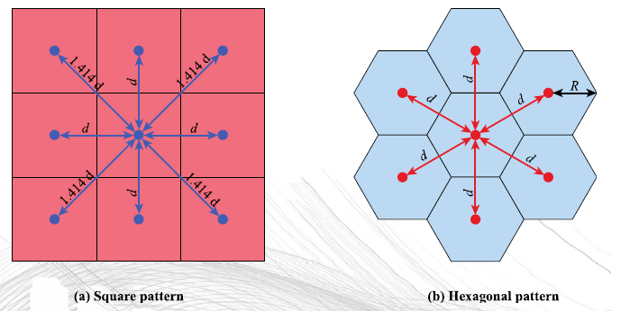
Cellular network organization
Cellular geometries

Slide 5
Cellular network organization
Why not a large service area
  Number of simultaneous user to serve would be limited
  Mobile handset needs to have larger power requirement
Smaller cells
  Allows frequency reuse, hence increased capacity for the same area of coverage
  Lower power handset
  Cons : Cost of cells, hands off between cells must be supported, need to track user to route incoming call or message

Slide 6
Frequency reuse
Adjacent cells assigned different frequencies to avoid interference or crosstalk
Objective is to reuse frequency in nearby cells
  10 to 50 frequencies assigned to each cell
  Transmission power controlled to limit power at that frequency escaping to adjacent cells
  The issue is to determine how many cells must intervene between two cells using the same frequency

Slide 7
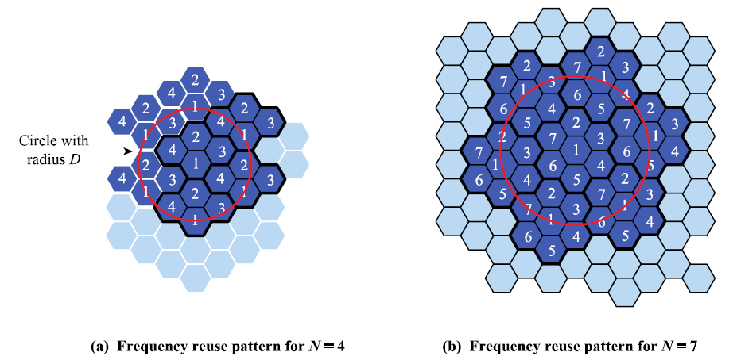
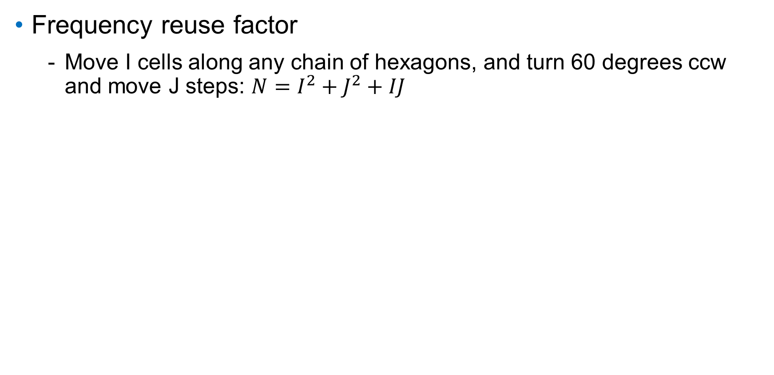
Frequency reuse
Frequency reuse factor
  Move I cells along any chain of hexagons, and turn 60 degrees ccw and move J steps: $N=I^{2}+J^{2}+IJ$

Slide 8
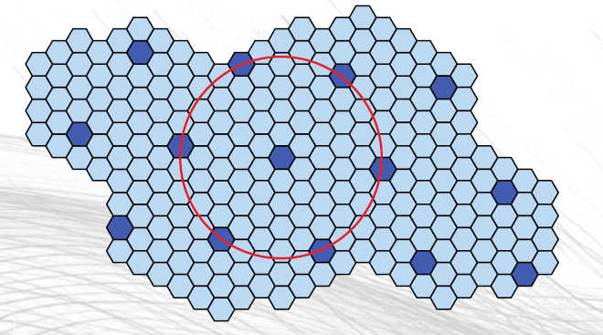
Frequency reuse
Exercise: What is N here?

Slide 9
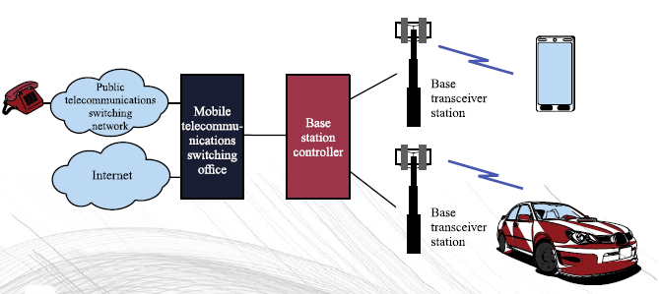
Cellular system overview

Slide 10
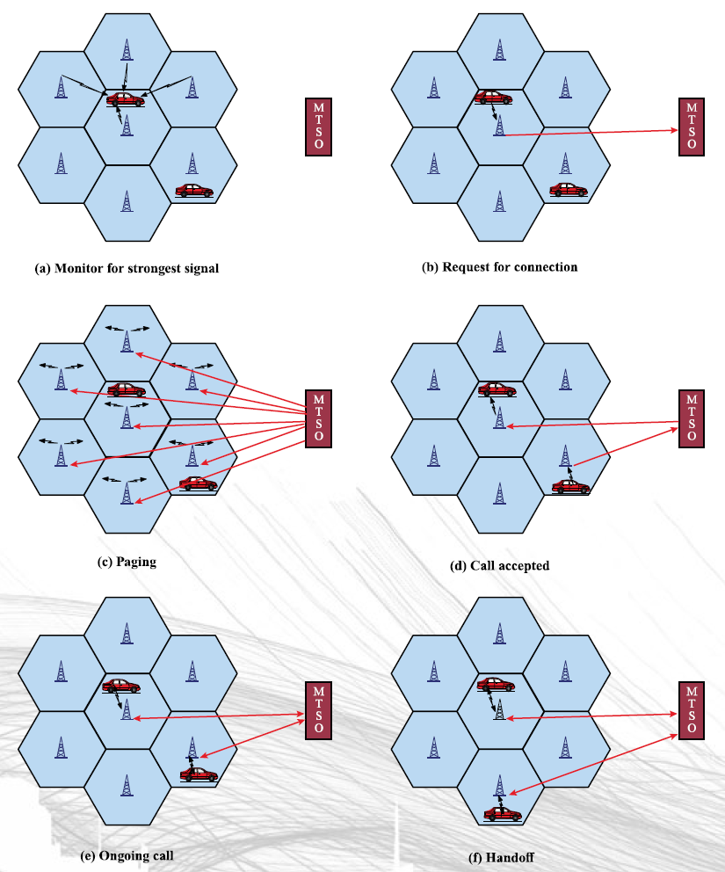
Example of mobile cellular call

Slide 11
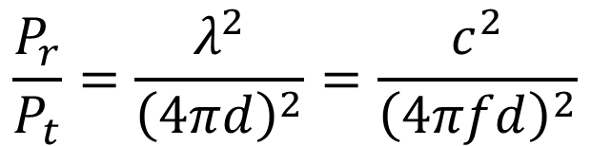
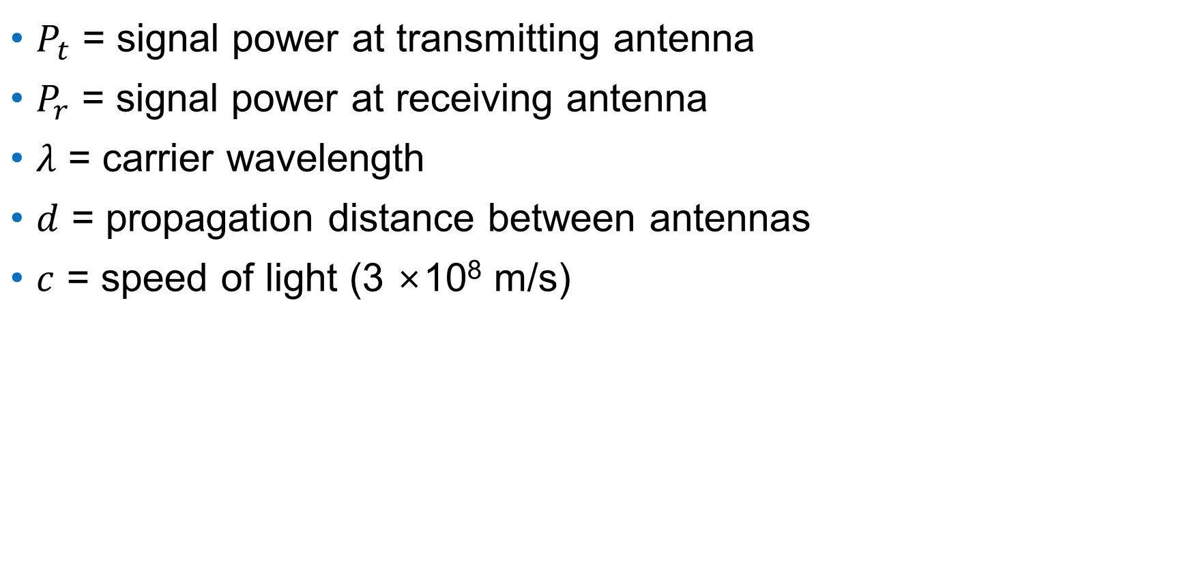
Free space loss
$P_{t}$ = signal power at transmitting antenna
$P_{r}$ = signal power at receiving antenna
$λ$ = carrier wavelength
$d$ = propagation distance between antennas
$c$ = speed of light (3 ×10⁸ m/s)
$$\frac{P_{r}}{P_{t}}=\frac{λ^{2}}{{\left(4πd\right)}^{2}}=\frac{c^{2}}{{\left(4πfd\right)}^{2}}$$

Slide 12
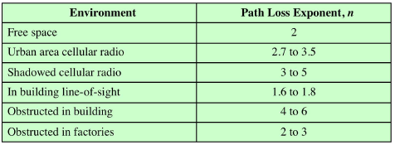
Free space loss
In practice, received power decreases logarithmically with distance
Value of n
$\frac{P_{r}}{P_{t}}=\frac{λ^{2}}{{\left(4πd\right)}^{2}}=\frac{c^{2}}{{\left(4πf\right)}^{2}d^{n}}⇒L=20\log\left(f\right)+10n\log\left(d\right)−147.56$

Slide 13
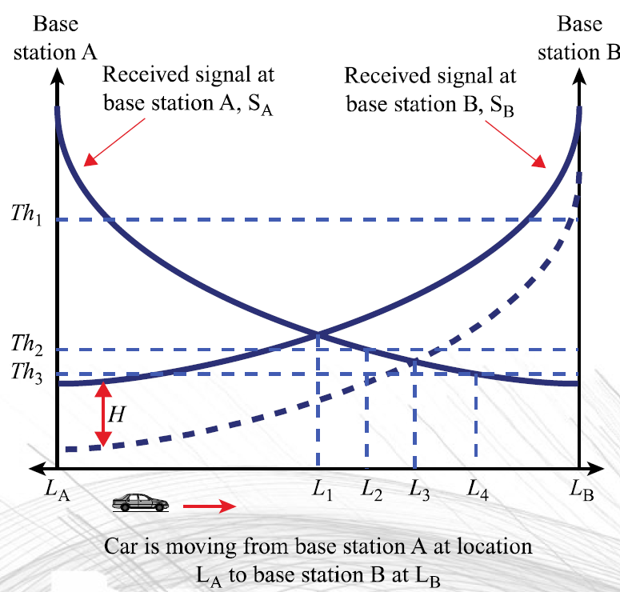
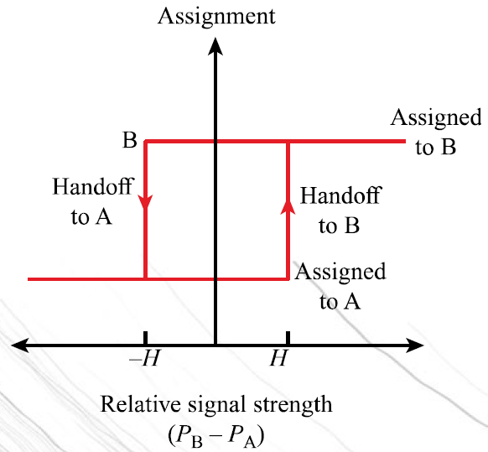
Handoff strategies

Slide 14
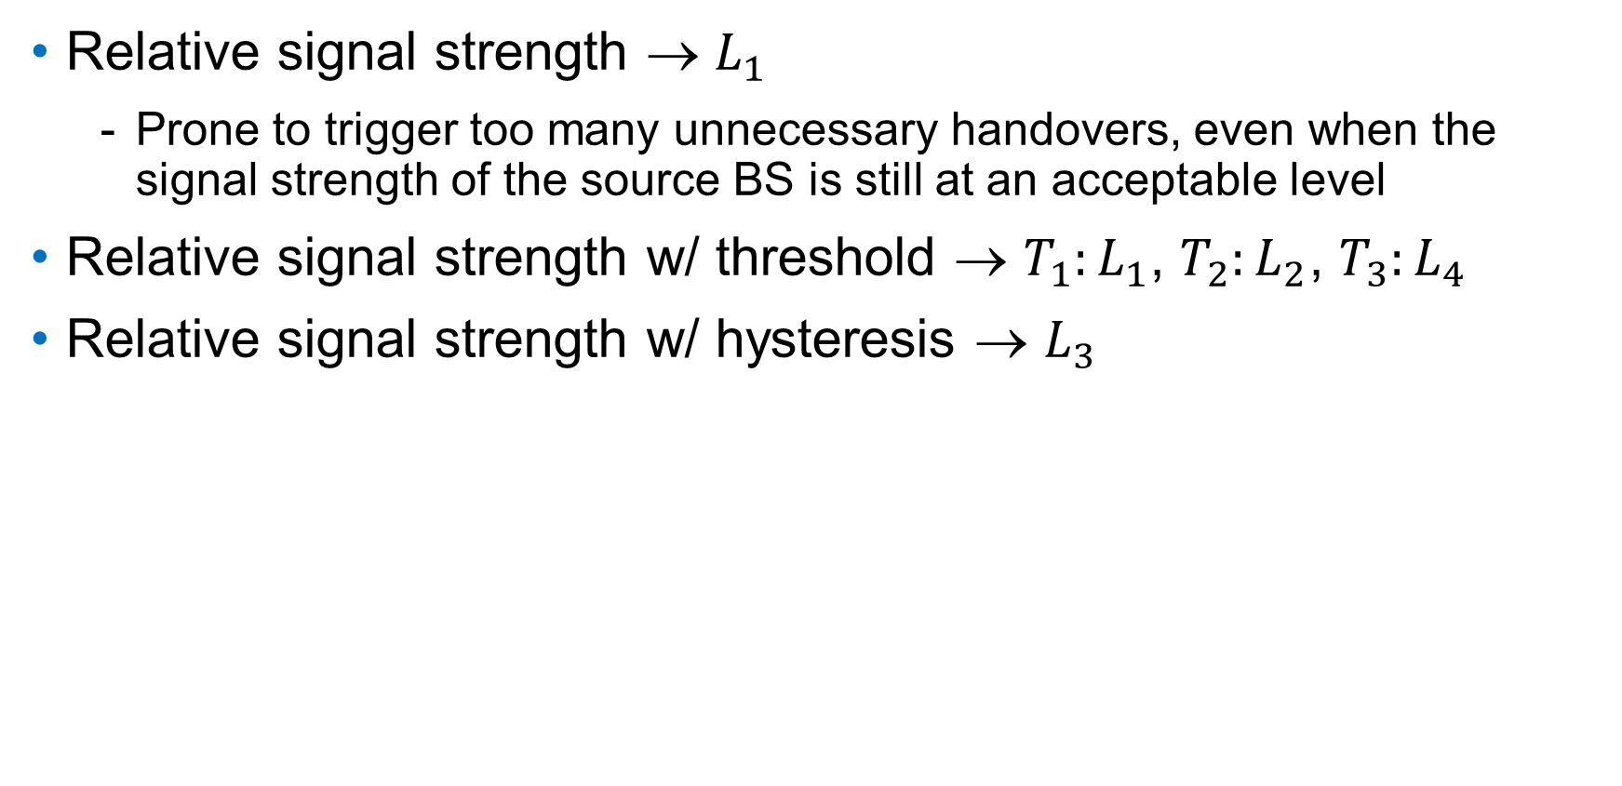
Handoff strategies
Relative signal strength → $L_{1}$
  Prone to trigger too many unnecessary handovers, even when the signal strength of the source BS is still at an acceptable level
Relative signal strength w/ threshold → ${T_{1}:L}_{1}$, ${T_{2}:L}_{2}$, ${T_{3}:L}_{4}$
Relative signal strength w/ hysteresis → $L_{3}$

Slide 15
Identifiers in GSM
IMSI (International Mobile Subscriber Identity)
  Uniquely identifies a GSM subscriber
  Stored in SIM, does not change over time
MSISDN (Mobile Station International Subscriber Directory Number)
  Dialed number
  Different MSISDN can be associated with a SIM
IMEI (International Mobile Equipment Identity)
  Identifies the physical unit mobile equipment

