Slide 1
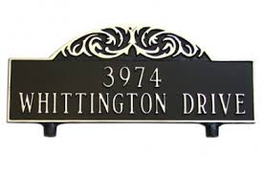
Internet address architecture
Lecture 3

Slide 2
Introduction
Every interface connected to Internet has at least 1 IP address
IPv4 addr
  32 bits → dotted decimal notation
IPv6 addr
  128 bits → colon hexadecimal notation
  Block = 4 hexadecimals

Slide 3
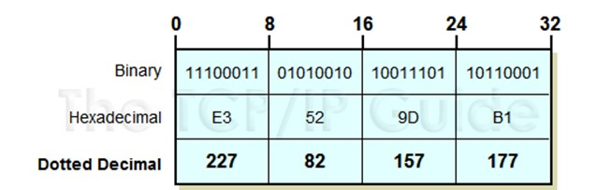
Dotted decimal notation
Only for human convenience
Computer program still needs 32-bit representation – will be translated

Slide 4
Introduction
Three types of IPv4 addresses
Unicast – most applications use this
Multicast – IPTV uses this
Broadcast
IPv6: broadcast addresses are called multicast

Slide 5
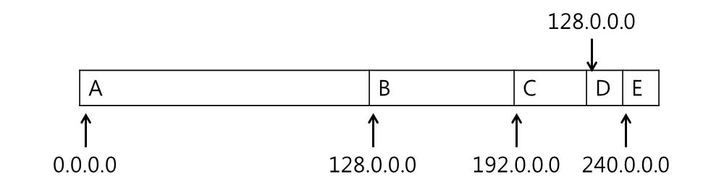
Classful addressing
Class (A, B, C, D, E) determines allocation size
  A, B, C unicast
  D multicast
  E reserved
How many blocks are in A, B, C?
Now → classless addressing

Slide 6
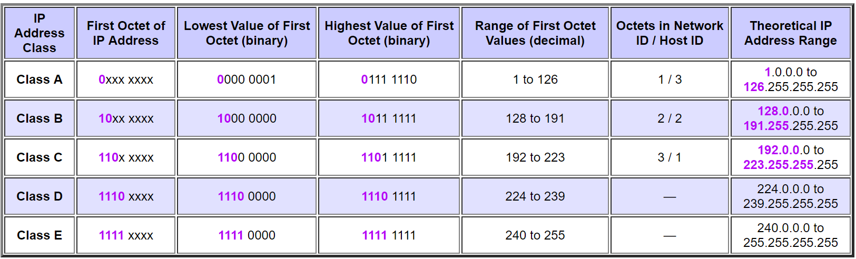
Classful addressing

Slide 7
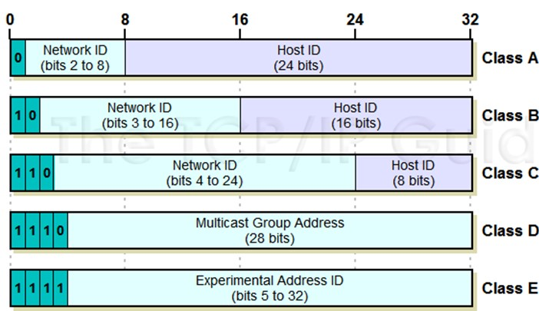
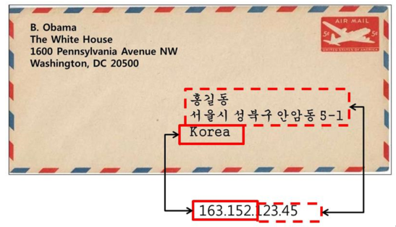
IPv4 unicast address structure
Originally two-tier structure – reflects Internet structure

Slide 8
Problems of classful IP addressing
Lack of internal address flexibility → subnetting
Inefficient use of address space → classless addressing
Proliferation of router table entries → CIDR

Slide 9
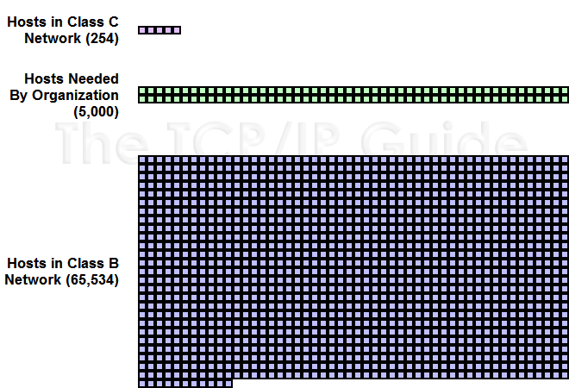
Inefficient use of addresses

Slide 10
Classless addressing
Names still remain (e.g. Class A space)
Now you can salami or aggregate blocks
No fixed boundary between network and host
Classless InterDomain Routing (CIDR)

Slide 11
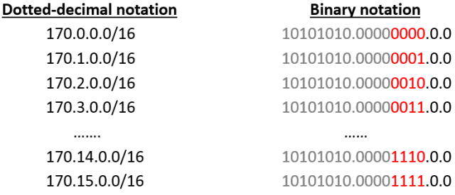
Classless addressing
Aggregation example
These 16 entries in the routing table can be merged to a single entry

Slide 12
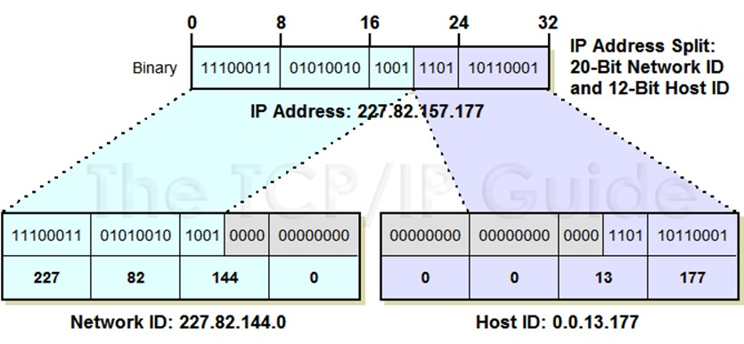
Classless addressing
Example

Slide 13
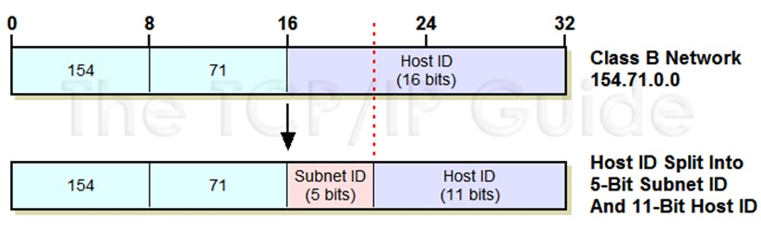
Subnetting
IPv4 address = network + host
Subnetting splits host → subnet + host
“Subnet mask” tells |subnet|

Slide 14

Subnetting
223.1.1.0/24
223.1.2.0/24
223.1.1.1
223.1.1.2
223.1.2.1
223.1.1.4
223.1.2.9
223.1.2.2
223.1.1.3
223.1.3.27
subnet
223.1.3.1
223.1.3.2
223.1.3.0/24
subnet mask: /24

Slide 15
Subnetting
223.1.1.2
223.1.1.1
223.1.1.4
223.1.1.3
223.1.9.2
223.1.7.0
223.1.9.1
223.1.7.1
223.1.8.1
223.1.8.0
223.1.2.6
223.1.3.27
223.1.2.1
223.1.2.2
223.1.3.1
223.1.3.2

Slide 16
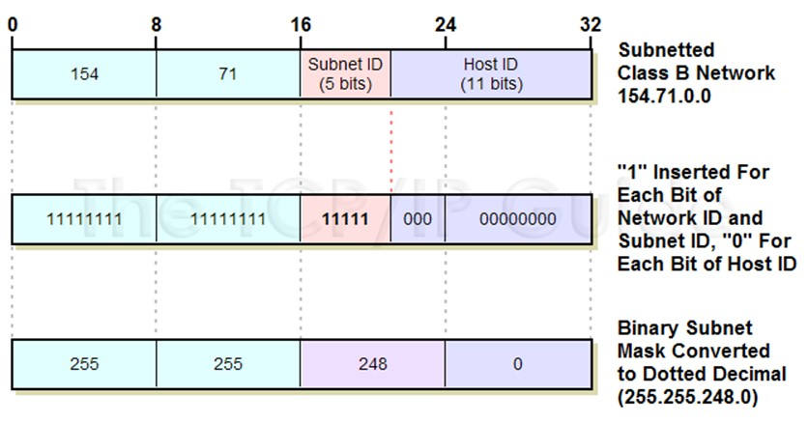
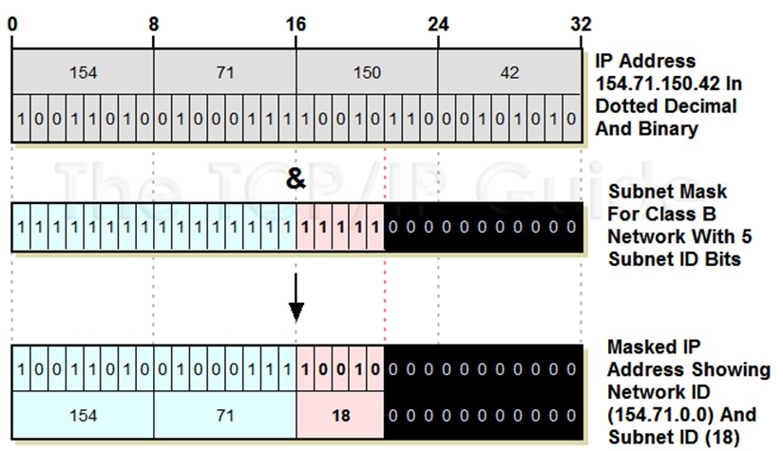
Subnetting

Slide 17
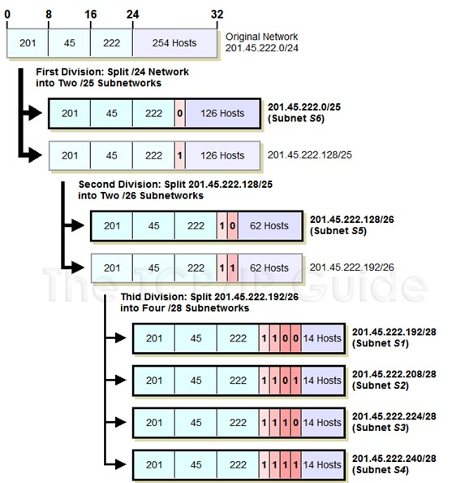
Sub-sub-subnet?
As long as routing table is correctly set up!

Slide 18
Subnetting – what’s good
Better match to physical network structure
Flexibility – subnet size can be customized
Invisibility to public Internet
No routing table entry proliferation

Slide 19
Subnetting
In Korea University …

Slide 20
Broadcast addresses
Broadcast target is marked by all 1’s
Limited
Directed
  Policy dictates if directed broadcast is forwarded

Slide 21
CIDR & aggregation
CIDR notation
Routing table size reduction
  Fig. 2-8

Slide 22
Special-use addresses
IPv4 → Tab. 2-7
  Private → one in each class
  Loopback
  Test
  Reserved
  Multicast
  Broadcast
  Unspecified

Slide 23
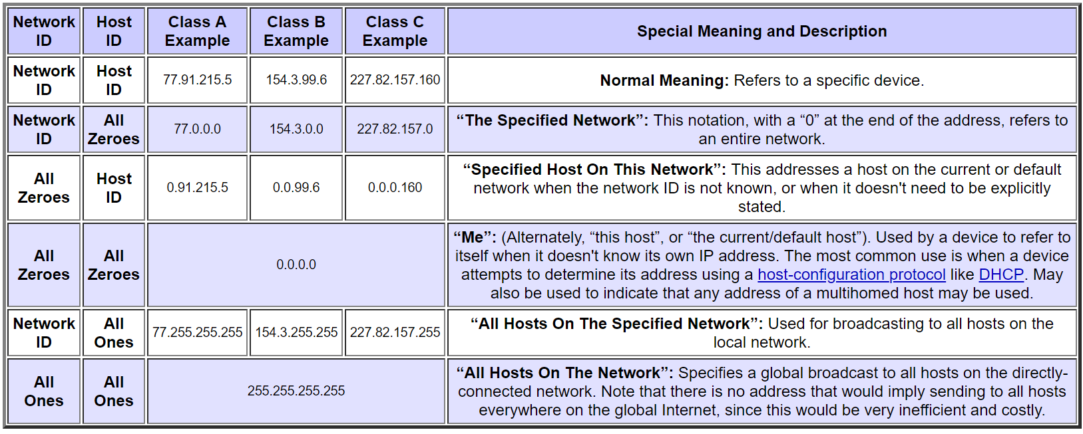
Special-use addresses

Slide 24
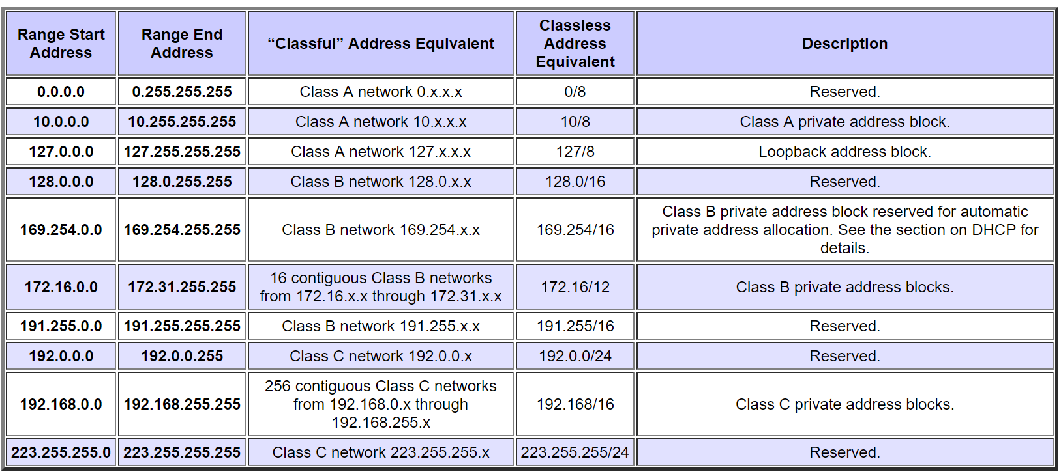
Special-use addresses

Slide 25
Special-use addresses
IPv6 → Tab. 2-8
  Default route
  Unspecified
  Loopback
  V4→v6 transition related
  Test and documentation
  Link local
  multicast

Slide 26
Multicast addresses
Tab. 2-9
  SSM vs. ASM
  GLOP (233) → 16 b ASN
  UBM (234)
  Administrative scope → analogous to private unicast addr

Slide 27
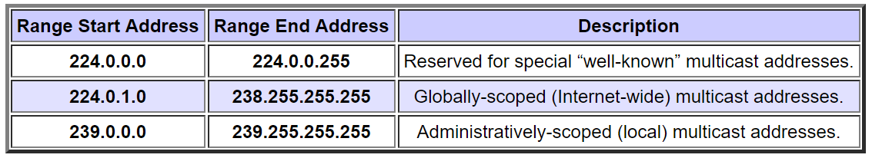
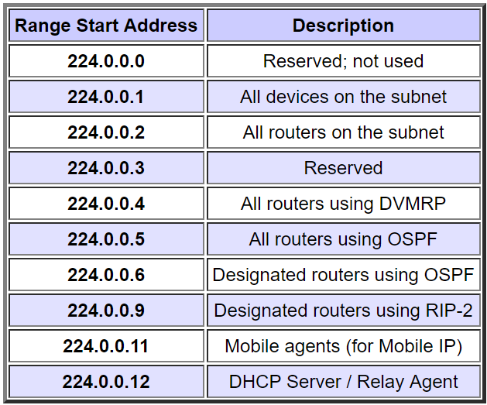
Multicast addresses

Slide 28
IPv6 multicast addresses
No “broadcast” in IPv6
Reserved block → ff00::/8
  ff02 → link local multicast
  ff0e → global multicast
P=1 (ff3)
  UBM (IPv6) or
  Link scoped → IID used
    T=1
R=1 (ff7)

Slide 29
Anycast
Closest
DNS, RP, 6to4 servers

Slide 30
Allocation
IANA, top of the hierarchy
RIR
Provider aggregatable vs. provider independent (PI)

Slide 31
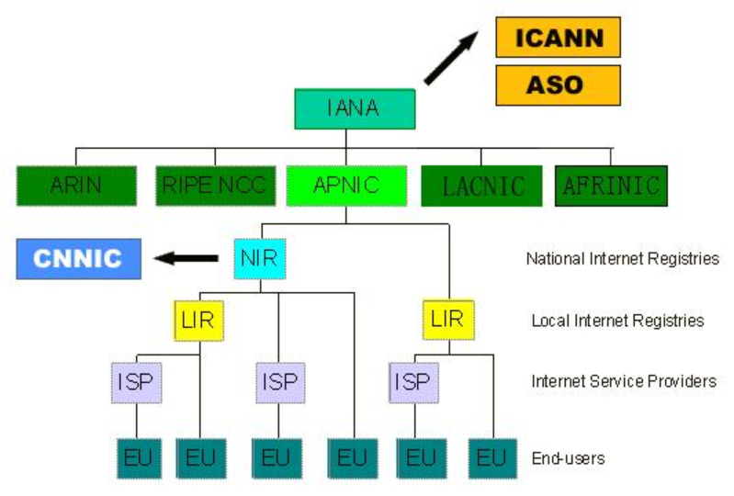
Allocation

Slide 32
Allocation of IPv4 – end in sight
IANA was depleted on 3 Feb. 2011
RIRs are distributing last /8
IoT aggravates IP address shortage
Time to migrate to IPv6? – may or may not be

Slide 33
IPv6 addresses
Unicast
Multicast – includes broadcast!
Anycast – not explicitly, but through assigning the same IP address to more than one device

Slide 34
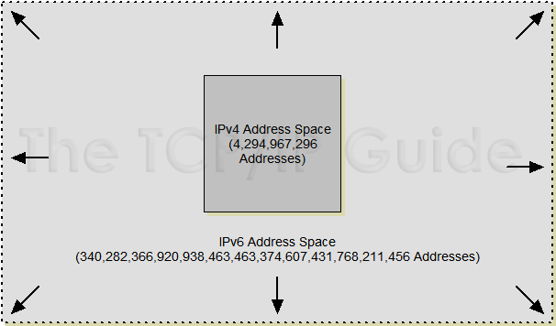
IPv6 address space
2¹²⁸ addresses – 1.6 inch vs. solar system

Slide 35
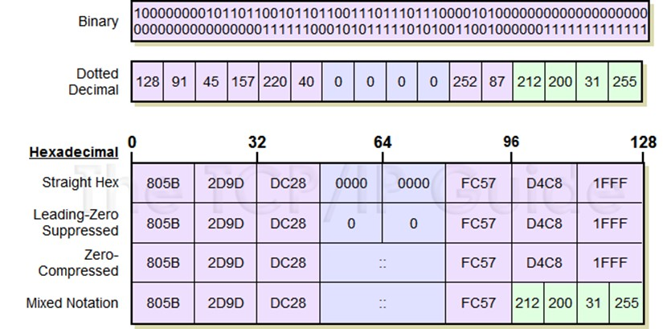
IPv6 address notation
Colon-hexadecimal, also for human convenience

Slide 36
IPv6 addresses
Leading zeros can be omitted in a block
All 0’s in a block → ::
  Can be used only once in an IPv6 addr
IPv4-mapped IPv6 addr → ::ffff:a.b.c.d

Slide 37
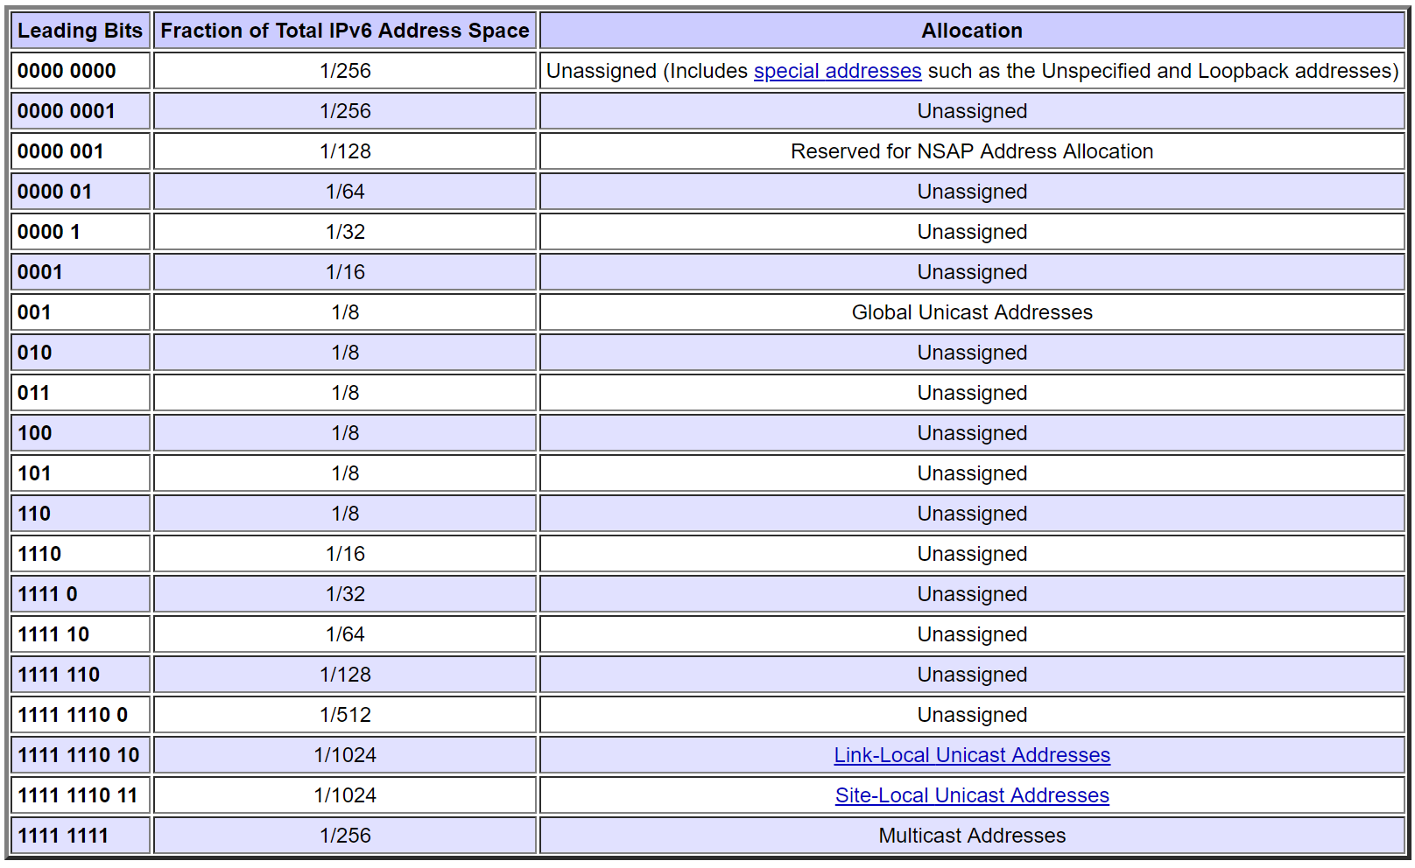
IPv6 address space allocations

Slide 38
IPv6 address structure
Scope
  Node local, link local, global
Link-local
  Prefix (64b) + interface ID (64b)
IID → usually modified EUI-64

Slide 39
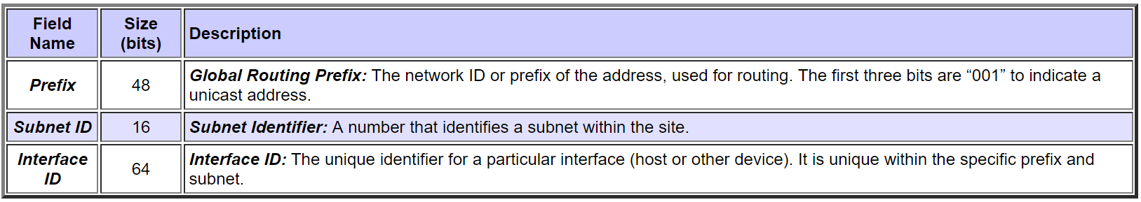
IPv6 global unicast address
You can split the subnet ID part any way you want – e.g. no subnet, single-level subnet, sub-sub-sub net, etc.

Slide 40
Modified EUI-64
EUI-48
  First 24b → Organizationally unique identifier (OUI)
  Last 2 bits of the first byte of OUI
    U : 1=locally administered
    G : 1=multicast
Modified EUI-64 = OUI + 0xFFFE + 3B
  “modified” → u bit inverted

Slide 41
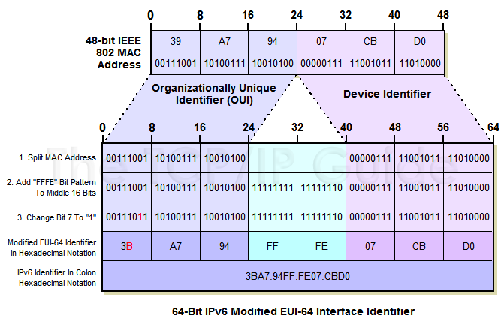
Modified EUI-64

Slide 42
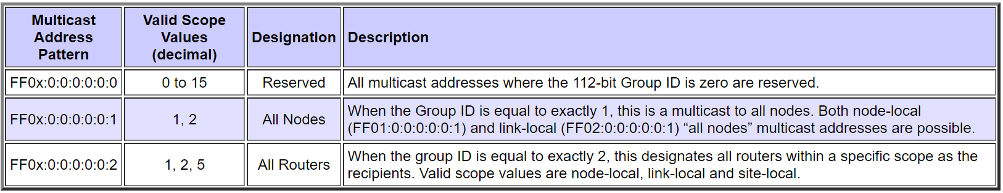
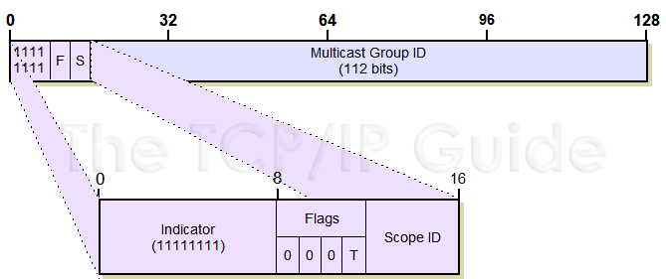
IPv6 multicast addresses
Starts with FF

Slide 43
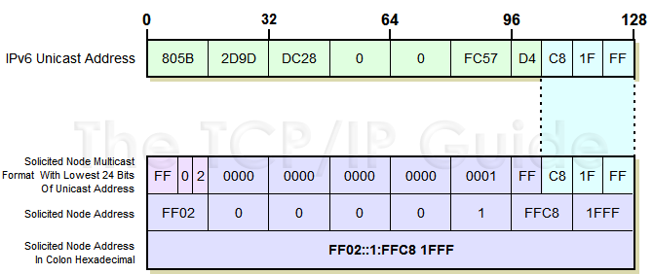
IPv6 multicast: solicited-node multicast address
There is no ARP protocol in IPv6… instead,

Slide 44
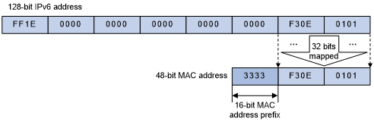
IPv6 multicast address to MAC mapping
The interface that joins the SNM address registers this MAC addr. to the hardware NIC
So that the NIC can pick up the IPv6 datagram that corresponds to the MAC

Slide 45
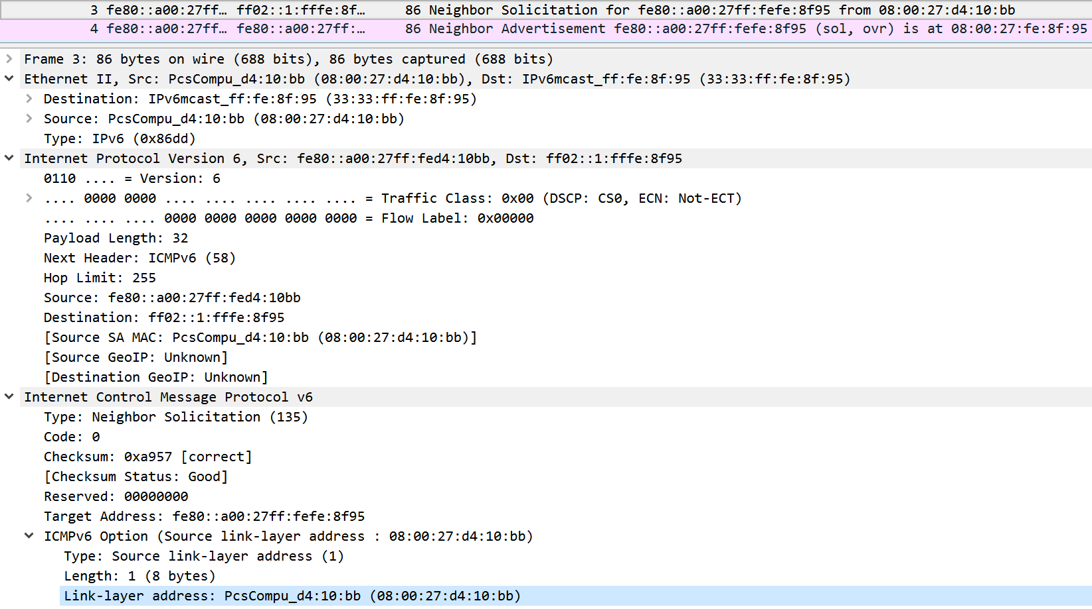
IPv6 multicast: solicited-node multicast address

Slide 46
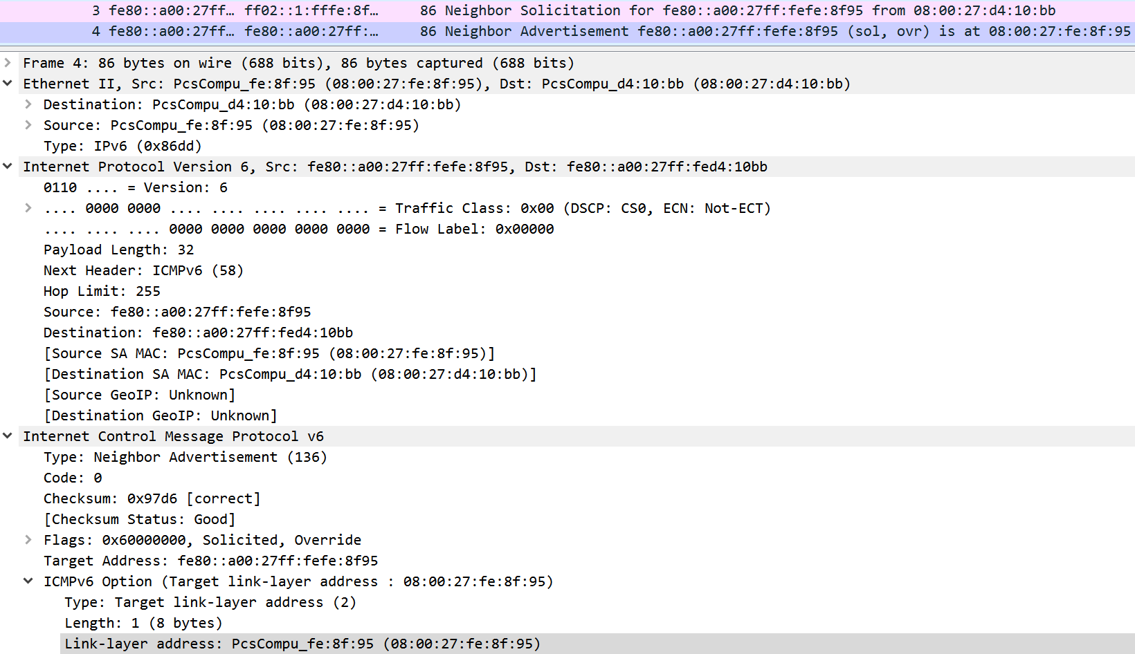
IPv6 multicast: solicited-node multicast address

Slide 47
IPv6 adoption
Google: 8% of clients access services via IPv6
NIST: 1/3 of all US government domains are IPv6 capable
Long (long!) time for deployment, use
  20 years and counting!
  think of application-level changes in last 20 years: WWW, Facebook, streaming media, Skype, …
  Why? “NAT is IPv4ever.”

Slide 48
Tunneling
A
B
IPv4 tunnel
connecting IPv6 routers
E
F
logical view:
IPv6
IPv6
IPv6
IPv6
A
B
C
D
E
F
physical view:
IPv6
IPv6
IPv4
IPv4
IPv6
IPv6
flow: X
src: A
dest: F
data
src:B
dest: E
src:B
dest: E
flow: X
src: A
dest: F
data
Flow: X
Src: A
Dest: F
data
Flow: X
Src: A
Dest: F
data
A-to-B:
IPv6
B-to-C:
IPv6 inside
IPv4
B-to-C:
IPv6 inside
IPv4
E-to-F:
IPv6

