Slide 1
Section 6.3: Stateless Address Autoconfiguration (SLAAC)
이경운
2015010337
Notes:
- 네트워크를 이용한 서비스 제공을 위한 어플리케이션

Slide 2
Address assignment
Manual assignment
Automatic assignment
  For addresses that are to be used only on a single link (link local addresses)
    Address not in use on the link
    → Stateless Address Autoconfiguration (SLAAC)
  For addresses that are to be used for global connectivity
    Some portion of the address must generally be managed
Notes:
Type of server instance is depending on what the underlying OS supports
Request 처리가 끝나면 server instance는 종료됨

Slide 3
Dynamic configuration of IPv4 link-local addresses
Automatic Private IP Addressing (APIPA)
  RFC3927
  A mechanism whereby a host can automatically generate its own IPv4 address from the link-local range (169.254.1.1 ~ 169.254.254.254) using the 16 bit subnet mask
  A host selects a random address in the rage,
  checks to see if the address is already in use → IPv4 ACD

Slide 4
IPv6 SLAAC for link-local addresses
Automatic self-assignment of link-local IPv6 addresses
  RFC4862
  3 major steps
    Obtaining a link-local address
    Obtaining a global address (with routers)
    Detecting whether the address is in use
  Stateless DHCPv6: host obtains information in addition
Address selection in IPv6
  RFC4291, RFC4941
  Only to multicast-capable networks
  fe80::0

Slide 5
IPv6 Duplicate Address Detection (DAD)
RFC4862
ICMPv6 Neighbor Solicitation, Neighbor Advertisement messages
How DAD works
  A node joins the All Nodes multicast address, the Solicited-Node multicast address
  A node sends 1 or more ICMPv6 NS messages
  Target address: the address being checked
  NA message is received in responses -> DAD failure

Slide 6
IPv6 SLAAC for Global addresses
Using prefix provided by a router
  “prefix option” in router advertisement
  “flag” indicates whether the prefix should be used in forming global addresses with SLAAC
Prefix + interface identifier
  Same one used in a link-local address configuration
The Prefix option determines the preferred and valid lifetime

Slide 7
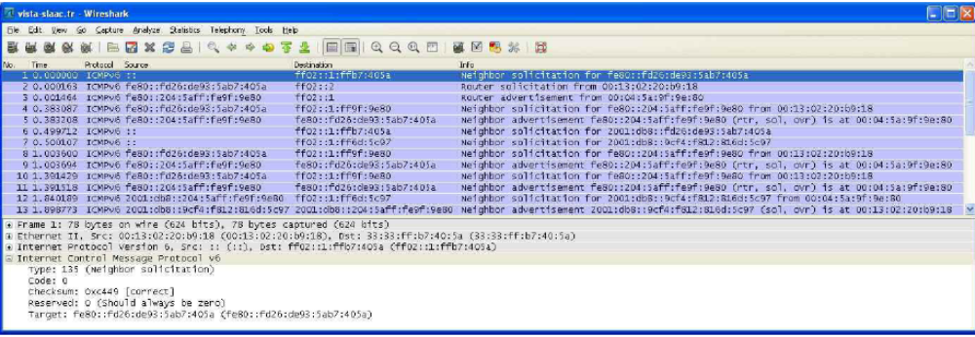
Example
ICMPv6 NS for fe80::fd26:de93:5ab7:405a
RS sent to the All Systems multicast address (ff02::2)
RA from fe80::204:5aff:fe9f:9e80

Slide 8
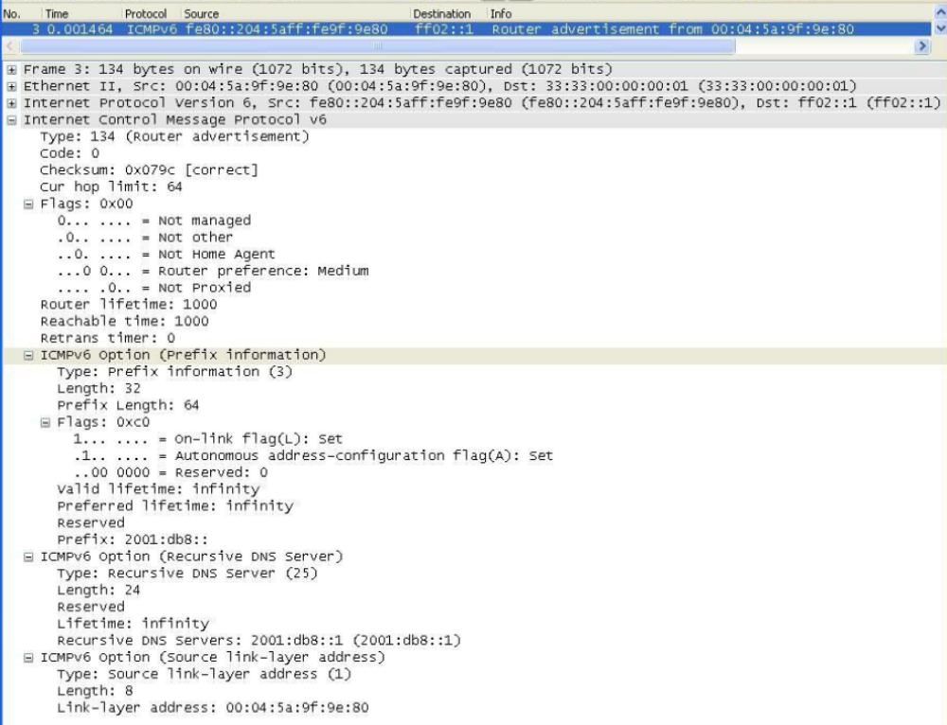
Example – Contd.
Flags: 0x00 – no DHCPv6
Prefix: 64bit (2001:db8::)
Flags: 0xc0

Slide 9
Stateless DHCP
SLAAC + DHCPv6
  RFC3736
  No address assignment, configuration information provide
Requirements for Stateless DHCPv6
  DHCPv6 INFORMATION-REQUEST, REPLY, RELAY-FORM, RELAY-REPL
  Option request, Status code, Server identifier, Client message, Server message, Interface-ID
  (useful) DNS Server, DNS Search list, SIP Servers
  (useful, but not required) Preference, Elapsed time. User class, Vender class, Vender-specific information, Client identifier, Authentication

Slide 10
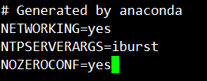
The utility of address autoconfiguration
Limitations of APIPA
  O : Local subnet access
  X : Internet routing and DNS
To disable APIPA
  In linux, /etc/sysconfig/network
  or /etc/sysconfig/network-scripts/ifcfg-eth0
Limitations of IPv6 SLAAC
  Relationship between a name and its address is not secure
To disable IPv6 SLAAC
  To arrange the router advertisement messages to turn off the “auto” flag in the prefix option
  Local configuration

Slide 11
Section 6.4: DHCP and DNS Interaction
Notes:
- 네트워크를 이용한 서비스 제공을 위한 어플리케이션

Slide 12
DHCP and DNS Interaction
The client system convert DNS names to the addresses required by the protocol implementation to make transport-layer connection
It is convenient to couple the act of providing a DHCP-assigned address with a method for updating the DNS mappings corresponding to that address
DNS/DHCP server
  configured to give out IP address leases and other information
  reads the Client Identifier or Domain Name present in a DHCPREQUEST
  updates an internal DNS database with the name-to-address request initiated either by the DHCPACK

