Slide 1
LED-to-LED Visible Light Communication Networks
Stefan Schmid, Giorgio Cobellini, Stefan Mangold, Thomas R. Gross
Disney Research & ETH Zurich
MobiHoc’13

Slide 2
Introduction
Visible Light Communication (VLC)
  With Light Emitting Diodes(LEDs) as transmitters and receivers
    To enable low bitrate wireless adhoc networking for short distances
  With each other over free space optical line-of-sight channels
    Overall network throughput of less than a megabit per second at distances of no more than a few meters

Slide 3
Introduction
Low-complexity LED-to-LED VLC network
  Useful
    Sensor networks, home networks, smart illuminations
  Devices are not configured to operate with photodetectors to receive data
    Using LEDs
  Use off-the-shelf 8bit microcontrollers
    Powerful enough to operate the required adhoc communication protocols
  Obscures the exchange of visible light messages
    No effect on the level of brightness

Slide 4
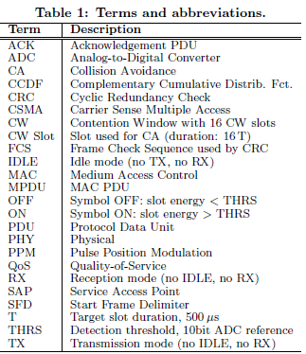
Contributions
Low complexity VLC PHY layer and a contention based VLC MAC protocol layer
  Evaluates the effectiveness of these layers
Introduce a time synchronization to improve link reliability
Define a method to adapt the sensitivity of the VLC receiver
MAC layer, Carrier Sense Multiple Access with Collision Avoidance(CSMA/CA) protocol, its performance evaluated
    Without priority support

Slide 5
Software-Defined PHY-LAYER
PHY layer
  Frame delivery over the free-space optical medium
    For synchronization, medium idle/busy sensing
    PHY-Protocol Data Units(PHY-PDUs)
VLC system consists of small consumer devices
  With one or more LEDs for light effects and communication
    Microcontroller is used to process the transmitted and received signals(PHY layer)
      To run the MAC protocols(MAC layer)

Slide 6
Software-Defined PHY-LAYER
To setup, VLC devices use the same LEDs for TX, RX
  Using time slots of target duration T = 500㎲
    A higher data throughput with shorter slot duration
      To ensure that a common low-cost 8bit microcontroller has sufficient time for processing
      Slots in which at least one VLC device emits light are interpreted to carry the symbol “ON”
        No VLC device emits any light : “OFF”
          Depending on device locations, ambient light, network conditions

Slide 7
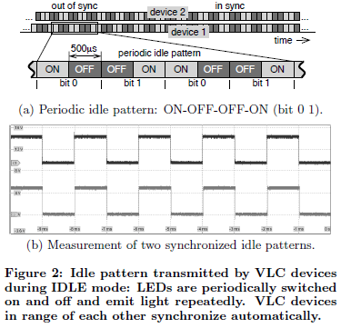
IDLE, TX, and RX Modes
Three communication modes
  IDLE mode
    If it doesn’t have any frame to TX/RX
    VLC device periodically transmits idle pattern
      To let the LED appear to be switched on at constant brightness
      ON/OFF symbols following a predefined pattern
        with a given alternation frequency (1/(2 * T))
        T : duration of each slot(T=500㎲)
      Repetition of four consecutive time slots {ON-OFF-OFF-ON}
        bit 0 and 1

Slide 8

IDLE, TX, and RX Modes
TX mode
  Device modulates the slots with the 16 slot preamble and the subsequent bitstream
    ON/OFF symbol pattern change depending on the transmitted frame(data bitstream)
      Bit encoding : 2-Pulse Position Modulation(2-PPM) with 50% duty cycling
        On average, the same number of ON/OFF symbols are emitted
          No visual flickering
            IDLE mode, LEDs continue to appear switched on without flickering
RX mode
  It interprets the amount of incoming light during each OFF symbol as incoming symbols
    It intends to receive a frame

Slide 9
Receiving with an LED
VLC system use LEDs for transmission and photodetectors for reception
  Phtodetector converts light photons into electrical current
  One way : one LED & one photodetector
    Frames are transmitted from LED to the photodetector
      Doesn’t provide a feedback channel back to the LED
  Two way : two components per devices
    Allows feedback
    An LED to transmit, and a photodetector to receive
    Possible to use the LED as photodetector to receive optical messages
    A set up that reduces the complexity per device

Slide 10
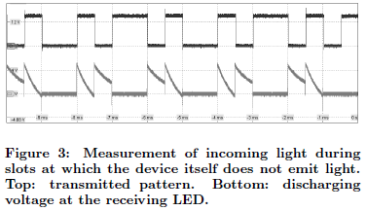
Receiving with an LED
How LEDs that are charged in reverse bias can be used to receive incoming light
  Depending on the intensity of the incoming light
    LED capacitance discharges at different speed
      Stronger -> faster discharge the discharge
  Drawback of using LED
    Less sensitive than a photodetector
      Negatively affects the achievable communication rage
    Limited throughput due to the required multiplexing
      LED can’t do TX/RX at the same time

Slide 11
Synchronization
Time-synchronized way
  VLC devices are synchronized if the beginning of each slot occurs at the same time for all devices
    Synchronization errors
      Clock shift and jitter are undesirable and reduce the system performance
    Using LEDs as a receiver, leads to low sensitivity to optical energy
      So, un-synchronize + synchronization preamble -> overhead
      Periodically repeated idle pattern
        All LEDs are perceived as switched on
          When power on, device performs an initial measurement for few milliseconds
            (ambient) light intensity, amount of light

Slide 12
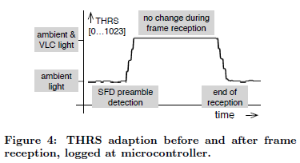
Adaptive Bit Detection Threshold(THRS)
Light intensity modulation is used to differentiate and detect symbols ON and OFF
  Receiver side
    Ability of detecting symbols
      be affected by the attenuation of the transmitted light
      Intensity of the ambient light
Optimal detection threshold
  Average of the amount of light corresponding to the reception of a symbol ON/OFF

Slide 13
Start Frame Delimiter(SFD) Preamble
To set THRS (optimal value)
  Receivers should receive patterns consisting of an even number of symbols ON/OFF
    Transmission by a SFD preamble(sixteen slots)
    At the end of the SFD, at any receiving device
      Value of THRS is adapted to the current ambient light situation
      Closer to the optimal value for THRS
    SFD is decoded, receiver stops updating THRS
    End of reception, THRS adapts again and converges to the value related to ambient light

Slide 14
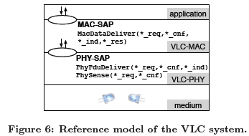
Carrier Sensing
Medium as busy or idle
  Depending on ongoing frame transmission and/or the level incoming ambient light
    MAC requests a carrier sensing with PhySense_req() service
      PHY-Service Access Point(PHY-SAP) : PHY layer
        PHY reports back the information
          Difference between THRS and instantaneous level of ambient light
            Deviation is higher : channel is busy
            IDLE mode, small

Slide 15
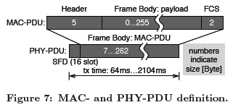
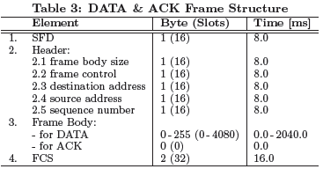
Low-complexity MAC-Layer
MAC layer entity serves the application layer by providing the data delivery
  MacDataDeliver_req(data)
  Two types of frames
    DATA frame
      Application payload of variable size(0...255byte)
    ACK frame
      Control frame

Slide 16
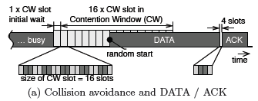
Low-complexity MAC-Layer
DATA/ACK frame exchange with the preceding Contention Window(CW)
  After the medium became idle,
    Initial first wait time of 16 slots is followed by the CW of 16SFD preamble durations
      ACK frames are not interfered with
    A short idle time of four slots between DATA and ACK
    Within the CW, maximum of 16 CW slots
      Each CW slot has the duration
        16 T = 16 * 500 ㎲
      Each CW slot is assigned the same probability for TX start
        Minimal collision probability

Slide 17
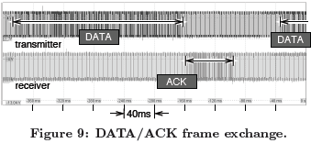
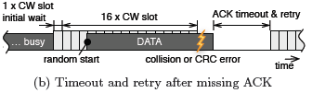
Low-complexity MAC-Layer
Each message begins and ends during the second ON slot of the idle pattern.
  When a device receives a message
    Computes the final CRC and transmits ACK at the second following ON slot
ACK timeout
  Missing ACK frame and lead to retransmission
  Interval of 134 slots
    Helps to main a sync

Slide 18
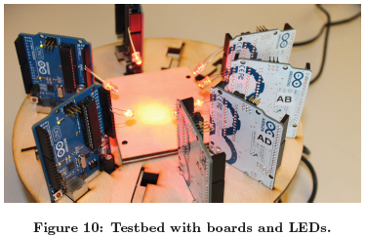
Evaluation
Testbed
  Atmel ATmega328P evaluation boards connected to a computer
    Computer generates the traffic and collects the measurement results
  Each evaluation board operates one transceiver LED to mimic one VLC device
    Operate in saturation
      Distribution of the inter-arrival time is not relevant
    Same type of LED
      5mm red LED, type Kingbrigth L-7113SEC-J3, with transparent case
      a peak wavelength of 640 nm, a 20° field of view (radiation angle), and a brightness of 12000mcd

Slide 19
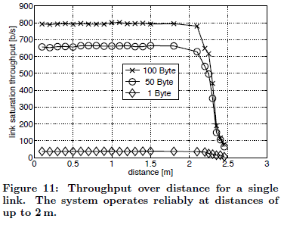
Single Link
Achievable maximum throughput
  Using two VLC device
  Two LEDs are pointed to each other
  Distance : 10 cm ~ 250 cm
Throughput results for different payload sizes
  Larger than 2.3m, achievable link saturation throughput drops with the increasing distance
    Because of CSMA/CA protocol
      Saturation throughput depends on the payload size

Slide 20
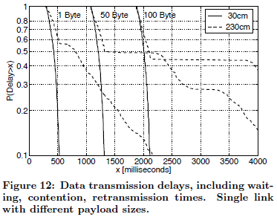
Single Link
The Complementary Cumulative Distribution Function (CCDF) for the delivery delay
  Three different payload sizes
  Two distances
    30 cm & 230 cm
  Delivery delay is the time
Transmission time
  Minimum of transmission time
    Can be taken from the curves at probability 1
  Prolonged delays result from additional waiting and retransmission time
  Closer distance(30cm)
    Retransmission don’t occur, and CCDFs show similar behaviors
  Larger distance(120cm)
    CCDFs indicate a considerable increase of delivery delay
      High number of retransmissions
        Because of CRCs failing – long distance

Slide 21
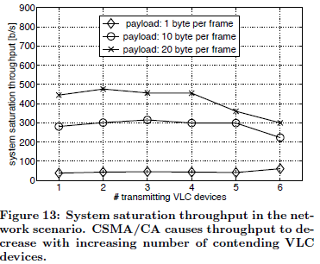
Network
Multiple VLC devices that are all in communication range are active
  Because of CSMA/CA
    Throughput decreases with increasing number of contending VLC devices
      Collided frames lead to retransmissions
        Consume additional resources
Because of the limited field of view of the used LEDs
  Only a small number of VLC devices

Slide 22
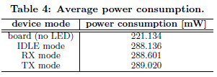
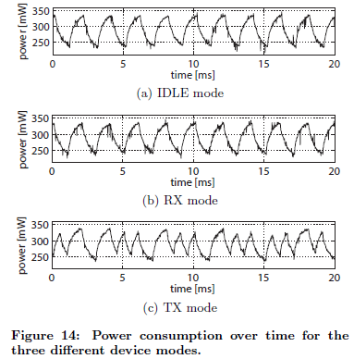
Power Consumption
Average power consumption for different device modes
  Evaluation board and microcontroller running an empty program without LEDs
  During each slot of duration T
    Processes the signal
      Processing cost changes from slot to slot
      Depends on the current mode
Three modes
  IDLE mode
    Increases while switching on the LED for two slots
    Decrease LED off
  RX mode
    Same pattern
      Additional processing cost is so small
  TX mode
    2-PPM encoded message
      Lead to more mode change of the LED
        Increase of the overall power consumption

Slide 23
Conclusions
LED-to-LED VLC networks
  Use LEDs as transmitters and receivers
VLC adhoc network is designed for smaller packets
LEDs consume relatively small energy
  Correlating with their brightness

Slide 24
Adaptive Bit Detection Threshold(THRS)
Consider two devices that are out of communication range
  Two devices THRS set to the average lever of the ambient light
  Update THRS value averaging the amount of light
    Out of range, stay un-synchronization
    Placed close to each other, devices try to synchronize
  Devices emit and receive light at the same time

