Slide 1
MicroCast: Cooperative Video Streaming on Smartphones
Lorenzo Keller, Anh Le, Blerim Cici, Hulya Seferoglu, Christina Fragouli, Athina Markopoulou
MobiSys’12
박해월

Slide 2
Outline
Introduction
The MicroCast System
Performance Evaluation
Conclusion

Slide 3
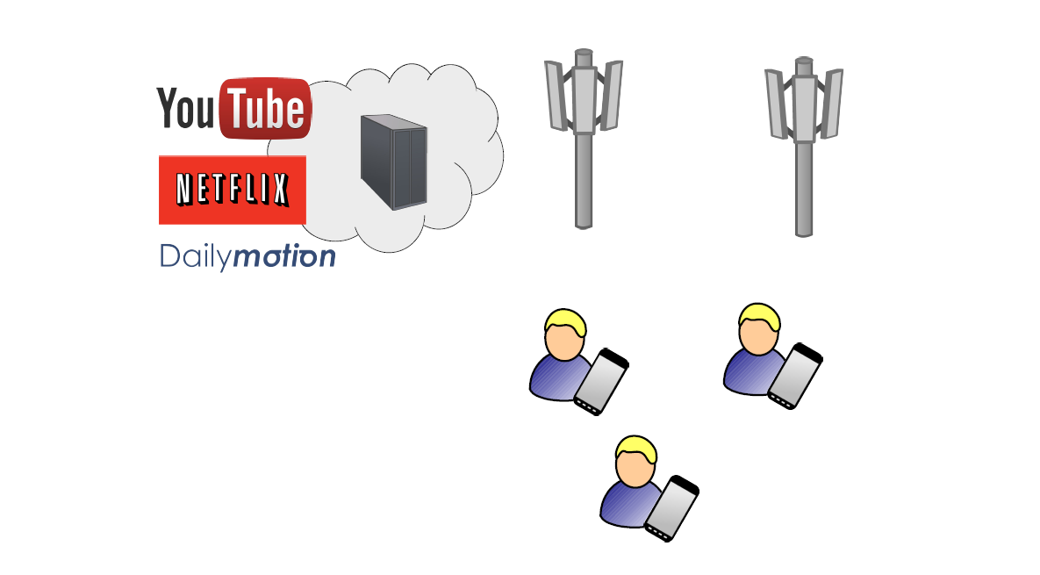
The “Micro” Setting

Slide 4
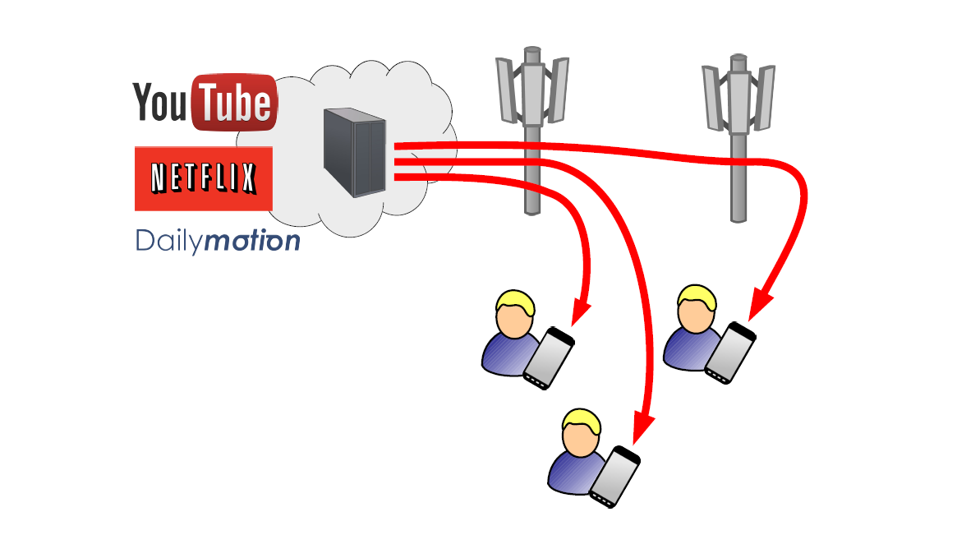
Current Approach: Multiple Downloads

Slide 5
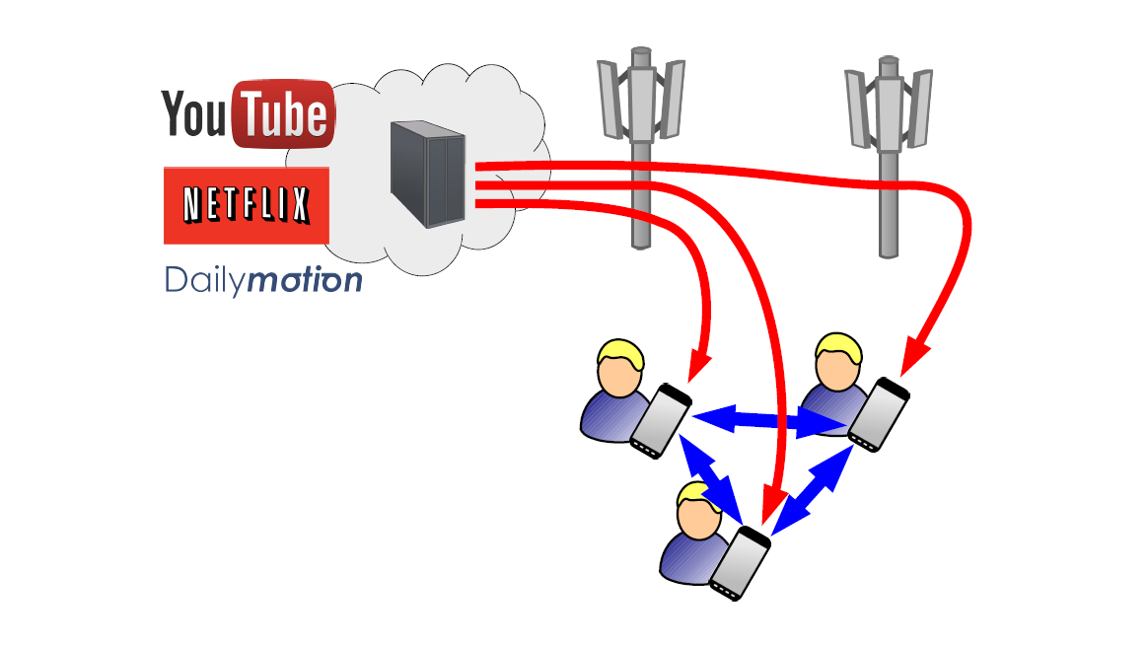
MicroCast:
Jointly Use Multiple Interfaces

Slide 6
Outline
Introduction
The MicroCast System
Performance Evaluation
Conclusion

Slide 7
Outline
Introduction
The MicroCast System
  MicroCast Architecture
  MicroCast Algorithm
  Implementation
Performance Evaluation
Conclusion

Slide 8
Setup and Assumptions for the “Micro” Setting
Small number of users (up to 6-7)
These users know and trust each other
All users are within proximity of each other and all local links have similar rates on average
  Single-hop, broadcast transmissions
Use cellular connection for the downlink, and WiFi to establish local, device-to-device links
Notes:
3. although we do not need multihop transmissions due to close proximity, we could still incorporate them in our system – as we do in our Bluetooth-based implementation that supports multihop; see Section 7
4. lternatives, including WiFi for the downlink or Bluetooth for the local link, are discussed in Section 7.
Each phone downloads segments of the video from the server and shares these with the rest of the group locally

Slide 9
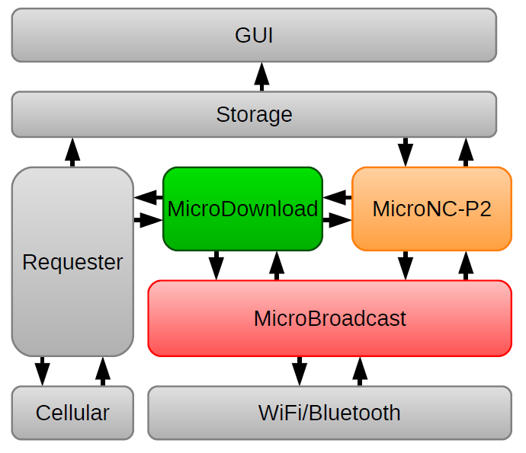
MicroCast Architecture

Slide 10
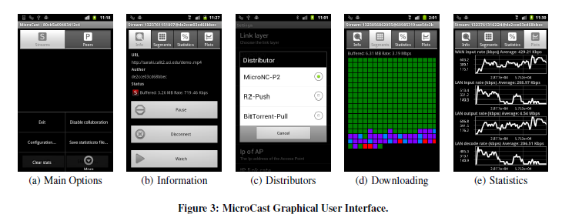
GUI
Notes:
기본기능
create video streams, share local videos, start/stop downloading video files, join existing video streams, and play/pause video
협력자 찾기
the GUI lets users discover and connect to other devices, specify the wireless interface that should be used for the local dissemination, and decide whether the phone should collaborate for video downloading.
실험용
The GUI also allows users to select system modules as well as run-time parameters for experimental purposes.

Slide 11
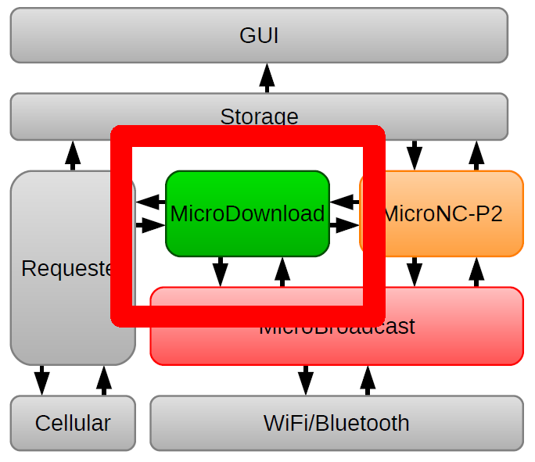
MicroDownload: Download Coordination

Slide 12
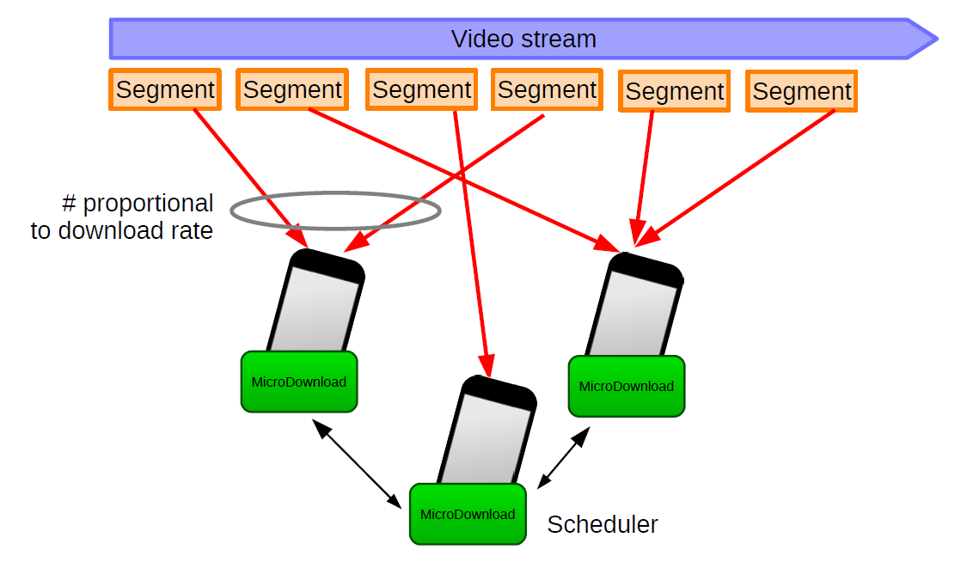
How MicroDownload Works

Slide 13
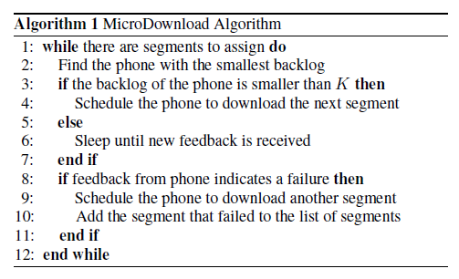
MicroDownload Algorithm

Slide 14
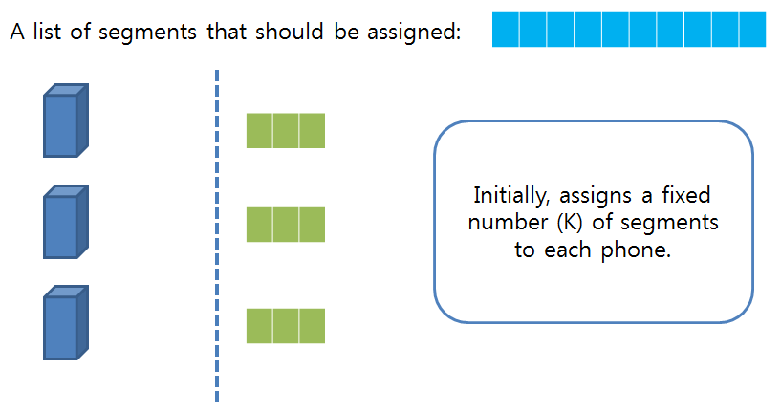
MicroDownload Algorithm

Slide 15
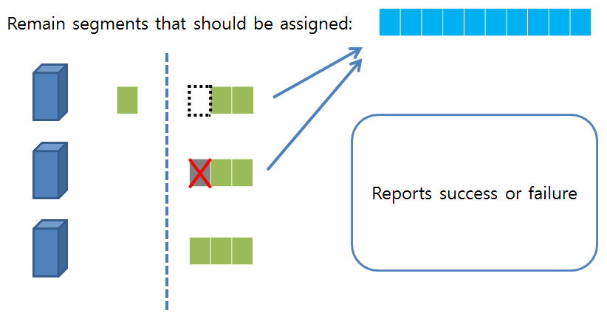
MicroDownload Algorithm

Slide 16
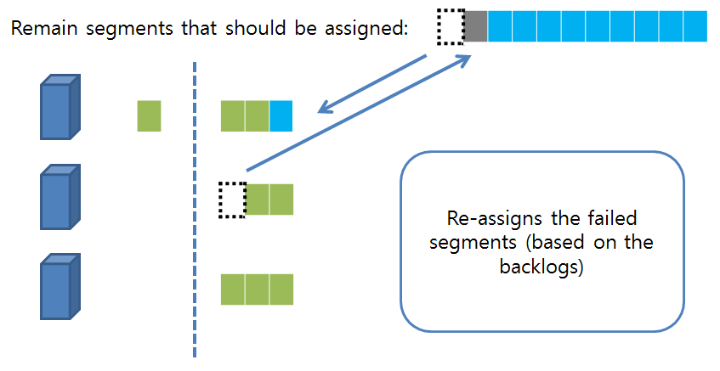
MicroDownload Algorithm

Slide 17
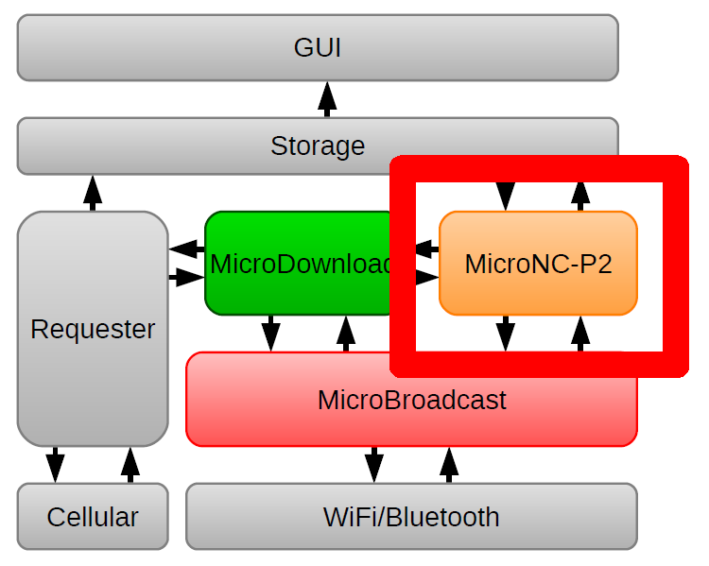
MicroNC-P2:
P2P Optimized for the “Micro” Setting

Slide 18
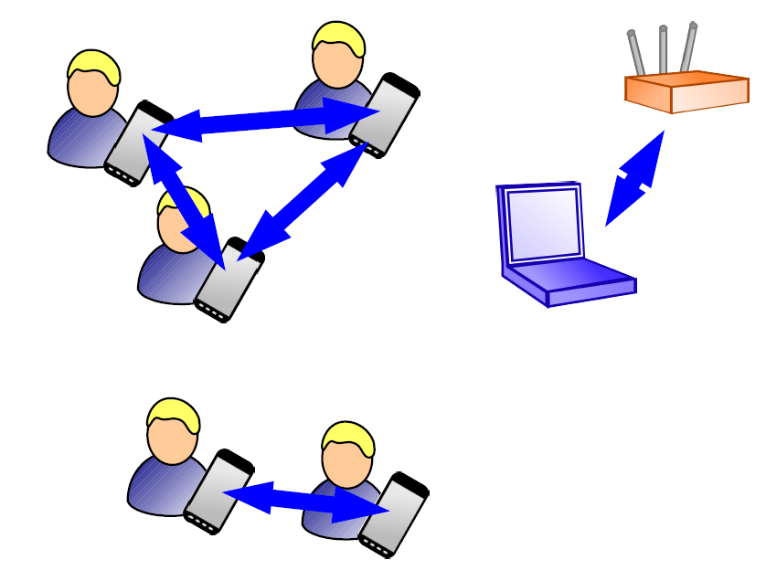
Local Wireless Capacity is Limited

Slide 19
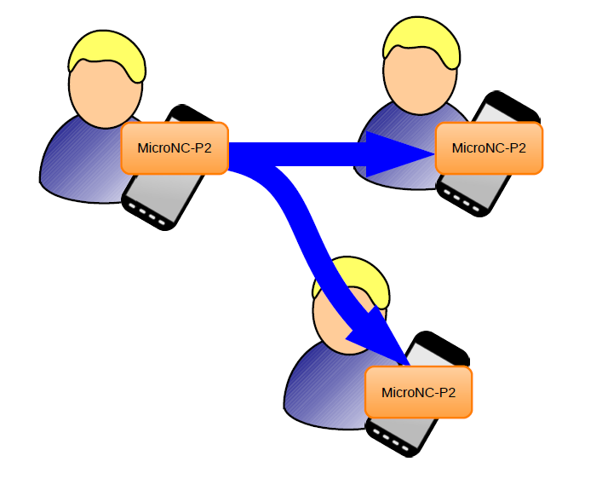
Efficient Transfer Using Broadcast

Slide 20
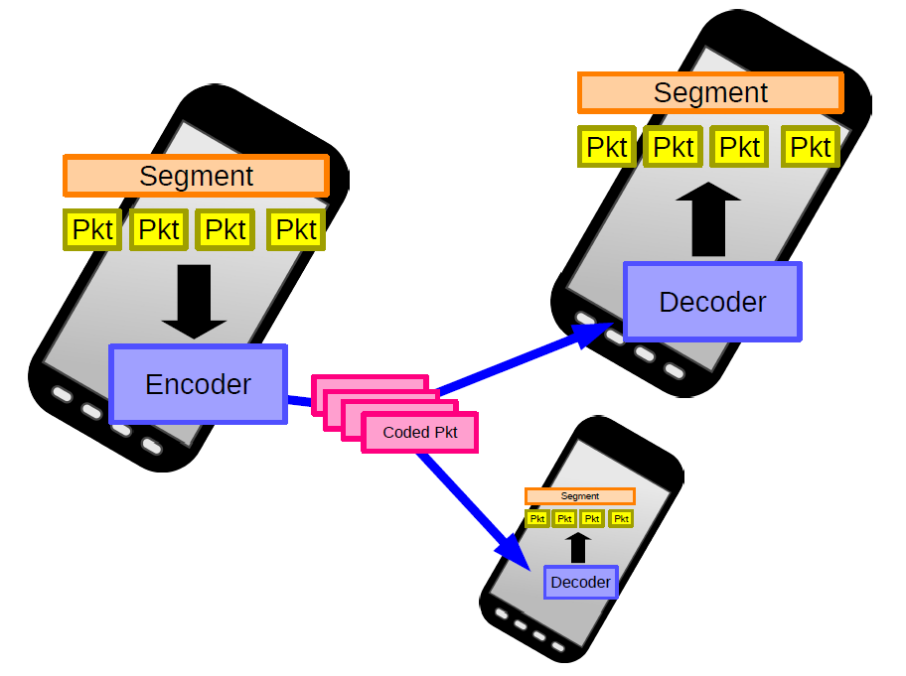
Efficient Broadcast
Using Network Coding

Slide 21
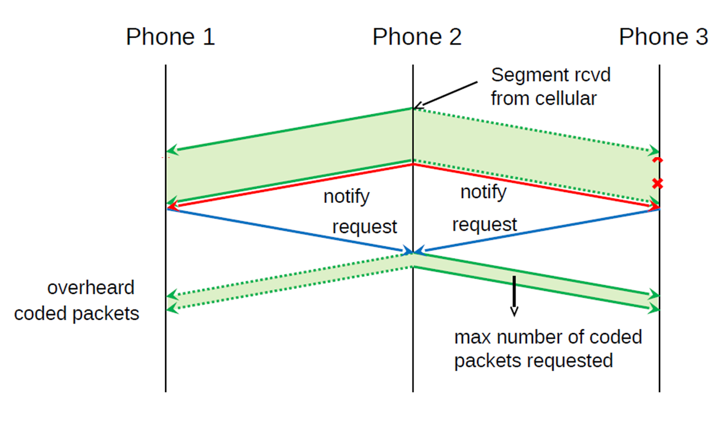
MicroNC-P2 Algorithm

Slide 22
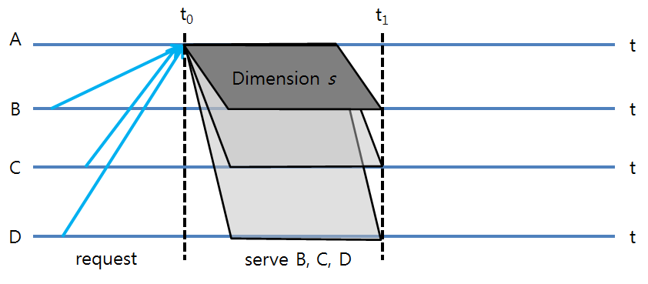
MicroNC-P2 Algorithm
Notes:
가정
For simplicity, assume perfect overhearing.

Slide 23
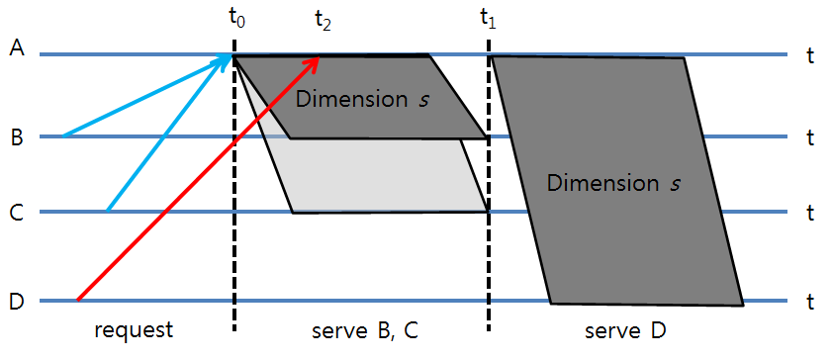
MicroNC-P2 Algorithm

Slide 24
MicroNC-P2 Algorithm
Initial push of segment s
  When A finishes downloading segment s
  Sends all dimensions of s to a randomly selected neighbor before advertising the segment
This effectively creates a perfect synchronization of the reception of the initial requests of segment s

Slide 25
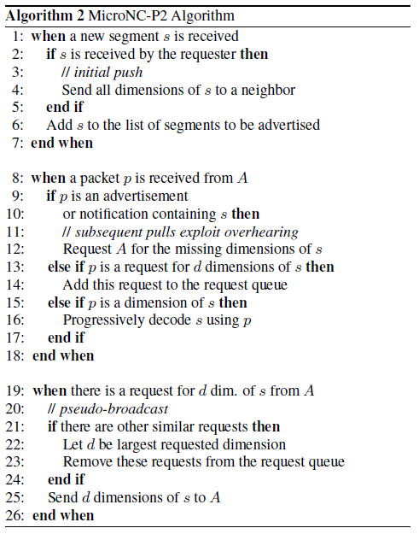
MicroNC-P2 Algorithm

Slide 26
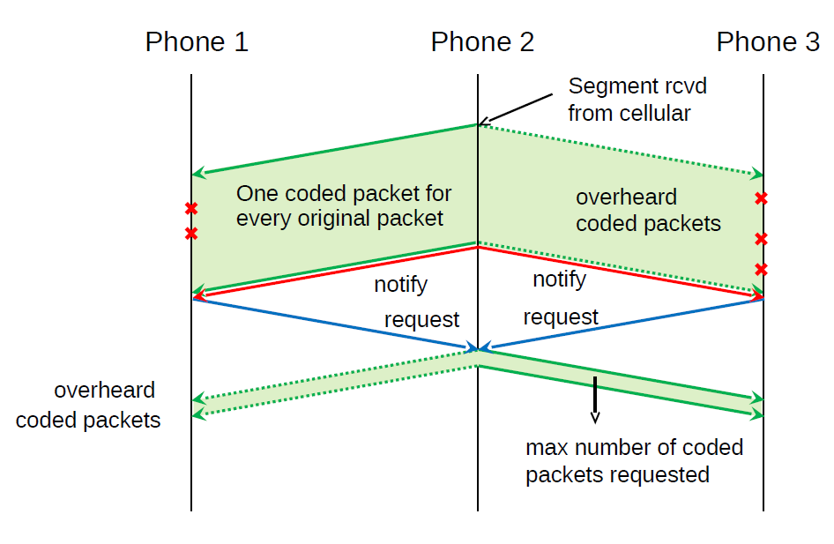
MicroNC-P2 Algorithm

Slide 27
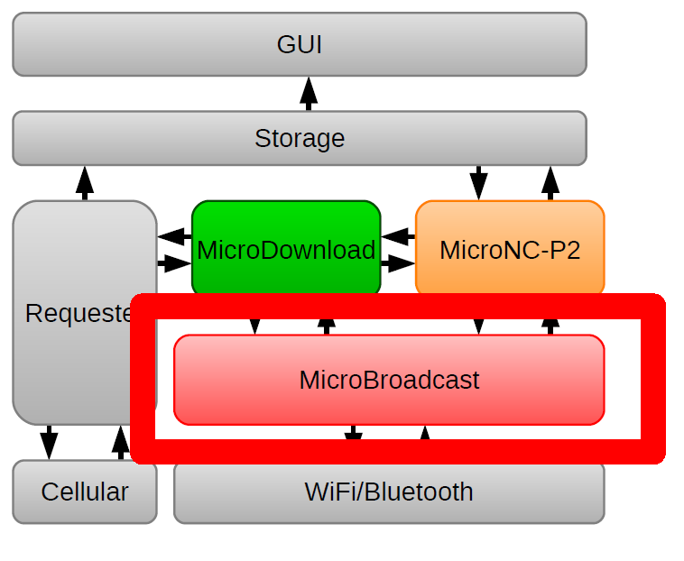
MicroBroadcast: High Rate Broadcast

Slide 28
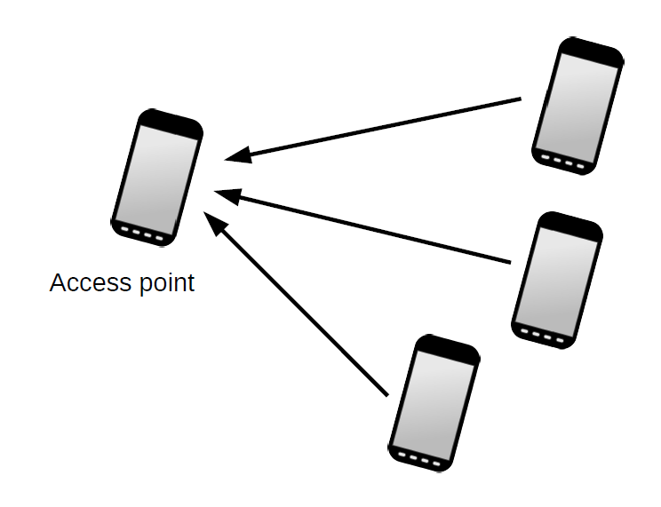
Mobile WiFi Hotspot

Slide 29
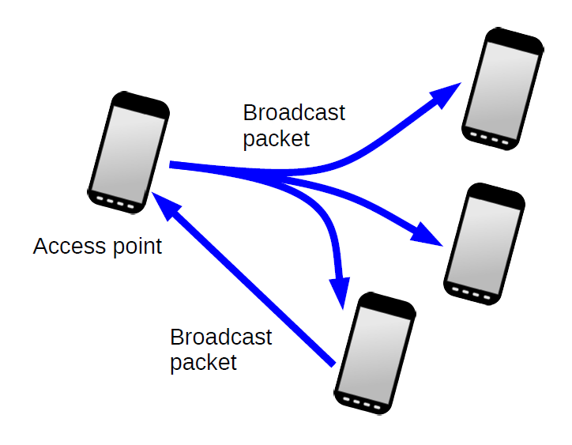
Broadcast in 802.11 Infrastructure Mode

Slide 30
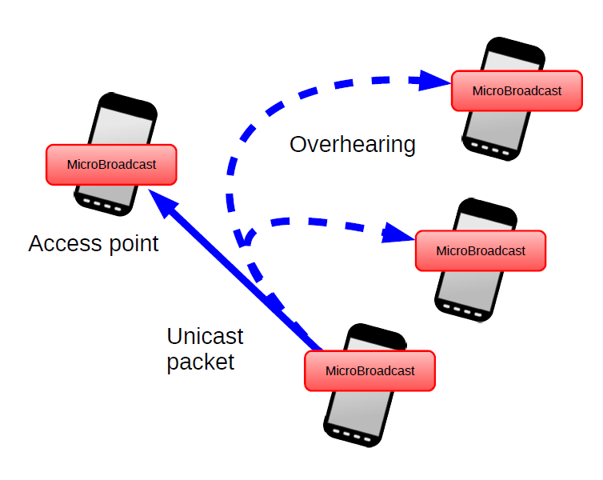
Pseudo-Adhoc with MicroBroadcast

Slide 31
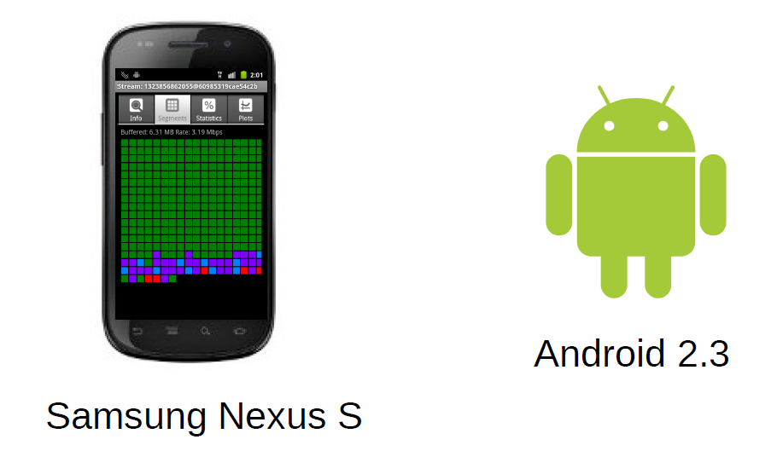
Implementation on Android

Slide 32
Implementation Details
Develop environments
  Mostly in Java, some minor parts in C
  Runs on Android 2.3 & 4.0, Java 2 SE
Architecture Details
  Requester: producers (HTTP, file, content)
  Storage: embedded HTTP server
  GUI: playback and download are decoupled
  MicroBroadcast: contains an application layer implementation of a networking stack
Notes:
requester
It internally uses components called producers to retrieve segments of the video from the source of the stream. Our current implementation contains producers for three types of sources: HTTP, file, and content. The first one (HTTP) loads segments from an HTTP server using range requests. The second one (file)
loads video from locally available files. Finally, the third one (content) retrieves data using the ContentProvider API of Android (e.g., videos can be captured with the phone camera).
storage
This second interface allows us to play the video stream using the native Android media API. In order to support playback of non-streamable video, for instance, MP4 files with moov atom at the end of the file, our embedded
HTTP server supports range requests; thus, the Android Media Player can perform random access of the video stream.
GUI
Playback and download are decoupled thanks to our storage mechanism: a phone could be participating in the download while its video player is paused. To render the video, the application uses the media playback API
included in Android, which supports various containers and video formats, such as H.264 in a MP4 container. The video can be displayed while MicroCast is still downloading; therefore, live streaming is supported.
MicroBroadcast
Depending on the wireless technology used, features of MicroBroadcast are either implemented using a native mechanism or emulated.

Slide 33
Network Coding: CPU Limitations
Network coding is a CPU intensive operation
  Limit the size of the coding generation
  Seek to optimize implementation of network coding
    Pure Java, runs in the Dalvik virtual machine, encode at 2.9Mbps and decode at 4.3Mbps, portable across different hardware platforms
    Native code, runs natively on the phone CPU invoked through the Java Native Interface, encode and decode at 24Mbps
With the native implementation, MicroCast can support 2.5Mbps stream to a group of 7 phones

Slide 34
Multiple Network Interfaces
3G & WiFi vs. WiFi & Bluetooth
  Bluetooth and WiFi share partially overlapping parts of the spectrum , and often implemented in the same chip
3G & WiFi vs. 3G & Bluetooth
  WiFi support larger number of connections at higher rates
Challenges when 3G is utilized simultaneously with WiFi
  Undocumented API that forces routing of packets for the HTTP server through the 3G interface
Notes:
Bluetooth 2.4GHz WiFi 2.4GHz, 3.6GHz, 5GHz..
Bandwith bluetooth 800 Kbps WiFi 11 Mbps
This suggests that using WiFi (for the connection to the server) together with Bluetooth (for the local network) may noticeably decrease the transmission rate, which was indeed the case during our initial experiments.
3G와 WiFi를 동시에 키지 못함. 배터리 절약을 위해

Slide 35
Implementing High-Rate WiFi Broadcast
Challenges
  Promiscuous mode: CyanogenMod 7 ROM, but only in infrastructure mode
  Not pass the overheard packets up to the application layer: own overhearing API, C library and C binary executable program with irrelevant packet filtering
  Not available in ad-hoc mode: Pseudo-broadcast (overhearing), combines the benefits of unicast (rate, back-off) and broadcast (reduce redundantly transmissions)
Notes:
In computer networking, promiscuous mode or promisc mode is a mode for a wired network interface controller (NIC) or wireless network interface controller(WNIC) that causes the controller to pass all traffic it receives to the central processing unit (CPU) rather than passing only the frames that the controller is intended to receive.

Slide 36
Outline
Introduction
The MicroCast System
Performance Evaluation
Conclusion
Notes:
MicroCast Algorithm
scheduling algorithm, MicroDownload, that decides which parts of the video each phone should download from the server, based on the phones’ download rate
all-to-all local dissemination scheme, MicroNC-P2, for sharing content among group members, which outperforms state-of-the-art peer-to-peer schemes in our setting.

Slide 37
Outline
Introduction
The MicroCast System
Performance Evaluation
  Benefits of Collaborative Download
  Benefits of MicroNC-P2
  Energy Cost
  Limitations and Extensions
Conclusion
Notes:
MicroCast Algorithm
scheduling algorithm, MicroDownload, that decides which parts of the video each phone should download from the server, based on the phones’ download rate
all-to-all local dissemination scheme, MicroNC-P2, for sharing content among group members, which outperforms state-of-the-art peer-to-peer schemes in our setting.

Slide 38
Performance Evaluation
Experiments on an Android testbed consisting of seven smartphones
  Samsung Captivate (4), Nexus S (3)
  1Ghz Cortex-A8 CPU, 512MB RAM
  Android Gingerbread 2.3 (6), Android Ice Cream Sandwich 4.0 [Nexus S] (1)

Slide 39
Performance Evaluation: MicroDownload
Setup
  Three Nexus S connected to the same cellular network provider
  Place within proximity of each other (distances are approximately 2 cm)
  Indoor environment
  Disabled MicroNC-P2 and measured the download rate over 100 seconds

Slide 40
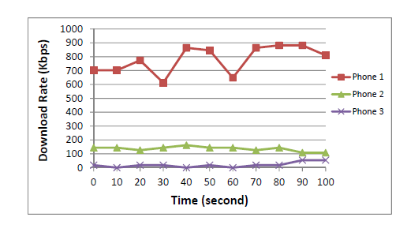
Cellular Link Rates
Notes:
Edge, 같은 셀룰라망임에도 불구하고 다르다. 하여 고정하기보단 adaptive한게 낫다.
The figure shows that despite being in close proximity and being connected to the same operator the phones experience significantly different average download rates. Phone 3 has a very low rate because it uses EDGE.
The other two phones use the same 3G network but still have significantly different download rates. Moreover, phone 1 experiences significant rate variations. This variability in time and across phones is our motivation to develop MicroDownload to adaptively request data according to the downlink rates of cellular links, instead of making static decisions, such as splitting the requests equally among the phones.

Slide 41
Performance Evaluation: MicroNC-P2
MicroNC-P2 vs.
  BitTorrent-based distributor (BitTorrent-Pull), a pull-based P2P protocol
    [B. Cohen. Incentives build robustness in BitTorrent. In Proceedings of the First Workshop on Economics of Peer-to-Peer Systems, Berkeley, CA, USA, 2003.]
  R2-based distributor (R2-Push), random network coding and random push
    [M. Wang and B. Li. R2: Random push with random network coding in live Peer-to-Peer streaming. IEEE Journal on Selected Areas in Communications, 25(9):1655–1666, Dec. 2007.]
Topology: Star, clique
Protocol: UDP
Notes:
BitTorrent ﬁle distribution system
R2 is designed to improve the performance of live streaming in terms of initial buffering delays, resilience to peer dynamics, as well as reduced bandwidth costs on dedicated streaming servers, all of which are beyond the basic requirement of stable streaming playback.

Slide 42
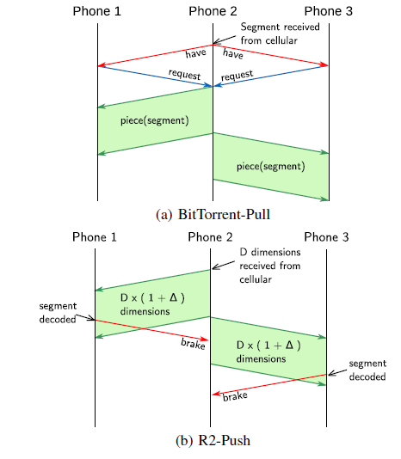
BitTorrent-Pull and R2-Push
Notes:
BitTorrent-Pull
In particular, our implementation of the protocol supports three main types of messages:
(i) Bitfield and have messages, which are used by a phone to advertise the segments to its neighbors; (ii) request messages, which are used by a phone to request specific segments from its neighbors; and (iii) piece messages, which contain the actual data.
R2-Push
supports two main types of messages: (i) data messages, which are random linear combinations of packets belonging to the same segment; and (ii) brake messages, which are used by phones to inform their neighbors that they successfully received and decoded specific segments. The purpose of brake messages is to ensure that the neighbors would stop pushing (unnecessary) linear combinations of the decoded data segments.

Slide 43
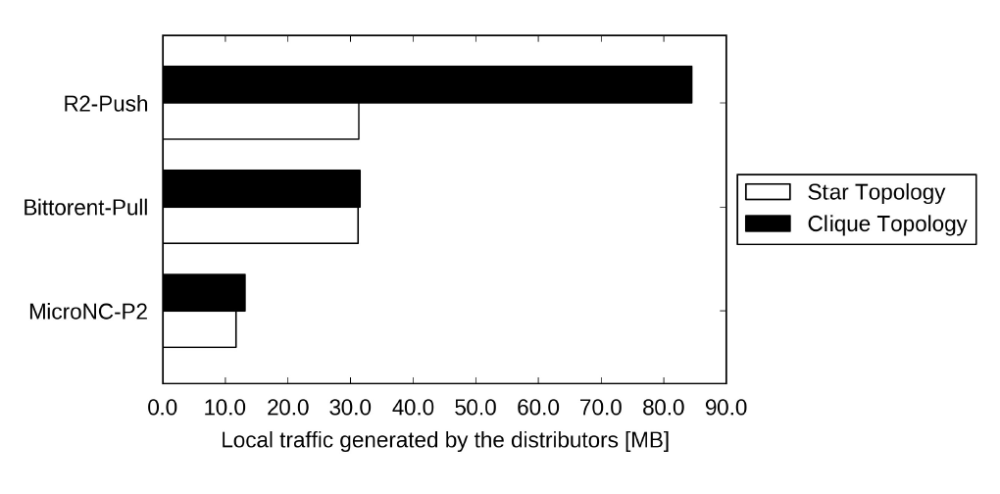
Performance Evaluation: MicroNC-P2
Notes:
Note that the difference between these topologies are that in the star topology, a hub is
used as an access point (AP), and in the clique topology a random phone is chosen to serve as an AP. In both topologies, all phones overhear all the transmissions in the group, e.g., from phones to
the AP which is either a hub or a phone. MicroNC-P2 utilizes pseudo-adhoc as described in Section 5.
For R2-Push, we choose = 3%. the local network bandwidth is sufficient, each of the phone receives at the rate similar to the phone which downloads the file through 3G. Each reported number is averaged over three experiments.
We first observe from Fig. 7 that the amount of traffic introduced by both BitTorrent-Pull and R2-Push are more than three times higher than that of MicroNC-P2.
Fig. 7 also shows that in a clique topology, R2-Push introduces much more traffic as compared to the star topology, while BitTorrent-Pull and MicroNC-P2 introduce similar amount of traffic in both
clique and star topologies. This is due to the fact that in a clique topology, a phone may simultaneously receive linear combinations of the same segment from multiple neighbors. When this happens, it is critical that the neighbors which are sending to this phone stop pushing linear combinations in a timely manner. This could only be achieved with a timely arrival of the brake (stop) messages, which is not always possible in the clique topology, or in a setup where additional traffic is very high.

Slide 44
Performance Evaluation:
MicroCast System
Setup: Non-Congested Local Area
  Seven phones: four w/ 3G rates varying from 480 Kbps to 670 Kbps, three w/o 3G connections
  Packets are exchanged locally using UDP, support up to 20 Mbps
  Star topology, pseudo-adhoc
  Video file size: 9.93 MB

Slide 45
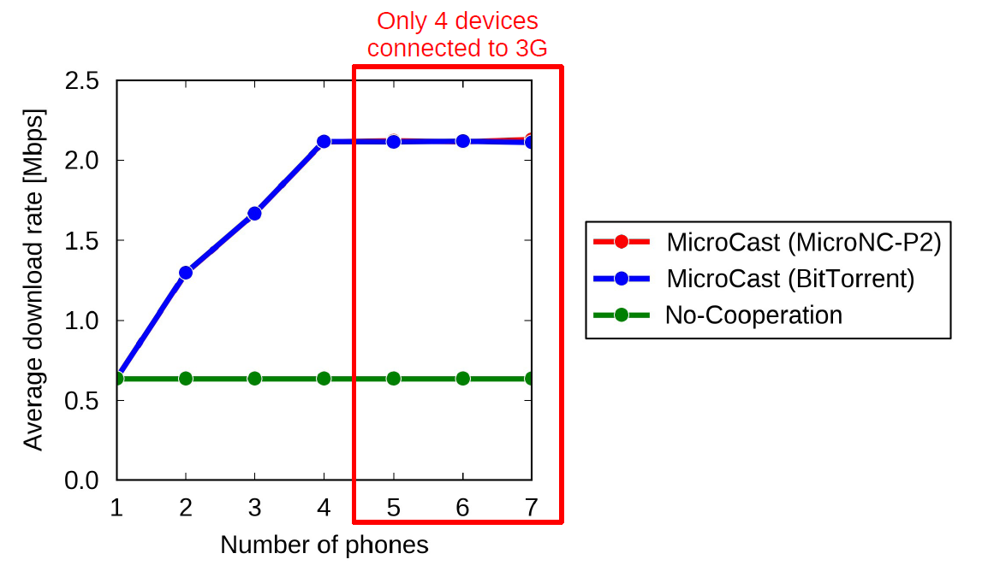
Download Rate in Non-Congested Local Area
Notes:
Fig. 8 shows the average download rate versus the number of phones. We observe that both MicroCast and BitTorrent-Pull are able to improve the average download rate up to the sum capacity
of the 3G links. Note that MicroCast and BitTorrent-Pull do not provide any improvement for more than four phones because only four phones have 3G connections in our setup, and the average download rate is limited by the sum capacity of the four corresponding 3G links.

Slide 46
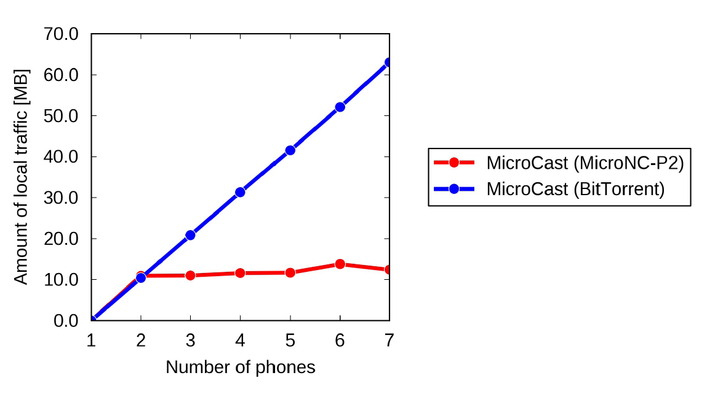
Local Traffic Generated by P2P Modules
Notes:
Fig. 9 shows that BitTorrent-Pull introduces a larger amount of local traffic (which increases linearly in the number of phones) as compared to MicroCast. This behavior of BitTorrent-Pull is detrimental in terms of the average download rate in congested networks. An important observation is that, as the number of phones increases, MicroCast rate does not increase. This indicates that, even with many nodes, overheard packets are lost very rarely.

Slide 47
Performance Evaluation:
MicroCast System
Setup: Congested Local Area
  16 Mbps background UDP traffic on the same 802.11 channel (w/ interference from other sources)
  Local network can support up to 20 Mbps
    Leftover traffic is less than 4 Mpbs

Slide 48
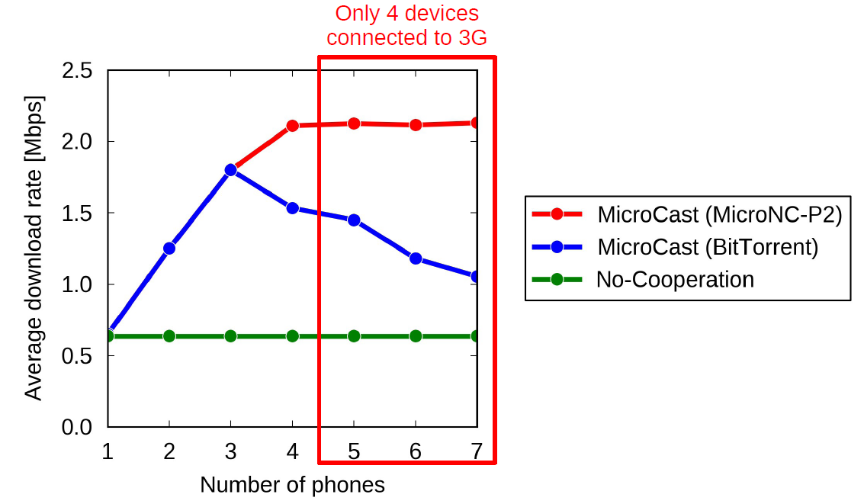
Download Rate in Congested Local Area
Notes:
Fig. 10 presents the average download rate versus the number of phones in this setup. We see that the average download rate of BitTorrent-Pull reduces when we have more than three phones. This is because BitTorrent-Pull introduces a large amount of local traffic (as illustrated in Fig. 9), which leads to congestion. Note that the addition of the 5th, 6th, and 7th phones also increases the local traffic in BitTorrent-Pull, even though they do not have 3G connection. This is because they still need to receive the file in the local area, which contributes to local area traffic.
On the other hand, Fig. 10 shows that MicroCast still improves the average download rate up to the total capacity of 3G links (of four phones) in a congested network. This is because it introduces
only a small amount of local traffic (e.g., even for seven phones, MicroCast only introduces 2.6 Mbps traffic to the local network). It can be observed from Fig. 10 that the average download
rate of MicroCast is more than three times higher than that of No-Cooperation. Also, the improvement of MicroCast over BitTorrent-Pull in terms of average download rate is as high as 75%

Slide 49
Performance Evaluation:
Energy Consumption
Setup
  Fully charged four phones: three phones are connected to a fourth one that acts as AP
  3G rates vary from 450 Kbps to 700 Kbps
  Size of video file is 95.4 MB
  Wireless interface is turned off
Use BatteryManager class of the Android SDK for the power consumption measurements
  Battery states are recorded every 10 seconds

Slide 50
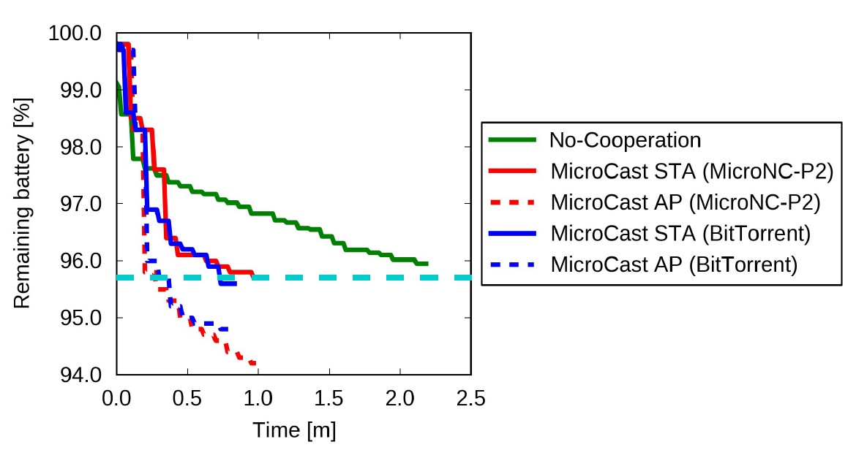
Performance Evaluation:
Energy Consumption
Notes:
Note that “MicroNC-P2 Access Point” and “BitTorrent-Pull Access Point” show the battery consumption levels of the phone which is selected to act as an AP in Micro-Cast and BitTorrent-Pull schemes, respectively.
“MicroNC-P2 Normal” and “BitTorrent-Pull Normal” show the battery
consumption levels of a phone which is not an AP.
Observe from Fig. 11 that the No-Cooperation scheme has less battery consumption compared to MicroCast and BitTorrent-Pull at a given time, e.g., at 400 second. However, the time required to download the video file of No-Cooperation is very high (more than two times) as compared to MicroCast and BitTorrent-Pull.
If we look at the battery levels of all schemes when the file transmission is completed, we see that the battery consumption levels of No-Cooperation, MicroCast, and BitTorrent-Pull are similar. This demonstrates that employing cooperation in the long term (to download a video file) does not bring any significant battery cost. Finally, the phones which act as APs consume more battery as compared to the other phones: this is expected because the AP phone has additional tasks. However, even in the worst case (for the AP phone), MicroCast consumed approximately 6% of the battery to download the whole file. Considering that the phones are downloading a large file (i.e., 95.4 MB), this battery consumption level is reasonable. These considerations show that the rate benefit of MicroCast comes at no significant battery cost.

Slide 51
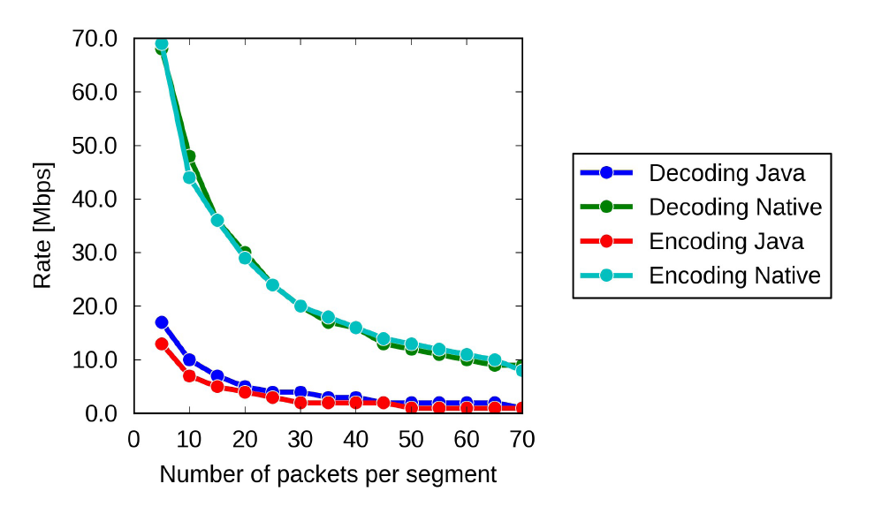
Performance Evaluation:
NC Implementations
Notes:
we present the performance of the two implementations of network coding we developed: native (written in C) and Java-based coding.
Fig. 12 shows the highest achievable decoding and encoding data rates. The slowest encoding rate for the Java implementation is 1 Mbps, while for the Native implementation, it is 8 Mpbs, which is significantly higher than what is needed for video streaming applications considered in this paper.

Slide 52
Limitations and Extensions
Bluetooth instead of WiFi
  Attractive feature
    Can be used w/o rooting the phone
    Supports both single-hop and multi-hop transmission via piconets and scatternets
  Downside
    Do not support broadcast
    It would be interesting to study potential benefits of Bluetooth in multi-hop scenarios
Use WiFi for downloading the content from the server
  Already support, however, downlink and the local transmissions are no longer independent
  Already analyzed this problem theoretically

Slide 53
Limitations and Extensions
Limitations
  Does not take into account the local link quality between the nodes
  Does not try to download in parallel blocks on multiple devices when spare capacity is available
  Can not exploit broadcast capabilities of the WAN link (if connected to an 802.11 AP)
  Can not support more than 7 concurrent devices (when an Android 4.0 device acts as the AP), or 6 devices (when an Android 2.3 device acts as the AP)
    Limitation of the softAP currently implemented in Android

Slide 54
Conclusion
MicroCast: Collaborative video streaming on smartphones
  MicroDownload: Collaborative use of downlinks
  MicroNC-P2: All-to-all dissemination protocol, customized for the “micro” setting to exploit broadcast and network coding
  MicroBroadcast: High rate WiFi broadcast

Slide 55
demo

