Slide 1
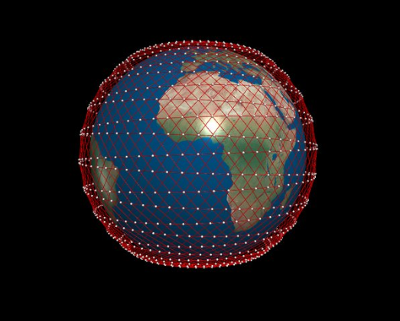
Starlink Scheduling

Slide 2
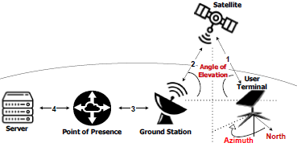
Starlink’s hierarchical scheduling
Two schedulers
  Global network controller
  MAC controller
Global network controller
  Allocates a satellite to each user terminal based on
    Load, geospatial conditions, satellite charge, etc
  Reschedules every 15 seconds, globally
MAC controller schedules flows from the user terminals assigned to it
  Round-robin

Slide 3
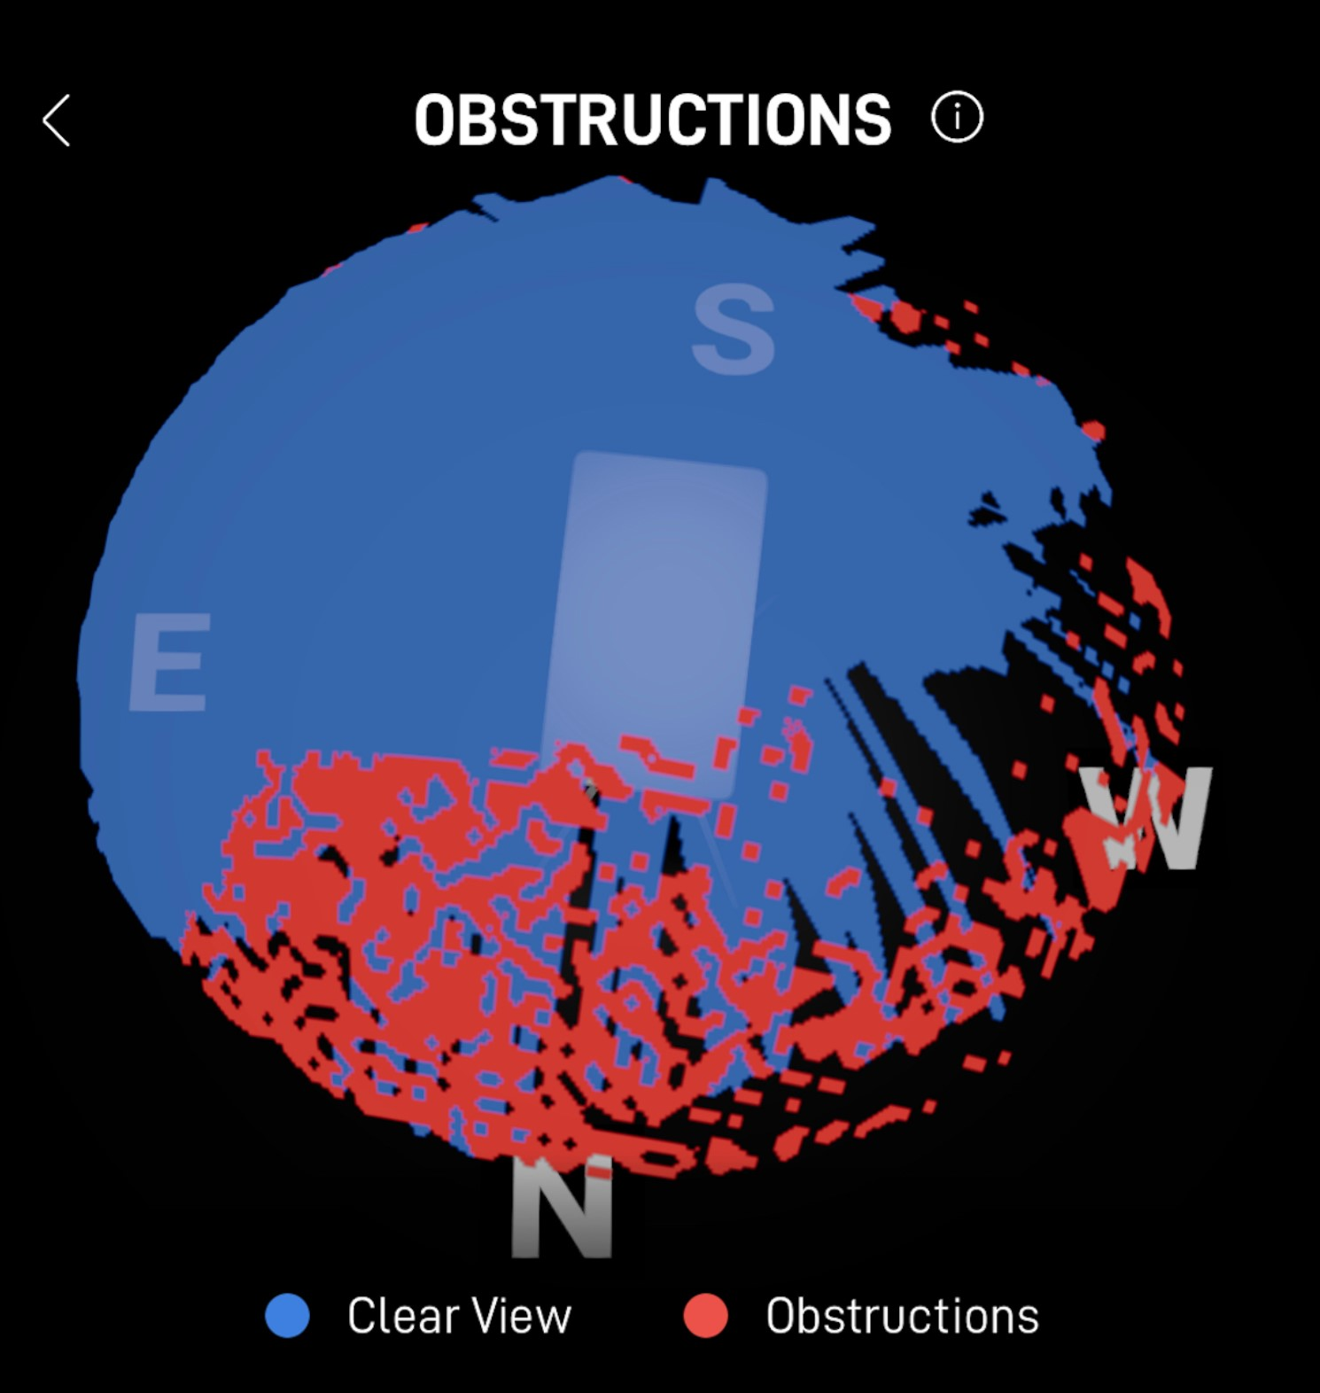
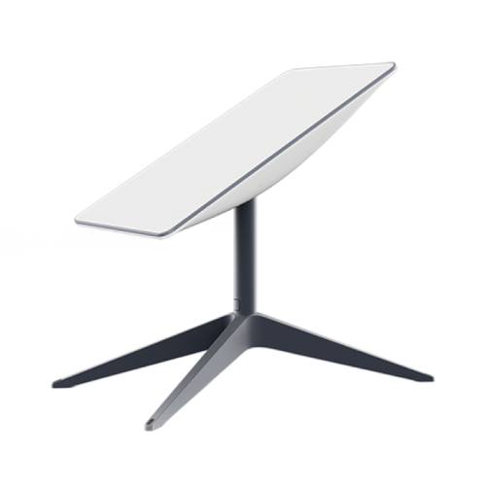
User terminals
Phased-array antennas equipped with a motor
  Motor physically repositions the angle of the dish to track fast moving satellites in the sky
    Only used in initial calibration!
Can connect to any satellite at AOE > 25◦
A terminal can connect to only one satellite at a time

Slide 4
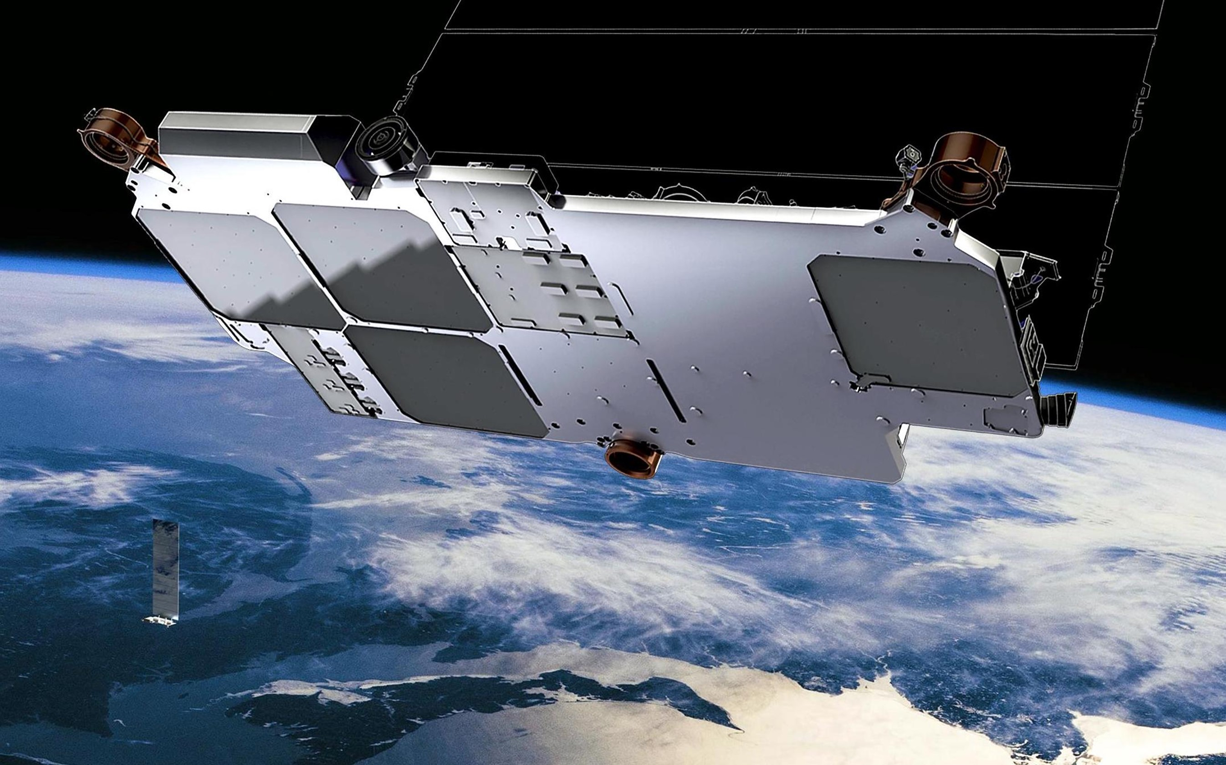
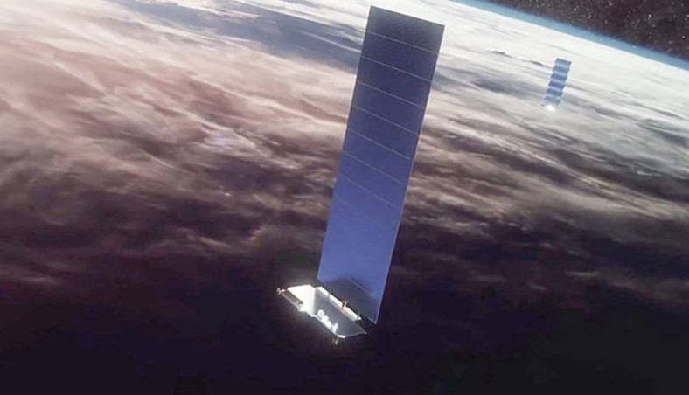
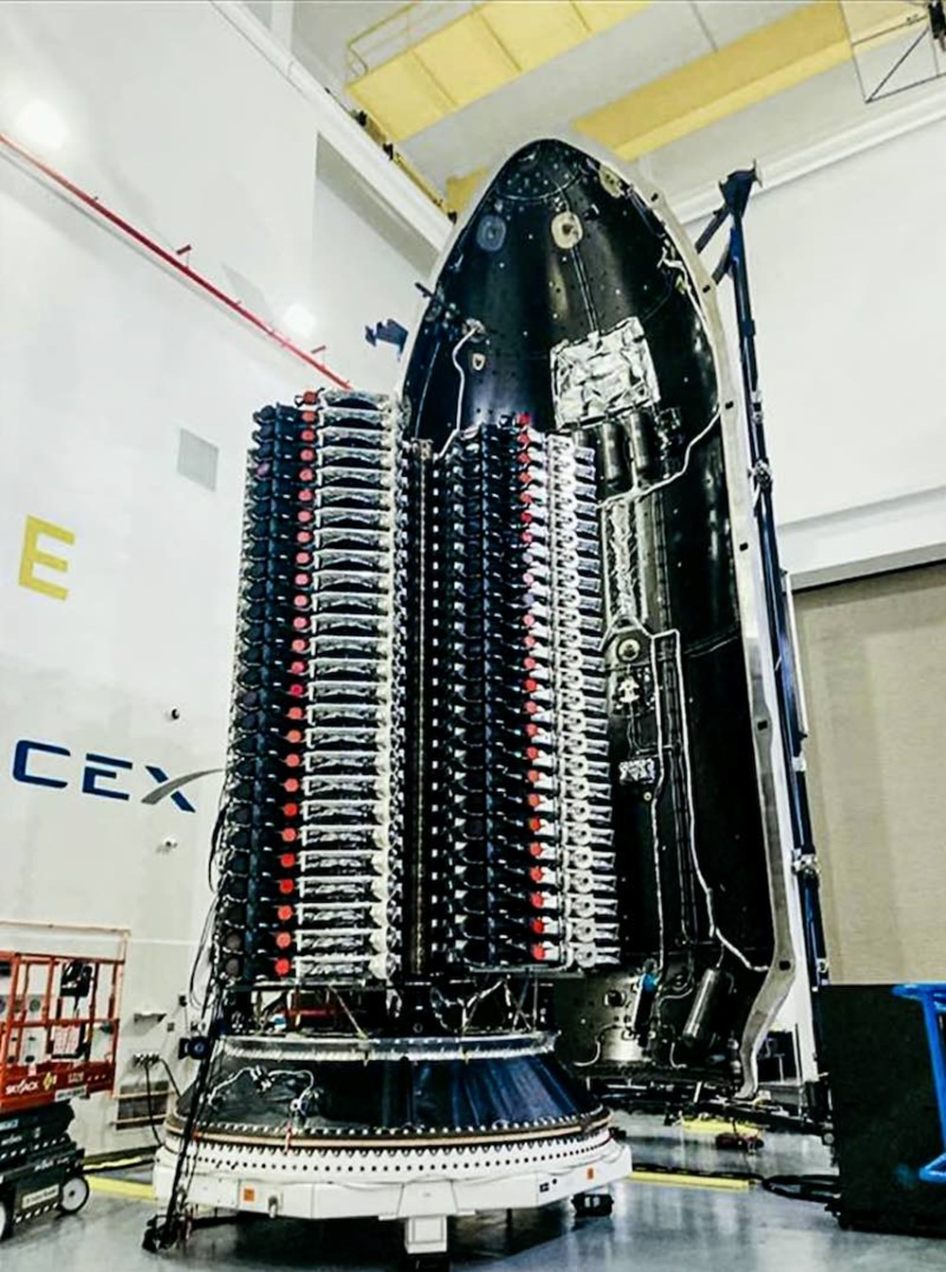
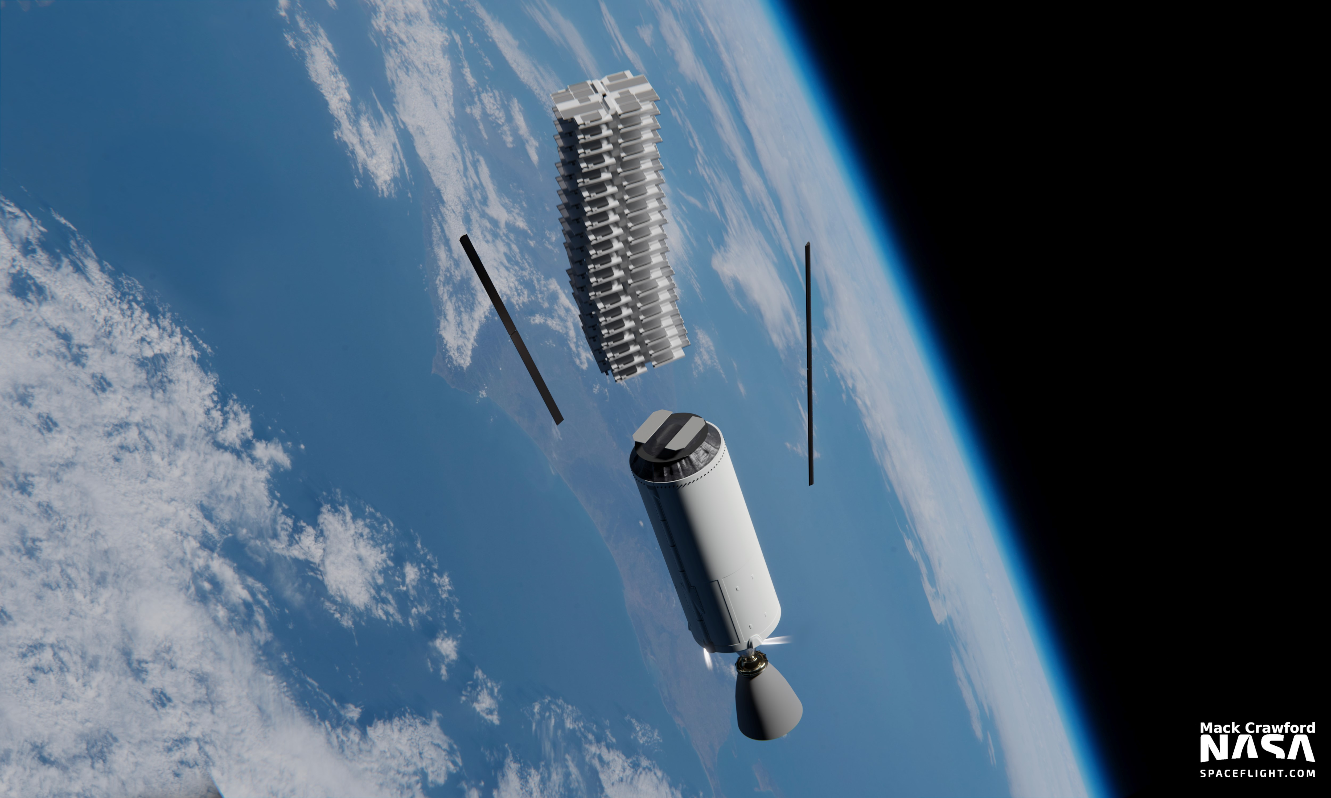
Satellite
Connects to multiple user terminals at a time
Allocates radio frames to user terminals mapped to them to exchange data
  On-board “MAC controller”
MAC controller considers following factors when forwarding the traffic from user terminals to ground stations
  User priority
  Current load
  Per-terminal flow characteristics

Slide 5
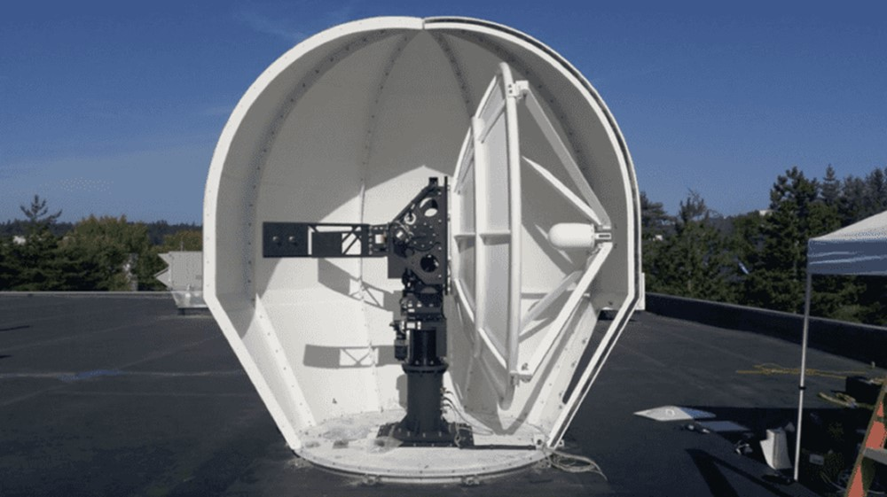
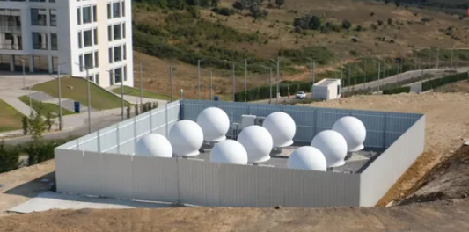
Ground stations and PoPs
Ground stations consist of a set of phased-array antennas
  Receive traffic from satellites and send it through wired links to Starlink’s PoPs
  Can communicate with satellites at AOE > 25◦
PoPs are connected to the Internet backbone
  From the PoP, the traffic is routed to destination on the Internet

Slide 6
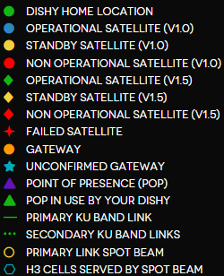
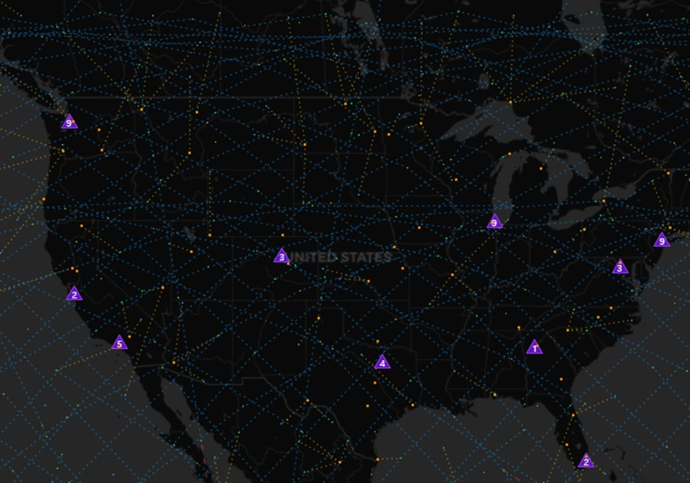
Ground stations and PoPs

Slide 7
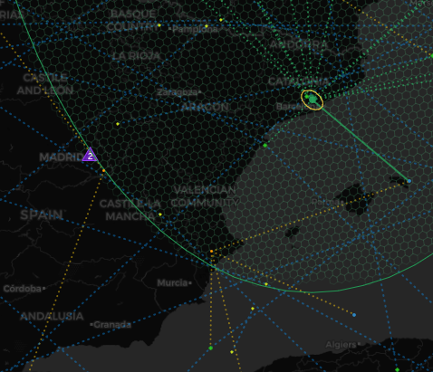
Ground stations and PoPs

Slide 8
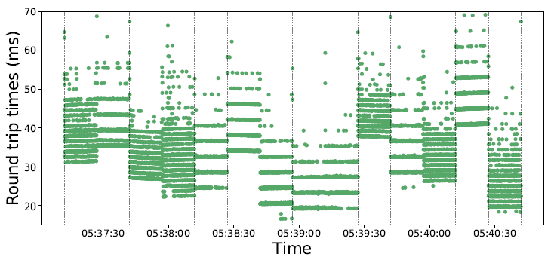
Manifestation in measured RTTs
Ping @ 50 Hz
Major changes in latency characteristics occur every 15 s
  12th, 27th, 42nd, and 57th second past every minute
  Statistically different (Mann-Whitney U test; 𝑝 < .05) from each other

Slide 9
Manifestation in measured RTTs
Within the 15s time interval, latency frequently form parallel bands that are a few milliseconds apart
  Radio frames are allocated to user terminals by an on-satellite controller in a somewhat round-robin fashion

Slide 10
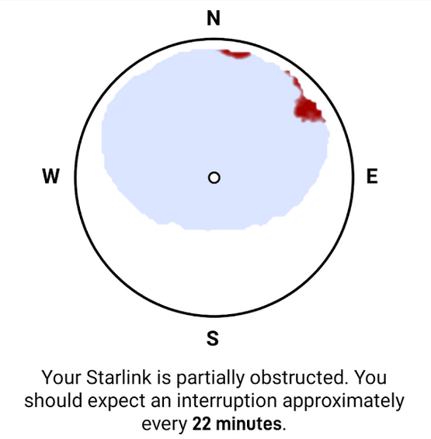
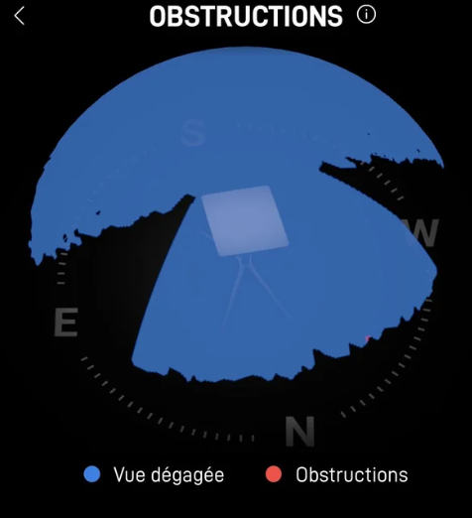
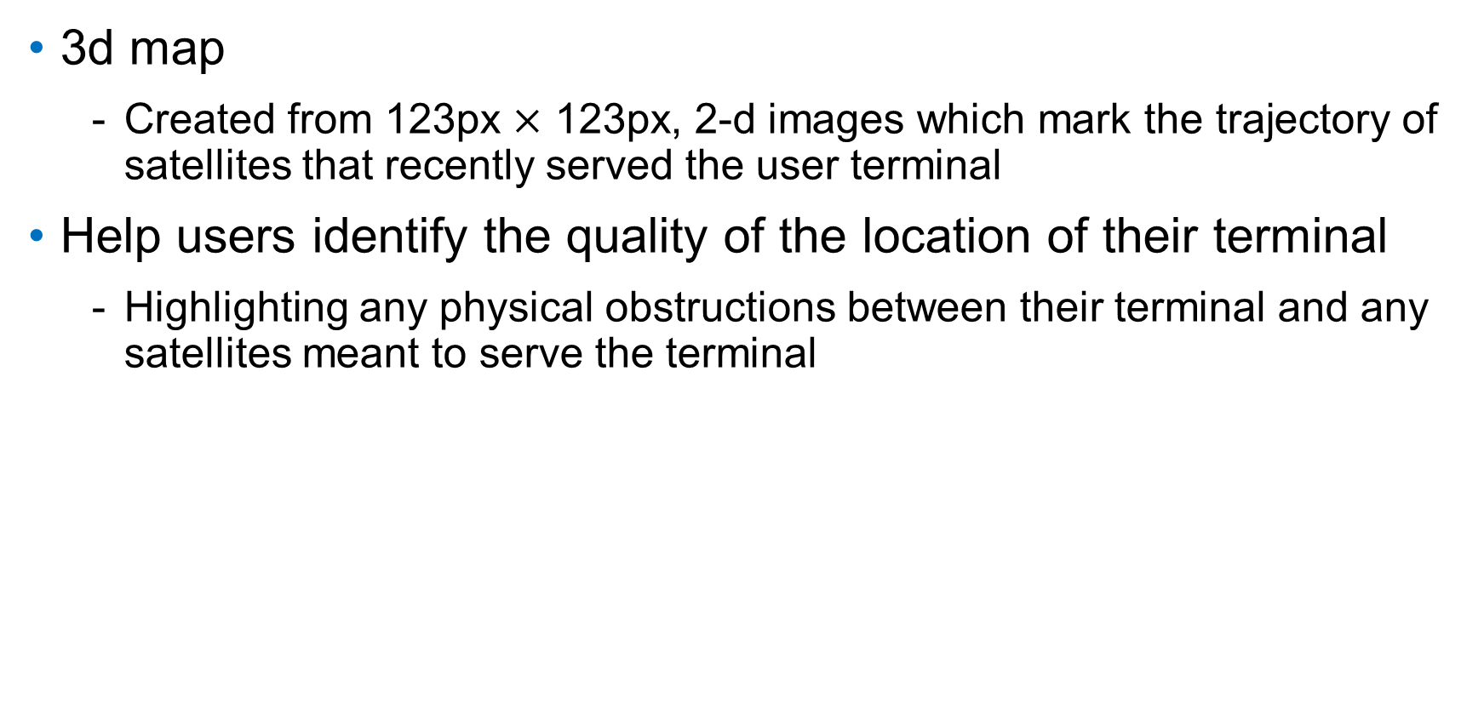
Obstruction maps
3d map
  Created from 123px $×$ 123px, 2-d images which mark the trajectory of satellites that recently served the user terminal
Help users identify the quality of the location of their terminal
  Highlighting any physical obstructions between their terminal and any satellites meant to serve the terminal
Tall tree2
Firmware choosing not to Tx or Rx on either side of the equatorial band (a licensing requirement to prevent earth stations interfering with GEO satellites due to signal continuing on outward beyond LEO)
Tall tree1

Slide 11
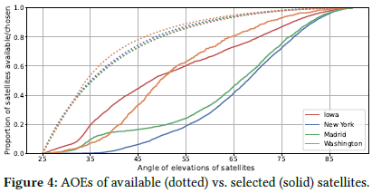
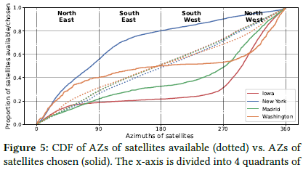
Global scheduler
35~44 satellites in the field of view of a user terminal in any 15 seconds slot
  One of them will be selected for connection during a slot
Median AOE of selected sats is 22.9° higher than others’
  Only 30% are in 45~90° range
  More energy-efficient
Azimuths of selected sats skewed towards North
  82% of the time, while 58% of available sats are towards North

Slide 12
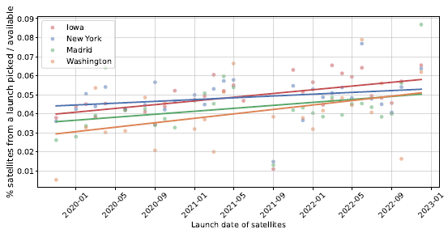
Global scheduler
More likely to pick a satellite launched later
  To evenly spread service times of satellites
  Allowing the constellation to stay stable for longer
More likely to pick a sunlit satellite
  72.3%
  Dark satellites selected only when dark ones are over 35%
  Selected dark sats 25° higher than sunlit counterparts

Slide 13
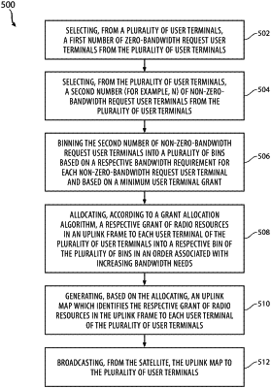
MAC scheduler
US Patent 11,540,301 B1
  System and method of providing a medium access control scheduler
  Issued Dec. 2022
  Withdrawn? Not available in USPTO

Slide 14
Backup slides

Slide 15
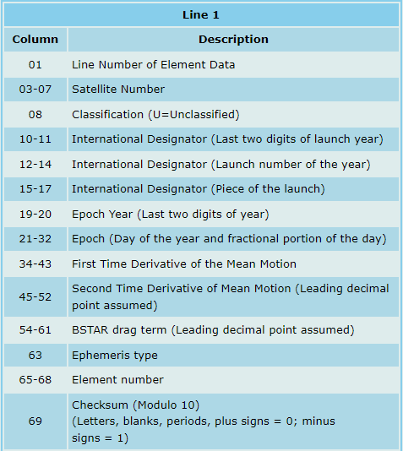

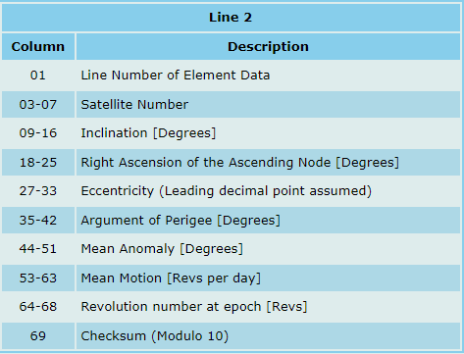
Satellite positions
Two Line Element (TLE) format
  Location updated every 6 hours
    https://www.satellite-calculations.com/TLETracker/SatTracker.htm

Slide 16
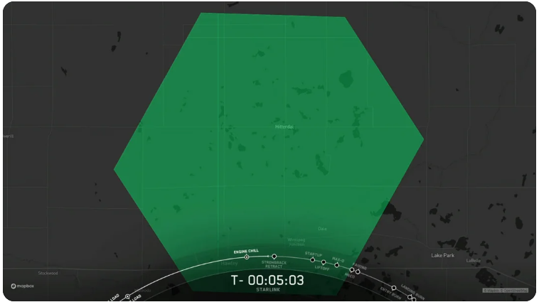
Starlink cells
24~25 km long diagonal
Starlink “assigns a beam” to it, creating an “active cell”
  Sats are programmed to target the cell as they fly by it

Slide 17
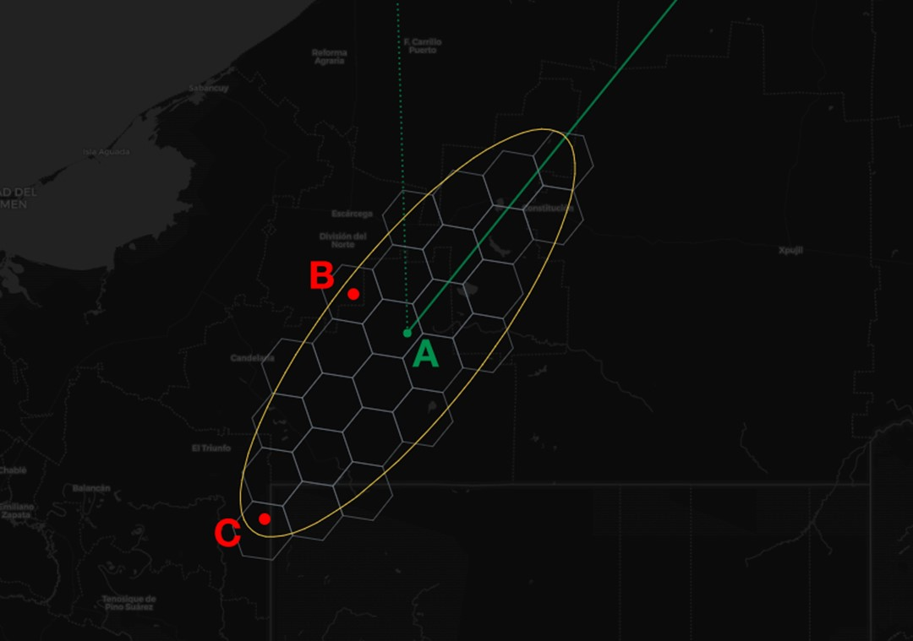
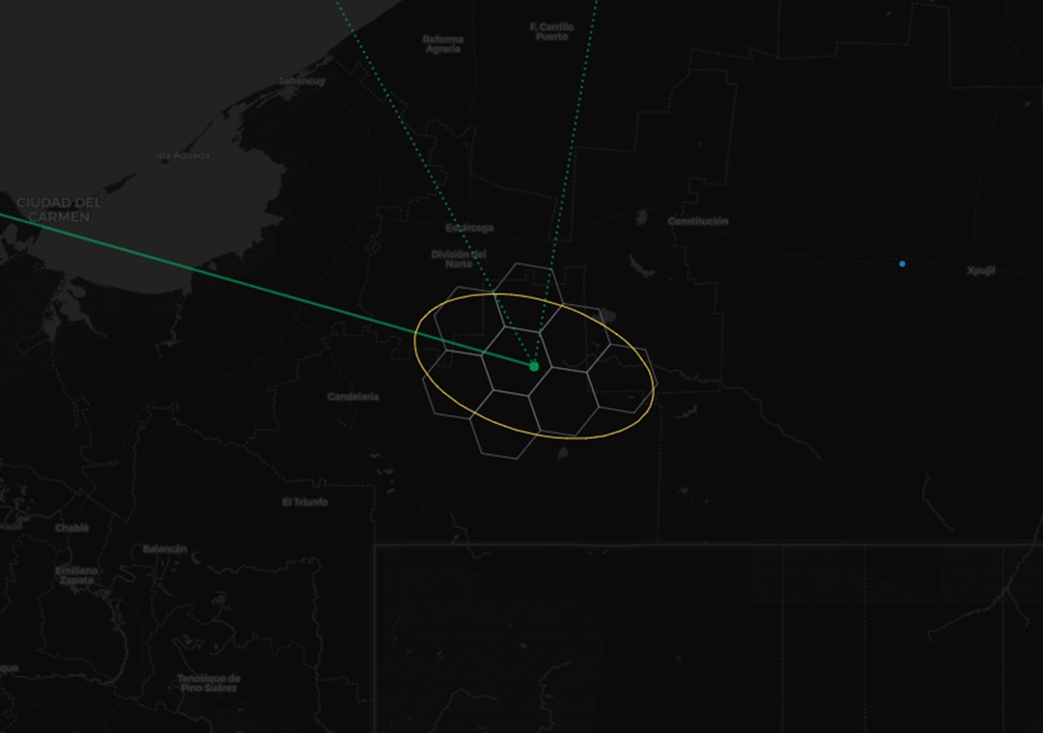
Starlink cells
Cell A will get normal service, depending on local obstructions, etc.
Cells B and C will also get service, but at lower SNRs
  Any cell between A and C will also be able to get service
  Any cells further away than B stand little chance of being served
As the satellite moves, the ellipse rotates, and B will get service for a longer period of time than C

Slide 18
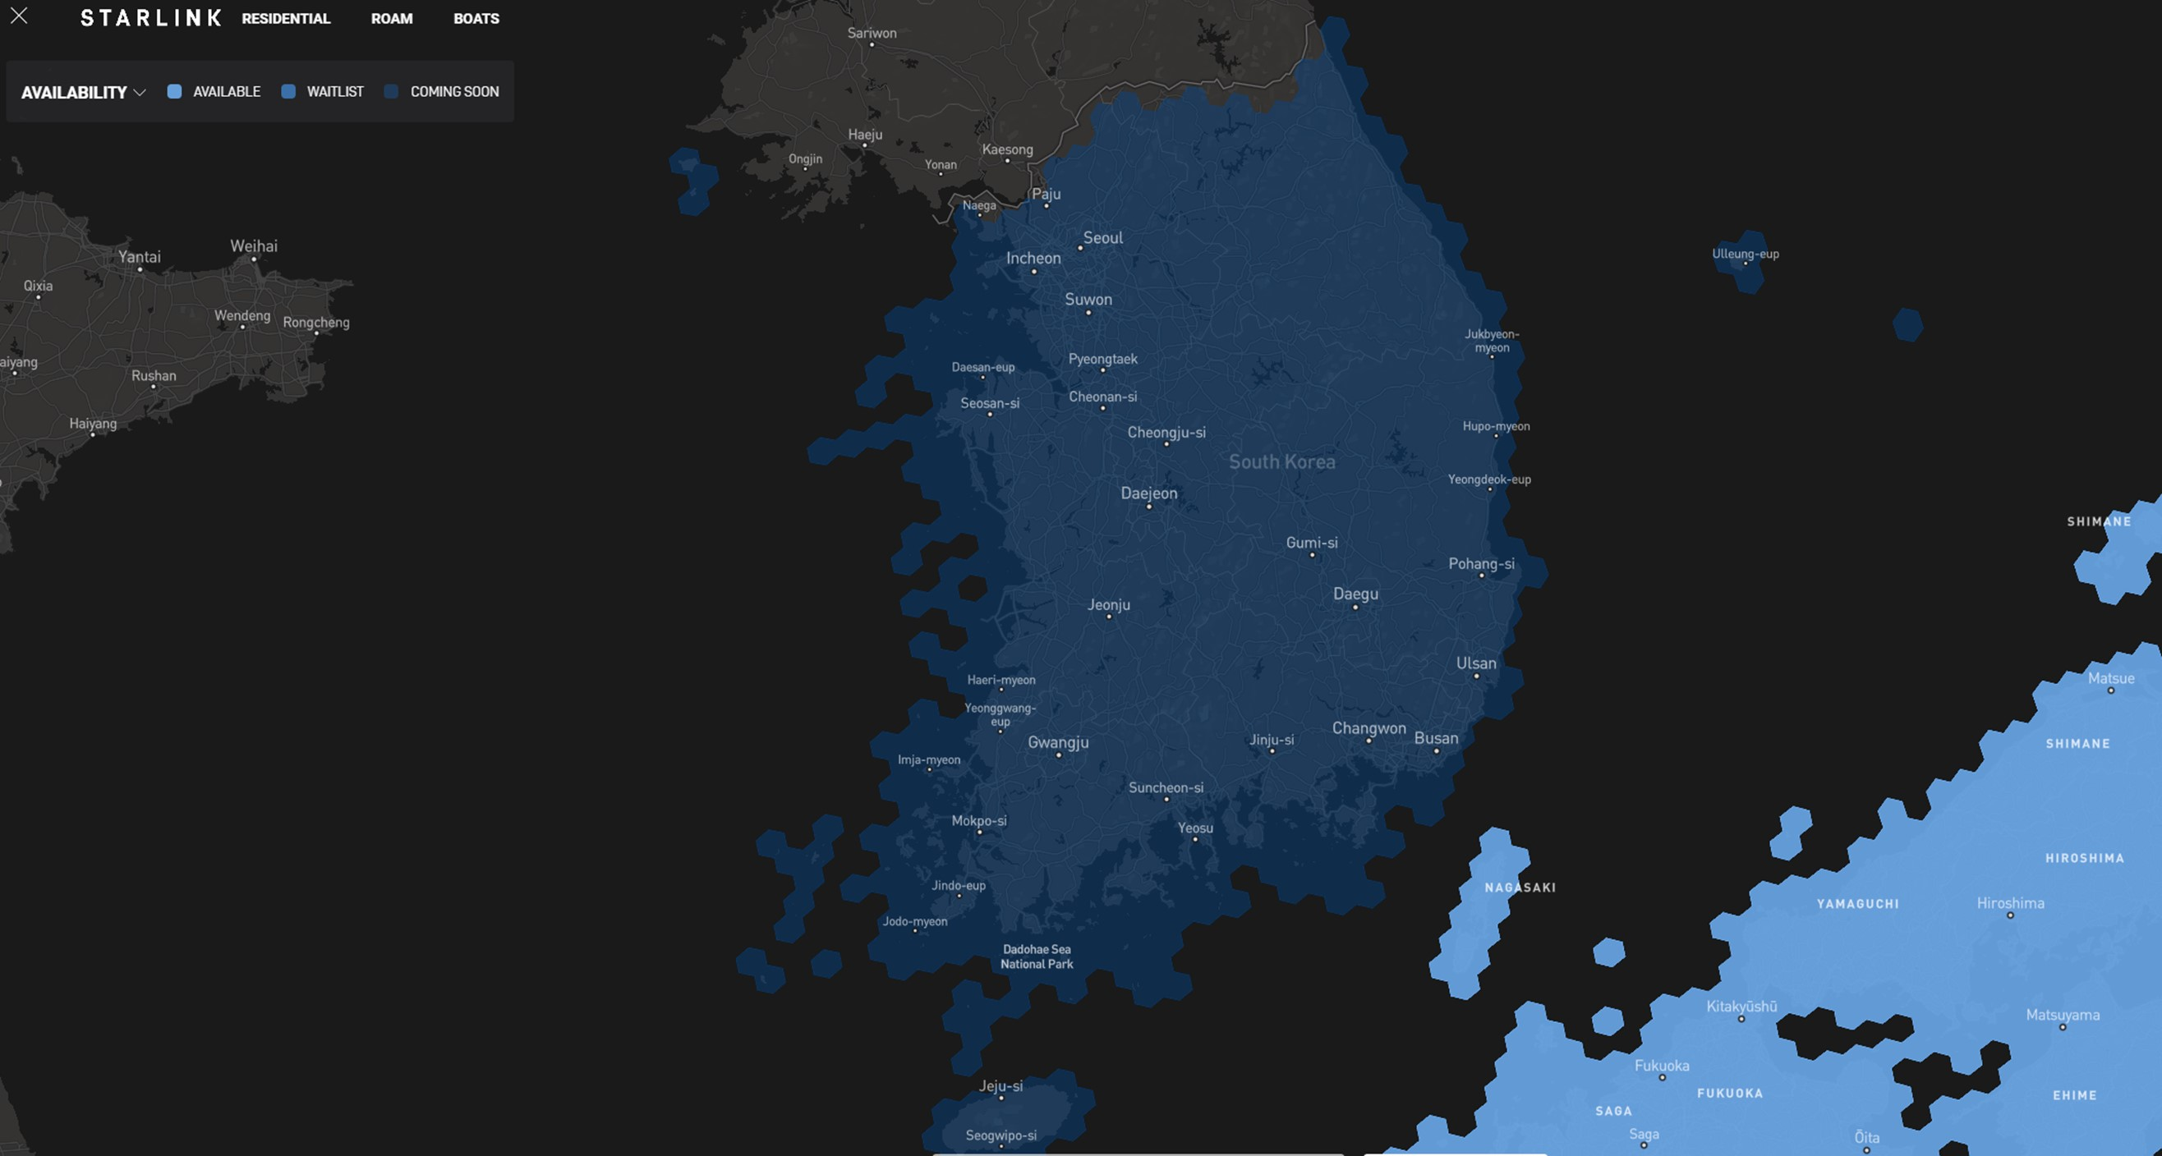
Starlink cells
As of Dec. 2023

Slide 19
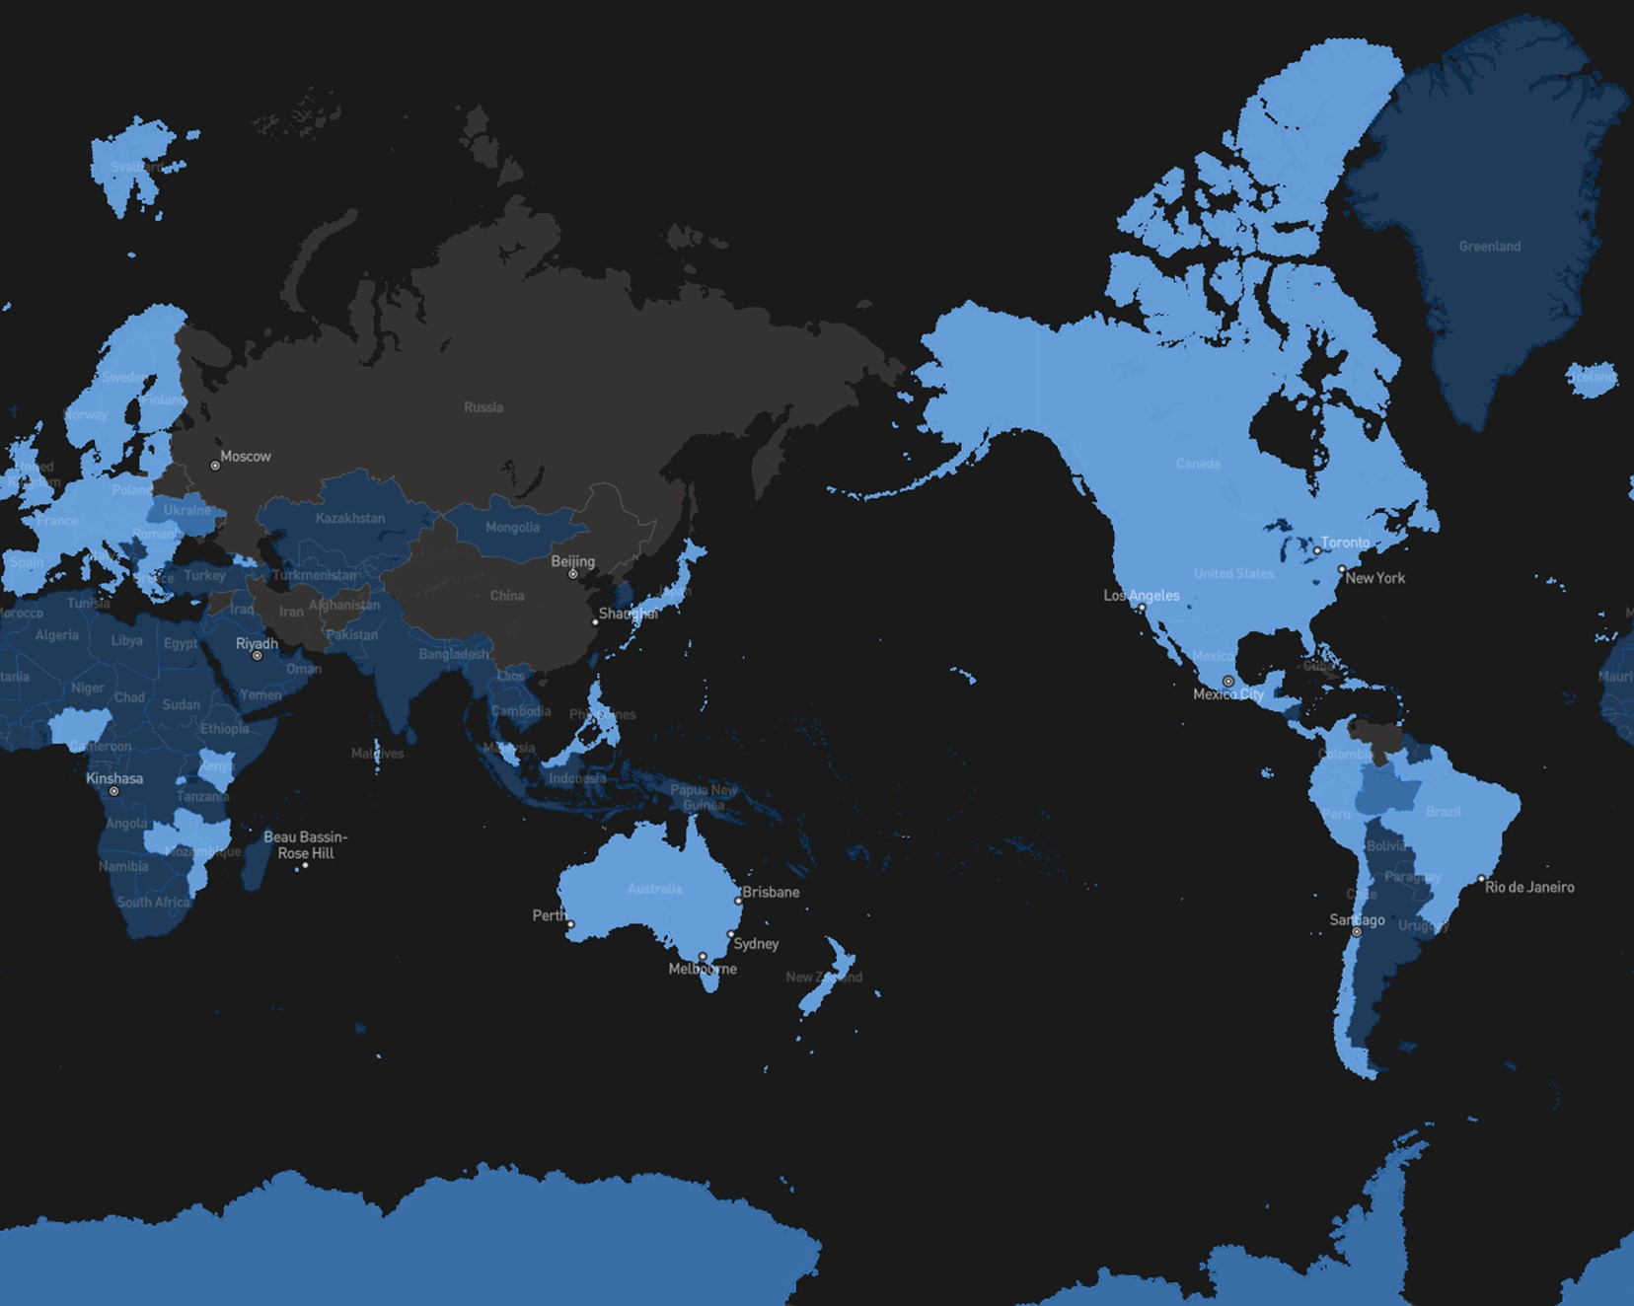
Starlink cells
As of Dec. 2023

Slide 20
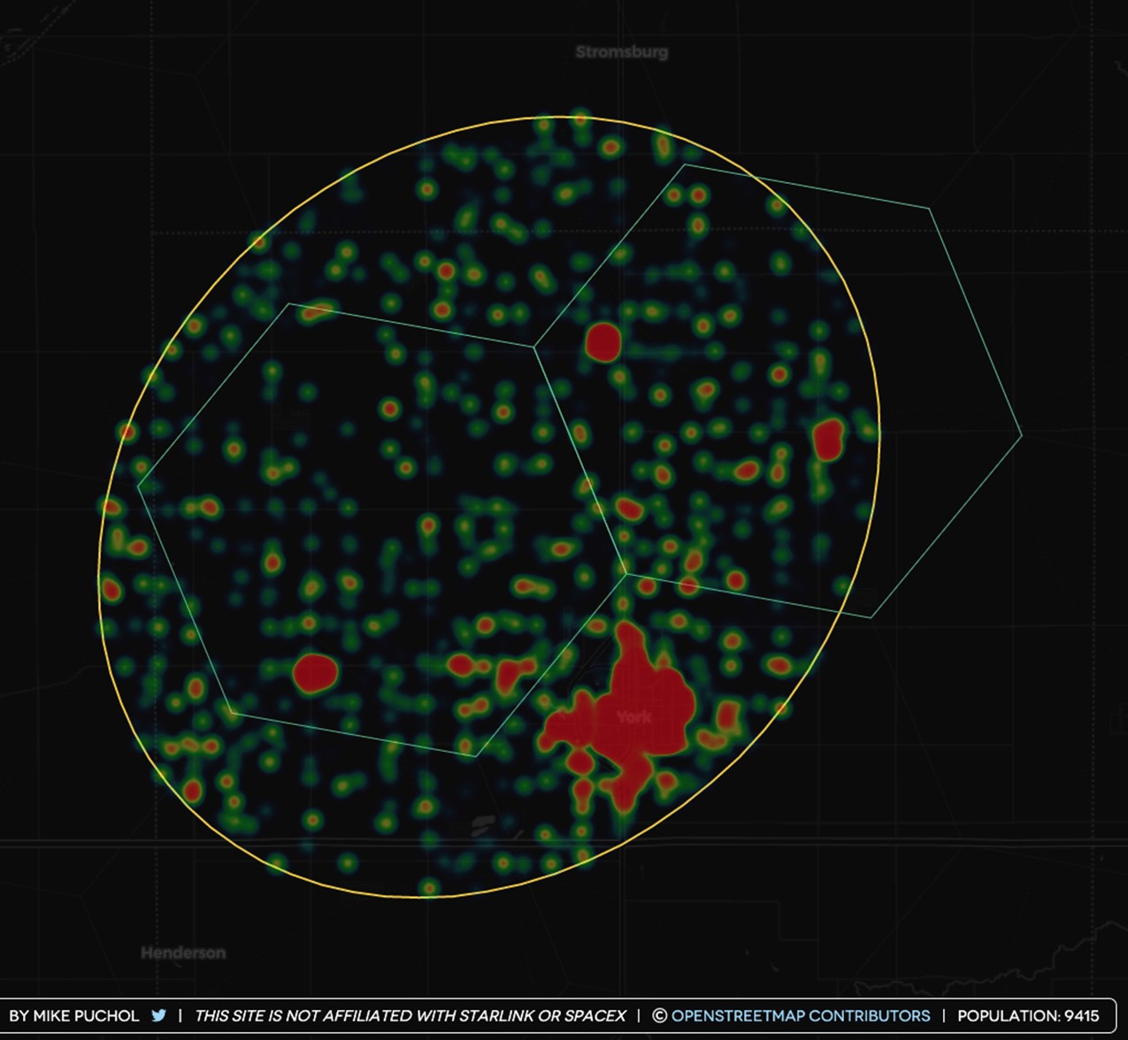
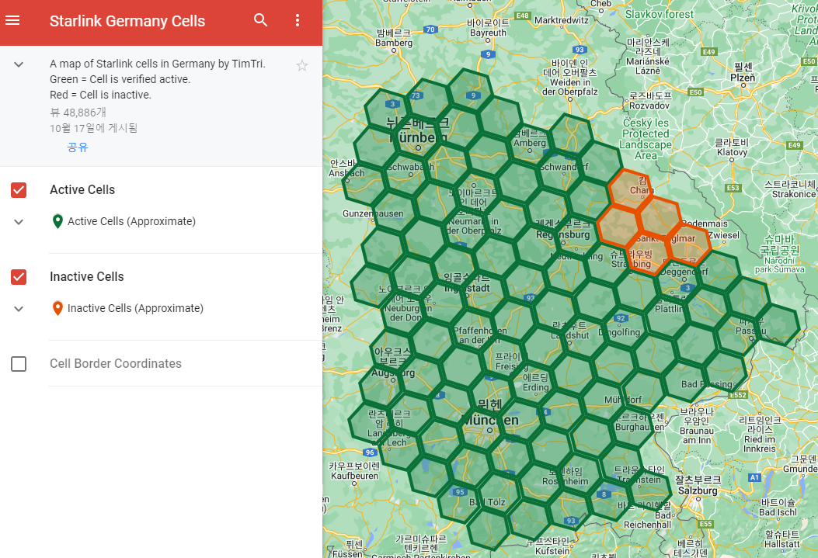
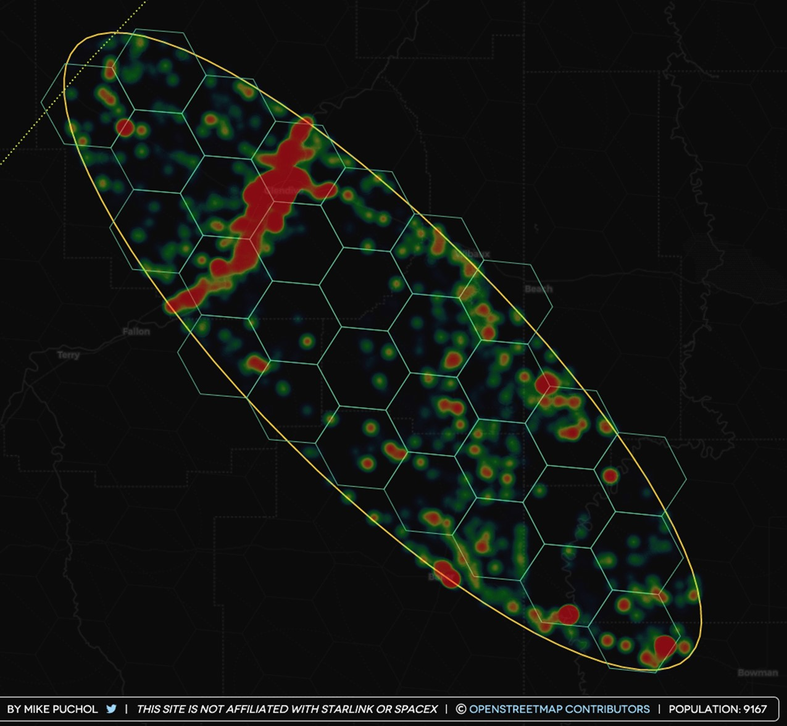
Starlink cells
Active vs. inactive cells would depend on subscriber density and the shape of the beam

