Slide 1
Hierarchical Aggregate Classification with Limited Supervision for Data Reduction in Wireless Sensor Networks
Lu Su, Yong Yang, Bolin Ding, Jing Gao, Tarek F.Abdelzaher, and Jiawei Han
Department of Computer Science
University of Illinois at Urbana-Champaign
SenSys ‘11, November 1-4, 2011.
Hyungjoo Lee
Korea Univ.

Slide 2
Agenda
Introduction
Aggregation Model
Decision Aggregation
Hierarchical Aggregation Classification
Constrained HAC
Performance evaluation
Conclusions

Slide 3
Introduction
Classification
  The task of assigning objects to one of several predefined categories(classes)
  Basic idea is to use a function(classifier) “learned” from a set of training data
Conduct intensive experiments
  Synthetic data
  Real testbed
Notes:
But existing classification techniques designed for
sensor networks fail to take into account the fact that in many
applications of sensor networks, the amount of labeled training
data is usually small.
Without sufficiently large training set,
the learned classifier may not be able to describe the characteristics of each class,
and tends to make bad predictions on new data.
To reduce the amount of data delivered to the sink,
authors let each node locally cluster events and
report only its clustering result (also called decision in this paper) to the parent node.

Slide 4
Aggregation Model
S_{i} : Each node based on sensory readings
D_{i} : S_{i}’s decision
S₀
S₀: D=F(D₀, D₂, D₅)
S₁
S₂
S₁: D₅=F(D₁, D₃, D₄)
S₂
S₃
S₄
S₃
S₄
(a) Aggregation Model
(b) Decision Aggregation
Notes:
In this part, authors introduce the general aggregation model.
Si means each node based on sensory readings.
And they divides the events into different clusters through its local clustering algorithm.
And After that, si forwards the clustering result to its parent node.
the nonleaf node s1 aggregates the decisions of s3 and s4, together with its own decision.
In this paper, authors use function F(¢) to represent the operation of decision aggregation.
Then, s1 forwards the aggregated decision D5 to the sink node s0.
At s0, D5 is further combined with s0 and s2’s decisions.
Finally, the global decision D is obtained.

Slide 5
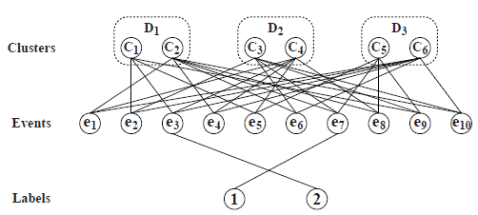
Decision Aggregation
Belief Graph
  iCluster
  oCluster
n=3 decision
t=10 events
m=2 different class
l = mn = 6 different iCluster
Notes:
Here is the decision aggregation algorithm. This is the aggregation function used by the HAC and cHAC protocols at each nonleaf node.
Given a nonleaf node, suppose it receives n decisions from its children nodes.
In each decision, the events are partitioned into m clusters.
Thus, we have totally l = mn different clusters.
In this paper, authors call these clusters the input clusters (iCluster for short) of a decision aggregation.
On the other hand, the decision aggregation operation will output an aggregated decision also composed of m clusters,
Authors define these cluster asoutput clusters (oCluster for short).

Slide 6
Decision Aggregation
Terminology
  Weight parameter associated with each decision
  Each decision is manually assigned a weight
    Based on the properties of the sensor node
  Same weight
    All the clusters within a decision
Notes:
And in their design, there is weight parameter associated with each decision.
Each decision is manually assigned a weight based on the properties (sensing capability, location, and so on) of the sensor node.
And all the clusters within a decision have the same weight as the decision.

Slide 7
Hierarchical Aggregate Classification
HAC protocol
  Apply the Decision Aggregation algorithm
  The message carrying the decision
    t entries (corresponding to t events)
S₀
S₀: D=F(D₀, D₂, D₅)
S₁
S₂
S₁: D₅=F(D₁, D₃, D₄)
S₂
S₃
S₄
S₃
S₄
(a) Aggregation Model
(b) Decision Aggregation
Notes:
In this part, they explain how the HAC protocol utilizes this algorithm to aggregate the decisions along the tree.
HAC applies the Decision Aggregation algorithm
on each of the nonleaf nodes to aggregate all the decisions it collects.
The output of the algorithm serves as one of the input decisions in the aggregation at its parent node.
The message carrying the decision consists of t entries, corresponding to t events.
As previously defined, the ID of each oCluster is the label of this oCluster.
However, these labels may not be useful in later aggregations,
because the oClusters will probably be combined with other
clusters whose labels are unknown.
For example, at the sink s0, the labeled clusters in decision D5 are
combined with unlabeled clusters in D0 and D2.
Finally, the global decision is obtained at the sink node,
and each event is assigned a predefined label.

Slide 8
cHAC (Constrained HAC)
The decision aggregation algorithm
Intelligently plans the decision aggregation
Decision information is lost during the process of aggregation
  Bad for accuracy of the aggregated decision
Add a constraint to the HAC
Notes:
In this section, they introduce an extended version of the HAC protocol, called cHAC protocol.
cHAC also uses the Decision-Aggregation algorithm as the aggregation function.
However, different from HAC, each nonleaf node aggregates all the decisions it collects,
cHAC intelligently plans the decision aggregations throughout the tree.
HAC can improve the classification accuracy as well as the consumption of communication energy
Through combining decisions coming from different sensor nodes.
However, decision information is lost during the process of aggregation,
and this may hurt the accuracy of the aggregated decision.
For this reason, authors add a constraint to the hierarchical aggregation classification.
In each decision aggregation along the tree, the weight of each input decision cannot be larger than a predefined percentage
of total weight of all this aggregation’s input decision.

Slide 9
Performance Evaluation
Evaluate the proposed schemes
  Synthetic data
  A solar-powered sensor network testbed
Design two baseline methods
  Clustering Voting
    Each node locally groups the events into different clusters
    Count the labeled events in each cluster
    All the events are assigned the label with the largest count
  Classification Voting
    Each node apply classification algorithms on the labeled data and predict the labels of the rest
    The events are labeled based on the vote
Notes:
Authors evaluate the proposed schemes.
For the reason of comparison, authors design two baseline methods.
(Both of the baselines adopt the strategy of majority-voting,
and they are different in the ways of generating votes.)
The first baseline method suggests each node locally groups the
events into different clusters, and then count the labeled events in each cluster.
Within a cluster, all the events are assigned the label with the largest count.
(For example, there are 100 events in a cluster,
with three events labeled 1 and two events labeled 0,
then all the 100 events are labeled 1 according to the clustering voting scheme.)
Each node apply classification algorithms on the labeled data,
and predict the labels of the rest.
Then, the events are labeled based on the vote.

Slide 10
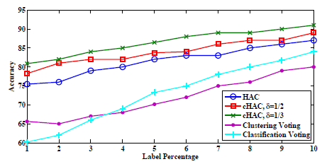
Performance Evaluation
Experiment on Synthetic Data
  HAC, cHAC(1/2, 1/3), two baseline schemes
Comparison of accuracy (Synthetic Data)
Notes:
They randomly build aggregation trees with the number of tree nodes ranging from 20 to 80.
Δ = delta
The picture is compares the classification accuracy of the proposed HAC
and cHAC (with weight balance threshold δ=1/2 one half, 1/3 one third) protocols,
And the two baseline schemes.
As can be seen, when the percentage of labeled events is less than 10,
the proposed protocols can always achieve better performance than the baselines.
With the decrease of label percentage, the accuracy of all the five methods degrade.
Among them, the accuracy of the classification voting decreases the fastest.
This is reasonable since compared with clustering methods,
Classification models are normally more sensitive to the label percentage.
Another notable point is that the cHAC with smaller δ can achieve higher accuracy.

Slide 11
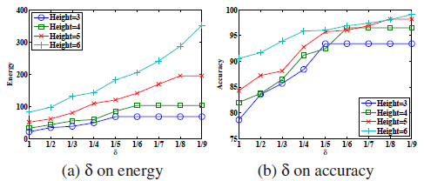
Performance Evaluation
When δ decreases,
  More energy is consumed (a)
  Higher accuracy can be achieved (b)
Large height
  Higher accuracy
  More cost of
  energy
  consumption
Impact of δ on energy and accuracy (Synthetic Data)
Notes:
This graph shows the impact of weight balance threshold δ
on the communication energy and classification accuracy of the cHAC protocol.
In this experiment, authors assume 5% of the events are labeled.
And test four groups of aggregation trees with height 3, 4, 5, and 6.
When δ decreases, more energy is consumed and higher accuracy can be achieved.
Furthermore, given a δ, the trees with larger height tend to have higher accuracy,
However, at the cost of more energy consumption.
This is because usually better diversity can
be obtained when more nodes are involved in the aggregation.

Slide 12
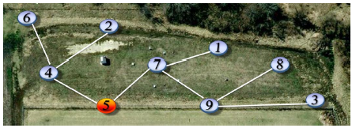
Performance Evaluation
Experiment on Real Testbed
  Testbed located on the edge of a forest
    9 nodes since August 2008.
    Node 5 works as the sink
    All the nodes have weight 1
Tree topology of the 9 deployed nodes
Notes:
In this part, authors test the performance of the proposed protocols
on their solar-powered sensor network testbed.
This outdoor testbed is located on the edge of a forest.
Currently, 9 nodes have been deployed and running since August 2008.
Furthermore, to avoid packet collision and overhearing during the process of decision aggregation,
They employ a distributed aggregation scheduling algorithm.
Under this scheduling strategy, at any time slot only a subset of the sensor nodes
are allowed to send packets and their transmissions do not
interfere with each other.
The wireless interfaces of the rest nodes are shut down so as to save the energy of idle listening.
And authors design two experiments on this testbed.

Slide 13
Performance Evaluation
Classification of Bird Species
  Automatically recognizing different bird species
    Based on their vocalizations
  Bird species recognition system
    Feature extraction phase
      Represented with a few acoustical parameters of the sound
    Classification phase
  MFCC (Mel-frequency cepstral coefficients)
Notes:
The first one is classification of bird species.
In this experiment, they target on automatically recognizing
different bird species based on their vocalizations.
Building bird species recognition system normally
involves two phases: feature extraction phase and classification phase.
In the feature extraction phase, bird vocalizations
are represented with a few acoustical parameters (features)
of the sound.
The most widely used parameterization method is the model
of MFCC, which is adopted in this experiment.
After the features are extracted, each audio data point is
reduced to a vector of features.
And after that, in the classification phase,
classification or clustering algorithms can be directly applied on the feature vectors
like usual classification tasks.

Slide 14
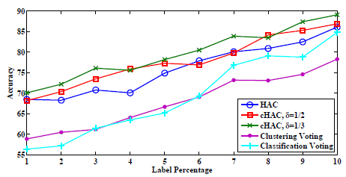
Performance Evaluation
Classification of Bird Species
  Three bird species
    Song sparrow, American crow, red-winged blackbird
Comparison of accuracy (Species classification)
Notes:
In this test, three bird species are studied. song sparrow, American crow, and red-winged blackbird.
They are among the most frequently observed species around the place where the testbed is deployed.
And they apply the same five methods.
Due to the unexpected noise in both the feature values and the labels,
The curves are not as smooth as those shown in the experiment on synthetic data.
But, we can still observe the same curve patterns as discovered in the previous experiment.
In short, the proposed schemes always perform better than the
baseline methods given a label percentage less than 10.

Slide 15
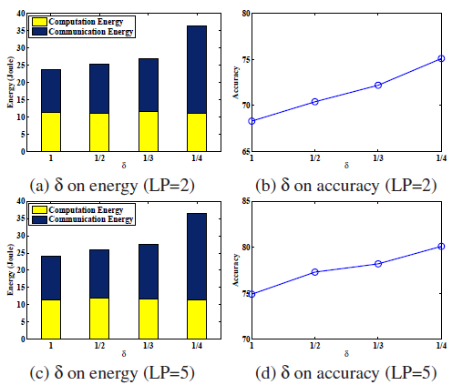
Performance Evaluation
Classification of Bird Species
Impact of δ on energy and accuracy (Species classification)
Notes:
The graph demonstrates the tradeoff between energy and accuracy.
In this test, authors study two scenarios
when the percentage of labeled data is 2 (LP=2) and 5 (LP=5).
But the relation between energy and accuracy can still
be clearly observed.
and (c) show the impact of δ on the total computation energy as well as the total communication energy.
The computation energy is nearly invariant regardless of δ.
In contrast, the communication energy increases with the decrease of δ.
On the other hand, as shown in (b) and (d),
the classification accuracy is improved when δ goes down.
Therefore, our expectation is the cHAC protocol can trade energy for accuracy is realized.
As a comparison, we also measure the energy needed to transport all the extracted feature vectors to the sink.

Slide 16
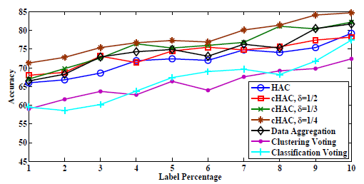
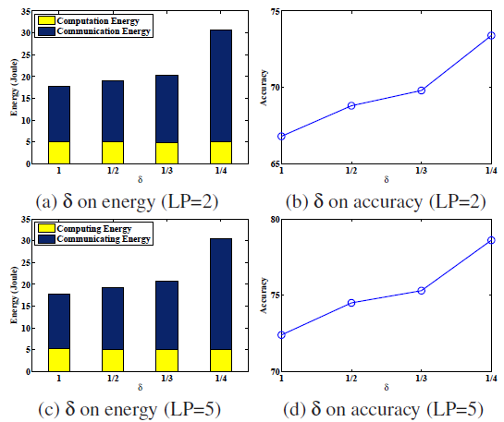
Performance Evaluation
Classification of Bird Vocalization Intensity
Comparison of accuracy (Intensity classification)
Impact of δ on energy and accuracy
(Intensity classification)
Notes:
And authors design the second experiment to test the proposed schemes on more types of sensors.
As you can see, the accuracy of data aggregation is higher than that of the HAC protocol,
but lower than the accuracy of cHAC when all the decisions are delivered to the sink (i.e., d = 1=4).
This is because some information is lost during the process of data aggregation.
More importantly, data aggregation consumes about 64.87 joules of energy to
deliver the sensory readings to the sink, much larger than the communication energy consumed by the proposed protocols.
And right graph is the tradeoff between energy and accuracy.
In this experiment, the ratio of communication energy over computation energy is larger than species classification experiment.
Because ,in this case, the dimension of data(which is 6) is smaller,
And thus the clustering algorithms consume less energy.

Slide 17
Conclusions
HAC
  Each sensor node locally make cluster analysis
  Forward the decision to its parent node
  The decisions are aggregated along the tree
  The global consensus is achieved at the sink node
cHAC
  Trade energy for accuracy
  Be able to provide flexible service to various applications
Notes:
HAC let each sensor node locally make cluster analysis and
forward the decision to its parent node.
The decisions are aggregated along the tree,
and eventually the global consensus is achieved at the sink node.
As an extension of HAC,
cHAC can trade energy for accuracy,
and thus is able to provide flexible service to various applications.

Slide 18
Thank you

