Slide 1
60 GHz Flyways:
Adding multi-Gbps wireless links to data centers
Daniel Halperin
Srikanth Kandula, Jitu Padhye
Victor Bahl, David Wetherall

Slide 2
Today’s data center networks are oversubscribed in the core
Perform well in average case with job placement
Bottlenecks in core can be workload “hotspots”
…
…

Slide 3
Eliminating oversubscription is expensive
No core hotspots
No job placement
Costly switches
Complex wiring
…
…

Slide 4
Our goal: Flyways
To enable a network with
an oversubscribed core to act like
a non-oversubscribed network
by dynamically injecting
high-bandwidth links.

Slide 5

Our approach: Wireless Flyways
Oversubscribed Core
Low cost
Perform well in most cases with
job placement
Dynamically inject links where needed
…

Slide 6
System overview
Data
placement
Jobs
DC
Scheduler
Demands
Flyway
Controller

Slide 7
Outline of the rest of this talk
60 GHz wireless technology
Wireless flyways system design
Evaluation on real data center workloads

Slide 8
60 GHz Wireless

Slide 9

60 GHz primer
7 GHz of unlicensed spectrum @60 GHz
Forthcoming IEEE 802.11ad: 3 channels, bitrates to 6.76 Gbps
Challenge:
  60 GHz link has 55 dB (312,000x) worse SNR
  than 2.4 GHz link
  Directionality is a fundamental mechanism
  to enable 60 GHz communication
2.4 GHz
5 GHz
60 GHz

Slide 10
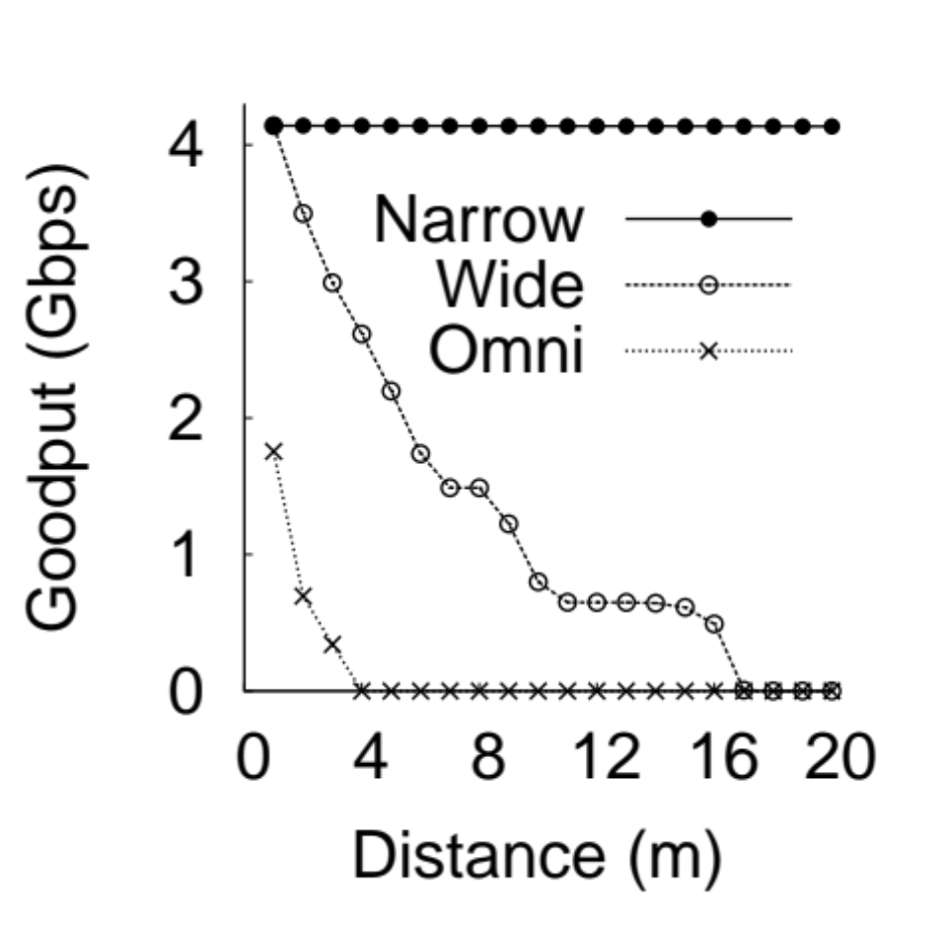
Directionality is crucial
4
3
Goodput (Gbps)
2
1
0
0 5 10 15 20
Distance (m)

Slide 11

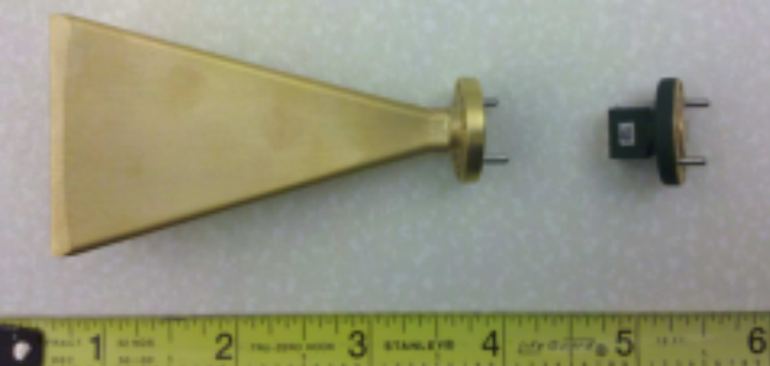
60 GHz directional technology
Phased Array
Physical Antenna
Compact (1 in²)
Electronic steering (µs)
Fixed position

Slide 12
60 GHz for Flyways
60 GHz links
Multi-Gbps
Directional
Steerable
Flyways must be
Reliable
Densely deployed

Slide 13
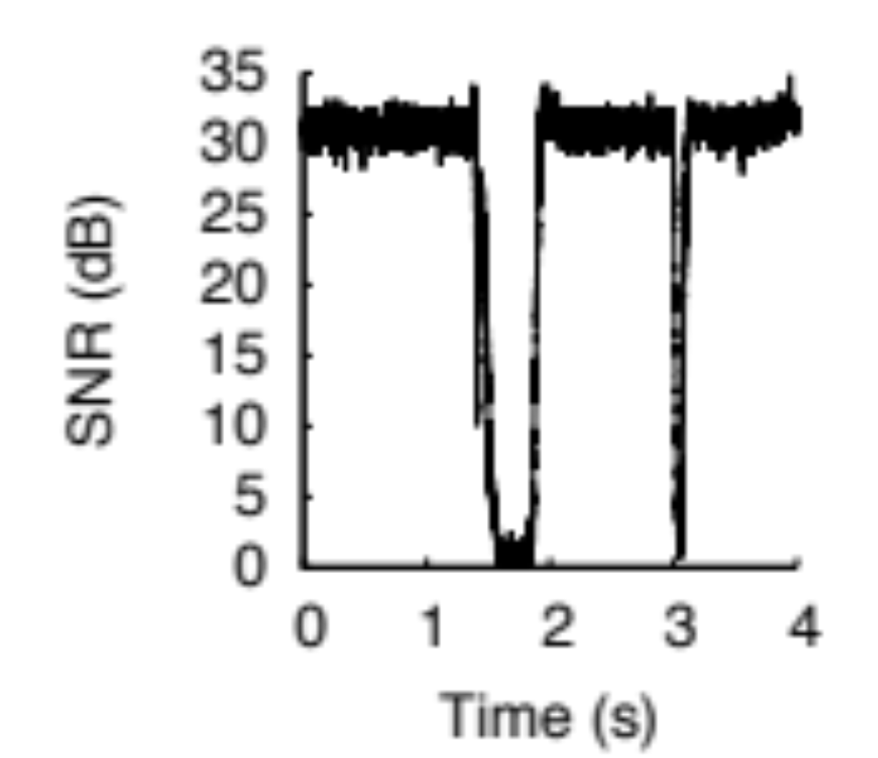
Directional 60 GHz links are not robust to blockage
Beam Interrupted
30
SNR (dB)
15
0
Time (s)

Slide 14
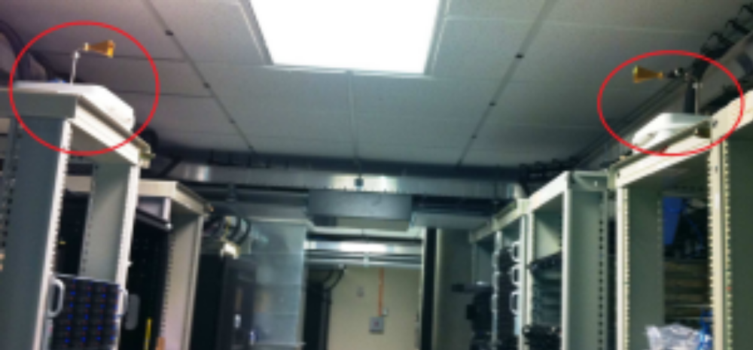
A 60 GHz link in a data center

Slide 15
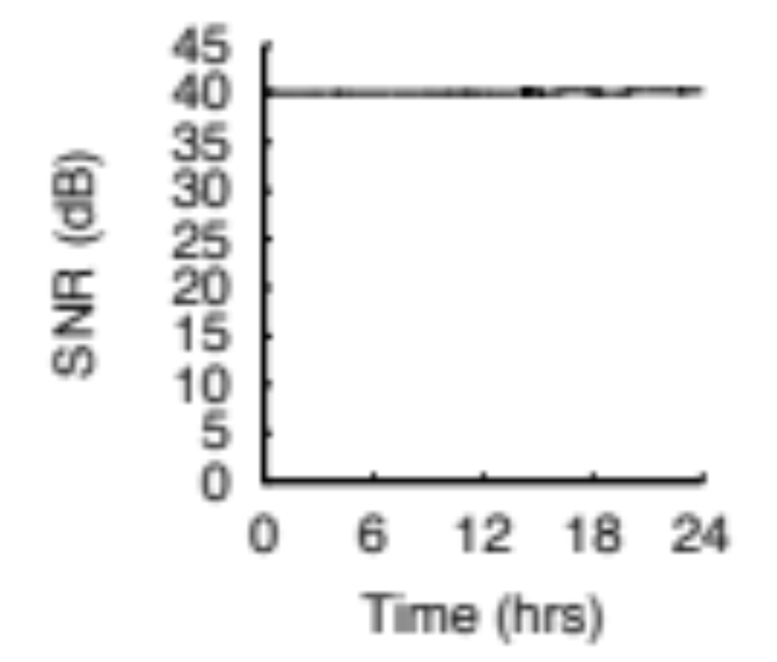
Directional 60 GHz links are stable in a data center
Beam Interrupted
24h in Data Center
40
30
SNR (dB)
SNR (dB)
20
15
0
0
Time (s)
Time (s)

Slide 16
Measurement-based 802.11ad simulator
Simulator to evaluate many concurrent flyways
  Channel model from indoor/DC RF measurements
  Measured 60 GHz antenna patterns
  Also compared to 8-element 2.4 GHz “Phocus” array
Implementation in ns-3
  802.11ad physical layer and protocol
  TCP and UDP packet simulations
  Dozens of concurrent multi-Gigabit links

Slide 17
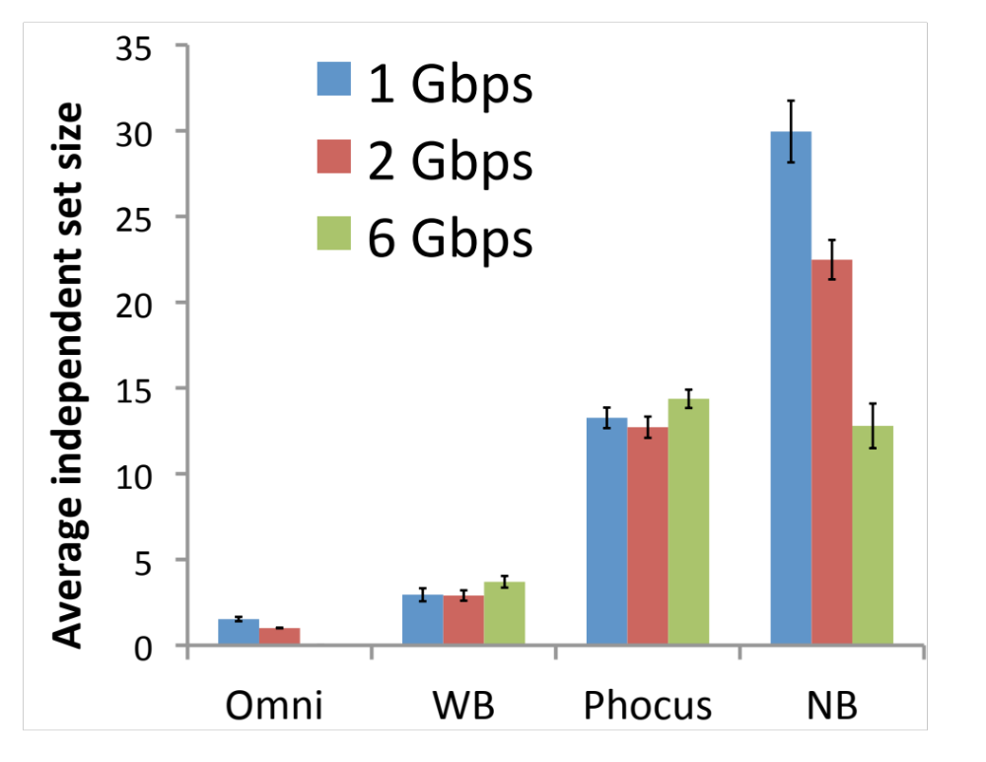
Flyways can be densely deployed
160 racks, based on
real DC topology
Draw random links until no more can be added
Ensure all links meet rate threshold
12-30 links per channel, depending on rate
# Concurrent links per channel
Omni
Wide
Phocus
Narrow

Slide 18
Measurement summary
60 GHz offers multi-Gbps, directional, steerable wireless links with IEEE 802.11ad
Measurements and simulations show
  Links are reliable in data centers
  With directionality, links can be densely deployed
Many additional measurements in paper

Slide 19
Wireless Flyways System Design

Slide 20
System overview
Data
placement
Jobs
DC
Scheduler
Demands
Flyway
Controller

Slide 21
Flyway controller architecture
Wireless links
& Rates
Traffic
Demands
Compute optimal Flyways set
Configure flyways

Slide 22
Flyway controller architecture
Wireless links
& Rates
Update
Traffic
Demands
Y
Iteratively choose best flyway
More?
N
Configure flyways

Slide 23
Flyway controller architecture
How to setup links,
predict bitrates,
and manage interference
How to select flyways that will improve performance
Wireless links
& Rates
Iteratively choose best flyway

Slide 24
Coordinating devices
✘
Leverage the wired backbone
to sidestep issues of coordination

Slide 25
Orienting antennas
Traditional algorithms search, e.g. sector sweep
Data center topology is known and stable

Slide 26
Predicting bitrate
This is hard in
multi-path environments
Directionality alleviates
multi-path: SNR lookup table
[DIRC, SIGCOMM’09]
Use SINR for interference

Slide 27
High-efficiency MAC
Offload small reverse TCP
packets to wired network:
+25% wireless goodput

Slide 28
Flyway controller architecture
Wireless links
& Rates
How to setup links,
predict bitrates,
and manage interference
How to select flyways that will improve performance
Iteratively choose best flyway

Slide 29
Selecting flyways: Simple example
Base 10 Gbps network:
15 seconds
S1
D
S2
S3
50
Gb
40
Gb
60
Gb

Slide 30
“Straggler”: Flyway at largest hotspot
Base 10 Gbps network:
15 seconds
Straggler:
12.2 seconds
3 Gbps
S1
D
S2
S3
50
Gb
40
Gb
60
Gb

Slide 31
“Transit”: Forward traffic on flyway
Base 10 Gbps network:
15 seconds
Straggler:
12.2 seconds
Transit:
11.7 seconds
3 Gbps
S1
D
S2
S3
50
Gb
40
Gb
60
Gb

Slide 32
“Greedy”: Choose faster flyways
Base 10 Gbps network:
15 seconds
Straggler:
12.2 seconds
Transit:
11.7 seconds
Greedy:
9.4 seconds
6 Gbps
S1
D
S2
S3
50
Gb
40
Gb
60
Gb

Slide 33
Flyway controller architecture
Wireless links
& Rates
Update
Traffic
Demands
Y
Iteratively choose best flyway
More?
N
Configure flyways

Slide 34
Evaluation

Slide 35
Evaluation using real DC workloads
We studied four live data centers
  Mix of applications (Cosmos, IndexSrv, 2xHPC)
  Pre-production and production servers
76 hours of traces, 114 TB of traffic
  Measured application demand

Slide 36


Traffic matrix example
Hypothetical demand
matrix needs full-bisection
Destination Rack
Demand
Source Rack

Slide 37
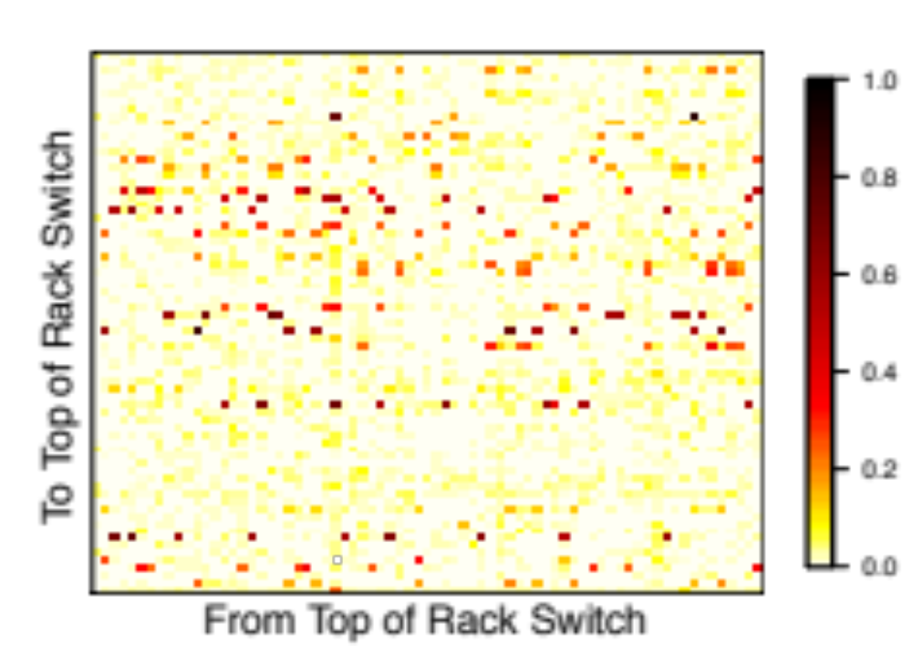
Real traces have localized hotspots
Very few hotspots!
Affect
only a
few racks
Destination Rack
Source Rack

Slide 38
Evaluation setup
Evaluated 60 GHz flyways improvements
on real demand matrices in an ns-3 topology based on real DC layout
Metric: Completion time of Demands (CTD)
  Relative to non-oversubscribed network
  CTD of 1 ➠ same as non-oversubscribed
  CTD of 2 ➠ same as 1:2 oversubscribed

Slide 39
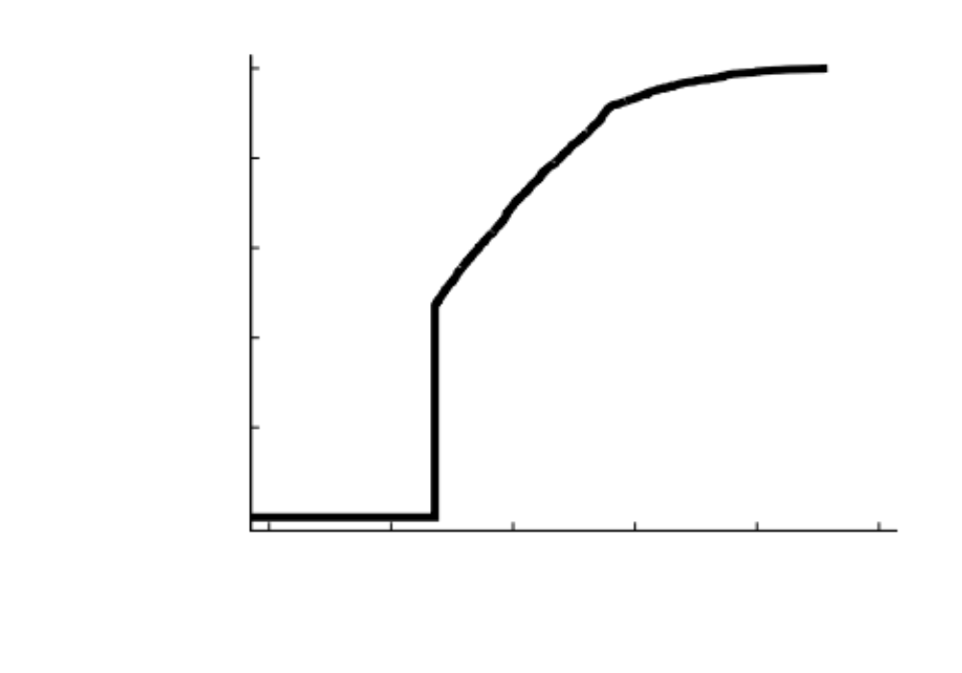
1 flyway device / node
CDF
over
Demand
Matrices
CTD < 1.5 for >80% of traces
Smallest possible CTD for 50% of traces
1.5
1
2
CTD

Slide 40
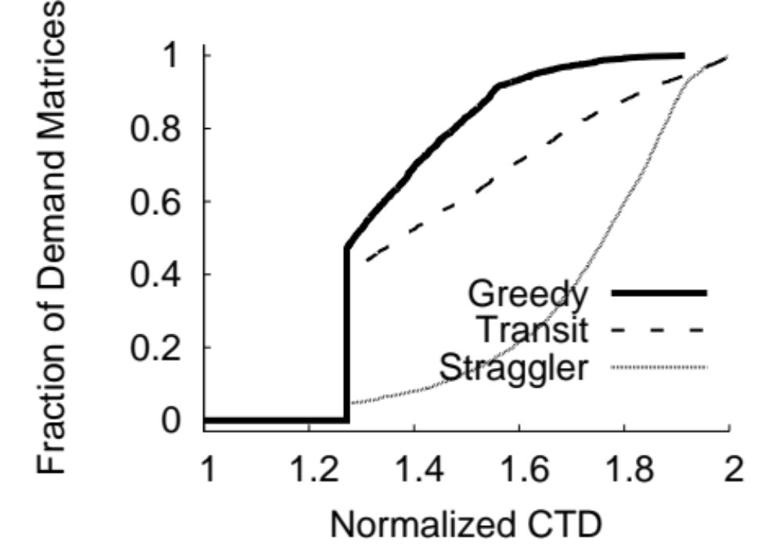
Incremental benefit of strategies
CDF
over
Demand
Matrices
1.5
1
2
CTD

Slide 41
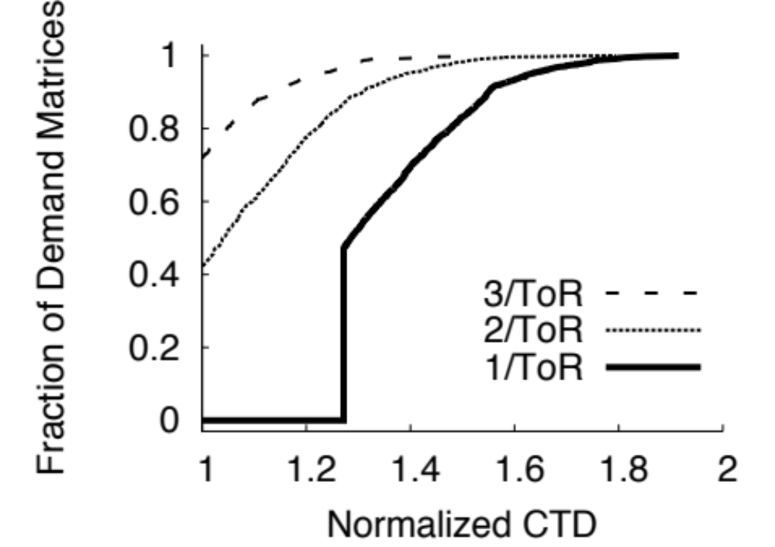
1-3 devices / node
CDF
over
Demand
Matrices
1.5
1
2
CTD

Slide 42
Conclusions
60 GHz flyways can substantially improve performance in oversubscribed DC
Traffic indirection crucial for practical benefit in real workloads
Novel techniques leverage wired backbone to dramatically simplify and speed hybrid system
Read more: http://r.halper.in/paper/flyways_sigcomm11

