Slide 1
Wireless human monitoring through walls
• 3D tracking via body radio reflections (NSDI ‘14)
• Real-time breath monitoring using wireless signals (Mobicom ‘14 demo)

Slide 2
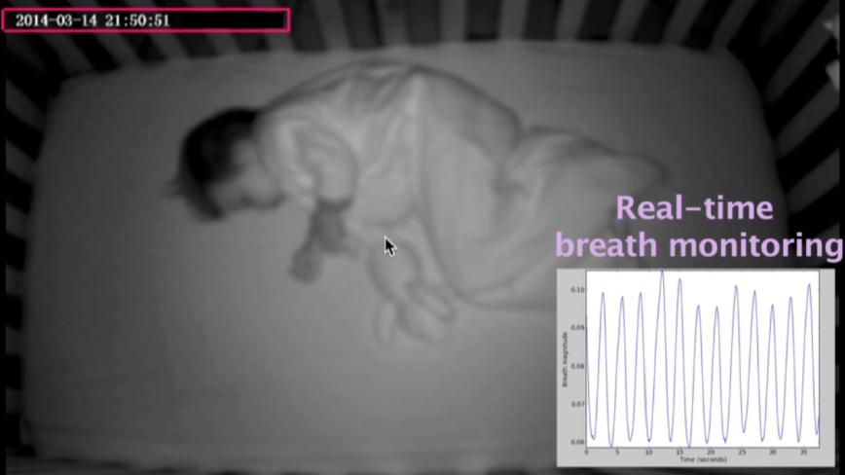
Questions
Can we track a human with only wireless signals?
Over the wall?
With cm-scale precision?
With no special device carried by the human?
Safe?

Slide 3
Possible applications
Military
Security
Smart building
Baby/elderly care
Health monitoring
IoT
Game

Slide 4
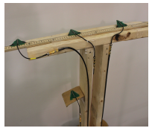
Technology overview: WiTrack
Directional antennas – Tx + n Rx
  n=3: x, y, z
  Arranged in T shape
Tx an RF signal, and capture reflections off a human body
Processing steps
  Time of flight (TOF) estimation
  3D localization using geometric constraints
  Fall/pointing detection

Slide 5
TOF estimation
One conceivable method (not practical)
  Transmit a pulse, capture its echo, measure the delay
  Requires sampling the signal at sub ns intervals
    E.g. 10m / 3*10¹¹ m/s = 3*10⁻¹¹ s
    Requires high speed analog-to-digital converters (ADC) that operate at GS/s: power-consuming, expensive, and low bit resolution
Proposed approach: frequency-modulated carrier waves (FMCW)
  Transmit a narrowband signal (e.g. a few KHz)
  Change carrier frequency linearly with time
  Compare carrier frequency of reflected signal to that of Tx signal
  Delays in reflected signal → frequency shifts → TOF

Slide 6
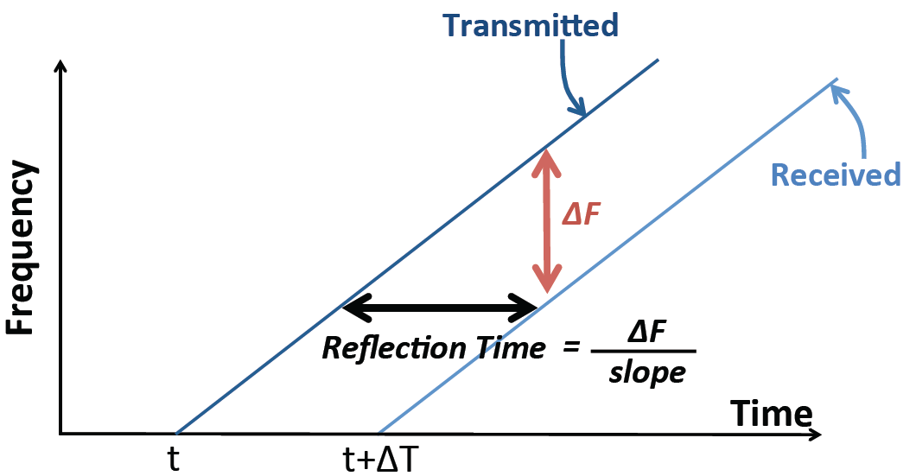
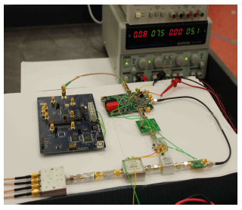
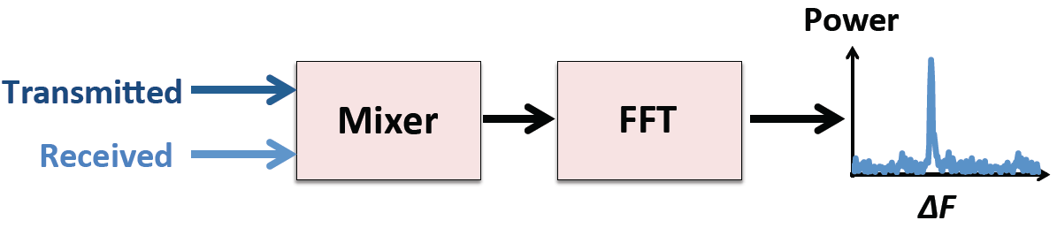
FMCW
Multiple reflectors: take FFT of Rx baseband signal
Question: how do we measure Δf ?
  Easy: remove carrier by using cheap, low-power mixer

Slide 7
FMCW resolution
Ability to distinguish two nearby locations
  Depends on TOF resolution → depends on Δf resolution
Minimum Δf (Δf_{min}) is equal to the size of 1 bin of FFT
  FFT is taken over a duration of 1 sweep of carrier frequencies (T_{sweep}= 2.5ms)
    Size of 1 FFT bin = 1/T_{sweep}
  Δf_{min} = 1/T_{sweep}
Resolution is 8.8cm
  C* TOF_{min} / 2 = C * Δf_{min} / (2* slope) = C / 2B
  C is very large → high resolution requires large B
    5.56GHz – 7.25GHz (subject to FCC regulations) at 0.75mW

Slide 8
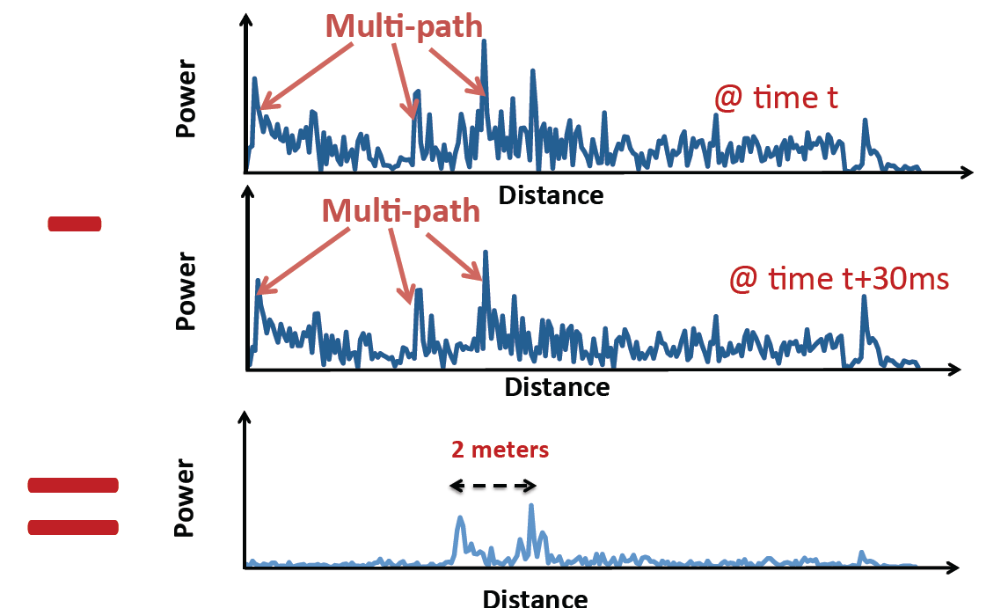
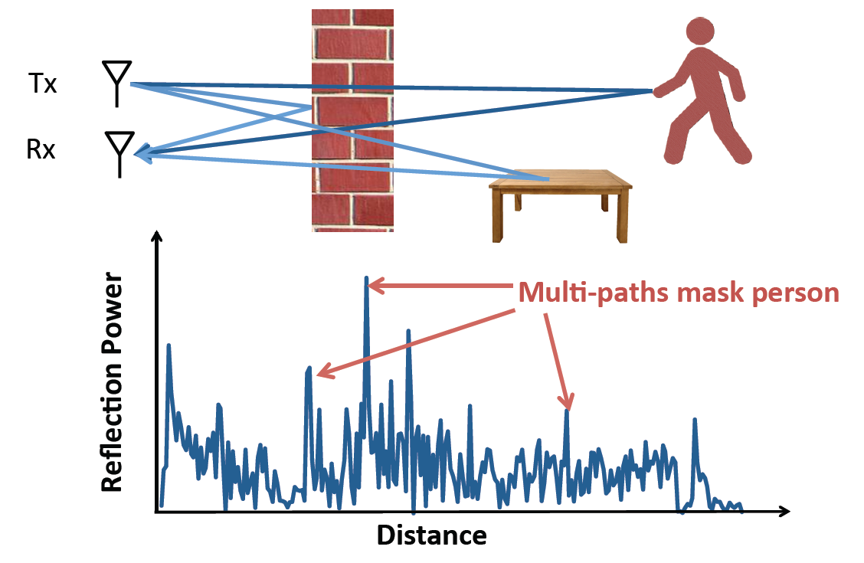
Addressing static multipath
Removing reflections from furniture and walls
  Much stronger than human reflections behind the wall
    “Flash effect”
  Take FFT every sweep interval, compute power in each frequency, subtract FFT output from previous FFT output (“background subtraction”)

Slide 9
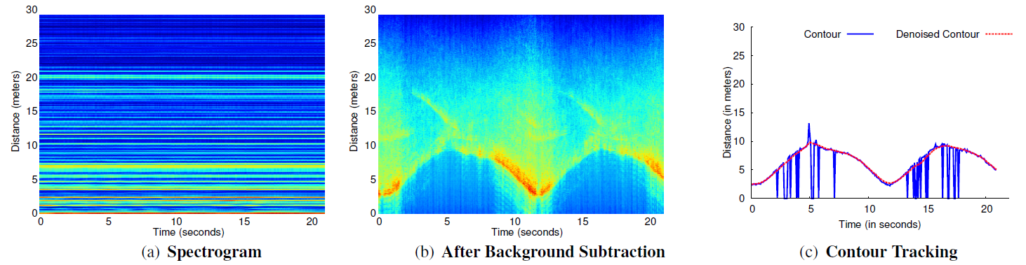
Background subtraction
Each strip = static reflector
  Strong ones: red/orange
Background subtraction exposes moving reflector

Slide 10
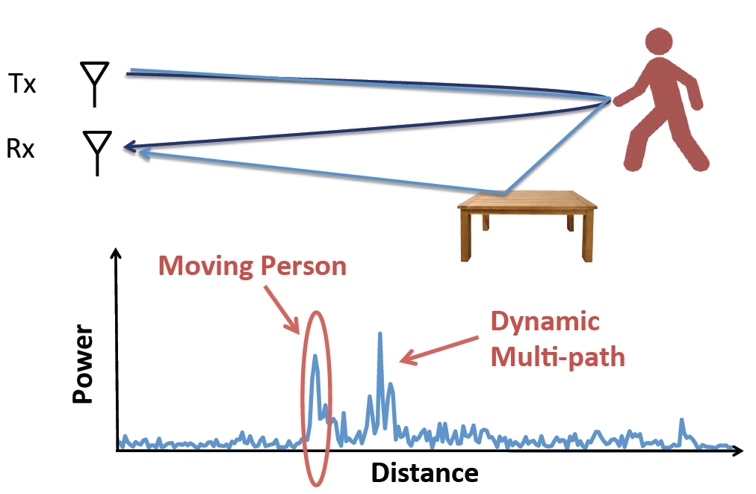
Addressing dynamic multipath
Human body
  Smallest frequency shift after background subtraction
  Trace the bottommost contour
Human body + environment

Slide 11
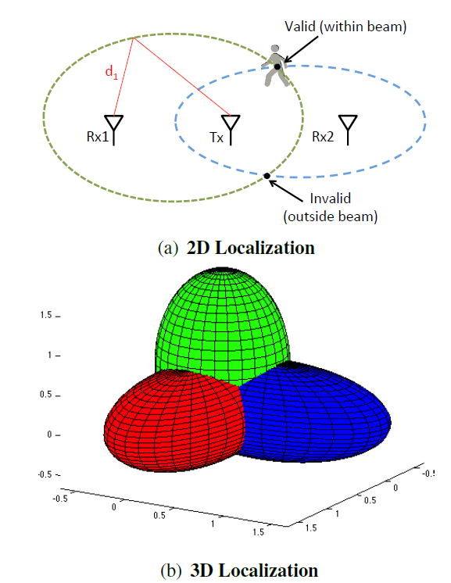
Localization in 3D
Using T-shaped antenna, obtain a unique solution in 3D

Slide 12
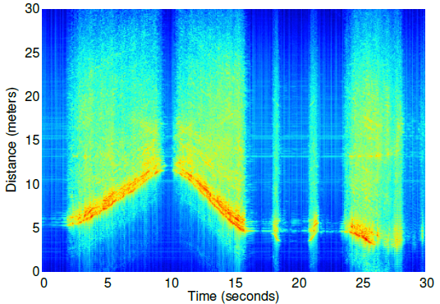
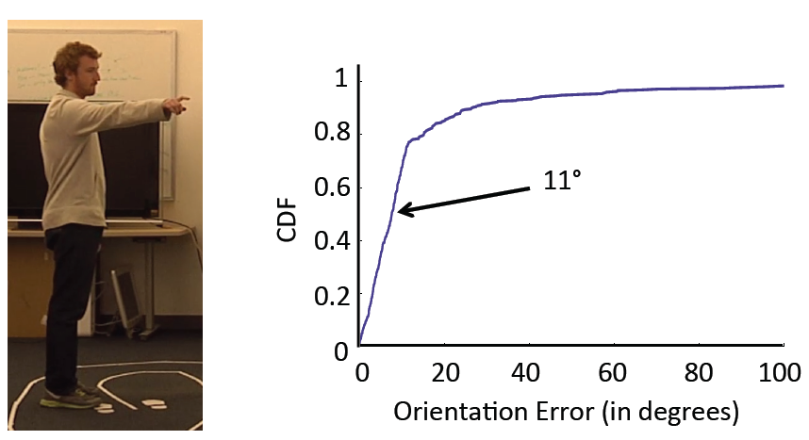
Pointing angle estimation
Use 3D estimation
Signal variance is much smaller → body part

Slide 13
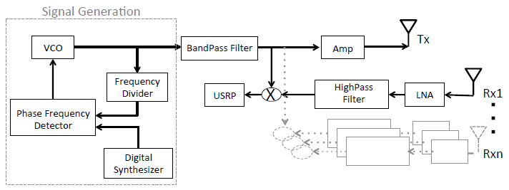
Implementation
FMCW front-end as a daughterboard for USRP software radio
  Voltage controlled oscillator (VCO) for frequency sweep
    Phase frequency detector for highly linear sweep
  Frequency divider allows reference signal sweep from 136.5-181.25 MHz
  WA5VJB directional antennas

Slide 14
Implementation
Low-noise amp and high-pass filter for improved SNR
Frequency offset is obtained by downconverting (mixing) Rx signal with Tx signal
Mixer output is fed to LFRX-LF daughterboard on USRP2
  Sampling at 1MHz
  Digitized samples to UHD driver

Slide 15
Implementation
Tracking is implemented in UHD driver of USRP SDR
Signal from each Rx antenna is transformed to frequency domain using FFT whose size matches FMCW sweep period of 2.5ms
Instead of solving a system of ellipsoid equations in real-time, use known antenna positions to get solutions

Slide 16
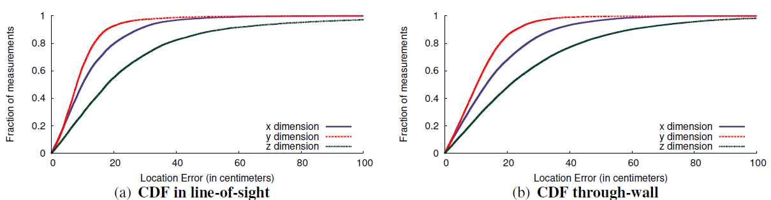
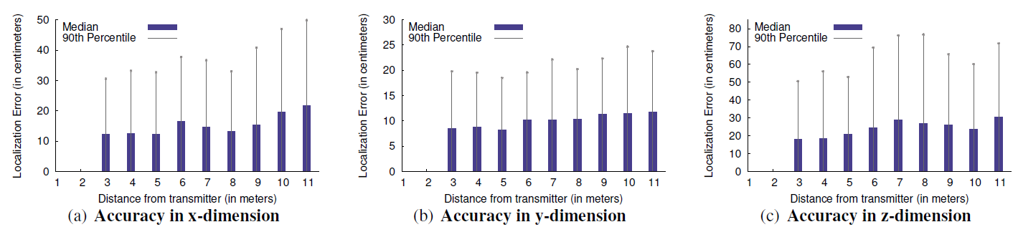
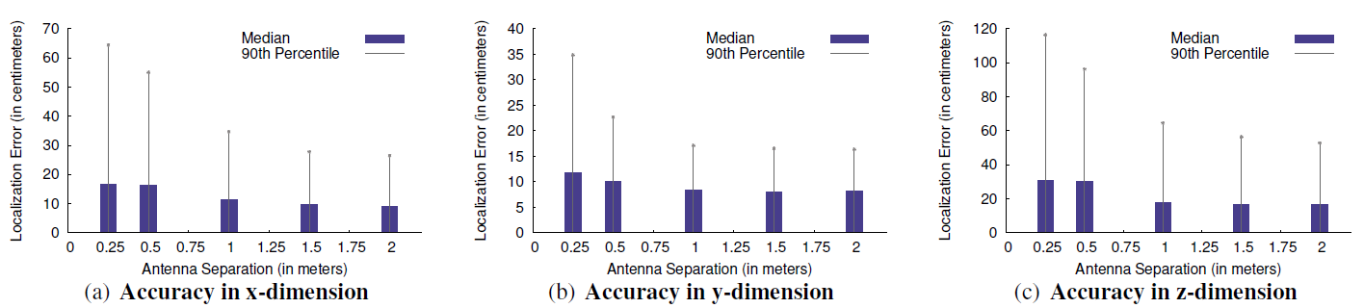
Evaluation

Slide 17
Limitations
Requires human motion to detect
Can track one person only
Distinguishing body parts requires more complex model

Slide 18
Breath monitoring
Questions
  Can we monitor breathing remotely or even under non-LOS?
  Without any body contact?
Builds on WiTrack
  Required enhancements: localization resolution should be even finer
Applications
  Smart home, smart building
  Healthcare: e.g. sleep monitoring, exercise monitoring
  Security: breathing is an inherent vital sign

Slide 19
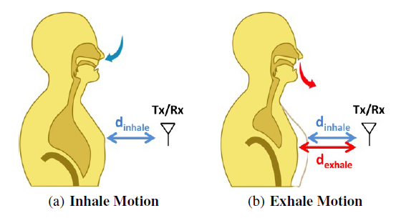
Technology overview
Non-intrusive
  No chest band, no nasal probe, no special mattress, etc.
Monitors periodic movements
  Hints at heart beat monitoring as well
WiTrack has 10-15cm error
  Not good enough for chest motion detection

Slide 20
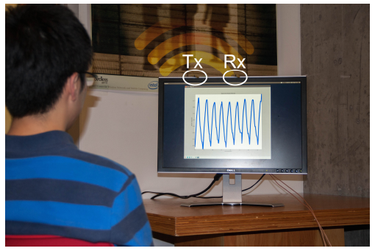
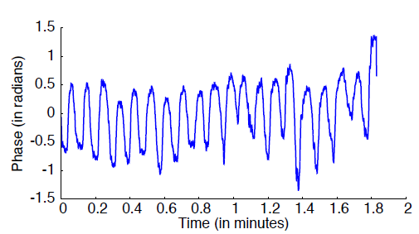
Processing steps
Use WiTrack to detect only moving objects
  Sort reflections based on distances
Differentiate body motion from breathing motion
  Breathing motion is much slower: less than 1mm/s?
Analyze breathing signal: measure phase of reflection
  Increase/decrease ↔ inhale/exhale

