Slide 1
11.6 : Sort Lists, Round-Robin, and Split DNS
좌희정
2013011036

Slide 2
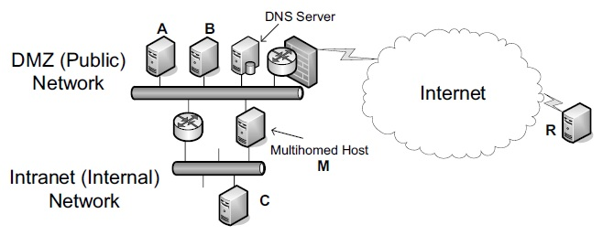
Sort Lists
A DNS server could return all matching data to any client in whatever order the server finds most convenient.
A private network and a public network including a DNS server. A multihomed host (M) spans the DMZ and internal networks.

Slide 3
Round-Robin
To achieve load balancing, the DNS server may be configured to use DNS round-robin, which means that the server permutes the order of the returned address records.
Ex) 210.111.222.1 -> A
210.111.222.2 -> B
210.111.222.3 -> C
210.111.222.4 -> D
210.111.222.5 -> E
But, not the road balance.

Slide 4
Split DNS
A final consideration regarding the data returned by a DNS server is support for privacy. Most often, the client is identified by IP address or address prefix.

Slide 5
11.7 : Open DNS Servers and DynDNS

Slide 6
A number of so-called open Dynamic DNS (DDNS) servers are available that support a special update protocol called the DNS Update API [DYNDNS], whereby a user may update an entry in a provider’s DNS server given a preregistration or account.
When the service is invoked, the client program contacts the server, provides the current global IP address of its host and goes quiescent ->
After that, it periodically renews the information with
the server. ->
Doing so allows the server to clear the information if
an update is not received within a certain time interval.

Slide 7
11.8 : Transparency and Extensibility

Slide 8
[RFC5507] considers various methods for extending the DNS, ultimately concluding that creation and implementation of new RR types is the most attractive approach.
[RFC5625] specifies the proper operation of a DNS proxy, essentially requiring DNS RRs to be uninterpreted and merely relayed by the proxy.

Slide 9
11.9 : Translating DNS from
IPv4 to IPv6 (DNS64)

Slide 10
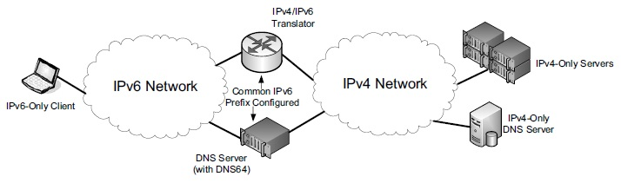
DNS64 translates A records to AAAA records and works together with an IPv4/IPv6 translator to allow IPv6-only clients to access services in IPv4 networks.

Slide 11
The DNS64 device acts as a caching DNS server. IPv6-only clients use it as the primary DNS server and are able to request AAAA records for domain names. DNS64 converts such requests to requests for both A and AAAA records on its IPv4 side.

Slide 12
11.10 : LLMNR and mDNS

Slide 13
LLMNR
Link-Local Multicast Name Resolution
It is a protocol based on DNS developed by Microsoft and used in local environments to help discover devices on a local area network, such as printers and file servers.

Slide 14
mDNS
Multicast DNS (mDNS) is another form of local DNS-like capability developed by Apple.
When it is combined with the DNS Service Discovery protocol, Apple calls the resulting framework Bonjour.
A mechanism in mDNS is used to detect and resolve conflicts.

Slide 15
11.11 : LDAP

Slide 16
LDAP
LDAP is an application protocol for the Internet that provides access to general directories in accordance with the X.500 data and service models.
An LDAP directory is a tree of directory entries, where each entry consists of a set of attributes.
As TCP/IP has become more popular, LDAP has
evolved from its roots to work in conjunction with DNS.
LDAP servers are used most often within enterprises to hold directory information
such as location, telephone number, and organizational
unit.

