Slide 1
Fine-grained Spectrum Adaptation in WiFi Networks
ACM Mobicom 2013
Sangki Yun et al.
Presenter : Yongtae Park

Slide 2
Contents
Introduction
Fine-grained Spectrum Access
Spectrum Adaptation
Testbed Experiments
Simulation
Conclusion

Slide 3
Introduction
WiFi traffic has grown explosively
  Need to developed new technology to dramatically improve spectrum efficiency
  IEEE 802.11n supports up to 40MHz channels
  IEEE 802.11ac increases the channel width up to 160MHz
Using larger channel width is not always desirable
  A 40MHz channel can be easily starved by nodes using 20MHz channels
  A wider channel reduces the communication range due to less concentrated energy
  Increases energy consumption due to a higher sampling rate

Slide 4
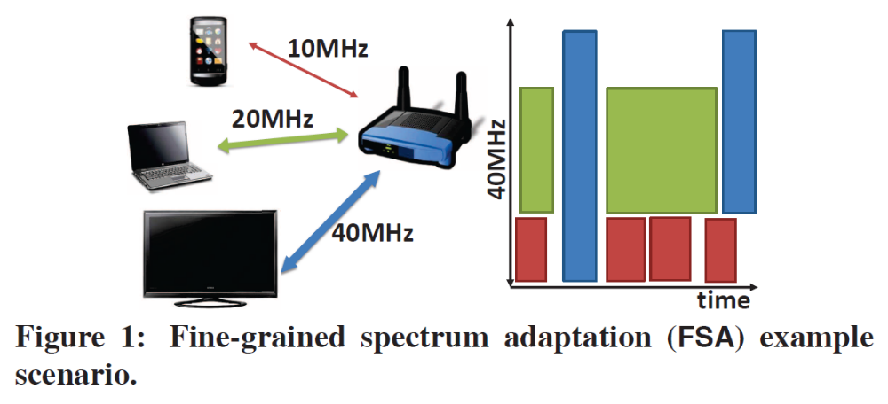
Fine-grained Spectrum Adaptation
The right approach is to determine spectrum based on the application need and current channel condition
  A mobile device on 10MHz channel to conserve power and achieve a higher SNR over the same distance
  A laptop on a standard 20MHz channel to balance power and bandwidth requirements
  HDTV on a wider channel to achieve high capacity

Slide 5
Challenges
Promptly switch to the desired spectrum
  Solution: Dynamically change the center frequency and channel width on a per-frame basis
Accurately detect the spectrum used by the transmission within a preamble time
  Solution: Quickly identify the spectrum used by the sender based on the IEEE 802.11 preamble signature
Determine which spectrum to user for each transmission to optimize performance and avoid interference
  Solution
    Takes into account both frequency diversity and interference
    Can support joint allocation of spectrum, schedule, and AP

Slide 6
Fine-grained Spectrum Access
Baseband Design
  Design goal is to support efficient spectrum change with negligible overhead
  Option 1: Communicate through narrow channel
    Pros: To use a small number of subcarriers for data transmission (like OFDMA)
    Cons: But inflexible because it needs tightly synchronization with very small misalignment
  Option 2: To use narrower subcarrier width
    Pros:
      5MHz and 10MHz channels in addition to the default 20MHz channels
      Most commercial devices support it
      Then nodes independently communicate without the need to synchronize
    Cons:
      Incur non-negligible delay in changing the channel width
    They use up-sampling and down-sampling to adjust subcarrier width without increasing delay

Slide 7
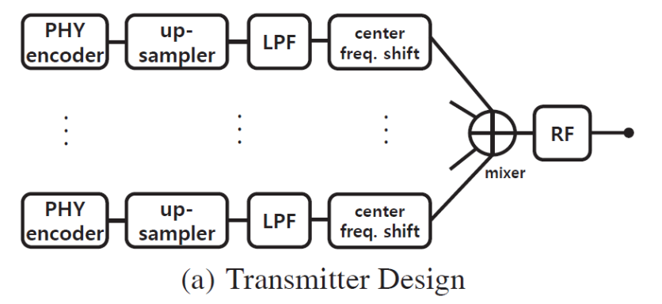
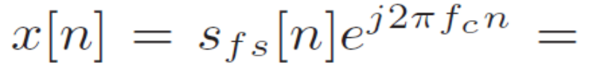
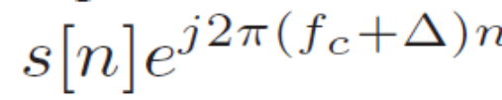
Fine-grained Spectrum Access
Transmitter
  Based on available channel and the application requirement, the sender decides which spectrum to use (5, 10 or 20 MHz bandwidth)
  Up-sampling process adds interpolated samples for each signal
    To increase the signal duration and decrease the spectrum width of the signal
    Low pass filter is required to avoid generating adjacent channel interference
  Shift center frequency
    The baseband signal that the sender transmits
    The passband signal
  Upsamples all signals to 40MHz according to Nyquist Theorem

Slide 8
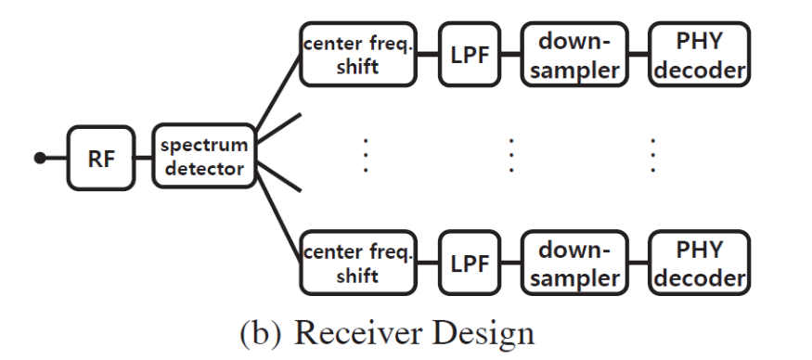
Fine-grained Spectrum Access
Receiver
  Compensates the center frequency shifting
  Filters the signal outside the channel width by LPF
  Downsamples the signal to match the sampling rate to that of the transmitter
  After that, the signal is delivered to the 802.11a PHY decoder
  While decoding the already detected signal, the detector keeps sensing the spectrum to detect new signal form the remaining idle spectrum

Slide 9
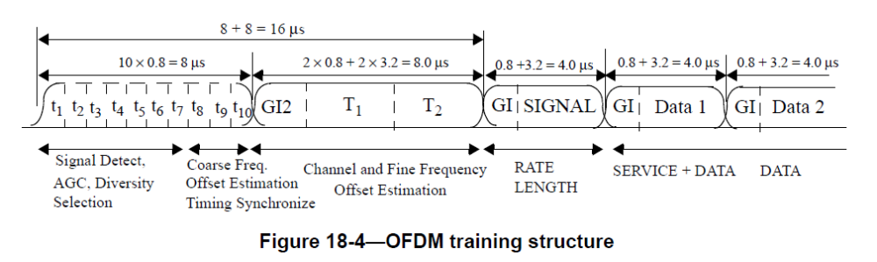

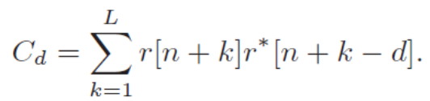

Fine-grained Spectrum Access
Detecting the Spectrum
  The receiver should know which center frequency and channel width the sender uses for transmission
  802.11a frame detection
    802.11a preamble consists of
      Long Training Field(LTF) used for the channel estimation
      Short Training Field(STF) used for the frame detection
    STF has a special property in time domain
      Ten periods, each with 16 samples, altogether 160 samples
      The energy of the received signal r as
      The auto-correlation of the signal with d delayed samples
      The detection metric
- L: the number of signals used for energy measurements
- *: represents the complex conjugate of the signal
d is 16 and m₁₆ is detection metric for 802.11a
If m₁₆ is higher than the threshold, then we consider that a valid 802.11a frame is detected

Slide 10
Fine-grained Spectrum Access
Spectral and Temporal analysis based spectrum detection (STD)
  Temporal analysis
    The receiver measures m₁₆, m₃₂ and m₆₄
    If all M_{k}s are below threshold, the signal is considered as non-802.11a signal
    Otherwise, it selects the channel width that gives the best match
    It cannot identify the center frequency of the signal
  Spectral analysis
    The receiver calculates Power Spectral Density (PSD) by performing Fast Fourier Transfer (FFT) of the received signal
    Identify both the channel width and center frequency
    It cannot distinguish how many transmissions exist in the detected spectrum when multiple transmissions continuously occupy the spectrum
      For example, 10MHz spectrum is occupied by two 5MHz channel signals
      Cannot tell whether it is one transmission on a 10MHz channel or two transmission on two consecutive 5MHz channel

Slide 11
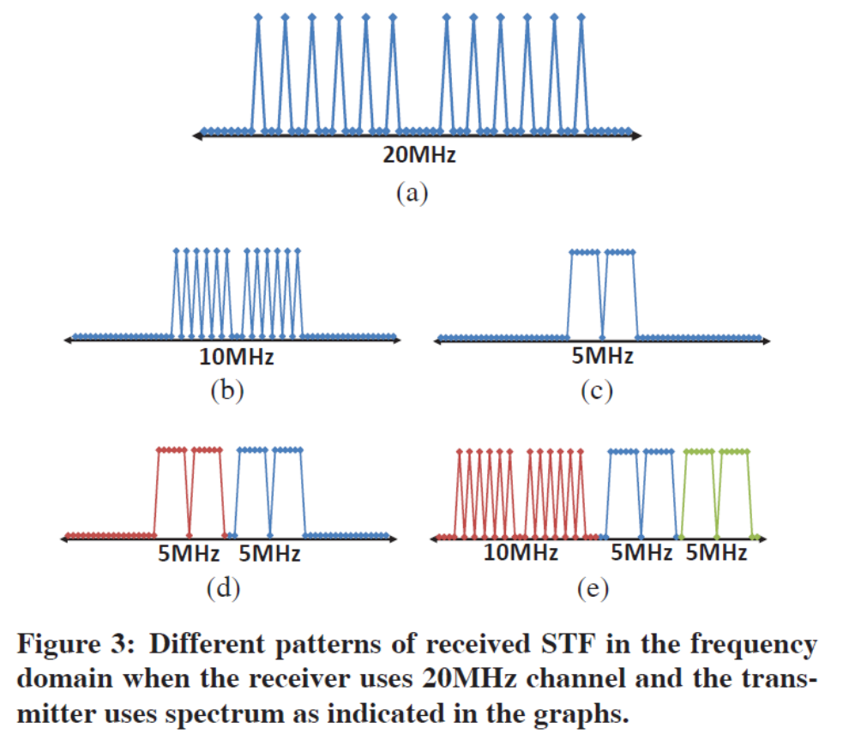
Fine-grained Spectrum Access
Fine-grained Spectrum Detection (FSD)
  STF consists of 12 subcarriers with unit magnitude and 54 subcarriers with zero energy
  Interval between adjacent subcarriers with non-zero energy is 4
  The subcarrier width of the 20MHz receiver is twice as large as that of the 10MHz sender
    The signals of 2 subcarriers from 10MHz sender are merged into one subcarrier of 20MHz receiver, Reduces the subcarrier interval from 4 to 2
    5MHz case, the subcarrier interval is 1
  Comparing Figure 3(b) and (d), it can be easily distinguished what bandwidth is used to transmit

Slide 12
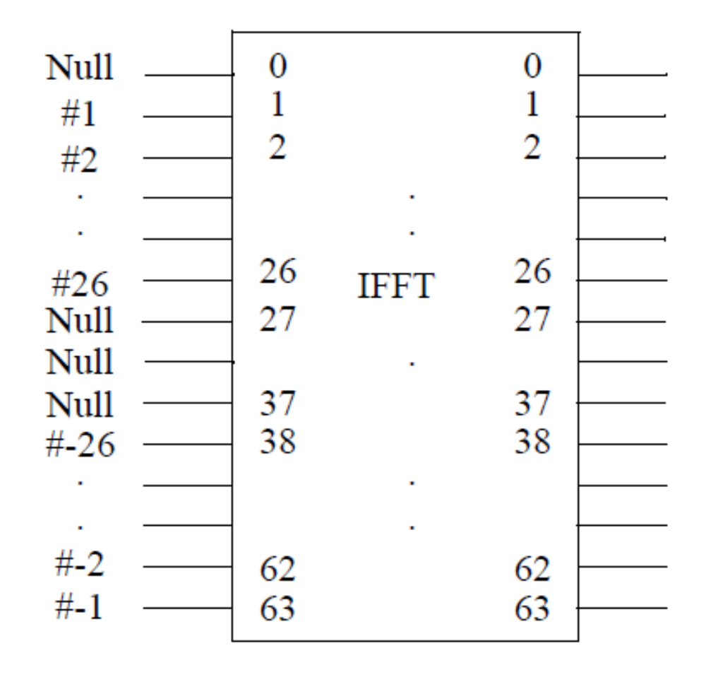
5MHz
20MHz
10MHz

Slide 13
Spectrum Adaptation
Problem Specification
  A natural question: which spectrum should be assigned to a given transmission
    1. Existing channel assignments assume an AP can transmit one frame at a time
    2. most channel assignment schemes consider fixed channel width and center frequency
    3. Most exiting channel assignments restrict an AP to user the same channel to communicate with all its clients for an extended duration of time
    4. OFDMA supports only synchronous transmissions
  In this paper, this spectrum adaptation problem can be formulated as follows
    Given a frame and SNR to the client across the entire spectrum
    Decide which spectrum and start time should be assigned to the frame in order to optimize a given objective
    The finish time of all transmission as the primary objective

Slide 14
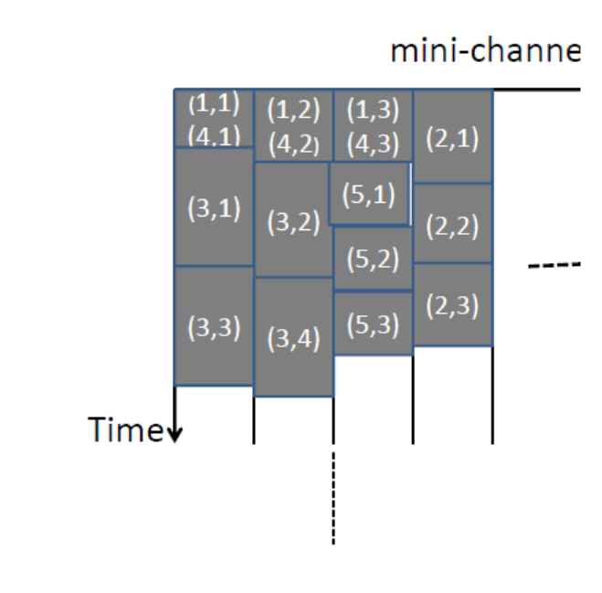

Spectrum Adaptation
Our Adaptation Algorithm
  The main challenge in the spectrum adaptation is the huge space
    The spectrum with different center frequency and channel width
    Non continuous block of spectrum
  Joint spectrum adaptation and scheduling
    Divide a frame into multiple mini-frames and divide the entire spectrum into multiple mini-channel (4 * 250-byte mini frames, 5MHz mini-channels in this paper)
    Use the greedy assignment with iterative improvement
    Compute the finish time by measuring the SNR of the mini channel and mapping the SNR to data rate

Slide 15
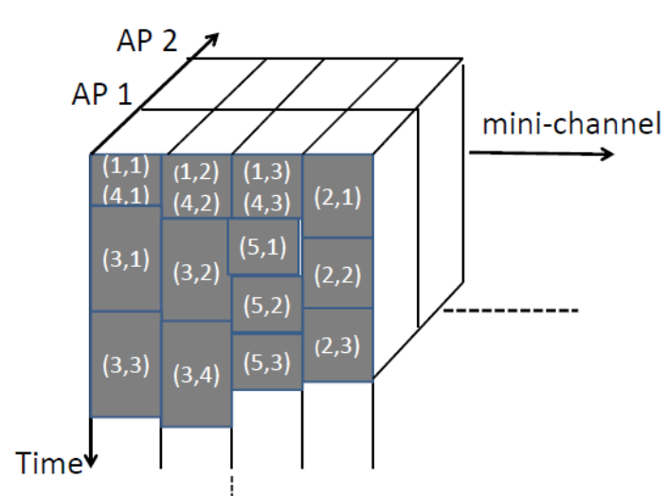

Spectrum Adaptation
Joint spectrum adaptation, scheduling, and AP assignment
  Simply assigning to the closest AP or the AP with the highest SNR is not always the best choice
    E.g. such an AP may be overloaded
  Therefore, propose a simple extension considers a 3-D schedule

Slide 16
Testbed Experiments
Implement FSA in SORA SDK 1.6
DELL XPS 850 with Intel i7 Quad-core processor
8GB memory
Without FPGA-level modification
  Sampling rate conversion
  Center frequency shifting
  Concurrent transmission of multiple frames in different subbands
  Fine-grained spectrum detection
  Decoding a single frame from subband in real-time
Due to the capacity limit of the general purpose processor
  Cannot decode multiple frames in real time concurrently
  Decoding is done offline using the captured signal dump

Slide 17
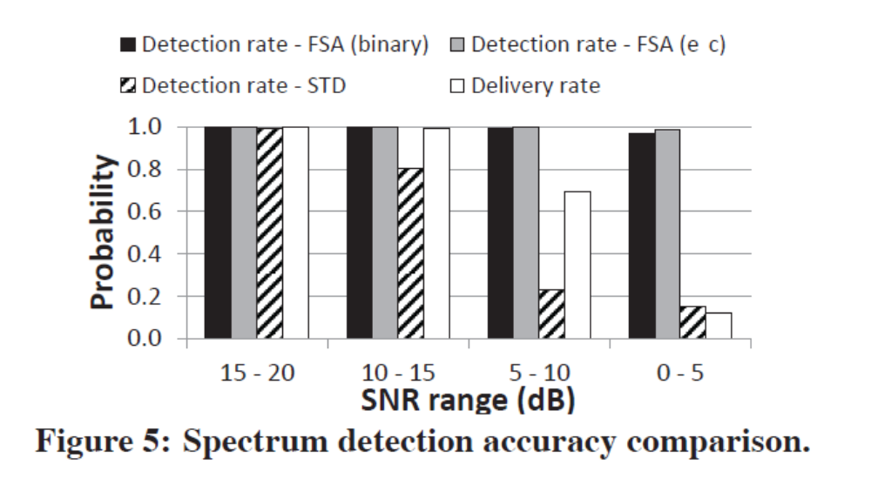
Spectrum Detection Acuuracy
FSA achieves over 99% detection accuracy from 5to 20dB SNR range
FSA still 96% detection accuracy under 0-5dB SNR, 10% frame delivery ratio)
Euclidean Distance based detection achieves accuracy of 98%
STD detection accuracy drops to 80% when SNR is below 10 dB
  STD relies on PSD analysis and temporal correlation check, which are sensitive to the channel noise
  FSA detection method is tolerable in a channel that gives 8% BER in BPSK modulation

Slide 18
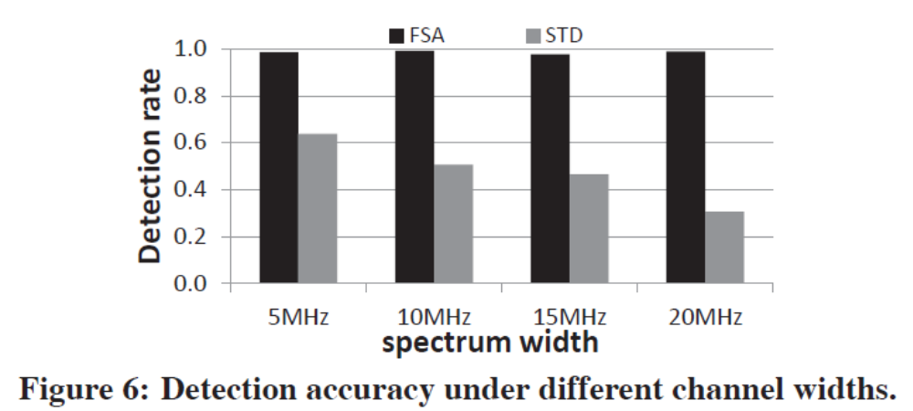
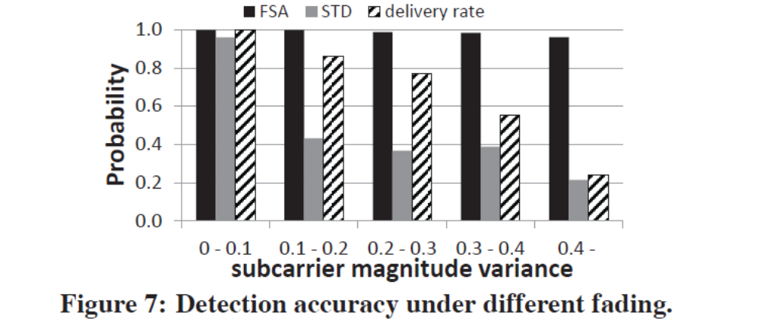
Spectrum Detection Accuracy
Figure 6
  The power of STF is distributed over wider spectrum which reduces reliability
  Wider and also gives more possible subband combinations
Figure 7
  If the channel is flat, every subcarrier has similar magnitude and the variance is small (~0.1)
  If the channel is frequency selective, the variance becomes large (larger than 0.4 indicates severe fading)
  STD works in flat fading channel and its performance significantly degrades in medium level fading channel

Slide 19
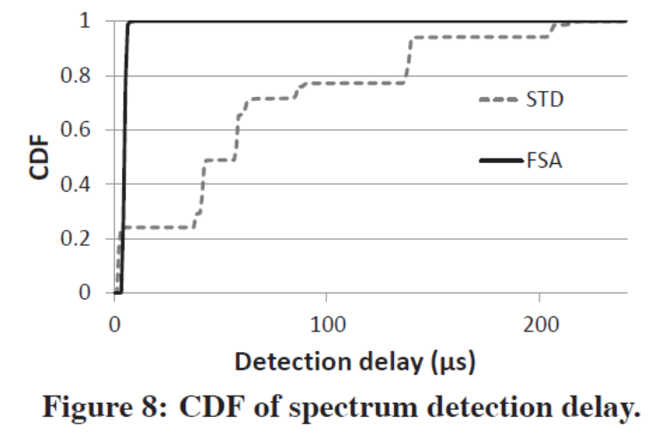
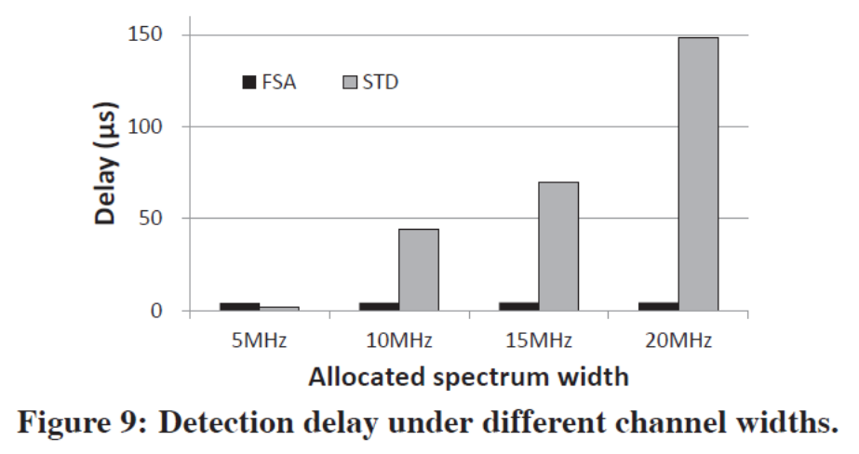
Spectrum Detection Delay
Figure 8
  The median delay of FSA is 4.2us, which enables real-time detection even in SORA implementation
  On the other hand, the median delay of STD is 56 us
  STD processing time depends on the detected subband width as shown in Figure 9
Figure 9
  When the detected bandwidth is 5MHz, STD achieves detection delay of 1us
  When 20MHz channel width is detected, STD takes 149us to process on average
    Low pass filtering, frequency shifting, and auto-correlation check to identify the subband type

Slide 20
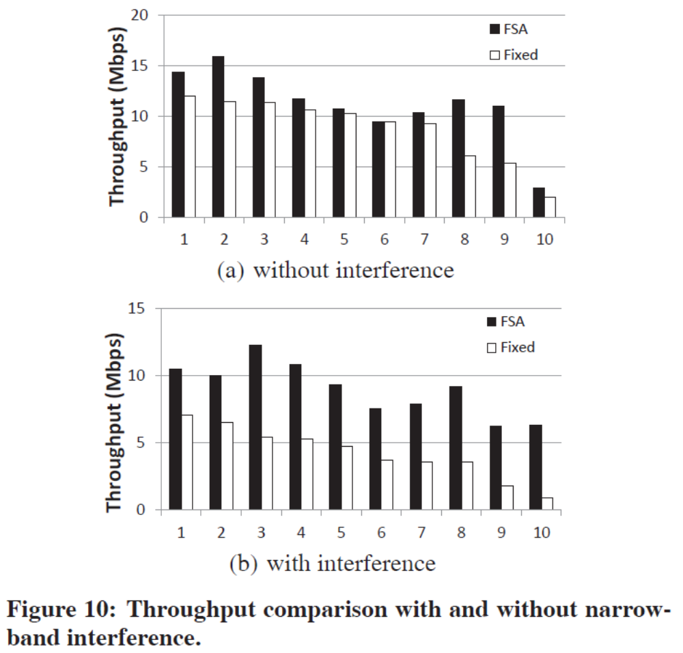
Spectrum Adaptation
Environments
  6Mbps to 24Mbps TX rate using flexible subband width from 5MHz to 20MHz
  1 APs and 3 SORA clients
  Use USRP2 device to generate 2MHz narrowband signal to interfere
Throughput
  FSA achieves the throughput gain of 27%
  When affected by the narrow band interference, the throughput gain of FSA is 110%
  Though the interference is only 2MHz, significantly degrades SNR for the fixed bandwidth approach

Slide 21
Simulation
Methodology
  Measure RSS from 50 different links, each with 1000 frames
  The trace report SNR for every 5MHz channel across the entire 80MHz spectrum
  SND of the link ranges from 3dB to 20dB
  Transmission rate is selected as either 6Mbps, 12Mbps, or 24Mbps
  Randomly map an AP-to-client link to one of the links in the traces
 | Channel assignment | Channel width(MHz) | Center frequency
RANDOM | Random | 20 | Fixed | Random channel assignment
GREEDY | Greedy | 20 | Fixed | AP-to-AP interference based channel assignment
FSA-fixed | Flexible | 20 | Fixed
FSA-variable | Flexible | 5~20 | Flexible
FLUID (1ms) | Flexible | 20~40 | Flexible | Channel switching interval is 1ms
FLUID (6ms) | Flexible | 20~40 | Flexible | Channel switching interval is 6ms

Slide 22
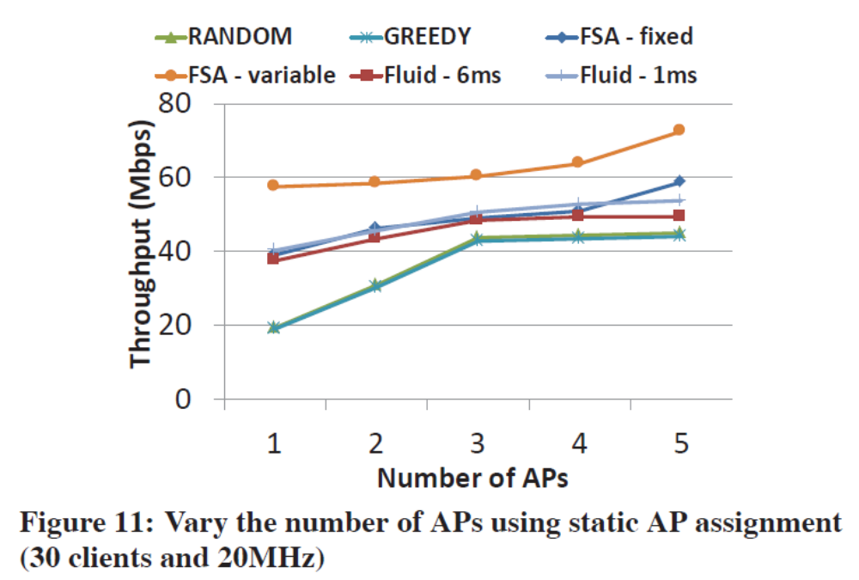
Simulation Results
FSA-variable
  Out-performs static channel assignment by 88% by adapting the spectrum per-frame
  Out-performs FSA-fixed by 25% by leveraging fine-grained spectrum access instead of restring to 20MHz channel
  Out-performs FLUID by 26% by supporting multiple transmissions, non-contiguous spectrum allocation and more frequent spectrum adaptation
The spectrum instead of the number of APs becomes the bottleneck when there are enough APs

Slide 23
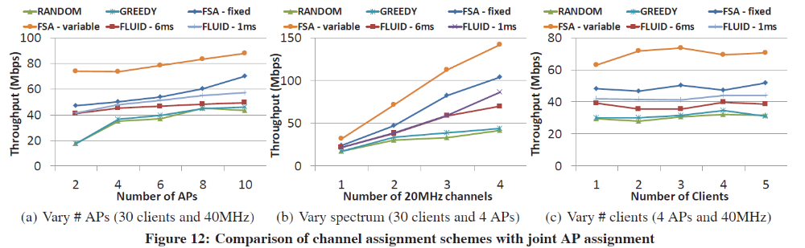
Simulation Results
(a) Observe that the benefit of joint AP and FSA-variable
(b) The spectrum becomes wider, the benefit of flexible channel adaptation increases
  Due to more significant frequency diversity and narrowband interference in a wider spectrum
(c) The number of clients does not significantly affect the performance in all the schemes
  When scheduling queue becomes saturated
  # of frames that can be processed within the same time is almost fixed regardless of # of clients

Slide 24
Conclusion
In this paper,
  Develop the first per-frame spectrum adaptation approach and prototype for WiFi networks
  It consists of
    A flexible baseband design
    A fast and accurate spectrum detection method
    An effective spectrum adaptation algorithm
  Plan to conduct field trials to further understand and improve its performance in different environments

Slide 25

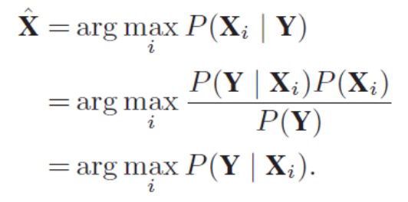

Fine-grained Spectrum Access
ML detection algorithm
  Optimal when the probabilities of all of the channel combinations are equal
    Y be the generated by performing FFT-64 on the received STF signals
    X_{i} be one of the possible preamble magnitude patterns generated by the channel combination
The likelihood function that the transmitted preamble magnitude pattern is Xi given the received preamble Y
According to Bayes theorem
Because P(Y) is a constant and P(Xi) is the same for all Xi since we do not have a prori that a certain magnitude pattern is more likely

Slide 26
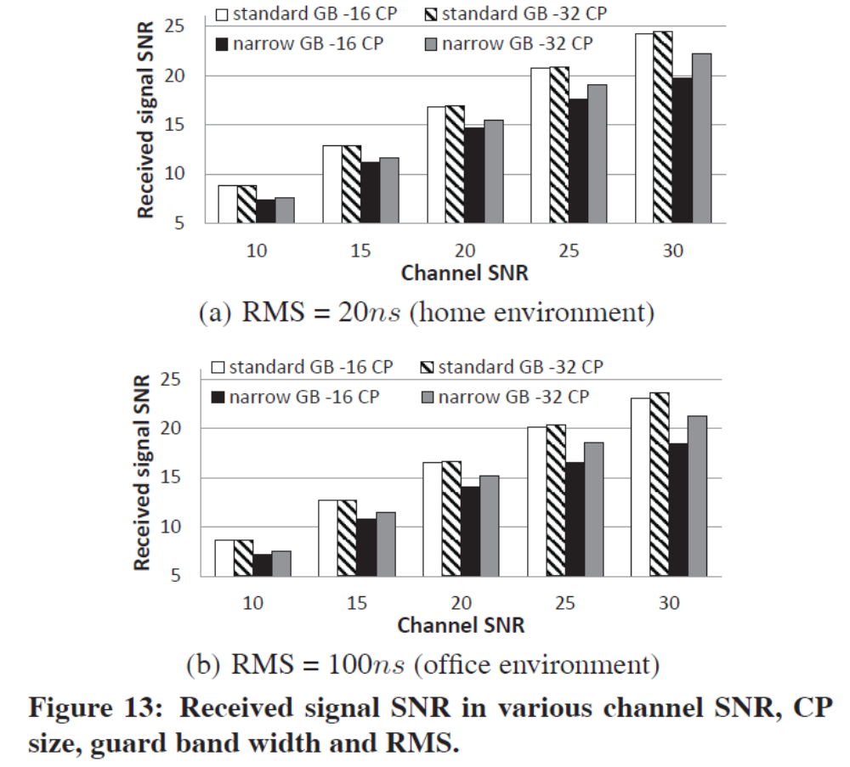
Simulation Results
Comparison with WiFi-NC

