Slide 1

Internet Protocol (IP)
5강

Slide 2
Overview – IP’s roles
IP is commissioned with two roles:
Overcome the incompatibility between the link layer technologies of the incoming interface and the outgoing interface (“internetworking”)
Determine the outgoing interface + next hop IP address, for an incoming IP datagram to reach the next hop (“forwarding”)

Slide 3
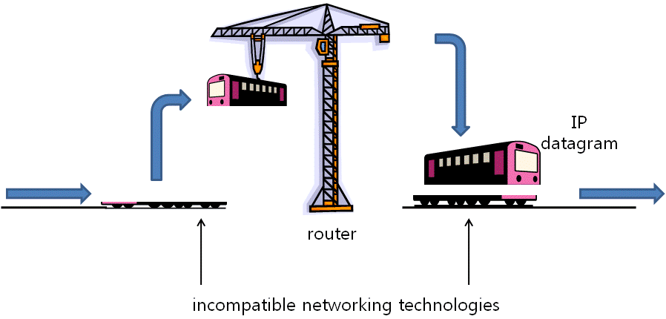
Internetworking

Slide 4
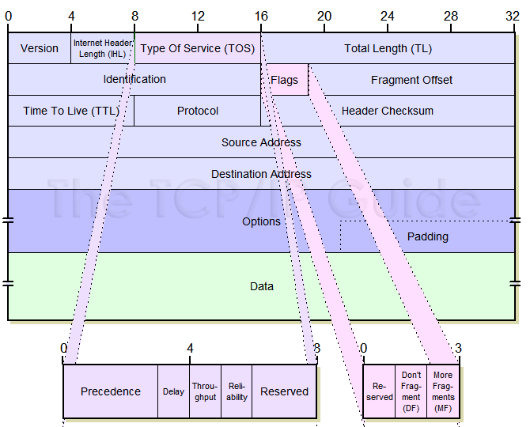
IP header

Slide 5
Some history of IP versions
“TCP” version 1 was designed in 1973 (RFC 675)
“TCP” version 2 was documented in March 1977
In August 1977, Jon Postel realized it was violating the principle of layering
TCP and IP were split, with both being versioned number 3 in the spring of 1978
Stability was added in the fourth revision and that is how we got to IPv4
As the idea of streaming video and other new media become a reality, RFC 1190 was submitted for a formal implementation of IPv5. But IPv4 Internet took off!

Slide 6
IP header
IHL : length in 4-byte units
  Should be aligned : may need padding bytes at the end of the header
Total length: in bytes
Max length = 65535

Slide 7
DS & ECN
DS: for QoS
  No hope of this in the general Internet
ECN: Congestion control (more later …)
Rarely used today

Slide 8
Fragmentation
Id increases by 1 for each datagram from the current host to a given destination IP
Flags: DF, MF
Fragment offset: in 8-byte units

Slide 9
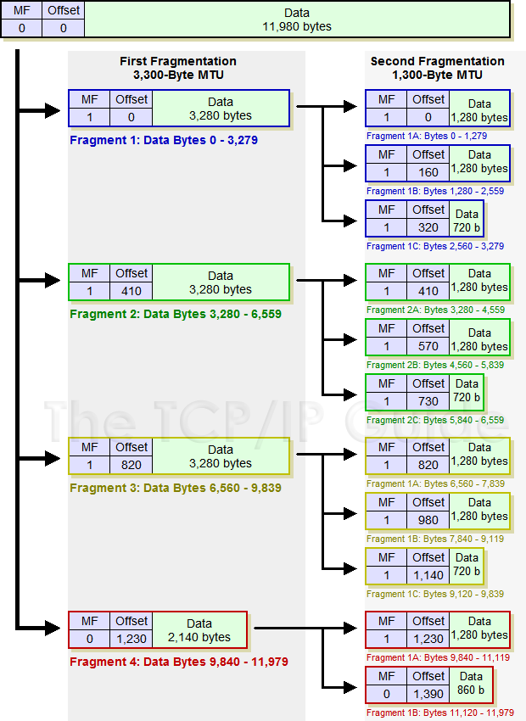

Slide 10
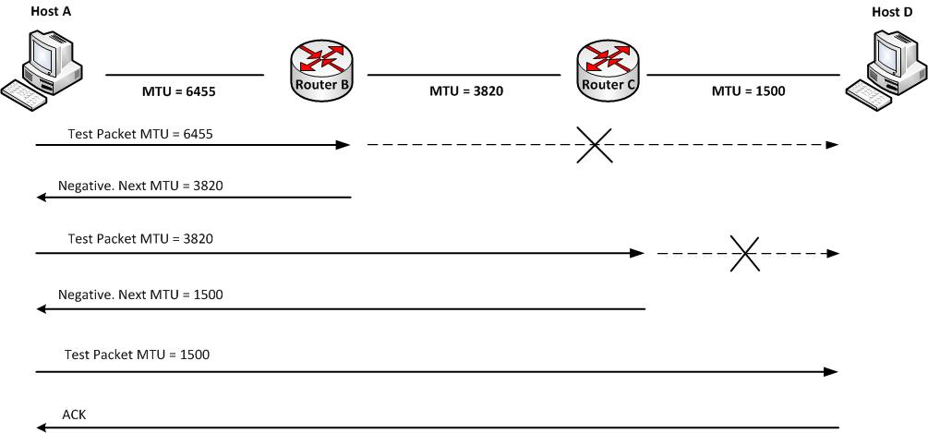
Path MTU discovery
DF bit set by transport layer (e.g. TCP: default)
  More on ICMP later on

Slide 11
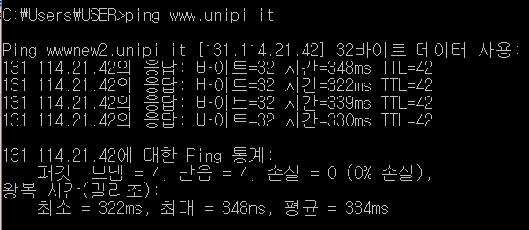
TTL
Time to live is time to death
Was originally “time” but …

Slide 12
TTL
Initial value depends on OS, protocol, and kernel version
  Try “ping localhost”
Windows: 128
Linux: 64 or 255
Android: 64 (/proc/sys/net/ipv4/ip_default_ttl)

Slide 13
Tracert/traceroute
Is exploiting TTL
When a router finds an incoming diagram with TTL=1
ICMP error message is sent back to the source of the killed IP datagram
See Wireshark with displayfilter “ICMP”

Slide 14
IP header

Slide 15
Protocol
Transport layer protocol that created this IP datagram
For demultiplexing
TCP=6, UDP=17, ICMP=1, IGMP=2, …

Slide 16
Internet checksum
Check, sum
1’s complement of 1’s complement sum
  Almost all Internet protocols use it
1’s complement = sign change
S + (-S) = 0: check?

Slide 17
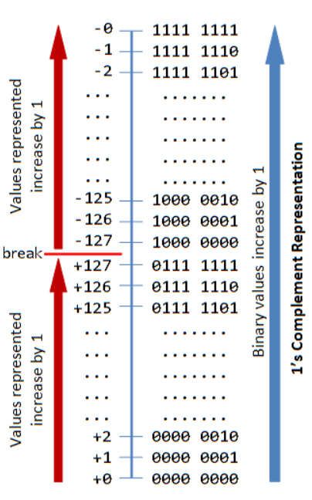
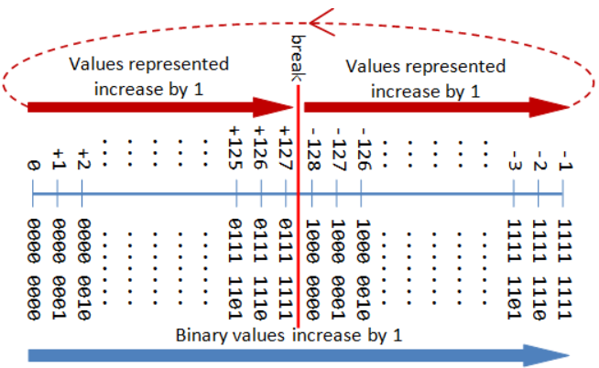
1’s vs. 2’s complement notations

Slide 18
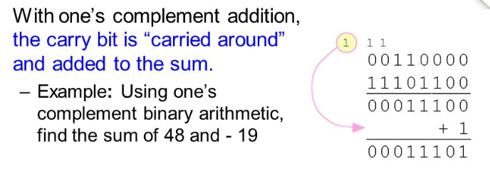
Internet checksum

Slide 19
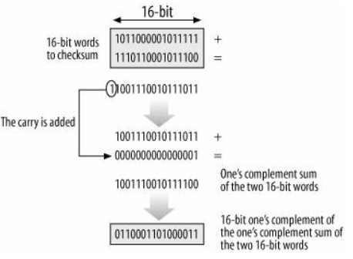
Internet checksum

Slide 20
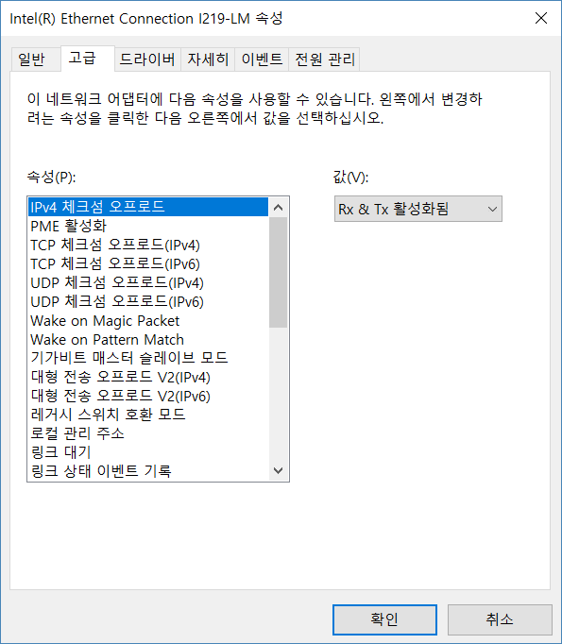
Checksum offload

Slide 21
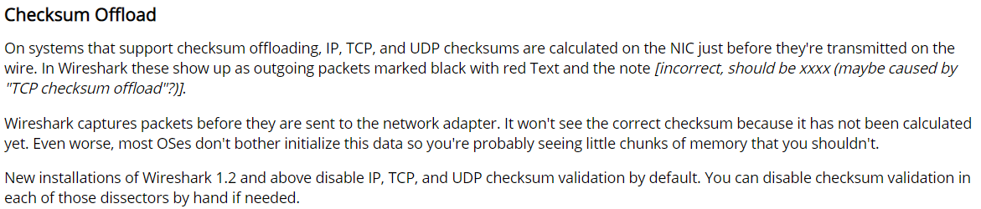
Wireshark and checksum
Checksum validation in Wireshark disabled by default
Due to NIC offloading

Slide 22
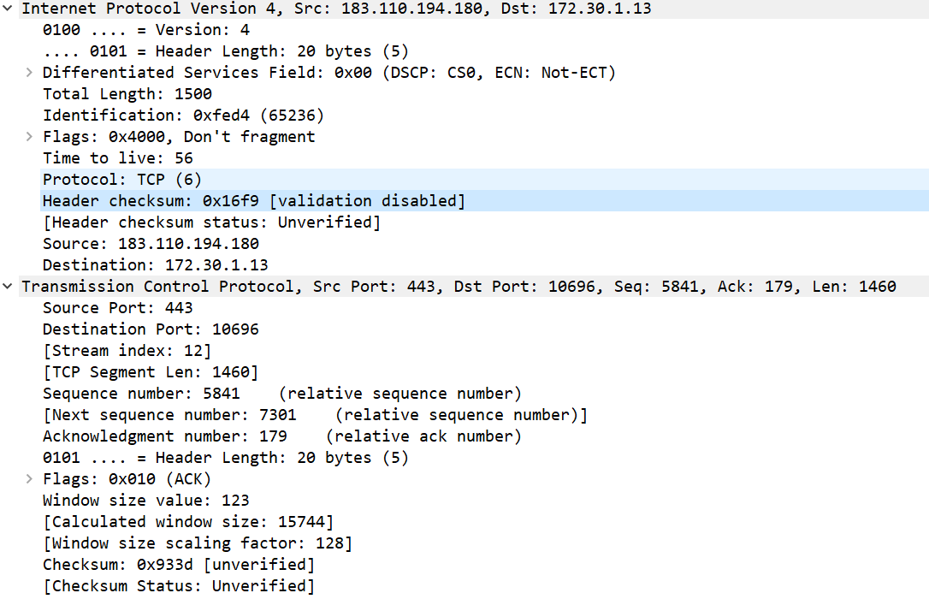
Wireshark and checksum

Slide 23
Options
TLV format: what’s good about this?
Only a couple remain useful
  Router Alert
Most are security threats
    Filtering rules recommendation: RFC7126
    Try “tracert –j xxx.xxx.xxx.xxx yyy.yyy.yyy.yyy”

Slide 24
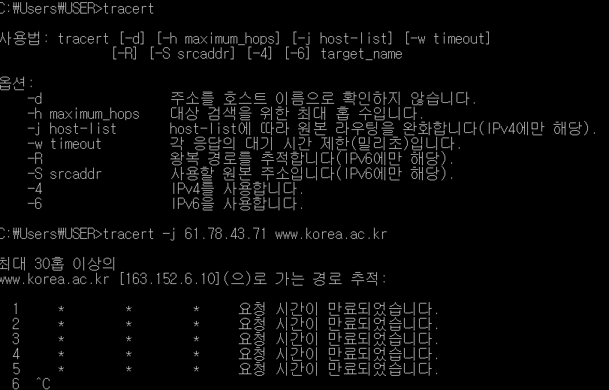
Tracert -j

Slide 25
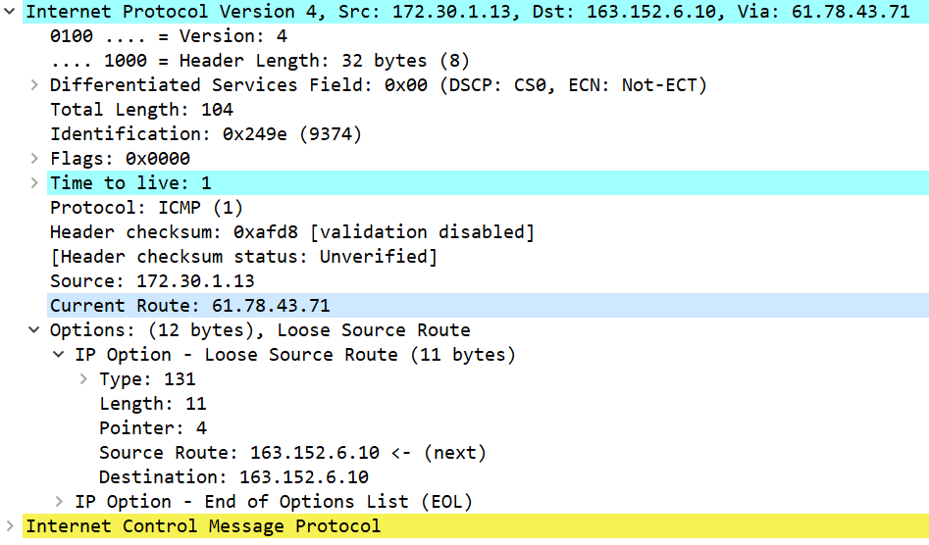
Tracert -j

Slide 26
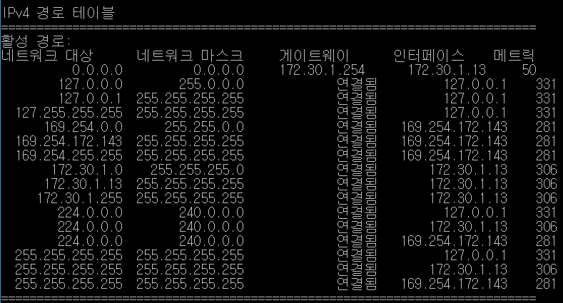
Routing table

Slide 27
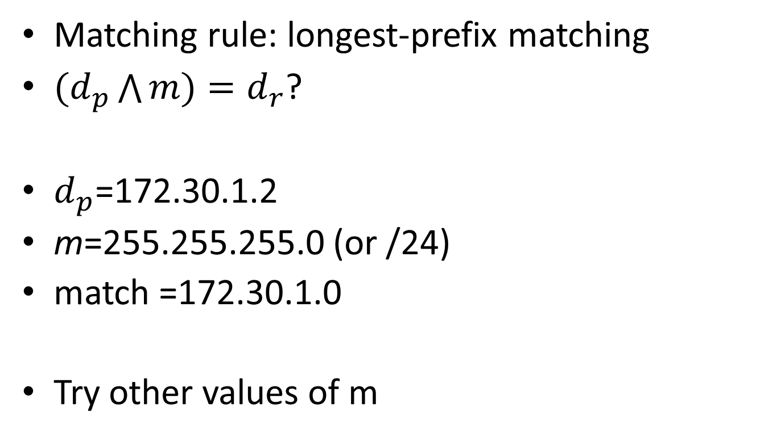
IP forwarding
Matching rule: longest-prefix matching
$(d_{p}\bigwedge{m)}=d_{r}$?
$d_{p}$=172.30.1.2
m=255.255.255.0 (or /24)
match =172.30.1.0
Try other values of m

Slide 28
Host processing rules
What if destination IP does not match my interface?
  “Be conservative in what you send, be liberal in what you accept” (Robustness Principle a.k.a. Postel’s Law)
Kill it silently or forward it?
Needs filtering anyway – consider multicast

Slide 29
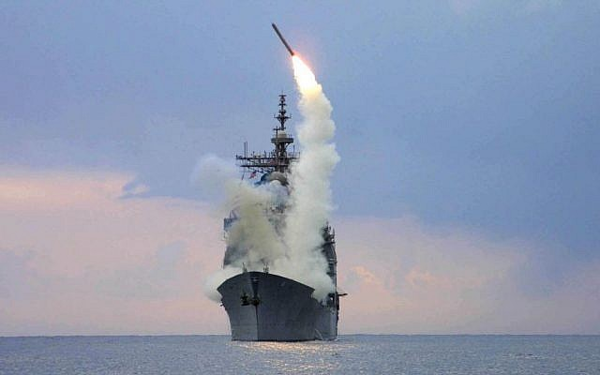
IP service characteristics
Connectionless
“Best-effort” service
Datagram: wherever you launch from, you will get to the destination

Slide 30
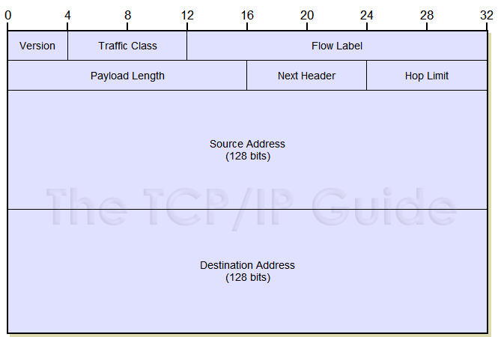
IPv6: header

Slide 31
IPv4 to IPv6
Remove useless fields from IPv4
  Checksum, Fragmentation
Add new fields
  Flow label for QoS – but still no hope
Rename some fields
  TTL → hop count
  Protocol → next header
  Total length → payload length (payload + extention header)
No “options”

Slide 32
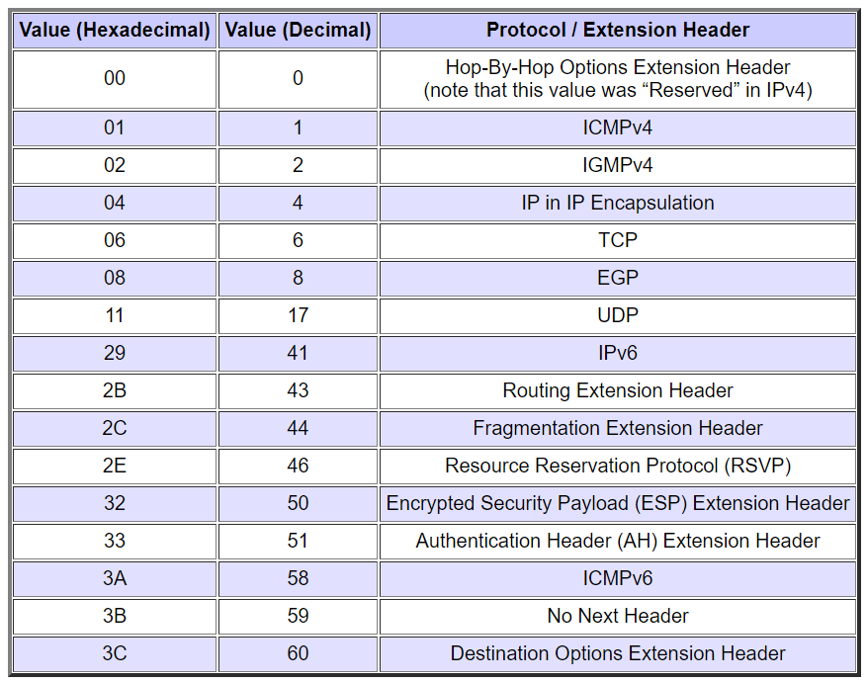
IPv6 header
Version = 6
Traffic class/flow label : QoS…forget it
Next header: demultiplexing

Slide 33
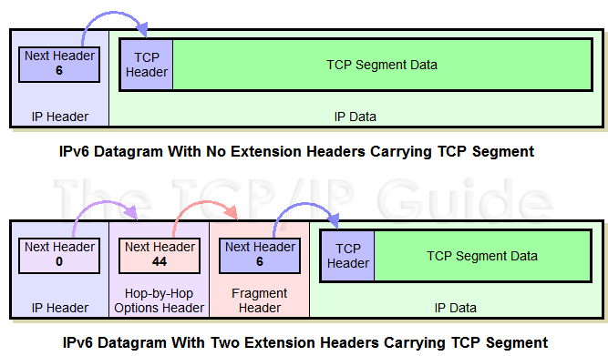
IPv6 extension headers

Slide 34
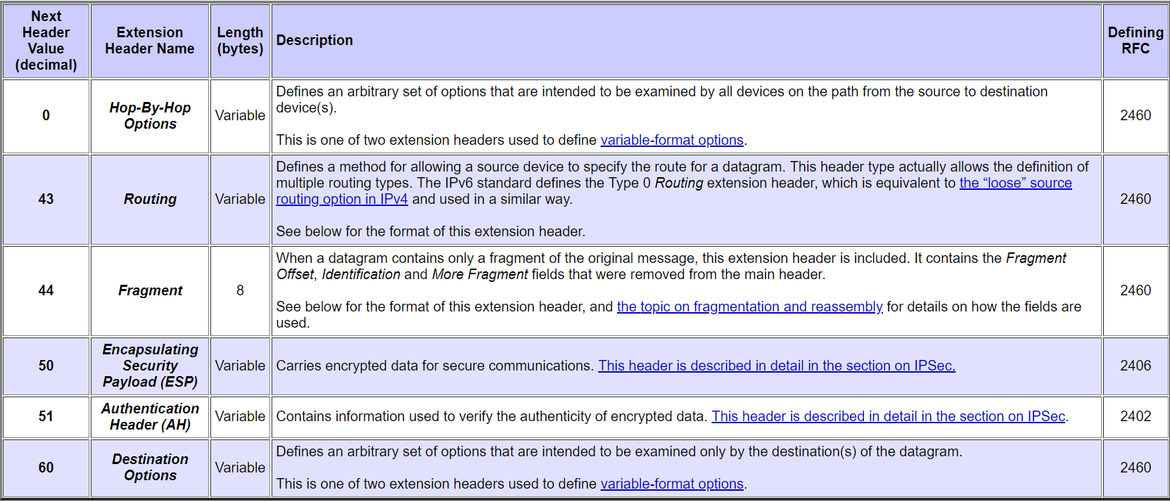
Extension headers

Slide 35
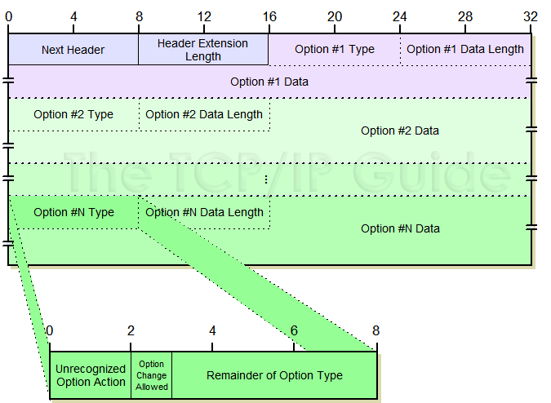
Options

Slide 36
Misc.
No ARP in IPv6 world
No IGMP in IPv6 world
They are done by ICMPv6
But the functionalities live!

