Slide 1
Chapter 8
Switching
Connecting n devices without n squared links
Forouzan, Data Communications and Networking, 5th ed., Chapter 8
8.1 Introduction, 8.2 circuit-switched networks
8.3 Packet switching, 8.4 structure of a switch
Textbook figures, plus Figures 8.22 and 8.23 missing from the original deck
Printed errors corrected, outdated material brought up to date

Slide 2
8.1-8.2
Circuit switching
8.3-8.4
Packet switching, switch structure
Dedicated path reserved end to end
Three phases: setup, transfer, teardown
Physical layer, no packets
Low delay, low efficiency
Datagram: each packet independent
Virtual circuit: setup, then labels
Circuit switch: space division, time division
Packet switch: ports, routing processor, fabric
Chapter 8
Where we are
Chapters 3 to 6: one link, and how to share it
Chapter 8: many links, many devices
mesh of n devices needs n(n-1)/2 links
switches cut that to a few links per device
The two answers, reserve a path or label every packet, still divide networking today

Slide 3
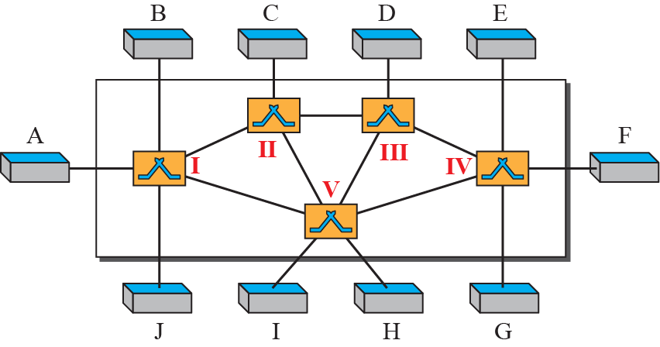
8-1
Introduction
Figure 8.1
Switched network
Network = set of connected devices
Mesh: too many links. Bus: capacity and distance limits
Switched network: switches joined by links
End systems at the edge, switches inside

Slide 4
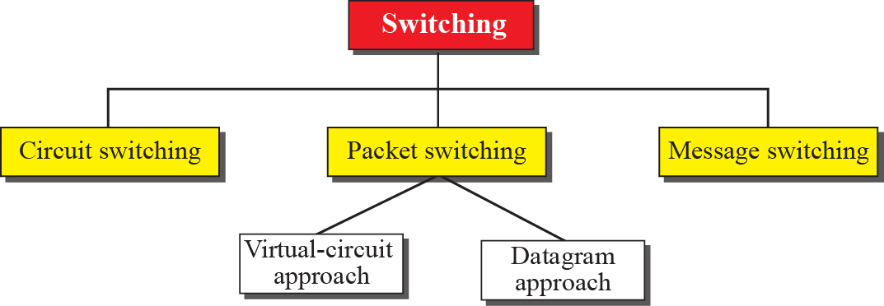
8.1.1
Three methods
Figure 8.2
Taxonomy of switched networks
Circuit switching, packet switching, message switching
First two in use today
Packet switching splits into datagram and virtual circuit
Message switching: store and forward a whole message
telegram era, phased out in general networks
Original deck numbers these 8.8.1 and 8.8.2: corrected to 8.1.x
8.1.2
Switching and TCP/IP layers
Today
Where the book is dated
Physical layer: circuit switching only, no packets
Data-link layer: packet switching, normally virtual-circuit style
Network layer: packet switching, datagram or virtual circuit
the Internet uses datagrams
Application layer: message switching only, conceptually
Book: tendency is to move to virtual circuit
What happened: IP stayed datagram at the edge
carrier cores run MPLS, a label-swapped virtual circuit
segment routing puts the path in the header instead of in switch state
So both approaches coexist, in different layers of the same network

Slide 5
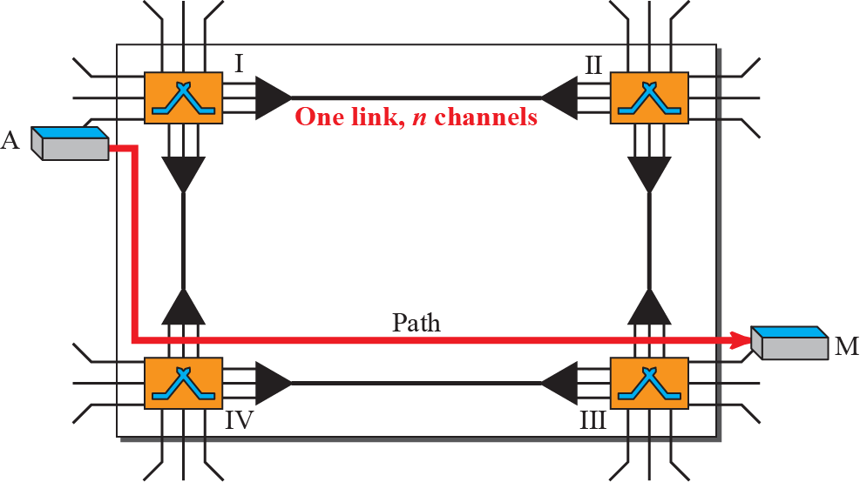
8-2
Circuit-switched networks
Figure 8.3
A trivial circuit-switched network
Switches joined by physical links
Each link divided into n channels by FDM or TDM
Connection = one dedicated channel on each link of the path
Reserved for the whole call, used or not

Slide 6
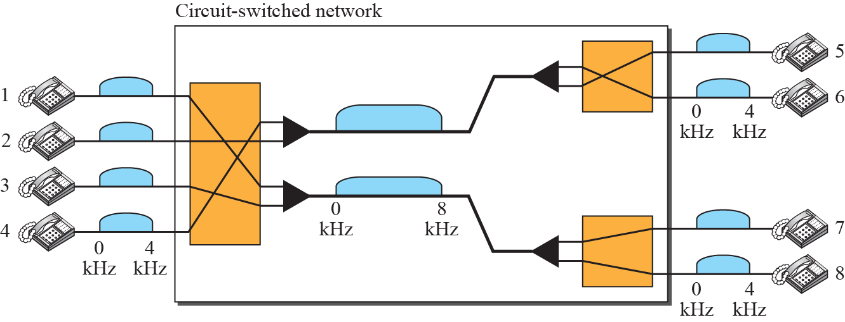
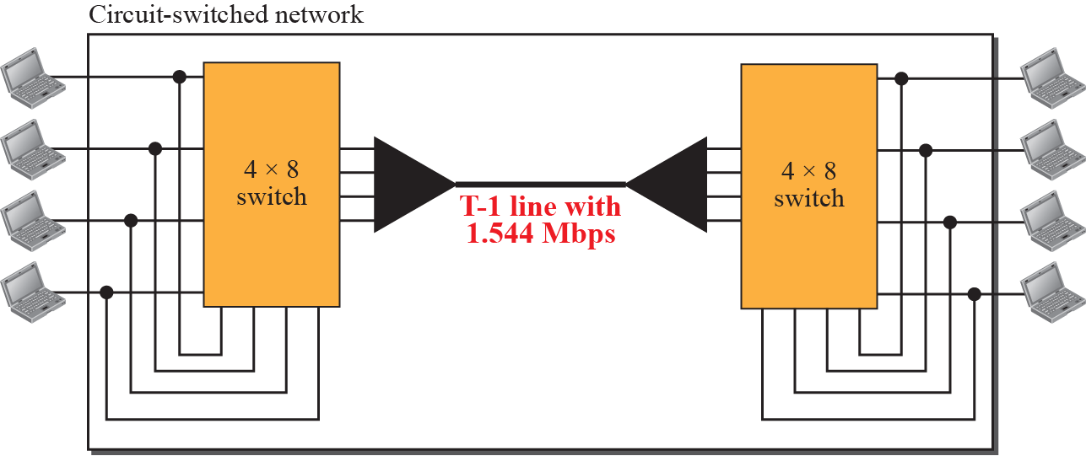
Example 8.1
Eight telephones, FDM links
Figure 8.4
Example 8.1
Voice 4 kHz, each link carries 2 voice channels, so 8 kHz
Connection = one 4 kHz band on each link
4 connections at most, no more
Example 8.2
Two offices over a T-1
Figure 8.5
Example 8.2
Two 4 × 8 switches, T-1 line between them
T-1 carries 24 channels of 64 kbps (Chapter 6)
Four outputs folded back to the office, four to the link

Slide 7
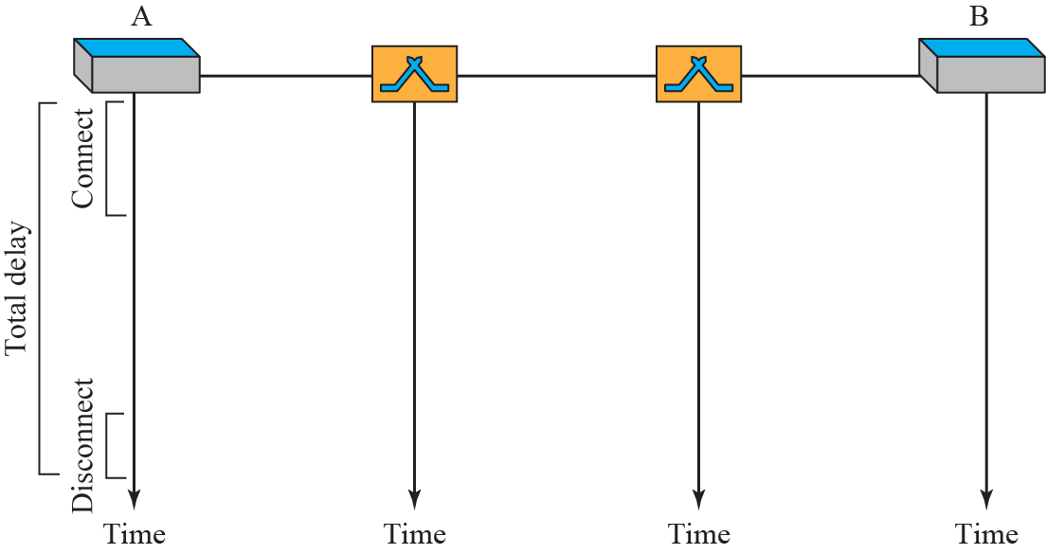
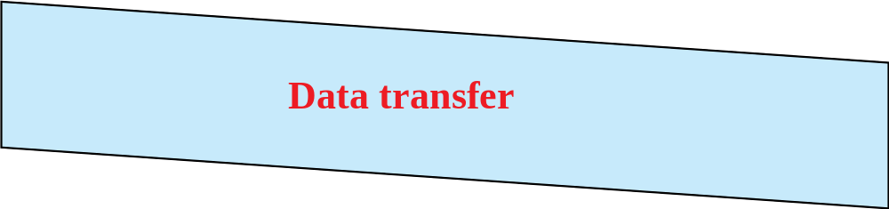
8.2.1
Three phases
8.2.2
Efficiency
Setup: request forwarded switch by switch, channels reserved
end-to-end address needed here, telephone number or equivalent
acknowledgment returns before data flows
Data transfer: no addressing, no per-packet decision
Teardown: signal releases the channels
Resources held for the whole connection, idle or not
Silence in a phone call still owns its channel
Less efficient than packet switching
That was acceptable when the traffic was voice
8.2.3
Delay
Figure 8.6
Delay in a circuit-switched network
Minimal and, once set up, constant
Setup: request plus acknowledgment, end to end
Transfer: propagation and transmission only, no queuing at switches
Teardown: one more signal
That constant delay is the property real-time traffic wants

Slide 8
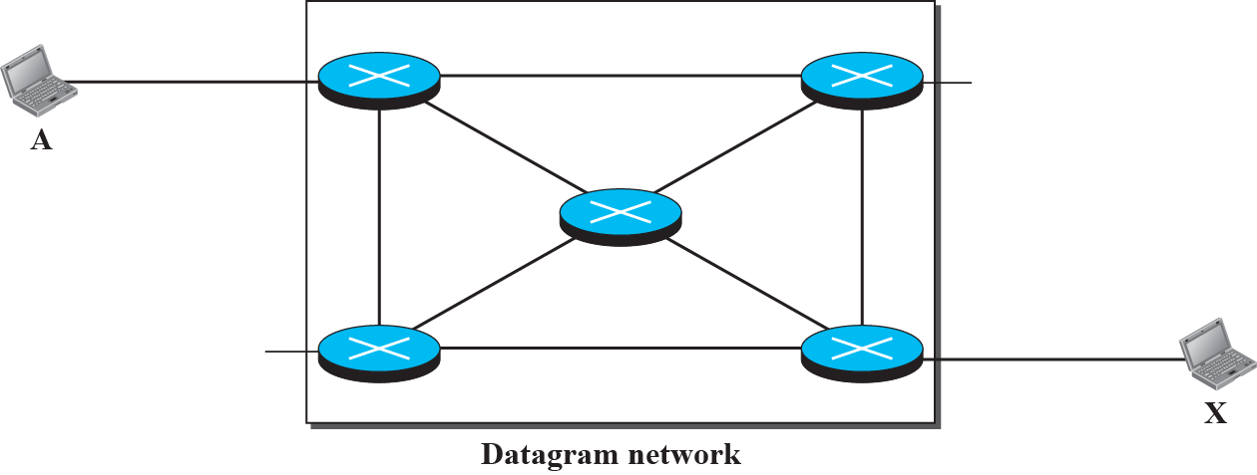


8-3
Packet switching
8.3.1
Datagram networks
Message split into packets, fixed or variable size
No reserved resources, no setup in the datagram case
Resources allocated on demand, first come first served
Queues at switches: delay varies, loss possible
Each packet treated independently
Header carries the destination address, end to end
Packets of one message may take different paths
May arrive out of order, or not at all
Connectionless: no state in the switch for a flow
Figure 8.7
Datagram network with four switches
8.3.1
Routing table
Indexed by destination address
Entry gives the output port
Table built by routing protocols, changes over time
Lookup on every packet

Slide 9
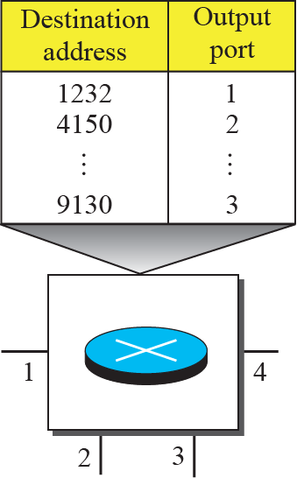
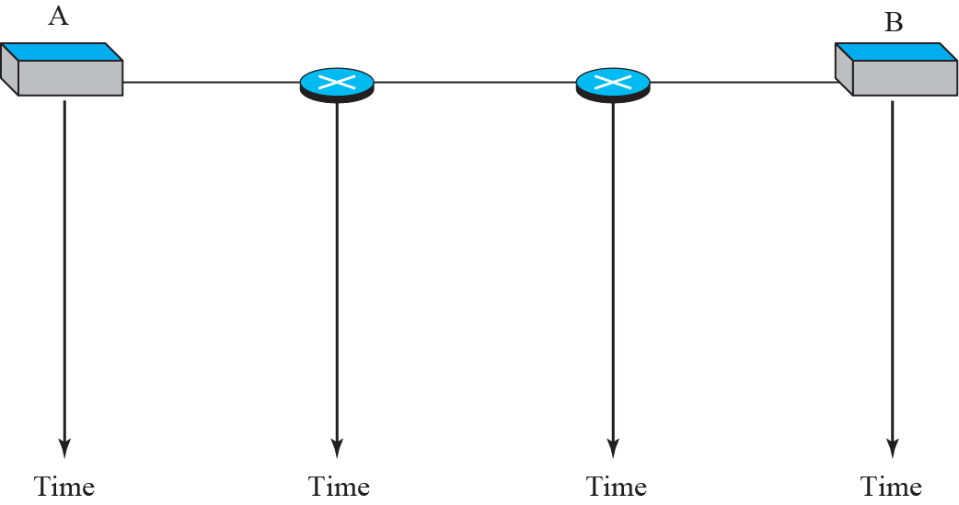




Figure 8.8
Routing table in a datagram network
8.3.1
Efficiency
Figure 8.9
Delays in a datagram network
Better than circuit switching: nothing reserved in advance
Idle source consumes nothing
8.3.1
Delay
Higher and variable: queue at every switch
Per-packet: wait + transmission + propagation
No setup delay

Slide 10
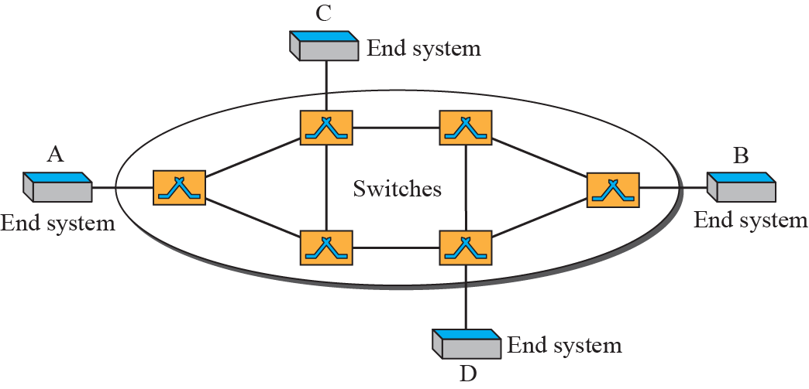
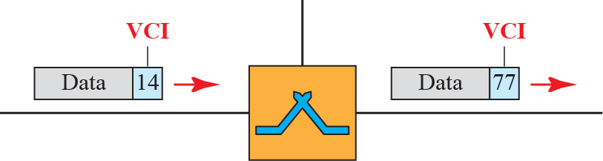
8.3.2
Virtual-circuit networks
Figure 8.10
Virtual-circuit network
A cross between the two
Setup and teardown phases, as in circuit switching
Data packetized with a header, as in datagram
Address in the header is local, not end to end
All packets of a connection follow one path
Resources reserved at setup, or on demand
Figure 8.11
Virtual-circuit identifier
8.3.2
VCI is not an address
Small number, local to one link
Changes at every switch
Destination address used once, at setup

Slide 11
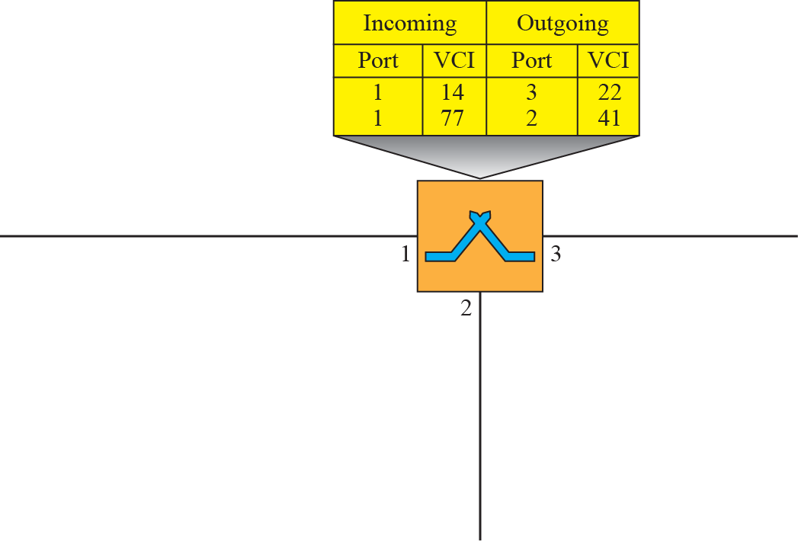



Figure 8.12
Switch and table for a virtual-circuit network
8.3.2
Switching table
Four fields: incoming port, incoming VCI, outgoing port, outgoing VCI
Frame arrives on port 1 with VCI 14
table says out on port 3 with VCI 22
Entry created at setup, removed at teardown
No address lookup, no routing decision per packet

Slide 12
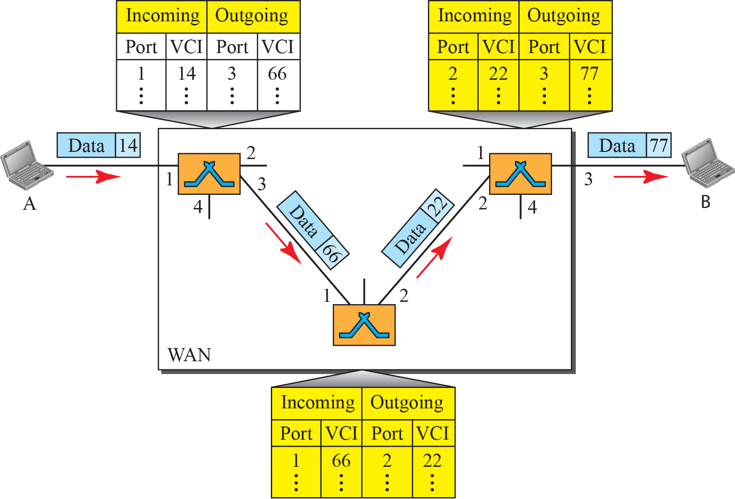
Figure 8.13
Source-to-destination transfer in a virtual-circuit network
Correction
Deck caption
Deck reads circuit-switched network
Figure 8.13 is the virtual-circuit case: VCI changes hop by hop

Slide 13
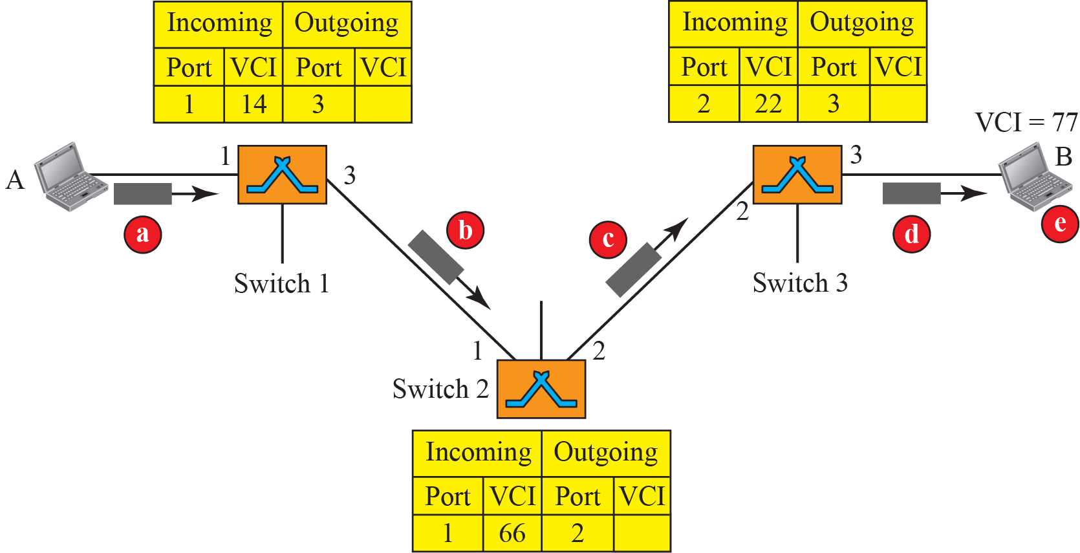
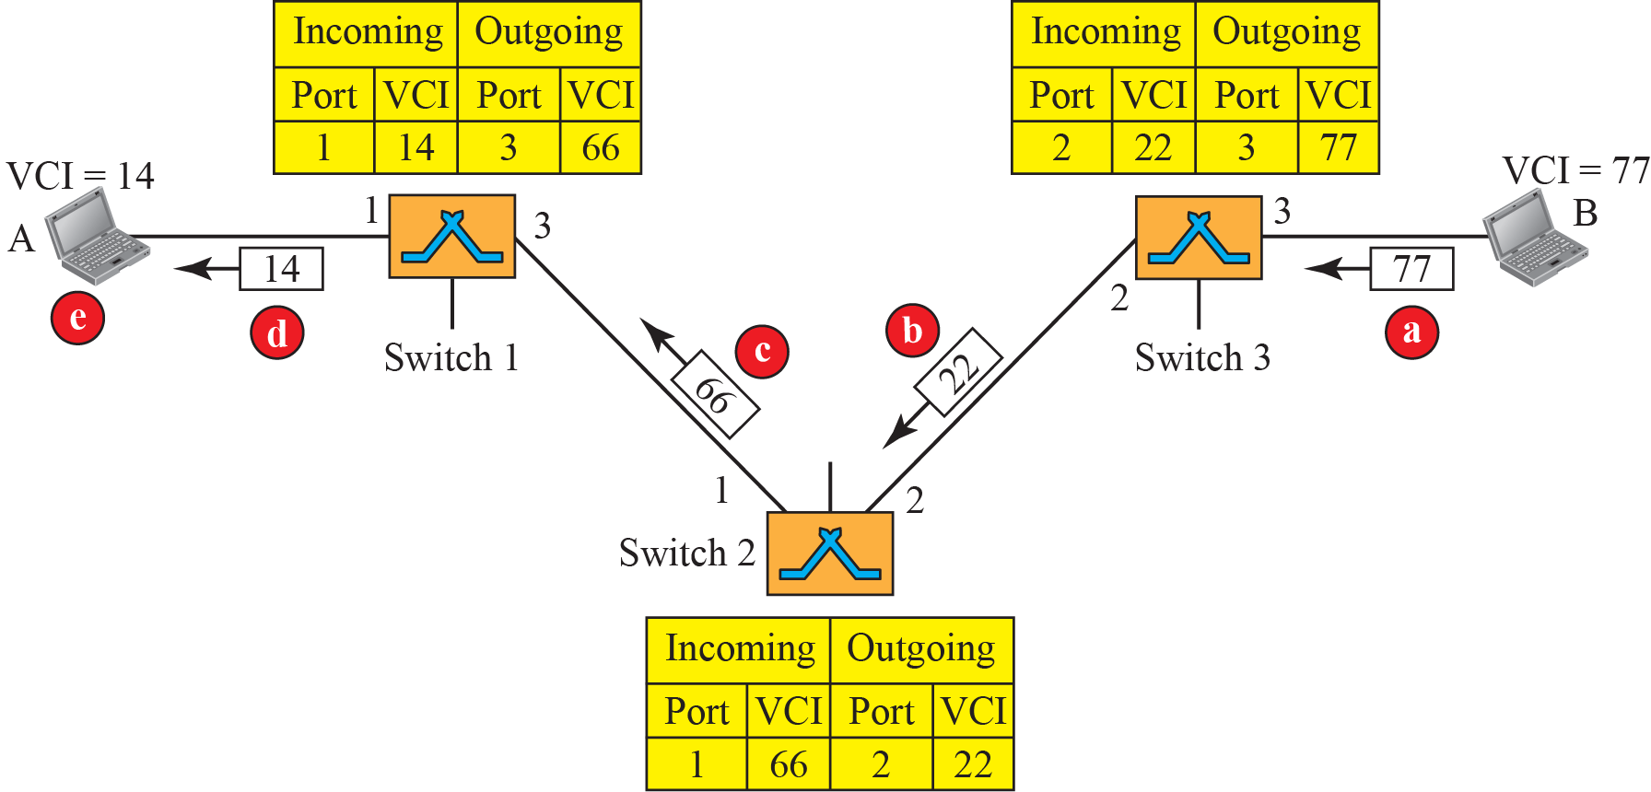
Figure 8.14
Setup request
Figure 8.15
Setup acknowledgment
8.3.2
Setup in two passes
8.3.2
Efficiency and delay
Request carries the destination address toward B, each switch makes a table entry with the incoming VCI
Acknowledgment travels back, filling in the outgoing VCIs
After that the address is never used again
One-time setup and teardown delay
Reserved at setup: no wait, constant delay per packet
On demand: delay varies, but the source can check availability first
Per-packet work is a table index, not a longest-prefix search

Slide 14
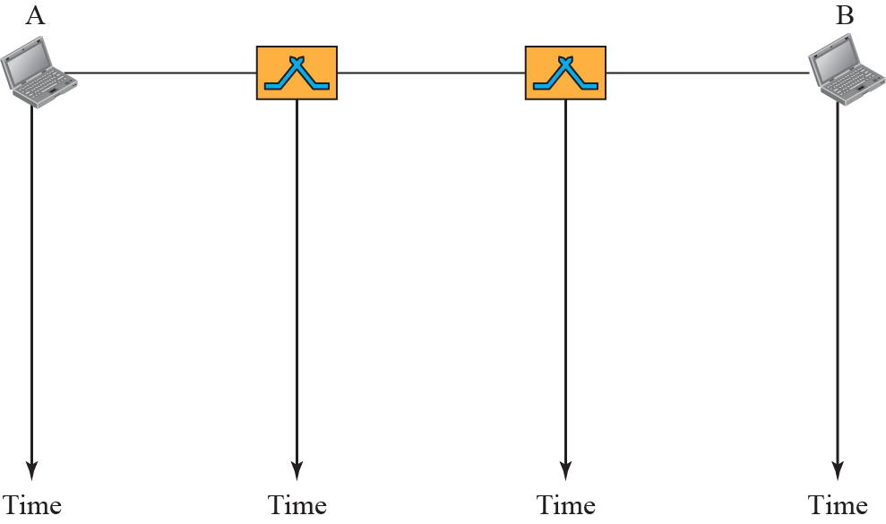


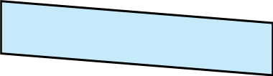

Figure 8.16
Delay in a virtual-circuit network
Today
Virtual circuits now
ATM and Frame Relay: gone
MPLS: the same idea, label swapped at each hop
carrier cores, traffic engineering, VPNs
Segment routing: path carried in the header, no per-flow state
VLAN tags and tunnels: local labels under another name

Slide 15
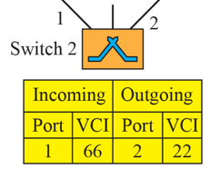
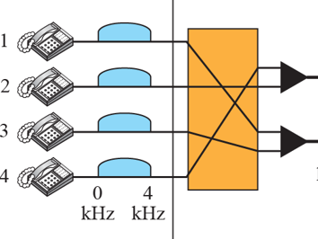
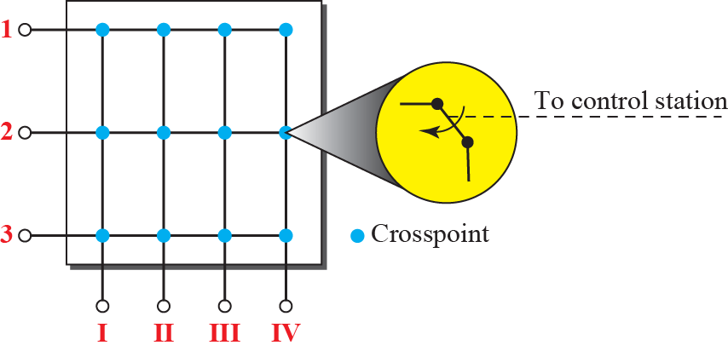
8-4
Structure of a switch
8-4
Two kinds of switch, two kinds of state
8.4.1
Space-division switch
Circuit switches: space or time division
Packet switches: ports, processor, fabric
Paths separated in space
Crossbar: n × m grid, microswitch at each crosspoint
Any input to any free output, never internally blocked
Limit: n × m crosspoints
1000 × 1000 needs a million
fewer than 25 percent ever in use
Figure 8.17
Crossbar switch, three inputs and four outputs
8.4.1
Why crossbars do not scale
Crosspoints grow as n²
Most sit idle
Answer: split into stages and share the middle

Slide 16
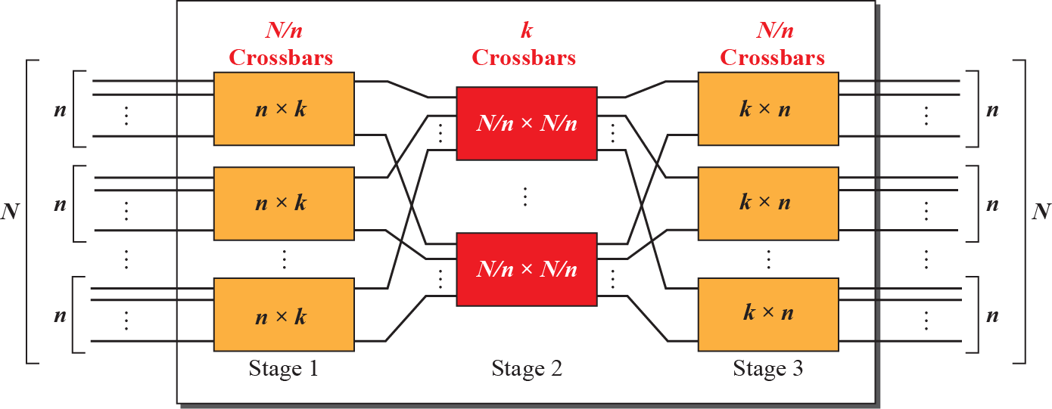
Figure 8.18
Multistage switch
8.4.1
Multistage design
Split N inputs into groups of n
Stage 1: N/n crossbars of n × k
Stage 2: k crossbars of (N/n) × (N/n)
Stage 3: N/n crossbars of k × n
Crosspoints = 2kN + k(N/n)²
Example 8.3
200 × 200, k = 4, n = 20
8.4.1
Blocking
Stage 1: 10 crossbars of 20 × 4
Stage 2: 4 crossbars of 10 × 10
Stage 3: 10 crossbars of 4 × 20
Total 2000 crosspoints, 5 percent of 40,000
Middle-stage crossbars are shared
Blocked: free input and free output, but no free path between them
Here only 4 of each 20 inputs can be served at once
Single-stage crossbar never blocks internally
More stages: fewer crosspoints, more blocking

Slide 17
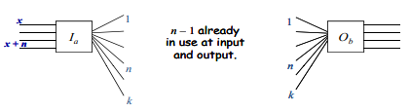
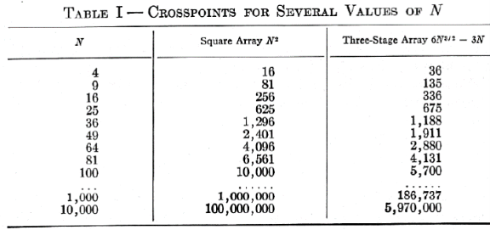
Clos
Nonblocking condition
Clos
Crosspoints under the Clos criteria
8.4.1
Clos criteria
Example 8.4
200 × 200 nonblocking, corrected
Nonblocking needs k ≥ 2n - 1
Minimum crosspoints at n = (N/2)^(1/2)
Then total ≈ 4N[(2N)^(1/2) - 1]
100,000 ports: about 200 million crosspoints, against 10 billion for one crossbar
n = (200/2)^(1/2) = 10, k = 2n - 1 = 19
Stage 1: 20 crossbars of 10 × 19
Stage 2: 19 crossbars of 20 × 20
book prints 10 × 10: wrong, N/n = 20
Stage 3: 20 crossbars of 19 × 10
Total 15,200, that is 38 percent of 40,000
book totals 9500 and says 24 percent

Slide 18
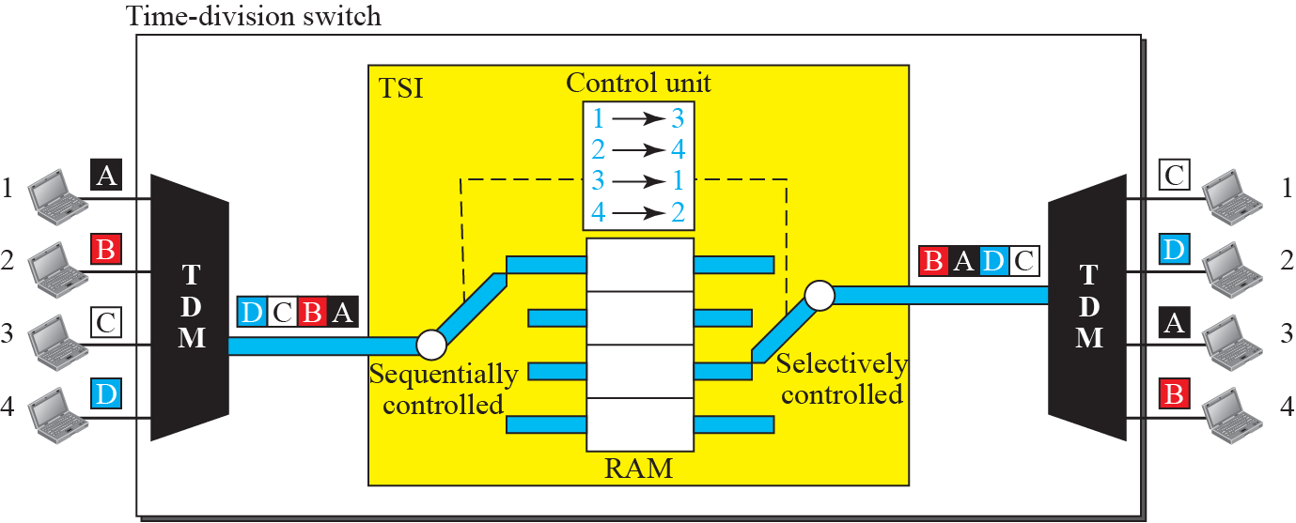
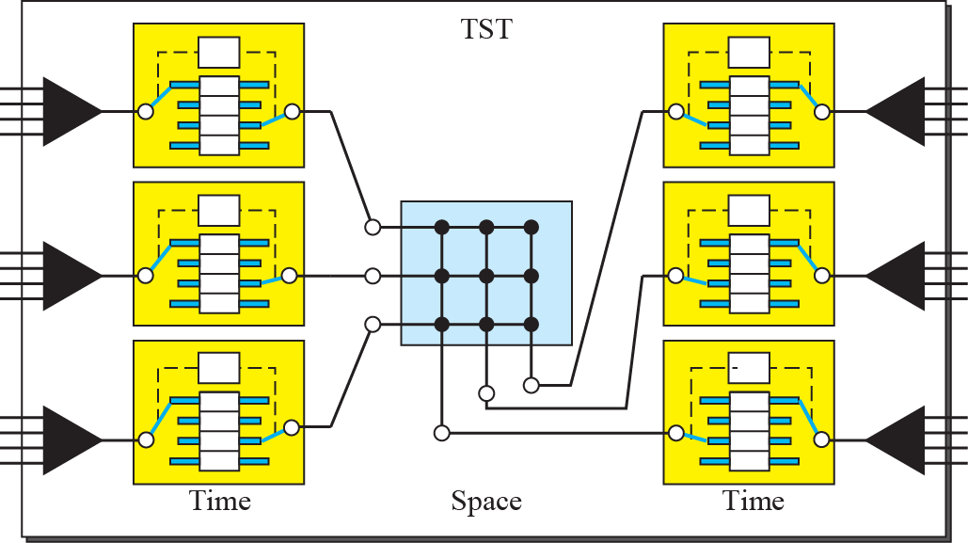
8.4.1
Time-division switch
Figure 8.19
Time-slot interchange
Digital, no crosspoints
Time-slot interchange: write slots to memory, read in another order
Cost moves to memory access time, and it adds delay
Figure 8.20
Time-space-time switch
8.4.1
TST
Two time stages around one space stage
Fewer crosspoints than space alone, less memory than time alone
How digital telephone exchanges were built

Slide 19
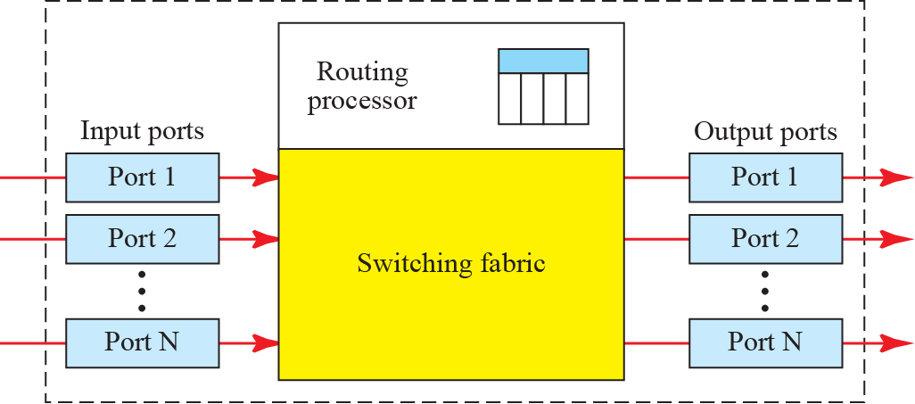
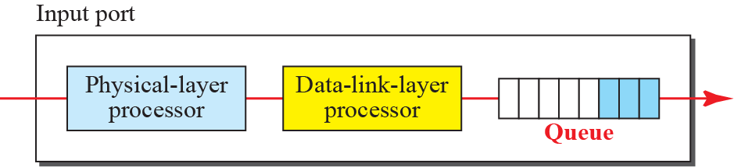
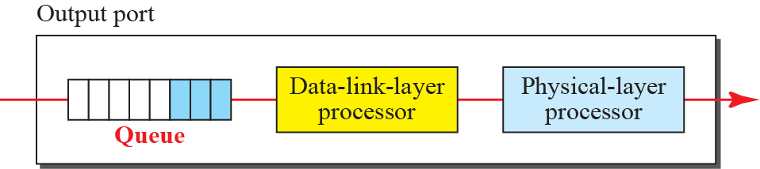
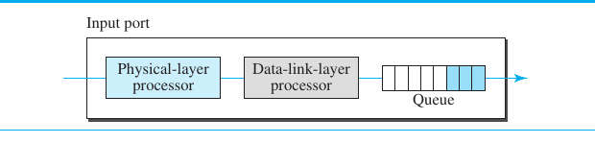
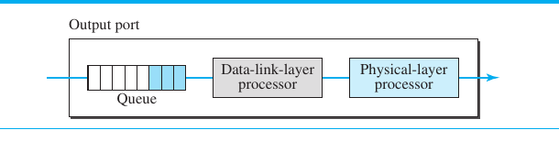
Figure 8.21
Packet switch components
8.4.2
Four components
Input ports, output ports, routing processor, switching fabric
Store and forward in the classical design
Deck text cites 8.28 by mistake: the figure is Figure 8.21
Figure 8.22
Input port, missing from the original deck
Figure 8.23
Output port, missing from the original deck
8.4.2
Ports and processor
Input port: physical layer, data-link layer, queue
Output port: queue, data-link layer, physical layer, reverse order
Routing processor: table lookup, next hop and output port
Book notes the lookup moving into the input ports
today it is an ASIC with TCAM on each line card

Slide 20
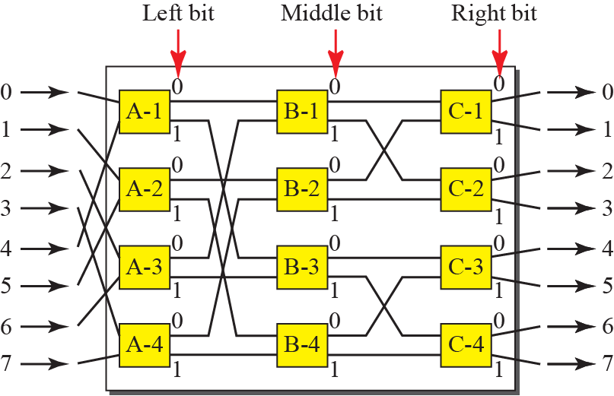
8.4.2
Switching fabrics
Figure 8.24
A banyan switch, 8 × 8
Hardest job: move packets from input queue to output queue fast
Early switches: a computer memory or a bus
Crossbar: simplest fabric, as in circuit switching
Banyan: multistage, self-routing on the output address

Slide 21
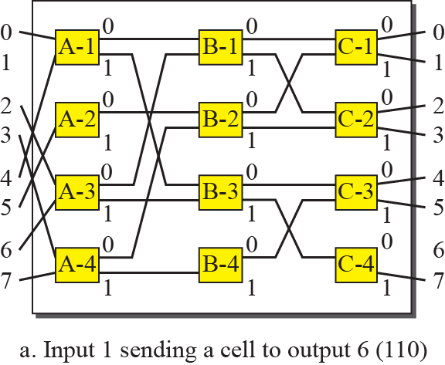
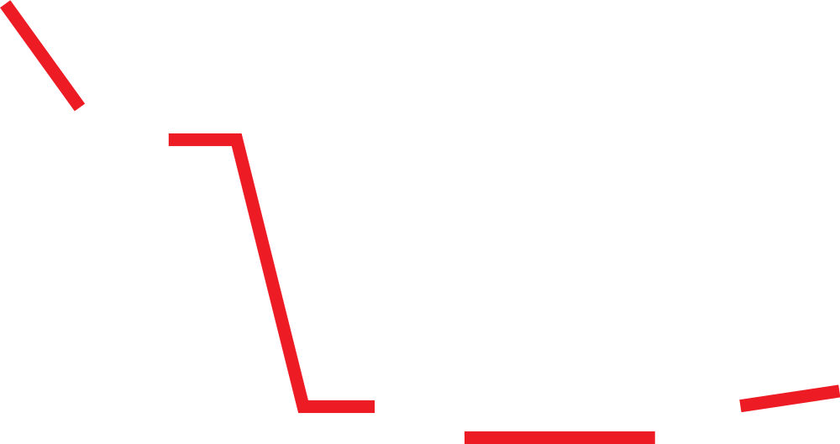
8.4.2
Banyan routing
Figure 8.25a
Input 1 to output 6 (110)
log2 n stages, n/2 microswitches per stage
Stage i routes on bit i of the output address
bit 0 up, bit 1 down
Self-routing: no table, the header is the route
8 inputs, 8 outputs, 3 stages

Slide 22
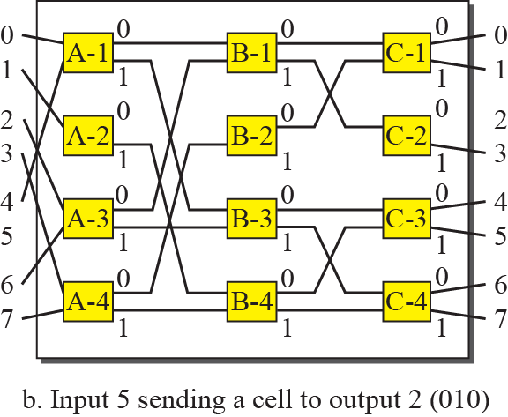

Figure 8.25b
Input 5 to output 2 (010)
8.4.2
Internal blocking
Two packets to different outputs can still need the same internal link
Banyan alone is internally blocking
Not the same as output contention, where two packets want one output
8.4.2
When a banyan does not block
Destinations all distinct
Arranged in ascending order at the inputs
Concentrated: no idle input between active ones
0 1 3 4 6 7 at inputs 0 to 5 is fine
0, idle, 1 3 4 6 7 is not: the gap breaks it
Hence a sorter, and a concentrator, in front of the banyan

Slide 23
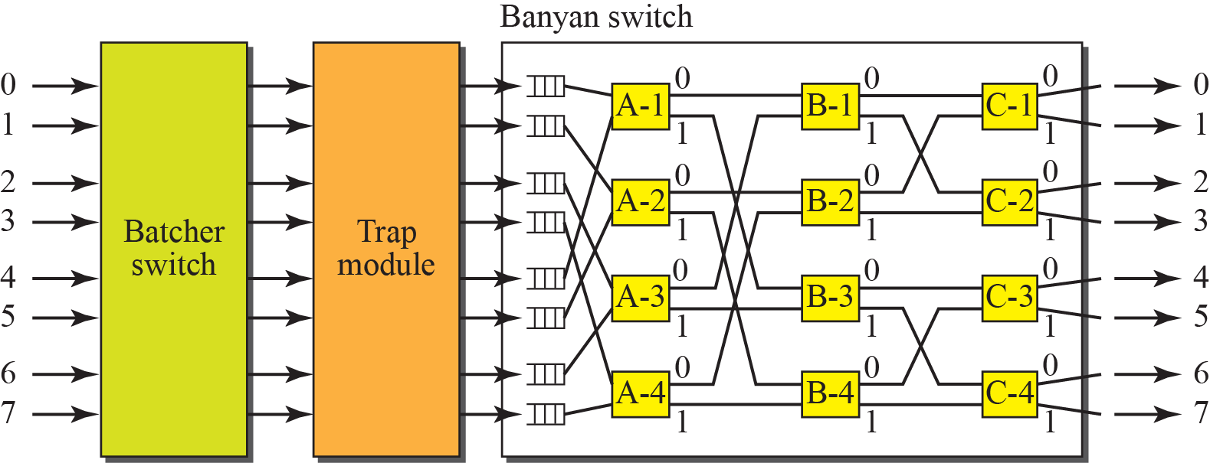
Figure 8.26
Batcher-banyan switch
8.4.2
Batcher-banyan
Batcher network sorts packets by destination address
Sorted and concentrated input makes the banyan internally nonblocking
A concentrator removes the gaps between active inputs
Output contention remains: two packets for one output in one cycle
one is held or recirculated, that is a trap in the design
ATM-era design, 1980s and 1990s
8.4.2
Which fabric today
Small switches: shared memory, every port reads and writes one buffer
Large switches: crossbar with virtual output queues and a scheduler
Very large: multistage Clos, the same arithmetic as Section 8.4.1
Self-routing multistage fabrics like banyan did not survive the ATM era

Slide 24
8.1-8.4
What replaced what
Idea in the chapter
Status today
What is used now
Circuit switching
legacy in telephony
optical circuits: wavelengths and ROADM, Chapter 6
Message switching
gone as a network
store and forward survives in email and messaging
Datagram switching
dominant
IP, with longest-prefix lookup in ASIC and TCAM
Virtual circuit
alive under new names
MPLS labels, VLAN tags, tunnels, segment routing
Crossbar
alive
crossbar plus virtual output queues and a scheduler
Multistage and Clos
alive, and central
leaf-spine data center fabrics are folded Clos networks
Time-slot interchange
legacy
replaced by packet fabrics, TDM only in carrier legacy
Banyan, Batcher-banyan
historical
shared memory for small switches, crossbar or Clos for large
Store and forward
partly replaced
cut-through forwarding where latency matters
Routing processor in the box
split apart
control plane may be centralized: SDN, OpenFlow, P4
Head-of-line blocking: a FIFO input queue caps throughput near 58 percent, because the packet at the head holds up those behind it. Virtual output queues, one queue per output at each input, remove that cap. The book does not mention it.
Clos lives on: n inputs per leaf, k spines, the same k ≥ 2n - 1 argument decides oversubscription in a data center fabric.

Slide 25
Errata
Corrections to the printed slides and textbook
Where
Printed
Corrected
Section headings
8.8.1, 8.8.2
8.1.1, 8.1.2
Deck slide 1
a leftover Chapter 6 slide, DSSS example
removed
Figure 8.13 caption
circuit-switched network
virtual-circuit network
Section 8.4.2 text
as shown in Figure 8.28
Figure 8.21
Example 8.4, stage 2
19 crossbars of 10 × 10
19 crossbars of 20 × 20, since N/n = 20
Example 8.4, total
9500 crosspoints, 24 percent
15,200 crosspoints, 38 percent
Figures 8.22, 8.23
missing from the deck
recovered from the textbook
Banyan slides
two figures with no text
nonblocking condition stated

Slide 26
EXPLORE
Switch fabrics
EXPLORE
Labels and control planes
Stanford EE384X, handout 9: head-of-line blocking, the 58 percent result, and VOQ
https://web.stanford.edu/class/ee384x/EE384X//handouts/handout9.pdf
McKeown, iSLIP: how a crossbar scheduler actually matches inputs to outputs
http://nms.lcs.mit.edu/6829-papers/islip-ton.pdf
ipSpace, leaf-and-spine myths: why a Clos fabric is not automatically nonblocking
https://blog.ipspace.net/2018/10/leaf-and-spine-fabric-myths-part-1/
Stanford, OpenFlow MPLS: a label switched router built on an SDN switch
http://yuba.stanford.edu/~peyman/docs/ofmpls.pdf
Wikipedia, MPLS: the virtual circuit of this chapter, in today's carrier core
https://en.wikipedia.org/wiki/Multiprotocol_Label_Switching
Grotto Networking, MPLS data plane: label push, swap and pop, worked through
https://www.grotto-networking.com/BBMPLS.html
MPLS and SDN flow tables: label switching inside an OpenFlow network
https://arxiv.org/pdf/1805.07993
Illinois thesis, MPLS on OpenFlow: where the control plane went
https://assured-cloud-computing.illinois.edu/files/2015/02/Bellessa_John.pdf

