Slide 1
AutoSense: Unobtrusively Wearable Sensor Suite for Inferring the Onset, Causality, and Consequences of Stress in the Field
Emre Ertin, Nathan Stohs, Santosh Kumar, Andrew Raij, Mustafa al’Absi, Siddharth Shah
Sensys’ 11

Slide 2
Abstract
The paper presents a wireless sensor suite called AutoSense that collects and processes cardiovascular, respiratory, and thermoregularity measures of stress in the field.
Overcomes several challenges
Unobtrusively wearable
Low power design
Sensor measurements are robust to several sources of errors and confounds
Integrates and ANT radio for low power and integrated quality of service, guaranteed even in crowded environments

Slide 3
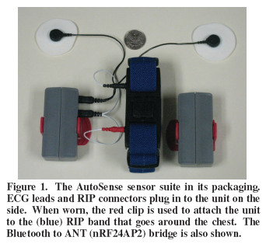
1. Introduction
Autosense combines six sensors into a conveniently wearable chest band
ECG
Respiratory Inductive Plethysmograph
Galvanic Skin Response
skin temperature thermistor
ambient temperature sensor
accelerometer

Slide 4
1. Introduction
With built in USB charging and battery monitoring circuits.
Bluetooth to ANT(nRF24AP2) bridge to wirelessly communicate with a smart phone
All sensor boards include digital sensor/radio power switches for duty cycling

Slide 5
1. Introduction
For unobtrusive wearing the GSR is placed at the chest rather than its usual placement on fingers or earlobes.
High impedance circuitry is used to limit current flow for added protection in case of physical breaking of the sensor board or shorting of the battery leads

Slide 6
1. Introduction
Autosense also incorporates several innovations..
-Integrates ANT(nRF24AP2) radio for low power and QoS guarantee with built-in TDMA
-33% -> 0.1% power loss(will be proved later on…)
-using frequency range of ANT to avoid Wi-Fi interference
-developed appropriate buffer management

Slide 7
1. Introduction
Autosense is complemented with FieldStream
FieldStream
-a software framework on the mobile phone
-receives measurements from AutoSense
-computes a variety of features from the measurements, and makes behavioral inferences
-behavioral inferences include stress levels

Slide 8
1. Introduction
Autosense and FieldStream platforms have been used and is being used in real-life
-21 human subjects, 2 days of experiment-> enabled the development of new stress models that provide high accuracy
-30 subjects -> comfortable
-50+ subjects now being experimented for 1~4 weeks

Slide 9

2. Selecting the Set of Sensors for AutoSense
The reason AutoSense chose the sensors introduced above…
-ECG for HRV analysis(time intervals between heartbeats), but ECG sensor by itself is not enough
-HRV is also affected by respiration rate and posture, so in order to control these effects, respiration band and accelerometer was included
-Skin conductance, ambient temperature was chosen to monitor activation of thermoregulatory and nervous systems of the body.
In addition…
Remember! AutoSense is a carefully designed sensor suite to be worn unobtrusively for a long time

Slide 10
3. AutoSense Sensor System – Hardware Design(3.1 Respiratory Sensing)
Autosense uses an elastic band to measure relative lung volume(via chest expand). This is known as plethysmography -> nonobtrusive
2 alternative approaches for plethysmography
-Piezoelectric sensors
-Inductance based sensors

Slide 11
3. AutoSense Sensor System – Hardware Design(3.1 Respiratory Sensing)
Piezoelectric Sensors
-Rely on piezoelectric crystals placed where the two ends of the band connect. The crystal generates a voltage when compressed or stretched.
-Inexpensive, simple
But…
Prone to “Trapping” artifact : In daily life, for example, when laying down or leaning against furniture, often times a portion of the band’s tension is overestimated

Slide 12

3. AutoSense Sensor System – Hardware Design(3.1 Respiratory Sensing)
Respiratory Inductance Plethysmography(RIP)
-Uses a conductive thread that is sewn in a zigzag fashion to the elastic band
-Inductance measurement depends purely on the geometry of the band and is not related to the tension of the band
->AutoSense’s choice?

Slide 13
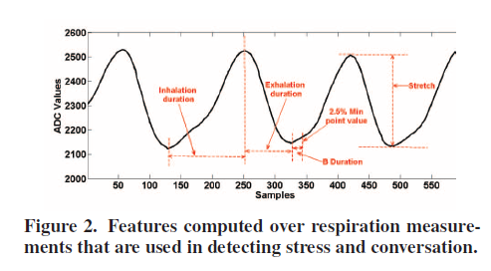
3. AutoSense Sensor System – Hardware Design(3.1 Respiratory Sensing)
Not exactly…
-Commercially available RIP bands are sold with expensive, big, power consuming electronic boards that measure the inductance.
Therefore…
-Designed a new sensor board for RIP bands for low power sensing and direct integration with the mote hardware.
-More than 87% accuracy when measuring

Slide 14
3. AutoSense Sensor System – Hardware Design(3.2 Integrated ECG and GSR Sensing)
AutoSense integrated ECG and GSR(Galvanic Skin Response) onto the same electrode
->Maximize comfort, simplify the procedure for wearing the band
GSR readings provide valuable information that is used in ECG signal processing -> Supports the weakness of two-lead ECG

Slide 15
3. AutoSense Sensor System – Hardware Design(3.3 Temperature and Accelerometer Sensors)
Skin temperature gradient not only indicates stress levels but also environmental conditions for the subject
-Body temperature
-Ambient temperature
AutoSense also uses the ADXL335 three-axis accelerometer from Analog devices

Slide 16
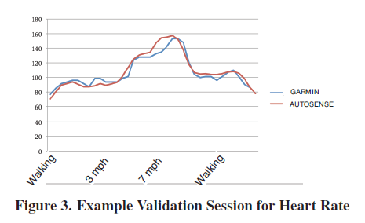
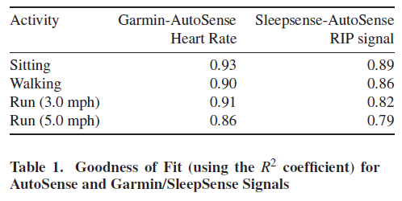
3. AutoSense Sensor System – Hardware Design(3.4 Comparison of the ECG and RIP sensor measurements with Commercial Sensors)
To compare AutoSense with commercially available sensors, they collected sitting, walking, running data on a treadmill.
AutoSense & Garmin Forerunner 305

Slide 17
4. Sampling and Wireless Communication
One of the main function of the AutoSense is to sample and transmit data to the user’s mobile phone.
Uses Time Division Multiple Access(TDMA) to power-cycle both the receiver and the transmitter.

Slide 18
4. Sampling and Wireless Communication
Radio Selection
-Nordic Semiconductor nRF24AP8 : Bidirectional radio transceiver with built in firmware implementing the ANT protocol developed by Dynastream Innovations Inc.
-Packet payload size is optimized for slow data rate sensors at short packets of 8 bytes/packet

Slide 19
4. Sampling and Wireless Communication
Bluetooth to ANT bridge
-ANT radios are available on very few smart phones -> hard to communicate between ANT sensors and smart phones
-Alternatively, Bluetooth radio can be integrated onto a sensor node itself -> however, power consuming…
-To accommodate a wide variety of smart phones, AutoSense added a bridge node in between the wearable sensors and the mobile devices -> Bridge node allows pairing up mobile phones with any ANT sensor without additional coupling requirements

Slide 20
4. Sampling and Wireless Communication(4.1 Obtaining Precise Energy Measurements)
Constructing precise current consumption profile for AutoSense is challenging
-> Due to numerous S/W, H/W components affecting current consumption across time
Follows an alternative option where measurements are made on multiple channels at various points of the board simultaneously

Slide 21
4. Sampling and Wireless Communication(4.2 Energy Profiling)
Radio Transceiver
-Transmission of an 8 Byte packet only takes 150 µs
But
-Setup time is significantly longer, and proper power consumption figures should include radio/MCU communication

Slide 22
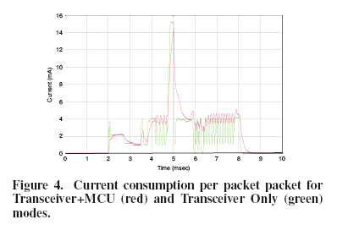
4. Sampling and Wireless Communication(4.2 Energy Profiling)
Overall energy efficiency of Autosense : 1106nJ/bit
Commercially available 802.15.4 transceivers(TelosB) : 816nJ/bit

Slide 23
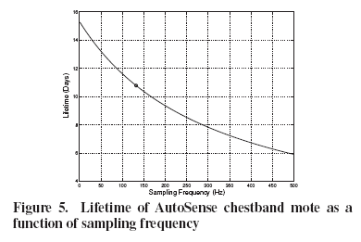
4. Sampling and Wireless Communication(4.2 Energy Profiling)
Sensor Boards
-To characterize power consumption of AutoSense sensors, they measured power consumption by enabling and disabling various components of the sensor system
-Result : When operated in real-life deployments, which corresponds to 132 samples, expected lifetime was 10.75 days

Slide 24
4. Sampling and Wireless Communication(4.3 Antenna Optimization for Body Sensors)
AutoSense sensor motes use ceramic multilayer chip ANT from TDK with the reference tuning circuit from Nordic Semiconductor
The human body affectes ANT performance in 2 ways
-Body’s water causes power loss
-Body acts as a ground plane, causing detuning

Slide 25
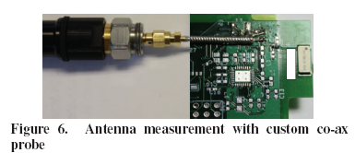
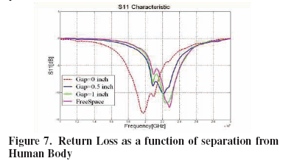
4. Sampling and Wireless Communication(4.3 Antenna Optimization for Body Sensors)
Mismatch Loss(ML) happens… when the input impedance of the radio is not matched to the output impedance of the transceiver
To perform return loss measurements…

Slide 26
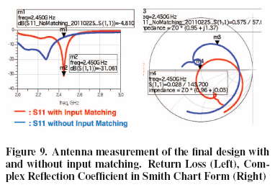
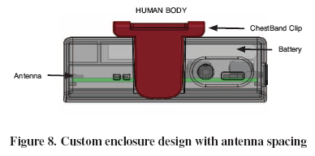
4. Sampling and Wireless Communication(4.3 Antenna Optimization for Body Sensors)
Without a proper tuning circuit : return loss -4.8dB, leading to 33.1% loss of transmission power. Since the loss occurs both on the transmit and receive ends, it leads to -3.5dB power loss, resulting in 35% decrease in communication range
When customized, power loss only -0.1dB

Slide 27
4. Sampling and Wireless Communication(4.4 Using Empirical Study for Frequency Channel Selection)
802.11, Bluetooth, 802.15.4 share the same 2.4GHz ISM band -> channels should be carefully selected to avoid interference from higher power 802.11 radio
The journey to find usable channels…
-For each 802.11-nRF24AP2 channel pair, they recorded packet reception performance using 1000 packets under 2 scenarios :
Background traffic to and from the access point encountered in a typical campus environment
Sustained data transfer to the laptop of a large file through FTP

Slide 28
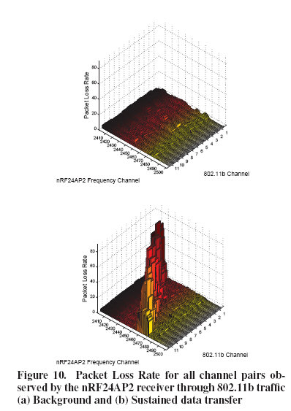
4. Sampling and Wireless Communication(4.4 Using Empirical Study for Frequency Channel Selection)
Results : Under heavy traffic, as high as 80% packet loss rate. But for the channels outside the 802.11 band, average loss of 0.57%
->Found 45 channels where the loss rate is quite low

Slide 29
4. Sampling and Wireless Communication(4.5 Optimizing Sampling and Communication)
AutoSense support 2 modes of sampling and processing :
Streaming mode
Feature mode

Slide 30
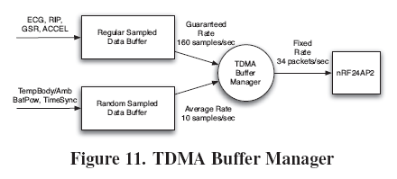
4. Sampling and Wireless Communication{4.5 Optimizing Sampling and Communication(4.5.1 Streaming Mode)}
AutoSense has a sampling rate of 132 samples/s
Uses customized TDMA(Time Division Multiple Access)
-The buffer manager fills the output buffer from the regular sampled data buffer. Otherwise, fills the empty space from random sampled data buffer
-> A simple scheme that provides all the available time slots with valid data, also allows asynchronous independent operation

Slide 31
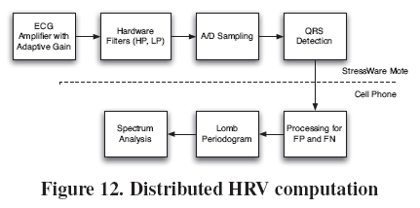
4. Sampling and Wireless Communication{4.5 Optimizing Sampling and Communication(4.5.2 Feature Mode)}
Energy consumption can be further reduced if additional computation is performed locally on the mote
AutoSense provides a distributed computation method for computing Heart Rate Variability(HRV) measures between the AutoSense Mote and a mobile computing platform
-> Increases resolution while reducing required communication drastically

Slide 32
4. Sampling and Wireless Communication(4.6 Identifying Samples Lost in ANT Wireless Transmission)
Payload of 8 Bytes -> small, but does not include sequence numbers(used to identify which samples were lost in the wireless transmission)
AutoSense chooses a fixed sampling and transmission schedule in order to acknowledge when the samples were lost and which sensors’ it corresponds to.

Slide 33
5. FieldStream : A Software Framework on Smart Phones
FieldStream : A S/W framework that collects sensor measurements, processes these measurements to produce inferences about the user, and then shares these measurements and inferences to external applications.

Slide 34
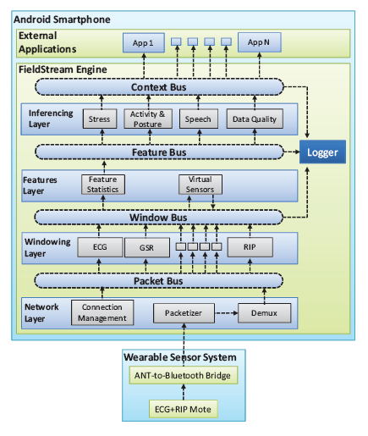
5. FieldStream : A Software Framework on Smart Phones(5.1 Architecture)
Sends contexts into external apps
Inferences are computed
Computes statistics
Of the windows
Buffers sensor data into ‘windows’
Identify which sensor it corresponds to
Transports raw
Byte stream

Slide 35
5. FieldStream : A Software Framework on Smart Phones(5.2 Data Quality Monitoring)
FieldStream includes a module that detects common situations that lead to lower quality data->When detected, the mobile phone informs the user to take action
E.g. Wearing AutoSense for a long time may cause it to loosen from the body. This loosening results in lower quality data, so FieldStream informs the user.

Slide 36
5. FieldStream : A Software Framework on Smart Phones(5.3 Handling Data Losses)
AutoSense detects lost packets(as described in 4.6) and inserts null packets in the data stream to replace them
When valid data is >=66% : Send data
When valid data is <66% : Discard process to prevent further process consumption

Slide 37
6. Real-Life Deployment Experience
Goal of the study : Capture physiological response to stress in the lab and in the field so that reliable models for inferring stress from physiological measurements could be developed.
-> subjects have been experimented and are being experimented.

Slide 38
6. Real-Life Deployment Experience(6.1 Accomplishing User Study Goals)
AutoSense is a reliable tool for capturing sensor data(ECG, respiration..) in natural environments.
FieldStream provides a mechanism to capture self-reports in the natural environment and synchronize them with the signals captured by AutoSense

Slide 39
6. Real-Life Deployment Experience(6.2 Evaluation of Usability and Comfort)
Administered a survey at the end of the first and second field study days.
-4 point scale(0=Strongly Disagree, 1=Disagree, 2=Agree, 3=Strongly Agree)
-Participants felt that
Chestband was easy to use (2.06±0.3)
It was not a nuisance (1.8±0.6)
Did not interfere significantly with daily activities (1.6±0.6) or social interactions (2.0±0.6)
Not self-conscious in public (1.8±0.7)
Did not cause physical discomfort (1.7±0.7)
*(Mean±SD)

Slide 40
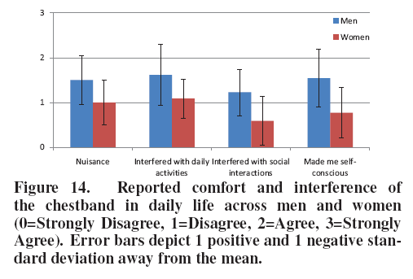
6. Real-Life Deployment Experience(6.2 Evaluation of Usability and Comfort)
Men vs Women
Compared to women, men indicated the chestband was more of a nuisance, less socially acceptable and interfered more with daily life.
->Probably because…

Slide 41
6. Real-Life Deployment Experience(6.3 Additional Ongoing Real-Life Usage of AutoSense and Fieldstream)
Growing demand for use in additional studies of stress
Since April 2011, over 40 people have used.
In Fall, 2011, another 30 participants will be using…
So on and so forth

Slide 42
7. Related Works(7.1 Physiological Sensor Suite)
Compared to CodeBlue, BSN, Berkeley Tricorder, SHIMMER
->AutoSense is not cumbersome to wear, has 10 days of lifetime while continuously sampling and transmitting all six sensors, tolerant to proximity to human body and tolerant to crowding scenarios.

Slide 43
7. Related Works(7.2 Mobile Phone Platforms)
Compared to MyExperience or JigSaw framework…
FieldStream is…
Capable of more sophisticated inferencing
Uses hierarchical buses to share data and computation among system entities(see 5.1)
Capable of collecting and processing data from external wireless sensors
Detects sensor detachments and provides information to the user
The one and only mobile sensing framework that has been evaluated in real-life scientific field studies

Slide 44
7. Related Works(7.3 Usage of AutoSense and FieldStream Platforms)
Used to collect reliable data from natural environment for various user studies
Envision to be used to monitor various physical, mental and behavioral health issues and to administer timely interventions in the natural environment of individuals

Slide 45
8. Conclusion and Future Work
AutoSense provides low-power sensors that can be worn unobtrusively in the natural environment of subjects to enable collection of physiological measurements associated with stress response.
AutoSens will provide measurement of stress and various behaviors that may be related to stress such as drinking, smoking, physical activity, movement patterns, conversations etc.

