Slide 1


Enabling Reliable, Asynchronous, and Bidirectional Communication in Sensor Networks over White Spaces
Abusayeed Saifullah†, Mahbubur Rahman†, Dali Ismail†
Chenyang Lu‡, Jie Liu⁂, Ranveer Chandra⁂
†Wayne State University, ‡Washington University, ⁂Microsoft Research
Presented by Yongseok Jeon

Slide 2

Introduction
Wireless Sensor Network (WSN)
  Network of sensors that deliver their data to a base station
  Characteristics of WSN
    Large number of nodes
    Battery powered
    Small packet
    Low data rate, power and cost
Figure 1. Wireless sensor network

Slide 3
Introduction
WSN in large-scale and wide-area applications often needs to connect thousands of sensors over long distances
  Ex. Urban sensing, civil infrastructure monitoring, oil field management, etc.
Existing WSN technologies has short communications
  IEEE 802.15.4 (30-40 m)
  IEEE 802.11 (140 m [802.11b])
  Bluetooth (10-10 m)
  Multi-hop approach?!

Slide 4
Introduction
Sensor Network Over White Spaces (SNOW)
  White spaces
    The allocated but locally unused TV spectra
    UHF (470~689 MHz in South Korea)
    Long transmission range
    Obstacle penetration
    It can be used by unlicensed devices in many countries
  Exploiting white spaces for sensor networking is the goal
  of the on-going IEEE 802.15.4m standardization effort

Slide 5
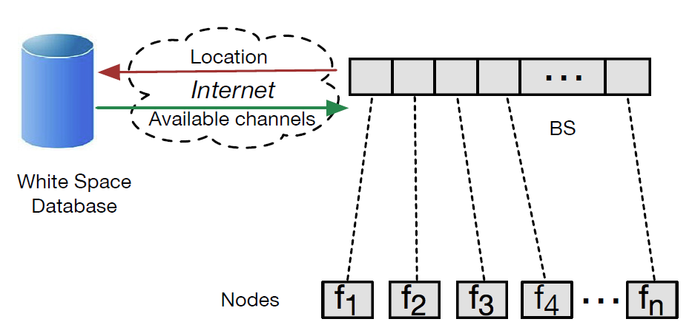
Introduction
SNOW 1.0
  The first design of SNOW proposed by authors (SenSys’ 16)
  Design based on D-OFDM (distributed implementation of OFDM)
    Allow its base station to receive multiple packets in parallel
  It uses wide white space spectrum which is split into narrow band orthogonal subcarriers
  Each sensor node is assigned a subcarrier on which it transmits
Figure 2. The architecture of SNOW 1.0

Slide 6
Introduction
SNOW 1.0 has several important limitations
  Bi-directional communication over different subcarriers
  Concurrently transmit different packets to different nodes
  Support of per-transmission acknowledgement (reliability problem)
  Support of fully asynchronous operation (TDMA)
  Modulation scheme (ASK)

Slide 7
Introduction
SNOW 1.0 has several important limitations
  Bi-directional communication over different subcarriers
  Concurrently transmit different packets to different nodes
  Support of per-transmission acknowledgement (reliability problem)
  Support of fully asynchronous operation (TDMA)
  Modulation scheme (ASK)

Slide 8
Introduction
SNOW 2.0
  Highly scalable, low power, and long range WSN over TV white spaces
    Fully asynchronous
    Enables reliable massive parallel and asynchronous reception with a single antenna-radio
    Multiple concurrent data transmissions with a single antenna-radio
  PHY design with implementing D-OFDM for multiple access in both directions
  Reliable, light-weight MAC protocol

Slide 9
System Model
WSNs are characterized by small packets, low data rate, low power
The nodes are typically battery powered
→ Scalability and energy-efficiency are the key concerns in WSN

Slide 10
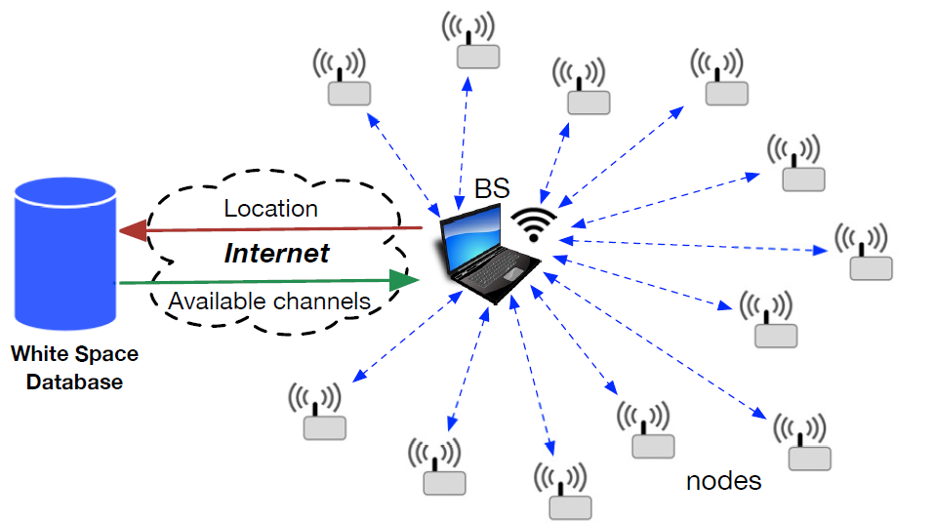
System Model
Each node is equipped with a single half-duplex
narrow-band radio operating in the white space spectrum
The BS uses a wide channel split into subcarriers, each of equal spectrum width (bandwidth)
The nodes do not do spectrum sensing or cloud access
The BS determines white spaces by accessing a
cloud-hosted databased through Internet
The BS knows the locations of the nodes
  Localization is out of scope of this paper
For integrity check, the senders add CRC at the end of each packet
Figure 3. The network structure of SNOW

Slide 11
Physical Layer Design
Three key design goals
  To allow the BS to receive concurrent and asynchronous transmissions from multiple nodes using a single antenna-radio
  To allow the BS to send different packets to multiple nodes concurrently using a single antenna-radio
  Support robust modulation such as BPSK

Slide 12
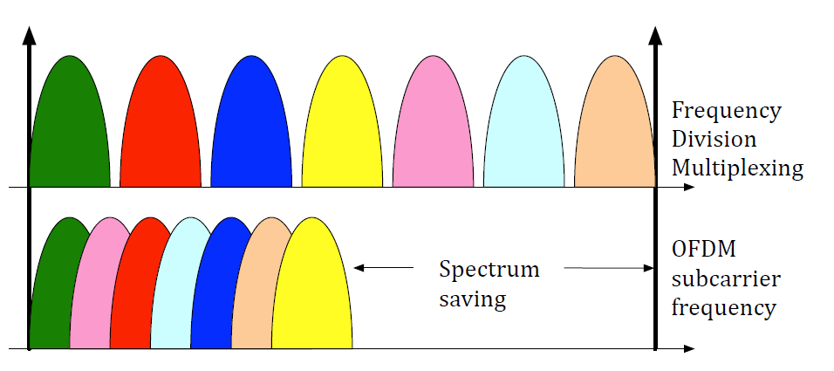
Physical Layer Design
D-OFDM
  For scalability and energy efficiency, it design the PHY based on D-OFDM
  OFDM
    Frequency-division multiplexing scheme that uses a large number of closely spaced orthogonal subcarrier signals to carry data on multiple parallel data stream between a sender and a receiver
  Distributed implementation of OFDM for multi-user access
  It enables multiple receptions using a single antenna and also enables different data transmissions to different nodes using single antenna
Figure 4. Typical frequency-division multiplexing vs OFDM

Slide 13
Physical Layer Design
In SNOW, the BS’s wide white space spectrum is split into narrowband
orthogonal subcarriers
It adopt D-OFDM by assigning the orthogonal subcarriers to different nodes
Each node transmits and receives on the assigned subcarrier
  Each subcarrier is modulated using BPSK
  Minor modification QPSK is also adoptable
Figure 4. Typical frequency-division multiplexing vs OFDM

Slide 14
Physical Layer Design
Upward communication (node → BS)
  The nodes can transmit on their respective subcarriers whenever they want without coordinating among themselves
  How BS enable parallel receptions at a single radio?
    It adopt Fast Fourier Transformation (FFT) to extract information from all subcarriers
    Run FFT on the entire range of the spectrum of the BS (Global FFT Algorithm),
    instead of running a separate FFT for each subcarrier
  To receive asynchronous transmissions, the BS keeps running the G-FFT algorithm
    The G-FFT is performed at every cycle of the baseband signal

Slide 15
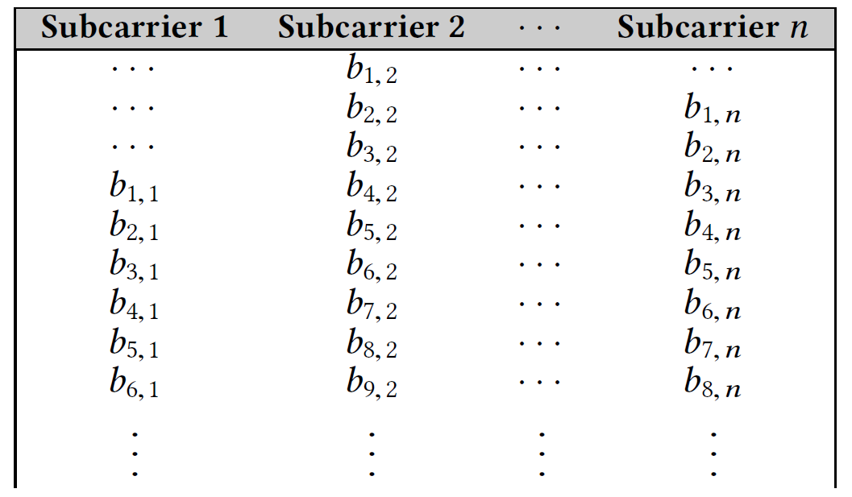

Physical Layer Design
Upward communication (node → BS) (cont’d)
  Any node can transmit any time without any synchronization
  The correct decoding of all packets is handled by maintaining a 2D matrix
    Where each column represents a subcarrier or its center frequency bin
$b_{i,j}$: $i$-th bit of $j$-th subcarrier
Figure 5. 2D matrix for decoding in upward communication

Slide 16
Physical Layer Design
Downward communication (BS → node)
  The BS should encode different data on the different subcarrier
  Node’s data will be encoded on the associated subcarrier
  The BS makes single transmission and all nodes decode data from their respective subcarrier
  This communication goal is challenging due to asymmetric bandwidth between Tx and Rx
    The BS uses entire channel
    Each node uses only one subcarrier

Slide 17
Physical Layer Design
Downward communication (BS → node) (cont’d)
  The main design technique lies in the encoding part at the BS
  Inverse FFT (IFFT)
    Encodes different data on different subcarrier
  IFFT is performed after encoding data on the subcarriers
  The transmission is made after IFFT
  A node listens to its subcarrier center frequency and receives only the signal component
  in its subcarrier frequency

Slide 18
Physical Layer Design
Fragmented spectrum
  White space spectrum may be found fragmented
    Ex. SNOW needs 2 channel but available channels are Ch. 13 and Ch. 15
  The G-FFT and IFFT algorithms will be run on the entire spectrum that include all fragments
    Ex. Run algorithms on Ch. 13 ~ Ch. 15
  The occupied spectrum will not be assigned to any node
  The corresponding bins will be ignored in decoding and encoding in G-FFT and IFFT, respectively

Slide 19
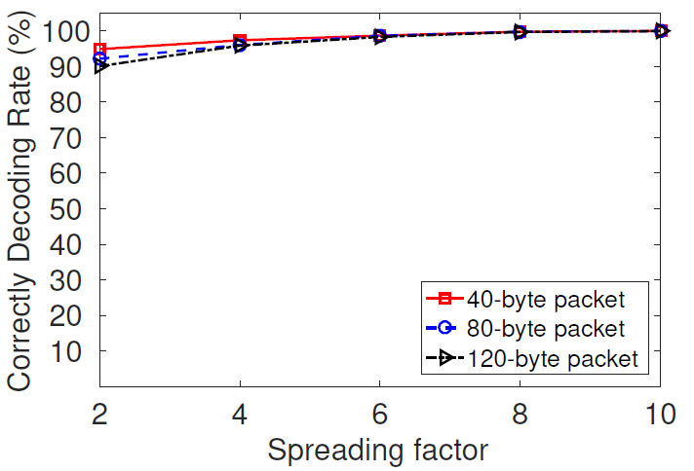
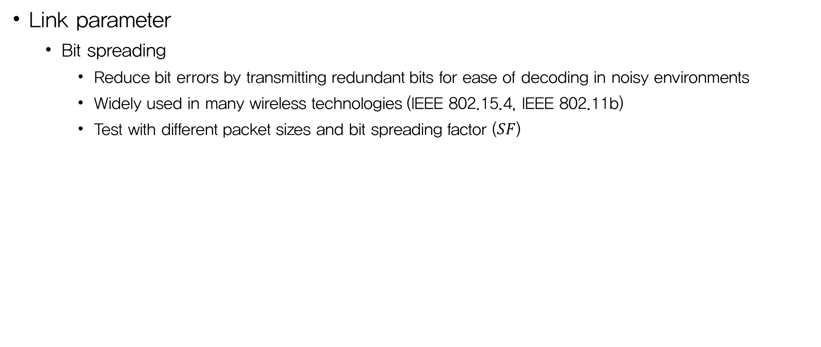
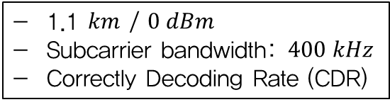
Physical Layer Design
Link parameter
  Bit spreading
    Reduce bit errors by transmitting redundant bits for ease of decoding in noisy environments
    Widely used in many wireless technologies (IEEE 802.15.4, IEEE 802.11b)
    Test with different packet sizes and bit spreading factor ($SF$)
1.1 $km$ / $0 dBm$
Subcarrier bandwidth: $400 kHz$
Correctly Decoding Rate (CDR)
Receiver can always decode over 90% of the packets
Figure 6. CDR under varying SF and packet size

Slide 20
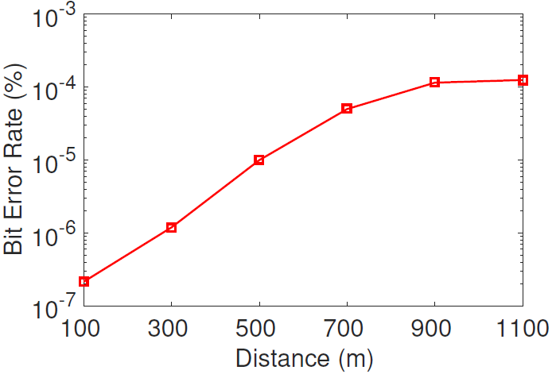
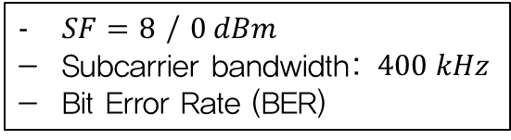
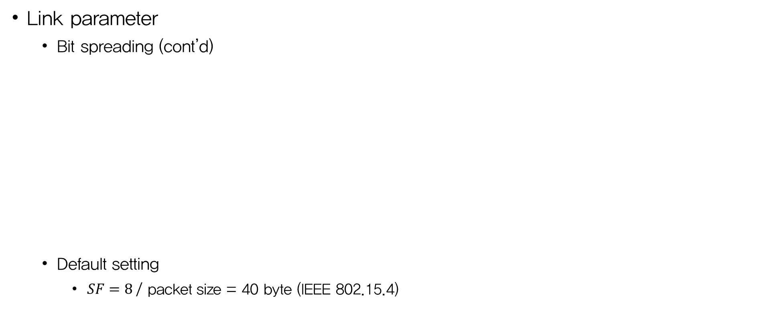

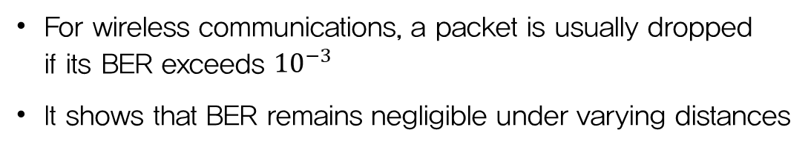
Physical Layer Design
Link parameter
  Bit spreading (cont’d)
  Default setting
    $SF=8$/ packet size = 40 byte (IEEE 802.15.4)
$SF=8$ / $0 dBm$
Subcarrier bandwidth: $400 kHz$
Bit Error Rate (BER)
For wireless communications, a packet is usually dropped
if its BER exceeds ${10}^{−3}$
It shows that BER remains negligible under varying distances
Figure 7. BER over distances when $SF=8$

Slide 21
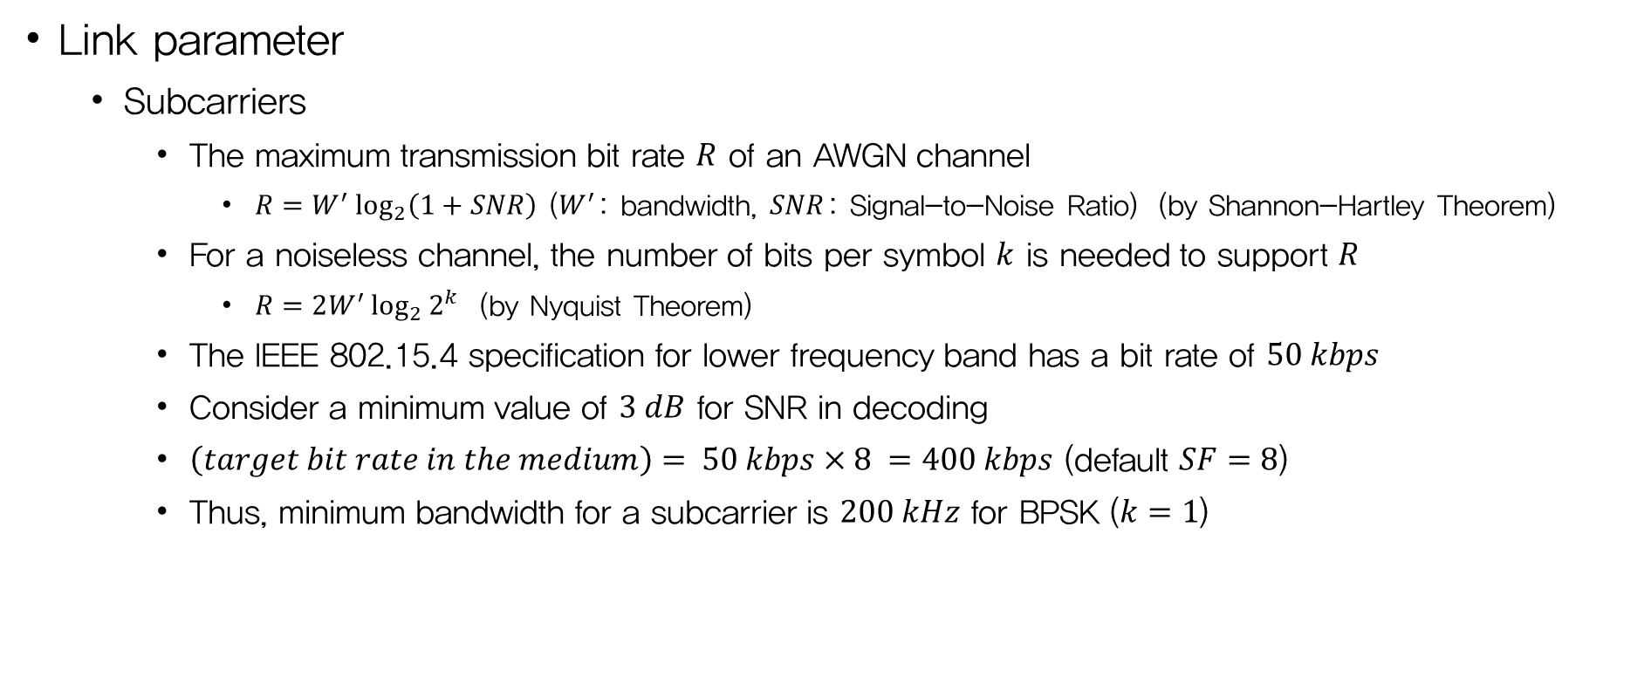
Physical Layer Design
Link parameter
  Subcarriers
    The maximum transmission bit rate $R$ of an AWGN channel
      $R=W^{′}\log_{2}\left(1+SNR\right)$ ($W^{′}$: bandwidth, $SNR$: Signal-to-Noise Ratio) (by Shannon-Hartley Theorem)
    For a noiseless channel, the number of bits per symbol $k$ is needed to support $R$
      $R=2W^{′}\log_{2}{2^{k}}$ (by Nyquist Theorem)
    The IEEE 802.15.4 specification for lower frequency band has a bit rate of $50 kbps$
    Consider a minimum value of $3 dB$ for SNR in decoding
    $\left(target bit rate in the medium\right)= 50 kbps×8 =400 kbps$ (default $SF=8$)
    Thus, minimum bandwidth for a subcarrier is $200 kHz$ for BPSK ($k=1$)

Slide 22
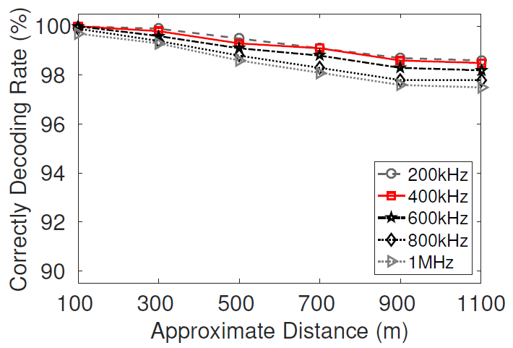
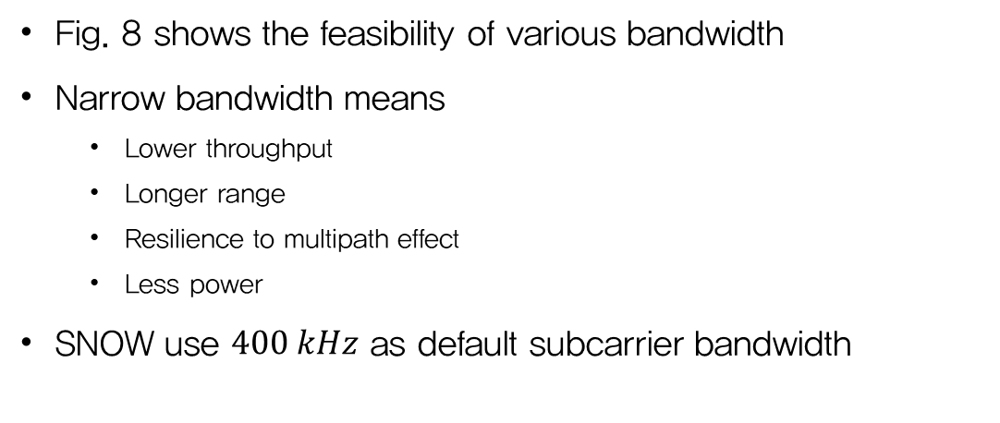
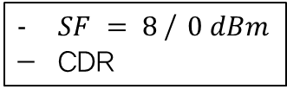
Physical Layer Design
Link parameter
  Subcarriers (cont’d)
$SF = 8$/ $0 dBm$
CDR
Fig. 8 shows the feasibility of various bandwidth
Narrow bandwidth means
  Lower throughput
  Longer range
  Resilience to multipath effect
  Less power
SNOW use $400 kHz$ as default subcarrier bandwidth
Figure 8. Reliability over distance

Slide 23
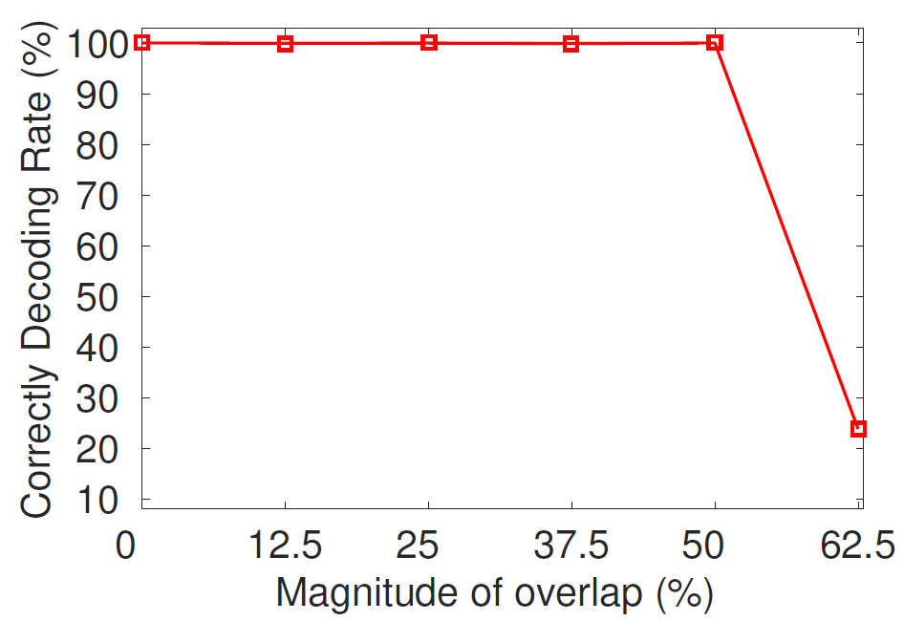
Physical Layer Design
Link parameter
  Subcarriers (cont’d)
$SF = 8$/ $0 dBm$
CDR
Figure 9. Magnitude of overlap between subcarriers
Fig. 8 shows the feasibility of various bandwidth
Narrow bandwidth means
  Lower throughput
  Longer range
  Resilience to multipath effect
  Less power
SNOW use $400 kHz$ as default subcarrier bandwidth
Figure 8. Reliability over distance

Slide 24
Physical Layer Design
Three key design goals
  To allow the BS to receive concurrent and asynchronous transmissions from multiple nodes using a single antenna-radio (Upward communication)
  To allow the BS to send different packets to multiple nodes concurrently using a single antenna-radio (Downward communication)
  Support robust modulation such as BPSK (Link parameters)

Slide 25
MAC Protocol
Develop a low overhead MAC protocol for operating the nodes with
  Greater freedom
  Low power
  Reliability
Implementing ACK for every transmission of each node
SNOW’s MAC protocol utilize
  Single half-duplex radio at each node
  Two half-duplex radio at the BS

Slide 26
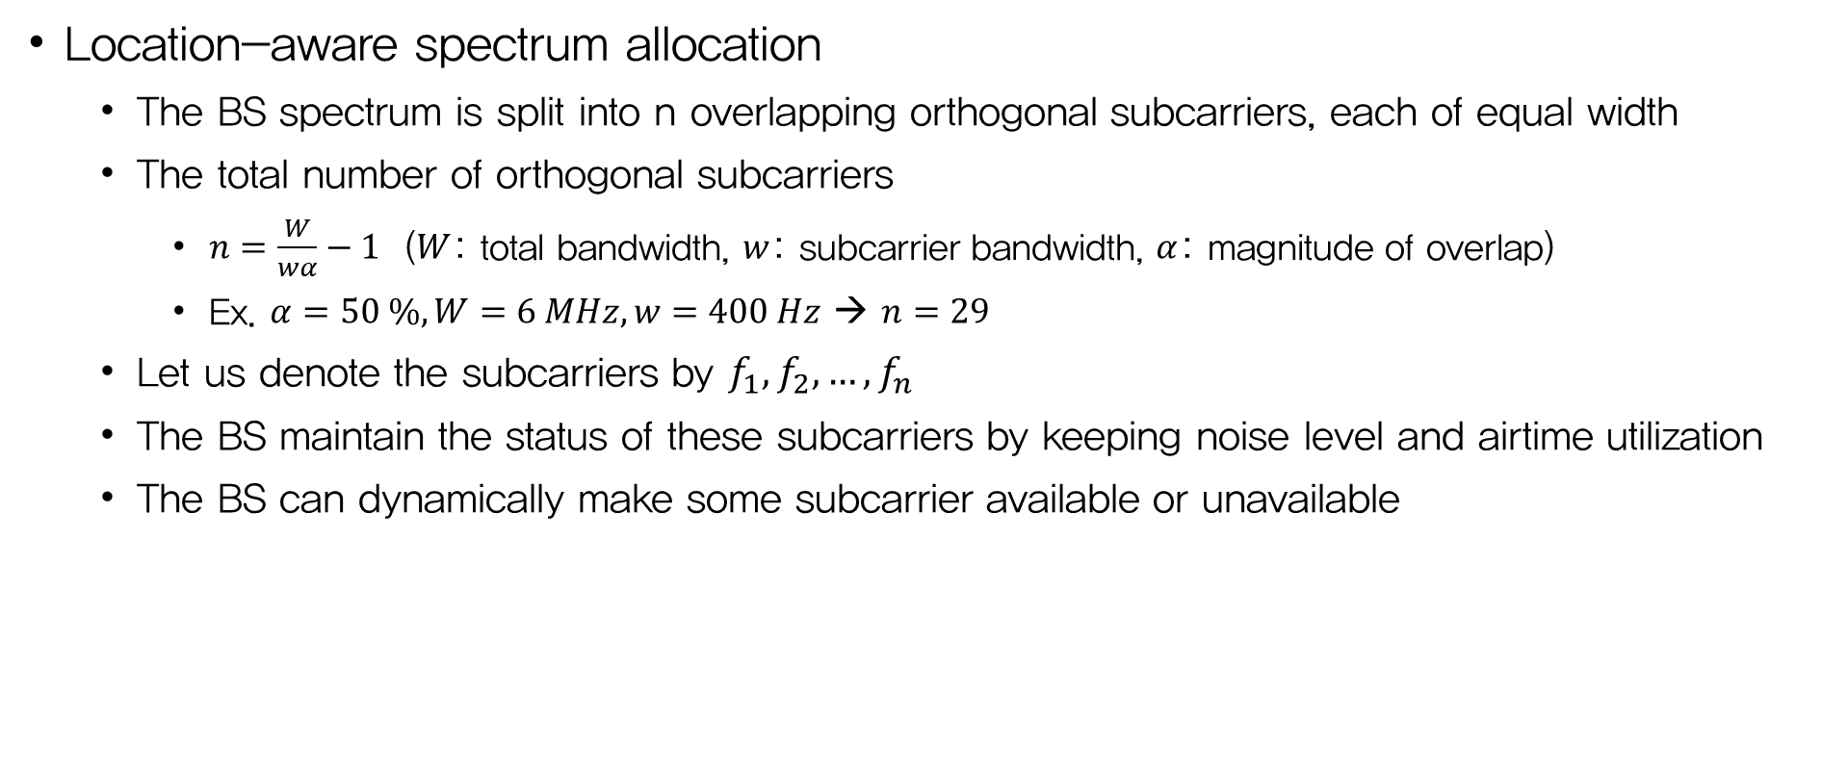
MAC Protocol
Location-aware spectrum allocation
  The BS spectrum is split into n overlapping orthogonal subcarriers, each of equal width
  The total number of orthogonal subcarriers
    $n=\frac{W}{wα}−1$ ($W$: total bandwidth, $w$: subcarrier bandwidth, $α$: magnitude of overlap)
    Ex. $α=50 \%, W=6 MHz, w=400 Hz$ → $n=29$
  Let us denote the subcarriers by $f_{1}, f_{2},…,f_{n}$
  The BS maintain the status of these subcarriers by keeping noise level and airtime utilization
  The BS can dynamically make some subcarrier available or unavailable

Slide 27
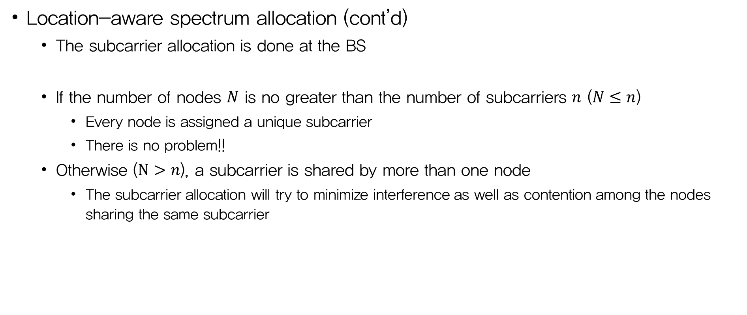
MAC Protocol
Location-aware spectrum allocation (cont’d)
  The subcarrier allocation is done at the BS
  If the number of nodes $N$ is no greater than the number of subcarriers $n$ ($N≤n$)
    Every node is assigned a unique subcarrier
    There is no problem!!
  Otherwise ($N>n$), a subcarrier is shared by more than one node
    The subcarrier allocation will try to minimize interference as well as contention among the nodes sharing the same subcarrier

Slide 28
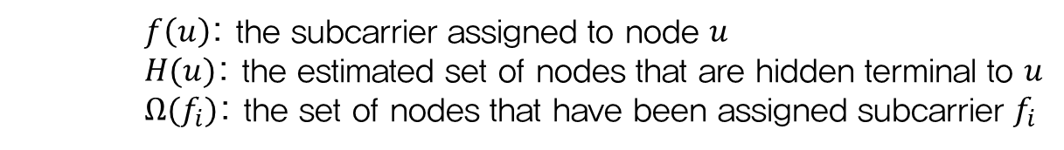
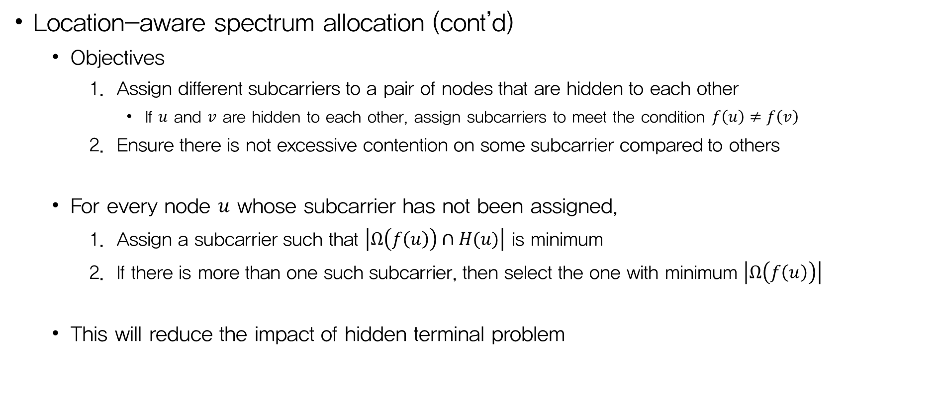
MAC Protocol
    $f\left(u\right)$: the subcarrier assigned to node $u$
    $H(u)$: the estimated set of nodes that are hidden terminal to $u$
    $Ω(f_{i})$: the set of nodes that have been assigned subcarrier $f_{i}$
Location-aware spectrum allocation (cont’d)
  Objectives
    Assign different subcarriers to a pair of nodes that are hidden to each other
      If $u$ and $v$ are hidden to each other, assign subcarriers to meet the condition $f\left(u\right)≠f\left(v\right)$
    Ensure there is not excessive contention on some subcarrier compared to others
  For every node $u$ whose subcarrier has not been assigned,
    Assign a subcarrier such that $\left|Ω\left(f\left(u\right)\right)∩H(u)\right|$ is minimum
    If there is more than one such subcarrier, then select the one with minimum $\left|Ω\left(f\left(u\right)\right)\right|$
  This will reduce the impact of hidden terminal problem

Slide 29
MAC Protocol
Transmission policy
  In SNOW, the nodes transmit to the BS using CSMA/CA approach
    More flexibility, decentralized management, energy efficient
    No time synchronization, time slot allocation, prescheduling
    The nodes will sleep by turning off the radios and will turn the radios on if they have data to send
    After sending the data, a node will go back to sleep again
  Adopt a simple CSMA/CA approach without any RTS/CTS frames
    When a node wakes up, it performs a random back-off in a fixed initial back-off window
    When the back-off timer expires, it runs CCA (Clear Channel Assessment)
      If the subcarrier is clear, it transmit the data
      If the subcarrier is occupied, then the node makes a random back-off in a fixed congestion back-off window
    The node then can go to sleep again

Slide 30
MAC Protocol
Transmission policy (cont’d)
  The BS station always remains awake to listen to nodes’ requests
  There can be messages from the BS such as management message
    Ex. Network management, subcarrier reallocation, control message, etc.
  Hence, SNOW adopt a periodic beacon approach for downward messages
    The BS can encode different data on different subcarriers, carrying different information on different subcarriers if needed

Slide 31
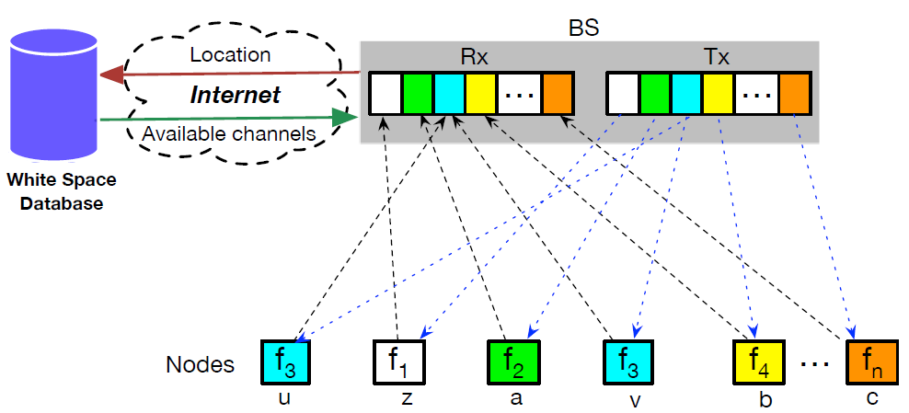
MAC Protocol
Reliability
  Sending ACK after every transmission is crucial for reliability but poses a number of challenges
    Tx/Rx switching overhead
    Tx subcarrier switching overhead
  Adopt a dual radio design at the BS
    One for only transmission, Tx radio
    The other for only reception, Rx radio
  Remain problems?
    Asynchronous ACK transmission
    Rx can be interfered by the ongoing Tx
    ACK on subcarrier can be interfered by other sharing node
Figure 10. SNOW architecture with dual radio BS & subcarriers

Slide 32
MAC Protocol
Partially handling hidden terminal
Peer-to-peer communication
Handling dynamics
  Spectrum dynamics
  Congestion control
  Node joining and leaving

Slide 33
MAC Protocol
Develop a low overhead MAC protocol for operating the nodes with
  Greater freedom
  Low power
  Reliability
Implementing ACK for every transmission of each node is extremely difficult
SNOW’s MAC protocol utilize
  Single half-duplex radio at each node
  Two half-duplex radio at the BS

Slide 34
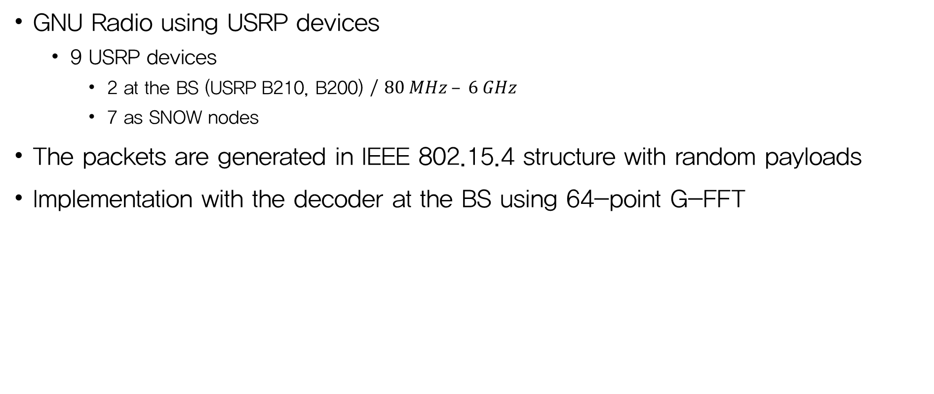
Implementation
GNU Radio using USRP devices
  9 USRP devices
    2 at the BS (USRP B210, B200) / $80 MHz – 6 GHz$
    7 as SNOW nodes
The packets are generated in IEEE 802.15.4 structure with random payloads
Implementation with the decoder at the BS using 64-point G-FFT

Slide 35
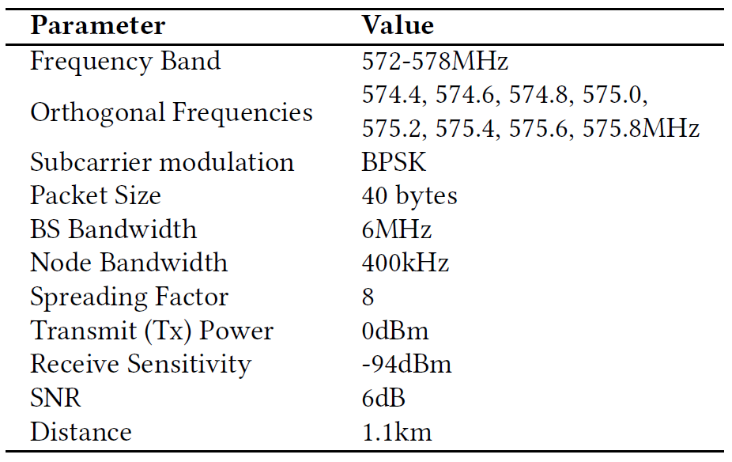
Experiments
Various environments
  Detroit (Michigan) metropolitan area
  Indoor environment
  Rural area of Rolla (Missouri)
Compare SNOW performance with existing similar technologies
Table 1. Default parameter settings

Slide 36
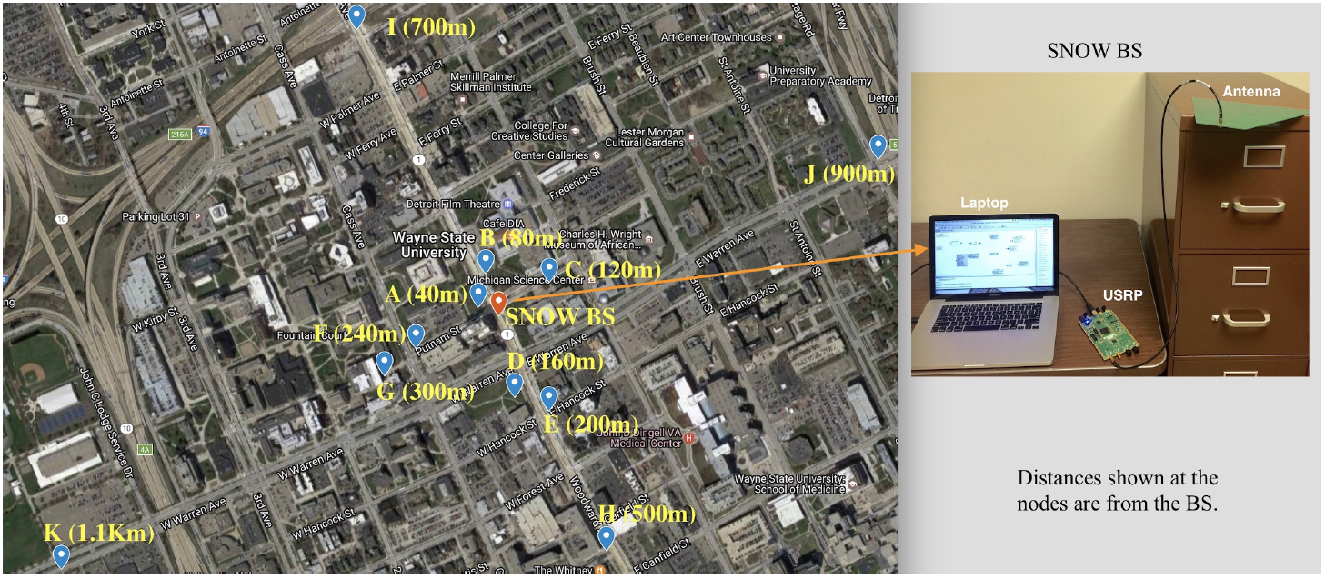
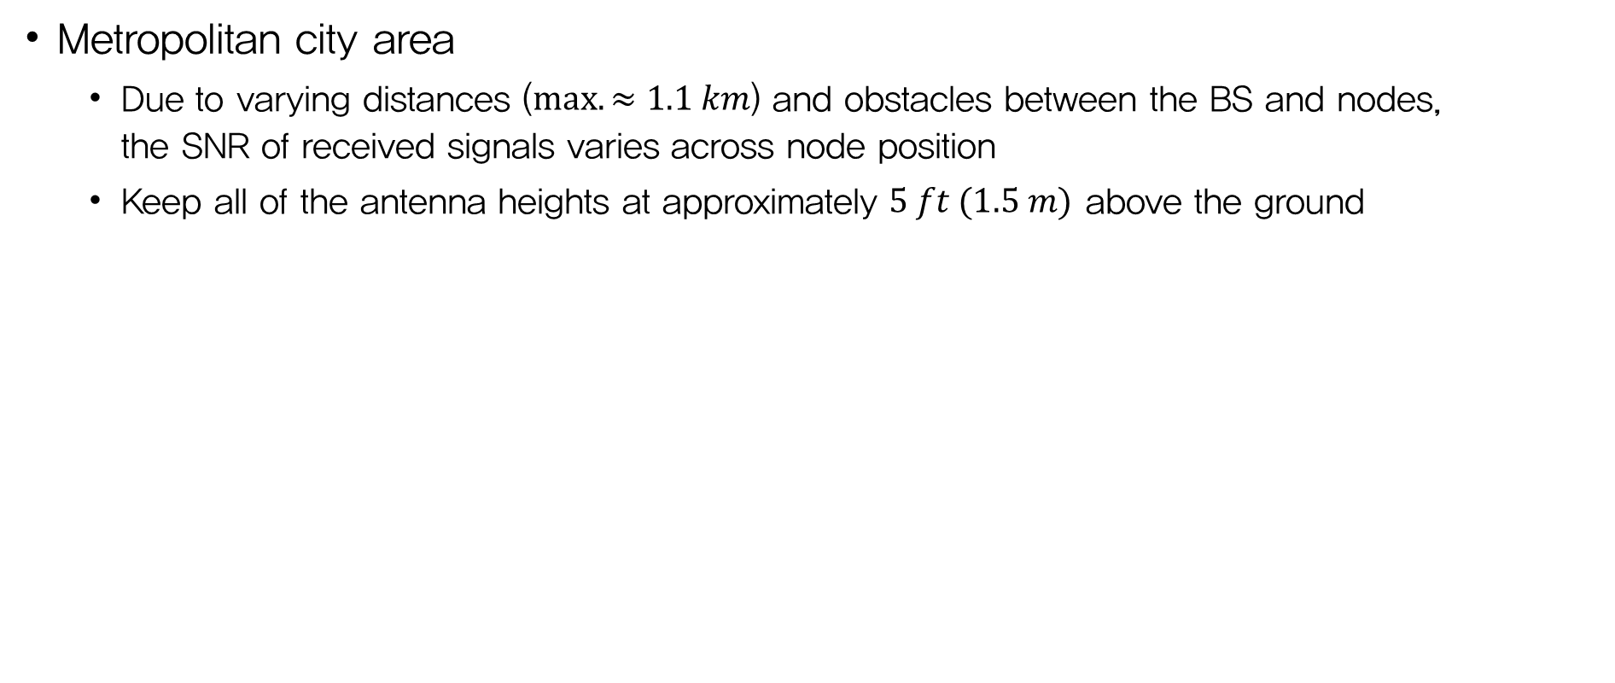
Experiments
Metropolitan city area
  Due to varying distances ($max. ≈1.1 km$) and obstacles between the BS and nodes,
  the SNR of received signals varies across node position
  Keep all of the antenna heights at approximately $5 ft (1.5 m)$ above the ground
Figure 11. Node positions in the Detroit metropolitan area

Slide 37
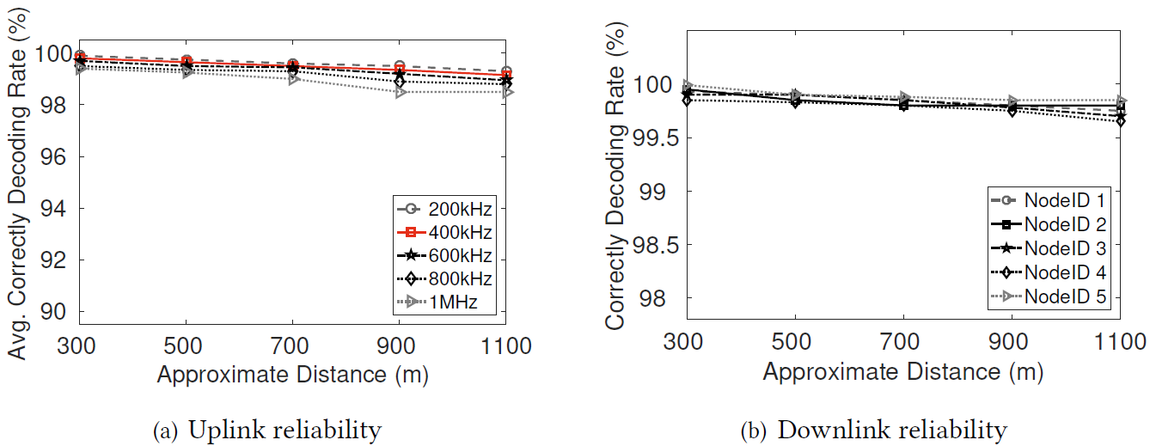
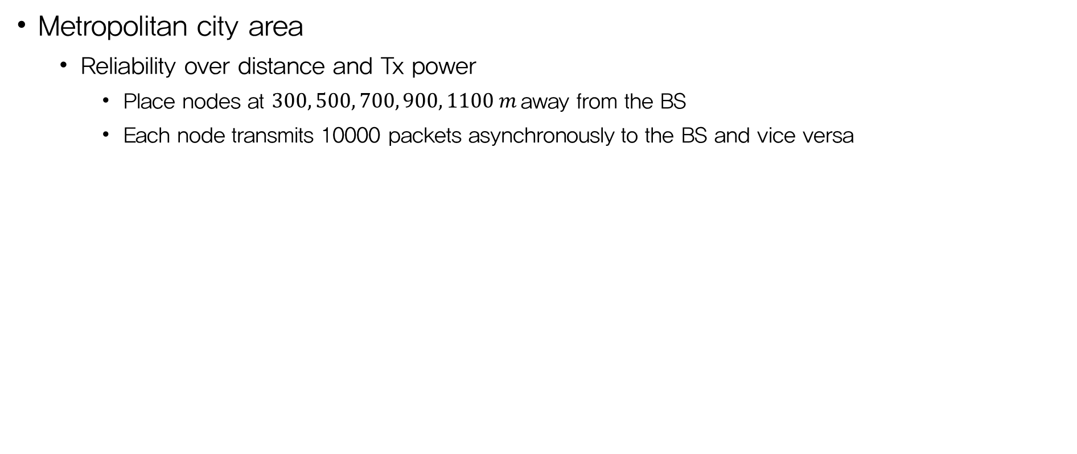
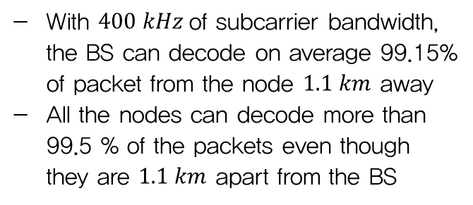
Experiments
Metropolitan city area
  Reliability over distance and Tx power
    Place nodes at $300, 500, 700, 900, 1100 m$away from the BS
    Each node transmits 10000 packets asynchronously to the BS and vice versa
With $400 kHz$of subcarrier bandwidth,
the BS can decode on average 99.15%
of packet from the node $1.1 km$ away
All the nodes can decode more than
99.5 % of the packets even though
they are $1.1 km$ apart from the BS
Figure 12. Reliability over distance

Slide 38
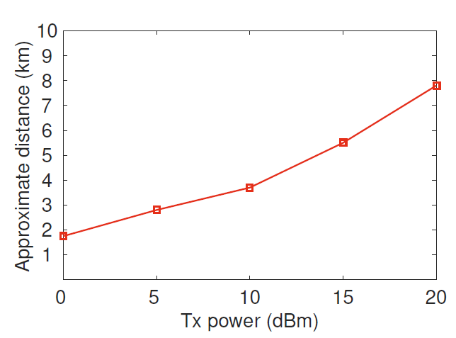
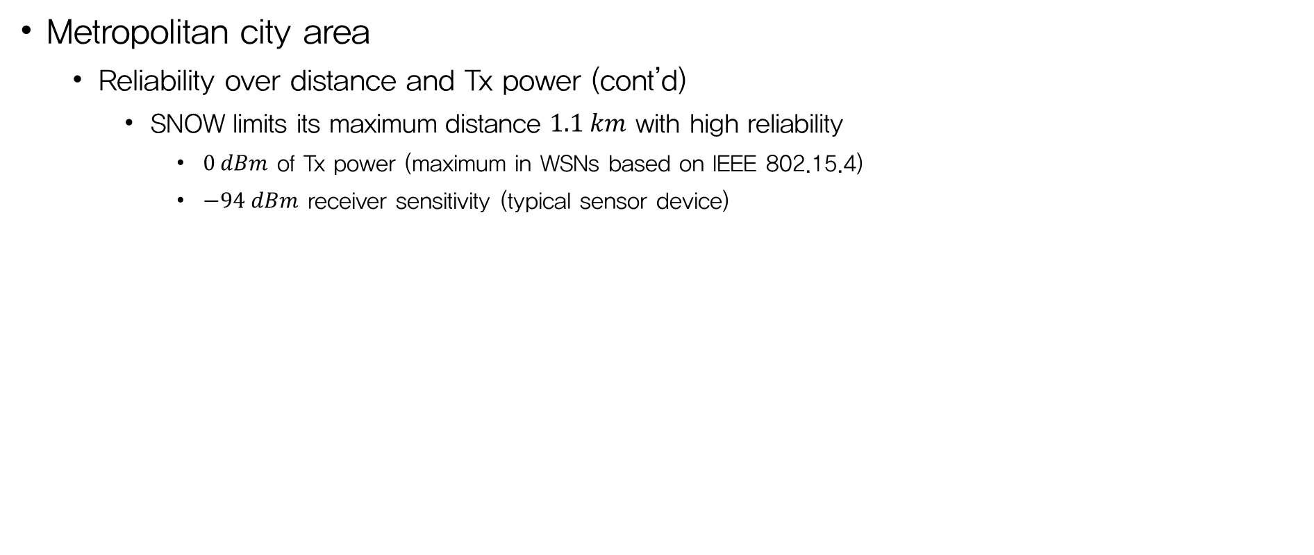
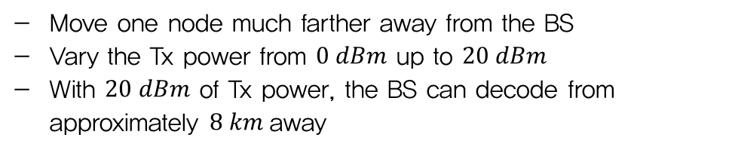
Experiments
Metropolitan city area
  Reliability over distance and Tx power (cont’d)
    SNOW limits its maximum distance $1.1 km$ with high reliability
      $0 dBm$ of Tx power (maximum in WSNs based on IEEE 802.15.4)
      $−94 dBm$ receiver sensitivity (typical sensor device)
Move one node much farther away from the BS
Vary the Tx power from $0 dBm$ up to $20 dBm$
With $20 dBm$ of Tx power, the BS can decode from
approximately $8 km$away
Figure 13. Distance with varying Tx powers

Slide 39
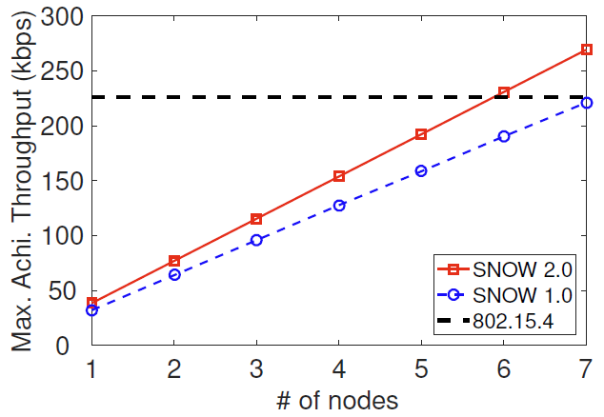
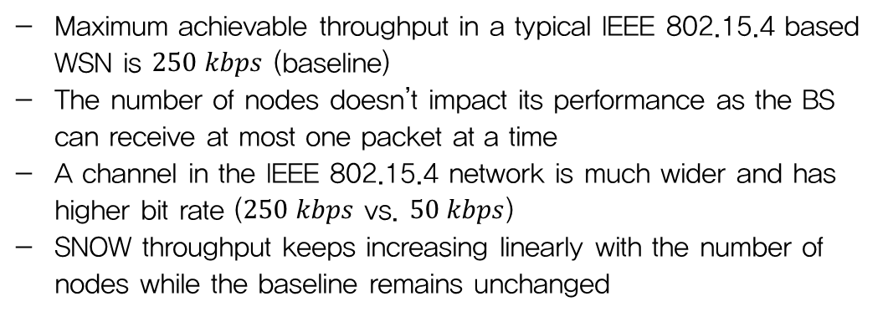
Experiments
Metropolitan city area
  Maximum achievable throughput
    Maximum total bits that the BS can receive per second
    Compare throughput between SNOW 1.0 and 2.0
Maximum achievable throughput in a typical IEEE 802.15.4 based WSN is $250 kbps$ (baseline)
The number of nodes doesn’t impact its performance as the BS can receive at most one packet at a time
A channel in the IEEE 802.15.4 network is much wider and has higher bit rate ($250 kbps$ vs. $50 kbps$)
SNOW throughput keeps increasing linearly with the number of nodes while the baseline remains unchanged
Figure 14. Maximum achievable throughput

Slide 40
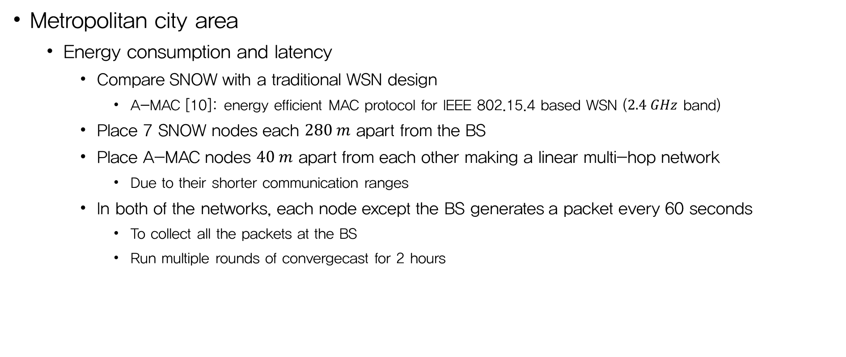
Experiments
Metropolitan city area
  Energy consumption and latency
    Compare SNOW with a traditional WSN design
      A-MAC [10]: energy efficient MAC protocol for IEEE 802.15.4 based WSN ($2.4 GHz$ band)
    Place 7 SNOW nodes each $280 m$ apart from the BS
    Place A-MAC nodes $40 m$ apart from each other making a linear multi-hop network
      Due to their shorter communication ranges
    In both of the networks, each node except the BS generates a packet every 60 seconds
      To collect all the packets at the BS
      Run multiple rounds of convergecast for 2 hours
[10] Prabal Dutta, Stephen Dawson-Haggerty, Yin Chen, Chieh-Jan Mike Liang, and Andreas Terzis. 2010. Design and evaluation of a versatile and efficient receiverinitiated link layer for low-power wireless. In SenSys ’10.

Slide 41
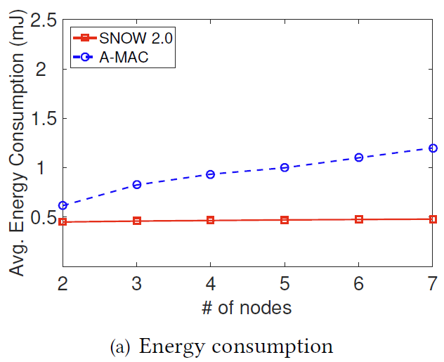
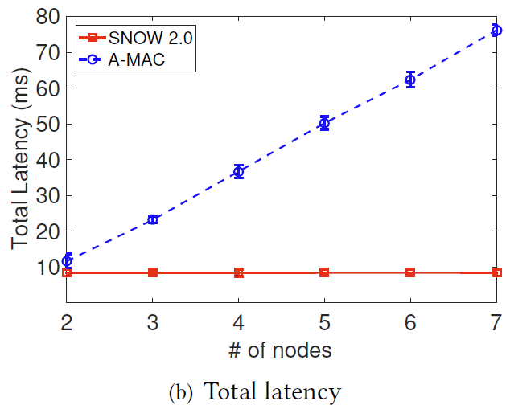
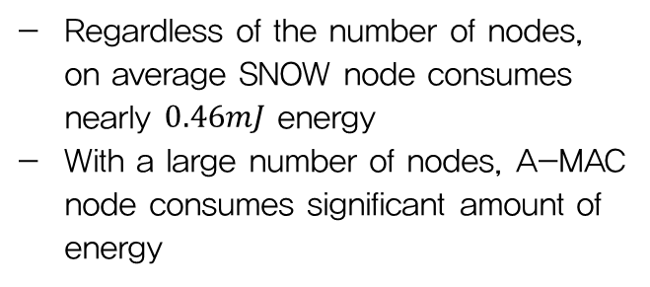
Experiments
Metropolitan city area
  Energy consumption and latency (cont’d)
Regardless of the number of nodes,
on average SNOW node consumes nearly $0.46mJ$ energy
With a large number of nodes, A-MAC
node consumes significant amount of energy
Figure 15. Energy consumption and latency in convergecast

Slide 42
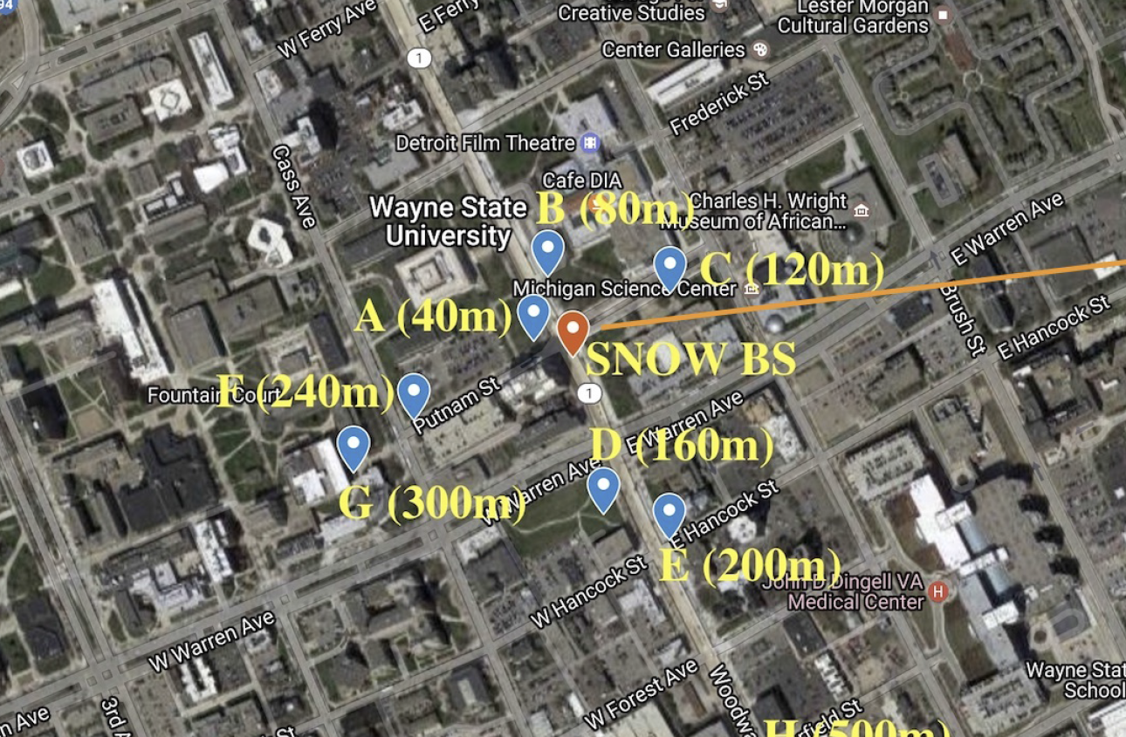
Experiments
Metropolitan city area
  Handling hidden terminal problem
Adjust the Tx powers of the nodes at the position shown in Fig. 16
1) A, B and C are hidden to D, E
2) D and E are not hidden to each other
3) A, B and C are not hidden to each other
Experiment 1
the hidden nodes are assigned the same subcarriers
Experiment 2
the BS assign different subcarriers to the nodes hidden to each other (reflect the SNOW MAC protocol)
Figure 16. Node positions for hidden terminal experiments

Slide 43
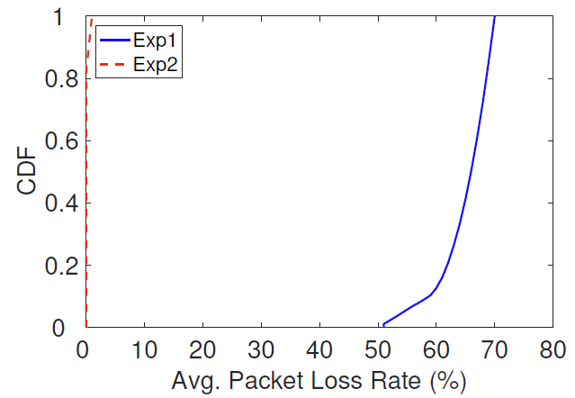
Experiments
Metropolitan city area
  Handling hidden terminal problem (cont’d)
Each node sends 100 packets to the BS
After getting the ACK for each packets, each node sleeps for a random time interval between 0-50 ms
After sending 100 packets, each node calculates its packet loss rate and average it
Exp1’s average packet loss rate is 65%
For SNOW MAC protocol (Exp2) it is 0.9%, which demonstrates the benefits of combining location-aware subcarrier allocation in SNOW MAC
Figure 17. Performance under hidden terminals

Slide 44
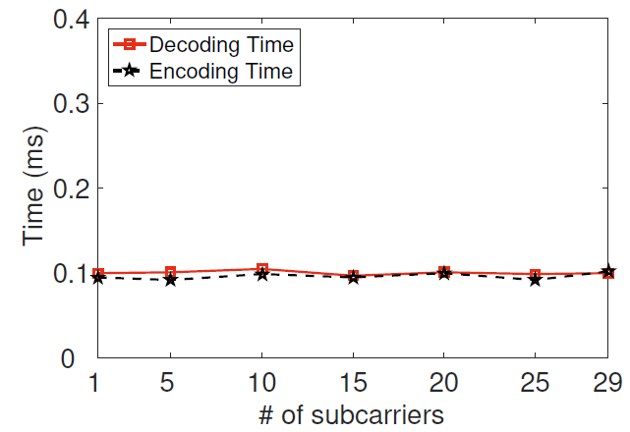
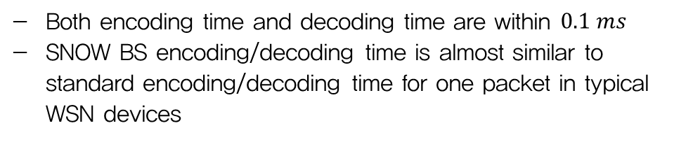
Experiments
Metropolitan city area
  BS encoding time and decoding time
    Theoretically, the encoding/decoding time for any number of nodes at the BS should be constant
    as the IFFT/G-FFT algorithm runs with the same number of bins every time
    Run each experiment for 10 minutes and record the time needed in the worst case
Both encoding time and decoding time are within $0.1 ms$
SNOW BS encoding/decoding time is almost similar to standard encoding/decoding time for one packet in typical WSN devices
Figure 18. Encoding and decoding time at BS

Slide 45
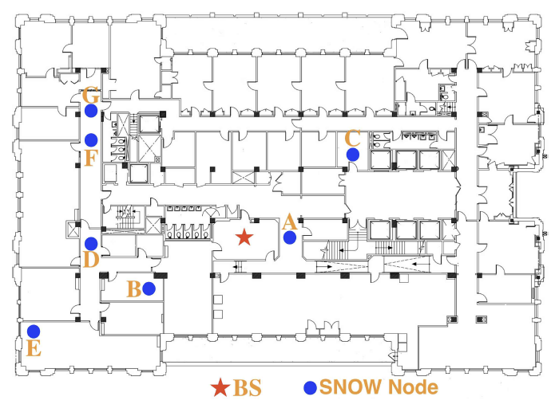
Experiments
Indoor deployment
  SNOW nodes and the BS are in the same floor
    Fixed BS (receiver)
    Various SNOW node
  A node transmits 10000 consecutive packets
  at each position
Figure 19. Indoor node positions

Slide 46
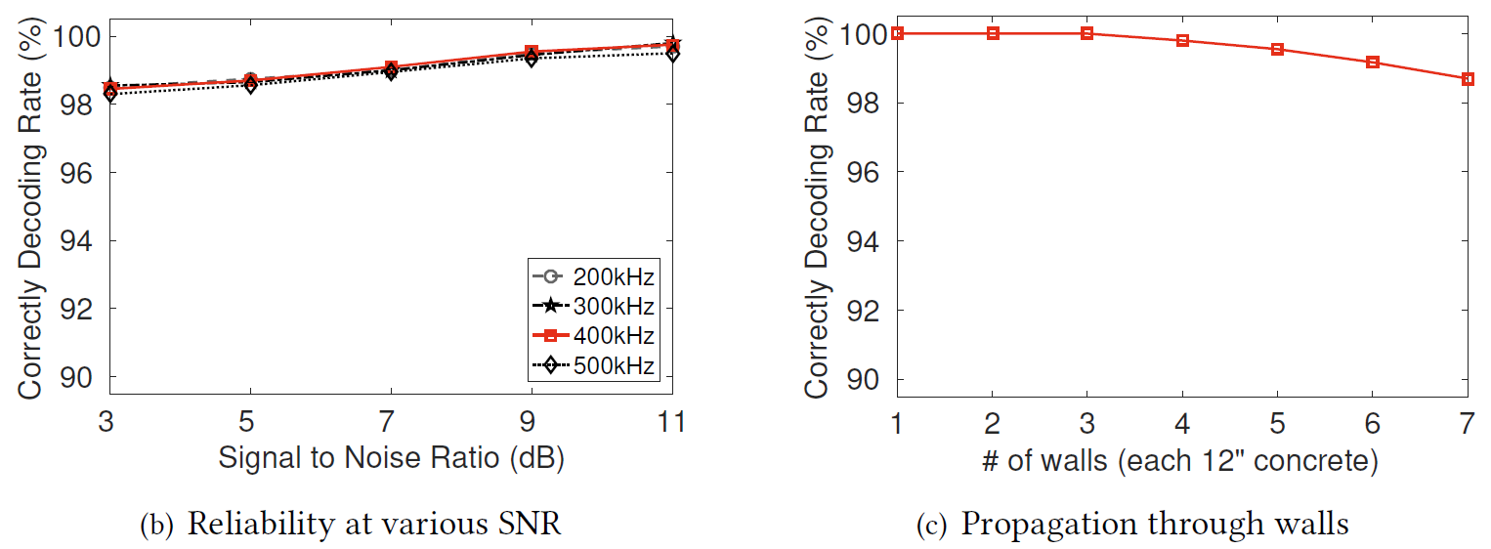
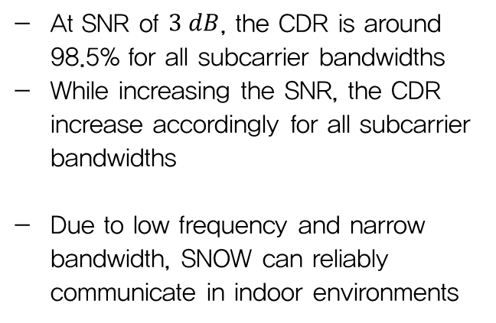
Experiments
Indoor deployment
  CDR over various SNR conditions under varying subcarrier bandwidths
  CDR under varying number of walls between sender and receiver
At SNR of $3 dB$, the CDR is around 98.5% for all subcarrier bandwidths
While increasing the SNR, the CDR increase accordingly for all subcarrier bandwidths
Due to low frequency and narrow bandwidth, SNOW can reliably communicate in indoor environments
Figure 20. Reliability in indoor environments

Slide 47
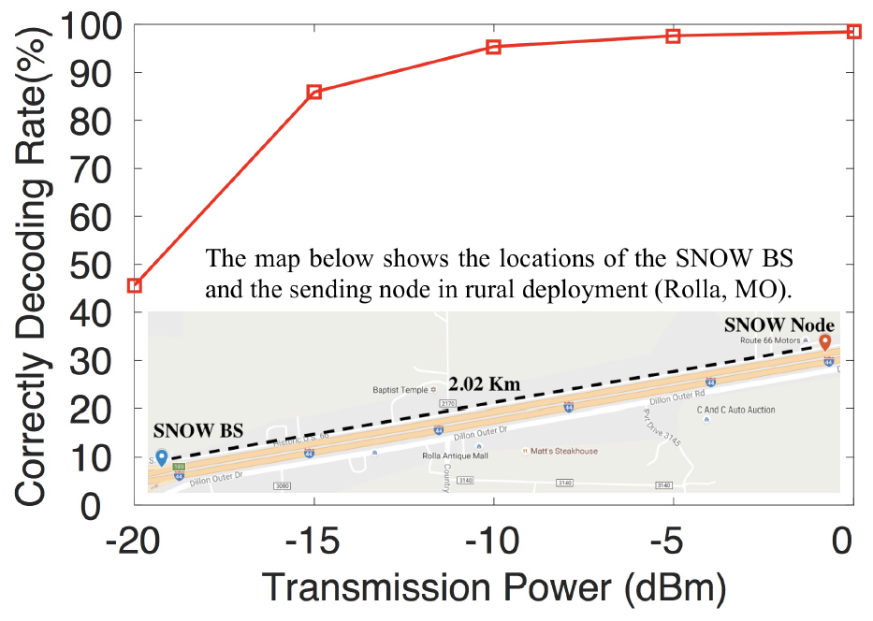
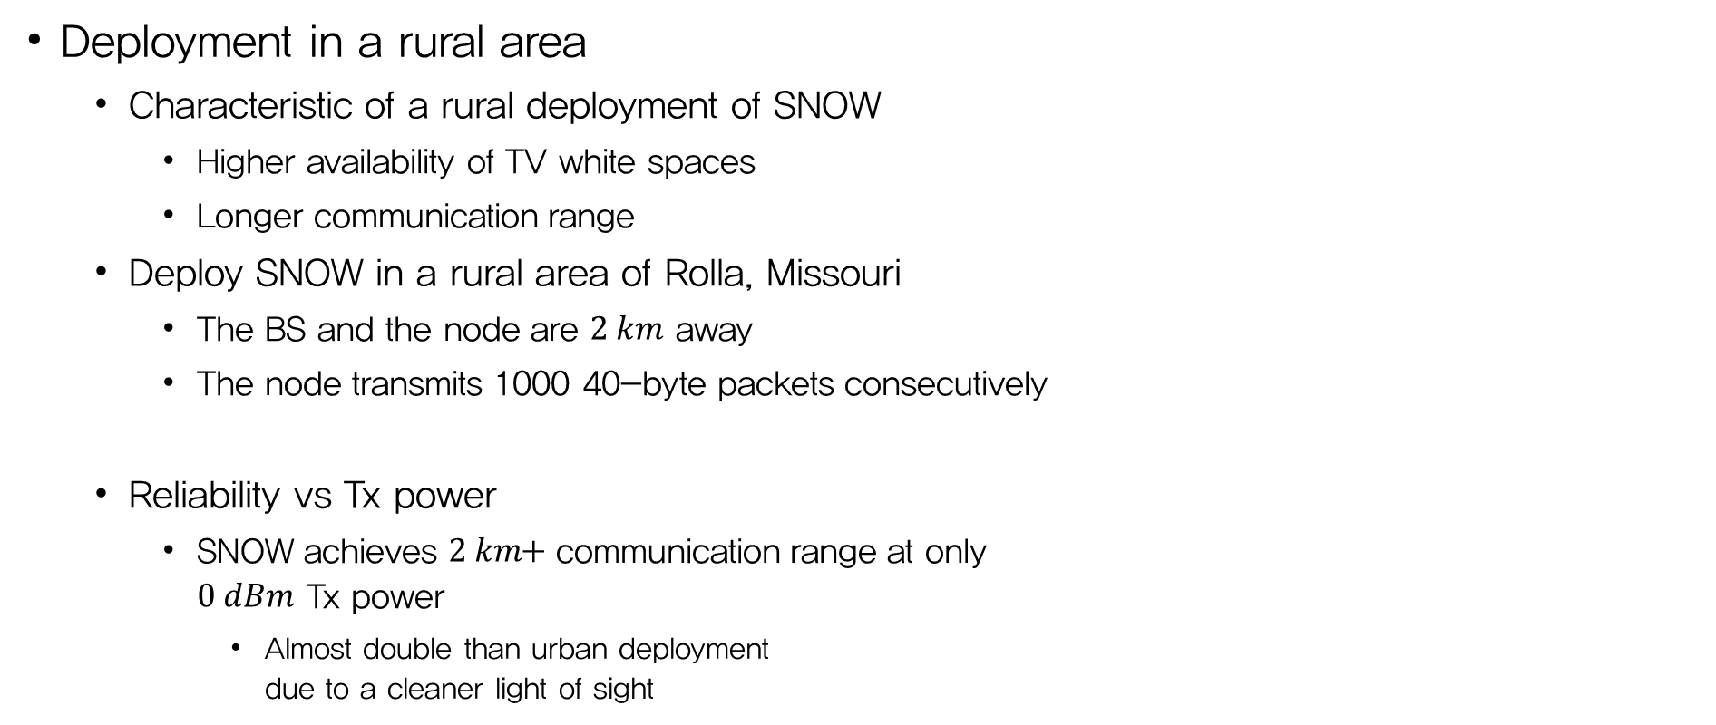
Experiments
Deployment in a rural area
  Characteristic of a rural deployment of SNOW
    Higher availability of TV white spaces
    Longer communication range
  Deploy SNOW in a rural area of Rolla, Missouri
    The BS and the node are $2 km$ away
    The node transmits 1000 40-byte packets consecutively
  Reliability vs Tx power
    SNOW achieves $2 km$+ communication range at only
    $0 dBm$ Tx power
      Almost double than urban deployment
      due to a cleaner light of sight
Figure 21. Reliability vs. Tx power in rural deployment

Slide 48
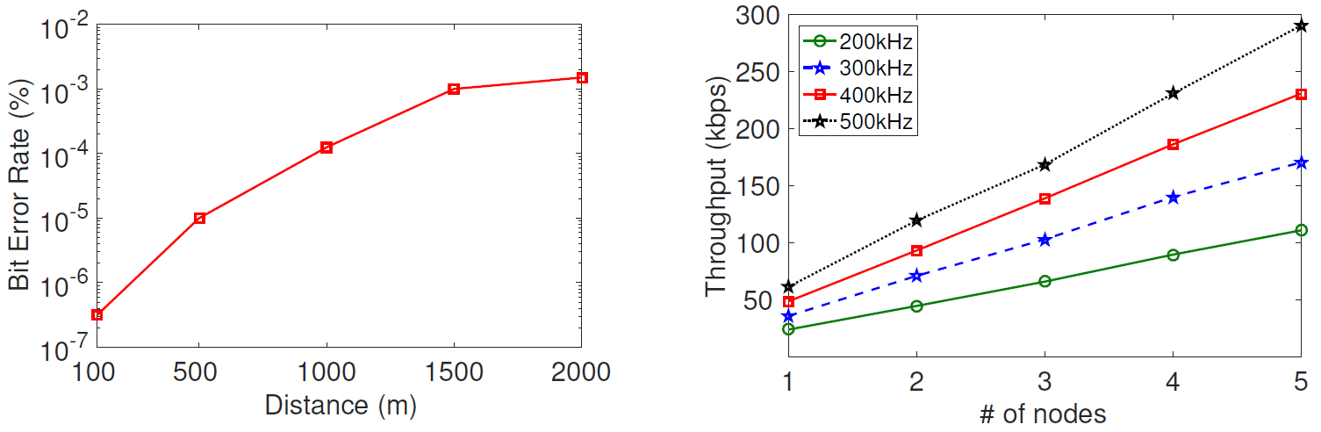
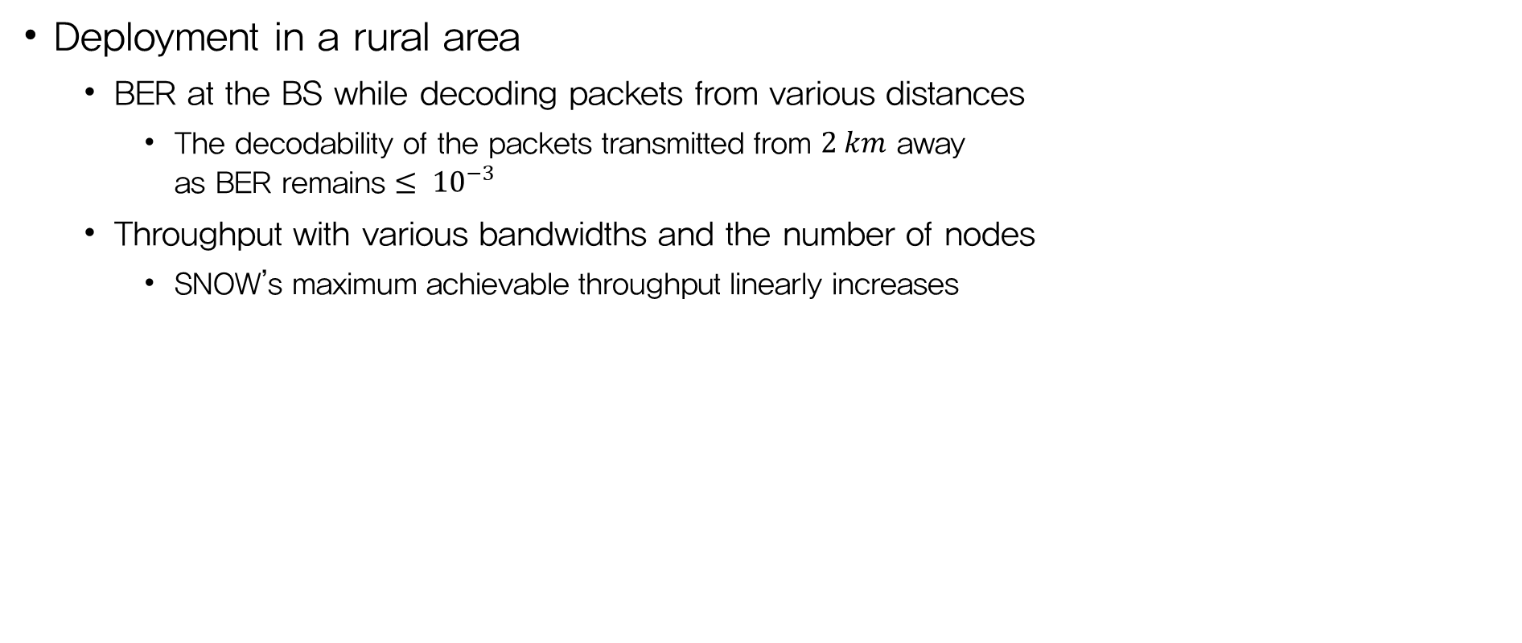
Experiments
Deployment in a rural area
  BER at the BS while decoding packets from various distances
    The decodability of the packets transmitted from $2 km$ away
    as BER remains $≤ {10}^{−3}$
  Throughput with various bandwidths and the number of nodes
    SNOW’s maximum achievable throughput linearly increases
Figure 22. BER over distances
Figure 23. Throughput vs bandwidth

Slide 49
Simulation
For large-scale evaluation of SNOW, perform simulations in QualNet
Compare SNOW’s performance with SNOW 1.0 and LoRa
  SNOW 1.0 and SNOW 2.0 take the advantage of wide white space spectrum
  LoRa operates in limited ISM band
  For a fair comparison, compare SNOW with these techniques separately under different setup

Slide 50
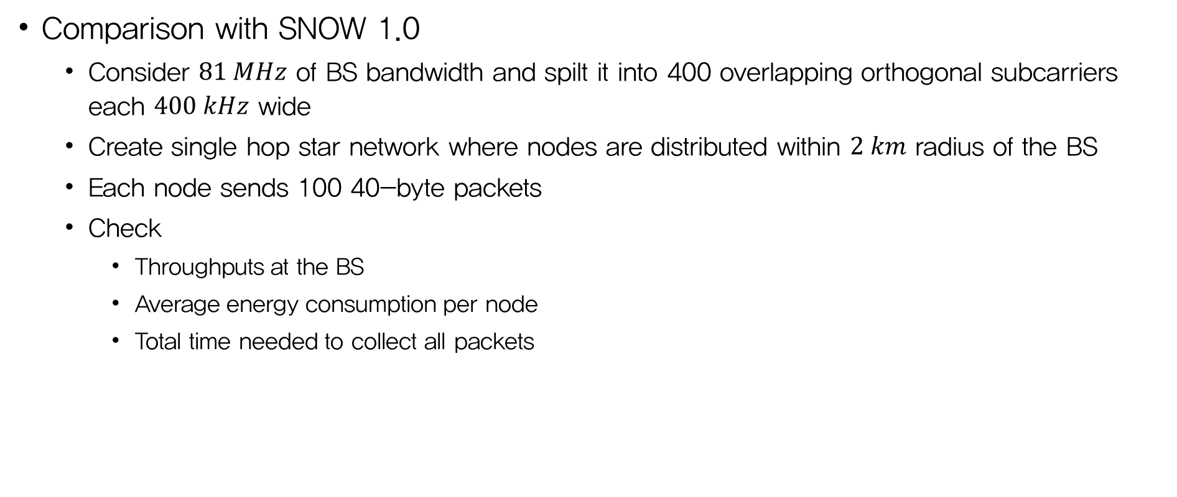
Simulation
Comparison with SNOW 1.0
  Consider $81 MHz$ of BS bandwidth and spilt it into 400 overlapping orthogonal subcarriers each $400 kHz$ wide
  Create single hop star network where nodes are distributed within $2 km$ radius of the BS
  Each node sends 100 40-byte packets
  Check
    Throughputs at the BS
    Average energy consumption per node
    Total time needed to collect all packets

Slide 51
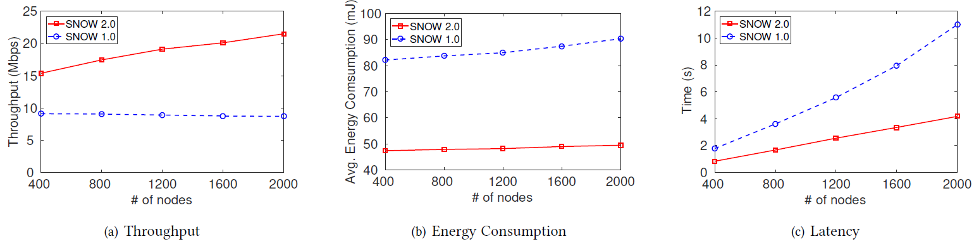
Simulation
Comparison with SNOW 1.0
  Throughputs in SNOW 1.0 increase slowly due to the longer downward communication cycles for delivering all the ACKs
  Both the energy consumption and latency in SNOW 1.0 are almost two times that in SNOW 2.0
    Demonstrates the superiority of SNOW 2.0 over SNOW 1.0 in terms of scalability
Figure 24. SNOW 2.0 vs. SNOW 1.0

Slide 52

Simulation
Comparison with LoRa
  As the superiority of SNOW 1.0 over LoRa in terms of throughput was numerically demonstrated in previous paper (SNOW 1.0) and it have already demonstrated the superiority of SNOW 2.0 over SNOW 1.0
  Hence, compare LoRa and SNOW 2.0 only in terms of energy consumption and latency
  Consider a LoRa gateway with 8 parallel demodulation path, each of $500 kHz$wide
  For fair comparison, we choose a SNOW BS bandwidth of $500 kHz×8=4 MHz$
  and split into 19 overlapping orthogonal subcarriers, each of $400 kHz$ wide
  For each, create a single-hop star network where the nodes are within $2 km$ radius of the BS
  LoRa use the pure ALOHA MAC protocol
  Every node sends 100 40-byte packets

Slide 53



Simulation
Comparison with LoRa
  For a 2000-node network, the packets are collected at the
    The SNOW BS within 0.79 minutes consuming $22.22 mJoule$ of average energy per node
    The LoRa gateway within 45.81 minutes consuming $450.56 mJoule$
  Using the same bandwidth, SNOW 2.0 can support a larger set of nodes
Figure 25. SNOW 2.0 vs. LoRa

Slide 54
Conclusion
Propose the design of an asynchronous, reliable and robust
Sensor Network over White spaces (SNOW)
The new design support reliable, asynchronous, bi-directional and concurrent communication between numerous sensors and the BS
Hardware experiments through deployments in multiple geographical areas
as well as simulations demonstrated that it significantly outperforms the state-of-the-art designs in terms of scalability, energy and latency

Slide 55
Critique
+ Continuity of work
+ PHY design considering IEEE 802.15.4 standard
+ Various environment experiments
Unsuitability for scenarios involving a large number of nodes
(only simulation…??)
Hidden terminal vs. TDMA

