Slide 1
1.3 The Architecture and Protocols of the TCP/IP Suite
곽종원
2015020798

Slide 2
We discuss the architecture and particular protocols that constitute the TCP/IP suite.
We begin by noting how the ARPANET reference model of layering, which ultimately formed the basis for the Internet’s protocol layering, differs somewhat from the OSI layering discussed earlier.
ARPANET
  The Advanced Research Projects Agency Network (ARPANET) was an early packet switching network and the first network to implement the protocol suite TCP/IP.
  was initially funded by the Advanced Research Projects Agency (ARPA) of theUnited States Department of Defense at 1969.

Slide 3
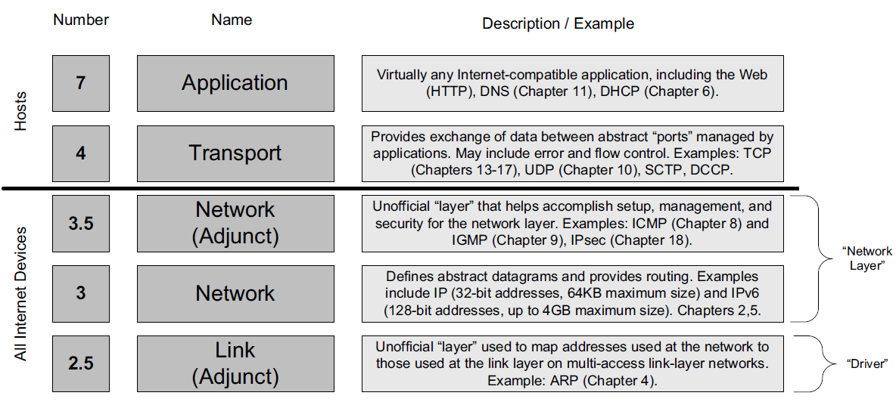
1.3.1 The ARPANET Reference Model

Slide 4
1.3.1 The ARPANET Reference Model
Layer 2.5 ( Link layer )
  “unofficial” layer
  Address Resolution Protocol (ARP)
    to convert between the addresses used by the IP layer and the addresses used by the link layer.
    In IPv6 the address-mapping function is part of ICMPv6

Slide 5
1.3.1 The ARPANET Reference Model
Layer 3 ( Network layer )
  IP
    The PDU that IP sends to link-layer protocols is called an IP datagram ( packet ).
    Fragmentation : Fitting large packets into link-layer PDUs (called frames) that may be smaller is handled
    Fragments / reassembly
    IPv4 - IP addresses and are 32 bits long.
    IPv6 - IP addresses and are 64 bits long.
    Forwarding : The destination address of each datagram is used to determine where each datagram should be sent, and the process of making this determination and sending the datagram to its next hop.
    Three types of IP addresses
    Unicast - destined for a single host
    broadcast - destined for all hosts on a given network
    multicast - destined for a set of hosts that belong to a multicast group

Slide 6
1.3.1 The ARPANET Reference Model
Layer 3.5 ( Network layer )
  “unofficial” layer
  Internet Control Message Protocol (ICMP)
    It is used by the IP layer to exchange error messages and other vital information with the IP layer in another host or router.
    ICMPv4
    ICMPv6 : is considerably more complex and includes functions such as address auto-configuration and Neighbor Discovery that are handled by other protocols (e.g., ARP)
    Application use it. ( e.g. ping, traceroute )
  Internet Group Management Protocol (IGMP)
    It is used with multicast addressing and delivery to manage.
    Multicast Listener Discovery protocol (MLD, used with IPv6).

Slide 7
1.3.1 The ARPANET Reference Model
Layer 4 ( Transport layer )
  Transmission Control Protocol (TCP)
    deals with problems such as packet loss, duplication, and reordering.
    connection-oriented (VC) fashion
    does not preserve message boundaries.
    provides a reliable flow of data between two hosts.
    dividing the data passed to it from the application into appropriately sized chunks for the network layer below.
    acknowledging received packets.
    setting timeouts to make certain the other end acknowledges packets that are sent.
    The PDU that TCP sends to IP is called a TCP segment.

Slide 8
1.3.1 The ARPANET Reference Model
Layer 4 ( Transport layer )
  User Datagram Protocol (UDP)
    preserve message boundaries.
    no rate control.
    Error control.
    there is no guarantee that the datagrams reach the other end.
    ➔ Any desired reliability must be added by the application layer.
    UDP provides is a set of port numbers for multiplexing and demultiplexing data, plus a data integrity checksum.

Slide 9
1.3.1 The ARPANET Reference Model
Layer 4 ( Transport layer )
  Datagram Congestion Control Protocol (DCCP)
    connection-oriented exchange of unreliable datagrams.
    with congestion control.
  Stream Control Transmission Protocol (SCTP)
    provides reliable delivery.
    not require the sequencing of data to be strictly maintained.
    allows for multiple streams to logically be carried on the same connection and provides a message abstraction.
    was designed for carrying signaling messages on IP networks that resemble those used in the telephone network.

Slide 10
1.3.1 The ARPANET Reference Model
Layer 7 - application layer
  The application layer is concerned with the details of the application and not with the movement of data across the network.

Slide 11
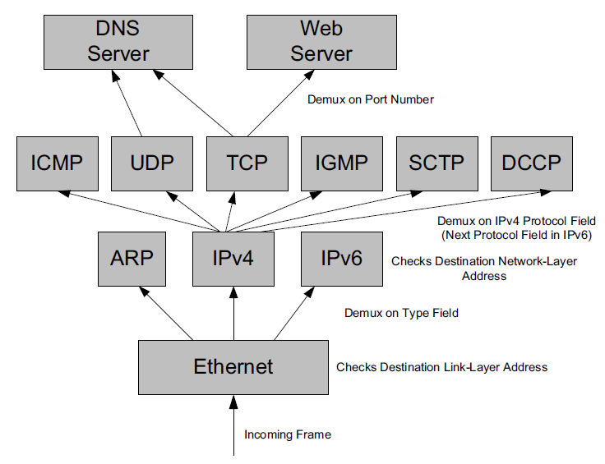
1.3.2 Multiplexing, Demultiplexing, and Encapsulation in Layered
Implementations
+ reassembled
0x0800
1. Checks Error.
2. Checks 48-bit destination address ( MAC )
+ a 16-bit field ( Ethernet type )
3. Removes header and tailor.
4. Gives payload to network layer to IP Processing.

Slide 12
1.3.2 Multiplexing, Demultiplexing, and Encapsulation in Layered
Implementations
Tunneling
  the 8-bit IPv4 Protocol field of IPv4 is below
  1 (ICMP), 2 (IGMP), 4 (IPv4), 6 (TCP), and 17 (UDP) …
  IP Datagram may appear “4 (IPv4)“inside the payload area of an IP datagram.
  ➔ This violates the original concepts of layering and encapsulation but is the basis for a powerful technique known as tunneling.

Slide 13
1.3.3 Port Number
16-bit nonnegative integers (i.e., range 0–65535).
Port Number are used for determining the correct receiving application.
e.g. a server first “binds” to a port number, and subsequently one or more clients establish connections to the port number using a particular transport protocol on a particular machine.

Slide 14
1.3.3 Port Number
Standard port numbers are assigned by the Internet Assigned Numbers Authority (IANA).
  the well-known port numbers (0–1023)
    e.g. Secure Shell Protocol (SSH, port 22), FTP (ports 20 and 21)
    Protocols with multiple ports (e.g., HTTP(18) and HTTPS(443)) often have different port numbers depending on whether Transport Layer Security (TLS) is being used with the base application-layer protocol.
  the registered port numbers (1024–49151)
  the dynamic/private port numbers (49152–65535)

Slide 15
1.3.4 Names, Addresses, and the DNS
IP addresses are not very convenient for humans to remember or manipulate.
Domain Name System (DNS) is a distributed database that provides the mapping between host names and IP addresses (and vice versa).
Names are set up in a hierarchy, ending in domains such as .com, .org, .gov, .in, .uk, and .edu.
DNS is an application-layer protocol.
There are both effectively equivalent at Web Browser.
  http://131.243.2.201/index.html
  http://[2001:400:610:102::c9]/index.html
  http://ee.lbl.gov/index.html

