Slide 1
Ad hoc and Sensor Networks
Chapter 10: Topology control
Holger Karl

Slide 2
Goals of this chapter
Networks can be too dense – too many nodes in close (radio) vicinity
This chapter looks at methods to deal with such networks by
  Reducing/controlling transmission power
  Deciding which links to use
  Turning some nodes off
Focus is on basic ideas, some algorithms
  Complexity results are only very superficially covered

Slide 3
Overview
Motivation, basics
Power control
Backbone construction
Clustering
Adaptive node activity

Slide 4
Motivation: Dense networks
In a very dense networks, too many nodes might be in range for an efficient operation
  Too many collisions/too complex operation for a MAC protocol, too many paths to chose from for a routing protocol, …
Idea: Make topology less complex
  Topology: Which node is able/allowed to communicate with which other nodes
  Topology control needs to maintain invariants, e.g., connectivity

Slide 5
Options for topology control
Topology control
Control node activity
– deliberately turn on/off nodes
Control link activity –
deliberately use/not use certain links
Topology control
Hierarchical network – assign different roles to nodes; exploit that to control node/link activity
Flat network – all nodes
have essentially same role
Power control
Backbones
Clustering

Slide 6
Flat networks
Main option: Control transmission power
  Do not always use maximum power
  Selectively for some links or for a node as a whole
  Topology looks “thinner”
  Less interference, …
Alternative: Selectively discard some links
  Usually done by introducing hierarchies

Slide 7
Hierarchical networks – backbone
Construct a backbone network
  Some nodes “control” their neighbors – they form a (minimal) dominating set
  Each node should have a controlling neighbor
  Controlling nodes have to be connected (backbone)
  Only links within backbone and from backbone to controlled neighbors are used
Formally: Given graph G=(V,E), construct D ½ V such that
Notes:
Improve: DS, MDS, MCDS in three steps…

Slide 8
Hierarchical network – clustering
Construct clusters
  Partition nodes into groups (“clusters”)
  Each node in exactly one group
    Except for nodes “bridging” between two or more groups
  Groups can have clusterheads
  Typically: all nodes in a cluster are direct neighbors of their clusterhead
  Clusterheads are also a dominating set, but should be separated from each other – they form an independent set
Formally: Given graph G=(V,E), construct C ½ V such that

Slide 9
Aspects of topology-control algorithms
Connectivity – If two nodes connected in G, they have to be connected in G⁰ resulting from topology control
Stretch factor – should be small
  Hop stretch factor: how much longer are paths in G⁰ than in G?
  Energy stretch factor: how much more energy does the most energy-efficient path need?
Throughput – removing nodes/links can reduce throughput, by how much?
Robustness to mobility
Algorithm overhead

Slide 10
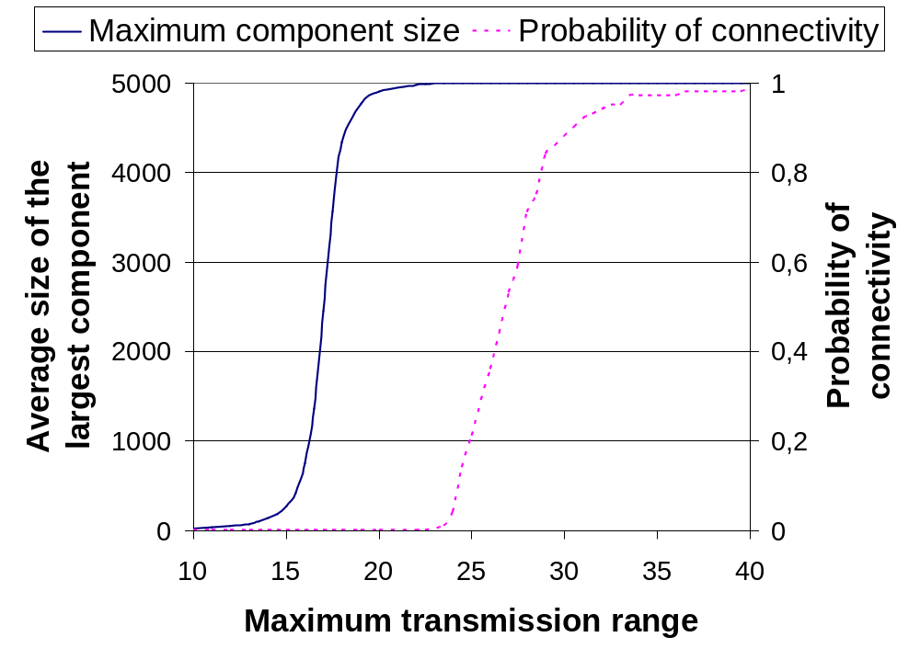
Example: Price for maintaining connectivity
Maintaining connectivity can be very “costly” for a power control approach
Compare power required for connectivity compared to power required to reach a very big maximum component

Slide 11
Overview
Motivation, basics
Power control
Backbone construction
Clustering
Adaptive node activity

Slide 12
Power control – magic numbers?
Question: What is a good power level for a node to ensure “nice” properties of the resulting graph?
Idea: Controlling transmission power corresponds to controlling the number of neighbors for a given node
Is there an “optimal” number of neighbors a node should have?
  Is there a “magic number” that is good irrespective of the actual graph/network under consideration?
Historically, k=6 or k=8 had been suggested as such “magic numbers”
  However, they optimize progress per hop – they do not guarantee connectivity of the graph!!
  ! Needs deeper analysis

Slide 13
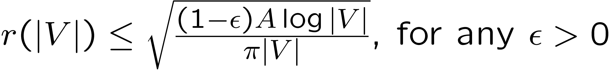
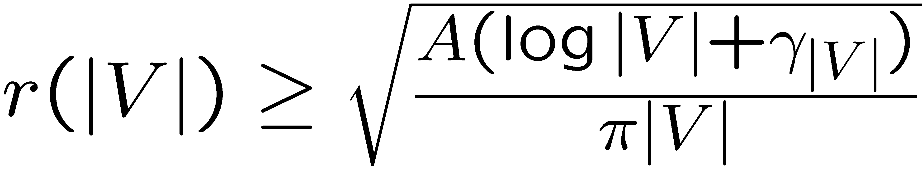
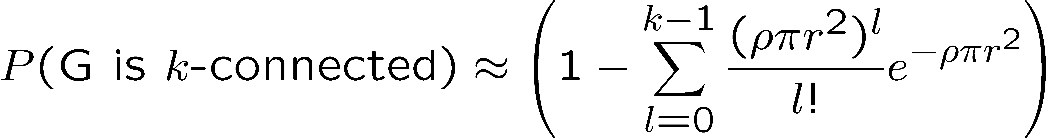
Controlling transmission range
Assume all nodes have identical transmission range r=r(|V|), network covers area A, V nodes, uniformly distr.
Fact: Probability of connectivity goes to zero if:
Fact: Probability of connectivity goes to 1 for
if and only if γ_{|V|} ! 1 with |V|
Fact (uniform node distribution, density ρ):

Slide 14
Controlling number of neighbors
Knowledge about range also tells about number of neighbors
  Assuming node distribution (and density) is known, e.g., uniform
Alternative: directly analyze number of neighbors
  Assumption: Nodes randomly, uniformly placed, only transmission range is controlled, identical for all nodes, only symmetric links are considered
Result: For connected network, required number of neighbors per node is Θ (log |V|)
  It is not a constant, but depends on the number of nodes!
  For a larger network, nodes need to have more neighbors & larger transmission range! – Rather inconvenient
  Constants can be bounded

Slide 15
Some example constructions for power control
Basic idea for most of the following methods:
Take a graph G=(V,E), produce a graph G⁰=(V,E⁰) that maintains connectivity with fewer edges
  Assume, e.g., knowledge about node positions
  Construction should be local (for distributed implementation)

Slide 16
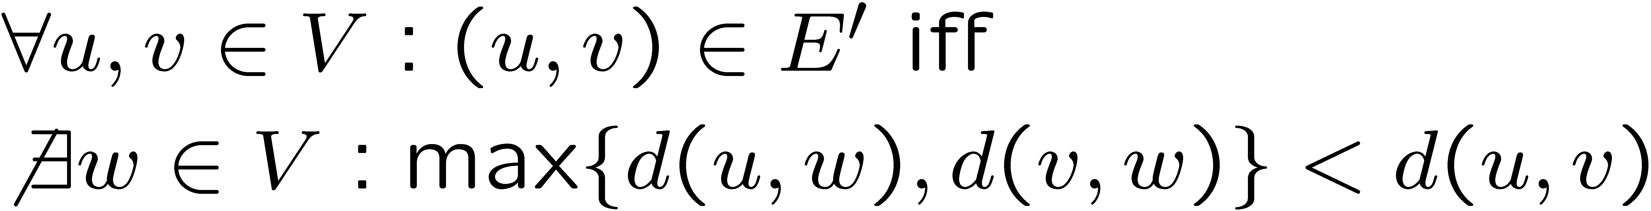
Example 1: Relative Neighborhood Graph (RNG)
Edge between nodes u and v if and only if there is no other node w that is closer to either u or v
Formally:
RNG maintains connectivity of the original graph
Easy to compute locally
But: Worst-case
spanning ratio is Ω (|V|)
Average degree is 2.6
This region has to be empty for the two nodes to be connected

Slide 17
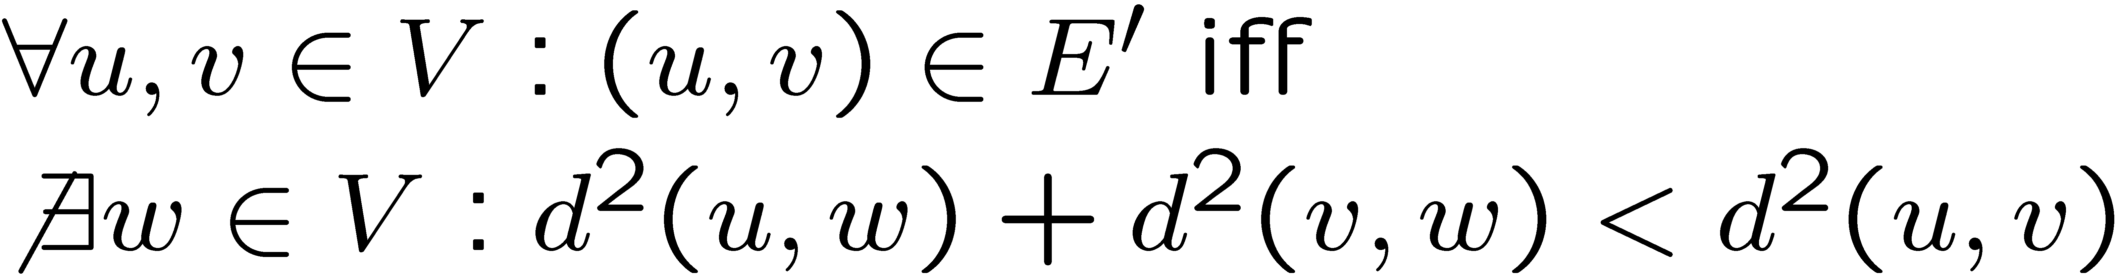
Example 2: Gabriel graph
Gabriel graph (GG) similar to RNG
Difference: Smallest circle with nodes u and v on its circumference must only contain node u and v for u and v to be connected
This region has to be empty for the two nodes to be connected
Formally:
Properties: Maintains connectivity, Worst-case spanning ratio Ω(|V|^{1/2}), energy stretch O(1) (depending on consumption model!), worst-case degree Ω (|V|)

Slide 18
Example 3: Delaunay triangulation
Assign, to each node, all points in the plane for which it is the closest node
  ! Voronoi diagram
  Constructed in O(|V| log |V|) time
Connect any two nodes for which the Voronoi regions touch
  ! Delaunay triangulation
Problem: Might produce very long links; not well suited for power control
Voronoi region for upper left node
Edges of Delaunay triangulation

Slide 19
Example: Cone-based topology control
Assumption: Distance and angle information between nodes is available
Two-phase algorithm
Phase 1
  Every node starts with a small transmission power
  Increase it until a node has sufficiently many neighbors
  What is “sufficient”? – When there is at least one neighbor in each cone of angle α
  α = 5/6π is necessary and sufficient condition for connectivity!
Phase 2
  Remove redundant edges: Drop a neighbor w of u if there is a node v of w and u such that sending from u to w directly is less efficient than sending from u via v to w
  Essentially, a local Gabriel graph construction

Slide 20
Example: Cone-based topology control (2)
α/2
α/2
α/2
α/2
α/2
α/2
α/2
α/2
Properties: simple, local construction
Extensions for k-connectivity (Yao graph)
Little exercise: What happens when α < or > 5/6 π?

Slide 21
Centralized power control algorithm
Goal: Find topology control algorithm minimizing the maximum power used by any node
  Ensuring simple or bi-connectivity
  Assumptions: Locations of all nodes and path loss between all node pairs are known; each node uses an individually set power level to communicate with all its neighbors
Idea: Use a centralized, greedy algorithm
  Initially, all nodes have transmission power 0
  Connect those two components with the shortest distance between them (raise transmission power accordingly)
Second phase: Remove links (=reduce transmission power) not needed for connectivity
Exercise: Relation to Kruskal’s MST algorithm?

Slide 22
Centralized power control algorithm
Topology
1) Connect A-C and B-D
2) Connect A-B
E
F
E
F
E
F
4
4
3
C
D
C
D
C
D
1
1
1
1
1
1
A
2
B
A
B
A
2
B
3) Connect C-D
4) Connect C-E and D-F
5) Remove edge A-B
E
F
E
F
E
F
4
4
4
4
3
3
3
C
D
C
D
C
D
1
1
1
1
1
1
A
2
B
A
2
B
A
B

Slide 23
Overview
Motivation, basics
Power control
Backbone construction
Clustering
Adaptive node activity

Slide 24
Hierarchical networks – backbones
Idea: Select some nodes from the network/graph to form a backbone
  A connected, minimal, dominating set (MDS or MCDS)
  Dominating nodes control their neighbors
  Protocols like routing are confronted with a simple topology – from a simple node, route to the backbone, routing in backbone is simple (few nodes)
Problem: MDS is an NP-hard problem
  Hard to approximate, and even approximations need quite a few messages

Slide 25
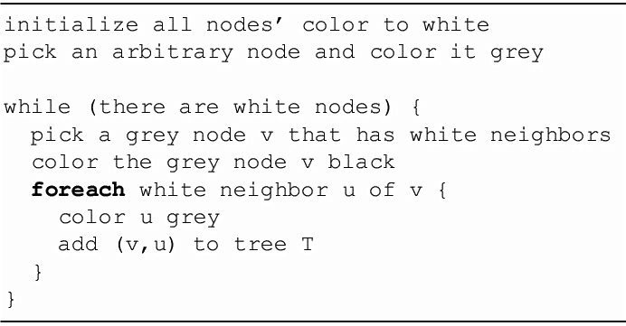
Backbone by growing a tree
Construct the backbone as a tree, grown iteratively

Slide 26
Backbone by growing a tree – Example
1:
2:
3:
4:

Slide 27
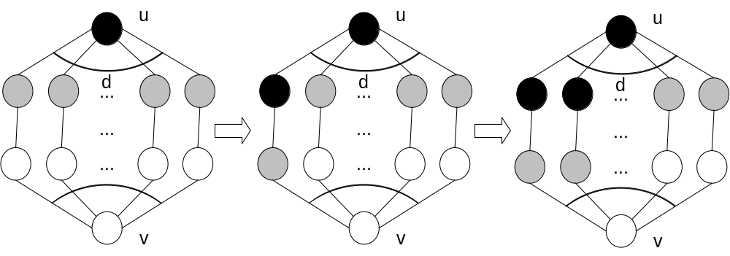
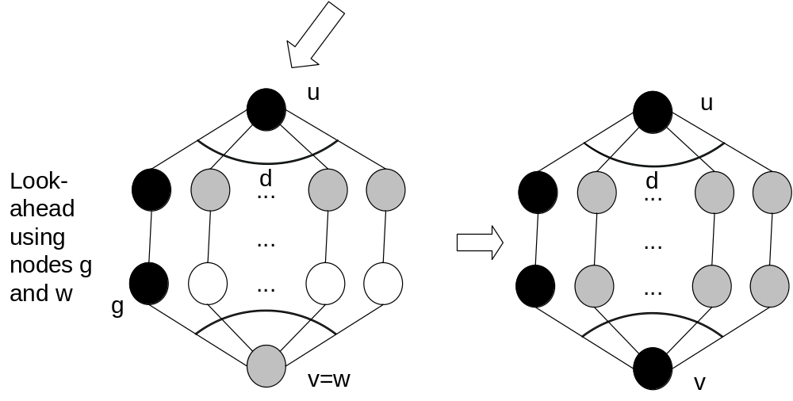
Problem: Which gray node to pick?
When blindly picking any gray node to turn black, resulting tree can be very bad
Solution:
Look ahead!
One step suffices

Slide 28
Performance of tree growing with look ahead
Dominating set obtained by growing a tree with the look ahead heuristic is at most a factor 2(1+ H(Δ)) larger than MDS
  H(¢) harmonic function, H(k) = ∑_{i=1}^{k} 1/i <= ln k + 1
  Δ is maximum degree of the graph
It is automatically connected
Can be implemented in a distributed fashion as well

Slide 29
Start big, make lean
Idea: start with some, possibly large, connected dominating set, reduce it by removing unnecessary nodes
Initial construction for dominating set
  All nodes are initially white
  Mark any node black that has two neighbors that are not neighbors of each other (they might need to be dominated)
  ! Black nodes form a connected dominating set (proof by contradiction); shortest path between ANY two nodes only contains black nodes
Needed: Pruning heuristics

Slide 30
Pruning heuristics
Heuristic 1: Unmark node v if
  Node v and its neighborhood are included in the neighborhood of some node marked node u (then u will do the domination for v as well)
  Node v has a smaller unique identifier than u (to break ties)
Heuristic 2: Unmark node v if
  Node v’s neighborhood is included in the neighborhood of two marked neighbors u and w
  Node v has the smallest
  identifier of the tree nodes
Nice and easy, but
only linear approximation
factor
u
v
w
a
b
c
d

Slide 31
One more distributed backbone heuristic: Span
Construct backbone, but take into account need to carry traffic – preserve capacity
  Means: If two paths could operate without interference in the original graph, they should be present in the reduced graph as well
  Idea: If the stretch factor (induced by the backbone) becomes too large, more nodes are needed in the backbone
Rule: Each node observes traffic around itself
  If node detects two neighbors that need three hops to communicate with each other, node joins the backbone, shortening the path
  Contention among potential
  new backbone nodes handled
  using random backoff
A
B
C

Slide 32
Overview
Motivation, basics
Power control
Backbone construction
Clustering
Adaptive node activity

Slide 33
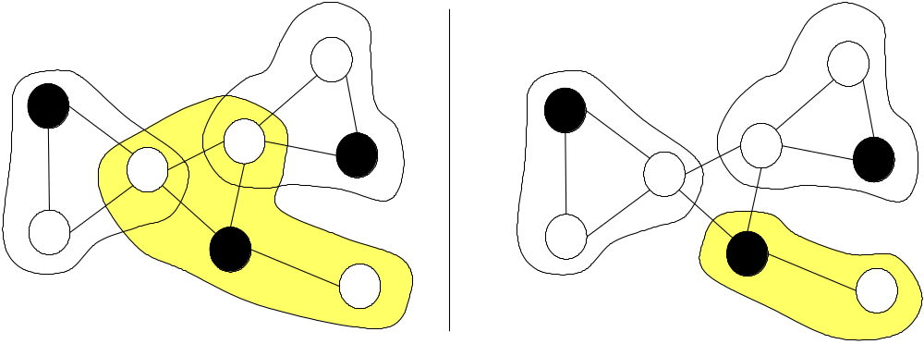
Clustering
Partition nodes into groups of nodes – clusters
Many options for details
  Are there clusterheads? – One controller/representative node per cluster
  May clusterheads be neighbors? If no: clusterheads form an independent set C:
  Typically: clusterheads form a maximum independent set
  May clusters overlap? Do they have nodes in common?

Slide 34
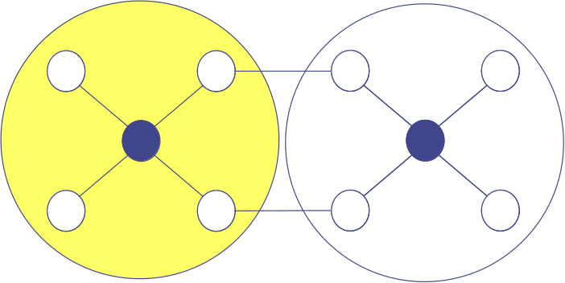
Clustering
Further options
  How do clusters communicate? Some nodes need to act as gateways between clusters
  If clusters may not overlap, two nodes need to jointly act as a distributed gateway
  How many gateways exist between clusters? Are all active, or some standby?
  What is the maximal diameter of a cluster? If more than 2, then clusterheads are not necessarily a maximum independent set
  Is there a hierarchy of clusters?

Slide 35
Maximum independent set
Computing a maximum independent set is NP-complete
Can be approximate within (Δ +3)/5 for small Δ, within O(Δ log log Δ / log Δ) else; Δ bounded degree
Show: A maximum independent set is also a dominating set
Maximum independent set not necessarily intuitively desired solution
  Example: Radial graph, with only (v₀,v_{i}) 2 E

Slide 36
A basic construction idea for independent sets
Use some attribute of nodes to break local symmetries
  Node identifiers, energy reserve, mobility, weighted combinations… - matters not for the idea as such (all types of variations have been looked at)
Make each node a clusterhead that locally has the largest attribute value
Once a node is dominated by a clusterhead, it abstains from local competition, giving other nodes a chance
Init:
1
2
3
7
6
5
4
Step 1:
1
2
3
7
6
5
4
Step 2:
1
2
3
7
6
5
4
Step 3:
1
2
3
7
6
5
4
Step 4:
1
2
3
7
6
5
4

Slide 37
Determining gateways to connect clusters
Suppose: Clusterheads have been found
How to connect the clusters, how to select gateways?
It suffices for each clusterhead to connect to all other clusterheads that are at most three hops
  Resulting backbone (!) is connected
Formally: Steiner tree problem
  Given: Graph G=(V,E), a subset C ½ V
  Required: Find another subset T ½ V such that S [ T is connected and S [ T is a cheapest such set
  Cost metric: number of nodes in T, link cost
  Here: special case since C are an independent set

Slide 38
Rotating clusterheads
Serving as a clusterhead can put additional burdens on a node
  For MAC coordination, routing, …
Let this duty rotate among various members
  Periodically reelect – useful when energy reserves are used as discriminating attribute
  LEACH – determine an optimal percentage P of nodes to become clusterheads in a network
    Use 1/P rounds to form a period
    In each round, nP nodes are elected as clusterheads
    At beginning of round r, node that has not served as clusterhead in this period becomes clusterhead with probability P/(1-p(r mod 1/P))

Slide 39
Multi-hop clusters
Clusters with diameters larger than 2 can be useful, e.g., when used for routing protocol support
Formally: Extend “domination” definition to also dominate nodes that are at most d hops away
Goal: Find a smallest set D of dominating nodes with this extended definition of dominance
Only somewhat complicated heuristics exist
Different tilt: Fix the size (not the diameter) of clusters
  Idea: Use growth budgets – amount of nodes that can still be adopted into a cluster, pass this number along with broadcast adoption messages, reduce budget as new nodes are found

Slide 40
Passive clustering
Constructing a clustering structure brings overheads
  Not clear whether they can be amortized via improved efficiency
Question: Eat cake and have it?
  Have a clustering structure without any overhead?
  Maybe not the best structure, and maybe not immediately, but benefits at zero cost are no bad deal…
! Passive clustering
  Whenever a broadcast message travels the network, use it to construct clusters on the fly
  Node to start a broadcast: Initial node
  Nodes to forward this first packet: Clusterhead
  Nodes forwarding packets from clusterheads: ordinary/gateway nodes
  And so on… ! Clusters will emerge at low overhead

Slide 41
Overview
Motivation, basics
Power control
Backbone construction
Clustering
Adaptive node activity

Slide 42
Adaptive node activity
Remaining option: Turn some nodes off deliberately
Only possible if other nodes remain on that can take over their duties
Example duty: Packet forwarding
  Approach: Geographic Adaptive Fidelity (GAF)
Observation: Any two nodes within a square of length
r < R/5^{1/2} can replace each other with respect to forwarding
  R radio range
Keep only one such node active, let the other sleep
r
R
r

Slide 43
Conclusion
Various approaches exist to trim the topology of a network to a desired shape
Most of them bear some non-negligible overhead
  At least: Some distributed coordination among neighbors, or they require additional information
  Constructed structures can turn out to be somewhat brittle – overhead might be wasted or even counter-productive
Benefits have to be carefully weighted against risks for the particular scenario at hand

