Slide 1
Chapter 9
Introduction to the Data-Link Layer
Node to node: frames, links, and the addresses that move them
Forouzan, Data Communications and Networking, 5th ed., Chapter 9
9.1 Introduction: nodes and links, services, link types, sublayers
9.2 Link-layer addressing: unicast, multicast, broadcast, ARP
Console output from the original deck rebuilt in English
Printed errors corrected, outdated material brought up to date

Slide 2
9.1
Introduction
9.2
Link-layer addressing
Nodes and links
Services: framing, flow, error, congestion control
Point-to-point and broadcast links
Two sublayers: DLC and MAC
Why IP addresses are not enough
Unicast, multicast, broadcast
ARP: IP address → link-layer address
One datagram, followed hop by hop
Chapter 9
Where we are
Chapters 3 to 8: signals, links, sharing, switching
Chapter 9: the first layer that sees frames and addresses
Chapters 10 to 12: error control, DLC, MAC in detail
The data-link layer works one hop at a time, every hop

Slide 3
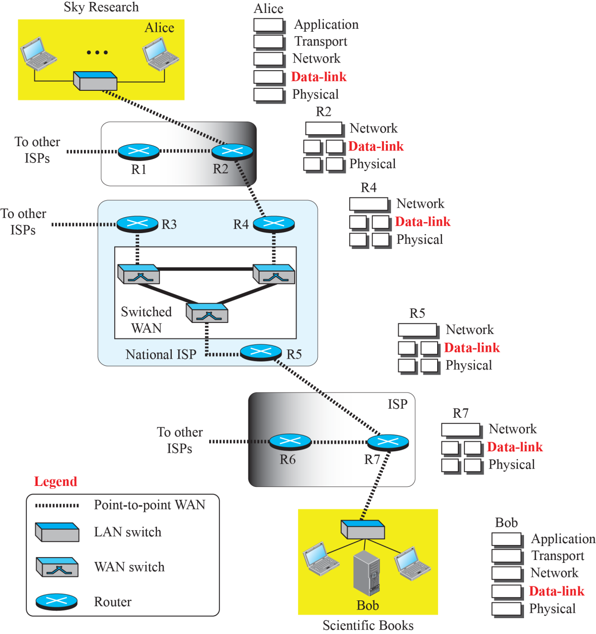
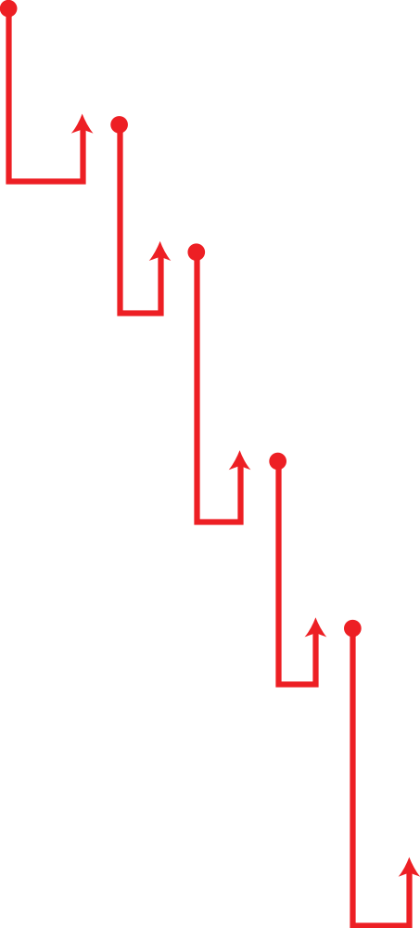
9-1
Introduction
Figure 9.1
Communication at the data-link layer
Internet = networks joined by routers and switches
A packet crosses many networks host to host
Same scenario as Chapter 3, now at the data-link layer
Each hop: its own link, its own frame

Slide 4
9-1
Seoul to Pisa in 24 hops: tracert www.unipi.it
Hop
Round trip
Router
Where
1
2 to 4 ms
homehub.olleh.com (172.30.1.254)
home gateway, Seoul
2 to 7
6 to 29 ms
125.143.x, 61.78.x, 112.189.x, 112.174.x
KT network, Korea. Hop 5: Request timed out
8
136 ms
112.174.87.18
after the Pacific crossing
9 to 16
141 to 270 ms
Cogent: lax, phx, elp, iah, atl, dca, jfk
across the United States
17
307 to 338 ms
ccr42.par01.atlas.cogentco.com
Paris, after the Atlantic crossing
18 to 20
300 to 351 ms
Cogent: mrs01, goa01, rom01
Marseille, Genoa, Rome
21 to 23
297 to 323 ms
149.6.22.74, rx1-pi1.garr.net
GARR, Italian research network, Pisa
24
296 to 298 ms
wwwnew2.unipi.it (131.114.21.42)
University of Pisa
Each row is one link and one data-link hop: a new frame, new link-layer addresses, the same IP datagram
Pacific crossing adds about 100 ms round trip: about 10,000 km at two thirds of c, there and back (Chapter 3)
Round trip is not monotonic, hop 15 is faster than hop 14: routers answer probes at low priority

Slide 5
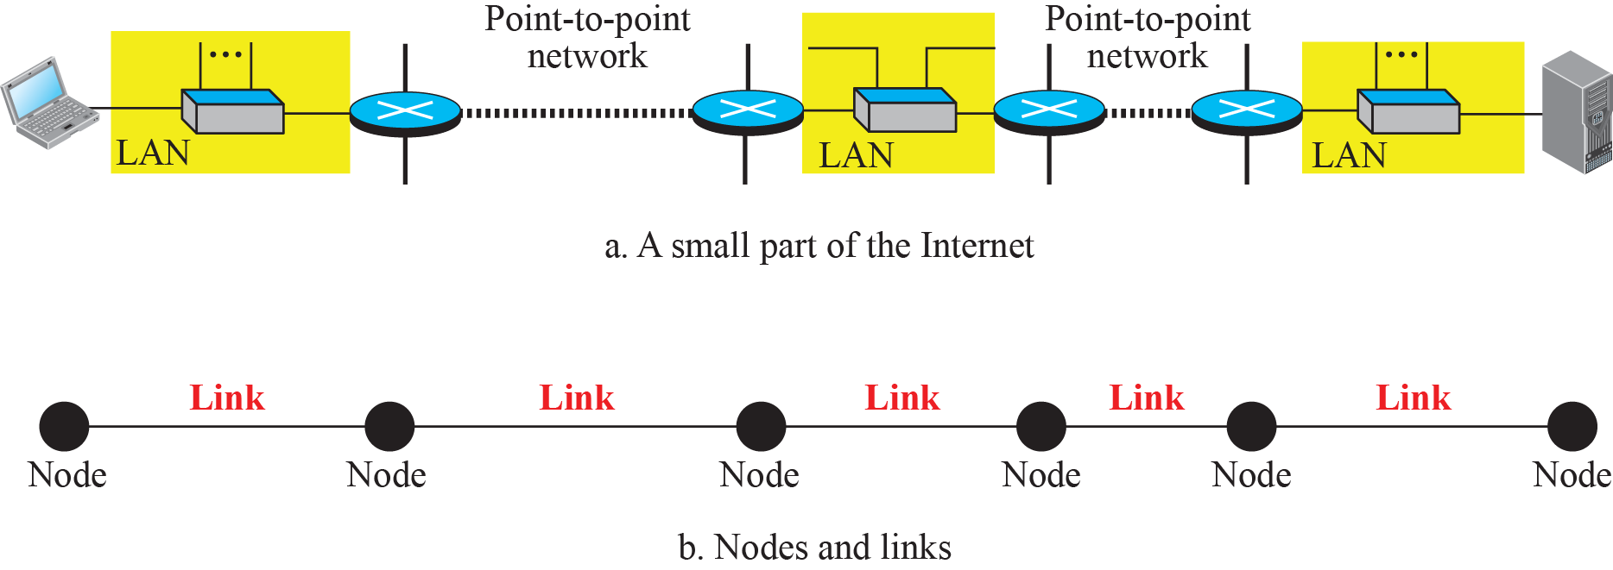
9.1.1
Nodes and links
Figure 9.2
Nodes and links
Communication at this layer: node to node
Nodes: the two end hosts and the routers
Links: the networks in between, LAN or WAN
Figure: six nodes, five links
9.1.2
Four services
9.1.3
Two categories of links
Framing: datagram in a frame, header and often a trailer
Flow control: receiver full, drop or tell the sender to slow down
Error control: detect, then correct or discard and resend (Chapter 10)
Congestion control: listed in the book, missing from the deck
rarely done at this layer, end to end by nature
Point-to-point: dedicated to two devices, two landline phones
Broadcast: shared by many, cellular phones share the air
Today: switched Ethernet port is point-to-point, Wi-Fi and cellular are broadcast

Slide 6
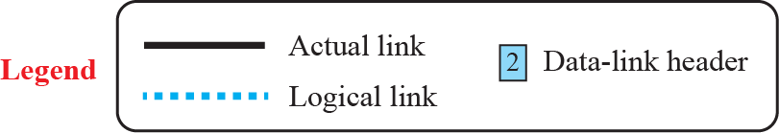
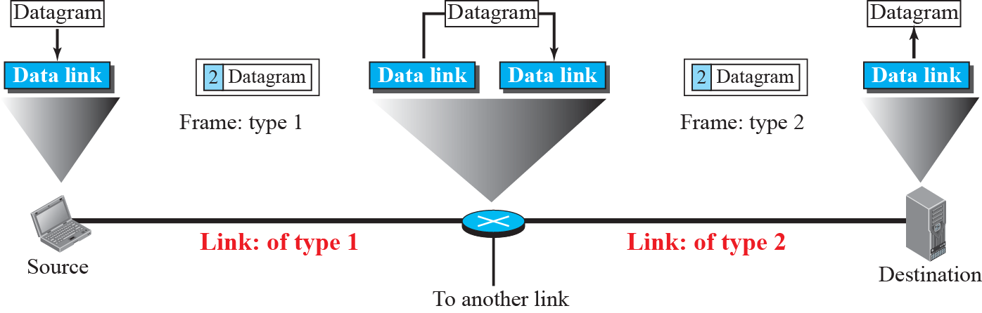
9.1.2
Encapsulation at every hop
Figure 9.3
A communication with only three nodes
Sits between the physical and network layers
Scope: deliver a datagram to the next node only
Source: encapsulate. Destination: decapsulate
Every router: decapsulate, then encapsulate again
next link may use another protocol and frame format
even the same protocol needs new link-layer addresses
Book's analogy: taxi, train, taxi. Same traveller, three vehicles

Slide 7
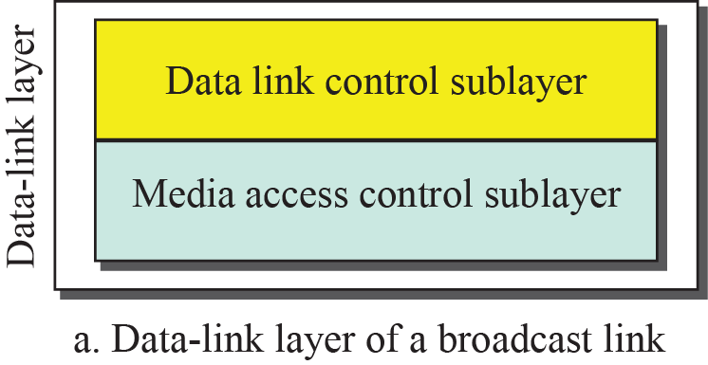
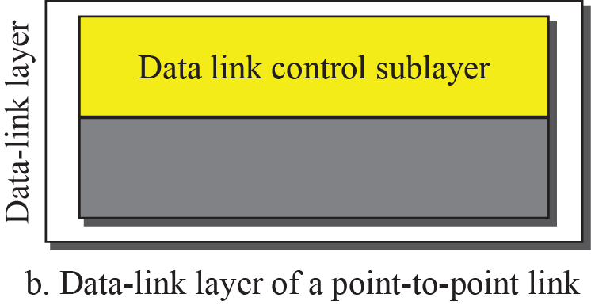
9.1.4
Two sublayers
Figure 9.4
Dividing the data-link layer into two sublayers
Data link control (DLC)
framing, flow and error control
common to both link types
Media access control (MAC)
who transmits when on a shared link
broadcast links only
Point-to-point link: DLC only
IEEE 802 names the upper sublayer LLC
Original deck numbers this figure 9.3 again: it is Figure 9.4

Slide 8
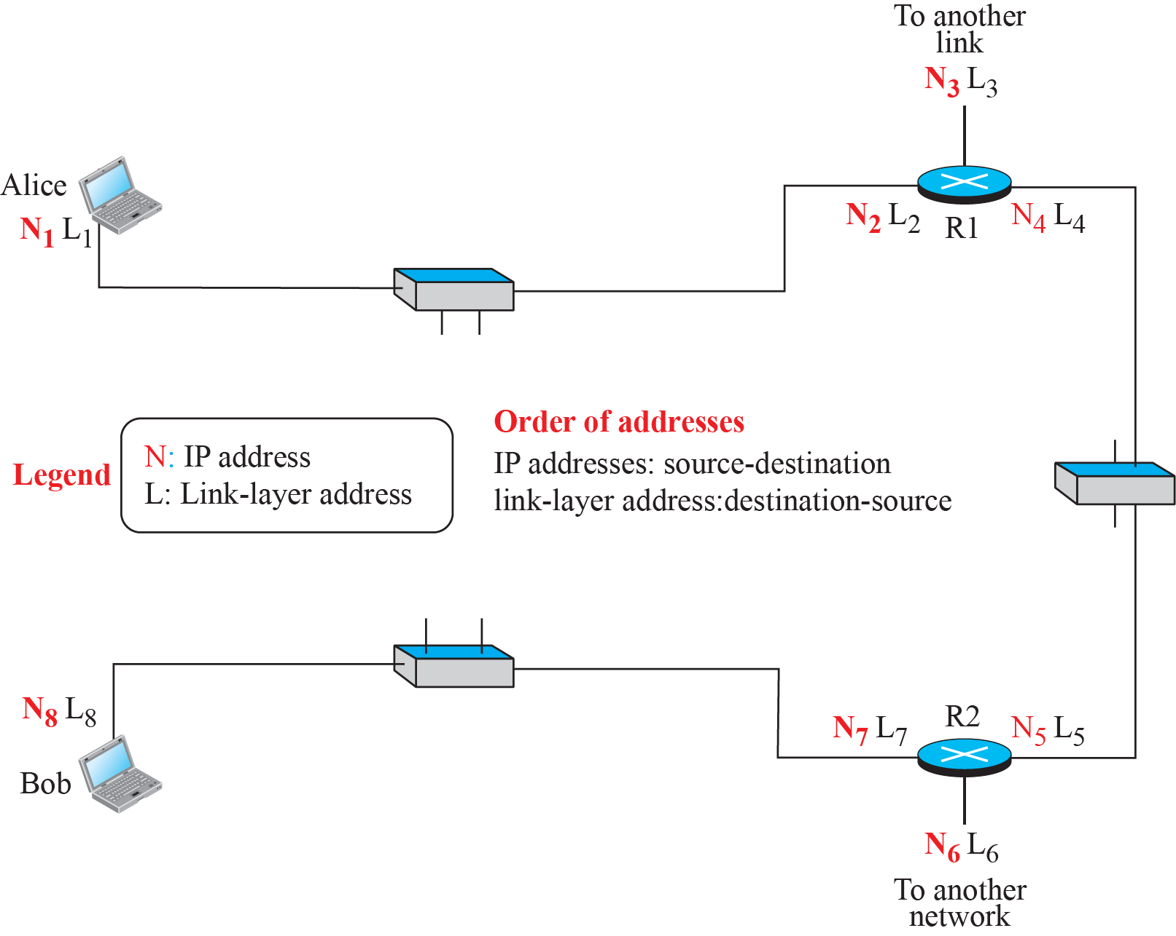
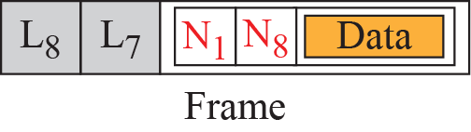
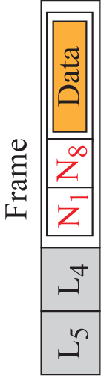
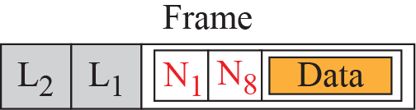
9-2
Link-layer addressing
Figure 9.5
IP addresses and link-layer addresses in a small internet
IP addresses name the two ends
They do not say which links the datagram takes
Each hop needs the next node's link-layer address
Also called link address, physical address, MAC address
Frame carries source and destination link-layer addresses
they change at every hop, the IP addresses do not

Slide 9
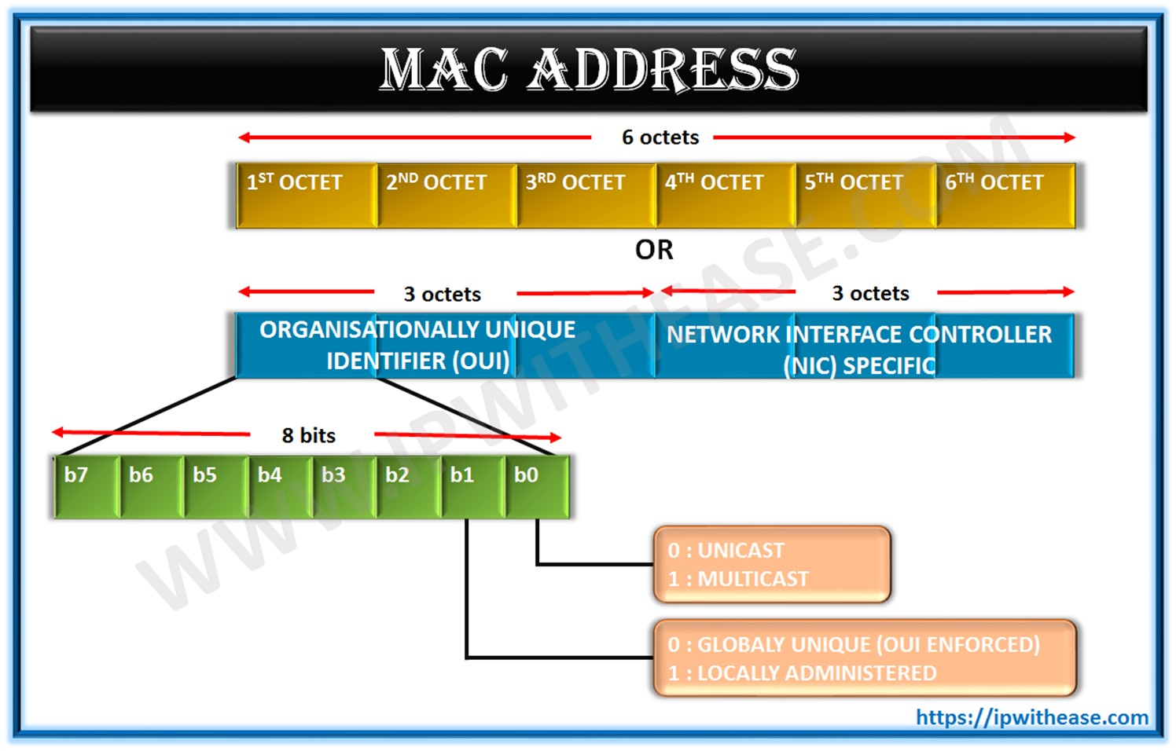
9.2.1
Three types of addresses
MAC
Address structure: OUI, I/G bit, U/L bit
Unicast: one to one, one interface
Multicast: one to many, only inside the link
Broadcast: one to all on the link
Ethernet: 48 bits, 12 hex digits
First 24 bits: OUI, assigned by the IEEE Registration Authority
one-time fee about US$3,600, not per year
annual fee only to keep the owner name private

Slide 10
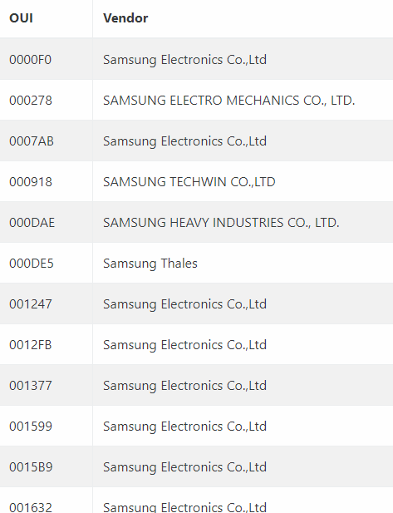
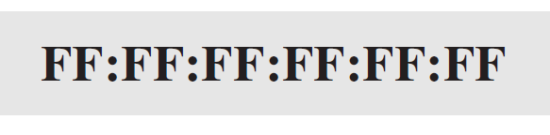
OUI
Samsung's OUIs in the IEEE public listing
Example 9.1
Unicast: A2:34:45:11:92:F1
Example 9.3
Broadcast: all 48 bits 1
I/G bit (lowest bit of first byte) = 0 → unicast
second hex digit even
U/L bit = 1 here: a locally administered address
FF:FF:FF:FF:FF:FF
Example 9.2
Multicast: A7:34:45:11:92:F1
I/G bit = 1 → multicast, second hex digit odd

Slide 11
Today
MAC address randomization
9.2.2
ARP: address resolution
Phones no longer show the factory address to Wi-Fi
Android 10+, iOS 14+: random address per network
Windows 10/11: optional
Random address: U/L bit 1, I/G bit 0, other 46 bits random
second hex digit 2, 6, A or E
Purpose: stop tracking across networks
Cost: OUI no longer names the vendor, MAC-based access lists break
Sender knows the next node's IP address
default router, forwarding table, or destination
Frame needs the next node's link-layer address
ARP maps IP address → link-layer address
Auxiliary protocol of the network layer
9.2.2
An ARP cache on a home PC: arp -a
9.2.2
Reading the cache
Internet address
Physical address
Type
Interface 172.30.1.4
Dynamic: learned by ARP, expire after minutes
172.30.1.254 is the home gateway, hop 1 of the tracert
Static: computed, never asked
subnet and limited broadcast → all 1s
IPv4 multicast → 01-00-5e + low 23 bits of the group
224.0.0.251 → 01-00-5e-00-00-fb
172.30.1.43
48-e2-44-27-c7-21
dynamic
172.30.1.254
00-07-89-82-0d-aa
dynamic
172.30.1.255
ff-ff-ff-ff-ff-ff
static
224.0.0.251
01-00-5e-00-00-fb
static
239.255.255.250
01-00-5e-7f-ff-fa
static
255.255.255.255
ff-ff-ff-ff-ff-ff
static

Slide 12
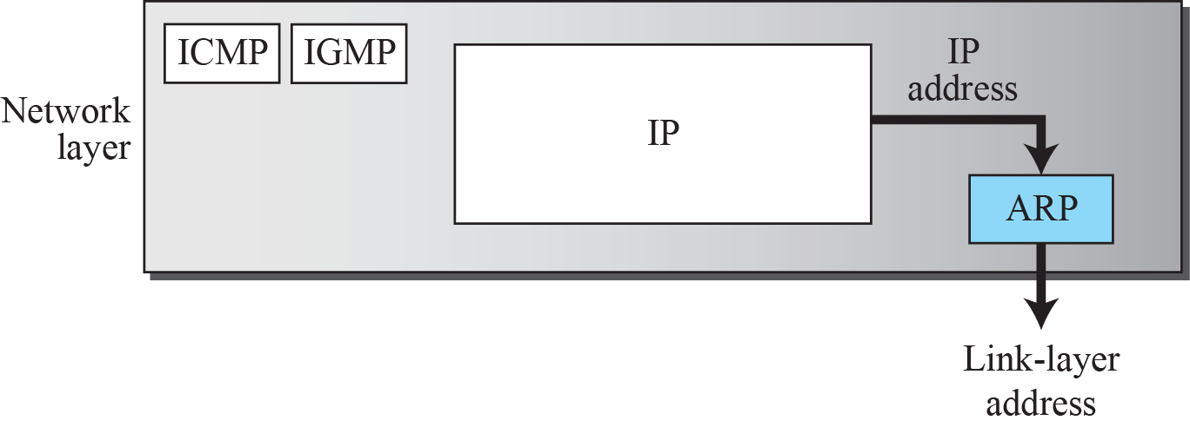
Figure 9.6
Position of ARP in the TCP/IP suite
9.2.2
Request and reply
Request: sender's IP and link-layer address, target IP
broadcast: link-layer address unknown
Every node processes it, only the target answers
Reply: unicast, carries the target's link-layer address
Today
ARP, then and now
No authentication: any node can answer
ARP spoofing: claim the gateway's IP, intercept traffic
defence: dynamic ARP inspection on managed switches
Gratuitous ARP: announce your own mapping, detect duplicates, fail over fast
IPv6 has no ARP: Neighbor Discovery (RFC 4861) over ICMPv6
solicited-node multicast instead of broadcast

Slide 13
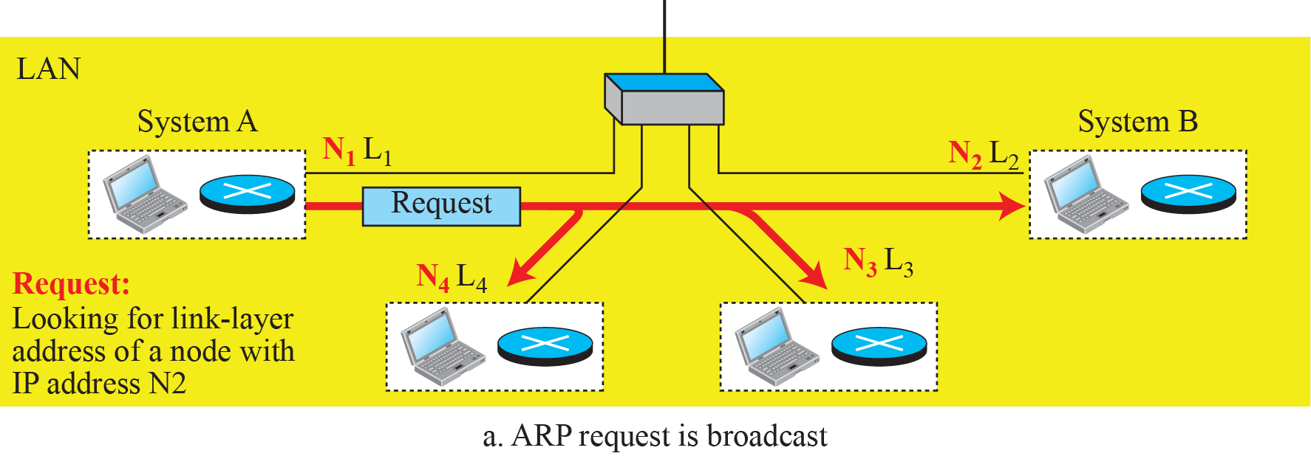
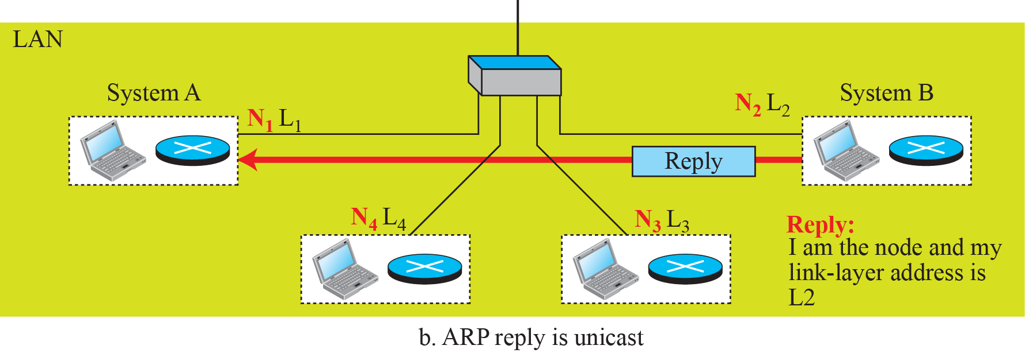
Figure 9.7
ARP operation
9.2.2
Caching
Why not just broadcast the datagram itself?
20 nodes, 10 datagrams to B
no ARP: 18 × 10 = 180 broadcasts processed and dropped
ARP: 18 processed, then 9 unicasts
Book concludes the first method is preferable: wrong, the second (ARP) is

Slide 14
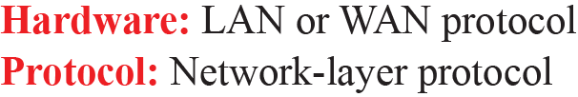
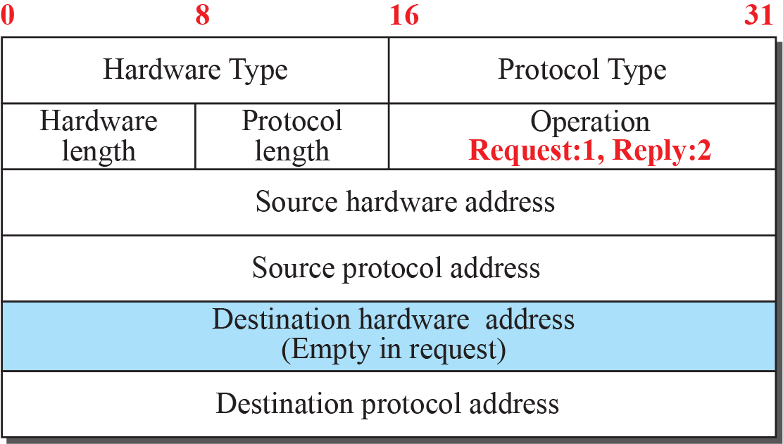
Figure 9.8
ARP packet
9.2.2
Packet fields
Hardware type: Ethernet = 1
Protocol type: IPv4 = 0x0800
Address lengths: 6 and 4 for Ethernet and IPv4
Operation: 1 request, 2 reply
Sender and target, hardware and protocol addresses
Carried directly in a frame, EtherType 0x0806

Slide 15
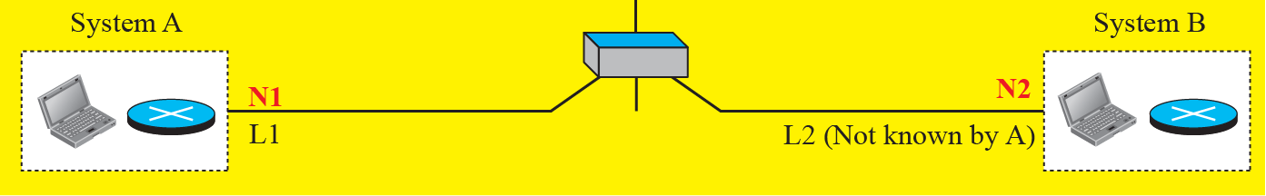
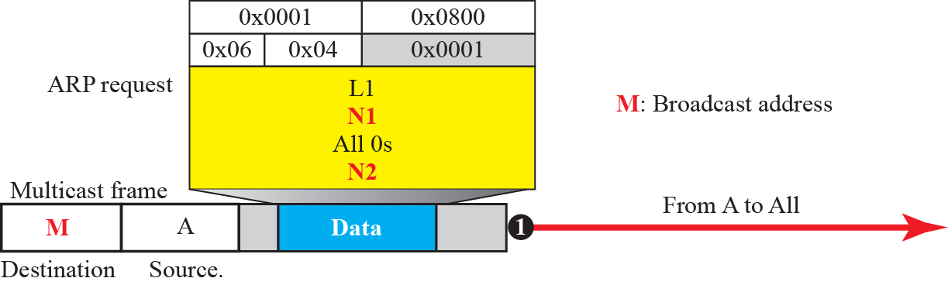
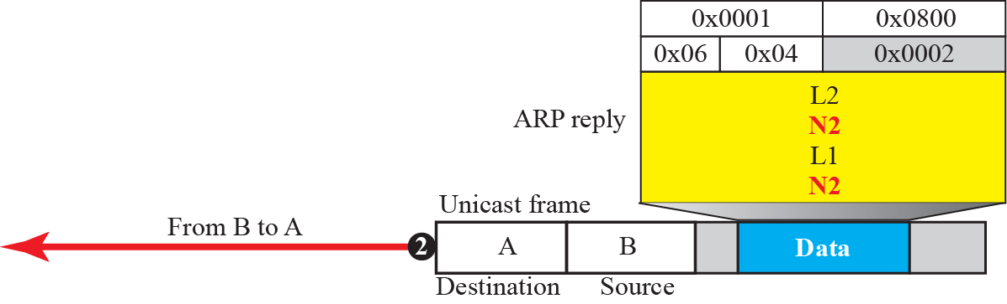
Example 9.4
Same network, N1 to N2
Figure 9.9
Example 9.4
Host N1/L1 needs L2 for N2
Request: broadcast, target hardware field empty
Reply: unicast to L1, carries L2

Slide 16
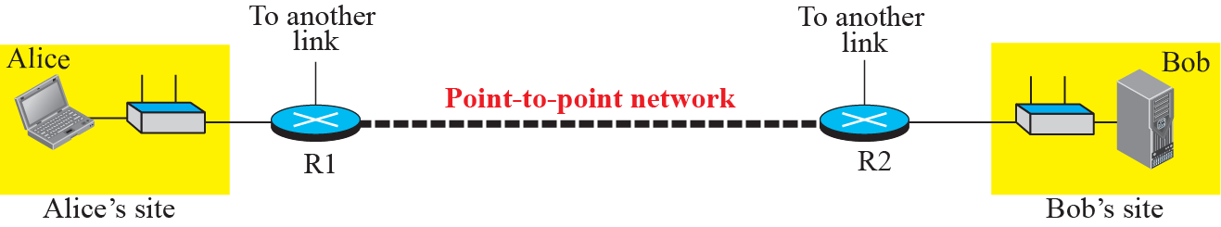
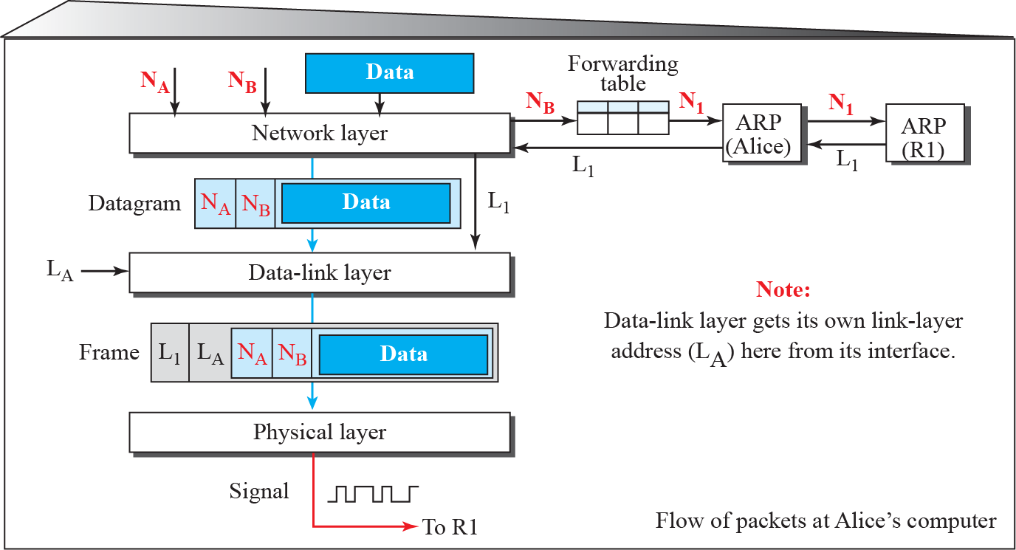
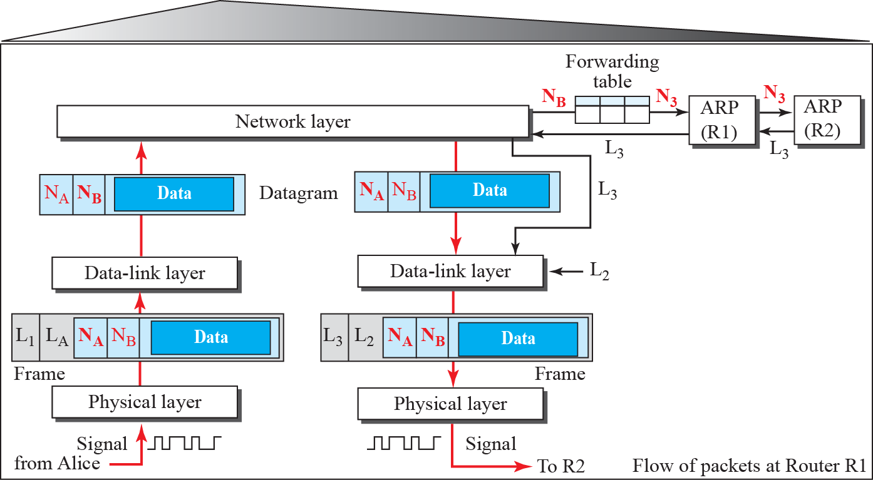
9.2.3
An example of communication
Figure 9.10
The internet for our example
Alice sends a datagram to Bob, three nodes away
Alice knows Bob's IP address (DNS, Chapter 26)
At every node: forwarding table → next-hop IP → ARP → frame
9.2.3
Alice, then R1
Figure 9.11
At Alice's computer
Figure 9.12
At router R1
Alice: next hop is default router R1, ARP for R1
R1: decapsulate, next hop R2, ARP for R2, new frame

Slide 17
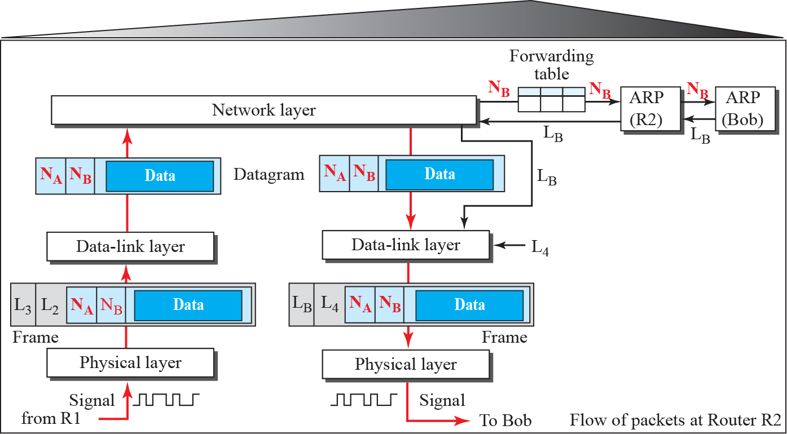
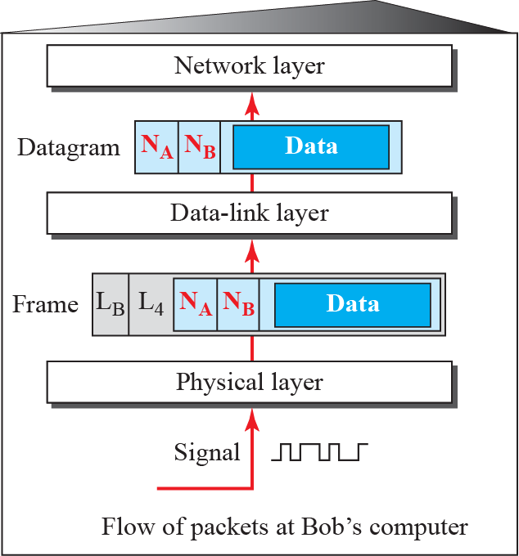
9.2.3
R2, then Bob
Figure 9.13
At router R2
Figure 9.14
At Bob's site
R2: last router, ARP for Bob directly
Bob: address matches, decapsulate, hand the datagram up
9.2.3
What stays, what changes
IP source and destination: the same on every hop
Link-layer source and destination: replaced at every router
Frame format: may change from link to link
ARP: once per new neighbour, then answered from the cache

Slide 18
Errata
Corrections to the printed slides and textbook
Where
Printed
Corrected
Two sublayers figure
numbered Figure 9.3 a second time
Figure 9.4
Services slide
framing, flow control, error control
plus congestion control, as in the book
OUI fee
$3000 per year
one-time, about US$3,600; annual fee only for a private listing
ARP caching argument
the first method is preferable
the second method, ARP with caching
Console output
Korean messages and headers
translated: Request timed out, Interface, Internet address, Physical address, Type, dynamic, static
Example 9.1
second digit must be even
the I/G bit must be 0; A2 also sets U/L = 1, a local address
Figure 9.11, 9.13 captions
Alice site, flow of activities at R2
Alice's computer, activities at router R2
EXPLORE
Addresses
EXPLORE
Resolution
IEEE RA, MA-L: what an OUI costs and what it buys
https://standards.ieee.org/products-programs/regauth/oui/
IEEE RA FAQ: MA-L, MA-M, MA-S block sizes
https://standards.ieee.org/faqs/regauth/
Android, MAC randomization: which bits are set, and when it changes
https://source.android.com/docs/core/connect/wifi-mac-randomization-behavior
Mist, MAC randomization: spotting a random address by its second digit
https://www.mist.com/get-to-know-mac-address-randomization-in-2020/
Ip2Geo, MAC addresses explained: ARP, NDP and ARP spoofing in one page
https://ip2geo.dev/blog/mac-address-explained
Try it: run arp -a and tracert on your own machine

