Slide 1
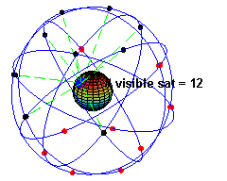
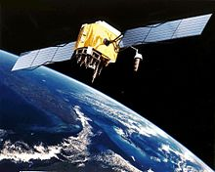
Energy Efficient GPS Sensing with Cloud Offloading
Jie Liu et al.
Sensys 2012

Slide 2
Outline
Introduction
GPS receiving overview
  GPS signals
  Acquisition
  Location calculation
  Coarse time navigation
Co-GPS design
  Shadow locations
  Guessing reference locations
  Solution pruning
  Accuracy considerations
  Web services
Evaluation
  Acquisition quality
  Overall location accuracy
  Time sensitivity
Platform implementation
  GPS sensing
  Time synchronization using WWVB
  Energy consumption
Related work
Conclusion

Slide 3
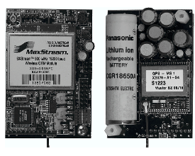
Introduction
GPS* is essential but processing-intensive and energy-consuming
  E.g. ZebraNet sensor node: 1 GPS location fix ← turn on GPS chip for 25s X 462mW
    Uses 540g solar cell array + 287g 2Ah lithium-ion battery for GPS reading every 3 minutes → 70% of the total weight (1.151kg)
Typical smart phone drains out battery for 6 hrs of GPS
  Cannot be used in unattended deployments for long

Slide 4
*GPS
One of Global Navigation Satellite Systems (GNSS)
  GPS (US)
  Glonass (Russia)
  Galileo (EU)
  Compass (China)

Slide 5
Introduction
Why so much energy?
  Ephemeris* (time & satellite trajectory info) sent from satellites at 50b/s
    Receiver should be turned on for up to 30 sec for full data packets from satellites for computing its location
  Large amount of signal processing to acquire and track satellites due to
    Weak signal
    Doppler frequency shifts
  GPS chip cannot easily be duty-cycled for energy saving!
  Powerful CPU for post-processing & least-square calculation

Slide 6
*Ephemeris & Almanac
Navigation messages
Almanac
  Coarse orbital parameters for all satellites (SVs)
  Each SV broadcasts Almanac for all SVs
  Considered valid up to several months
  When receiver wakes up in more than 30min, it uses Almanac and current time to look for SVs (initial search)
  If moved more than 100s of miles or accurate time lost, Almanac is invalid → “sky search” or re-initialization for Almanac download
Ephemeris
  Precise orbital and clock correction information for each SV
  Necessary for precise positioning
  Broadcast every 30 seconds
  Considered valid for about 30 minutes (since constantly updated by ground stations)

Slide 7
*Almanac
Old GPS receivers had to look out for a maximum of 32 satellites, each search could take multiple minutes
  20 are not visible at all
In order to speed this up, the almanac was introduced
  As a memory the receiver would keep in order to predict the
  satellites visible for a given time and position on earth
  Reducing the unnecessary searches for satellites that are not visible
A cold start is a start without an almanac or with an almanac outdated to an extent that it is not representing the actual constellation
  On a warm start, a receiver will discard all satellites from the search that compute invisible from the current almanac
These days parallel search is used thanks to better H/W

Slide 8
Introduction
This paper addresses GPS energy consumption problem by
  Splitting GPS location sensing → device part + cloud part
  Many mobile apps are delay-tolerant → compute location off-line from signal sample at cloud server
  Use ephemeris from other channels
    NASA publishes through Web services
    What we need is rough notion time, set of visible satellites, and “code phase”*
    Code can be derived from every millisecond of baseband signals
    Significant opportunity to duty cycle if location computation is moved to cloud
  Storage is relatively cheap → store GPS data with other sensor data rather than process immediately

Slide 9
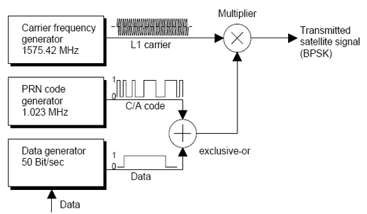
*GPS signal structure
Coarse/Acquisition (C/A) code = unique identifier
  1023 pseudorandom noise bits repeated every 1ms

Slide 10
Introduction
Split of local and cloud processing
  Device runs only for a few milliseconds to
    Collect enough GPS baseband signals
    Tag them with a rough time stamp
  Cloud processes signal off-line using
    Greater processing power
    Online ephemeris
    Geographical information to determine the receiver locale
    Cloud-Offloaded GPS (“CO-GPS”)
Challenges
  Can’t have a real-time clock synchronized to satellites
  Hard to get nearby reference location
  Signal quality can suffer from temporary degradation due to duty-cycling

Slide 11
Introduction
Will evaluate the accuracy of CO-GPS with real GPS traces
Will show
  Time sync requirement is not very high
  Amount of data for offline processing is only a few KBs
Built a sensor node called CLEO using
  GPS receiving front end chip MAX2769
  WWVB*-based time synchronization mechanism
Takes less than 0.5mJ to collect a GPS data point vs. 1J for GPS sensing on mobile phones
  A pair of AA batteries (2Ah) can sustain continuous GPS sensing at 1s/sample granularity for 1.5 years

Slide 12
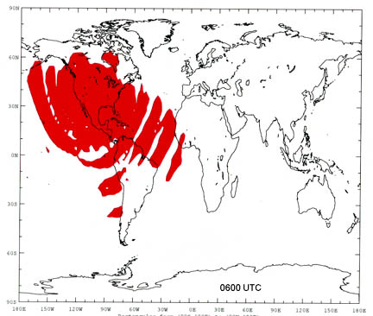
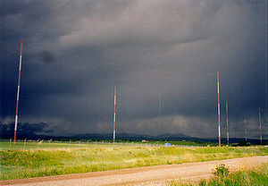
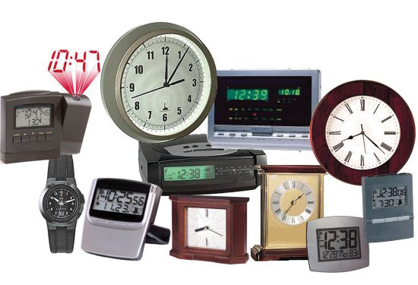
*WWVB
Is a NIST time signal radio station near Fort Collins, Colorado
Broadcasts on 60KHz frequency band
  1bps
  Takes a full minute to send a complete time code (generated by atomic clock)
Want to hear the sound? Not a real one but …enjoy ;-)

Slide 13
Outline
Introduction
GPS receiving overview
  GPS signals
  Acquisition
  Location calculation
  Coarse time navigation
Co-GPS design
  Shadow locations
  Guessing reference locations
  Solution pruning
  Accuracy considerations
  Web services
Evaluation
  Acquisition quality
  Overall location accuracy
  Time sensitivity
Platform implementation
  GPS sensing
  Time synchronization using WWVB
  Energy consumption
Related work
Conclusion

Slide 14
GPS receiving overview
A GPS receiver computes its location by measuring the distance from the receiver to multiple GNSS satellites (SVs)
It needs to infer three pieces of information
  A precise time T
  A set of visible SVs and their locations at T
  The distances from the receiver to each SV at time T (pseudoranges*)
Obtained from signals and data sent from SVs
Receiver can use least-squares (LS) minimization to estimate its location

Slide 15
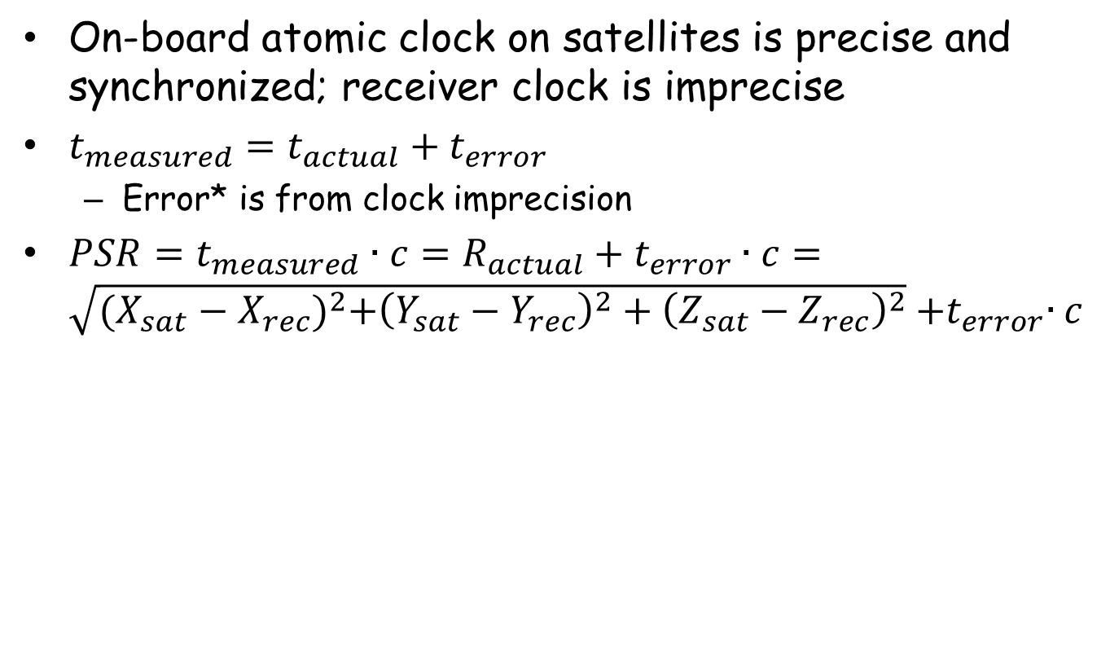
*Pseudorange
On-board atomic clock on satellites is precise and synchronized; receiver clock is imprecise
$t_{measured}=t_{actual}+t_{error}$
  Error* is from clock imprecision
$PSR=t_{measured}∙c=R_{actual}+t_{error}∙c=\sqrt{{(X_{sat}−X_{rec})}^{2}+{\left(Y_{sat}−Y_{rec}\right)}^{2}+{\left(Z_{sat}−Z_{rec}\right)}^{2}}{+t}_{error}∙c$

Slide 16
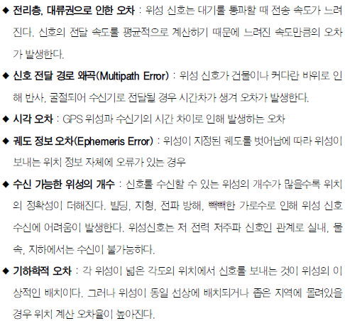
*Errors

Slide 17
GPS signals
31 (+1 for redundancy) GNSS satellites in the sky, each orbiting the Earth about two cycles a day
A set of ground stations send the satellites 2 kinds of trajectory information
  Almanac → coarse orbit and status information
  Ephemeris → precise values of the satellite’s trajectory
All satellites are synchronized to within a few uS
  After clock correction, within a few nS
Satellites simultaneously and continuously broadcast time and orbit information through CDMA signals at L1 =1.575 GHz towards the Earth

Slide 18
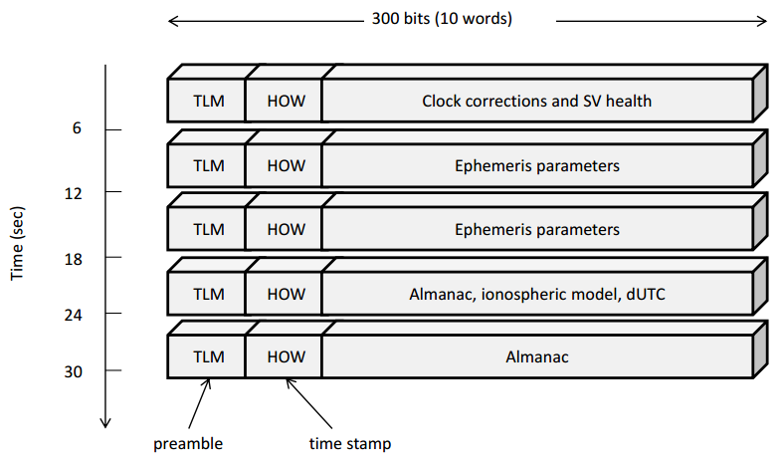
GPS signals
Bit-rate of data packets* is a mere 50 bps, but the bits are modulated with a higher frequency (1MHz) signal for detecting propagation delays
  A full data packet from a satellite broadcast is 30S long, containing five 6S-long frames

Slide 19
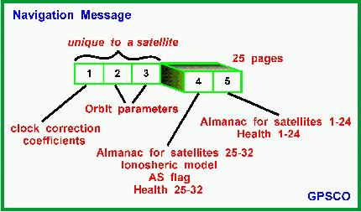
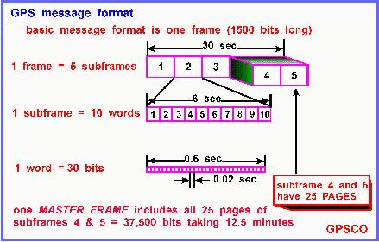
*GPS packet – different views

Slide 20
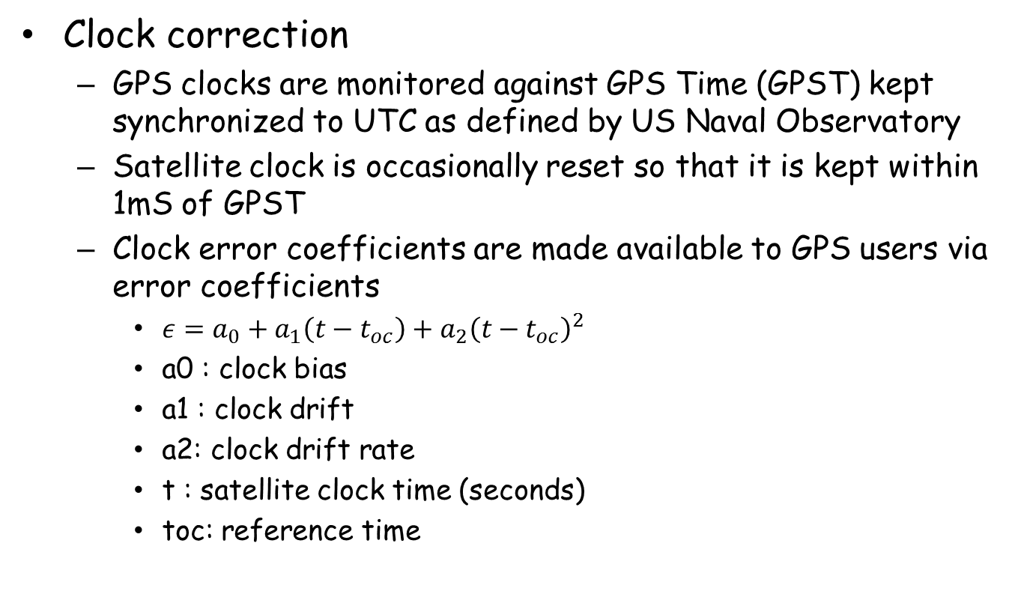
*GPS packet – clock correction
Clock correction
  GPS clocks are monitored against GPS Time (GPST) kept synchronized to UTC as defined by US Naval Observatory
  Satellite clock is occasionally reset so that it is kept within 1mS of GPST
  Clock error coefficients are made available to GPS users via error coefficients
    $ε=a_{0}+a_{1}\left(t−t_{oc}\right)+a_{2}{\left(t−t_{oc}\right)}^{2}$
    a0 : clock bias
    a1 : clock drift
    a2: clock drift rate
    t : satellite clock time (seconds)
    toc: reference time

Slide 21
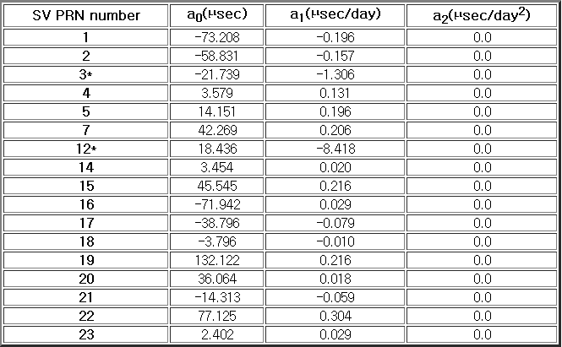
*GPS packet – clock correction
Typical values

Slide 22
GPS signals
A frame starts with a preamble (called Telemetry Word, or TLM) and a time stamp (called Handover Word, or HOW)
  Each data packet contains the ephemeris of the transmitting satellite and the almanac of all satellites
A precise time stamp can be decoded every 6 seconds, and the high accuracy satellite trajectory can be decoded every 30 seconds
  Can take up to a minute to acquire its ﬁrst location, a metric called time to ﬁrst ﬁx (TTFF)

Slide 23
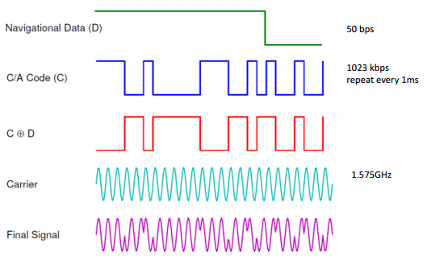
GPS signals
Pseudorange from each SV to the receiver is obtained using much lower-level signal processing techniques
  Not from data
Each satellite encodes its signal using a satellite-specific C/A code of length 1023 chips at 1023 kbps
  C/A code repeats every mS → 20 repetitions of the C/A code for each data bit sent

Slide 24
GPS signals
C/A code identifies SV and to estimate how long it took the signal to propagate from SV to receiver
  Typically, GPS signals take 64 ~ 89 mS from a satellite to the Earth’s surface
Light travels 300km/ms, receiver must estimate the delay to the us level for accurate distance measurement
Millisecond (NMS) and sub-millisecond (subMS) parts of the propagation time are derived very differently
  NMS is decoded from the packet frames
  subMS propagation time is detected at the C/A code level using correlations

Slide 25
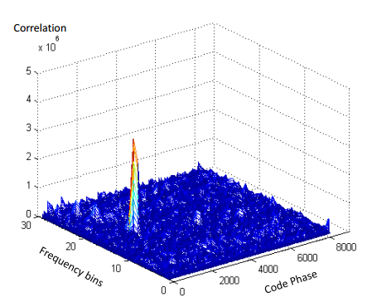
Acquisition
When a GPS receiver first starts up, it needs to detect what satellites are in view
  Done by detecting the presence of the corresponding C/A codes in the received signal, typically by correlating the signal with each known C/A code template
  A visible satellite will show a spike in the correlation results

Slide 26
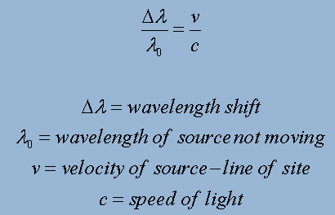
Acquisition
Doppler frequency shift
  Caused by the motion of SV and receiver
  A rising GPS satellite can move at up to 800m/s towards a receiver, causing a frequency shift of L1 * 800/c = 4.2kHz
  A setting SV as well
To correct the shift, the receiver must generate the C/A code within 500Hz of the shifted frequency
  In the frequency dimension, the receiver needs to search up to 18 bins (9*500Hz = 4.5KHz → both sides: 18)
  Most GPS receivers use 25 to 40 frequency bins for local receiver movement & better sensitivity

Slide 27
Acquisition
After Doppler frequency shift compensation, receiver must determine code phase delays*
Receiver must search over the delay dimension
  Receiver not synchronized with SV
  Signal propagation delay can be affected by atmospheric conditions
Receiver usually oversamples the 1023 Kbps C/A code
  Sampling the baseband signal @ 8 MHz, the receiver will search 8184 (=1023*8) code phase positions to find the best correlation peak
Code phase changes over time
  Satellites and device move
  GPS receivers use a tracking mode for continuous operation
  Ater 30S of non-tracking, Doppler shift and code phase info become stale → start all over again

Slide 28
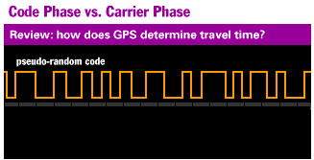
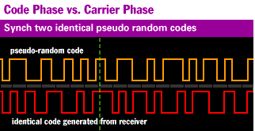
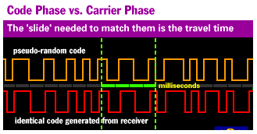
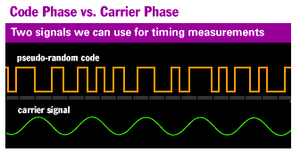
*Code phase delay
Out of phase is the source of positioning error
  Cycle width approximately a uS
  At the speed of light → 300m error!!!
  1-2% error → 3-6m error

Slide 29
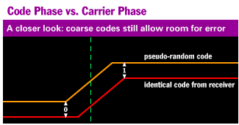
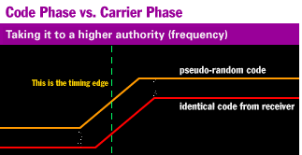
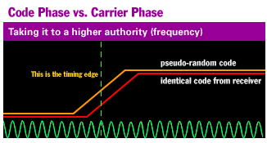
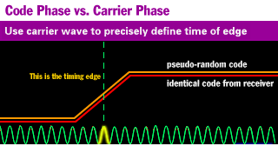
*Code phase delay
Carrier frequency is O(1000) higher
  Can be used to get more precise match
  20cm wavelength
  1-2% → 3-4 mm error

Slide 30
Acquisition
Acquisition is expensive
  Search through 30+ frequency bins times 8,000+ code phase possibilities for every single satellite
W/ prior information about SV, less work
  Cold start ← no prior knowledge
    One code phase search per milliseconds → O(seconds) for a single SV acquisition
    Collect new ephemeris
  Warm start*: w/ a previous lock to SVs, search around previous Doppler shift and code phases
    If less than 30 seconds old
    Remembers (last position, almanac, UTC time) but not visible SVs
    Don’t collect new ephemeris

Slide 31
Acquisition
W/ prior information about SV, less work (cont’d)
  Hot start: receiver can skip the acquisition and start directly from tracking to refine the Doppler and code phases
    When the previous SV locks are within a second
    Quickest re-acquisition of a GPS lock
    Remembers (last position, almanac, UTC time, visible SVs)
    This is why “continuous GPS sampling” defined as one location sample / sec

Slide 32
Acquisition
W/ prior information about SV, less work (cont’d)
  A-GPS*
    Mobile-Station Based A-GPS (or AGPSB) mode
      Infrastructure provides up-to-date ephemeris → GPS receiver does not have to decode them from the satellite signals
      Successful decoding of HOW is enough to provide a location fix
      TTFF is around 6S
    Mobile-Station Assisted A-GPS (or AGPSA) mode
      Infra is given the estimated location
      Infra provides initial values for Doppler and code phase searches
      Receiver jumps directly to warm start
    The first successful decoding of HOW is enough to provide a location fix
    Allows the receiver to jump directly into the warm start → TTFF ~ 6 S

Slide 33
* A-GPS
In 1999, FCC tightened rules regarding wireless 911 emergency location technology
  Network-based solution for Automatic Location Identification (ALI)
    100m accuracy 67% of time
    300m accuracy 95% of time
  GPS-based solution for ALI
    50m accuracy 67% of time
    150m accuracy 95% of time
Assisted GPS (A-GPS) became a central technology for mobile networks
  Time to First Fix → a few seconds

Slide 34
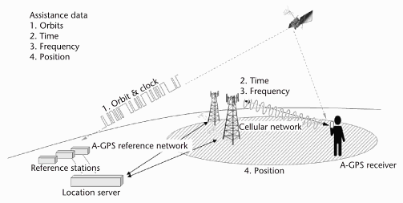
*A-GPS
Orbits and clock come from A-GPS reference network that gets them from satellites
Time & frequency often come from cellular network
Position comes from cellID in DB

Slide 35
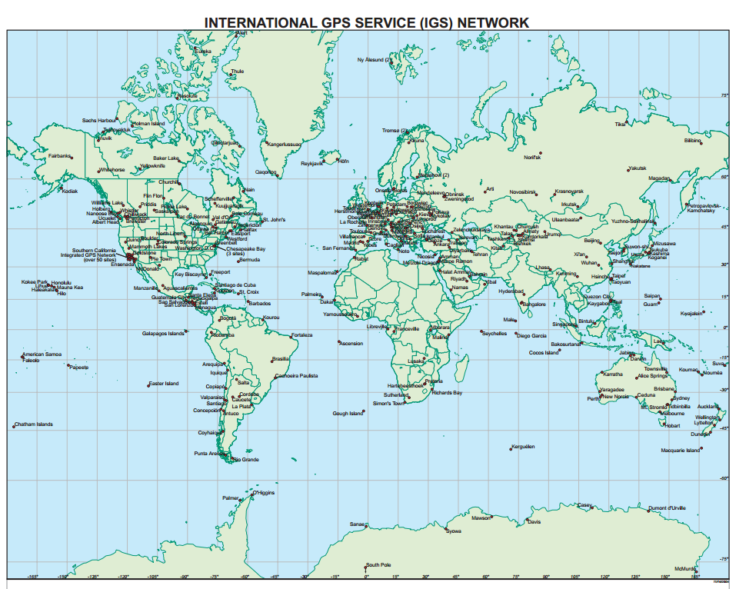
*A-GPS
Reference network: e.g. Suwon & Daejon (ROK)

Slide 36
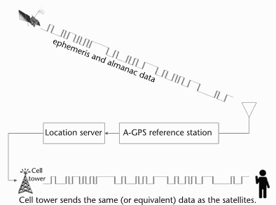
* A-GPS
Stand-alone GPS receivers take 40s ~ a few minutes to first fix (TIFF)
  In cities, satellite signals can be weak
A-GPS uses assistance server in the network
  Acquisition assistance data
    Send to mobile in order to reduce time to acquisition
  Sensitivity assistance data
    Helps mobile performance in detecting signals
  Differential correction information

Slide 37
* A-GPS
Acquisition assistance data
  GPS signal is spread spectrum signal, received with different Doppler frequency and code phase
  Network can provide code phase and Doppler frequency information as well as
    GPS time sync of base station (if available)
    Location of the base station
Sensitivity assistance data (“modulation wipe-off”)
  Contains predicted data bits of the GPS navigation message, which are expected to modulate the GPS signal of specific satellites at specified times
  Receiver can remove bit modulation in the received GPS signal prior to coherent integration
  3-4dB improvement

Slide 38
*A-GPS
With correct tracking, receiver can decode the packets from SVs
  W/o assistance information, receiver needs to decode SV ephemeris every 30 minutes (its valid time span) and time stamps every 6 seconds
  Decoding is energy consuming → has to run tracking continuously for the packet duration in order to receive all the bits
  With A-GPS, receiver is not required to decode ephemeris, but it must still decode HOW
Standardization (3GPP)
  TS 136 355 LTE Positioning Protocol (LPP)

Slide 39
Location calculation
Output from acquisition → code phase
  Gives sub-mS propagation delay
  W/ decoded HOW, it knows the time the signals left the satellites
  Pseudorange can be found
C/A code repeats every mS → 1ms of data is enough for acquisition (ideal case)
  E.g. 8MHz baseband sampling frequency, the minimum amount of data needed for acquisition is 8*1023 = 8184 samples
  For most GPS receiver chips, each sample is two bits (one bit sign and one bit magnitude), thus the storage requirement for 1ms of baseband data is 2046 bytes
C/A code is used to modulate the data packets at 50bps, for every 20ms, there is a possibility of a bit transition
  If the transition is in the middle of the 1ms sample, then the acquisition of the corresponding satellite will fail
  So, in practice, 2ms is more reliable for satellite acquisition

Slide 40
Location calculation
GPS receiver performs position calculation using constraint optimization techniques
  E.g. Least Squares minimization
With the receiver’s latitude, longitude, altitude, and the precise satellite time as optimization variables, typical receivers must have at least 4 SVs in view*
  Unsync’d local clock is treated as one variable in the minimization solver
  4 unknown variables

Slide 41
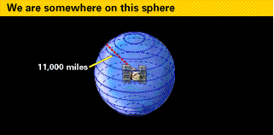
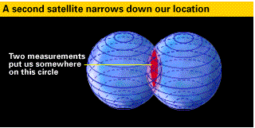
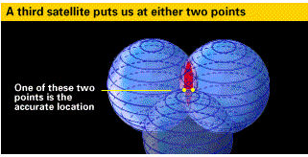
*Triangulation

Slide 42
Coarse-time navigation
A-GPS
  Ephemeris, Doppler shift, code phase, approximate position, almanac, time, frequency assists
Time assistance classification by mobile network (3GPP)
  Order of seconds → “coarse time assistance” (accuracy S)
    Can’t be used directly due to large errors in SV position
    SV moving at up to 800m/s → ±2 seconds → range error of ±1.7 kilometers
  Order of microseconds → “fine time assistance” (accuracy 10ms)
    Can be used directly, good TTFF

Slide 43
Coarse-time navigation
Advantages
  Obtaining a position fix under signal power conditions near or below data decoding threshold
  Energy savings obtained by using milliseconds of information to get a position fix instead of tracking SVs for six (or more) seconds to decode HOW
A priori
  A valid set of ephemerides
  Approximate user position within a few kilometers
  Approximate HOW accurate to within a few seconds
  Sub-millisecond pseudorange measurements

Slide 44
Coarse-time navigation
Without decoding HOW, receiver cannot synchronize to the satellites’ transmission times
  Leverage a nearby landmark to estimate NMS
    E.g. mobile phones → nearest cell tower (covers less than 10km)
  Light travels @ 300 km/ms → 2 locations within 150km of each other will have the same mS part of the propagation delay, (rounded to the nearest integer)
  Get the mS part of the pseudorange
  But sub-millisecond pseudorange measurements
    Modulo-1ms measurements → lack the integer-ms delay part! → up to 1ms error

Slide 45

Coarse-time navigation
Van Diggelen’s method to reconstruct the full pseudoranges while avoiding the integer rollover problem
  The signal travel time from SV k can be written as
    NMS and ϕ are mS and sub-mS components
    τ is actual travel time
    δ is satellite clock error (from ephemeris)
    ε is unknown errors
    b is common clock bias (to be eliminated through this process)

Slide 46
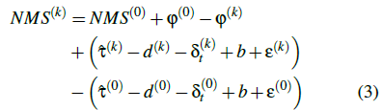
Coarse-time navigation
Select a reference satellite
  mS part of the pseudorange of the reference SV k=0
  Then

Slide 47

Coarse-time navigation
We have an initial position and coarse time close to the correct values (~ 100km and 1min), the order of magnitude is << 1/2s
Full pseudorange is estimated by using NMS as the millisecond part, and the sub-millisecond is obtained by the code phase estimate
With CTN, the only device-dependent data are the acquisition results
  Can be computed with as little as 1ms of raw signal → move the location computation completely to the cloud!

Slide 48
Outline
Introduction
GPS receiving overview
  GPS signals
  Acquisition
  Location calculation
  Coarse time navigation
Co-GPS design
  Shadow locations
  Guessing reference locations
  Solution pruning
  Accuracy considerations
  Web services
Evaluation
  Acquisition quality
  Overall location accuracy
  Time sensitivity
Platform implementation
  GPS sensing
  Time synchronization using WWVB
  Energy consumption
Related work
Conclusion

Slide 49
CO-GPS design
Leverages CTN principle but …
Remove the dependency on nearby landmarks
  E.g. embedded sensors without cellular connections that are expected to have high mobility over their lifetimes, it is not always possible to provide nearby landmarks
Leverage computing resources in the cloud to generate a number of candidate landmarks
  Use geographical constraints to filter out wrong solutions
Device = GPS receiver + time sync + data storage

Slide 50
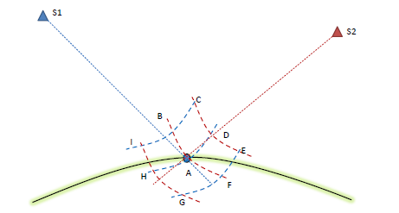
Shadow locations
Sense location! → turn on GPS to get at least 2ms of GPS baseband signal
  To avoid possible bit boundaries
No reference landmark → shadow locations
  No exact mS of delay → A,B,C,D, … are all feasible solutions (ambiguous)
  # of satellites is just one factor to solve the ambiguity

Slide 51
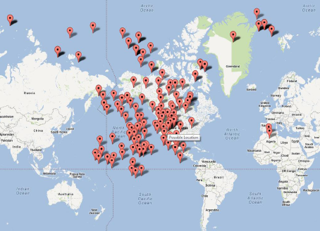
Shadow locations
Real GPS trace (1ms durations) + array of landmarks + 6 satellites in view
  Landmarks are generated by dividing the latitude and longitude with a 1° resolution around the globe
  180x360 =64800 landmarks with adjacent distance <= 111km
  166 converged points (w/o) landmark knowledge

Slide 52
Guessing reference locations
Reduce the # of possible landmark guesses
  Assume that sensor has not moved > 150km bet’n samples
  Use the past location as landmark
Following acquisition, we get visible SVs and frequency bin (identifying Doppler shift) for each SV
  Doppler tells relative velocity; absolute velocity can be obtained from ephemeris
  Derive each angle bet’n SV and receiver → define intersecting cones

Slide 53
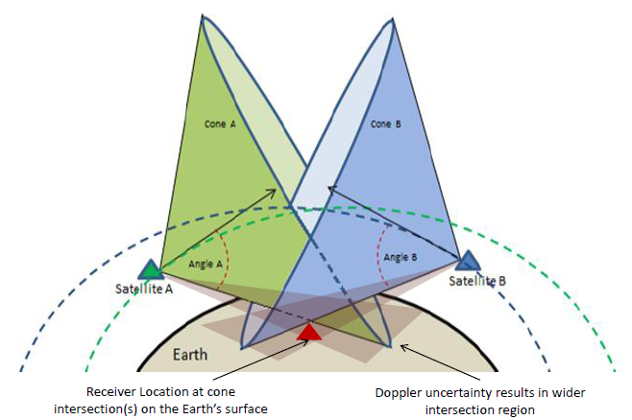
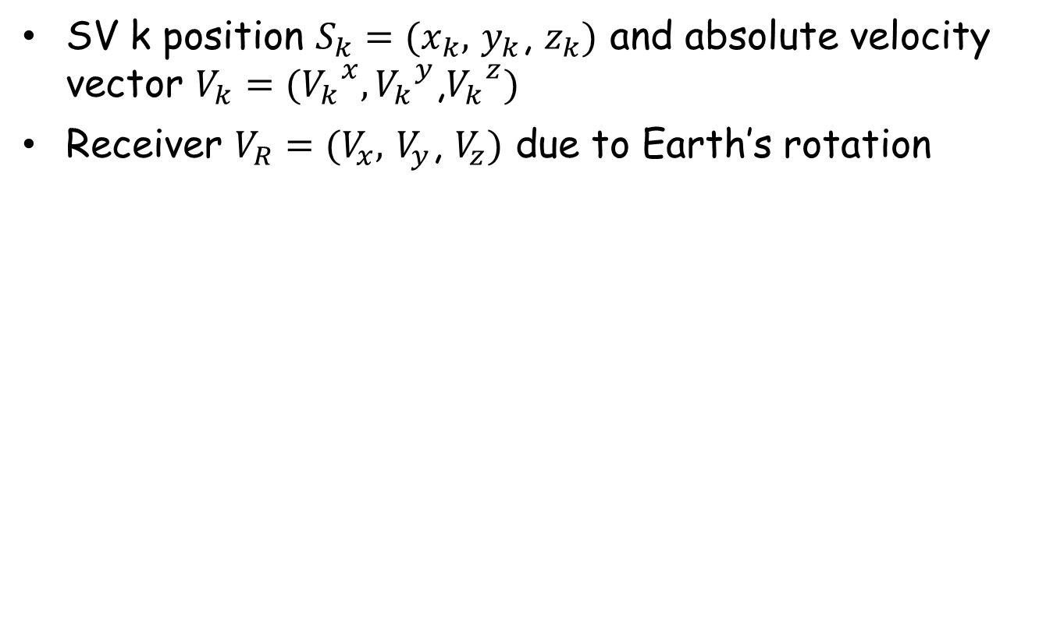
Guessing reference locations
SV k position $S_{k}=(x_{k},$ $y_{k}$, $z_{k})$ and absolute velocity vector $V_{k}=({V_{k}}_{}^{x},{V_{k}}_{}^{y}$,${V_{k}}_{}^{z})$
Receiver $V_{R}=(V_{x},$ $V_{y}$, $V_{z})$ due to Earth’s rotation

Slide 54


Guessing reference locations
Relative to Earth’s rotation and satellite movement, receiver movement is negligible
Angle betw’n 2 velocity vectors
K-th Doppler shift is
X,y,z are unknowns → need 3 SVs to identify intersection

Slide 55
Guessing reference locations
Challenges
  W/o precise timestamps, SV locations and velocities may contain errors
  Doppler shifts fall into bins as wide as 500Hz → worst case error : 95m/s in speed or 12° error in latitude
For implementations, start with assumptions as follows:
  Precise Doppler shifts
  Precise timestamps

Slide 56
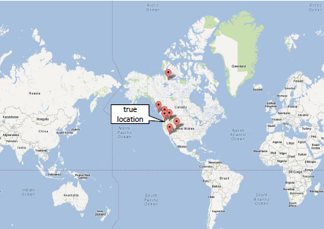
Solution pruning
Landmark guessing errors → cannot rule out shadow locations
Light-mS = 300km → elevation of shadow location far away from Earth’s surface
  Elevation = [-500,8000]m
  →

Slide 57
Solution pruning
Absolute elevation for each latitude/longitude is known from USGS → useful!
  Location D is computed when NMS for S2 is 1mS less than true NMS
  If ∠ (S2, tangent to Earth surface)=α, elevation diff bet’n A and D is ||zD - zA|| = 300 * sin(α)
  If α=15° (min elevation angle that GPS receivers consider a good view of a SV), ||zD - zA|| = 77km
  Adding more SVs makes diff even larger → unlikely that 2 locations 100s of kms apart that both elevations are correct

Slide 58
Accuracy considerations
Tradeoff bet’n accuracy & energy expense
GPS signal weak ← multipath, obstruction
  Typical GPS receivers use long signal durations & tracking loops → robust correlation spikes
  Energy and storage challenges for embedded sensor devices
CO-GPS only acquires code phases and Doppler shifts
  Timing & ephemeris derived off line
  Don’t decode signals → can use much shorter signal lengths
    Can detect only intermittently visible SVs or SVs with fading signal
Accuracy of timestamps
  CTN can tolerate some time stamp error ← treats common time bias as another optimization variable

Slide 59
Accuracy considerations
But if the error is too big, the least-squares may not converge or may converge to a wrong value
We can rely on clock radio
  Low power radio receiver can tune into a low frequency band (60KHz in US) to receive atomic clock synch signals
  Guaranteed to be present for a few hours every day in the entire continental US

Slide 60
Web services
Cloud responsibilities
  Update & maintain ephemeris DB
  Compute receiver locations given GPS raw data
Ephemeris service
  National Geodetic Survey of National Oceanic and Atmospheric Administration (NOAA) publishes SV orbits
    Final: takes a few weeks
    Rapid: at least one day behind
    Ultra-rapid: predicted, 4 times a day
  National Geospatial-Intelligence Agency
    Precise: 2 day latency
    Predicted: 7 days, less accurate
  Jet Propulsion Lab
    Real-time ephemeris, updated every minute, paid service

Slide 61
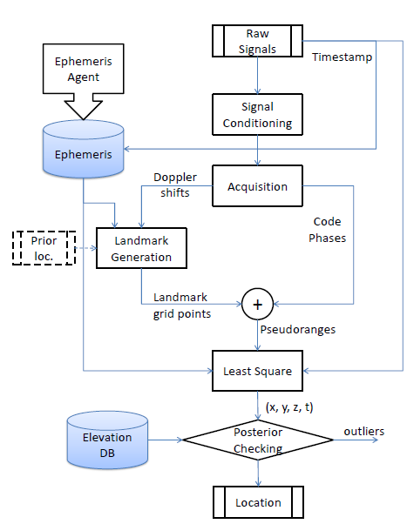
Web services
Location service
  Doppler and velocities determine initial landmarks
  Past location of receiver is used as a landmark
  Use CTN method to process each landmark

Slide 62
Outline
Introduction
GPS receiving overview
  GPS signals
  Acquisition
  Location calculation
  Coarse time navigation
Co-GPS design
  Shadow locations
  Guessing reference locations
  Solution pruning
  Accuracy considerations
  Web services
Evaluation
  Acquisition quality
  Overall location accuracy
  Time sensitivity
Platform implementation
  GPS sensing
  Time synchronization using WWVB
  Energy consumption
Related work
Conclusion

Slide 63
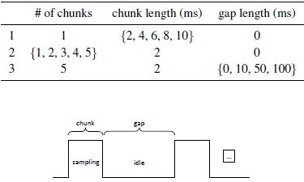
Evaluation
Uses about 100 sets of raw GPS data
  Taken from 6 different locations in both northern and southern hemisphere
  10~60 seconds
Server = Quadcore Intel Xeon 3520 @ 2.66GHz
  Acquisition : 2.6s
  CTN and least square: less than 300ms (X 10 landmarks = 3s)
Acquisition quality
  Tracking loop doesn’t help
    → rather duty cycle

Slide 64
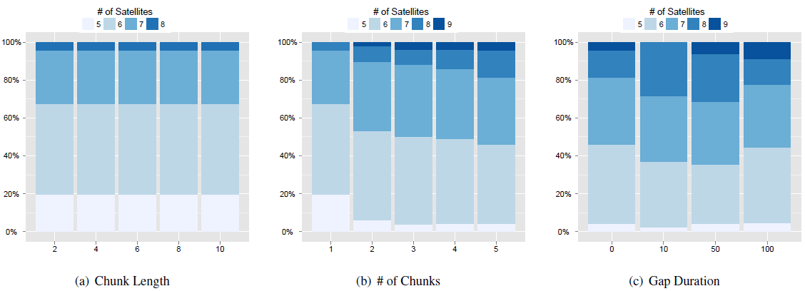
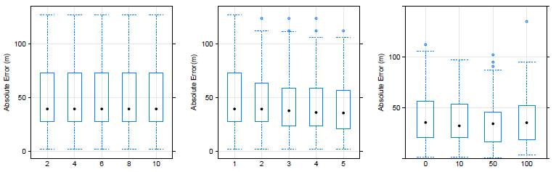
Acquisition quality

Slide 65
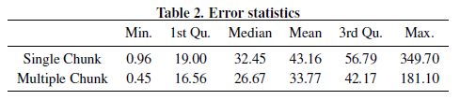
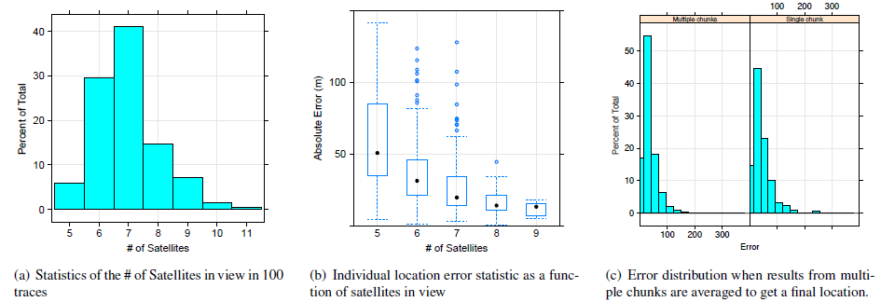
Overall location accuracy
As CO-GPS uses CTN, at least 5 SVs are required

Slide 66
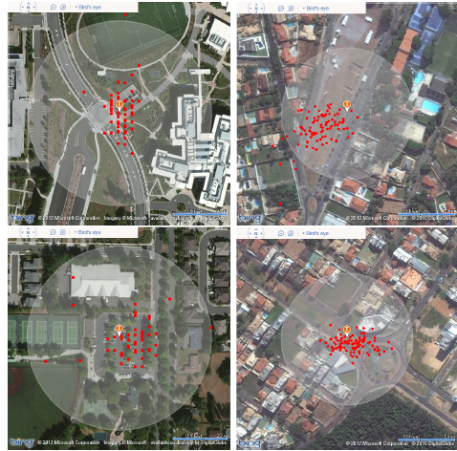
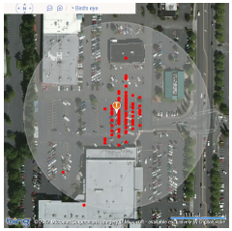
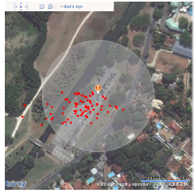
Overall location accuracy
On average, CO-GPS achieves < 35m accuracy with 10ms of data

Slide 67
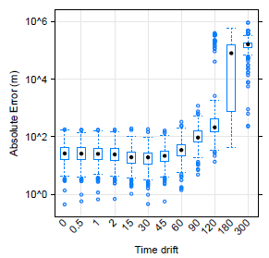
Time sensitivity
2 important pieces of information for CTN navigation
  Initial position
  TS corresponding to the moment GPS signal was collected
What is the effect of time drift increase?
  Under bad initial conditions, CTN navigation can’t estimate the pseudorange millisecond part properly
  3*10⁵m/ms → due to integer rollover

Slide 68
Outline
Introduction
GPS receiving overview
  GPS signals
  Acquisition
  Location calculation
  Coarse time navigation
Co-GPS design
  Shadow locations
  Guessing reference locations
  Solution pruning
  Accuracy considerations
  Web services
Evaluation
  Acquisition quality
  Overall location accuracy
  Time sensitivity
Platform implementation
  GPS sensing
  Time synchronization using WWVB
  Energy consumption
Related work
Conclusion

Slide 69
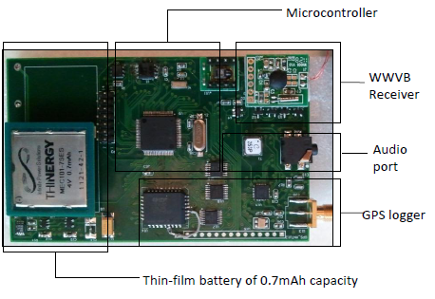
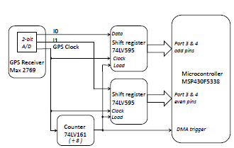
Platform implementation
GPS sensor platform named CLEO
  GPS receiver: Maxim MAX2769
  Microcontroller: TI MCU-MSP430F5338
  WWVB receiver module for time sync
  Serial flash chip for storage and glue logic
    8Mbit flash : 1000 GPS sample points
  Solar cell
  Thin-film Micro-Energy cell battery
  Hi-Jack audio communication port
Design goal: low energy consumption per GPS sample

Slide 70
Time sync using WWVB
Correct time stamping is essential for CO-GPS
CME6005 WWVB module offers universal time signal decoding from dedicated radio stations around the globe
  WWVB (US), DCF77(Europe), JJY (Japan), BPC (China) etc.
    2,400km away from WWVB, signal is available 47% of time indoors and 75% outdoors
    700km away from DCF77, 97% indoors
  Time sync can achieve 3.9ms (indoor) or 4.3ms (outdoor)
  Power consumption of CME6005 is 100uA (active) and 0.03uA (shutdown mode)
Between sync, CLEO uses real-time clock in the MCU
  32768Hz crystal → 20ppm accuracy → 1.728s/day drift
  Recollect 60s drift is tolerable → once/month sync

Slide 71
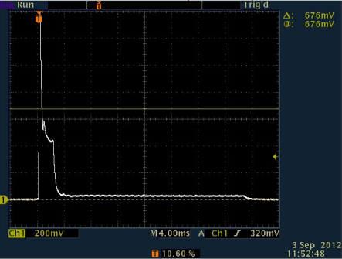

Energy consumption evaluation
Active working cycle for sampling and storing 2mS of GSP signal
  2mS for GPS receiving + 28.8ms for storing
Total energy
  3V x [1.5mA x 28.8ms + 42mA x 2.2ms ] = 0.407mJ
  Cf. A-GPS on mobile phone: 1J for the first location fix

Slide 72
Outline
Introduction
GPS receiving overview
  GPS signals
  Acquisition
  Location calculation
  Coarse time navigation
Co-GPS design
  Shadow locations
  Guessing reference locations
  Solution pruning
  Accuracy considerations
  Web services
Evaluation
  Acquisition quality
  Overall location accuracy
  Time sensitivity
Platform implementation
  GPS sensing
  Time synchronization using WWVB
  Energy consumption
Related work
Conclusion

Slide 73
Conclusion
Offloading GPS processing to the cloud
Using coarse-time navigation
Leveraging already available information on Web
  Satellite ephemeris
  Earth elevation
2ms of raw GPS signals is enough to obtain location fix
< 35m location-accuracy using 10ms of raw data (40KB)
Without need to do satellite acquisition, tracking, decoding, the receiver can be simple and duty-cycled
Built a prototype that uses 3 orders of magnitude energy-efficient

Slide 74
Thanks!

