Slide 1
Section 6.5: PPP over Ethernet (PPPoE)
이혁기
2015010635

Slide 2
For most LANs and some WAN connections, DHCP provides the most common method for configuring client systems. For WAN connections such as DSL, another method based on PPP is often used instead.
PPPoE is used in cases where the WAN connection device (e.g., DSL modem) acts as a switch or bridge instead of a router.
PPP is preferred as a basis for establishing connectivity by some ISPs because it may provide finer-grain configuration control and audit logs than other configuration options such as DHCP.
To provide Internet connectivity, some device such as a user’s PC must implement the IP routing and addressing functions.

Slide 3
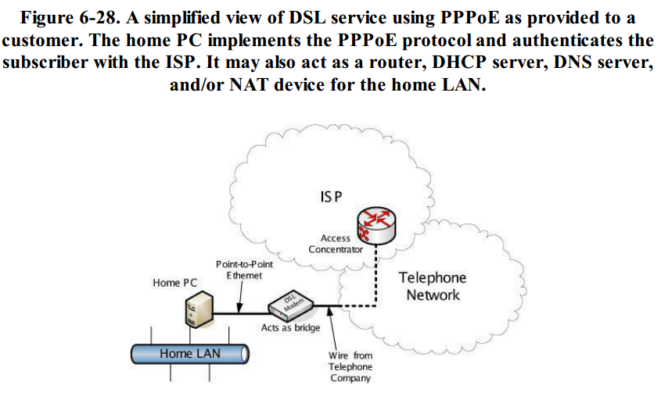

Slide 4
ISP providing services to many customers using D니
DSL provides a point-to-point digital link that can operate simultaneously with a conventional analog telephone line
The DSL modem effectively provides a bridged service to a PPP port on the ISP’s access concentrator (AC), which interconnects the customer’s modem line and the ISP’s networking equipment.
Once the DSL modem has successfully established a low-layer link with the ISP, the PC can begin the PPPoE exchange

Slide 5
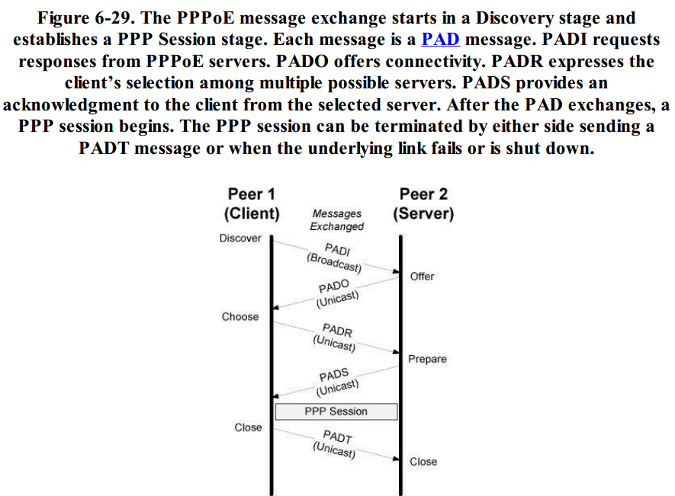

Slide 6
The protocol includes a Discovery phase and a PPP Session phase
The Discovery phase involves the exchange of several PPPoE Active Discovery (PAD) messages: PADI (Initiation), PADO (Offer), PADR (Request), PADS (Session Confirmation).
Once the exchange is complete, an Ethernet-encapsulated PPP session proceeds and ultimately concludes with either side sending a PADT (Termination) message
PPPoE messages use the format shown in Figure 6-30 and are encapsulated in the Ethernet payload area

Slide 7
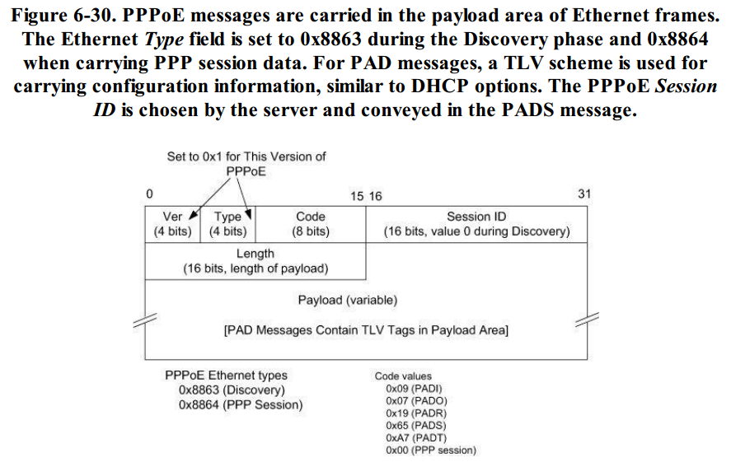

Slide 8
In Figure 6-30, the PPPoE Ver and Type fields are both 4 bits long and contain the value 0x1 for the current version of PPPoE.
The Code field contains an indication of the PPPoE message type
The Session ID field contains the value 0x0000 for PADI, PADO, and PADR messages and contains a unique 16-bit number in subsequent messages
PAD messages contain one or more tags, which are TLVs arranged as a 16-bit TAG_TYPE field followed by a 16-bit TAG_LENGTH field and a variable amount of tag value data. The values and meanings of the TAG_TYPE field are given in Table 6-2.

Slide 9
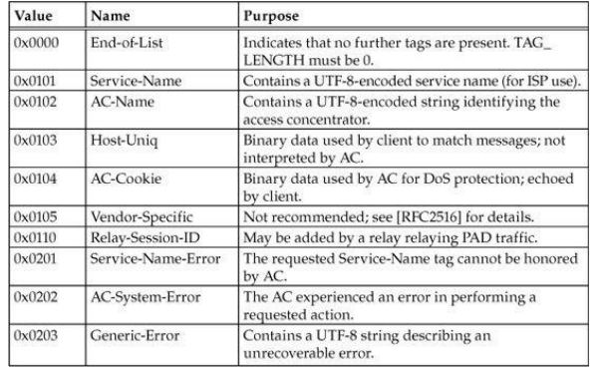

Slide 10
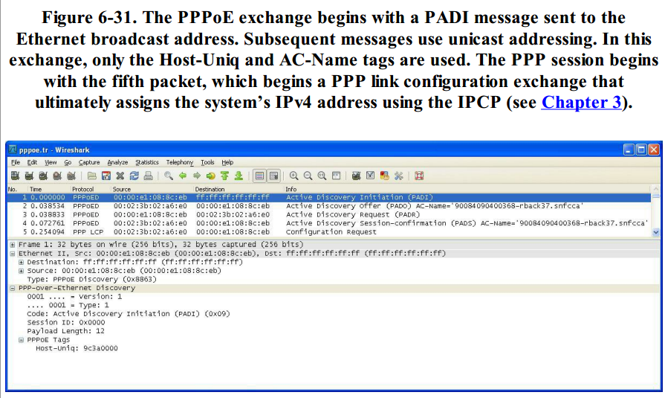

Slide 11
Figure 6-31 shows the expected exchange of PADI, PADO, PADR, and PADS messages
Each contains the Host-Uniq tag with value 9c3a0000. Messages coming from the concentrator also include the value 90084090400368-rback37.snfcca in the AC-Name tag. The PADS message can be seen in more detail in Figure 6-32.

Slide 12
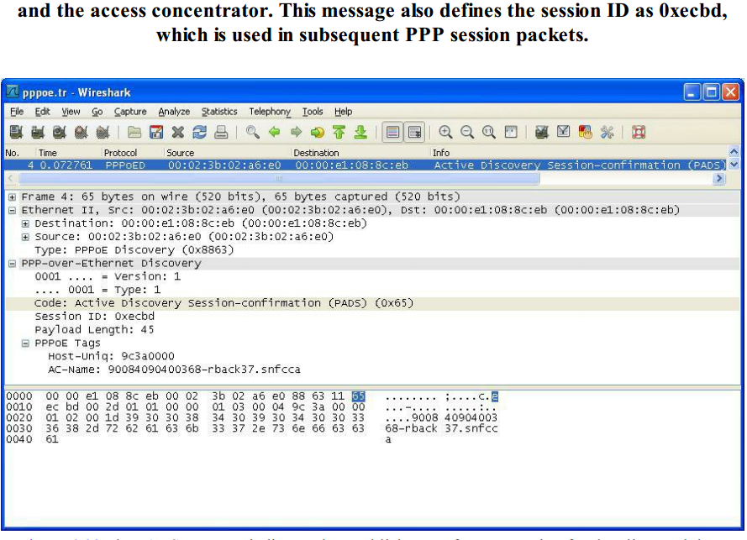

Slide 13
In Figure 6-32, the PADS message indicates the establishment of a PPP session for the client and the use of the session ID 0xecbd
The AC-Name tag is also maintained to indicate the originating AC
Figure 6-33 shows the first PPP session packet.

Slide 14
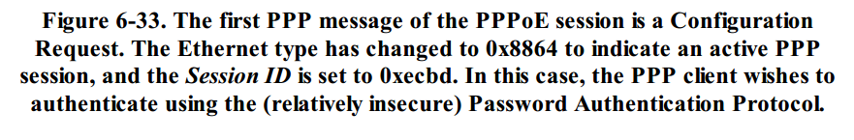
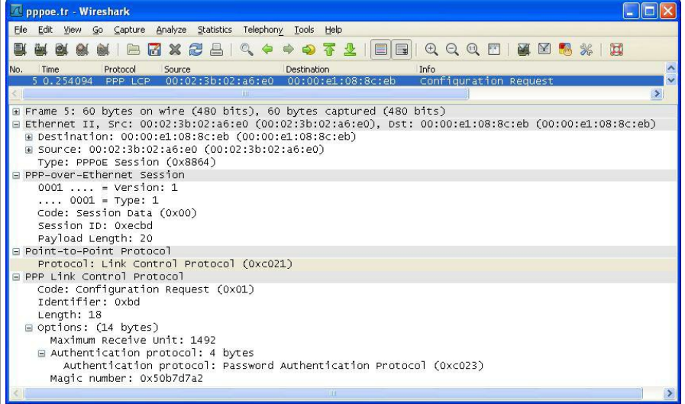

Slide 15
The figure indicates the beginning of the PPP Session phase within the PPPoE exchange
The PPP session begins with link configuration (PPP LCP) by the client sending a Configuration Request
Once the authentication exchange is complete and various link parameters are exchanged (e.g., MRU)
IPCP is used to obtain and configure the assigned IP address
Note that additional configuration information (e.g., IP addresses of the ISP’s DNS servers) may need to be obtained separately and, depending on the ISP’s configuration, configured by hand.

