Slide 1
Chapter 11
Data Link Control (DLC)
Framing, flow and error control, HDLC, PPP
Forouzan, Data Communications and Networking, 5th ed., Chapter 11
11.1 DLC services: framing, flow and error control, connections
11.2 Data-link protocols: Simple, Stop-and-Wait, piggybacking
11.3 HDLC: transfer modes, frames, control field
11.4 PPP: framing, phases, LCP, PAP and CHAP, IPCP, Multilink
Added: framing, ARQ, HDLC and PPP in use today, step-by-step figure builds, errata

Slide 2
11.1
DLC services
Data-link layer = DLC + MAC: DLC here, MAC in Chapter 12
DLC: node-to-node procedures, dedicated or broadcast link
Functions: framing, flow control, error control, connection handling
Physical layer: bit synchronization, same bit duration and timing
Data-link layer: frame synchronization, where each frame starts and ends
Analogy, envelope: delimiter + sender and receiver addresses
Destination address: where the frame goes
Source address: lets the receiver acknowledge
Many small frames, not one big one
One bit error → resend the whole big frame
Small frames → resend only the frame hit
Frame size: fixed (ATM cell) or variable (LANs, HDLC, PPP)
Variable size needs delimiters: character-oriented or bit-oriented framing
Network layer
Part IV: end to end
Data link control (DLC)
Chapter 11: node to node
Media access control (MAC)
Chapter 12: shared links
Physical layer
Part II: bits as signals
New Data-link layer = DLC + MAC
2

Slide 3
11.1.1
Fixed-size frames still need delineation
test HEC at
every bit position
check HEC
cell by cell
locked: cell
boundaries known
correct HEC
δ correct
in a row
HUNT
PRESYNC
SYNC
incorrect HEC
α incorrect in a row
New HEC-based cell delineation (ITU-T I.432)
Fixed size: no flag, frame length known in advance
Book: "size itself is the delimiter"
Only after the receiver has locked onto a boundary
ATM cell: 53 bytes = 5-byte header + 48-byte payload
5th header byte = HEC, CRC-8 over the first 4
HEC cell delineation
HUNT: slide bit by bit until HEC checks
PRESYNC: HEC must hold for δ cells in a row
SYNC: lost after α failures in a row
Same idea: T-1 frame alignment (Chapter 6)
Today: GFP over SDH/OTN finds variable frames the same way, 2-byte length + CRC-16
3

Slide 4
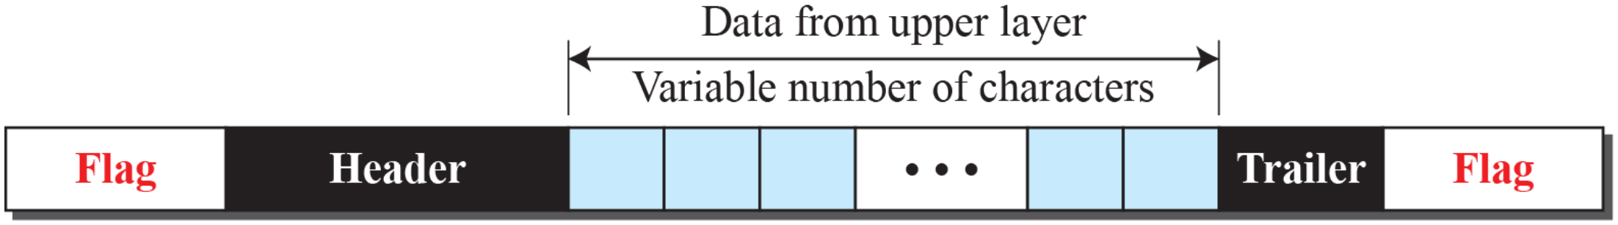
11.1.1
Character-oriented framing
Figure 11.1 A frame in a character-oriented protocol
Data: 8-bit characters, e.g. ASCII
Header: addresses, control information
Trailer: error-detection bits (Chapter 10)
Header and trailer: multiples of 8 bits
Flag: one protocol-dependent special byte at start and end
Fine while only text crossed the link
Binary data (images, audio, video): any byte value may appear
Flag pattern inside data → receiver sees a false end of frame
Fix: byte stuffing, next slide
4

Slide 5
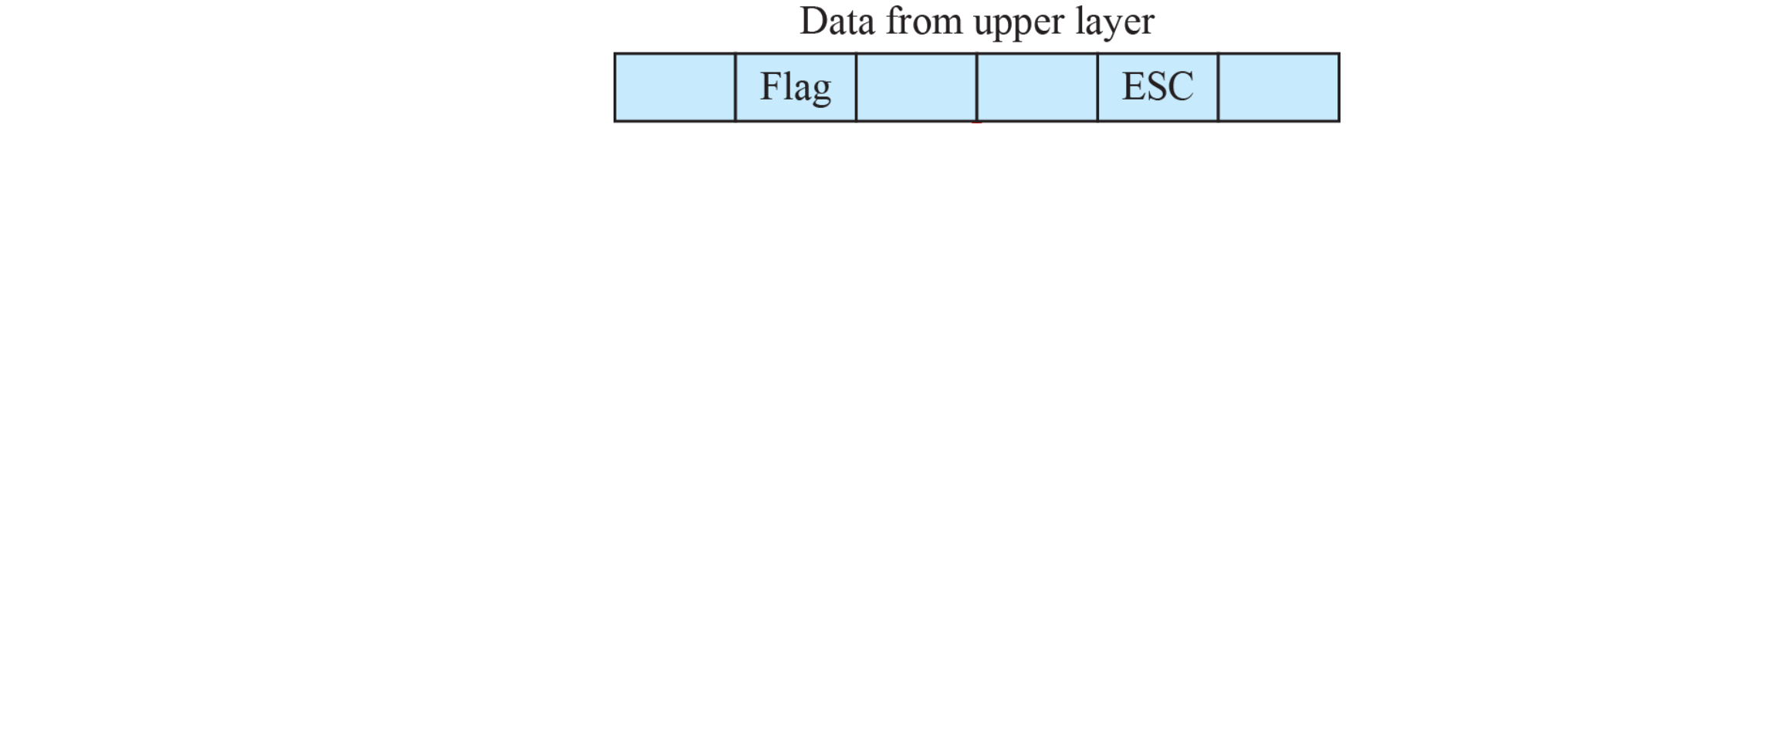
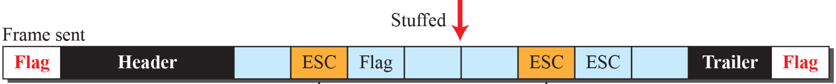
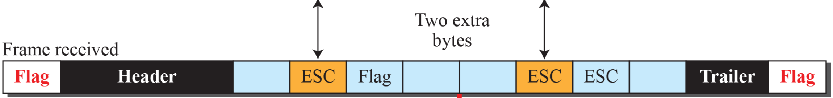

11.1.1
Byte stuffing
Sender: insert ESC before every data byte equal to Flag or ESC
Receiver: remove ESC, keep the next byte as data
ESC inside data also escaped: ESC ESC
Else a data ESC followed by Flag is misread
Receiver order: find the flags first, then unstuff
Overhead: 0 to 100%, worst case every byte escaped
Book: Unicode breaks byte stuffing? No: stuffing ignores content, any byte stream works
PPP's real rule: ESC 0x7D, then the byte XOR 0x20 (11.4.2)
Figure 11.2 Byte stuffing and unstuffing
5
Notes:
Animation: 3 clicks: stuffed frame, received frame, unstuffed data

Slide 6
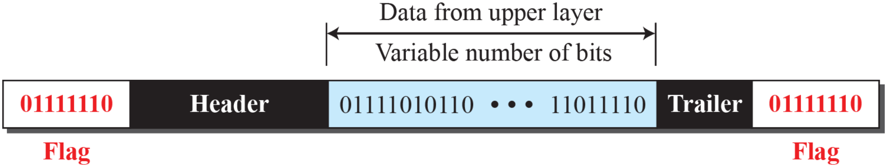
11.1.1
Bit-oriented framing
Figure 11.3 A frame in a bit-oriented protocol
Data: a bit sequence, any content
Flag: 01111110 (0x7E) at both ends
Same problem: flag pattern inside the data
Fix: bit stuffing, 1 bit instead of 1 byte
Sender: 0 then five 1s → insert 0, whatever the next bit
Receiver: 0, five 1s, 0 → drop that 0
Receiver: 0, six 1s, 0 → flag
Seven or more 1s → abort
Stuffed frame never holds six 1s in a row: flag stays unique
Overhead: at most 1 bit per 5 data bits (20%)
6

Slide 7
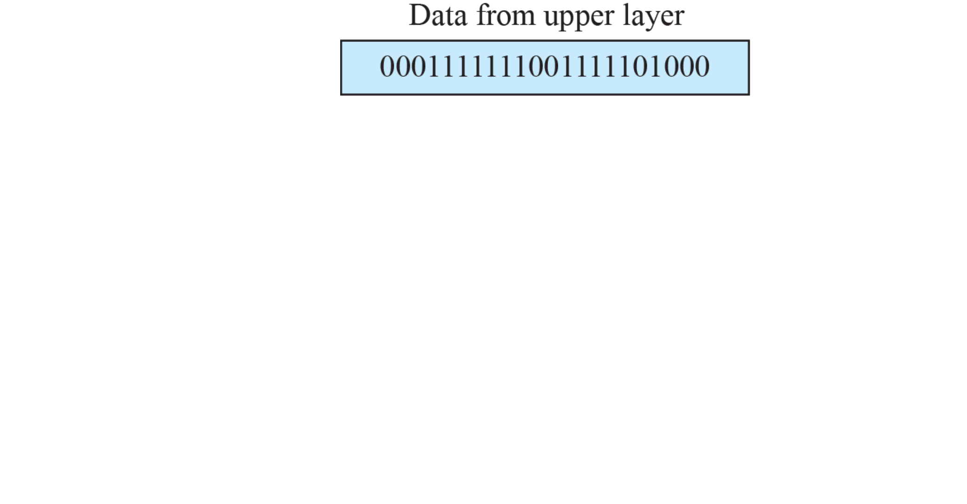



11.1.1
Bit stuffing, worked example
Data: 0001111111001111101000
Sent: 000111110110011111001000
Two stuffed 0s, each after a 0 and five 1s
1st: inside a run of seven 1s
2nd: next data bit already 0, stuffed anyway
Flag-like data 01111110 → sent as 011111010
Real flags never stuffed: receiver recognizes them
Receiver: find flags, then remove stuffed 0s
Same trick elsewhere: USB (after six 1s), CAN (after five equal bits), for clock recovery
Figure 11.4 Bit stuffing and unstuffing
7
Notes:
Animation: 3 clicks: stuffed frame, received frame, unstuffed data

Slide 8
Today
Where frame boundaries come from now
Link | Frame boundary | Stuffing
HDLC, PPP (serial, SONET/SDH) | Flag 0x7E | Bit or byte stuffing
USB 1.x and 2.0 | SYNC pattern, end-of-packet line state | Bit stuffing after six 1s, keeps NRZI transitions
CAN bus | Start-of-frame bit, fixed field layout | Stuff bit after five equal bits
Ethernet | Preamble + SFD, PHY code groups mark start and end (8b/10b, 64b/66b) | None
GFP over SDH/OTN (G.7041) | 2-byte length + CRC-16 core header, hunted like ATM | None
Wi-Fi A-MPDU | 4-byte delimiter: length, CRC-8, signature 0x4E | None
5G NR MAC | Size known from the grant (DCI), subheaders carry lengths | None
Trend: not bit-oriented, as the book says, but length fields and PHY coding, no stuffing
Stuffing survives with flags: HDLC family, PPP, low-speed buses
8

Slide 9
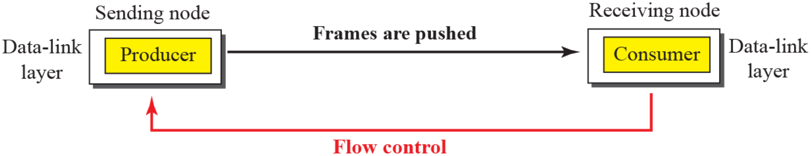
11.1.2
Flow control
Figure 11.5 Flow control at the data-link layer
Producer faster than consumer: consumer overwhelmed, frames dropped
Producer slower: consumer waits, lower efficiency
Flow control: prevent loss at the consumer
Four entities: network and data-link layers at each node
Here: only the two data-link layers
Feedback: receiver tells sender to stop or slow down
Buffers at sending and receiving DLC
Receiver buffer full → "stop"
Space again → "send more"
Example 11.1: one-slot buffer, slot empty → "send the next frame"
This is the ACK of Stop-and-Wait (11.2.2)
9

Slide 10
11.1.2
Error control and connections
Physical layer unreliable → error control at DLC
CRC: added by sender in the trailer (FCS), checked by receiver
Book says "header": it is the trailer
Method 1: corrupted → silently discard, intact → deliver
Wired LANs, Ethernet
Method 2: corrupted → discard, intact → deliver + ACK
ACK serves flow and error control
No ACK before timeout → sender assumes loss
NAK: explicit negative acknowledgment (HDLC REJ, SREJ)
11.1.3 Connectionless: independent, unnumbered frames, no ordering
Not "no physical link": no relation between frames
Most LAN data-link protocols
Connection-oriented: setup → transfer → teardown
Frames numbered, delivered in order
Some point-to-point links, wireless LANs, WANs
10

Slide 11
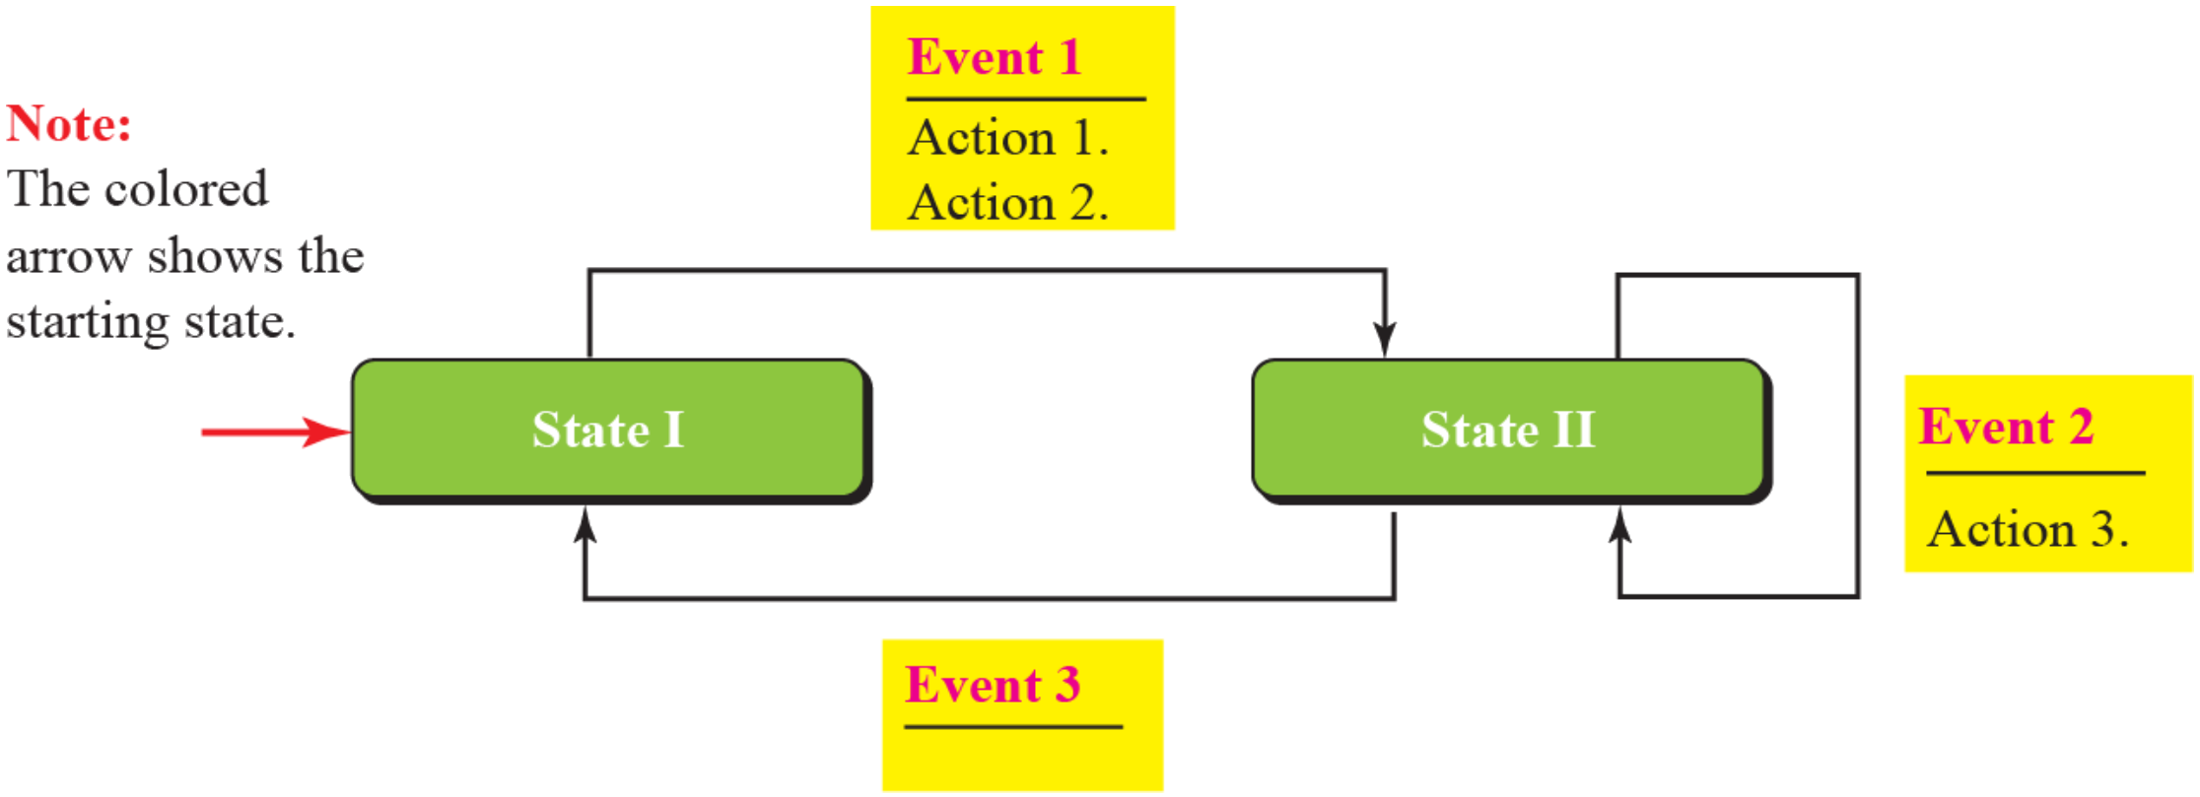
11.2
Data-link protocols and FSMs
Classic four: Simple, Stop-and-Wait, Go-Back-N, Selective-Repeat
This chapter: first two, all four in Chapter 23
Book: last two "disappeared" → alive in wireless links (Today)
FSM: finite number of states
Stays in a state until an event
Event → actions (maybe none) + next state (maybe same)
One initial state, marked by the colored arrow
Figure 11.6: two states
State I, event 1 → actions 1, 2 → State II
State II, event 2 → action 3, stay
State II, event 3 → no action → State I
Book text: "three states", "event 1 → action 3": wrong
Figure 11.6 An example FSM
11

Slide 12
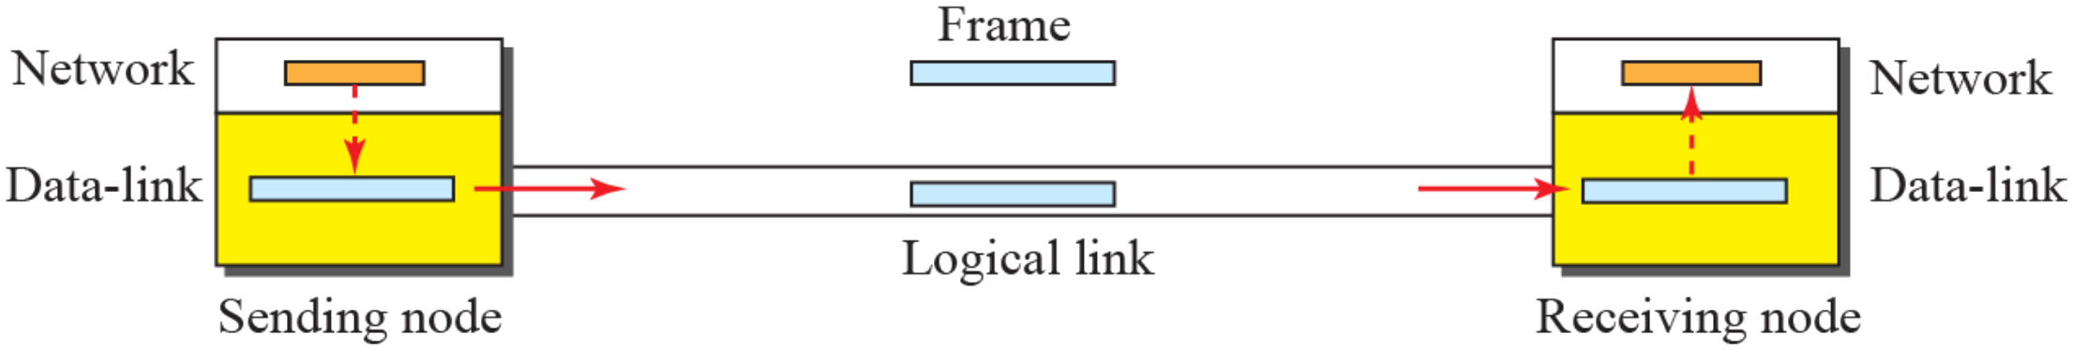
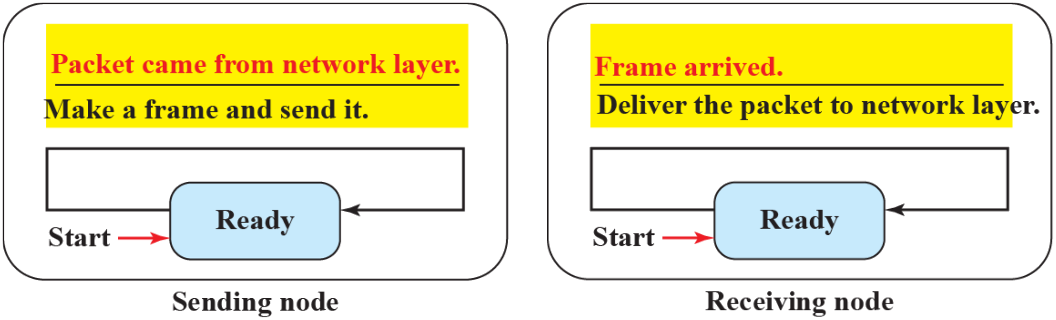
11.2.1
Simple protocol
No flow control, no error control
Assumption: receiver handles every frame at once, never overwhelmed
Sender DLC: packet from network layer → frame → send
Receiver DLC: frame → extract packet → deliver
FSMs: one state each, Ready
Sender waits for a packet from its network layer
Receiver waits for a frame from the link
Figure 11.7 Simple protocol
Figure 11.8 FSMs for the simple protocol
12

Slide 13
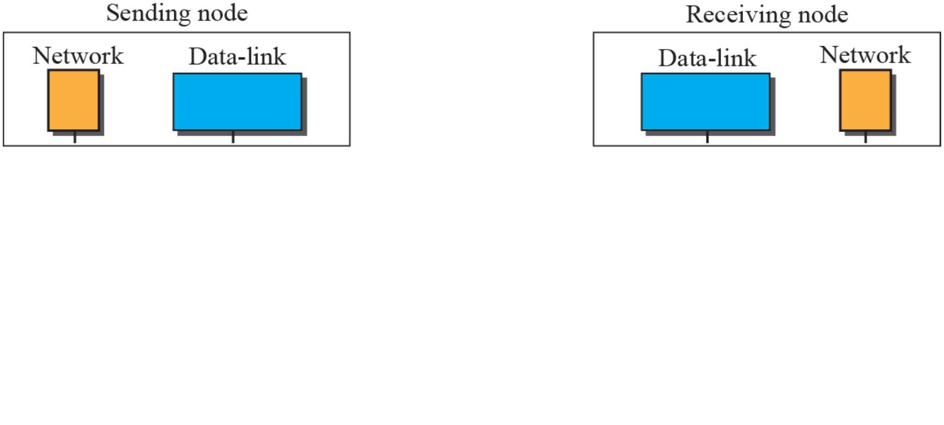
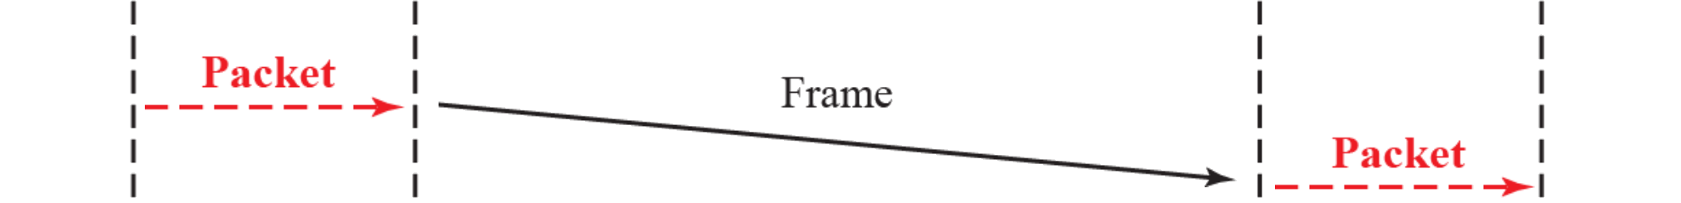
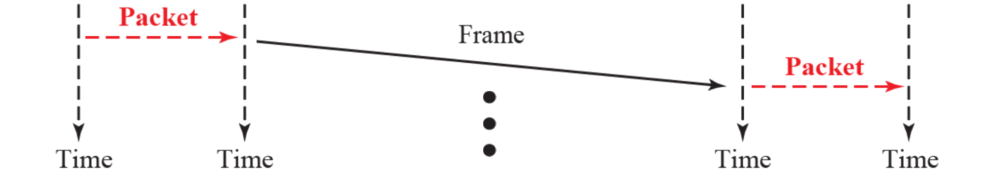
Example 11.2
Simple protocol in action
Sender: frames back to back, no waiting
Receiver: delivers each packet on arrival
Nothing flows back: no ACK, no feedback
Safe only if the receiver keeps up and the link never errs
Figure 11.9 Flow diagram for Example 11.2
13
Notes:
Animation: 2 clicks, one frame each

Slide 14
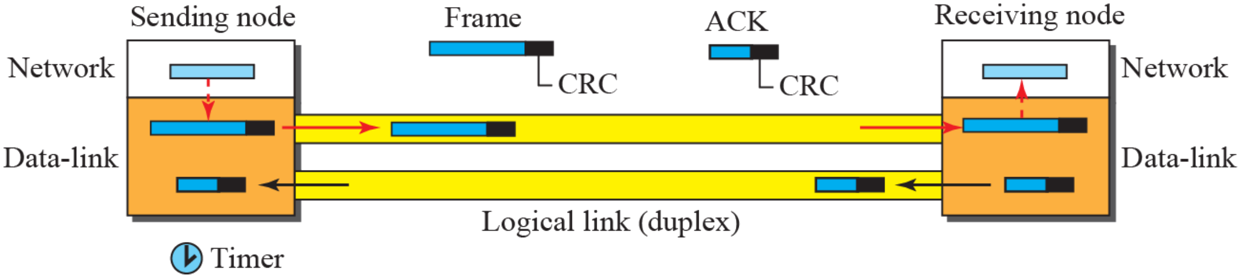
11.2.2
Stop-and-Wait protocol
Figure 11.10 Stop-and-Wait protocol
Flow control + error control
One frame at a time: wait for ACK before the next
CRC on each data frame: corrupted → silently discarded
Receiver silence = frame lost or corrupted
Timer: started at each send
ACK in time → stop timer, send next frame
Timeout → resend the saved copy
Sender keeps a copy until its ACK arrives
At most one frame and one ACK on the link
14

Slide 15
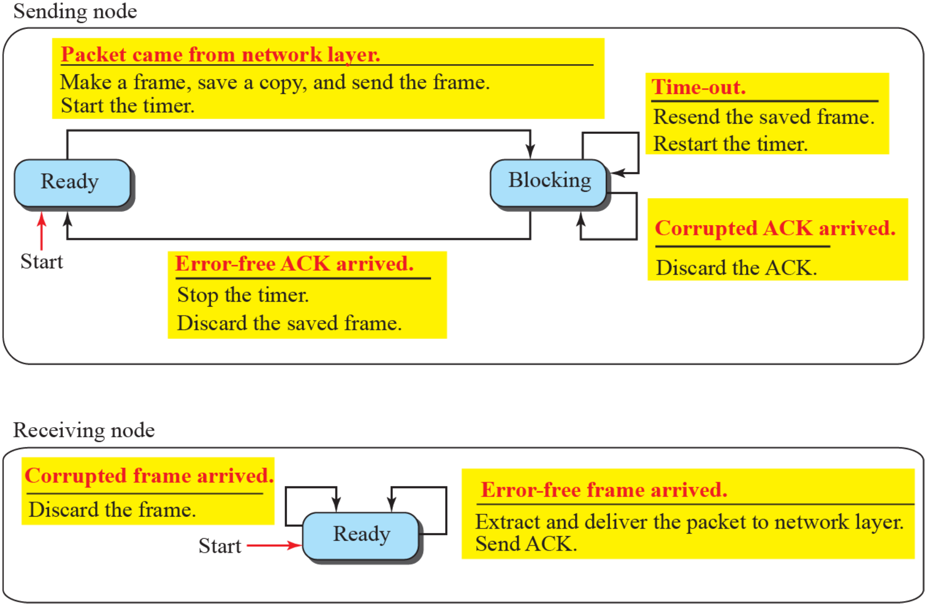
11.2.2
Stop-and-Wait FSMs
Sender, Ready state
Packet arrives → make frame, save copy, start timer, send → Blocking
Sender, Blocking state
Timeout → resend saved frame, restart timer
Corrupted ACK → discard it
Error-free ACK → stop timer, discard copy → Ready
Receiver, always Ready
Error-free frame → deliver packet, send ACK
Corrupted frame → discard
Figure 11.11 FSM for the Stop-and-Wait protocol
15

Slide 16
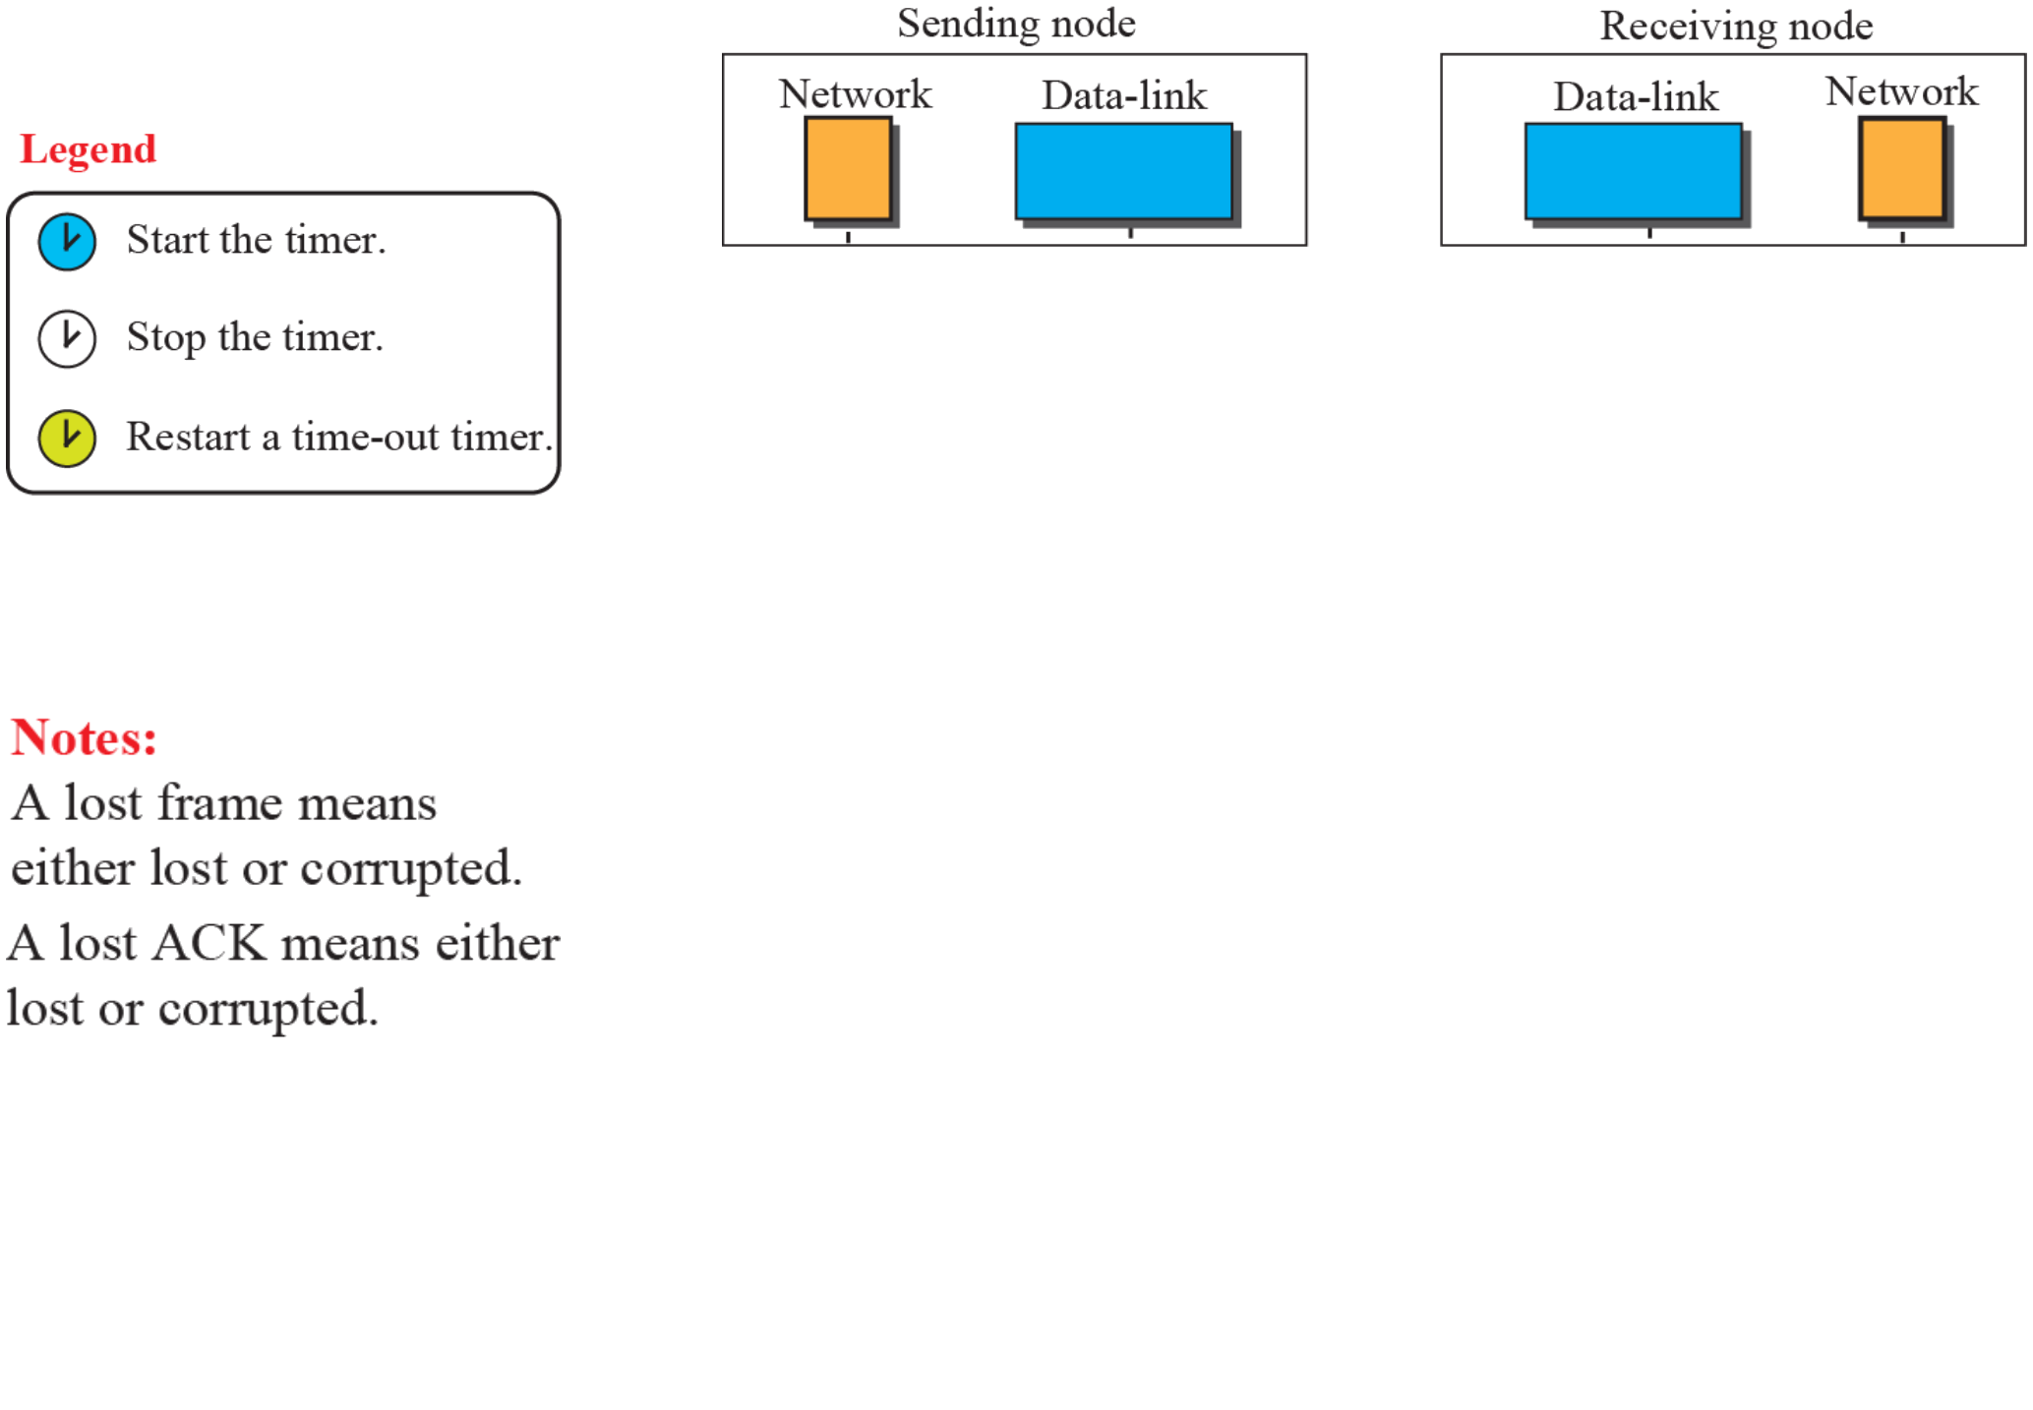
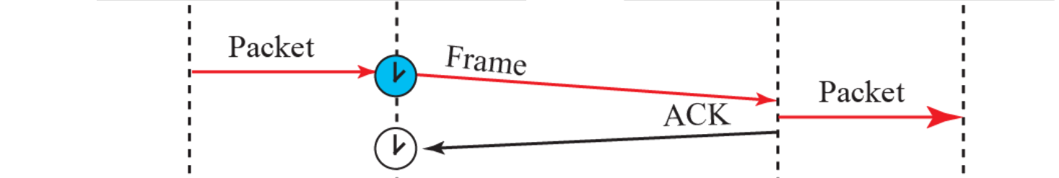
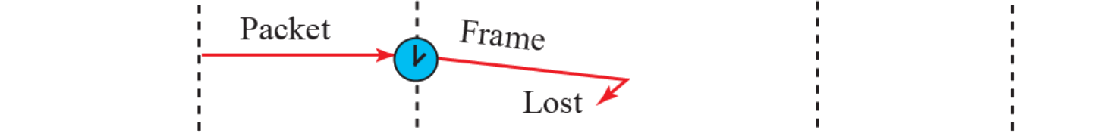
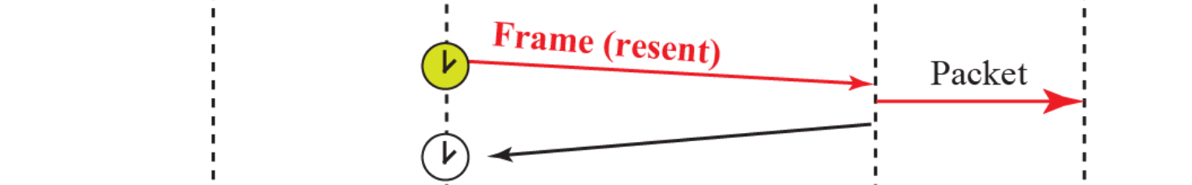
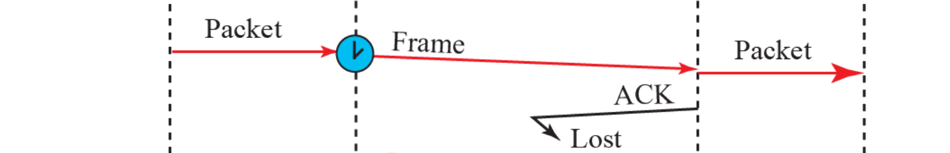
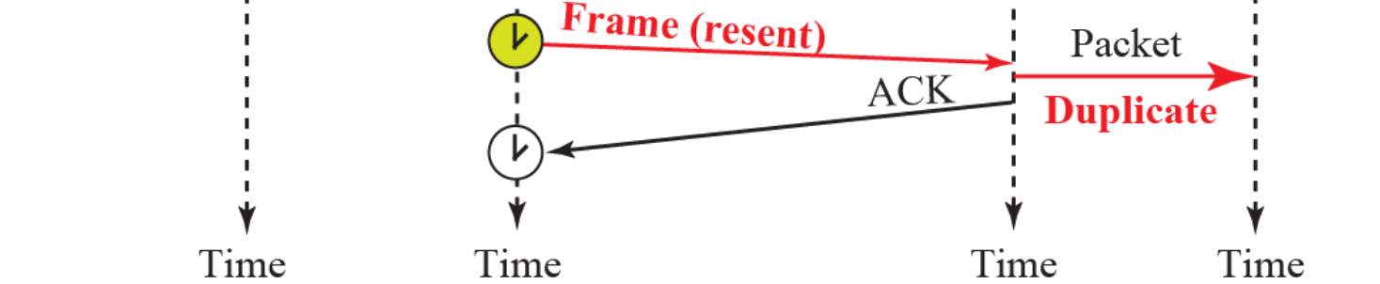
Example 11.3
Lost frame, lost ACK
Frame 1: sent, acknowledged
Frame 2: lost → timeout → resent
Frame 3: delivered, ACK lost → timeout → resent
Receiver delivers packet 3 twice: duplicate
Lost: lost or corrupted, frame or ACK
Fix: number the frames and the ACKs
Figure 11.12 Flow diagram for Example 11.3
16
Notes:
Animation: 5 clicks, one exchange each

Slide 17
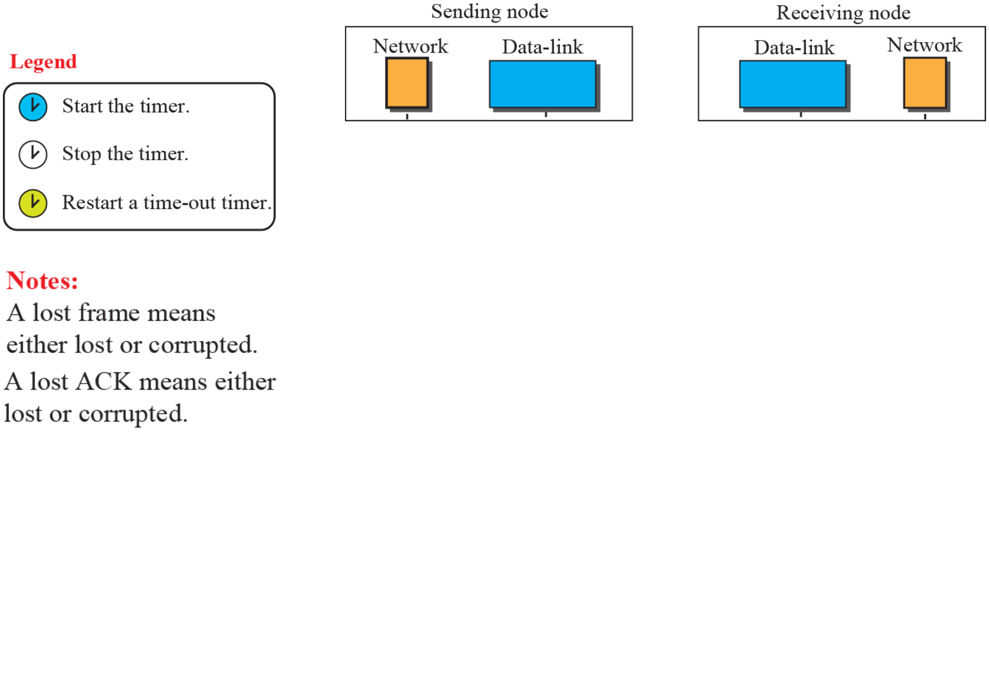
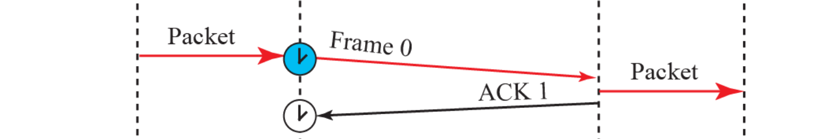
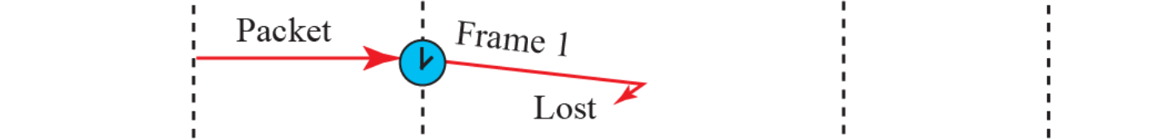
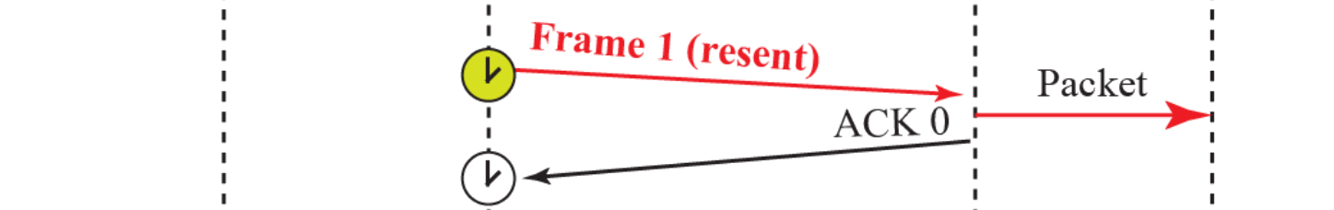
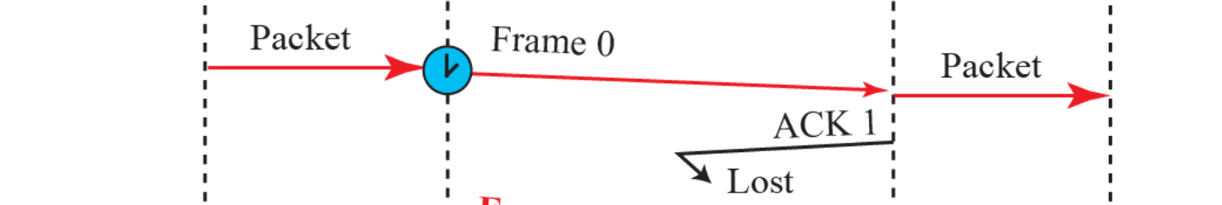
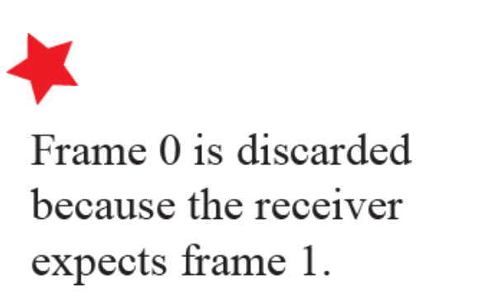
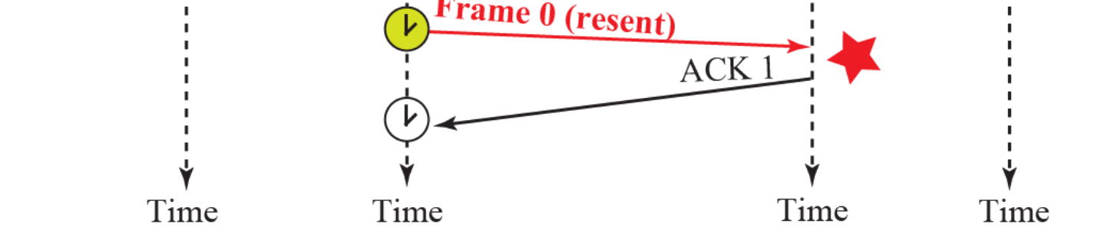
Example 11.4
Sequence and acknowledgment numbers
Duplicates as harmful as corruption: an online order placed twice
Sequence numbers: 0, 1, 0, 1, …
ACK numbers: 1, 0, 1, 0, …
ACK n = next frame expected is n
1 bit suffices: one frame outstanding
Example 11.4
Frame 0 → ACK 1
Frame 1 lost → resent → ACK 0
Frame 0 delivered, ACK 1 lost → Frame 0 resent
Receiver expects 1: discards it, re-sends ACK 1
In use: Bluetooth LE link layer, 1-bit SN and NESN (next expected SN)
Figure 11.13 Flow diagram for Example 11.4
17
Notes:
Animation: 5 clicks, one exchange each, the last also shows the discard note

Slide 18
11.2.3
Piggybacking, efficiency, ARQ today
Piggybacking: ACK rides on reverse data
HDLC N(R), TCP (Ch. 24)
Stop-and-Wait on long links: U = T_{f} / (T_{f} + RTT)
1 Gbps, 1500 bytes: T_{f} = 12 μs
100 m LAN, RTT ≈ 1 μs: U ≈ 92%
1000 km fiber, RTT ≈ 10 ms: U ≈ 0.12%
Fix: many frames in flight
Go-Back-N, Selective Repeat (Ch. 23)
Parallel Stop-and-Wait (HARQ)
Book: last two "disappeared": wireless links still need them
Link | Scheme | Numbering, window
Bluetooth LE | Stop-and-Wait | 1-bit SN and NESN
Wi-Fi 802.11 | Stop-and-Wait, Block Ack for aggregates (selective) | Window 64, 256 (11ax), 1024 (11be)
LTE, 5G NR HARQ | Parallel Stop-and-Wait processes + soft combining | LTE FDD 8, NR up to 16 (32 for NTN)
LTE, 5G NR RLC AM | Selective Repeat, receiver status reports | NR: 12- or 18-bit SN
LAPB, LAPD (HDLC) | Go-Back-N with REJ | Modulo 8 or 128
Ethernet, PPP | None: drop bad frames | Upper layers recover (TCP)
Today Link-layer ARQ in use
18

Slide 19
11.3
HDLC
High-level Data Link Control: bit-oriented, ISO/IEC 13239
Links: point-to-point, multipoint
Stations: primary + secondaries, or balanced peers
Book: "implements Stop-and-Wait" → sliding window
3-bit numbers: 7 outstanding, 7-bit: 127
REJ → Go-Back-N, SREJ → Selective Repeat
Book: "theoretical" → HDLC family still deployed
Not the Ethernet frame: no flags, no stuffing
Protocol | Where it runs
LAPB | X.25 packet networks (legacy), base of AX.25 amateur packet radio
LAPD, LAPDm | ISDN D channel, GSM signaling over the radio link
LAPF | Frame Relay
Cisco HDLC | Default encapsulation on Cisco serial WAN interfaces
PPP in HDLC-like framing | RFC 1662, Packet over SONET/SDH (RFC 2615)
IEEE 802.2 LLC | HDLC-style I, S, U control field on 802 LANs
IEC 62056-46 | Electricity meter reading (DLMS/COSEM) over HDLC
Today HDLC family in use
19

Slide 20
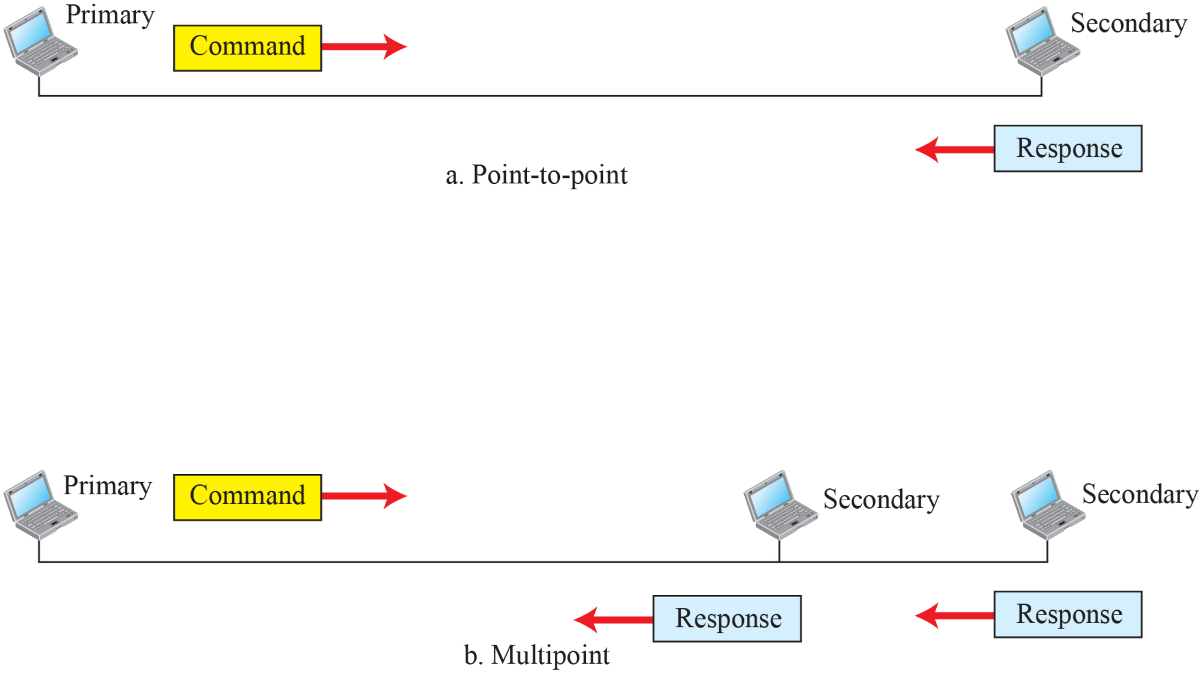
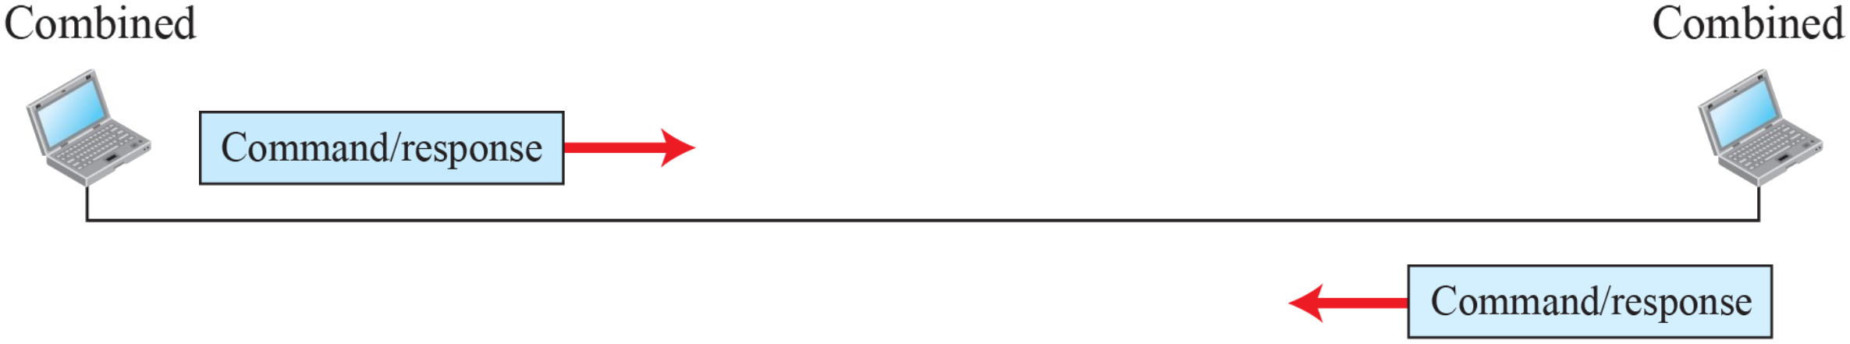
11.3.1
Transfer modes: NRM and ABM
NRM, normal response mode: unbalanced
One primary: sends commands
Secondaries: only respond
Point-to-point or multipoint
ABM, asynchronous balanced mode: balanced
Point-to-point only
Each station combined: primary + secondary
Either side may start: peers
Common mode today (LAPB, LAPD)
Figure 11.14 Normal response mode
Figure 11.15 Asynchronous balanced mode
20

Slide 21
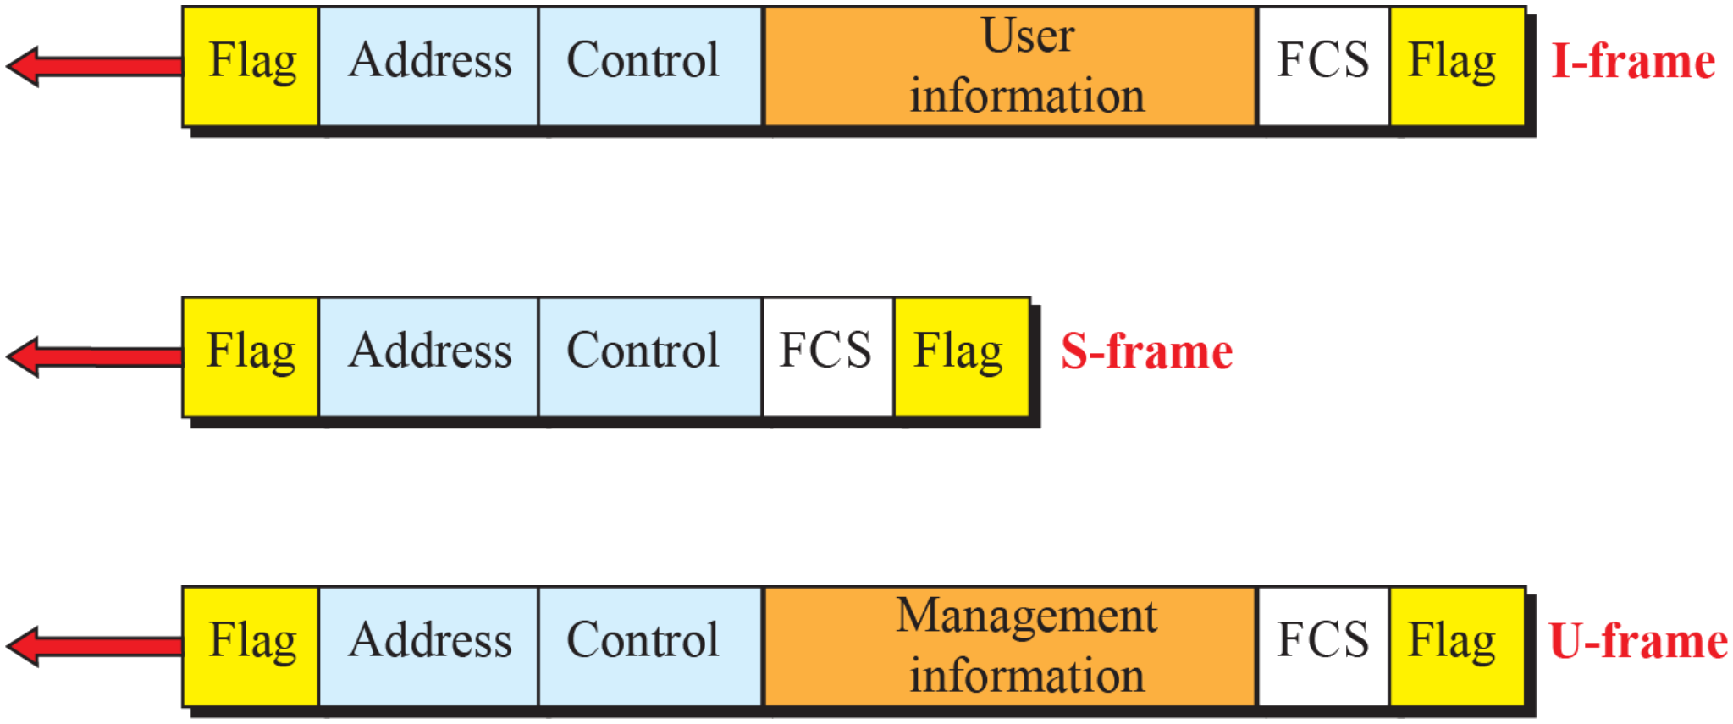
11.3.2
HDLC frames
I-frame: user data + piggybacked control
S-frame: flow and error control only, no information field
U-frame: link management
Fields
Flag: 01111110 at start and end
Address: secondary station, 1 or more bytes
From primary: "to" address, from secondary: "from" address
Control: 1 or 2 bytes, frame type and numbers
Information: user data (I) or management data (U)
FCS: CRC-16 or CRC-32
Back-to-back frames may share one flag
Figure 11.16 HDLC frames
21

Slide 22
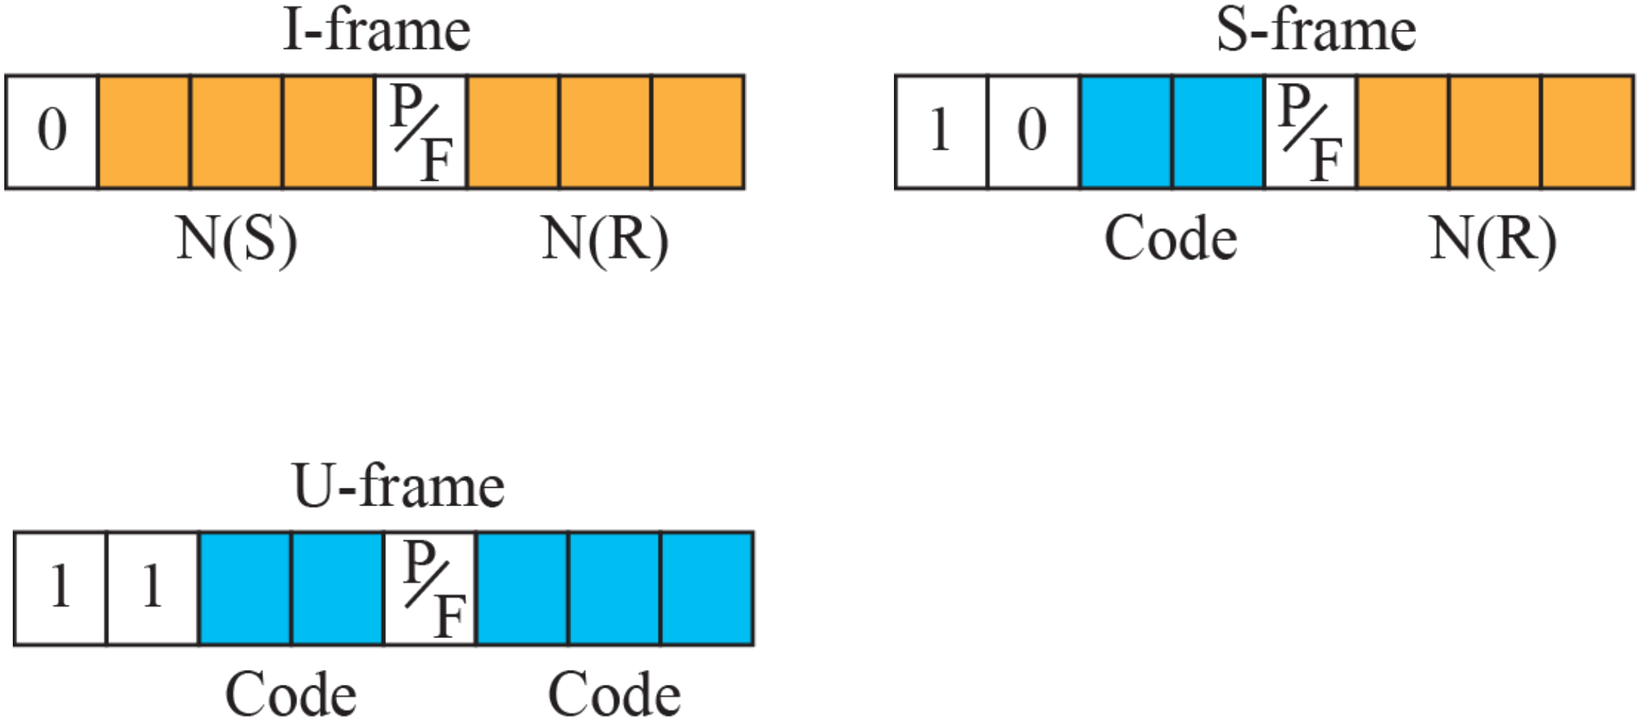
11.3.2
Control field
First bits = type: 0 → I, 10 → S, 11 → U
I-frame: N(S) 3 bits, P/F, N(R) 3 bits
N(S): sequence number of this frame
N(R): piggybacked ACK, next frame expected
P/F: Poll (primary → secondary), Final (secondary → primary)
S-frame codes, with N(R)
RR 00: ACK, ready for more
RNR 10: ACK, but busy, stop
REJ 01: NAK, resend from N(R) (Go-Back-N)
SREJ 11: NAK, resend only N(R) (Selective Repeat)
U-frame: 2 + 3 code bits → up to 32 types (SABM, UA, DISC, …)
Extended mode: 2-byte control, 7-bit N(S) and N(R)
Figure 11.17 Control field format for the different frame types
22

Slide 23
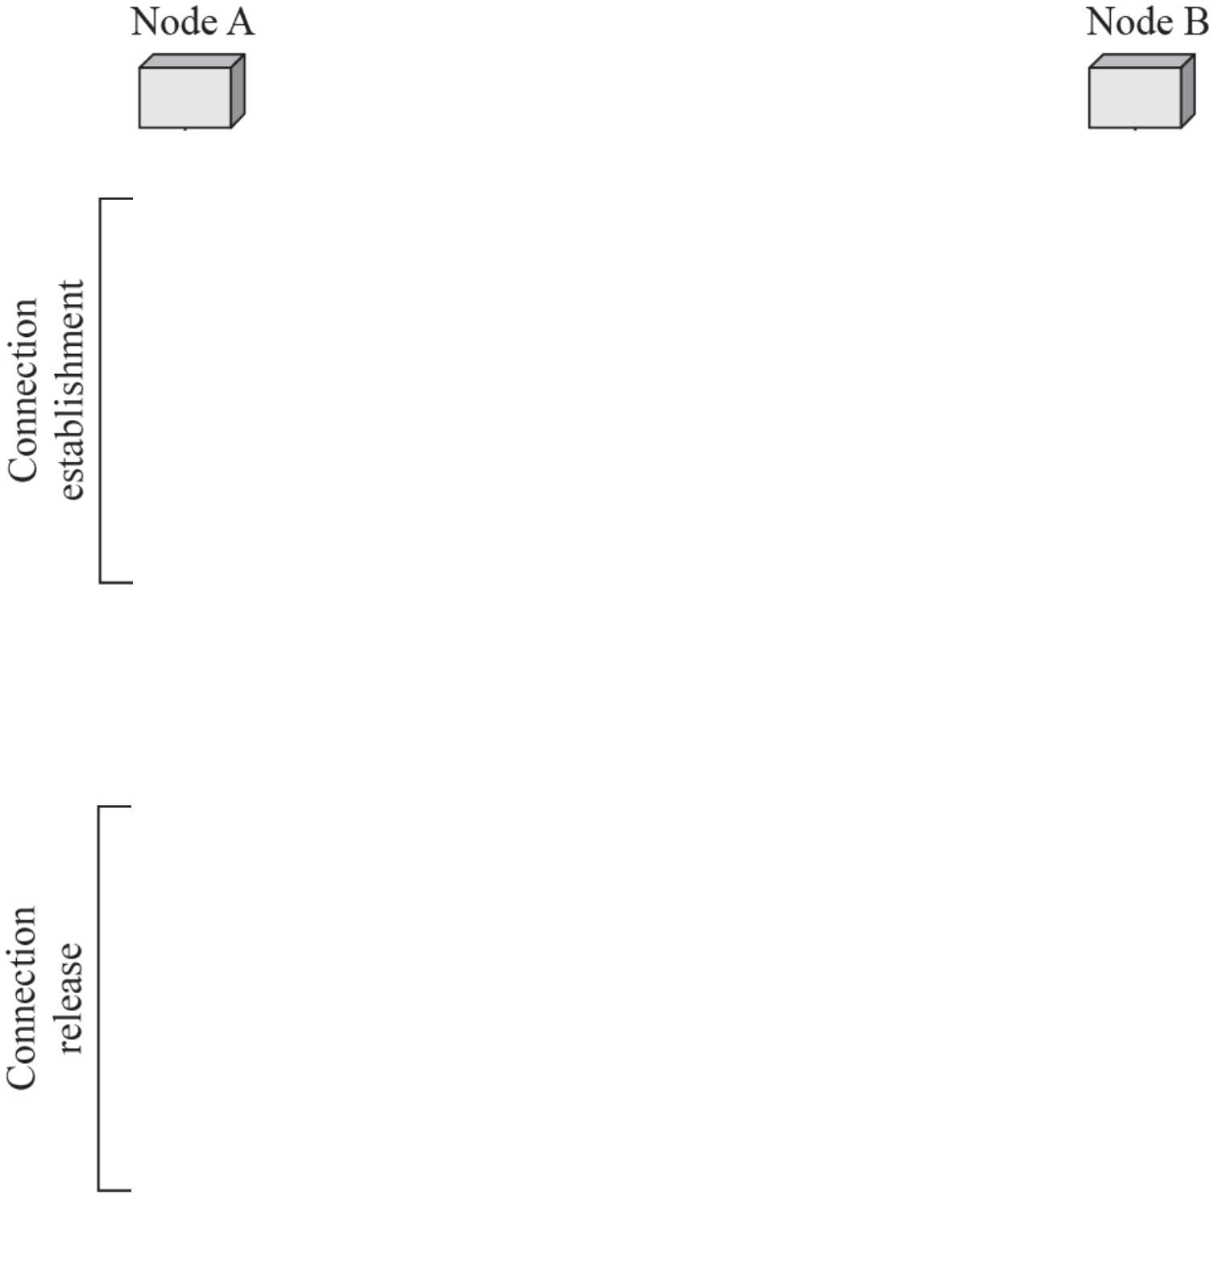
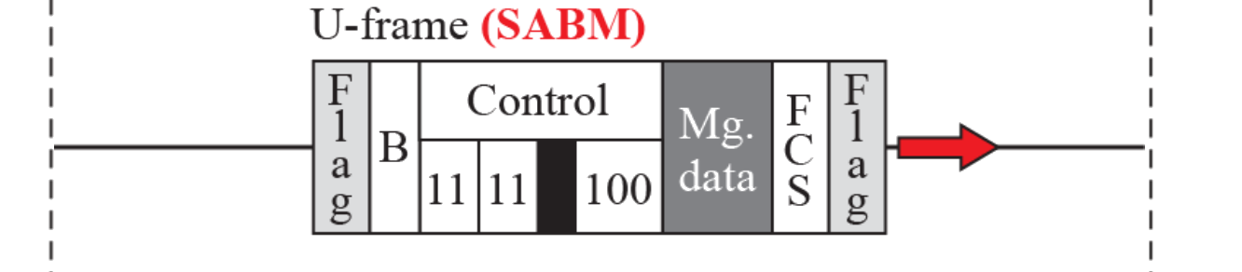
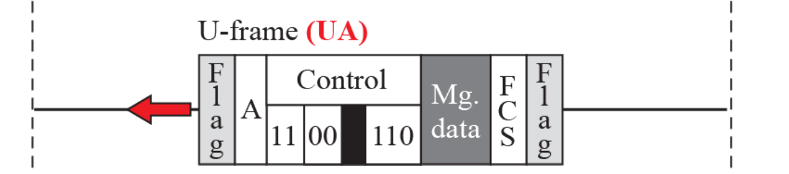
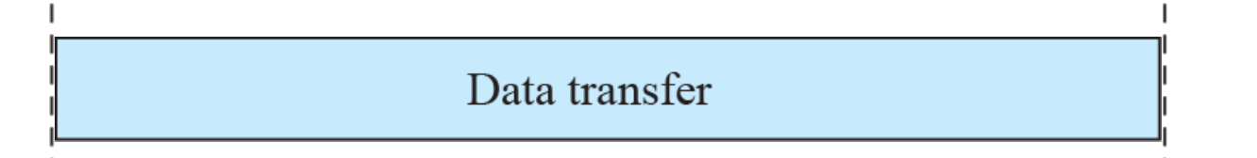
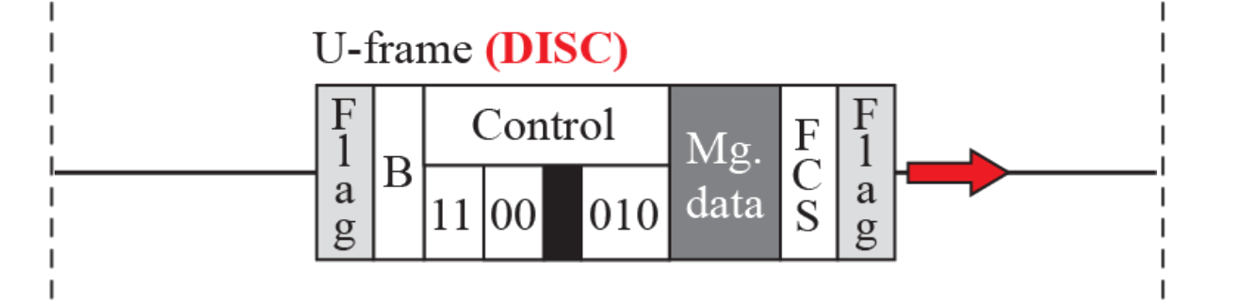
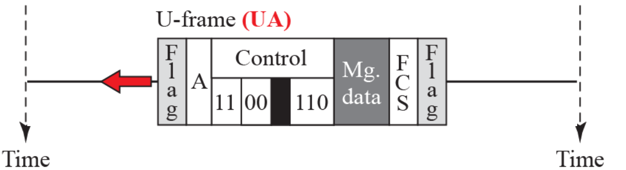
Example 11.5
Connection setup and release
SABM, A → B: set asynchronous balanced mode
Control bits 11 11 P 100
UA, B → A: unnumbered acknowledgment
Control bits 11 00 F 110
Data transfer: I-frames and S-frames
DISC, A → B: disconnect, control bits 11 00 P 010
UA, B → A: confirms the release
Book figure: UA from B carries address A → B, a response carries its sender's address
Figure 11.18 Example of connection and disconnection
23
Notes:
Animation: 5 clicks: SABM, UA, data transfer, DISC, UA

Slide 24

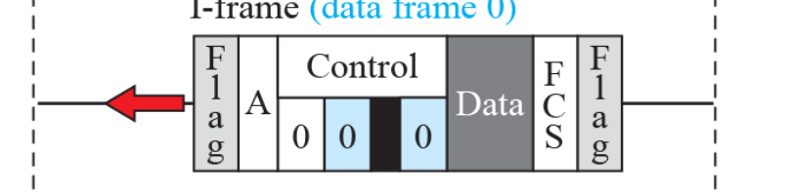
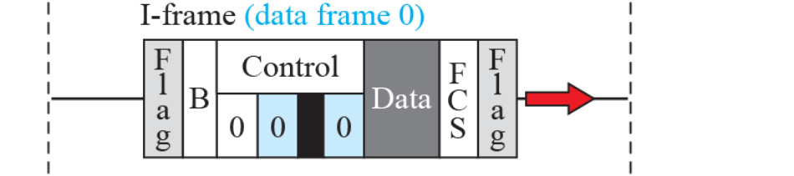
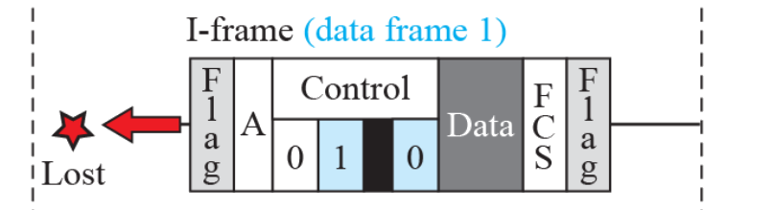
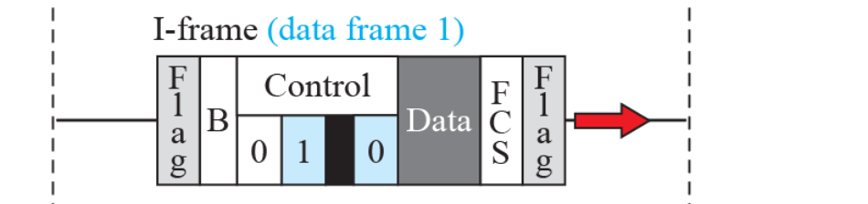
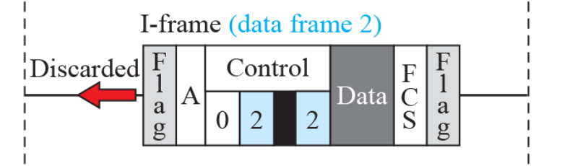
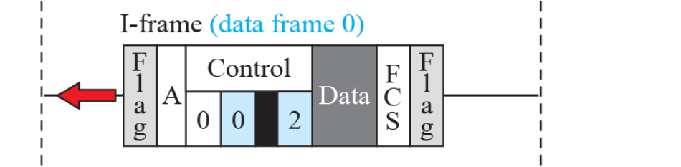
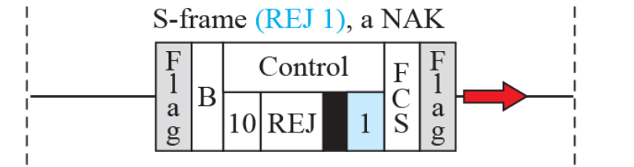
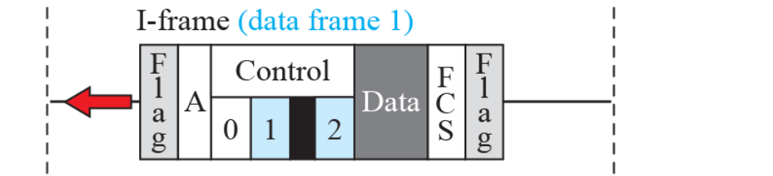
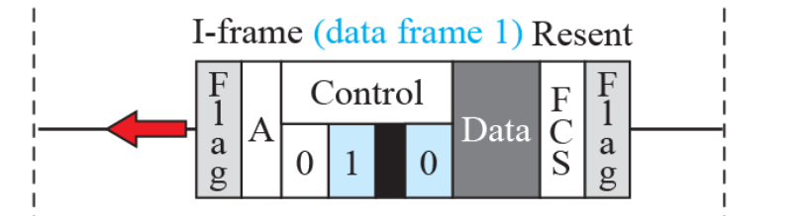
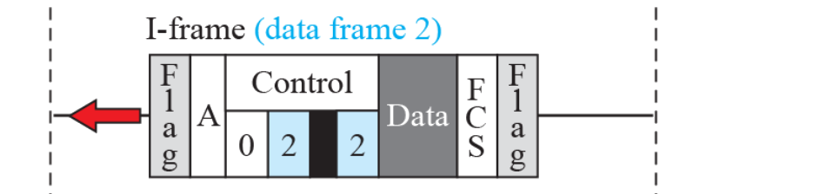
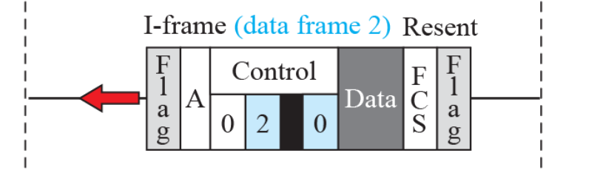
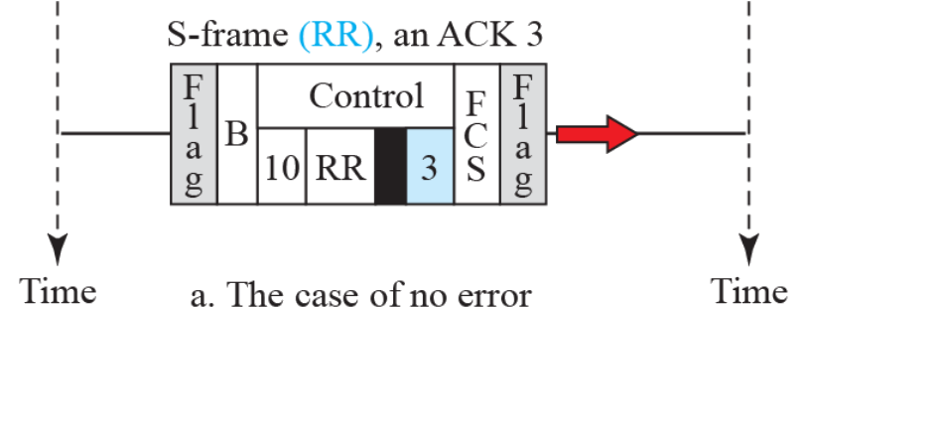

Example 11.6
Piggybacking with and without error
a. No error
A → B: I0, I1 with N(R) = 0, nothing from B yet
B → A: I0, I1, I2 with N(R) = 2, A's 0 and 1 received
A has no data: RR 3 acknowledges B's 0, 1, 2
b. Error
B's I1 lost, I2 out of order → discarded
A → B: REJ 1, a NAK: resend from 1 (Go-Back-N)
B resends I1, I2 → A answers RR 3
Book figure: discarded I2 shows N(R) = 2 → 0
Three frames outstanding: HDLC is not Stop-and-Wait
Figure 11.19 Example of piggybacking with and without error
24
Notes:
Animation: 13 clicks: six frames of case a, then seven frames of case b

Slide 25
11.4
PPP services
Point-to-Point Protocol: RFC 1661 (1994)
Book: most users reach the ISP by dial-up modem
Dial-up nearly gone, PPP lives on in PPPoE, L2TP, cellular modems (Today)
Provides
Frame format
Link negotiation: LCP
Several network layers: one NCP each
Optional authentication: PAP, CHAP, later EAP
Address configuration: IPCP gives the user an address
Multilink PPP: an extension (RFC 1990), not a new version
Does not provide
Flow control
Error recovery: CRC detects, bad frame silently dropped
Multipoint addressing
Book: "packets out of order"
A single link keeps order: frames get lost, not reordered
25

Slide 26

11.4.2
PPP framing
Figure 11.20 PPP frame format
Flag: 0x7E
Address: 0xFF, all stations
Control: 0x03, HDLC unnumbered information
Protocol: 2 bytes, 1 if compression negotiated
Payload: up to 1500 bytes by default (MRU)
FCS: CRC-16, or CRC-32 if negotiated
Byte stuffing on asynchronous links (RFC 1662)
Send 0x7D, then the byte XOR 0x20
7E → 7D 5E, 7D → 7D 5D
Bytes below 0x20 escaped by default, ACCM option relaxes it
Bit-synchronous links: HDLC bit stuffing instead
Padding optional: flags mark the end (book: "needed")
26

Slide 27

11.4.3
Transition phases
Dead: no carrier, line quiet
Establish: carrier detected, LCP negotiates options
Authenticate: only if agreed, PAP or CHAP
Failure → Terminate
Network: NCP, e.g. IPCP, configures the network layer
Open: data transfer
Terminate: LCP Terminate-Request and Terminate-Ack
Carrier dropped → Dead
RFC 1661 names: Link Dead, Establishment, Authentication, Network-Layer Protocol, Termination
Figure 11.21 Transition phases
27

Slide 28

11.4.4
Multiplexing in PPP
One link, several protocols: told apart by the Protocol field
LCP 0xC021: link setup, options, keepalive, teardown
Authentication: PAP 0xC023, CHAP 0xC223
NCPs: IPCP 0x8021, IPv6CP 0x8057, …
Data: IPv4 0x0021, IPv6 0x0057
Pattern: NCP 0x8xxx configures data 0x0xxx
NCP packets configure only: never carry user data
Figure 11.22 Multiplexing in PPP
28

Slide 29

11.4.4
LCP packets and options
Protocol field: 0xC021
Code: packet type (Table 11.1)
ID: matches a reply to its request
Length: whole LCP packet
Information: options as type, length, data
Configure-Request lists proposed options
Ack: all accepted
Nak: some values unacceptable, counter-proposal
Reject: some options unknown
Figure 11.23 LCP packet encapsulated in a frame
Option | Default
Maximum receive unit (payload field size) | 1500
Authentication protocol | None
Protocol field compression | Off
Address and control field compression | Off
Table 11.2 Common options
29

Slide 30
11.4.4
LCP packet types
Code | Packet type | Description
0x01 | Configure-request | Contains the list of proposed options and their values
0x02 | Configure-ack | Accepts all options proposed
0x03 | Configure-nak | Announces that some options are not acceptable
0x04 | Configure-reject | Announces that some options are not recognized
0x05 | Terminate-request | Request to shut down the line
0x06 | Terminate-ack | Accept the shutdown request
0x07 | Code-reject | Announces an unknown code
0x08 | Protocol-reject | Announces an unknown protocol
0x09 | Echo-request | A type of hello message to check if the other end is alive
0x0A | Echo-reply | The response to the echo-request message
0x0B | Discard-request | A request to discard the packet
Table 11.1 LCP packets
Codes 1 to 4: configuration (Establish)
Codes 5, 6: termination
Codes 7 to 11: monitoring, debugging
Echo: keepalive, e.g. PPPoE
30

Slide 31

11.4.4
PAP
Password Authentication Protocol: RFC 1334, Protocol 0xC023
Two steps
User → system: user name + password
System → user: Authenticate-Ack or Authenticate-Nak
Codes: 1 Request, 2 Ack, 3 Nak
Password in clear text: anyone on the link reads it
Book figure: Ack and Nak carry Msg-Length + Message, not a user name
Figure 11.24 PAP packets encapsulated in a PPP frame
31

Slide 32

11.4.4
CHAP
Challenge Handshake Authentication Protocol: RFC 1994, Protocol 0xC223
Three-way handshake
System → user: Challenge, a fresh random value
User → system: Response = MD5(ID, secret, challenge)
System computes the same → Success or Failure
Password never crosses the link
New challenge each time: replayed response useless
May re-challenge during the session
Codes: 1 Challenge, 2 Response, 3 Success, 4 Failure
Weakness: both ends store the secret in clear, MD5 dated
Figure 11.25 CHAP packets encapsulated in a PPP frame
32

Slide 33

11.4.4
NCP and IPCP
One NCP per network-layer protocol
IPCP 0x8021, IPv6CP 0x8057, OSI 0x8023, Xerox NS IDP 0x8025
IPCP packets: LCP codes 1 to 7 (Table 11.3)
IPCP options: IP address for the user, DNS servers (RFC 1877)
IPv6CP: only a 64-bit interface identifier, prefix via SLAAC or DHCPv6
Figure 11.26 IPCP packet encapsulated in PPP frame
Code | IPCP packet
0x01 | Configure-request
0x02 | Configure-ack
0x03 | Configure-nak
0x04 | Configure-reject
0x05 | Terminate-request
0x06 | Terminate-ack
0x07 | Code-reject
Table 11.3 Code values for IPCP packets
33

Slide 34


11.4.4
IP data and Multilink PPP
User data: Protocol 0x0021 for IPv4 (0x0057 IPv6, 0x0023 OSI)
Receiver dispatches by Protocol value, after the NCP is open
Multilink PPP (RFC 1990)
One logical link over several physical links, e.g. ISDN B channels
Logical frame split into fragments, Protocol 0x003D
Fragment header: sequence number, begin and end bits
Receiver reorders and reassembles
Figure 11.27 IP datagram encapsulated in a PPP frame
Figure 11.28 Multilink PPP
34

Slide 35






Example 11.7
A PPP session
Establish: LCP Configure-Request, Configure-Ack
Options: PAP, address and control field compression
Authenticate: PAP Request, Ack
Network: IPCP Configure-Request, Configure-Ack
Data transfer: IP packets, Protocol 0x0021
Terminate: LCP Terminate-Request, Terminate-Ack
IPCP alone can close: LCP stays up for another NCP
Book figure errors
PAP Ack: code 02, carries a Message, not a Name
LCP frames always keep FF 03, even after compression is agreed
Figure 11.29 An example
35
Notes:
Animation: 5 clicks: establish, authenticate, network, data transfer, terminate

Slide 36
Today
PPP today
Ethernet payload ≤ 1500 bytes
Ethernet
header
PPPoE
header
PPP
Protocol
IP packet
FCS
14 bytes
6
2
≤ 1492 = 1500 − 6 − 2
4
New PPPoE encapsulation and the 1492-byte MTU
Dial-up modem PPP: nearly gone
PPPoE (RFC 2516): PPP sessions over Ethernet, DSL and many fiber ISPs
6-byte PPPoE + 2-byte PPP header → IP MTU 1492
RFC 4638: 1500 with a larger Ethernet payload
LCP Echo as keepalive, PAP or CHAP carry the subscriber account
L2TP (RFC 2661, RFC 3931): PPP tunneled over IP, wholesale broadband, VPNs
Cellular: PPP between host and modem (AT commands), no PPP in the LTE and 5G core
EAP (RFC 2284, 1998): born as a PPP authentication protocol
Now in 802.1X Wi-Fi and Ethernet, and in 5G (EAP-AKA′)
MS-CHAPv2 broken (2012): avoid
36

Slide 37
Errata
Corrections (1 of 2): framing, protocols, HDLC
Where | Printed | Corrected
Book 11.1.1, fixed size | size itself is the delimiter | receiver must first find a boundary (ATM: HEC delineation)
Book 11.1.1, byte stuffing | 16- and 32-bit Unicode characters conflict with it | stuffing ignores content: any byte stream, UTF-8 included
Book 11.1.2 | CRC added to the frame header | CRC in the trailer (FCS)
Book Figure 11.6 and text | caption: connectionless and connection-oriented service, text: three states, event 1 → action 3 | generic FSM example: two states, event 2 → action 3
Book 11.2 | Go-Back-N, Selective Repeat disappeared from the data-link layer | alive: Wi-Fi Block Ack, LTE and NR RLC, LAPB REJ
Book 11.3, deck slide 32 | HDLC implements Stop-and-Wait | sliding window, up to 7 (127) frames outstanding, REJ and SREJ
Book 11.3, deck objectives | HDLC is the basis of Ethernet | only IEEE 802.2 LLC: Ethernet frame has no flags or stuffing
Book 11.3.2 | U-frame control field paragraph printed twice | printed once
Deck slide 7 | ATM: 53 bytes packet | 53-byte cell
37

Slide 38
Errata
Corrections (2 of 2): HDLC examples, PPP
Where | Printed | Corrected
Book Figure 11.18 | UA from node B carries address A | B: a response carries its sender's address
Book Figure 11.19b | discarded I-frame 2 with N(R) = 2 | N(R) = 0, as in its resend
Book 11.4, deck slide 43 | most users connect over dial-up modems | PPPoE, L2TP, cellular modems (Today slide)
Book 11.4.1 | Multilink PPP is a new version of PPP | an extension (RFC 1990)
Book 11.4.1 | no sequence numbers → out-of-order packets | single link keeps order: loss, not reordering
Book 11.4.2 | padding needed, no length field | padding optional (RFC 1661), flags mark the end
Book 11.4.2, deck slide 45 | escape = insert 01111101 | insert 0x7D, then send the byte XOR 0x20 (RFC 1662)
Book Figure 11.24 | Ack and Nak carry user name | Msg-Length + Message (RFC 1334)
Book Figure 11.29 | Authenticate-ack code 01 with Name, LCP Terminate without Address and Control | code 02 with Message, LCP always keeps FF 03 (RFC 1661)
38

Slide 39
Summary
Summary and practice
Framing: flags + byte or bit stuffing, fixed size + HEC hunting, or length fields
Flow control: receiver feedback, buffers
Error control: CRC, silent discard, ACK and timer
Stop-and-Wait: 1-bit numbers stop duplicates, wastes long links
HDLC: I, S, U frames, N(S) and N(R), RR, RNR, REJ, SREJ, sliding window
PPP: byte-stuffed HDLC-like frame, LCP → authentication → NCP → data
Try it
Bit-stuff 0111111011111100 by hand, then unstuff it
Q11-6, Q11-7: unstuff before or after removing the flags?
Examples 11.3 and 11.4: how many frames are in transit at once?
Stop-and-Wait over a 36,000 km satellite hop at 10 Mbps: utilization?
Capture a PPPoE login in Wireshark: PADI, PADO, LCP, PAP or CHAP, IPCP
39

