Slide 1
Lifestreams: a modular sense-making toolset for identifying important patterns from everyday life
SenSys 2013
Presenter : Jihye Kim

Slide 2
Introduction
Smartphones can capture diverse spatio-temporal data about an individual.
The resulting personal data streams can support powerful inference about..
  The user state, behavior, well-being and environment
However, making sense and acting on these multi-dimensional, heterogeneous data streams requires iterative and intensive exploration of the datasets.

Slide 3
Introduction
Introduce Lifestreams
Demonstration of Lifestreams’ ability
Explore the generality and extensibility of the Lifestreams

Slide 4
Lifestreams: A Modular mHealth Data Analysis Stack
Lifestreams is an open-source data analysis stack
  designed to run on top of an existing mobile data collection system
  designed for behavioral and health sciences researchers(end user) to analyze high-dimensional mHealth datasets
Lifestream consists of four layers
  Feature extraction and aggregation
  Feature selection
  Inference
  Visualization

Slide 5
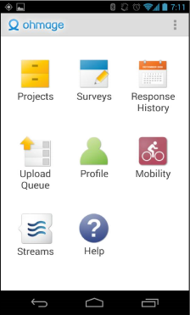
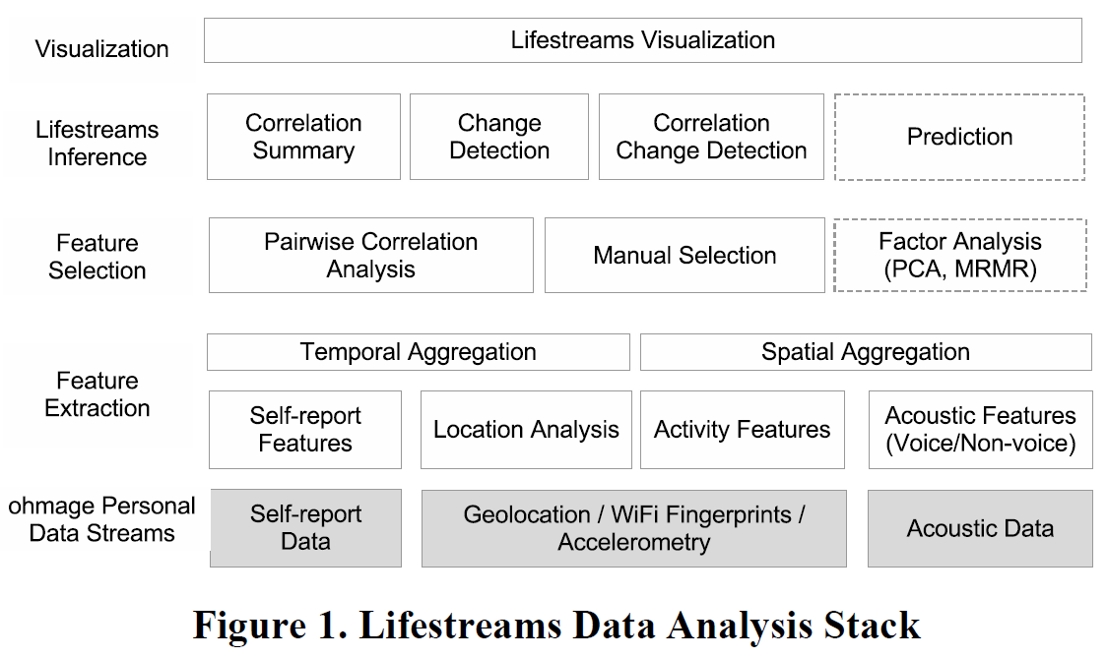
Lifestreams: A Modular mHealth Data Analysis Stack
Figure 1. Lifestreams Data Analysis Stack

Slide 6
Feature extraction & aggregation: Activity feature
Mobility state per minute
  States: still, walk, run and drive
Mobility events
Total Distance Travelled
Geo-Diameter

Slide 7
Feature extraction & aggregation: Activity feature
Activity events are calculated using accelerometer, Wi-Fi fingerprints, and location traces collected on the phone by ohmage.
The activity classification is performed in two stages.
  First, the accelerometer records one second’s worth of triaxial samples.
  To be orientation-independent, it first calculates the magnitude of acceleration and then calculates the variance.
  These are used to classify ambulation, i.e., sedentary, walking, or running.
If the user is classified as sedentary, then the current Wi-Fi fingerprint is compared to the access points encountered in the past 10 minutes.
  If the fingerprint has not changed, the user is classified as still.
  If it has changed, the user is presumed to be driving.

Slide 8
Feature extraction & aggregation: Semantic Location features
Each location data point collected by ohmage contains a Wi-Fi fingerprint and a GPS coordinate.
From this data stream we extract features
  Places
  Duration at a Place
  Time of Arriving and Leaving a Place
  Daily Work Schedule Deviation

Slide 9
Feature extraction & aggregation: Semantic Location features
To discover meaningful places,
  Assume that a place is a location where the user stays for more than a certain period of time.
Such locations are revealed with clustering algorithms (DBSCAN), where each resulting cluster is regarded as a place.

Slide 10
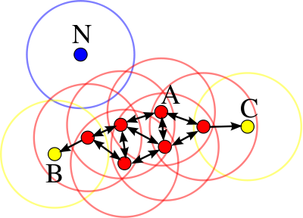
DBSCAN: Density-based Spatial Clustering of Applications with Noise
A density-based clustering algorithm
Neighbors
Eps
MinPts
Cluster
Points at A are core points. Points B and C are density-reachable from A and thus density-connected and belong to the same cluster. Point N is a noise point that is neither a core point nor density-reachable. (MinPts=3 or MinPts=4)

Slide 11
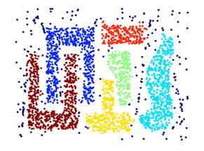
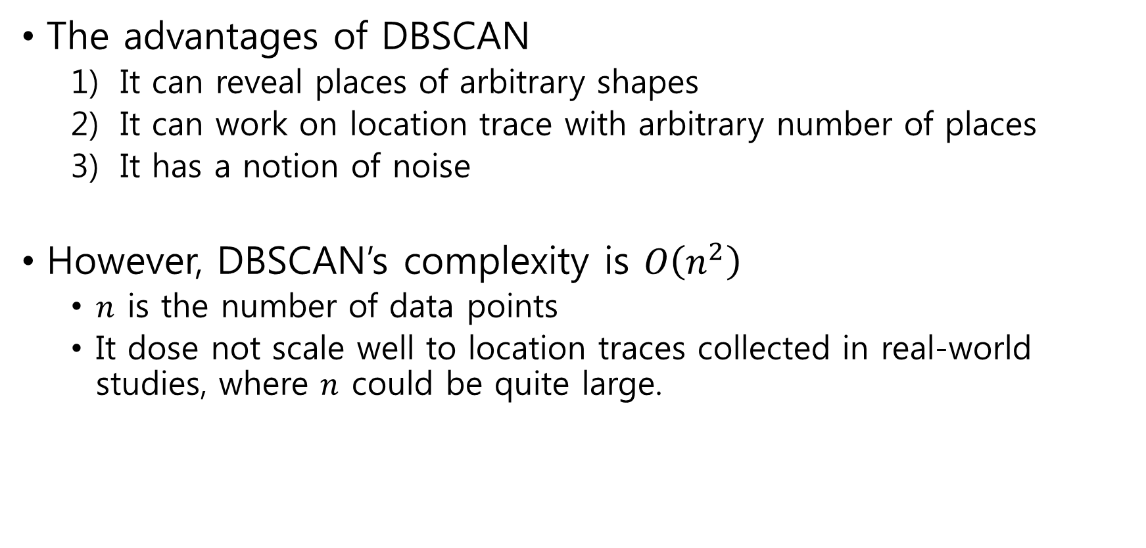
DBSCAN: Density-based Spatial Clustering of Applications with Noise
The advantages of DBSCAN
  It can reveal places of arbitrary shapes
  It can work on location trace with arbitrary number of places
  It has a notion of noise
However, DBSCAN’s complexity is $O\left(n^{2}\right)$
  $n$ is the number of data points
  It dose not scale well to location traces collected in real-world studies, where $n$ could be quite large.

Slide 12
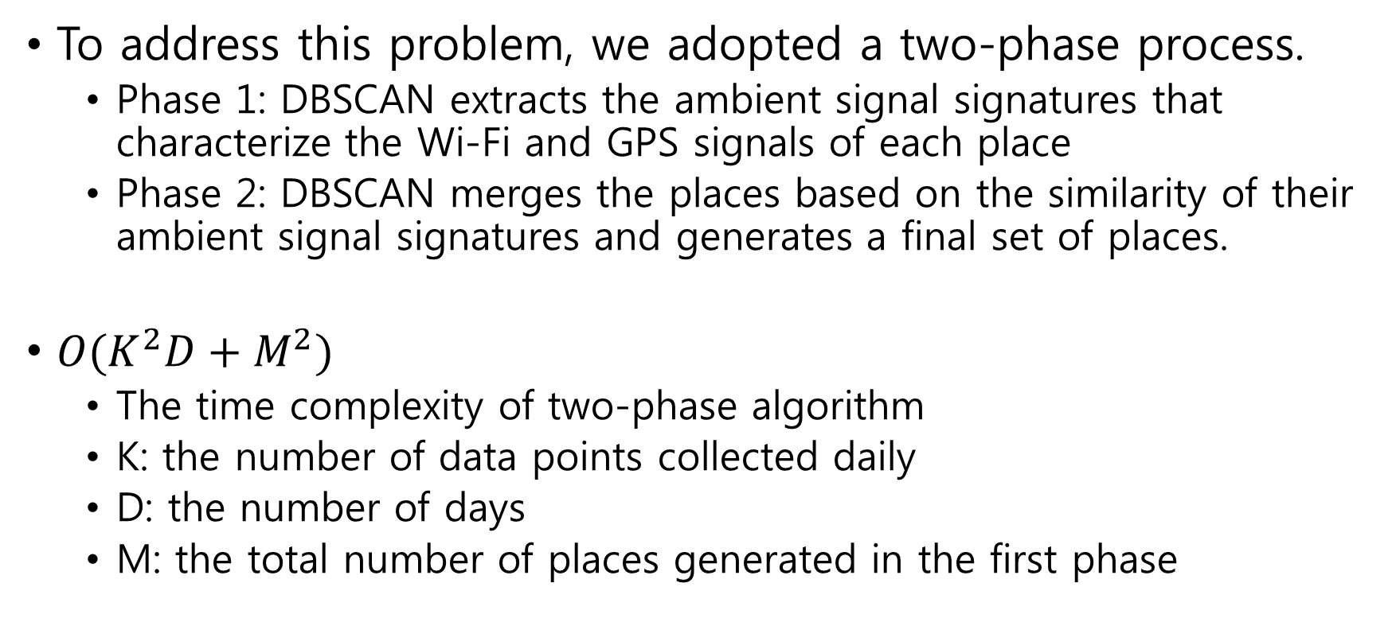
Feature extraction & aggregation: Semantic Location features
To address this problem, we adopted a two-phase process.
  Phase 1: DBSCAN extracts the ambient signal signatures that characterize the Wi-Fi and GPS signals of each place
  Phase 2: DBSCAN merges the places based on the similarity of their ambient signal signatures and generates a final set of places.
$O(K^{2}D+M^{2})$
  The time complexity of two-phase algorithm
  K: the number of data points collected daily
  D: the number of days
  M: the total number of places generated in the first phase
First, extract daily places based on 24 hours of location traces
And then, merge similar places extracted throughout the study into a final set of places.

Slide 13
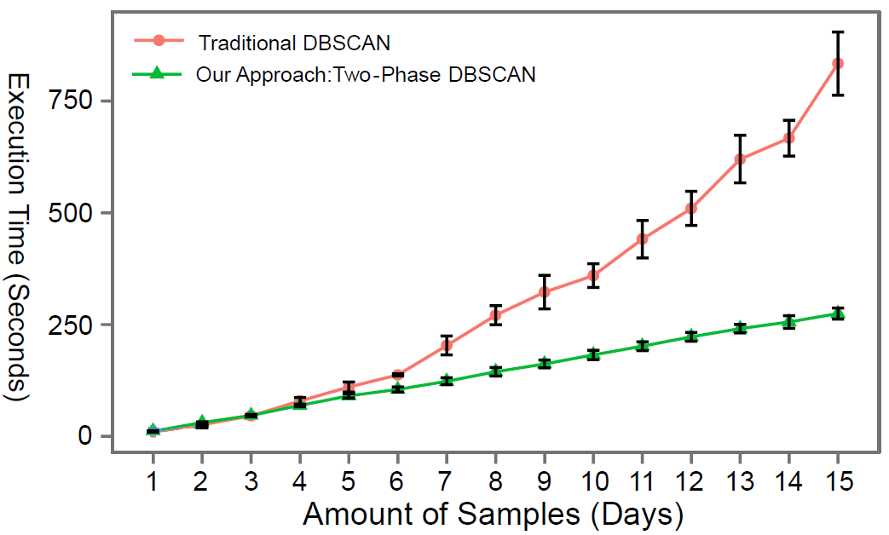
Feature extraction & aggregation: Semantic Location features
Figure 2 Comparison of execution time between the traditional DBSCAN and our Two-Phase approaches for different amount of samples (sample rate=1/60Hz).

Slide 14
Feature extraction & aggregation: Features extracted from self-report data
Self-report data are classified into
  Quantitative (e.g. number)
  Categorical (e.g. single choice/multiple choices)
    An ordinal feature
    (e.g. food quality rating as high, medium, low options)
    A nominal feature
    (e.g. cause of stress as relationship, financial, school/work, etc. option)

Slide 15
Feature extraction & aggregation: Data aggregation
All features derived from different modules can be further aggregated based on time and/or location.
For our analysis, we aggregate these features over 24 hour periods starting at midnight on the first day of the study to represent daily data point.

Slide 16
Lifestreams: A Modular mHealth Data Analysis Stack
Figure 1. Lifestreams Data Analysis Stack

Slide 17
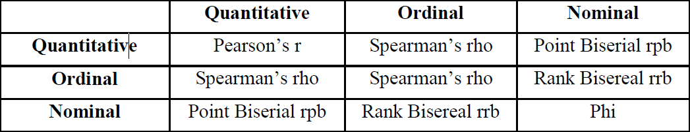
Feature selection
Feature selection is the process of selecting a subset of relevant features for use in model construction
  For use in model construction
  Using pairwise correlation analysis
Pairwise correlation analysis

Slide 18
Lifestreams: A Modular mHealth Data Analysis Stack
Figure 1. Lifestreams Data Analysis Stack

Slide 19
Lifestreams Inference
Lifestreams Inference layer focuses on techniques that enable researchers to understand user contexts, behaviors, and changes, based on selected features.
Three different inference methods
  Correlation summary
  Change detection
  Correlation change detection

Slide 20
Lifestreams Inference: Correlation summary
A thin layer on top of the pairwise correlation analysis
Provides different capabilities
  to quickly shift through the large 3D data
  to draw conclusion about long-term relationships
    Such as pairwise correlation for an individual and similarity across individuals
Allows researchers to identify common pairwise relationships among participants

Slide 21
Lifestreams Inference: Change detection (single feature)
Detects behavior changes on each individual feature
  Compare the distributions of recent observations of the participant’s behavior with previous observations
  Identify a potential behavior change when these two distributions are significantly different

Slide 22
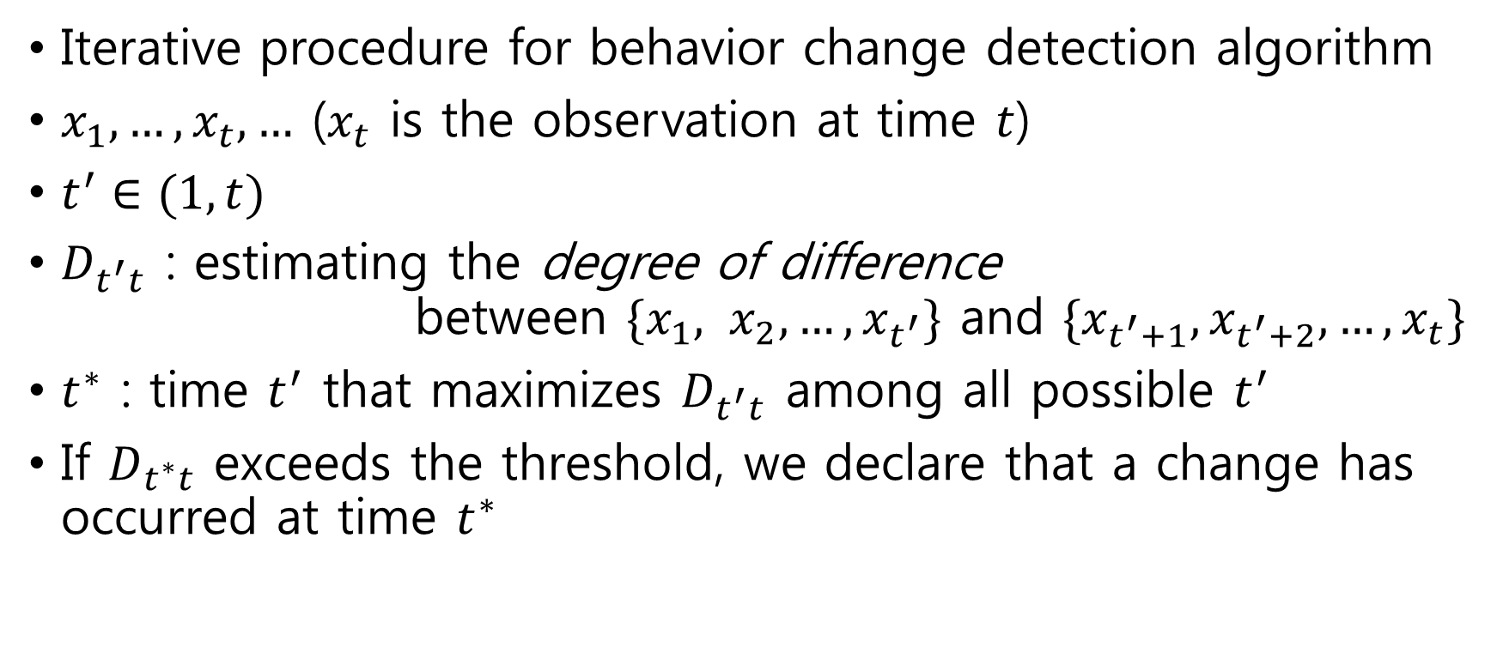
Lifestreams Inference: Change detection (single feature)
Iterative procedure for behavior change detection algorithm
$x_{1},…, x_{t}, …$ ($x_{t}$ is the observation at time $t$)
$t^{′}∈(1, t)$
$D_{t^{′}t}$ : estimating the degree of difference
between $\{x_{1}, x_{2}, …, x_{t^{′}}\}$ and $\{x_{t^{′}+1}, x_{t^{′}+2}, …,x_{t}\}$
$t^{∗}$ : time $t^{′}$ that maximizes $D_{t^{′}t}$ among all possible $t^{′}$
If $D_{t^{∗}t}$ exceeds the threshold, we declare that a change has occurred at time $t^{∗}$

Slide 23
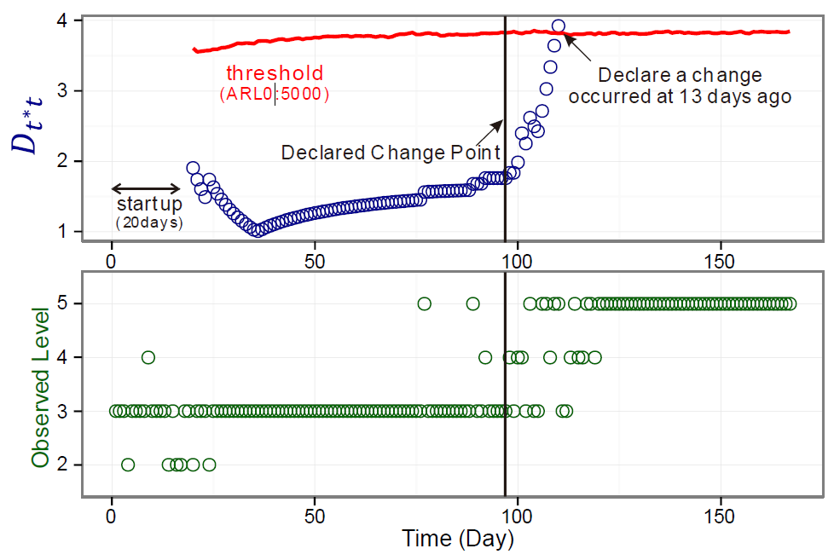
Lifestreams Inference: Change detection (single feature)
Figure 3. A walkthrough of the change detection algorithm

Slide 24
Lifestreams Inference: Correlation change detection
To further investigate changes in behavior based on pairwise features
To capture the changes of relationships between two feature
To discover the shorter-term relationship that could be overlooked

Slide 25
Lifestreams: A Modular mHealth Data Analysis Stack
Figure 1. Lifestreams Data Analysis Stack

Slide 26
Lifestreams Visualization
The purpose of Lifestreams visualization
  To allow researchers to quickly and flexibly navigate through high-dimensional personal data stream by focusing on important trends/patterns
  To explore visual aids for an intervention

Slide 27
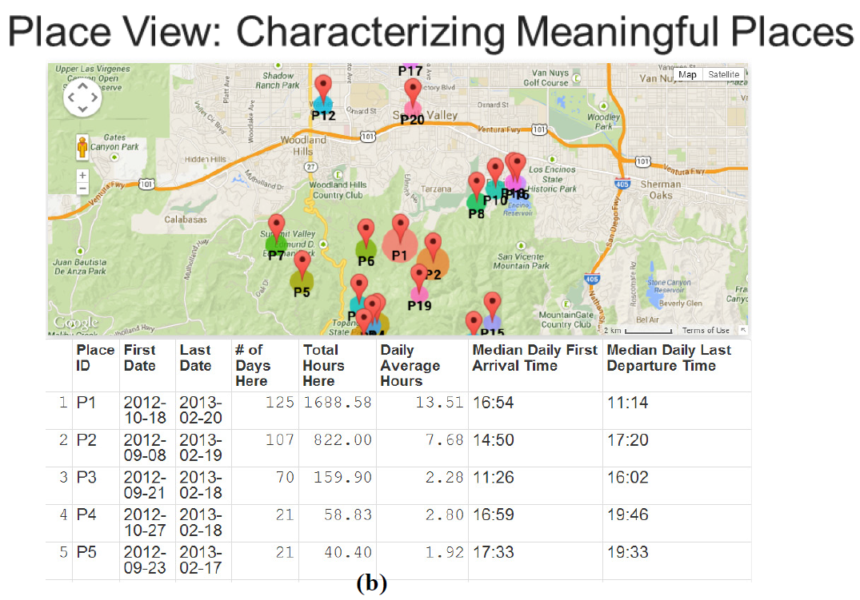
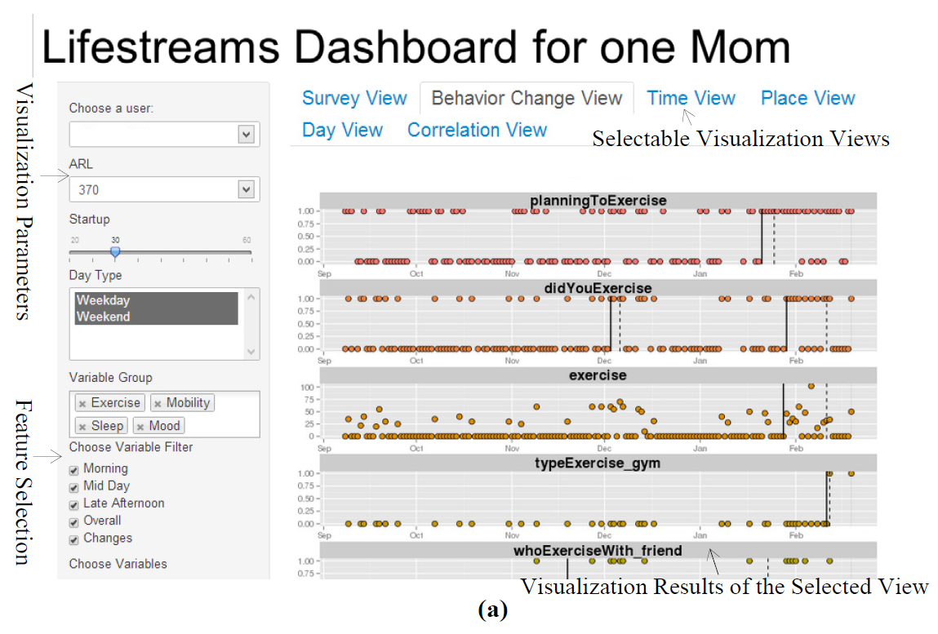
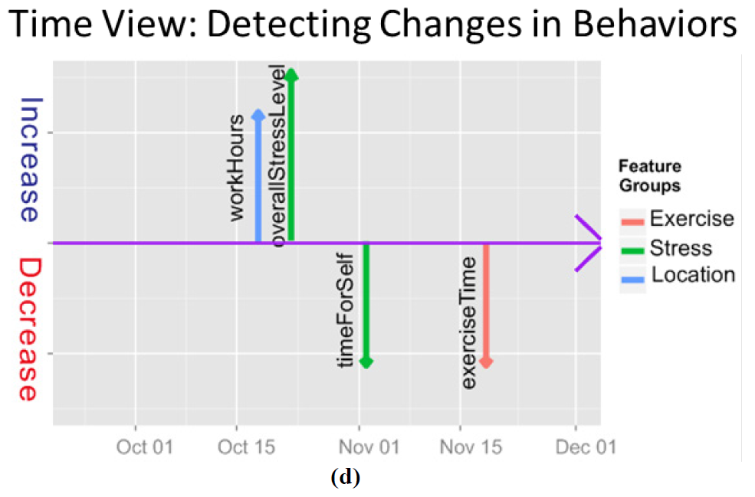

Slide 28
Exploring a Real Dataset with Lifestreams
Exploring the accuracy and utility of Lifestreams inference methods
Lifestreams inference methods were able to automatically identify trends and changes that were confirmed by participants.
In this study, behavioral researchers used Lifestreams to study cardiovascular risk factors in young mothers.

Slide 29
The dataset: diet, stress, and exercise in young moms
Participant info
  56 young moms residing in the Los Angeles area
    15 moms worked full time,
    24 moms worked part time,
    17 moms worked in the home
    All moms had at least one child
  The study start date : 2012/01 ~ 2012/09
  52 moms had completed their study (average duration: 7M)
    4 moms dropped out
  The experimental group consisted of 44 moms
    Ethnicity and races are diverse
    Ages range: 18 to 40 (mean age: 30)

Slide 30
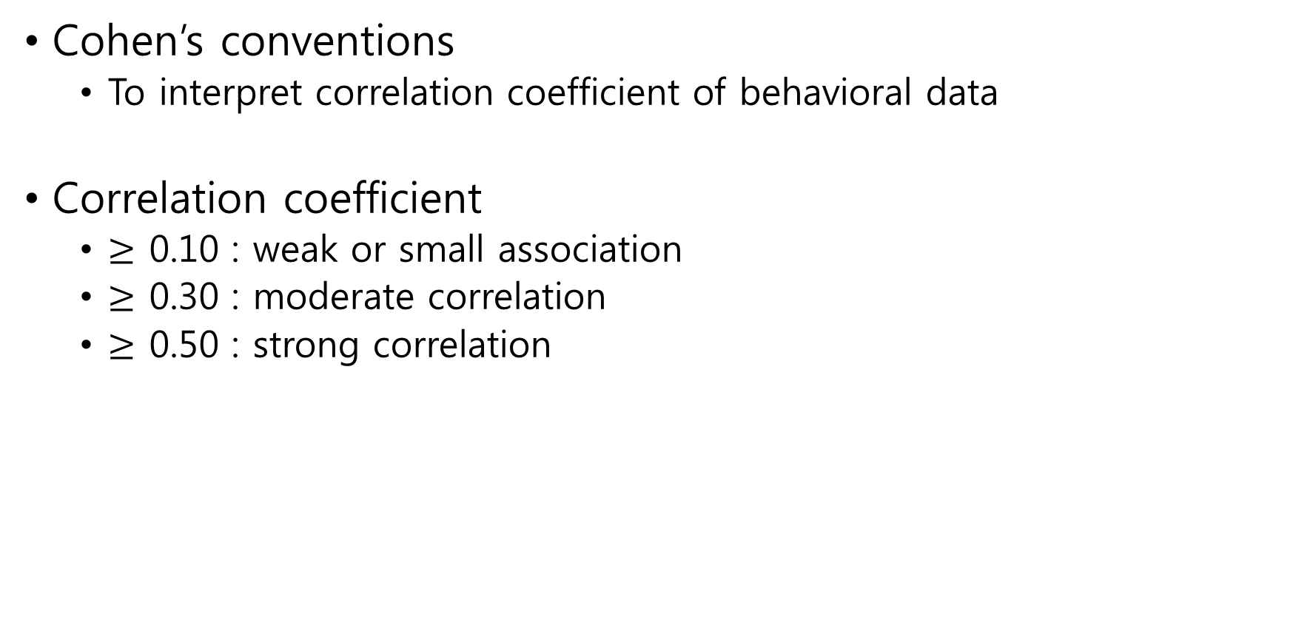
Result 1: Correlation summary
Cohen’s conventions
  To interpret correlation coefficient of behavioral data
Correlation coefficient
  $≥$ 0.10 : weak or small association
  $≥$ 0.30 : moderate correlation
  $≥$ 0.50 : strong correlation

Slide 31
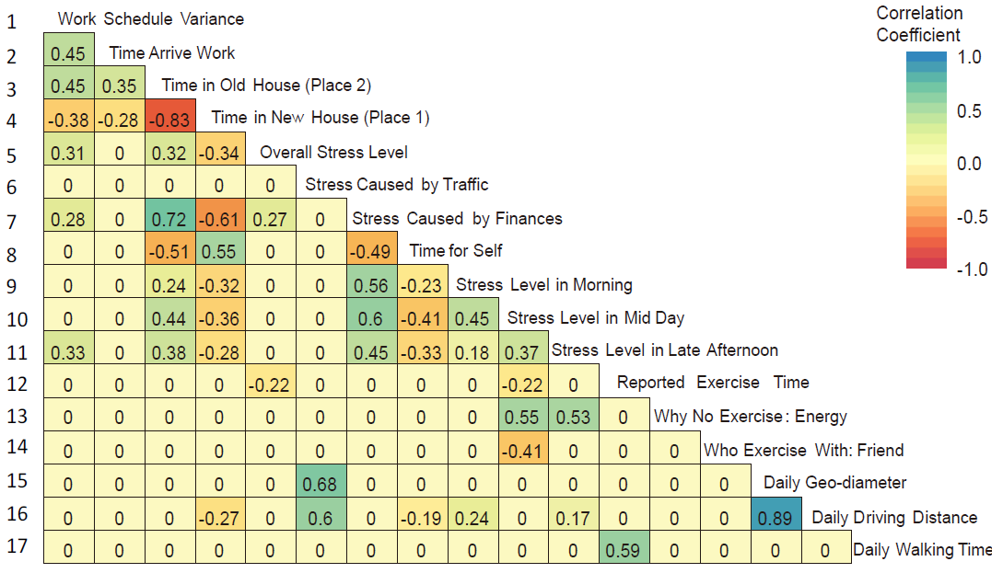
Result 1-1: Correlation Summary
Individual 2D correlation matrix
  can be used to infer her long-term behavioral patterns

Slide 32
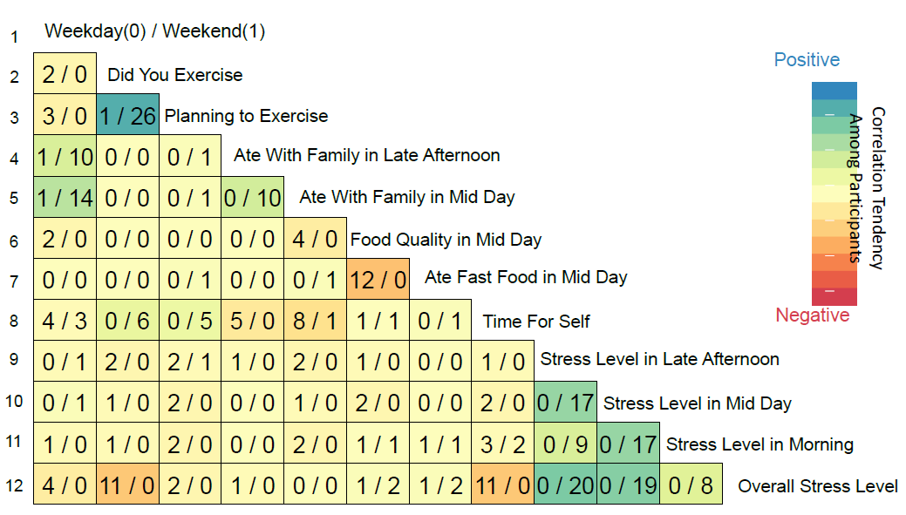
Result 1-2: Correlation Summary
Correlation statistic across all participants
  A 3D correlation matrix
    can provide researchers with an overview of significant patterns among the population,
    can help an individual understand how they fit in with the broader population

Slide 33
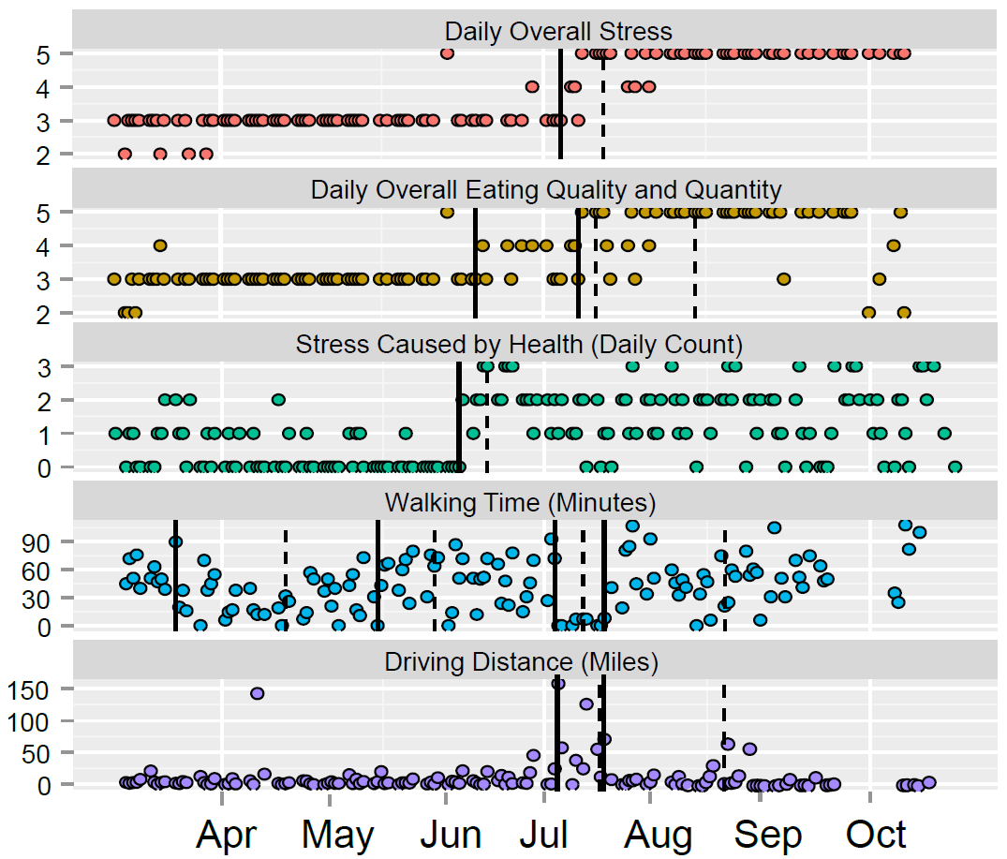
Result 2: Single feature change detection
To be one of the most useful building blocks in helping researchers make sense of behavioral data

Slide 34
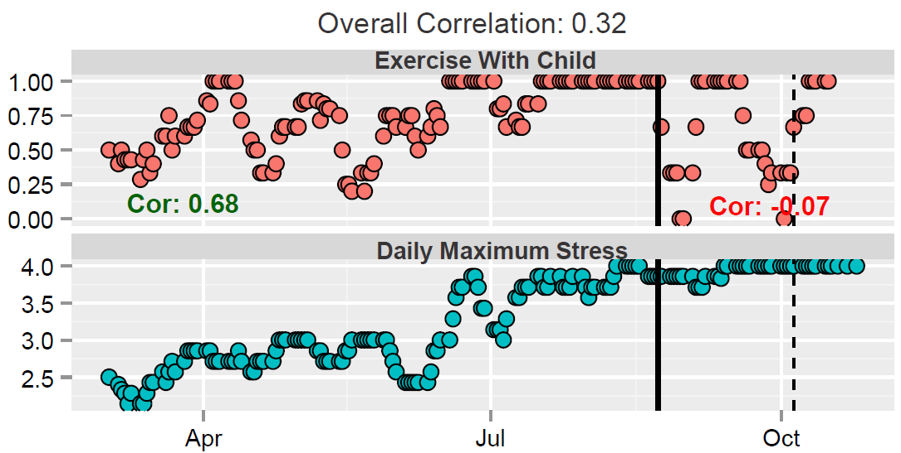
Result 3: Pairwise correlation change detection

Slide 35
Extensibility and Generalizability of Lifestreams
Family Wellness Study (a pilot study)
  To evaluate the feasibility of using mobile technologies for family behavior studies
  15 families
  Reused the existing self-report module and the correlation analysis module
  additional modules
    An audio data extraction module
Result
  Daily speech time is highly correlated with the levels of argument
    argument reported with the study child (coefficient = 0.85, p-value < 0.001)
    argument reported specifically in the evening (coefficient = 0.75, p-value < 0.01)

Slide 36
Limitation and Challenges
Incomplete or missing data
  Due to misunderstanding, participants’ constraints, and technical problem
The phone-based sensing applications may sometimes fail to capture user’s behavior
=> using wearable device
Participants' descriptions of their condition might be inaccurate
=> Expert domain knowledge is needed to provide further insight into and help validating the results.

Slide 37
Conclusion
Lifestreams facilitates the exploration and evaluation of multi-dimensional personal data streams for potential behavioral indicators.
Lifestreams inference methods identified significant behavioral trends and patterns.
Assisted with the visualizations generated by Lifestreams, the provider could use this information to guide the discussion with patients and families, to provide feedback.

